Slide 1

Big Data Open Source Software and Projects
Big Data Application Structure
Data Science Curriculum
March 15 2015
Geoffrey Fox
gcf@indiana.edu
http://www.infomall.org
School of Informatics and Computing
Digital Science Center
Indiana University Bloomington

Slide 2
NIST Big Data Sub Groups
Led by Chaitin Baru, Bob Marcus, Wo Chang

Slide 3
NBD-PWG (NIST Big Data Public Working Group) Subgroups & Co-Chairs
There were 5 Subgroups
Requirements and Use Cases Sub Group
  Geoffrey Fox, Indiana U.; Joe Paiva, VA; Tsegereda Beyene, Cisco
Definitions and Taxonomies SG
  Nancy Grady, SAIC; Natasha Balac, SDSC; Eugene Luster, R2AD
Reference Architecture Sub Group
  Orit Levin, Microsoft; James Ketner, AT&T; Don Krapohl, Augmented Intelligence
Security and Privacy Sub Group
  Arnab Roy, CSA/Fujitsu Nancy Landreville, U. MD Akhil Manchanda, GE
Technology Roadmap Sub Group
  Carl Buffington, Vistronix; Dan McClary, Oracle; David Boyd, Data Tactics
See http://bigdatawg.nist.gov/usecases.php
And http://bigdatawg.nist.gov/V1_output_docs.php

Slide 4
NIST Big Data Definition
More consensus on Data Science definition
than that of Big Data
Big Data refers to digital data
volume, velocity and/or variety that:
Enable novel approaches to frontier questions previously inaccessible or impractical using current or conventional methods; and/or
Exceed the storage capacity or analysis capability of current or conventional methods and systems; and
Differentiates by storing and analyzing population data and not sample sizes.
Needs management requiring scalability across coupled horizontal resources
Everybody says their data is big (!) Perhaps how it is used is most important

Slide 5
What is Data Science?
I was impressed by number of NIST
working group members who were
self declared data scientists
I was also impressed by universal adoption by participants of Apache technologies – see later
McKinsey says there are lots of jobs (1.65M by 2018 in USA) but that’s not enough! Is this a field – what is it and what is its core?
  The emergence of the 4th or data driven paradigm of science illustrates significance - http://research.microsoft.com/en-us/collaboration/fourthparadigm/
  Discovery is guided by data rather than by a model
  The End of (traditional) science http://www.wired.com/wired/issue/16-07 is famous here
Another example is recommender systems in Netflix, e-commerce etc. where pure data (user ratings of movies or products) allows an empirical prediction of what users like

Slide 6
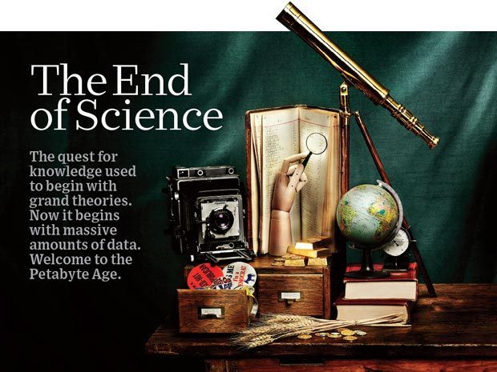
http://www.wired.com/wired/issue/16-07
September 2008

Slide 7
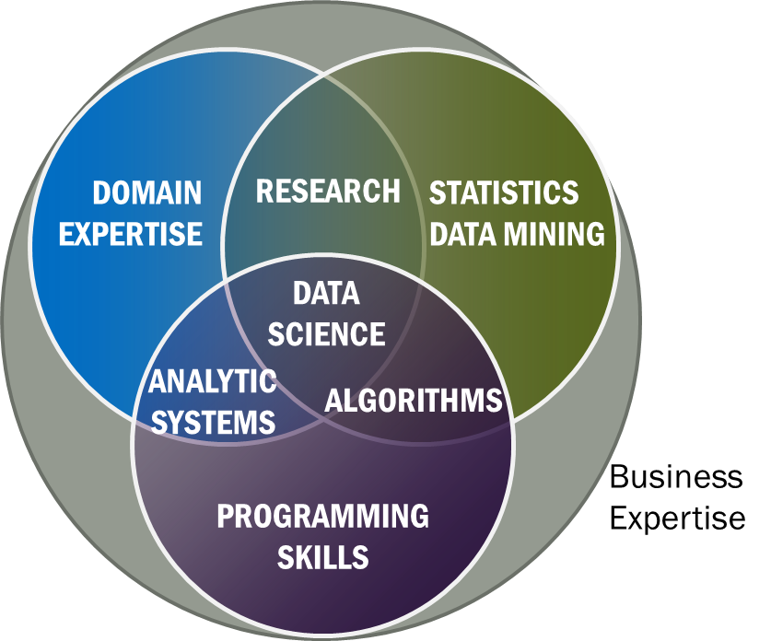
Data Science Definition
Data Science is the extraction of actionable
knowledge directly from data through a
process of discovery, hypothesis, and
analytical hypothesis analysis.
A Data Scientist is a practitioner who has sufficient knowledge of the overlapping regimes of expertise in business needs, domain knowledge, analytical skills and programming expertise to manage the end-to-end scientific method process through each stage in the big data lifecycle.
Notes:
Big Data refers to digital data volume, velocity and/or variety whose management requires scalability across coupled horizontal resources
Data Science is the extraction of actionable knowledge directly from data through a process of discovery, hypothesis, and analytical hypothesis analysis.
A Data Scientist is a practitioner who has sufficient knowledge of the overlapping regimes of expertise in business needs, domain knowledge, analytical skills and programming expertise to manage the end-to-end scientific method process through each stage in the big data lifecycle.

Slide 8
NIST Big Data Reference Architecture
INFORMATION VALUE CHAIN
System Orchestrator
Big Data Application Provider
Analytics
Data Provider
Curation
Visualization
Data Consumer
DATA
DATA
SW
Collection
Access
SW
DATA
SW
K E Y :
Big Data Framework Provider
Processing Frameworks (analytic tools, etc.)
IT VALUE CHAIN
Horizontally Scalable
Service Use
Vertically Scalable
Security & Privacy
DATA
Platforms (databases, etc.)
Management
Horizontally Scalable
Data Flow
Vertically Scalable
Infrastructures
SW
Horizontally Scalable (VM clusters)
Vertically Scalable
Analytics Tools Transfer
Physical and Virtual Resources (networking, computing, etc.)

Slide 9
Top 10 Security & Privacy Challenges: Classification
Infrastructure security
Secure Computations in Distributed Programming Frameworks
Security Best Practices for Non-Relational Data Stores
Data Privacy
Privacy Preserving Data Mining and Analytics
Cryptographically Enforced Data Centric Security
Granular Access Control
Data Management
Secure Data Storage and Transaction Logs
Granular Audits
Data Provenance
Integrity and Reactive Security
End-point validation and filtering
Real time Security Monitoring

Slide 10
NIST Big Data Use Cases

Slide 11

Use Case Template
26 fields completed for 51 areas
Government Operation: 4
Commercial: 8
Defense: 3
Healthcare and Life Sciences: 10
Deep Learning and Social Media: 6
The Ecosystem for Research: 4
Astronomy and Physics: 5
Earth, Environmental and Polar Science: 10
Energy: 1

Slide 12

Table 4: Characteristics of 6 Distributed Applications
Application Example | Execution Unit | Communication | Coordination | Execution Environment
Montage | Multiple sequential and parallel executable | Files | Dataflow (DAG) | Dynamic process creation, execution
NEKTAR | Multiple concurrent parallel executables | Stream based | Dataflow | Co-scheduling, data streaming, async. I/O
Replica-Exchange | Multiple seq. and parallel executables | Pub/sub | Dataflow and events | Decoupled coordination and messaging
Climate Prediction (generation) | Multiple seq. & parallel executables | Files and messages | Master-Worker, events | @Home (BOINC)
Climate Prediction (analysis) | Multiple seq. & parallel executables | Files and messages | Dataflow | Dynamics process creation, workflow execution
SCOOP | Multiple Executable | Files and messages | Dataflow | Preemptive scheduling, reservations
Coupled Fusion | Multiple executable | Stream-based | Dataflow | Co-scheduling, data streaming, async I/O
Part of Property Summary Table

Slide 13
Big Data Patterns:
Sources of Parallelism

Slide 14
51 Detailed Use Cases: Contributed July-September 2013
Covers goals, data features such as 3 V’s, software, hardware
26 Features for each use case. Biased to science
http://bigdatawg.nist.gov/usecases.php
https://bigdatacoursespring2014.appspot.com/course (Section 5)
Government Operation(4): National Archives and Records Administration, Census Bureau
Commercial(8): Finance in Cloud, Cloud Backup, Mendeley (Citations), Netflix, Web Search, Digital Materials, Cargo shipping (as in UPS)
Defense(3): Sensors, Image surveillance, Situation Assessment
Healthcare and Life Sciences(10): Medical records, Graph and Probabilistic analysis, Pathology, Bioimaging, Genomics, Epidemiology, People Activity models, Biodiversity
Deep Learning and Social Media(6): Driving Car, Geolocate images/cameras, Twitter, Crowd Sourcing, Network Science, NIST benchmark datasets
The Ecosystem for Research(4): Metadata, Collaboration, Language Translation, Light source experiments
Astronomy and Physics(5): Sky Surveys including comparison to simulation, Large Hadron Collider at CERN, Belle Accelerator II in Japan
Earth, Environmental and Polar Science(10): Radar Scattering in Atmosphere, Earthquake, Ocean, Earth Observation, Ice sheet Radar scattering, Earth radar mapping, Climate simulation datasets, Atmospheric turbulence identification, Subsurface Biogeochemistry (microbes to watersheds), AmeriFlux and FLUXNET gas sensors
Energy(1): Smart grid

Slide 15
51 Use Cases: What is Parallelism Over?
People: either the users (but see below) or subjects of
application and often both
Decision makers like researchers or doctors
(users of application)
Items such as Images, EMR, Sequences below; observations or contents of online store
  Images or “Electronic Information nuggets”; pixels within images
  EMR: Electronic Medical Records (often similar to people parallelism)
  Protein or Gene Sequences;
  Material properties, Manufactured Object specifications, etc., in custom dataset
  Modelled entities like vehicles and people
Sensors – Internet of Things
Events such as detected anomalies in telescope or credit card data or atmosphere
(Complex) Nodes in RDF Graph
Simple nodes as in a learning network
Tweets, Blogs, Documents, Web Pages, etc.
  And characters/words in them
Files or data to be backed up, moved or assigned metadata
Particles/cells/mesh points as in parallel simulations

Slide 16
First Set of Features

Slide 17
Features of 51 Big Data Use Cases I
PP (26) Pleasingly Parallel or Map Only:
bunch of independent tasks
MR (18) Classic MapReduce MR
(add MRStat below for full count)
MRStat (7) Simple version of MR where key computations are simple reduction as found in statistical averages such as histograms and averages
MRIter (23) Iterative MapReduce or MPI (Spark, Twister)
Graph (9) Complex graph data structure needed in analysis – Giraph or fourth form of MapReduce (MPI like!)
Fusion (11) Integrate diverse data to aid discovery/decision making; could involve sophisticated algorithms or could just be a portal – loosely coupled dataflow
Streaming (41) Some data comes in incrementally and is processed this way – very important for much commercial web and observational science – data is a time series

Slide 18
Category PP:
Pleasingly Parallel Processing
This is a simple but incredibly important class of
parallel computing problem.
Parallel computing involves organizing a set of computers to solve a given problem and one major task is organizing the separate computers so they are working together. In pleasingly parallel mode this task is at its simplest as different computers can work independently
When each user accesses a search site, they can be processed independently based on a common backend dataset that has accumulated contributions of all sites and all users
One example is the LHC particle physics analysis where several billion collision events (each of about 1.5 megabytes size for 2 largest experiments) are recorded each year. A major step in analysis is converting the raw data for each event into lists of produced particles and this takes about 10 seconds per core.
Each of the many billion computations are independent and so this problem is pleasingly parallel.
Actually there are several other correlated activities which in this case involve various global reductions such as forming averages for calibration and histograms for physics (see this section of class). We capture this as MRStat category.
Different users accessing a database or different sensors accessing cloud are other pleasing parallel use cases.

Slide 19
4 Forms of MapReduce
(1) Map Only
(2) Classic MapReduce
(3) Iterative Map Reduce or Map-Collective
(4) Point to Point or Map-Communication
Input
Input
Iterations
Input
map
map
map
Local
reduce
reduce
Output
Graph
BLAST Analysis Local Machine Learning Pleasingly Parallel | High Energy Physics (HEP) Histograms Distributed search Recommender Engines | Expectation maximization Clustering e.g. K-means Linear Algebra, PageRank | Classic MPI PDE Solvers and Particle Dynamics Graph Problems
MapReduce and Iterative Extensions (Spark, Twister) |  |  | MPI, Giraph
Integrated Systems such as Hadoop + Harp with Compute and Communication model separated

Slide 20
MR, MRStat, MRIter Categories
Variants of MapReduce
One can usefully classify runtime structure by 5 variants of MapReduce
  1. Pleasingly Parallel PP described earlier which is “map-only” in MapReduce
  2. Classic MapReduce MR
  2. Simple version of classic MapReduce MRStat
  3. Iterative MapReduce MRIter
  4. Graph processing Graph – See later
These categories are illustrated as runtime structure on previous slide using SPMD Single Program Multiple Data structure
Always parallelism comes from dividing up something that’s big (typically main dataset listed earlier for 51 use cases) and using lots of processes (cores) each process tackling part of problem.
The calculation done by each process is called a Map and there are various forms of communication between processes required for total answer .
No communication or Map Only is Pleasingly Parallel PP
Classic MapReduce MR has one set of Maps followed by one Reduction
MRStat is a special case of MR with simple reductions corresponding to global sums/averages needed in statistics and histograms
MRIter is seen when you use iterative algorithm as in Expectation maximization and parallel linear algebra. It has multiple waves of maps followed by reductions; efficiency of execution requires information to be stored in memory between iteration
Graph needs point to point communication as is familiar from parallel HPC computations

Slide 21
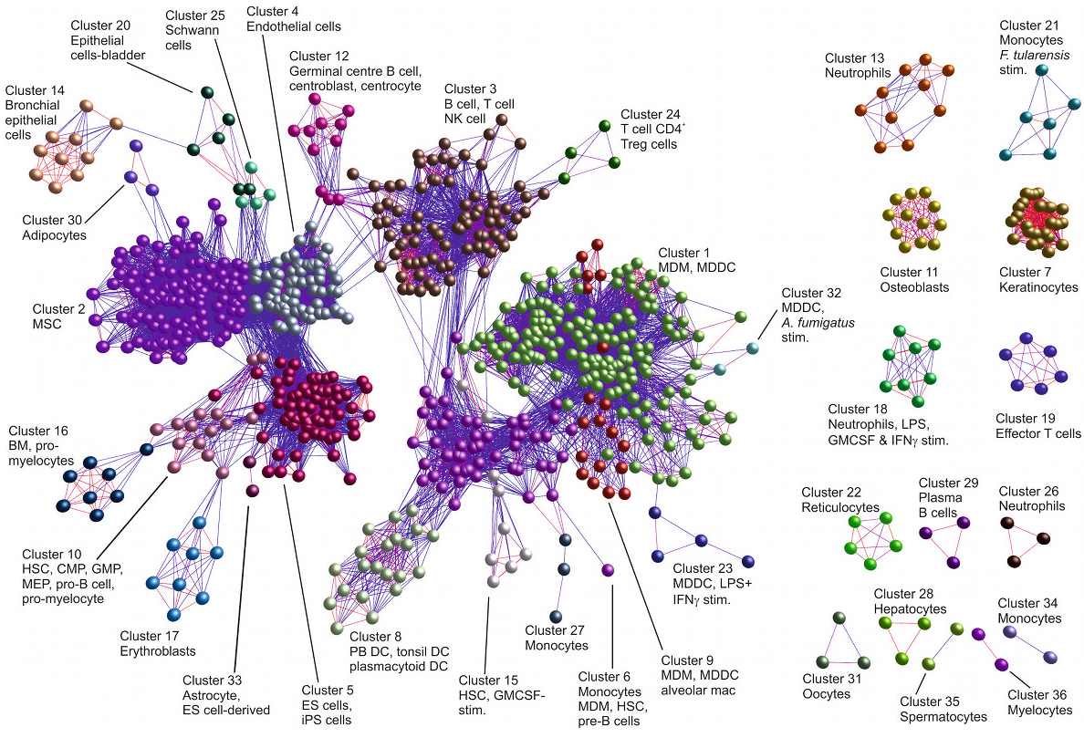
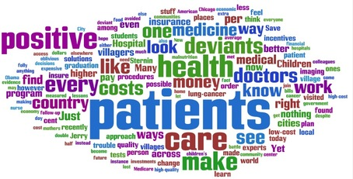
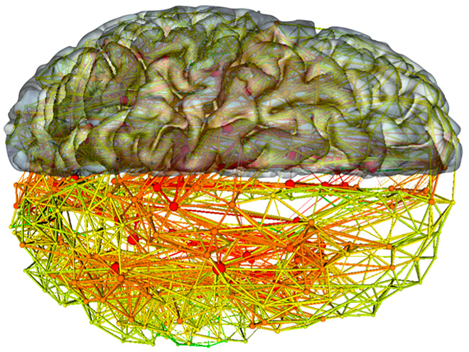
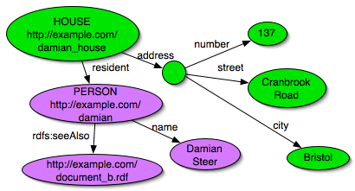
Graph Category
Many problems involve understanding a bunch of entities with complex connections (patients-drugs-doctors-hospitals, RDF Semantic graph,
neurons in brain or more general biological systems)
These require computations cognizant of the connection structure
When you decompose such problems with graph nodes spread over processors, the connections than cross processor boundaries require communication – ABDS systems Giraph and Pregel support this with is “4th form of MapReduce” – maps followed by point to point communication.
92 graph algorithms at http://en.wikipedia.org/wiki/Category:Graph_algorithms

Slide 22
Category Fusion and Workflow:
Data Fusion and Workflow
Data fusion and related areas like
“knowledge management” are well used
phrases with an intuitively clear meaning
but with no clear technical definition.
Almost all areas have multiple types and sources of data and integrating these together is important
  This corresponds to the “variety” feature of Big Data V’s
Raw Data → Data → Information → Knowledge → Wisdom → Decisions slide show a workflow with multiple services/clouds linked together in a data flow fashion to finally present results fused together in portal
The fusion can be as simple as placing results of analysis of different types of data in different parts of the portal so a decision maker can weigh the different results
Alternatively a clever machine learning algorithm can integrate the different pieces of information and reach a conclusion

Slide 23
First Set of Features:
Streaming Category

Slide 24

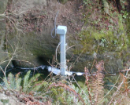
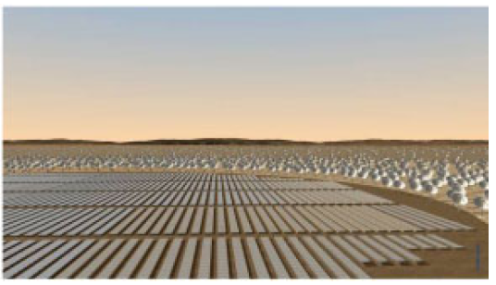
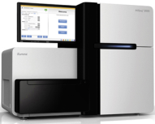
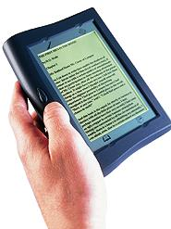





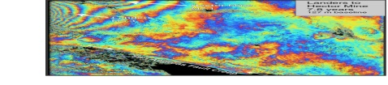
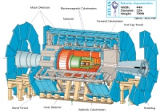
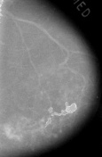



Raw Data → Data → Information → Knowledge → Wisdom → Decisions
Another
Grid
SS
SS
SS
SS
SS
SS
SS
Filter
Cloud
Discovery
Cloud
Portal
Filter
Cloud
Fusion for Discovery/Decisions
SS
Filter
Cloud
Another
Service
SS
Filter
Cloud
Filter
Cloud
Filter
Cloud
Discovery
Cloud
SS
SS
Filter
Cloud
Filter
Cloud
Filter
Cloud
Filter
Cloud
SS
SS: Sensor or Data
Interchange
Service
Workflow through multiple filter/discovery clouds or Services
Another
Cloud
SS
SS
SS
SS
SS
SS
SS
SS
SS
SS
SS
SS
SS
Compute
Cloud
Storage
Cloud
Distributed
Grid
Hadoop Cluster
Database

Slide 25
Streaming Category
We will look at several streaming examples later but most of the use cases involve this. Streaming can be seen in many ways
  There are devices – The Internet of Things and various MEMS in smartphones
  There are people tweeting or logging in to the cloud to search. These interactions are streaming
Apache Storm is critical software here to gather and integrate multiple erratic streams
Also important algorithm challenges to update quickly analyses with streamed data
http://www.kpcb.com/internet-trends

Slide 26
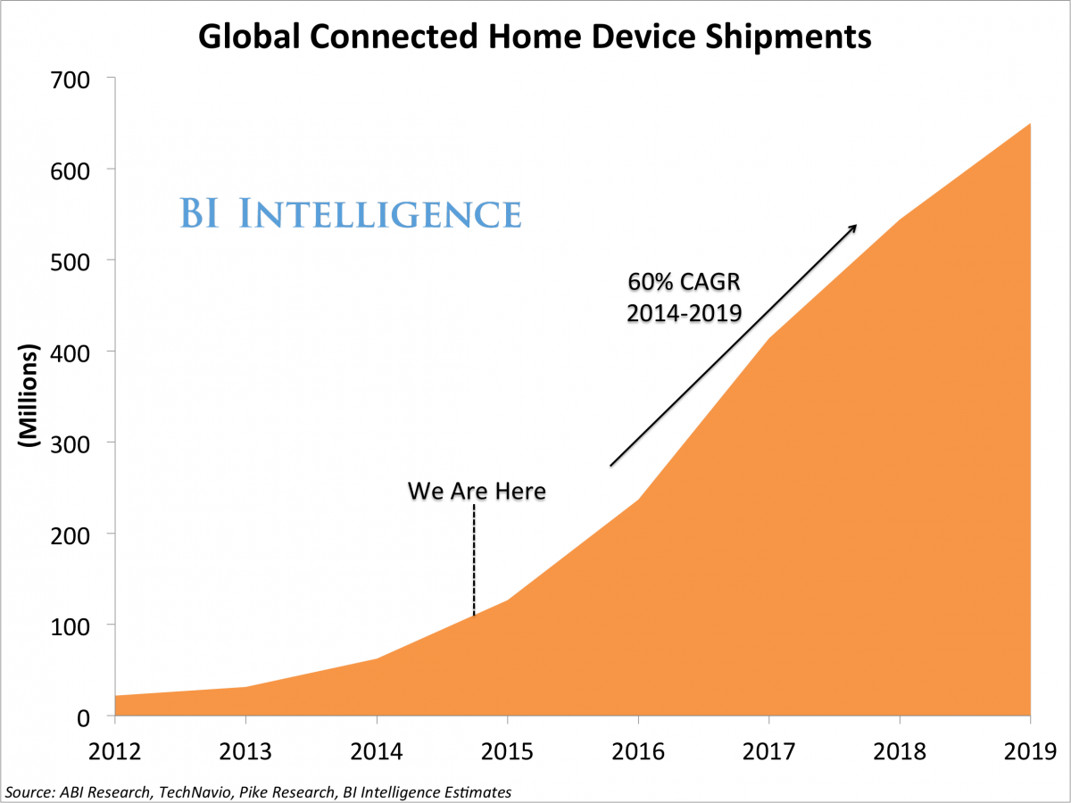
Home Devices

Slide 27
Host of Sensors processed on demand
Sensors are typically small and well served by a single virtual machine in the cloud (in fact share with many other sensors)
Cloud records data, controls and acts as a source of intelligence for sensors (perform hard calculation, access web)
It is projected that there will be 24-50 billion devices on the Internet by 2020

Slide 28
Second Set of Features

Slide 29
Features of 51 Big Data Use Cases II
S/Q/Index (12) Index, Search and Query.
to commercial applications
and suitable for MapReduce
Classify (30) Classification: divide data into categories (machine learning) with lots of different methods including clustering, SVM, learning networks, Bayesian methods, random Forests
CF (4) Collaborative Filtering for recommender engines; another key commercial application running under MapReduce; typical algorithm is k nearest neighbors
LML (36) Local Machine Learning (Independent for each parallel entity). Pleasing parallel running R or Image processing etc. on each item in parallelism.
GML (23) Global Machine Learning: Deep Learning, Clustering, LDA, PLSI, MDS,
  Large Scale Optimizations as in Variational Bayes, MCMC, Lifted Belief Propagation, Stochastic Gradient Descent, L-BFGS, Levenberg-Marquardt . Can call EGO or Exascale Global Optimization with scalable parallel algorithm

Slide 30
S/Q/Index Category
This is classic database problem with
  Very good indices for quick query response
  Fault tolerance done very well
The cloud has emphasized alternative solutions based on MapReduce and NoSQL databases
MapReduce can be viewed as exposing the parallel layer inside databases allowing systems like Hive (SQL on Hadoop) to be built which are more scalable (and so cheaper on big data) than classic databases
NoSQL systems support different data abstractions – tables with flexible schema, objects, graphs, documents
  Tools like Drill make them look like SQL stores

Slide 31
Categories Classify and CF:
Many big data use cases involve classification of
data in some fashion
Search classifies documents by their nearness to your search
Recommender systems classify items by their relevance to your interests
Network science divide people and the Internet into communities of like-minded folks
Biologists classify sequences by their role and the family to which they belong
Classification is implemented by Machine Learning ML in several ways
SVM divides data into regions by planes
Clustering divides data into groups where members of each group are near each other
Clustering is “unsupervised” learning as no input as to categories
Collaborative Filtering CF is supervised as use existing rankings to predict new rankings
Collaborative Filtering CF is a well known approach for recommender systems that match current user interests with those of others to predict interesting data to investigate
  It has three distinct subclasses user-based, item-based and content-based which can be combined in hybrid fashion
Learning networks train with existing classifications to be able to predict new ones and so are typically supervised (although use case 26 has both)

Slide 32
Second Set of Features
Machine Learning

Slide 33
Categories LML GML
Local and Global Machine Learning
So far we have classified overall features of
computing and applications.
Now we look at particular analysis applied to each data item i.e. to data analytics
There are two important styles – Global (GML) and Local (LML) – describing if analytics is applicable to whole dataset or is applied separately to each data point.
  Pleasing Parallel applications are defined by local analytics
  MRIter, EGO and EM (Expectation Maximization) applications are global
Global analytics require non trivial parallel algorithms which are often challenging either at algorithm or implementation level.
Machine learning ML can be applied locally or globally and can be used for most analysis algorithms tackling generic issues like classification and pattern recognition
  Note use cases like 39,40,43,44 have domain specific analysis (called signal processing for radar data in 43,44) that takes raw data and converts into meaningful information – this not machine learning although it could use local machine learning components

Slide 34
Aspects of Analytics
So Expectation Maximization EM is an
important class of Iterative optimization
where approximate optimizations are calculated iteratively. Each iteration has two steps – E and M – each of which calculates new values for a subset of variables fixing the other subset
  This avoids difficult nonlinear optimization but it is often an active research area to find the choice of EM heuristic that gives “best answer” measured by execution time or quality of result
A particularly difficult class of optimization comes from datasets where graphs are an important data structure or more precisely complicated graphs that complicate the task of querying data to find members satisfying a particular graph structure

Slide 35
Category GML: Global Machine Learning aka EGO – Exascale Global Optimization
Typically maximum likelihood or χ² with a
sum over the N data items – documents,
sequences, items to be sold, images etc. and often links (point-pairs). Usually it’s a sum of positive numbers as in least squares
Covering clustering/community detection, mixture models, topic determination, Multidimensional scaling, (Deep) Learning Networks
PageRank is “just” parallel linear algebra
Note many Mahout algorithms are sequential – partly as MapReduce limited; partly because parallelism unclear
  MLLib (Spark based) better
SVM and Hidden Markov Models do not use large scale parallelization in practice?
Detailed papers on particular parallel graph algorithms

Slide 36
Exascale Global Optimization EGO
  EGO is used to represent an artificial intelligence (AI)
  GML problem phrased as a giant optimization over
  many variables
    Name invented at Argonne-Chicago workshop
  The simplest case is χ² or similar Maximum likelihood formulations which end as minimization of a sum of terms which involve observational data and parameters to be determined
  This analytic formulation of AI is rather different from traditional rule based or expert system AI
    Its easy enough to minimize the sum of a billion terms but not so easy to reliably apply a billion rules
  One example illustrated later is Multi-dimensional scaling where for N entities (say sequences) one has N(N-1)/2 measures of similarities between pairs and one minimizes weighted sum of square of similarities minus predicted similarities from an assignment of entity to a position in some vector space.
  Information retrieval takes the world’s documents and finds best possible set of topics implied by them

Slide 37
Third Set of Features

Slide 38
Features of 51 Big Data Use Cases III
Workflow (51) Universal “orchestration” or dataflow
between different tasks in job
(Described earlier under Fusion)
GIS (16) Geographical Information System. Geotagged data and often displayed in ESRI, Microsoft Virtual Earth, Google Earth, GeoServer, Minnesota Map Server etc.
HPC (5) Classic large-scale simulation of cosmos, materials, etc. generating (visualization) data to be analyzed for turbulence, particle trajectories etc.
Agent (2) Simulations of models of data-defined macroscopic entities represented as agents. Use in simulations of cities (vehicle flow)or spread of information in complex system.

Slide 39
GIS Category
Support of spatial big data
Many use cases are involved with entities that are functions of space and time; in particular use cases from defense, earth, environmental, polar science are strongly correlated to position
  Some Physics and most Astronomy use cases can also have this feature
Note use cases 43 and 44 have map-based illustrations.
Fundamental physics use case 39 is not like this – partly as quantum mechanics makes traditional pictures misleading but physics often uses non map based 3D simulations.
A GIS – Geographical Information System – is designed to display spatial (“geo-located) data with information added or available as you browse via clicking; Google Earth and maps are familiar GIS and ESRI
The Open Geospatial Consortium has set standards and methodology to allow different owners of geolocated material present their wares so can be placed on same GIS display

Slide 40
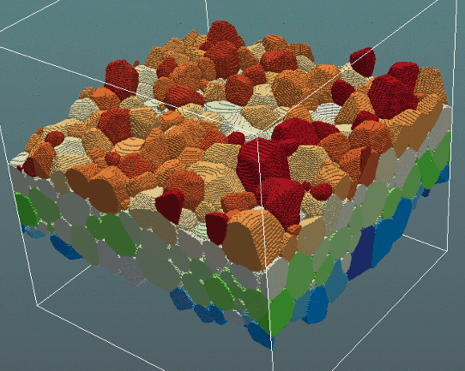
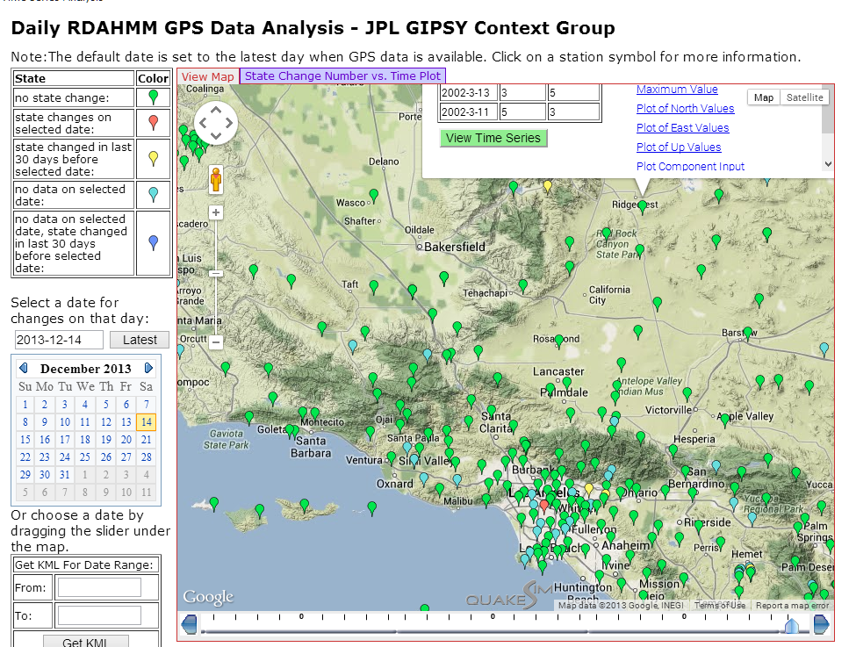
3D (4D with time) science has special displays or visualizations
3D view of a grain structure in a nanomaterial (use cases 11,12) http://www.icams.de/content/departments/stks/index.html
GIS of GPS sensors monitored at JPL http://www.quakesim.org/tools/timeseries for earthquake signatures
with one GPS clicked near top right to get more information

Slide 41
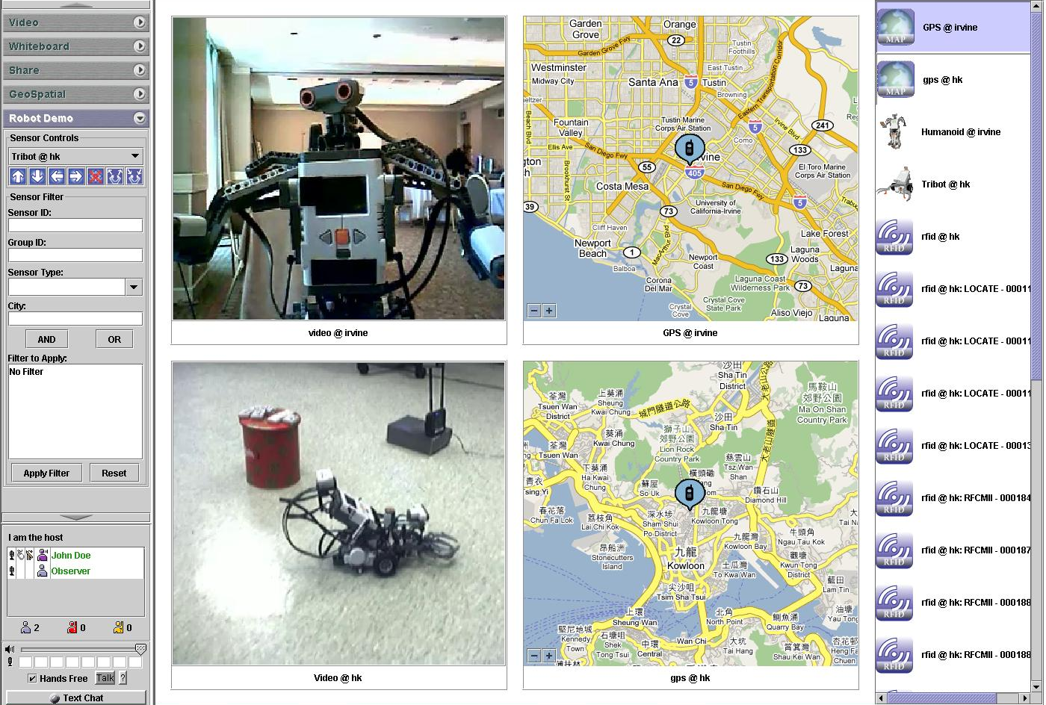
Sensor Control Interface with GIS and Information Fusion

Slide 42
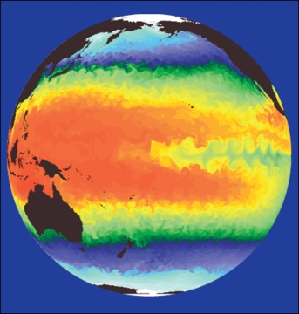
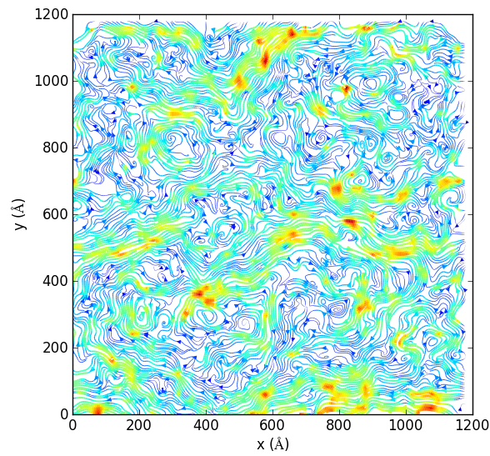
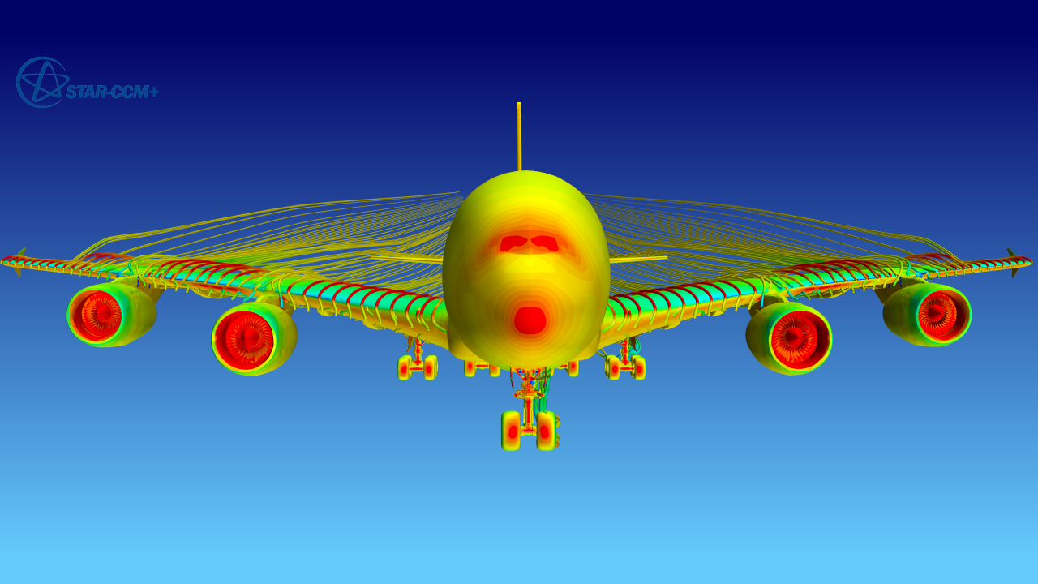
Category HPC
High Performance Computing
Large scale simulations produce output that can often be thought of as visualizations
These need to be automatically analyzed to identify key features
Here see molecular dynamics, airflow (turbulence) and climate
Petabyte/Second for an exascale supercomputer

Slide 43
Category Agent:
Agent-based modelling:
When one simulates a new material one
typically uses fundamental equations of
matter describing atoms, electrons, molecules. However if we want to simulate the stock market, transportation systems or reaction of population to disease or shock, then the basic entities are not fundamental quantities
Rather people, cars, stocks are “macroscopic quantities” defined not by Newton’s laws but by some set of interaction or time evolution “empirical” rules. They form complex systems
One uses Agents which are black boxes with defined responses to other agents and rest of context for this type of simulation
  Agents are sometimes evolved with slow event driven simulations but the methods used in use cases 23 and 24 are much faster although agent simulations are always slower (per entity) than simple fundamental particle simulations

Slide 44
Lessons / Insights
Introduced
NIST Big Data Initiative
Data Science is interesting
Discussed features of Big Data applications and where they got their parallelism
Discussed details of each feature
Global Machine Learning or (Exascale Global Optimization) particularly challenging

