Slide 1
Big Data Open Source Software and Projects ABDS in Summary XII: Layer 11B Part 1
Data Science Curriculum
March 1 2015
Geoffrey Fox
gcf@indiana.edu
http://www.infomall.org
School of Informatics and Computing
Digital Science Center
Indiana University Bloomington

Slide 2
Functionality of 21 HPC-ABDS Layers
Message Protocols:
Distributed Coordination:
Security & Privacy:
Monitoring:
IaaS Management from HPC to hypervisors:
DevOps:
Interoperability:
File systems:
Cluster Resource Management:
Data Transport:
A) File management B) NoSQL Part 1 C) SQL
In-memory databases&caches / Object-relational mapping / Extraction Tools
Inter process communication Collectives, point-to-point, publish-subscribe, MPI:
A) Basic Programming model and runtime, SPMD, MapReduce: B) Streaming:
A) High level Programming: B) Application Hosting Frameworks
Application and Analytics:
Workflow-Orchestration:
Here are 21 functionalities. (including 11, 14, 15 subparts)
4 Cross cutting at top
17 in order of layered diagram starting at bottom

Slide 3
Tools

Slide 4
Apache Lucene
http://lucene.apache.org/
Apache Lucene is an information retrieval software library. Lucene is of particular historical significance in the Apache Big Data Stack as the project that launched Hadoop, as well as other Apache projects such as Solr, Mahout and Nutch.
The Lucene Core subproject provides capabilities such as searching and indexing, spellchecking, hit highlighting and analysis/tokenization capabilities.
Lucene is very widely used in large scale applications, for example Twitter uses Lucene to support real-time search.

Slide 5
Apache Solr, Solandra
Solr http://lucene.apache.org/solr/ is the popular, blazing fast open source enterprise search platform from the Apache Lucene project.
Its major features include powerful full-text search, hit highlighting, faceted search, near real-time indexing, dynamic clustering, database integration, rich document (e.g., Word, PDF) handling, and geospatial search.
Solr is highly reliable, scalable and fault tolerant, providing distributed indexing, replication and load-balanced querying, automated failover and recovery, centralized configuration and more.
Solr powers the search and navigation features of many of the world's largest internet sites.
Solr is written in Java and runs as a standalone full-text search server within a servlet container such as Jetty.
Solr uses the Lucene Java search library at its core for full-text indexing and search, and has REST-like HTTP/XML and JSON APIs that make it easy to use from virtually any programming language.
Solr is essentially a powerful interface to Lucene
Solandra adds Cassandra to Solr http://www.datastax.com/wp-content/uploads/2011/07/Scaling_Solr_with_Cassandra-CassandraSF2011.pdf
In http://db-engines.com/en/ranking March 2015: #12

Slide 6
Types of NoSQL databases-
There are 4 basic types of NoSQL databases:
Key-Value Store – It has a Big Hash Table of keys & values {Example- Riak, Amazon S3 (Dynamo)}
Document-based Store- It stores documents made up of tagged elements. {Example- CouchDB}
Column-based Store- Each storage block contains data from only one column, {Example- HBase, Cassandra}
Graph-based-A network database that uses edges and nodes to represent and store data. {Example- Neo4J}

Slide 7
NoSQL: Key-Value Many surveys of NoSQL databases http://www.bigdata-madesimple.com/a-deep-dive-into-nosql-a-complete-list-of-nosql-databases/

Slide 8
Voldemort (LinkedIn)
Voldemort http://data.linkedin.com/opensource/voldemort http://www.project-voldemort.com/voldemort/ is a distributed open source Apache license key-value storage system (clone of Amazon Dynamo)
Data is automatically replicated over multiple servers.
Data is automatically partitioned so each server contains only a subset of the total data
Server failure is handled transparently
Pluggable Storage Engines -- BDB-JE, MySQL, Read-Only
Pluggable serialization is supported to allow rich keys and values including lists and tuples with named fields, as well as to integrate with common serialization frameworks like Protocol Buffers, Thrift, Avro and Java Serialization
Data items are versioned to maximize data integrity in failure scenarios without compromising availability of the system
Each node is independent of other nodes with no central point of failure or coordination
Good single node performance: you can expect 10-20k operations per second depending on the machines, the network, the disk system, and the data replication factor
Support for pluggable data placement strategies to support things like distribution across data centers that are geographically far apart.

Slide 9
Riak
In http://db-engines.com/en/ranking March 2015: #31
Riak is an Apache licensed open source, distributed key-value database. Riak is architected for:
Low-Latency: Riak is designed to store data and serve requests predictably and quickly, even during peak times.
Availability: Riak replicates and retrieves data intelligently, making it available for read and write operations even in failure conditions.
Fault-Tolerance: Riak is fault-tolerant so you can lose access to nodes due to network partition or hardware failure and never lose data.
Operational Simplicity: Riak allows you to add machines to the cluster easily, without a large operational burden.
Scalability: Riak automatically distributes data around the cluster and yields a near-linear performance increase as capacity is added
Riak uses Solr for search
Riak is written mainly in Erlang and client libraries exist for Java, Ruby, Python, and Erlang.
Comes from Basho Technologies and based on Amazon Dynamo

Slide 10
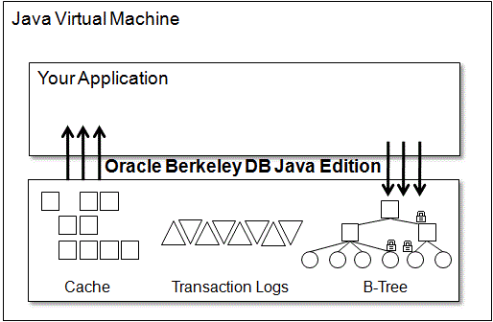
Oracle Berkeley DB Java Edition BDB-JE
Oracle Berkeley DB Java Edition is an open source, embeddable, transactional storage engine written entirely in Java. It takes full advantage of the Java environment to simplify development and deployment. The architecture of Oracle Berkeley DB Java Edition supports very high performance and concurrency for both read-intensive and write-intensive workloads.
It is not SQL and different from the majority of Java solutions, which use object-to-relational (ORM) solutions like the Java Persistence API (JPA) to map class and instance data into rows and columns in a RDBMS.
Relational databases are well suited to data storage and analysis, however most persisted object data is never analyzed using ad-hoc SQL queries; it is usually simply retrieved and reconstituted as Java objects.
In http://db-engines.com/en/ranking March 2015: #54

Slide 11
Google LevelDB
https://github.com/google/leveldb
http://en.wikipedia.org/wiki/LevelDB
Written by Google fellows Jeffrey Dean and Sanjay Ghemawat in 2011 based on BigTable design but not re-using any code so open source
LevelDB is used as the backend NoSQL database for Google Chrome's IndexedDB and is one of the supported backends for Riak
Benchmarks given by Google http://leveldb.googlecode.com/svn/trunk/doc/benchmark.html versus Kyoto Cabinet and SQLite
LevelDB is a Library not a Server
In http://db-engines.com/en/ranking March 2015: #80

Slide 12
Kyoto/Tokyo Cabinet
C++ with GNU license
http://fallabs.com/tokyocabinet/
http://fallabs.com/kyotocabinet/
Tokyo Cabinet and Kyoto Cabinet are two libraries of routines for managing key-value databases stored in files.
Tokyo Cabinet was sponsored by the Japanese social networking site, Mixi, and was a multithreaded embedded database manager, comparable in functionality to SQLite (but without an actual SQL implementation) and was announced by its authors as "a modern implementation of DBM".
Kyoto Cabinet is the designated successor of Tokyo Cabinet.
The database is a simple data file containing records, each is a pair of a key and a value.
Every key and value is serial bytes with variable length. Both binary data and character string can be used as a key and a value.
Each key must be unique within a database. There is neither concept of data tables nor data types. Records are organized in hash table or B+ tree
Kyoto Tycoon is SaaS version of Kyoto Cabinet as is Tokyo Tyrant for Tokyo Cabinet
In http://db-engines.com/en/ranking March 2015: Tokyo is #137, Tyrant #152, Kyoto #193, Tycoon #216

Slide 13
Google Cloud DataStore, Amazon Dynamo, Azure Table
Public Cloud NoSQL stores
https://cloud.google.com/products/cloud-datastore/
Datastore is a NoSQL database as a cloud service
This is a schemaless database for storing non-relational data. Cloud Datastore automatically scales as you need it and supports transactions as well as robust, SQL-like queries.
See http://aws.amazon.com/dynamodb/ for Amazon equivalent and Azure Table http://azure.microsoft.com/en-us/documentation/articles/storage-dotnet-how-to-use-tables/ for Azure equivalent

Slide 14
NoSQL: Document

Slide 15
MongoDB
In http://db-engines.com/en/ranking March 2015: #4
Affero GPL Licensed https://www.mongodb.org/ http://en.wikipedia.org/wiki/MongoDB document oriented NoSQL
MongoDB eschews the traditional table-based relational database structure in favor of JSON-like documents with dynamic schemas (MongoDB calls the format BSON), making the integration of data in certain types of applications easier and faster.
Document-oriented: Instead of taking a business subject and breaking it up into multiple relational structures, MongoDB can store the business subject in the minimal number of documents. For example, instead of storing title and author information in two distinct relational structures, title, author, and other title-related information can all be stored in a single document called Book, which is much more intuitive and usually easier to work with.
Ad hoc queries: MongoDB supports search by field, range queries, regular expression searches. Queries can return specific fields of documents and also include user-defined JavaScript functions.
Indexing: Any field in a MongoDB document can be indexed (indices in MongoDB are conceptually similar to those in RDBMSes). Secondary indices are also available.
Replication: MongoDB provides high availability with replica sets.
Load balancing: MongoDB scales horizontally using sharding. The user chooses a shard key, which determines how the data in a collection will be distributed. The data is split into ranges (based on the shard key) and distributed across multiple shards. (A shard is a master with one or more slaves.). MongoDB can run over multiple servers, balancing the load and/or duplicating data.
File storage: MongoDB can be used as a file system, taking advantage of load balancing and data replication features over multiple machines for storing files.

Slide 16
Espresso (LinkedIn)
Espresso http://data.linkedin.com/projects/espresso is a horizontally scalable, indexed, timeline-consistent, document-oriented, highly available NoSQL data store.
Expect to release it as an open-source project in 2014
As LinkedIn grows, our requirements for primary source-of-truth data are exceeding the capabilities of a traditional RDBMS system. More than a key-value store, Espresso provides consistency, lookups on secondary fields, full text search, limited transaction support, and the ability to feed a change capture service for easy integration with other online, nearline and offline data ecosystem.
To support our highly innovative and agile environment, we need to support on-the-fly schema changes, and for operability, the ability to add capacity incrementally with no downtime.
Espresso is in production today, and we are aggressively migrating many applications to use Espresso as the source-of-truth.
Examples include: member-member messages, social gestures such as updates, sharing articles, member profiles, company profiles, news articles, and many more.
As we support these applications, we are working through many interesting problems, such as consistency/availability tradeoffs, latency optimization, efficient use of system resources, performance benchmarking and optimization, and lots more.
Espresso uses Helix (layer 9) for resource management

Slide 17
CouchDB
In http://db-engines.com/en/ranking March 2015: #22
Apache CouchDB is a database that uses JSON for documents, JavaScript for MapReduce indexes, and regular HTTP for its API
“CouchDB is a database that completely embraces the web”
CouchDB http://en.wikipedia.org/wiki/CouchDB http://couchdb.apache.org/ is written in Erlang.
Couch is an acronym for cluster of unreliable commodity hardware
Unlike in a relational database, CouchDB does not store data and relationships in tables.
Instead, each database is a collection of independent documents.
Each document maintains its own data and self-contained schema.
An application may access multiple databases, such as one stored on a user's mobile phone and another on a server.
Document metadata contains revision information, making it possible to merge any differences that may have occurred while the databases were disconnected.
CouchDB provides ACID (Atomicity, Consistency, Isolation, Durability) semantics using a form of Multi-Version Concurrency Control (MVCC) in order to avoid the need to lock the database file during writes.
Conflicts are left to the application to resolve.
Resolving a conflict generally involves first merging data into one of the documents, then deleting the stale one

Slide 18
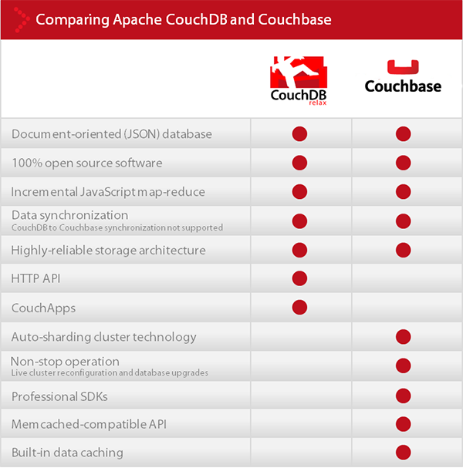
Couchbase
In http://db-engines.com/en/ranking March 2015: #24
distributed key-value / document database system
A variant of CouchDB developed by some common engineers.
C, C++, Erlang
Has memcached features
Has proprietary and open source version
http://en.wikipedia.org/wiki/Couchbase_Server

Slide 19
IBM Cloudant
Cloudant is based on the Apache-backed CouchDB project and the open source BigCouch project (from same vendor as Cloudant). IBM acquired software in 2014.
CouchDB and Cloudant have the same REST API, so they can be used in the same way.
http://en.wikipedia.org/wiki/Cloudant
https://cloudant.com/
In http://db-engines.com/en/ranking March 2015: #55

Slide 20
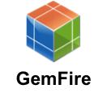
Pivotal Gemfire
Formerly VMware vFabric GemFire
http://www.vmware.com/products/vfabric-gemfire/overview.html
In http://db-engines.com/en/ranking March 2015: #55
Distributed in-memory document NoSQL system backed by HDFS
Pivotal GemFire can store JSON documents along with key-value/object data.

