Slide 1
Big Data Open Source Software and Projects ABDS in Summary XIII: Layer 11B Part 2
Data Science Curriculum
March 1 2015
Geoffrey Fox
gcf@indiana.edu
http://www.infomall.org
School of Informatics and Computing
Digital Science Center
Indiana University Bloomington

Slide 2
Functionality of 21 HPC-ABDS Layers
Message Protocols:
Distributed Coordination:
Security & Privacy:
Monitoring:
IaaS Management from HPC to hypervisors:
DevOps:
Interoperability:
File systems:
Cluster Resource Management:
Data Transport:
A) File management B) NoSQL Part 2 C) SQL
In-memory databases&caches / Object-relational mapping / Extraction Tools
Inter process communication Collectives, point-to-point, publish-subscribe, MPI:
A) Basic Programming model and runtime, SPMD, MapReduce: B) Streaming:
A) High level Programming: B) Application Hosting Frameworks
Application and Analytics:
Workflow-Orchestration:
Here are 21 functionalities. (including 11, 14, 15 subparts)
4 Cross cutting at top
17 in order of layered diagram starting at bottom

Slide 3
NoSQL: Column Also see Apache Flink in Programming

Slide 4
Google Bigtable & Apache HBase
http://hbase.apache.org/
Hbase is an open-source NoSQL database, modeled after Google’s Bigtable distributed storage system.
Massively scalable, capable of managing and organizing petabyte size data sets with billions of rows by millions of columns.
Features presented in the Big Table paper which have been implemented in HBASE include in-memory operation and the application of Bloom filters to columns. HBase can be accessed through a number of APIs, including Java, REST, Avro or Thrift.
Developed for a natural language search engine, it first became a subproject of Apache Hadoop, became a top level project in 2010.
In http://db-engines.com/en/ranking March 2015: #14

Slide 5
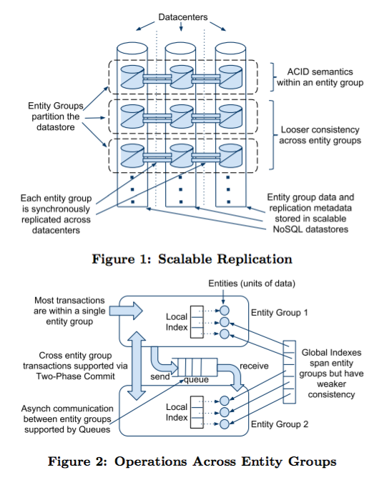
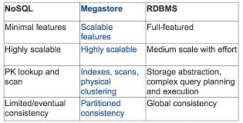
Google Megastore
Built on Google Chubby and Bigtable and an early interpolation between the easy usability of SQL databases and the scalability of NoSQL such as Bigtable (Apache Hbase)
http://research.google.com/pubs/pub36971.html
See comparison table where PK = Primary Key

Slide 6
Google Spanner
Spanner is Google's globally distributed NewSQL database, a successor to BigTable.
Spanner’s data model is not purely relational, in that rows must have names which are essentially keys
http://en.wikipedia.org/wiki/Spanner_%28database%29
https://www.usenix.org/system/files/conference/osdi12/osdi12-final-16.pdf
Because the lack of transactions in BigTable led to frequent complaints from users, Google made distributed transactions central to Spanner's design. Based on their experience with BigTable, Google argues that it is better to have application programmers deal with performance problems due to overuse of transactions as bottlenecks arise, rather than always coding around the lack of transactions.
The Google F1 SQL database management system (DBMS) is built on it, and replaces Google’s custom MySQL.
Spanner uses the Paxos algorithm as part of its operation to shard data across hundreds of datacenters. It makes heavy use of hardware-assisted time synchronization using GPS clocks and atomic clocks to ensure global consistency.

Slide 7
Apache Cassandra
http://cassandra.apache.org/
Apache Cassandra is an open source column oriented distributed NoSQL DBMS to handle large amounts of data for high availability and low latency, even over many servers or clusters spanning multiple datacenters.
Cassandra supports either synchronous or asynchronous replication, replication to multiple nodes eliminates points of failure and improves latency to clients.
Ranked as the most scalable data solution with highest throughput for largest number of nodes.
Originally developed at Facebook, became open source in 2008 and a top level Apache project in 2010
In http://db-engines.com/en/ranking March 2015: #8

Slide 8
Apache Accumulo RYA
https://accumulo.apache.org/
Accumulo is a distributed key/value store based on the same Google Bigtable design as Hbase and Cassandra.
Extends the BigTable model with additional functionality such as cell level security and server-side programming features.
Built on foundation of Apache Hadoop, Zookeeper, and Thrift
Accumulo is the third most popular wide column store after Cassandra and Hbase.
First developed in 2008, became part of Apache in 2011.
http://sqrrl.com/media/Rya_CloudI20121.pdf builds an RDF triple store Rya on top of Accumulo
In http://db-engines.com/en/ranking March 2015: #63 for Accumulo

Slide 9
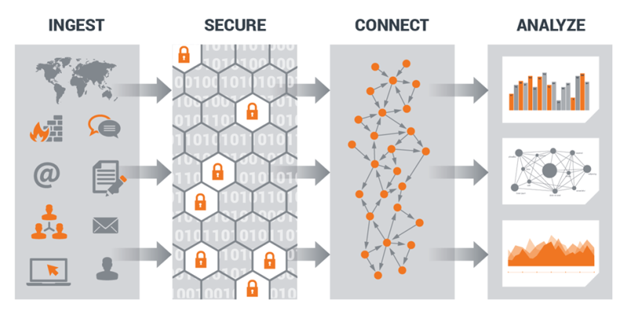
SQRRL
Sqrrl http://sqrrl.com/ is a spin off company from NSA (National Security Agency) led by their staff who worked on Apache Accumulo with focus on graph analytics for security, healthcare, terrorism
We discussed use in Big Data Security Analytics at level 3
Sqrrl Enterprise Product has: Web-based data exploration and investigation interface with User-configurable dashboards
Secure collaboration on investigative workflows
Save, share, and replay the steps of an analysis
Track provenance between raw data and context
Flexible data mappings and customizable aggregations
SqrrlQL query language and the Sqrrl Developer API
Compatibility and integration with all major distributions of Hadoop
In http://db-engines.com/en/ranking March 2015: #162

Slide 10
NoSQL: Graph

Slide 11
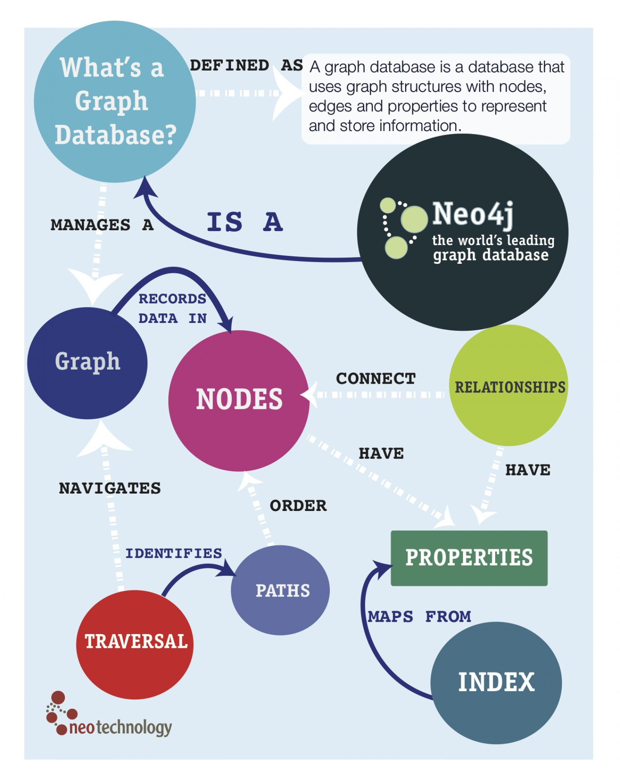
Neo4J
In http://db-engines.com/en/ranking March 2015: #23
Neo4j open source GPLv3 license http://www.neo4j.org/ http://en.wikipedia.org/wiki/Neo4j
Neo4j is an embedded, disk-based, fully transactional Java persistence engine that stores data structured in graphs rather than in tables.
Query by SparQL, native Java API, JRuby
Neo4j is the most popular graph database

Slide 12
Yarcdata Urika
http://www.yarcdata.com/Products/
Partnership with Cray
Proprietary shared memory Graph Database
Urika’s schema-free architecture, large shared memory, massively multi-threaded processors, and highly scalable I/O fuses diverse data sets into a high-performance, in-memory data model ready to be queried…all ad-hoc and in real-time.
No need to first lay out the data or predict the relationships – or even know all the queries to make upfront.
Supports SPARQL queries
Access built-in graph function BGF’s that include
Community detection: finds groups of vertices that are more densely connected within the community than outside the community
Betweenness centrality: ranks vertices on how often they are on the shortest path between other pairs of vertices
S-t connectivity: determines how long the path is from a source to a sink, if one exists
BadRank: ranks vertices on how close they are to bad vertices

Slide 13
AllegroGraph
Franz Inc. Proprietary graph database written in: Common Lisp
http://en.wikipedia.org/wiki/AllegroGraph http://franz.com/agraph/allegrograph/
AllegroGraph is a modern, high-performance, persistent graph database.
AllegroGraph uses efficient memory utilization in combination with disk-based storage, enabling it to scale to billions of quads while maintaining superior performance.
SOLR and MongoDB Integration
AllegroGraph is 100 percent ACID, supporting Transactions: Commit, Rollback, and Checkpointing.
Quads are <subject> <predicate> <object> <context> where triples are first three
AllegroGraph supports SPARQL, RDFS++, and Prolog reasoning from numerous client applications.
Query Method: SPARQLand Prolog,
Libraries: Social Networking Analytics & GeoSpatial,
AllegroGraph was developed to meet W3C standards for the Resource Description Framework, so it is properly considered an RDF Database. It is a reference implementation for the SPARQL protocol.
See http://www.w3.org/wiki/SparqlImplementations
In http://db-engines.com/en/ranking March 2015: #119

Slide 14
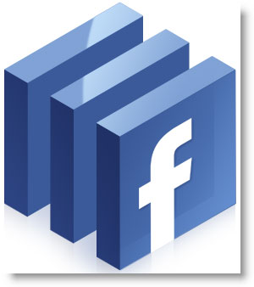
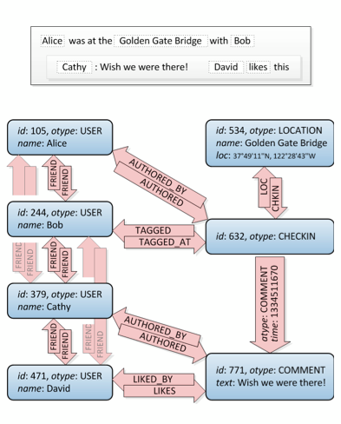
Facebook Tao I
TAO (“The Associations and Objects”) started in 2009 and runs on a large collection of geographically distributed server clusters.
TAO serves thousands of data types and handles over a billion read requests and millions of write requests every second.
The data set managed by TAO is partitioned into hundreds of thousands of shards. All objects and associations in the same shard are stored persistently in the same MySQL database, and are cached on the same set of servers in each caching cluster.
Shard == decomposition as at http://en.wikipedia.org/wiki/Shard_%28database_architecture%29

Slide 15
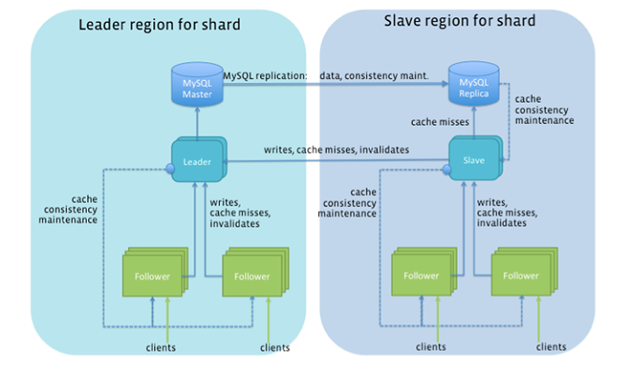
Facebook Tao II
There are three main classes of read operations on associations:
Point queries look up specific associations identified by their (id1, type, id2) triplets. Most often they are used to check if two objects are connected by an association or not, or to fetch data for an association.
Range queries find outgoing associations given an (id1, type) pair. Associations are ordered by time, so these queries are commonly used to answer questions like "What are the 50 most recent comments on this piece of content?" Cursor-based iteration is provided as well.
Count queries give the total number of outgoing associations for an (id1, type) pair. TAO optionally keeps track of counts as association lists grow and shrink, and can report them in constant time

Slide 16
Titan:db
Titan is a scalable open source graph database optimized for storing and querying graphs containing hundreds of billions of vertices and edges distributed across a multi-machine cluster. Titan is a transactional database that can support thousands of concurrent users executing complex graph traversals in real time.
http://thinkaurelius.github.io/titan/
Support for various storage backends:
Apache Cassandra
Apache HBase
Oracle BerkeleyDB
Native integration with the TinkerPop graph stack (layer 16)
Supports Hadoop (layer 14A) analysis, ElasticSearch, Solr and Lucene (layers 16, 11B)
In http://db-engines.com/en/ranking March 2015: #53

Slide 17
NoSQL: Triple Store

Slide 18
Apache Jena
http://jena.apache.org/ http://en.wikipedia.org/wiki/Jena_(framework)
Jena is an open source Semantic Web and linked data framework in Java. It provides an API to extract data from and write to RDF graphs. The graphs are represented as an abstract "model".
A model can be sourced with data from files, databases, URLs or a combination of these. A Model can also be queried through SPARQL and updated through SPARUL.
Jena is similar to Sesame; though, unlike Sesame, Jena provides support for OWL (Web Ontology Language).
The framework has various internal reasoners and the Pellet reasoner (an open source Java OWL-DL reasoner) can be set up to work in Jena.
TDB is a component of Jena for RDF storage and query.
It supports the full range of Jena APIs.
TDB can be used as a high performance RDF store on a single machine.
In http://db-engines.com/en/ranking March 2015: #79

Slide 19
Sesame
In http://db-engines.com/en/ranking March 2015: #85
http://www.openrdf.org/ http://en.wikipedia.org/wiki/Sesame_(framework)
Sesame is a de-facto standard framework for processing RDF data. This includes parsing, storing, inferencing and querying of/over such data. It offers an easy-to-use API that can be connected to all leading RDF storage solutions.
Sesame has been designed with flexibility in mind. It can be deployed on top of a variety of storage systems (relational databases, in-memory, filesystems, keyword indexers, etc.), and offers many tools to help developers to leverage the power of RDF and related standards.
Many other triplestores can be used through the Sesame API, including Mulgara, and AllegroGraph.
Sesame fully supports the SPARQL query language for expressive querying and offers transpararent access to remote RDF repositories using the exact same API as for local access.
Finally, Sesame supports all main stream RDF file formats, including RDF/XML, Turtle, N-Triples, TriG and TriX.
Sesame supports two query languages: SPARQL and SeRQL.
Another component of Sesame is Alibaba, an API that allows for mapping Java classes onto ontologies and for generating Java source files from ontologies.
This makes it possible to use specific ontologies like RSS, FOAF and the Dublin Core directly from Java.
Sesame is BSD licensed open software from Aduna – a Dutch company

