Slide 1
Big Data Open Source Software and Projects ABDS in Summary XIV: Layer 11C
Data Science Curriculum
March 5 2015
Geoffrey Fox
gcf@indiana.edu
http://www.infomall.org
School of Informatics and Computing
Digital Science Center
Indiana University Bloomington

Slide 2
Functionality of 21 HPC-ABDS Layers
Message Protocols:
Distributed Coordination:
Security & Privacy:
Monitoring:
IaaS Management from HPC to hypervisors:
DevOps:
Interoperability:
File systems:
Cluster Resource Management:
Data Transport:
A) File management B) NoSQL C) SQL
In-memory databases&caches / Object-relational mapping / Extraction Tools
Inter process communication Collectives, point-to-point, publish-subscribe, MPI:
A) Basic Programming model and runtime, SPMD, MapReduce: B) Streaming:
A) High level Programming: B) Application Hosting Frameworks
Application and Analytics:
Workflow-Orchestration:
Here are 21 functionalities. (including 11, 14, 15 subparts)
4 Cross cutting at top
17 in order of layered diagram starting at bottom

Slide 3
Database Rankings I
http://db-engines.com/en/ranking_definition
Covers NoSQL and SQL
Number of mentions of the system on websites, measured as number of results in search engines queries. At the moment, we use Google and Bing for this measurement. In order to count only relevant results, we are searching for <system name> together with the term database, e.g. "Oracle" and "database".
General interest in the system. For this measurement, we use the frequency of searches in Google Trends.
Frequency of technical discussions about the system. We use the number of related questions and the number of interested users on the well-known IT-related Q&A sites Stack Overflow and DBA Stack Exchange.
Number of job offers, in which the system is mentioned. We use the number of offers on the leading job search engines Indeed and Simply Hired.
Number of profiles in professional networks, in which the system is mentioned. We use the internationally most popular professional network LinkedIn.
Relevance in social networks. We count the number of Twitter tweets, in which the system is mentioned.

Slide 4
Database Rankings II
NoSQL

Slide 5
Apache Derby
http://db.apache.org/derby/
Apache Derby is a relational database management system written in Java and based on the SQL and JDBC standards
Derby offers a small footprint (~2.6 megabytes), an embedded JDBC driver, and is easy to deploy and use.
Derby originated in 1996 as a startup out of Oakland, CA called Cloudscape Inc. Cloudscape was acquired by Informix and then later by IBM. IBM donated the code to Apache in 2004, creating the Derby incubator project.
Derby is a subproject of Apache DB.
Derby has been included as part of the Java API since the Java 7 release, rebranded as “JavaDB”.
Typically used as an embedded database. Performance not competitive as a standalone system.
Derby #50 March 2015 http://db-engines.com/en/ranking

Slide 6
SQLite
Public domain http://www.sqlite.org/ http://en.wikipedia.org/wiki/SQLite is a lightweight RDBMS designed to be used as a library (i.e. embedded) rather than a standalone server
The browsers Google Chrome, Opera, Safari and the Android Browser all allow for storing information in, and retrieving it from, a SQLite database within the browser, using the Web SQL Database technology http://en.wikipedia.org/wiki/Web_SQL_Database.
Mozilla Firefox and Mozilla Thunderbird store a variety of configuration data (bookmarks, cookies, contacts etc.) in internally managed SQLite databases, and even offer an add-on to manage SQLite databases.
Skype is a widely deployed application that uses SQLite
It used inside main smartphone O/S – Apple, Microsoft, Blackberry, Symbian, Android
SQLite is ACID-compliant and implements most of the SQL standard, using a dynamically and weakly typed SQL syntax
SQLite #9 March 2015 http://db-engines.com/en/ranking

Slide 7
MySQL
Popular GNU license SQL database or relational database management system (RDBMS), http://en.wikipedia.org/wiki/MySQL
Second in number of installations to SQLite as an open source RDBMS
Now owned by Oracle with open source and supported versions.
Part of LAMP which refers to archetypal model of web service solution stacks, originally consisting of four components: Linux, the Apache HTTP Server, the MySQL relational database management system, and the PHP programming language.
As a solution stack, LAMP is suitable for building dynamic web sites and web applications.
Used in cloud architectures but not often as central storage engine but rather for “small” metadata and such
Though MySQL began as a low-end alternative to more powerful proprietary databases, it has gradually evolved to support higher-scale needs as well. It is still most commonly used in small to medium scale single-server deployments, either as a component in a LAMP-based web application or as a standalone database server.
Much of MySQL's appeal originates in its relative simplicity and ease of use, which is enabled by an ecosystem of open source tools such as phpMyAdmin.
In the medium range, MySQL can be scaled by deploying it on more powerful hardware, such as a multi-processor server
MySQL #2 behind Oracle March 2015 http://db-engines.com/en/ranking

Slide 8
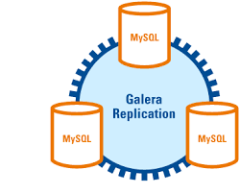
Galera Cluster
Galera is a multi-master extension for MySQL that enables multiple MySQL nodes to handle reads and writes, synchronizing the writes on each node simultaneously.
There is also a MySQL Cluster version; Galera comes from a fork of MySQL
MariaDB, a MySQL fork, now ships MariaDB Galera Cluster as its cluster solution too.
MariaDB #25 March 2015 http://db-engines.com/en/ranking

Slide 9
PostgreSQL
PostgreSQL http://en.wikipedia.org/wiki/PostgreSQL is an open source high quality object-relational database ORDBMS with many similarities to MySQL
According to http://www.wikivs.com/wiki/MySQL_vs_PostgreSQL originally PostgreSQL was known for my features and MySQL for more performance and better ease of use but with time, the systems have become more similar
PostgreSQL is developed by the PostgreSQL Global Development Group, a diverse group of many companies and individual contributors. It is free and open source software, released under the terms of the PostgreSQL License, a permissive free software license.
Michael Stonebraker, a distinguished Berkeley faculty member developed Ingres 1970-1985 on which PostgreSQL (Post Ingres) is based. He just got Turing award!
#5 http://db-engines.com/en/ranking

Slide 10
http://en.wikipedia.org/wiki/CUBRID
http://www.cubrid.org/
CUBRID is open source SQL-based relational database management system (RDBMS) with object extensions developed by Naver Corporation for web applications. The name CUBRID is a combination of the two words cube and bridge, cube standing for a sealed box that provides security for its contents while bridge standing for data bridge.
First released November 2008 and written in C
The feature that distinguishes CUBRID database from other relational database systems is its 3-tier client-server architecture, which consists of the database server, the connection broker and the application layer
Note Server GNU but clients more lenient BSD style license
Ranked #153 March 2015 at http://db-engines.com/en/ranking

Slide 11
Oracle, DB2, SQL Server
Dominant commercial object-relational (objects, classes and inheritance are directly supported in database schemas and in the query language) database management system ORDBMS with reputation for high quality and high cost http://en.wikipedia.org/wiki/Oracle_Database
Started in 1977 when Larry Ellison and friends founded Software Development Laboratories (SDL).
http://en.wikipedia.org/wiki/Comparison_of_relational_database_management_systems compares many other proprietary and open source systems
Microsoft SQL Server, IBM DB2 and to a lesser extent Sybase and Teradata are other major commercial RDBMS
Has all sorts of extensions such as spatial query support http://en.wikipedia.org/wiki/Oracle_Spatial_and_Graph and all sorts of “editions” (Enterprise, Standard, Express)
There is substantial debate comparing this classic approach to Hadoop based approaches like Hive which parallelize with greater performance
Oracle supports ACID (Atomicity, Consistency, Isolation, Durability) is a set of properties that guarantee that database transactions are processed reliably.
Compare with Eventually consistent services which provide BASE (Basically Available, Soft state, Eventual consistency) semantics,
BASE gets inconsistent answers before convergence of multiple distributed updates

Slide 12
SciDB
SciDB http://en.wikipedia.org/wiki/SciDB http://www.scidb.org/ is an array database designed for multidimensional data management and analytics common to scientific, geospatial, financial, and industrial applications.
Arrays are natively supported including parallel operations on them
It is developed by company Paradigm4, co-founded by Michael Stonebraker of PostgreSQL fame.
License is Affero General Public License AGPL
Key features include:
Support of provenance
Out of memory arrays
Massive scale math on the arrays for linear algebra and analytics.
Uncertainty can be modeled by associating error-bars with data.
Efficient storage.
Partly motivated as a database community answer to Hadoop
In http://db-engines.com/en/ranking March 2015: #150

Slide 13
Rasdaman
http://www.rasdaman.com/
Rasdaman ("raster data manager") is a Database Management System which adds capabilities for storage and retrieval of massive multi-dimensional arrays, such as sensor, image, and statistics data.
A frequently used synonym to arrays is raster data, such as in 2-D raster graphics; this actually has motivated the name Rasdaman.
However, Rasdaman has no limitation in the number of dimensions - it can serve, for example, 1-D measurement data, 2-D satellite imagery, 3-D x/y/t image time series and x/y/z exploration data, 4-D ocean and climate data.
There is a Rasdaman query language, rasql.

Slide 14
Pivotal Greenplum
http://pivotal.io/big-data/pivotal-greenplum-database
Greenplum is a classic SQL database acquired by EMC in 2010 and bundled in their spinoff Pivotal in 2012
Greenplum commercial and built on PostgresSQL and aimed at data warehousing
Note PostgresSQL license encourages use in commercial products whereas MySQL GNU license doesn’t
Parallelism by master-slave replication
#36 in march 2015 http://db-engines.com/en/ranking

Slide 15
Public Cloud SQL as a Service
Provides traditional databases as a service on clouds
Azure SQL Service http://msdn.microsoft.com/en-us/library/azure/dn133151.aspx based on SQL Server
Google Cloud SQL https://developers.google.com/cloud-sql/ based on MySQL
Amazon Relational Database Service (Amazon RDS) http://aws.amazon.com/rds/ with MySQL, PostgreSQL, Oracle and SQL Server

Slide 16
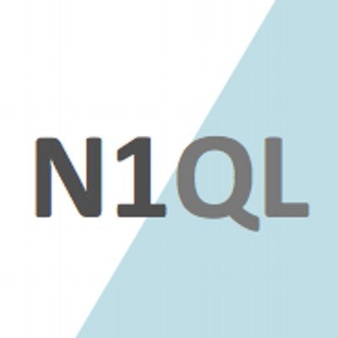
N1QL
N1QL builds on the SQL language and includes many of SQL's features in addition to features associated with document-oriented databases.
Designed for Couchbase document oriented caching NoSQL store
N1QL allows for joins, filter expressions, aggregate expressions, subqueries, data manipulation language (DML), and many other features to build a rich application.

Slide 17
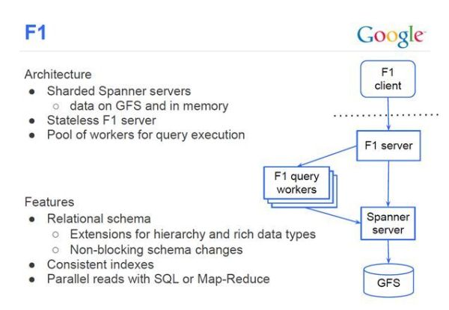
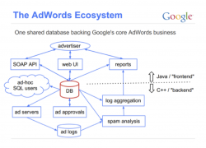
Google F1
http://research.google.com/pubs/pub38125.html supports Adwords
The strong consistency properties of F1 and its storage system come at the cost of higher write latencies compared to MySQL.
The commit latency on F1 is quite high (at 50-100ms). Read latency takes a hit as well, with simple reads in the 5-10ms range.
Google’s core ad business runs on F1, at a scale of 10s of TBs across 1000s of machines. Ability to keep good enough performance by scaling the system matters more than individual latency.

Slide 18
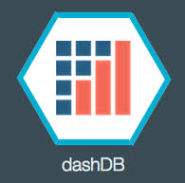
IBM dashDB
Similar to Amazon Redshift (level 15A) offering warehouse capabilities for data stored in NoSQL Cloudant
http://www-01.ibm.com/software/data/dashdb/

Slide 19
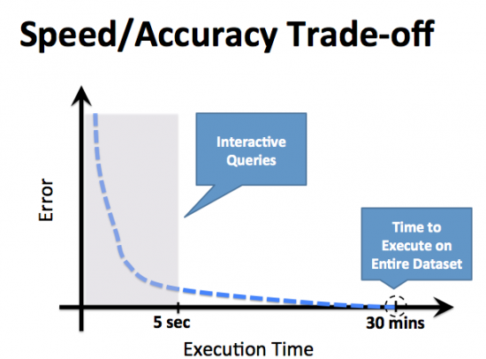
BlinkDB
BlinkDB, a massively parallel, approximate query engine for running interactive SQL queries on large volumes of data.
BlinkDB allows users to tradeoff query accuracy for response time, enabling interactive queries over massive data by running queries on data samples and presenting results annotated with meaningful error bars.
Builds on Hive/Shark but uses sampling to get high performance
Using a 100 node cluster BlinkDB can answer queries on up to 17 TBs of data in less than 2 seconds (over 200× faster than Hive), with an error of 2-10%

