Slide 1
Big Data Open Source Software and Projects ABDS in Summary XVIII: Layer 14A
Data Science Curriculum
March 1 2015
Geoffrey Fox
gcf@indiana.edu
http://www.infomall.org
School of Informatics and Computing
Digital Science Center
Indiana University Bloomington

Slide 2
Functionality of 21 HPC-ABDS Layers
Message Protocols:
Distributed Coordination:
Security & Privacy:
Monitoring:
IaaS Management from HPC to hypervisors:
DevOps:
Interoperability:
File systems:
Cluster Resource Management:
Data Transport:
A) File management B) NoSQL C) SQL
In-memory databases&caches / Object-relational mapping / Extraction Tools
Inter process communication Collectives, point-to-point, publish-subscribe, MPI:
A) Basic Programming model and runtime, SPMD, MapReduce: B) Streaming:
A) High level Programming: B) Application Hosting Frameworks
Application and Analytics:
Workflow-Orchestration:
Here are 21 functionalities. (including 11, 14, 15 subparts)
4 Cross cutting at top
17 in order of layered diagram starting at bottom

Slide 3
Hadoop (MapReduce)
Key algorithm supported by Hadoop for processing of large data sets in a parallel, distributed fashion
A two step process: data filtering and sorting (map) and data summarization (reduce)
Hadoop has become ubiquitous, used by more than half of Fortune 50 companies. Installations are enormous, Facebook stated in 2012 that they added 0.5 PB daily to their cluster.
MapReduce concept originated at Google (2004), Hadoop implementation grew out of Nutch search engine, largely developed at Yahoo
http://www.revelytix.com/?q=content/hadoop-ecosystem describes many components of Hadoop ecosystem

Slide 4
Apache Spark
Apache Spark is a general purpose computing framework aimed at large data analytics applications.
Spark APIs allow for programming in Java, Python or Scala, and are meant to be simple to understand and use to support rapid development.
Spark includes a set of tools to integrate tasks such as streaming, querying, graphing and machine learning.
Spark is a young project, only becoming an Apache top level project in February of 2014. Execution speed is a primary goal, with some types of applications running up to 100 times faster with Spark than with Hadoop.

Slide 5
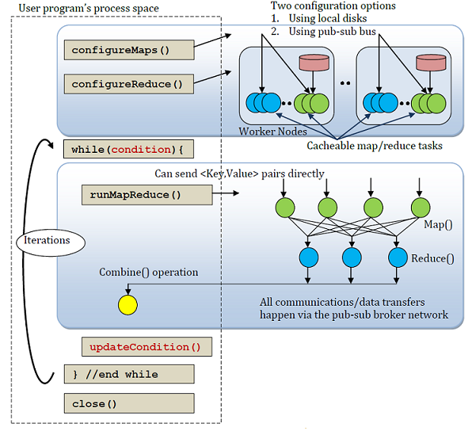
Twister
MapReduce programming model has simplified the implementations of many data parallel applications. The simplicity of the programming model and the quality of services provided by many implementations of MapReduce attract a lot of enthusiasm among parallel computing communities.
From the years of experience in applying MapReduce programming model to various scientific applications we identified a set of extensions to the programming model and improvements to its architecture that will expand the applicability of MapReduce to more classes of applications. Twister is a lightweight MapReduce runtime developed at Indiana University by incorporating these enhancements.
BSD style license http://www.iterativemapreduce.org/
Distinction between static and variable data
Configurable long running (cacheable) map/reduce tasks
Pub/sub messaging based communication/data transfers using ActiveMQ
Efficient support for Iterative MapReduce computations (much faster than Hadoop or Dryad/DryadLINQ)
Combine phase to collect all reduce outputs
Data access via local disks
Lightweight (~5600 lines of Java code)
Support for typical MapReduce computations
Tools to manage data
Automatically recover from faults when FaultTolerance is enabled

Slide 6
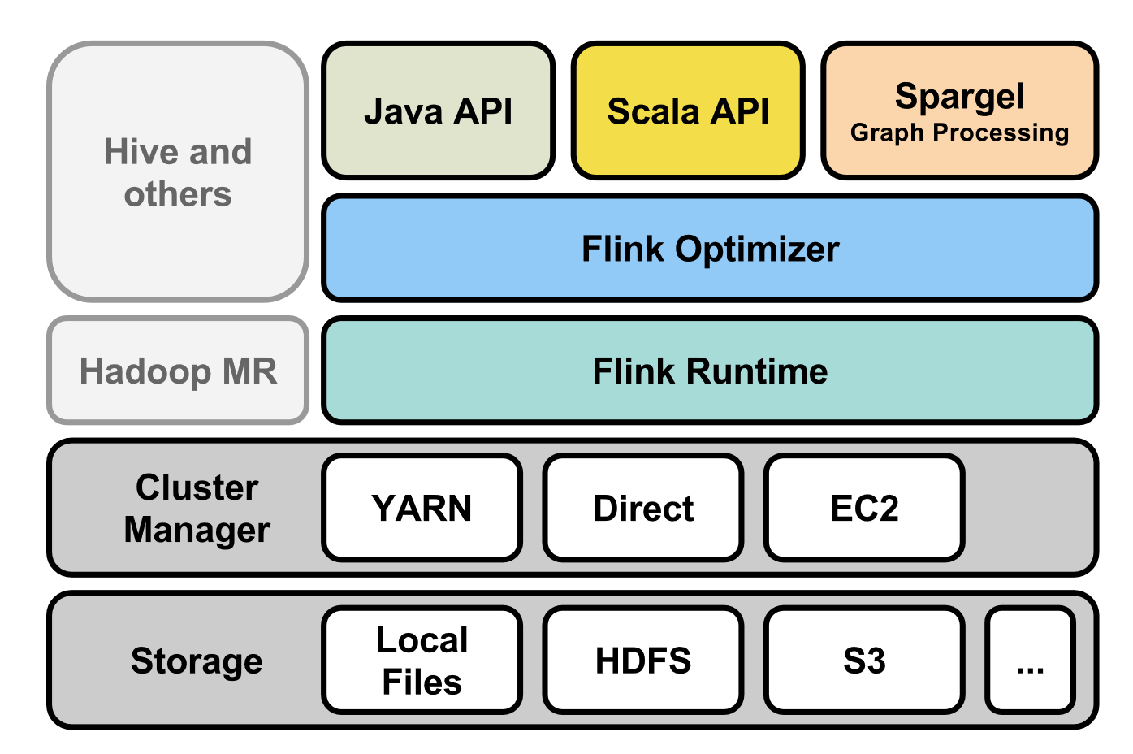
Stratosphere / Apache Flink
Originally developed in Germany but now Apache Flink http://flink.incubator.apache.org/. The Apache Flink stack consists of
Programming APIs for different languages (Java, Scala) and paradigms (record-oriented, graph-oriented).
A program optimizer that decides how to execute the program for good performance. It decides among other things about data movement and caching strategies.
A distributed runtime that executes programs in parallel distributed over many machines.
Flink runs independently from Hadoop, but integrates seamlessly with YARN (Hadoop's next-generation scheduler). Various file systems (including the Hadoop Distributed File System) can act as data sources.

Slide 7
Microsoft Reef
http://www.reef-project.org/ The Retainable Evaluator Execution Framework
This is a set of tools that building on Apache Yarn or Mesos (or Google Omega, and Facebook Corona) allow one to implement systems with capability of Hadoop and Spark
On these resource managers, REEF provides a centralized control plane abstraction that can be used to build a decentralized data plane for supporting big data systems, like those mentioned below.
Special consideration is given to graph computation and machine learning applications, which require data retention on allocated resources, as they execute multiple passes over the data. i.e. Reef supports iteration
More broadly, applications that run on YARN will have the need for a variety of data-processing tasks e.g., data shuffle, group communication, aggregation, checkpointing, and many more. Rather than re-implement these for each application, REEF aims to provide them in a library form, so that they can be reused by higher-level applications and tuned for a specific domain problem.

Slide 8
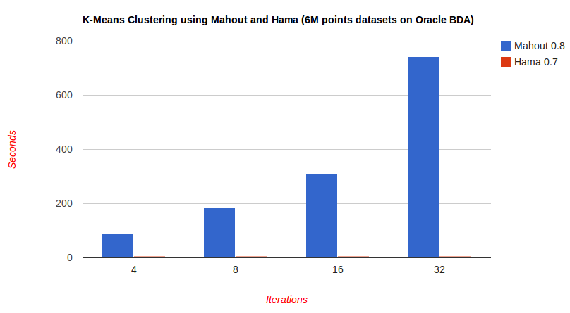
Apache Hama
https://hama.apache.org/
Apache Hama is a distributed computing framework based on Bulk Synchronous Parallel computing (BSP) techniques for massive scientific computations e.g., matrix, graph and network algorithms.
BSP is used in most MPI programs and involves coordinated communication separating computation (map) phases
Hama was inspired by Google's Pregel large-scale graph computing framework and is very similar in utility to the better known iterative MapReduce systems but directly supports Graph applications
These types of plots are well known for Iterative MapReduce
Hama much faster than Mahout on parallel K-means

Slide 9
Apache Giraph
http://giraph.apache.org/
Apache Giraph is an iterative graph processing system built for high scalability, to perform graph processing on big data.
Scalability and speed is impressive, for example Facebook used Giraph to analyze a trillion edges in 4 minutes.
Giraph originated as the open-source counterpart to Pregel, the graph processing architecture developed at Google and described in a 2010 paper. Both systems are inspired by the Bulk Synchronous Parallel model of distributed computation introduced by Leslie Valiant.
Giraph adds several features beyond the basic Pregel model, including master computation, sharded aggregators, edge-oriented input, out-of-core computation, and more.

Slide 10
Pegasus
Apache License http://www.cs.cmu.edu/~Pegasus/
http://www.cs.cmu.edu/~ukang/papers/PegasusICDM2009.pdf
PEGASUS is a Peta-scale graph mining system, fully written in Java. It runs in parallel, distributed manner on top of Hadoop.
PEGASUS provide large scale algorithms for important graph mining tasks such as: Degree, PageRank, Random Walk with Restart (RWR), Radius, and Connected Components
Graph Mining is an area of data mining to find patterns, rules, and anomalies of graphs. Graphs or networks are everywhere, ranging from the Internet Web graph, social networks (FaceBook, Twitter), biological networks, and many more.
Finding patterns, rules, and anomalies have numerous applications including, but not limited to, the followings:
Ranking web pages by search engine
'viral' or 'word-of-mouth' marketing
Patterns of disease with potential impact for drug discovery
Computer network security: email/IP traffic and anomaly detection

Slide 11
Ligra, GraphChi
Ligra is Light weight shared memory graph framework from CMU.
Faster and simpler than distributed memory
https://www.cs.cmu.edu/~jshun/ligra.pdf
Ligra implements breadth first search, graph radii estimation, graph connectivity, betweenness centrality, PageRank and single-source shortest paths.
GraphChi implements disk-based approach with parallel sliding windows to process graphs in chunks https://www.usenix.org/system/files/conference/osdi12/osdi12-final-126.pdf
http://www.slideshare.net/akyrola/largescale-graph-computation-on-just-a-pc-aapo-kyrola-phd-thesis-defense
http://www.sersc.org/journals/IJMUE/vol9_no2_2014/20.pdf offers improvements to GraphChi
GraphLab (Level 16) also shared (and distributed) memory

