Slide 1
Big Data Open Source Software and Projects ABDS in Summary XXI: Layer 15B Part 1
Data Science Curriculum
March 1 2015
Geoffrey Fox
gcf@indiana.edu
http://www.infomall.org
School of Informatics and Computing
Digital Science Center
Indiana University Bloomington

Slide 2
Functionality of 21 HPC-ABDS Layers
Message Protocols:
Distributed Coordination:
Security & Privacy:
Monitoring:
IaaS Management from HPC to hypervisors:
DevOps:
Interoperability:
File systems:
Cluster Resource Management:
Data Transport:
A) File management B) NoSQL C) SQL
In-memory databases&caches / Object-relational mapping / Extraction Tools
Inter process communication Collectives, point-to-point, publish-subscribe, MPI:
A) Basic Programming model and runtime, SPMD, MapReduce: B) Streaming:
A) High level Programming: B) Application Hosting Frameworks Part 1
Application and Analytics:
Workflow-Orchestration:
Here are 21 functionalities. (including 11, 14, 15 subparts)
4 Cross cutting at top
17 in order of layered diagram starting at bottom

Slide 3
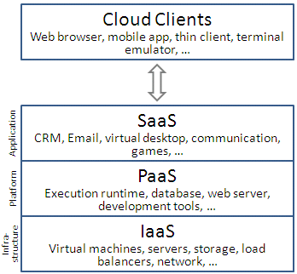
What is a Framework
We use this to cover to Platform as a Service PaaS plus common practice of bundling that with Infrastructure IaaS as a “full solution”.
So it does not include Amazon EC2 or Google Compute Engine but does include AWS Elastic Beanstalk and Google App Engine
Typically supports a subset of very popular languages and tools
Some aim to support a few important technologies very well
Others are lower level and support anything with correct scripts for configuration
Others just provide “management services”
Frameworks span from IaaS to DevOps to specialized support of key technologies and include tool kits as well as management systems

Slide 4
Google App Engine
https://cloud.google.com/appengine/ started in 2008 and offers a service aimed at cloud web resources and not for example at running Hadoop (data analytics) at scale.
Java and Python main languages with PHP, Go
Jinja2 and Django are supported Python frameworks
Memcached, SQL, NoSQL, web serving (Jetty) supported
Used by Snapchat, Rovio, and Khan Academy.
GAE part of https://cloud.google.com/ Google Cloud platform that also includes GCE Google Compute Engine
http://en.wikipedia.org/wiki/Google_App_Engine
Review https://www.trustradius.com/reviews/google-app-engine-2014-06-07-13-26-17

Slide 5
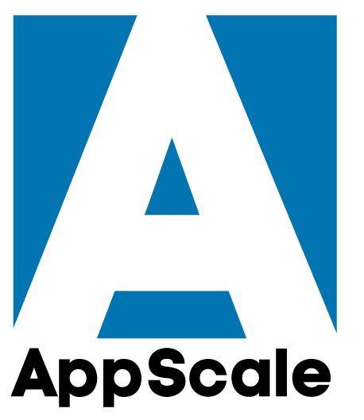
AppScale
AppScale http://www.appscale.com/ is an open-source cloud computing platform that automatically deploys and scales unmodified Google App Engine applications over many public and private cloud systems and on-premises clusters.
AppScale like GAE has support for Python, Go, PHP and Java applications
Uses Cassandra and ZooKeeper, memcached, RabbitMQ and Celery
Can run on Google Compute Engine, Amazon EC2, Softlayer (IBM), Microsoft Azure, RackSpace, OpenStack, CloudStack, Eucalyptus
http://en.wikipedia.org/wiki/AppScale
Spin off of UCSB Computer Science under Professor Chandra Krintz

Slide 6
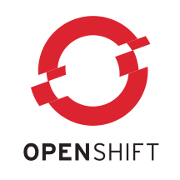
Red Hat OpenShift
OpenShift https://www.openshift.com/ is a cloud computing platform as a service product from Red Hat.
http://en.wikipedia.org/wiki/OpenShift
It allows the use of arbitrary languages and frameworks running on Red Hat Enterprise Linux.
OpenShift takes care of maintaining the services underlying the application and scaling the application as needed.
Supports MongoDB, MySQL, PostgreSQL and web-application frameworks Node.js for JavaScript, PSGI for Perl, Rack for Ruby and WSGI for Python. Django works for Python
Java also supported

Slide 7
Heroku
Heroku https://www.heroku.com/ is a cloud platform as a service (PaaS) supporting several programming languages. Heroku was acquired by Salesforce.com in 2010.
Heroku, one of the first cloud platforms, has been in development since June 2007, when it supported only the Ruby programming language, but has since added support for Java, Node.js, Scala, Clojure, Python and PHP and (undocumented) Perl.
The base operating system is Debian or, in the newest stack, the Debian-based Ubuntu.
Supports subsystems like Couchbase, MongoDB and Redis, PostgreSQL with detail at https://addons.heroku.com/
http://en.wikipedia.org/wiki/Heroku

Slide 8
Aerobatic
Aerobatic, the cloud platform for front-end developers that makes it fun to build nimble HTML5 web apps in record time.
So what is Aerobatic? In a nutshell, it's a platform as a service (PaaS) for single page web apps. You could think of it as Heroku for front-end client apps.
However, unlike Heroku, Aerobatic does not require developers to build and maintain a backend with Ruby, Node, Python, etc. Powerful applications can be built using only browser-based technologies, namely Javascript, HTML, and CSS.
In this respect Aerobatic provides similar functionality to static hosting with Amazon S3 or GitHub Pages.
Aerobatic provides the same ease of deployment and cloud level scale as those platforms, but layers on a management dashboard and a suite of smart hosting services that provide a greater level of functionality, performance, and security than can easily be achieved with with pure static pages.

Slide 9
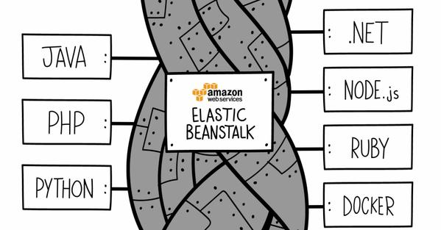
AWS Elastic Beanstalk
AWS Elastic Beanstalk http://aws.amazon.com/elasticbeanstalk/ is a PaaS (Platform as a Service) service from Amazon Web Services that allows users to create applications and push them to a set of AWS services, including Amazon EC2, Amazon S3, Amazon Simple Notification Service (SNS), Amazon CloudWatch, auto scaling, and elastic load balancers
http://en.wikipedia.org/wiki/AWS_Elastic_Beanstalk
Supports Java, .NET, PHP, Node.js, Python, Ruby, Go, and Docker on familiar servers such as Apache, Nginx, Passenger, and IIS.

Slide 10
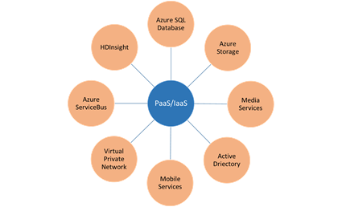
Azure
Microsoft Azure has both IaaS (equivalent to AWS EC2 etc.) and a PaaS which was their original 2010 offering. The PaaS is still very powerful but now matched by others – especially Amazon
Azure’s original platform was .NET based and that handicaps it as most technologies are produced in Linux (Java) versions
IaaS offers Linux or Windows
http://en.wikipedia.org/wiki/Microsoft_Azure
Technologies in PaaS include Object and Blob storage, Tables, Queues, Databases, Hadoop (HDInsight)

Slide 11
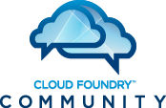
Cloud Foundry Pivotal
Cloud Foundry, used by IBM Bluemix, comes in three flavors
Cloud Foundry Open Source Software (OSS)
Available to anyone - see http://cloudfoundry.org.
Pivotal Cloud Foundry (Pivotal CF) which is a commercial product available from Pivotal. It provides extra tools for installation and administration not included in the OSS product.
Pivotal Web Services PWS http://run.pivotal.io/, which is an instance of Pivotal Cloud Foundry hosted on Amazon Web Services (AWS).
The following services are available to Pivotal CF and on PWS:
Data Storage: MySQL, PostgreSQL, MongoDB, Redis, Riak, DataStax (Cassandra), Neo4J, Pivotal HD (Hadoop)
Messaging: Pivotal RabbitMQ

Slide 12
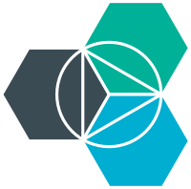
IBM BlueMix
IBM Bluemix https://console.ng.bluemix.net/ is a cloud platform as a service (PaaS) developed by IBM. It supports several programming languages and services as well as integrated DevOps to build, run, deploy and manage applications on the cloud.
Bluemix is based on Cloud Foundry open technology and runs on SoftLayer infrastructure.
Bluemix supports Java, Node.js, Go, PHP, Python, Ruby Sinatra, Ruby on Rails and can be extended to support other languages such as Scala through the use of buildpacks.
Uses OpenStack or Docker (IBM Containers)
Softlayer was a hosting service that was acquired by IBM to jump start their Cloud Services division
Subsystems supported not clear – includes Cloudant (IBM NoSQL) and Hadoop
http://en.wikipedia.org/wiki/Bluemix

Slide 13
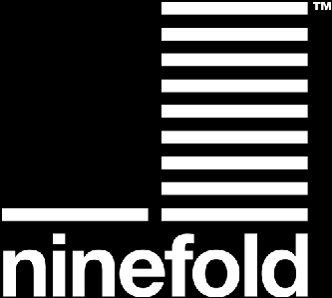
Ninefold
https://ninefold.com/
http://en.wikipedia.org/wiki/Ninefold
Server company in Australia offering bare metal or Docker set up in 2011

