Slide 1
Big Data Open Source Software and Projects ABDS in Summary XXII: Layer 15B Part 2
Data Science Curriculum
March 1 2015
Geoffrey Fox
gcf@indiana.edu
http://www.infomall.org
School of Informatics and Computing
Digital Science Center
Indiana University Bloomington

Slide 2
Functionality of 21 HPC-ABDS Layers
Message Protocols:
Distributed Coordination:
Security & Privacy:
Monitoring:
IaaS Management from HPC to hypervisors:
DevOps:
Interoperability:
File systems:
Cluster Resource Management:
Data Transport:
A) File management B) NoSQL C) SQL
In-memory databases&caches / Object-relational mapping / Extraction Tools
Inter process communication Collectives, point-to-point, publish-subscribe, MPI:
A) Basic Programming model and runtime, SPMD, MapReduce: B) Streaming:
A) High level Programming: B) Application Hosting Frameworks Part 2
Application and Analytics:
Workflow-Orchestration:
Here are 21 functionalities. (including 11, 14, 15 subparts)
4 Cross cutting at top
17 in order of layered diagram starting at bottom

Slide 3
Jelastic
Jelastic http://jelastic.com/ (acronym for Java Elastic) is a Platform-as-Infrastructure (PAI) cloud computing service combining PaaS and Infrastructure-as-a-Service within a single platform that provides networks, servers, and storage solutions to software development clients, enterprise businesses, OEMs and web hosting providers.
The company started in 2010 has developed technologies for moving Java, Node.js, Ruby, Python and PHP-based applications onto the cloud.
Originally based in Ukraine, the company’s headquarters are now in Palo Alto, California.
Supports Docker and OpenShift Cartridges
Jelastic can be installed on top of bare metal servers or third party IaaS solutions such as OpenStack, vSphere, AWS, Azure, Rackspace
http://en.wikipedia.org/wiki/Jelastic

Slide 4
Stackato
Stackato from ActiveState http://www.activestate.com/ is a secure, stable, and commercially supported Platform-as-a-Service (PaaS) that is built with and on top of various open source components such as Cloud Foundry and Docker containers.
Stackato runs on top of your cloud infrastructure, and is the middleware from which your applications are launched.
Developers simply upload their application source files to Stackato via IDE or command-line. Stackato automatically configures the required language runtimes, web frameworks, and data and messaging services.
Developers can replicate the same Stackato environments across each phase of development, i.e. testing, staging, and production, allowing for continuous deployments without manual processes.
Administrators can monitor and configure settings, such as user roles, application components, scaling, and memory usage, through the Stackato web interface or command line

Slide 5
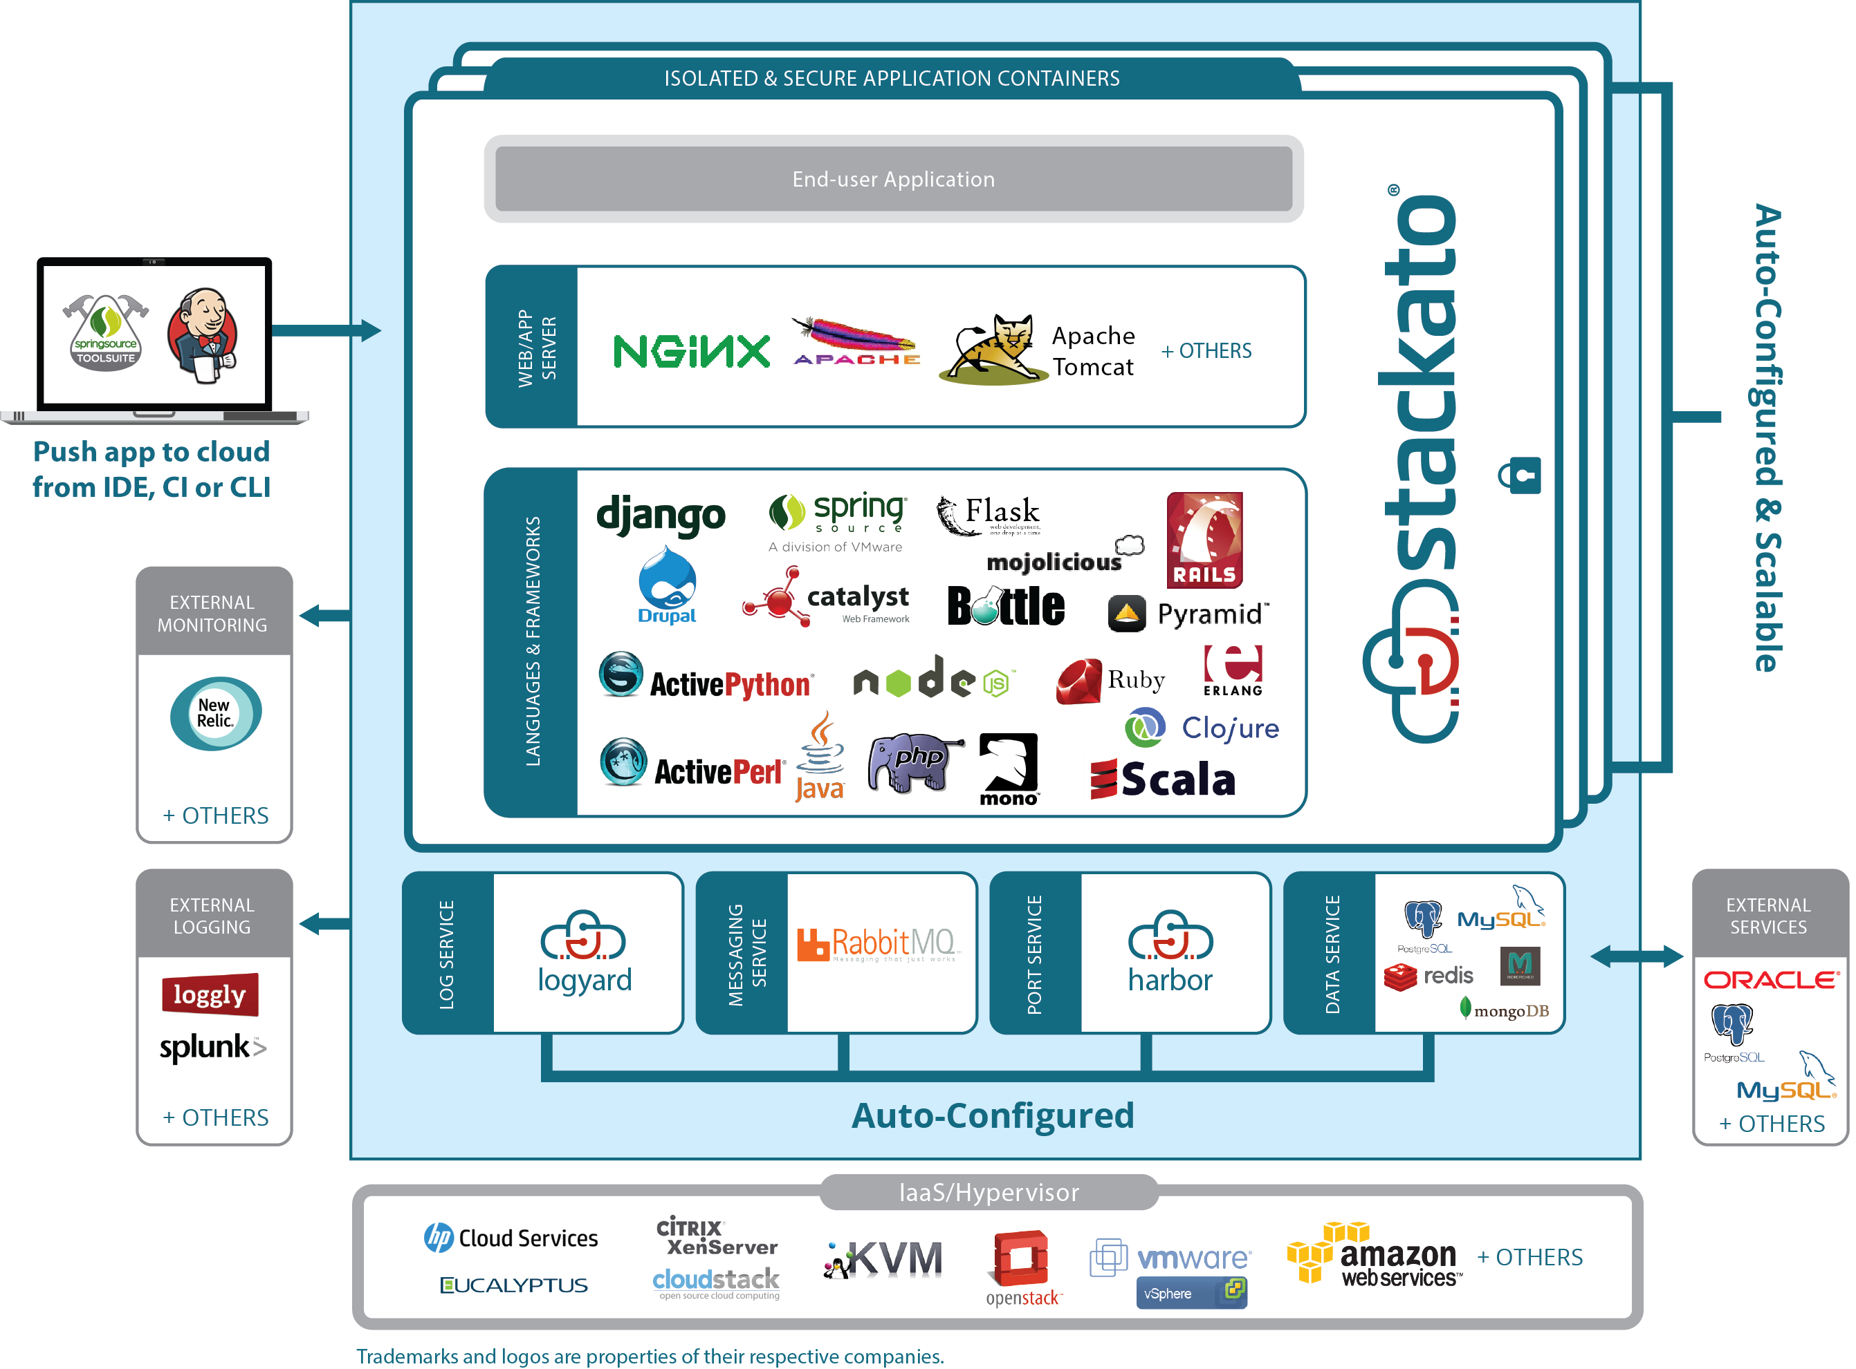
Stackato

Slide 6
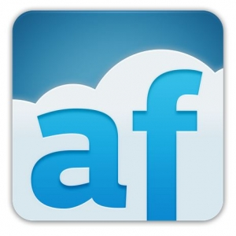
appfog
appFog https://www.appfog.com supports languages Java, Scala, Python, Node.js, PHP, Ruby, Erlang,
And services MySQL, MongoDB, Redis, RabbitMQ and PostgreSQL
Supports AWS US, Europe, Asia, Rackspace, CenturyLink (owns appFog), HP, Azure, and even Private Clouds
Cross Cloud support is a major feature (Platform as a Service for Public Clouds)

Slide 7
CloudBees
CloudBees http://www.cloudbees.com/ founded in 2010 had a Java and Jboss focus and is PaaS to support the entire application lifecycle from development to deployment.
CloudBees PaaS includes Jenkins Continuous Integration (CI) server as an integral part of its core cloud services and Jenkins http://jenkins-ci.org/ is now focus of company.
Building/testing software (builds) projects continuously
Monitoring executions of externally-run jobs, such as cron jobs and procmail jobs

Slide 8
Engine Yard
Engine Yard https://www.engineyard.com/ is a platform as a service company focused on Java, Ruby on Rails, PHP and Node.js with deployment and management (scale, monitor) Services
Self-service provisioning
Fine-grained controls
Scaling
Monitoring and alerting
Database replication
Cloning
Snapshots and backups
Business Continuity
High Availability
Security
http://en.wikipedia.org/wiki/Engine_Yard
Supports AWS and Azure

Slide 9
CloudControl dotCloud
CloudControl https://www.cloudcontrol.com is a European Platform as a Service offering management of applications built by user
Not clear what infrastructure is supported but services
Instant and zero-downtime deployment
Granular horizontal and vertical scaling
Management by CLI/GUI/API
Access to logs and diagnostic information
Low latency and robust routing tier
Large Add-on ecosystem
Rock-solid architecture
No lock-in through open stacks and buildpacks
24/7 platform-monitoring
Docker sold in 2014 its dotCloud Platform as a Service https://www.dotcloud.com business to Berlin-based cloudControl.

Slide 10
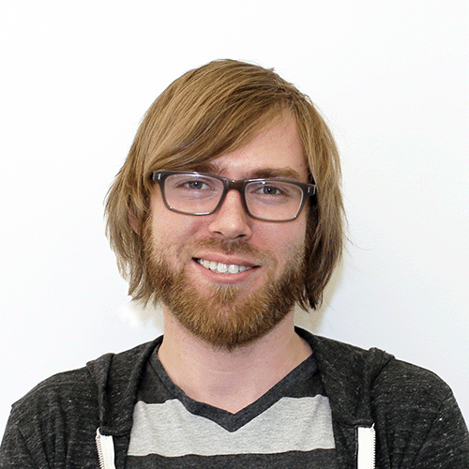
Dokku Gitreceive Buildstep
Dokku is written by Jeff Lindsay Progrium) in 100 lines of bash shell http://progrium.com/blog/2013/06/19/dokku-the-smallest-paas-implementation-youve-ever-seen/
It provides PaaS capabilities of Heroku to Docker using Gitreceive to allow Github to be a client and Buildstep to access Heroku buildpacks which define the software stack to load into Docker (see layer 6)

Slide 11
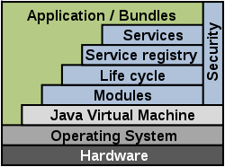
OSGi
The OSGi (Open Service Gateway initiative) specification describes a modular system and a service platform for the Java programming language that implements a complete and dynamic component model, something that does not exist in standalone Java/VM environments.
Applications or components, coming in the form of bundles for deployment, can be remotely installed, started, stopped, updated, and uninstalled without requiring a reboot; management of Java packages/classes is specified in great detail.
Application life cycle management is implemented via APIs that allow for remote downloading of management policies. The service registry allows bundles to detect the addition of new services, or the removal of services, and adapt accordingly.

Slide 12
HUBzero
HUBzero https://hubzero.org/ is an open source software platform for building websites that support scientific activities.
The web site built from open-source software: the Linux operating system, the Apache web server, the MySQL database, the Joomla content management system, and the PHP web scripting language.
The HUBzero software allows individuals to access simulation tools and share information. Sites using the hub infrastructure are standardized with the following modules:
Interactive simulation tools, hosted on the hub cluster and delivered to web browsers
Simulation tool development area, including source code control and bug tracking
Scientific workflows, including built-in support for the Pegasus Workflow Management System
Private "project" areas for scientific collaboration
Video seminars and animated presentations
Mechanism for uploading and sharing resources
5-star ratings and user feedback for resources
User support area, with question-and-answer forum
Statistics about users and usage patterns

Slide 13
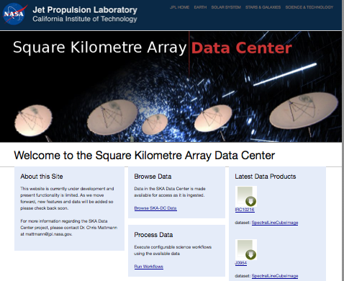
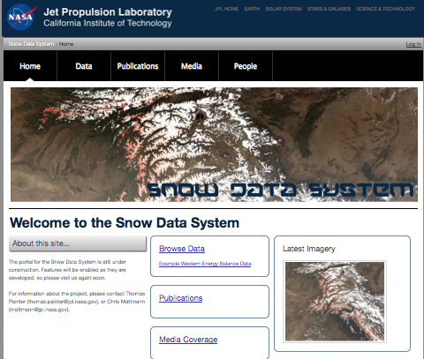
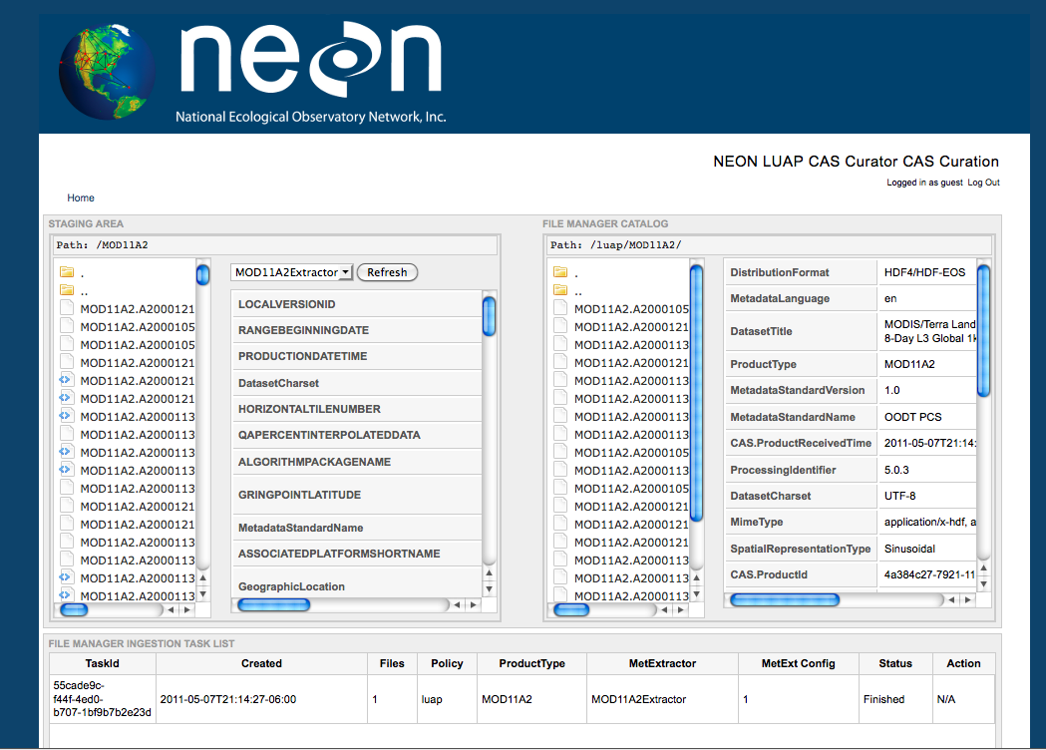
Apache OODT (Tools)
OODT/Science Web Tools
Archive
Client
Navigation Service
OBJECT ORIENTED DATA TECHNOLOGY FRAMEWORK
Catalog & Archive
Service
Profile
Service
Product
Service
Query
Service
Bridge to
External
Services
Other
Service 1
Other
Service 2
Profile
XML Data
Data
System 1
Data
System 2
Object Oriented Data Technology, or OODT, http://oodt.apache.org/ develops and promotes science data management and archiving systems that span scientific disciplines and enable interoperability among data agnostic systems in the fields of astrophysics, planetary, space science data systems, open source web analytics, etc. It was based on NASA JPL software
http://www.slideshare.net/chrismattmann/a-look-into-the-apache-oodt-ecosystem

Slide 14
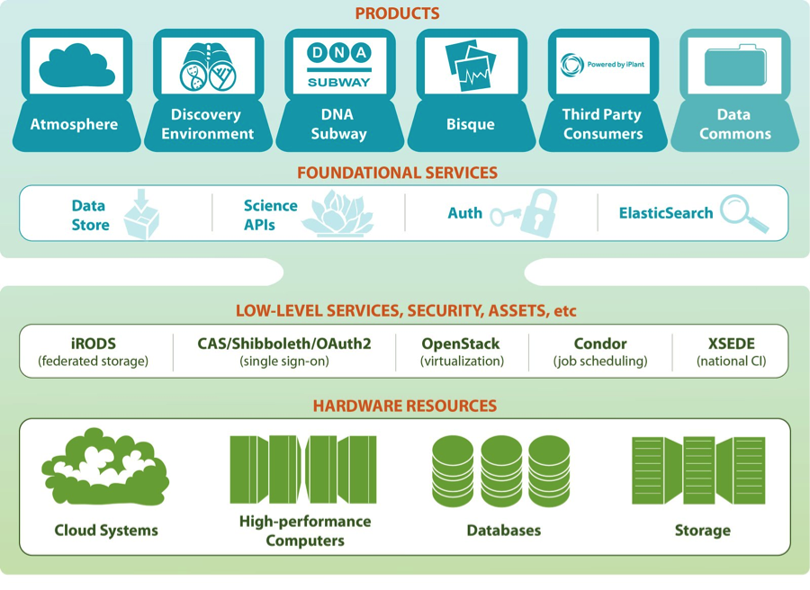
iPlant Agave and Atmosphere
Agave supports 600 of today's top plant biology applications on the latest HPC and Cloud systems.
Atmosphere is environment built on OpenStack, Condor and iRODS and an authentication/authorization service.
It includes science gateway (portal) and is Django based

