Slide 1
Big Data Open Source Software and Projects ABDS in Summary XXIV: Layer 16 Part 2
Data Science Curriculum
March 1 2015
Geoffrey Fox
gcf@indiana.edu
http://www.infomall.org
School of Informatics and Computing
Digital Science Center
Indiana University Bloomington

Slide 2
Functionality of 21 HPC-ABDS Layers
Message Protocols:
Distributed Coordination:
Security & Privacy:
Monitoring:
IaaS Management from HPC to hypervisors:
DevOps:
Interoperability:
File systems:
Cluster Resource Management:
Data Transport:
A) File management B) NoSQL C) SQL
In-memory databases&caches / Object-relational mapping / Extraction Tools
Inter process communication Collectives, point-to-point, publish-subscribe, MPI:
A) Basic Programming model and runtime, SPMD, MapReduce: B) Streaming:
A) High level Programming: B) Application Hosting Frameworks
Application and Analytics: Part 2
Workflow-Orchestration:
Here are 21 functionalities. (including 11, 14, 15 subparts)
4 Cross cutting at top
17 in order of layered diagram starting at bottom

Slide 3
Caffe
Caffe BSD-2 license http://caffe.berkeleyvision.org/ is a deep learning framework developed with cleanliness, readability, and speed in mind.
It was created by Yangqing Jia during his PhD at UC Berkeley, and is in active development by the Berkeley Vision and Learning Center (BVLC) and by community contributors. Clean architecture enables rapid deployment. Networks are specified in simple config files, with no hard-coded parameters in the code. Switching between CPU and GPU is as simple as setting a flag – so models can be trained on a GPU machine, and then used on commodity clusters.
Readable & modifiable implementation fosters active development. In Caffe’s first six months, it has been forked by over 300 developers on Github, and many have pushed significant changes.
Speed makes Caffe perfect for industry use. Caffe can process over 40M images per day with a single NVIDIA K40 or Titan GPU. That’s 5 ms/image in training, and 2 ms/image in test. We believe that Caffe is the fastest CNN (convolutional neural net) implementation available.
http://ucb-icsi-vision-group.github.io/caffe-paper/caffe.pdf

Slide 4
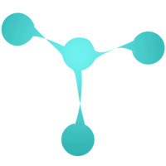
Torch
Torch supports tensors with a fast scripting language LuaJIT, and an underlying C and CUDA implementation.
Open source deep learning library first released in 2002.
Torch, Theano, Caffe are compared at http://fastml.com/torch-vs-theano/

Slide 5
Theano
http://deeplearning.net/software/theano/
Python deep learning supporting GPU’s using NumPy syntax.
Open source developed at Montreal
Supports symbolic differentiation – note nearly all optimization involves finding derivatives of function to be optimized with respect to parameters being optimized.
Use in deep learning for “steepest descent” parameter changes
Deep learning has very complex functions so hard to do algebra without computer help
Also well known efficient ways to arrange function and derivative computation

Slide 6
DL4J
Deep Learning for Java http://deeplearning4j.org/
A versatile n-dimensional array class.
GPU integration
Scalable on Hadoop, Spark and Akka (Java actor based parallel programming) + AWS and other platforms
Has several neural network architectures built in
Commercial version is Skymind http://www.skymind.io/

Slide 7
H2O
http://h2o.ai/ framework using R and Java and supporting a few important machine learning algorithms including deep learning, K-means, Random Forest.
Runs on Hadoop, HDFS
Not clear that user can add new code
Exact parallel model not clear
Uses Tableau http://www.tableau.com/ for display

Slide 8
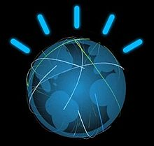
IBM Watson
Watson is a question answering (QA) computing system that IBM built to apply advanced natural language processing, information retrieval, knowledge representation, automated reasoning, and machine learning technologies to the field of open domain question answering
Watson was not connected to the Internet when it won the TV game Jeopardy, but it contained 200 million pages of structured and unstructured content consuming four terabytes of disk storage, including the full text of Wikipedia
Uses Apache UIMA (Unstructured Information Management Architecture) and Hadoop
Original computer had has 2,880 POWER7 processor cores and 16 terabytes RAM.
The key difference between QA technology and document search is that document search takes a keyword query and returns a list of documents, ranked in order of relevance to the query (often based on popularity and page ranking), while QA technology takes a question expressed in natural language, seeks to understand it in much greater detail, and returns a precise answer to the question.
According to IBM, "more than 100 different techniques are used to analyze natural language, identify sources, find and generate hypotheses, find and score evidence, and merge and rank hypotheses."

Slide 9
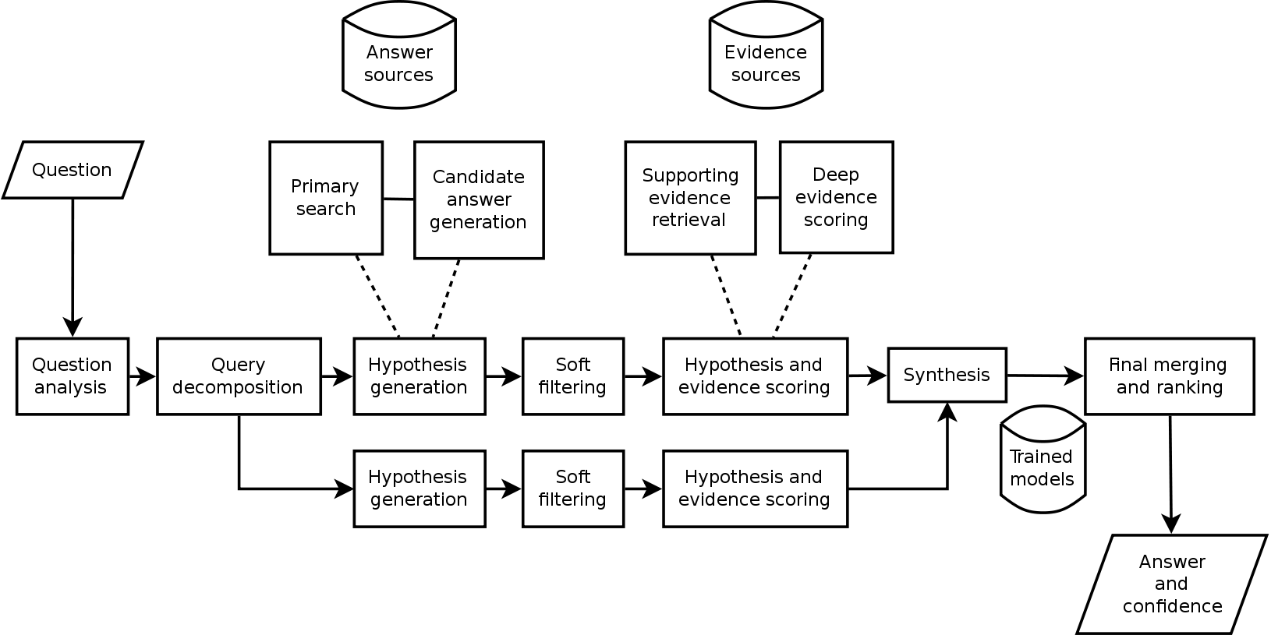
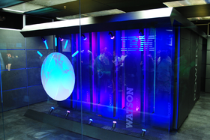
IBM Watson II
Watson machine and Architecture

Slide 10
Oracle PGX
Parallel Graph Analytics (PGX) from Oracle Labs uses Oracle database
PGX provides built-in implementations of many popular graph algorithms including Community Detection, Path Finding, Ranking, Recommendation, Pattern Matching, Influencer Identification
The OTN (Oracle Technology Network) public release contains only a small subset of available algorithms.
http://www.oracle.com/technetwork/oracle-labs/parallel-graph-analytics/overview/index.html

Slide 11
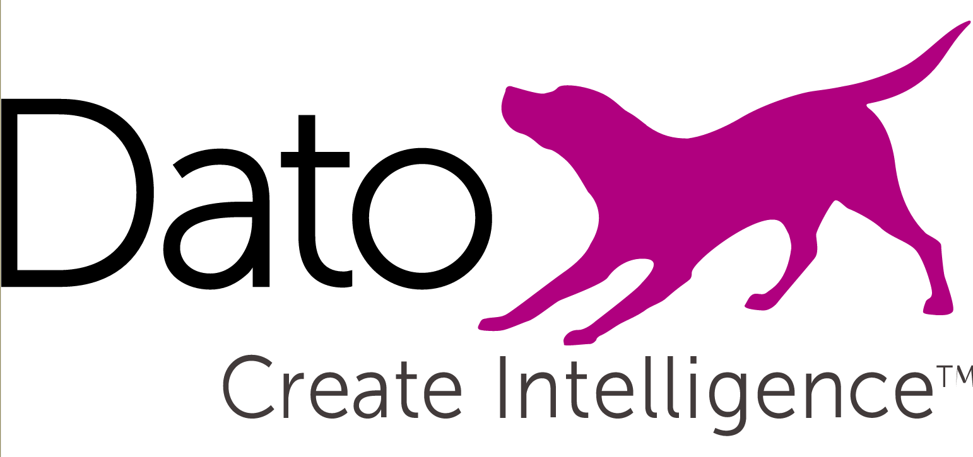
GraphLab
http://graphlab.org https://dato.com/
Company Dato formed in 2013 but original software from CMU
C++ environment with GPU and using HDFS with many libraries
Topic Modeling- contains applications like LDA which can be used to cluster documents and extract topical representations.
Graph Analytics- contains application like pagerank and triangle counting which can be applied to general graphs to estimate community structure.
Clustering- contains standard data clustering tools such as Kmeans
Collaborative Filtering- contains a collection of applications used to make predictions about users interests and factorize large matrices.
Graphical Models- contains tools for making joint predictions about collections of related random variables.
Computer Vision- contains a collection of tools for reasoning about images.
GraphLab Create is Python interface

Slide 12
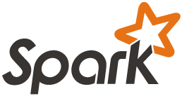
GraphX
https://spark.apache.org/graphx/ GraphX is Apache Spark's API for graphs and graph-parallel computations
Spark has Mllib for general machine learning and GraphX for graphs including
PageRank
Connected components
Label propagation
SVD++
Strongly connected components
Triangle count

Slide 13
IBM System G I
http://systemg.research.ibm.com/
System G has four types of Graph Computing tools: Graph Database, Analytics, Visualization, and Middleware
System G has four types of derived Network Science Analytics tools including Cognitive Networks, Cognitive Analytics, Spatio-Temporal Analytics, and Behavioral Analytics to make new applications;
100 published papers

Slide 14
IBM System G II

Slide 15
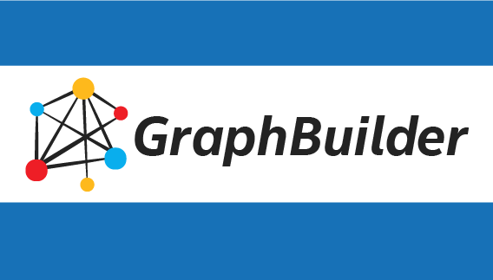
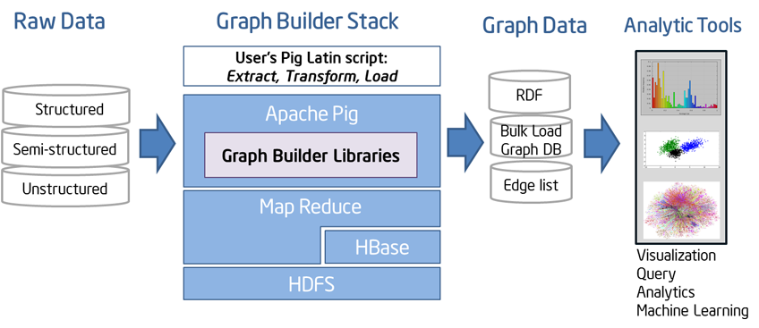
GraphBuilder (Intel)
Hadoop and Pig based https://01.org/graphbuilder
http://www.intel.com/content/www/us/en/software/intel-graph-builder-for-apache-hadoop-software.html

Slide 16
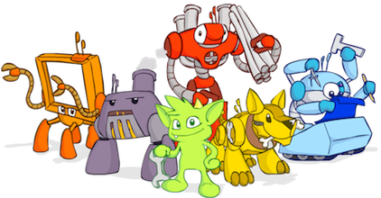
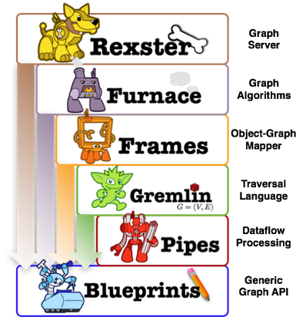
TinkerPop
http://www.tinkerpop.com/ Java framework that links to Neo4j and Hadoop
TinkerPop is a developer group creating an open-source stack for graphs
Blueprints is a collection of interfaces, implementations, and test suites for the property graph data model and are the analogy of JDBC for garphs.
Pipes support dataflow
Gremlin is a graph traversal language
Furnace is a graph algorithms package for Blueprints enabled graphs.

Slide 17
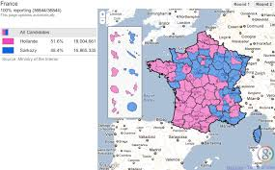
Google Fusion Tables
This tool https://support.google.com/fusiontables/answer/2571232 from Google is an experimental data visualization web application to gather, visualize, and share data tables.
Supports Tables in Google Docs
Maps are well supported
Appears not very active

Slide 18
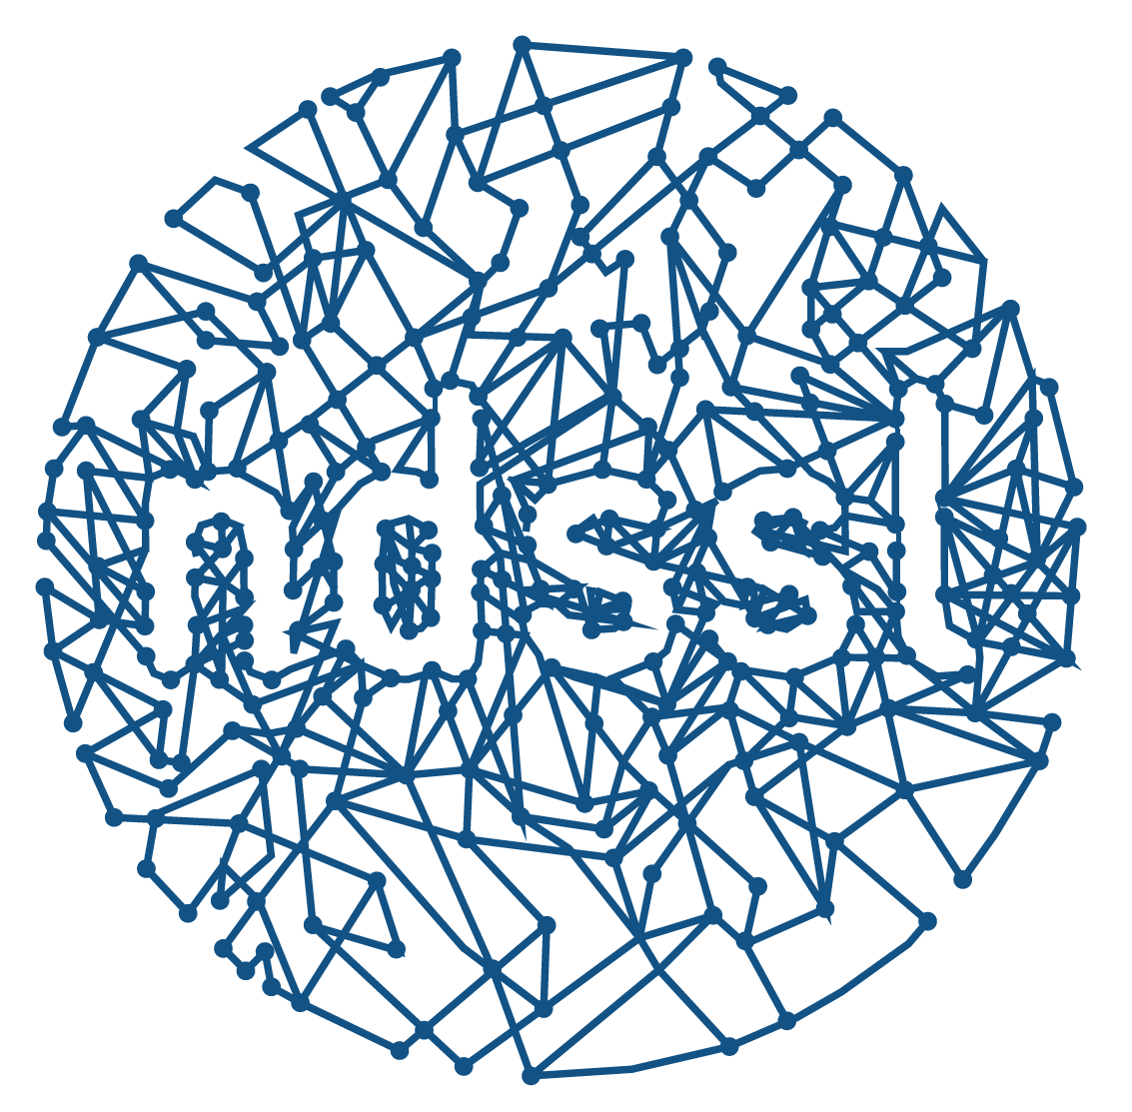
CINET: A CyberInfrastructure for Network Science
http://cinet.vbi.vt.edu/granite/granite.html has graph algorithms and a collection of networks (graphs) and network generators

Slide 19
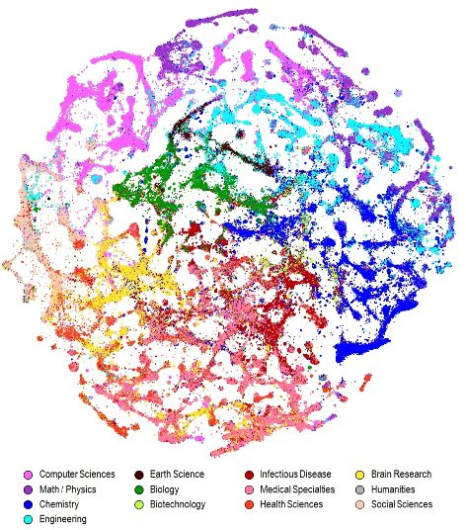
NWB
http://nwb.cns.iu.edu/
Network Workbench: A Large-Scale Network Analysis, Modeling and Visualization Toolkit for Biomedical, Social Science and Physics Research.
Last release in 2009
Has a focus on visualization as in picture here linking papers (journals) via citation

Slide 20
Elasticsearch Logstash, Kibana
In http://db-engines.com/en/ranking March 2015: #15
http://www.elasticsearch.org/ Search application built on Lucene; 2015 second to Solr in popularity http://db-engines.com/en/ranking/search+engine
http://en.wikipedia.org/wiki/Elasticsearch
Elasticsearch provides a distributed, multitenant-capable full-text search engine with a RESTful web interface and schema-free JSON documents.
Has an real-time analytics engine Kibana and logstash log and event analyser that compete with Splunk
Elasticsearch is developed in Java and is released as open source

Slide 21
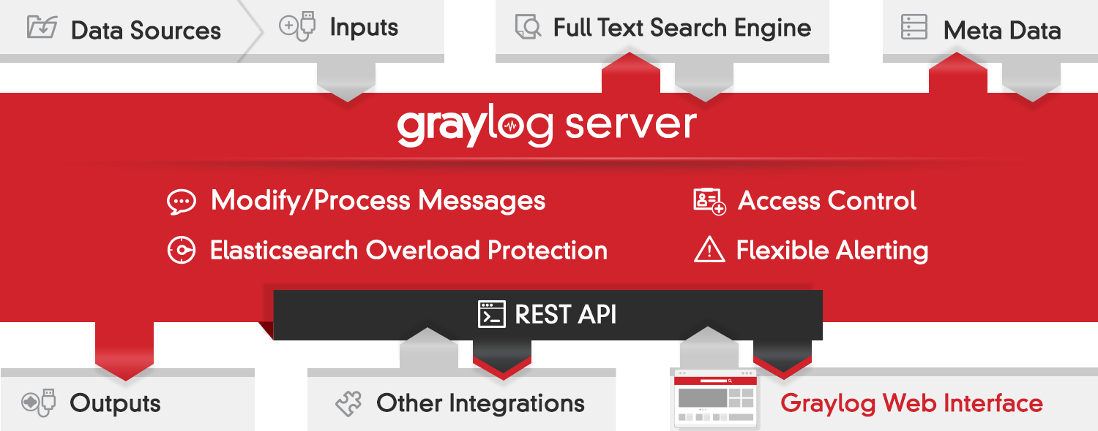
Graylog
https://www.graylog.org
Graylog is built on MongoDB for metadata and Elasticsearch for log file storage and text search
Full architecture on next page.
Note that a data ingestion or log forwarding tool is tedious to manage if the configuration has to be performed on the client machine and not centrally via REST APIs controlled by a centralized interface.

Slide 22
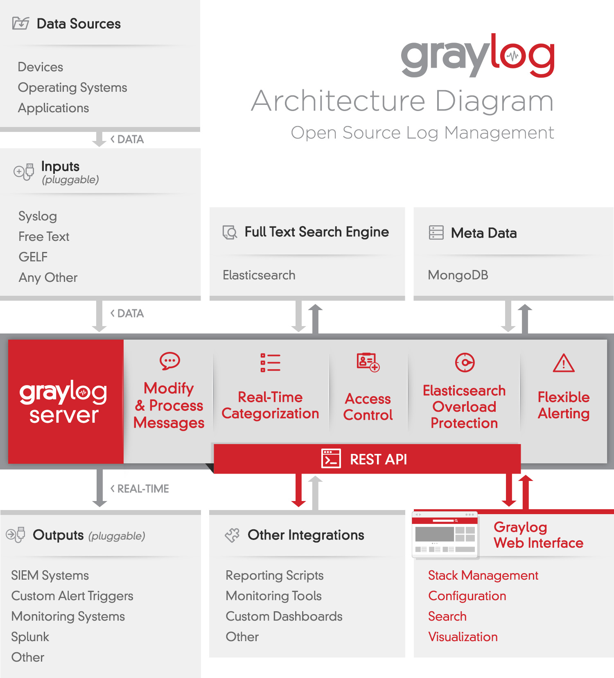
Graylog II
Software that stores and analyzes log data must have a very specific architecture to do it efficiently. It’s more than just a database or a full text search engine because it has to deal with both text data and time-series metric data. Searches are almost always time bound. A general purpose database or full text search engine is not ideal for managing log data.

Slide 23
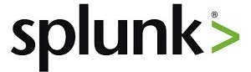
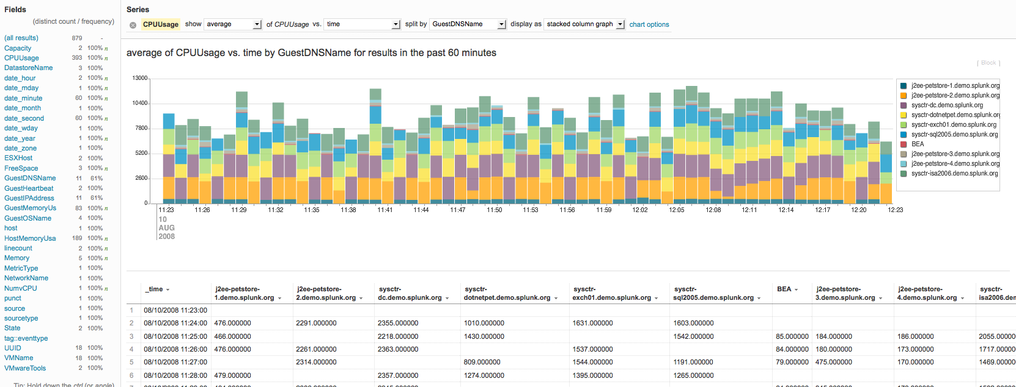
Splunk
http://en.wikipedia.org/wiki/Splunk
Splunk produces software for searching, monitoring, and analyzing machine-generated big data such as logs, via a web-style interface
In http://db-engines.com/en/ranking March 2015: #19
There is Splunk cloud and in 2013, Splunk announced a product called Hunk: Splunk Analytics for Hadoop, which supports accessing, searching, and reporting on external data sets located in Hadoop from a Splunk interface.
Splunk Visualization

Slide 24
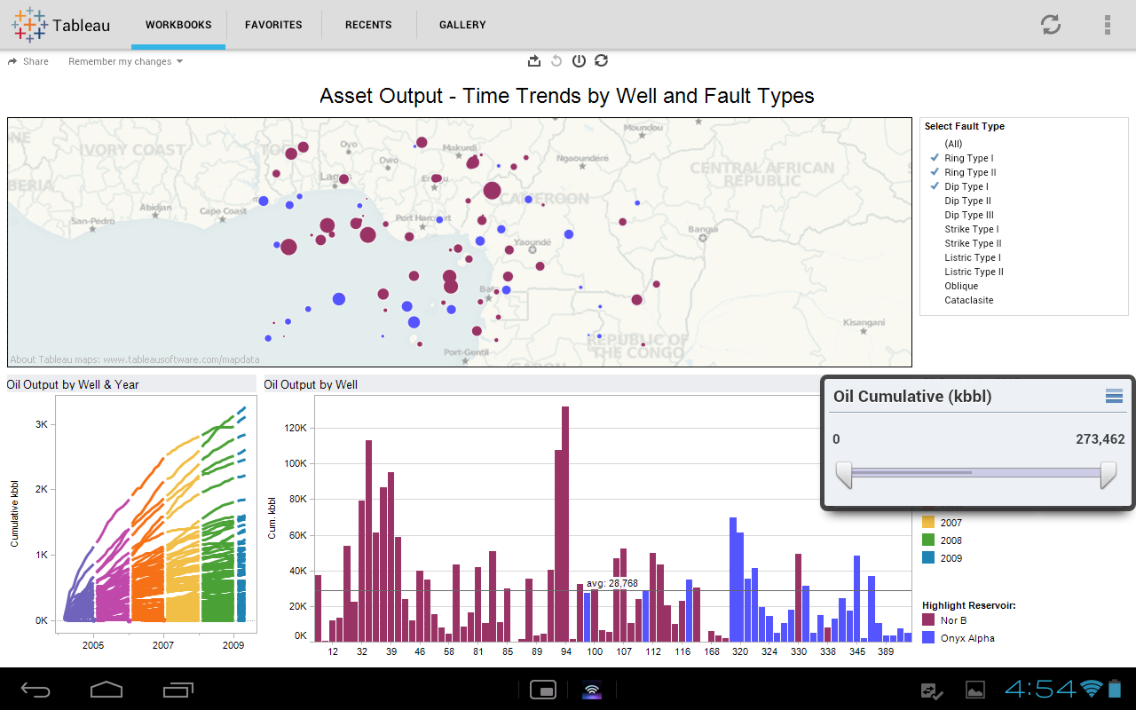
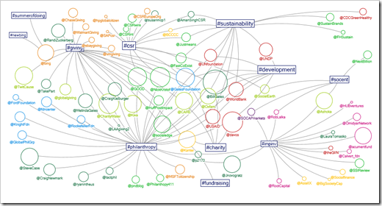
Tableau
Tableau is a family of interactive data visualization products focused on business intelligence
http://en.wikipedia.org/wiki/Tableau_Software
Free and paid versions
In 2003, Tableau was spun out of Stanford
The product queries relational databases, cubes, cloud databases,
and spreadsheets and then generates a number of graph types that can be combined into dashboards and shared over a computer network or the internet.

Slide 25
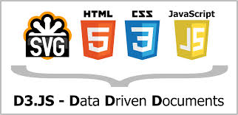
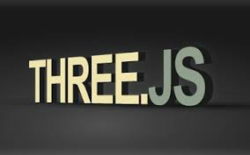
D3.js, three.js, Potree
Browser JavaScript visualization packages
Data-Driven Documents http://d3js.org/ (3 is 3 D’s in name)
D3 examples https://github.com/mbostock/d3/wiki/Gallery
3D Javascript Library http://threejs.org/ (3 is 3 dimensions) built on WebGL
http://potree.org/ is a point cloud plotter built on three.js
See also http://opensource.datacratic.com/data-projector/
As these are JavaScript, the action is local and underlying WebGL can utilize laptop GPU to process these.
http://en.wikipedia.org/wiki/WebGL
WebGL from Mozilla uses the HTML5 canvas element and is accessed using Document Object Model interfaces. Automatic memory management is provided as part of the JavaScript language.
D3 doesn't use WebGL, but there's a project that does that called PathGL http://pathgl.com/. See also http://engineering.ayasdi.com/2015/01/09/converting-a-d3-visualization-to-webgl-how-and-why

