Slide 1
Big Data Open Source Software and Projects ABDS in Summary XXV: Layer 17 Part 1: Pre-Cloud
Data Science Curriculum
March 1 2015
Geoffrey Fox
gcf@indiana.edu
http://www.infomall.org
School of Informatics and Computing
Digital Science Center
Indiana University Bloomington

Slide 2
Functionality of 21 HPC-ABDS Layers
Message Protocols:
Distributed Coordination:
Security & Privacy:
Monitoring:
IaaS Management from HPC to hypervisors:
DevOps:
Interoperability:
File systems:
Cluster Resource Management:
Data Transport:
A) File management B) NoSQL C) SQL
In-memory databases&caches / Object-relational mapping / Extraction Tools
Inter process communication Collectives, point-to-point, publish-subscribe, MPI:
A) Basic Programming model and runtime, SPMD, MapReduce: B) Streaming:
A) High level Programming: B) Application Hosting Frameworks
Application and Analytics:
Workflow-Orchestration: Part 1) Pre-Cloud 2) Cloud
Here are 21 functionalities. (including 11, 14, 15 subparts)
4 Cross cutting at top
17 in order of layered diagram starting at bottom

Slide 3
Apache Oozie
https://oozie.apache.org/ http://hortonworks.com/hadoop/oozie/
Oozie is a scalable, reliable and extensible server-based workflow scheduler system to manage Apache Hadoop jobs coming from Yahoo.
Oozie Workflow jobs are Directed Acyclical Graphs (DAGs) which specify a sequence of actions to execute. Oozie also provides Coordinator jobs, which are Workflow jobs which can be scheduled to recur based on time or data availability.
Oozie can schedule various types of Hadoop jobs (map-reduce, Pig, Hive and others) as well as other types of jobs such as Java programs and shell scripts.

Slide 4
Apache ODE™
The Orchestration Director Engine ODE http://ode.apache.org/ executes business processes written following the WS-BPEL standard. This is “Web Service approach to orchestration/workflow” and stresses control flow whereas usually dataflow more natural
Side-by-side support for both the WS-BPEL 2.0 OASIS standard http://docs.oasis-open.org/wsbpel/2.0/OS/wsbpel-v2.0-OS.html and the legacy BPEL4WS 1.1 vendor specification. (BPEL = Business Process Execution Language)
Supports 2 communication layers: one based on Axis2 (Web Services http transport) and another one based on the JBI http://en.wikipedia.org/wiki/Java_Business_Integration standard (http://jcp.org/en/jsr/detail?id=208).
Support for the HTTP WSDL binding (initial SOAP-based Web Service protocol), allowing invocation of REST-style (this won) web services.
Possibility to map process variables externally to a database table of your choice.
High level API to the engine that allows you to integrate the core with virtually any communication layer.
Hot-deployment of your processes.
Compiled approach to BPEL that provides detailed analysis and validation at the command line or at deployment.
Management interface for processes, instances and messages.
There were other open source BPEL projects but maybe this is only remaining one?
http://en.wikipedia.org/wiki/List_of_BPEL_engines

Slide 5
ActiveBPEL
This was top open source BPEL implementation from “Active Endpoints” which was acquired by Informatica
The last release was 5.0.2 in 2008 http://activebpel502.sourceforge.net/
See http://www.activevos.com/cp/329/active-endpoints-releases-milestone-1-of-activebpel-community-edition-with-bpel4people
Replaced by ActiveVOS (Visual Orchestration System) http://www.activevos.com/; proprietary coding of open BPEL standard and supports people in the loop (BPEL4People)
Implements BPMN visual interface (Business Process Model and Notation)

Slide 6
Apache Airavata
https://airavata.apache.org/
Apache Airavata is a workflow framework to enable the scheduling and execution of jobs and workflows on distributed computing resources, including local resources, national computing resources, and computing clouds.
Four main components:
workflow suite
application wrapper service
registry service
message broking service
Airavata evolved out of work at Indiana University’s Extreme Computing Lab, originally supporting the Linked Environments for Atmospheric Discovery (LEAD) project. The Open Gateway Computing Environments (OGCE) project abstracted and generalized the workflow developed for LEAD, making it applicable to other science gateways. Airavata became an incubator project in 2011 and a top level project in 2012.

Slide 7
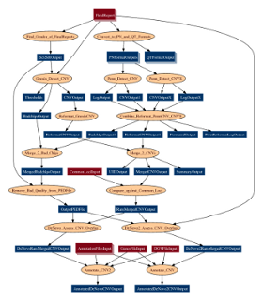
Pegasus
https://pegasus.isi.edu/
“Grid” workflow engine capable of executing tasks connected by data flow graphs as shown
The Pegasus project encompasses a set of technologies that help workflow-based applications execute in a number of different environments including desktops, campus clusters, grids, and clouds.
Pegasus bridges the scientific domain and the execution environment by automatically mapping high-level workflow descriptions onto distributed resources.
It automatically locates the necessary input data and computational resources necessary for workflow execution.
Pegasus enables scientists to construct workflows in abstract terms without worrying about the details of the underlying execution environment or the particulars of the low-level specifications required by the middleware (Condor, Globus, or Amazon EC2).
Pegasus also bridges the current cyberinfrastructure by effectively coordinating multiple distributed resources.

Slide 8
Kepler, BioKepler
The Kepler Project (UC Davis, UC Santa Barbara, and UC San Diego) https://kepler-project.org/ is dedicated to furthering and supporting the capabilities, use, and awareness of the free and open source, scientific workflow application, Kepler.
Kepler is designed to help scien­tists, analysts, and computer programmers create, execute, and share models and analyses across a broad range of scientific and engineering disciplines.
Kepler can operate on data stored in a variety of formats, locally and over the internet, and is an effective environment for integrating disparate software components, such as merging "R" scripts with compiled "C" code, or facilitating remote, distributed execution of models.
Using Kepler's graphical user interface, users simply select and then connect pertinent analytical components and data sources to create a "scientific workflow"—an executable representation of the steps required to generate results.
The Kepler software helps users share and reuse data, workflows, and compo­nents developed by the scientific community to address common needs.
Kepler is a java-based application that is maintained for the Windows, OSX, and Linux operating systems.
http://www.biokepler.org/ bioKepler is a Kepler module of scientific workflow components to execute a set of bioinformatics tools

Slide 9
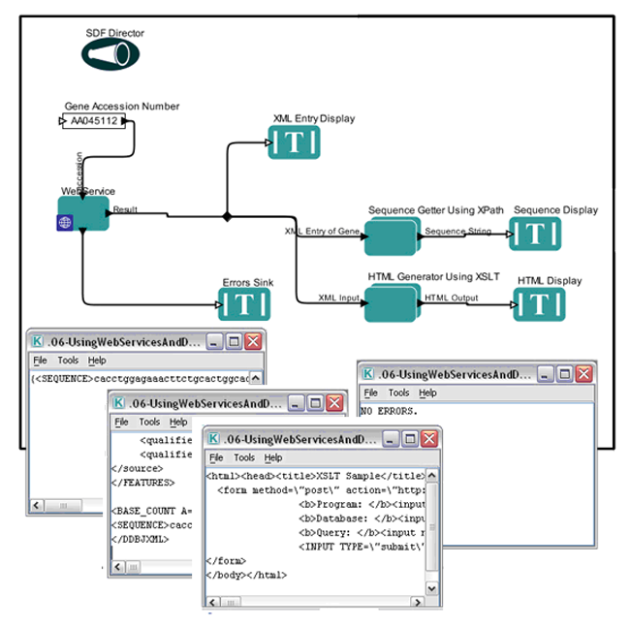
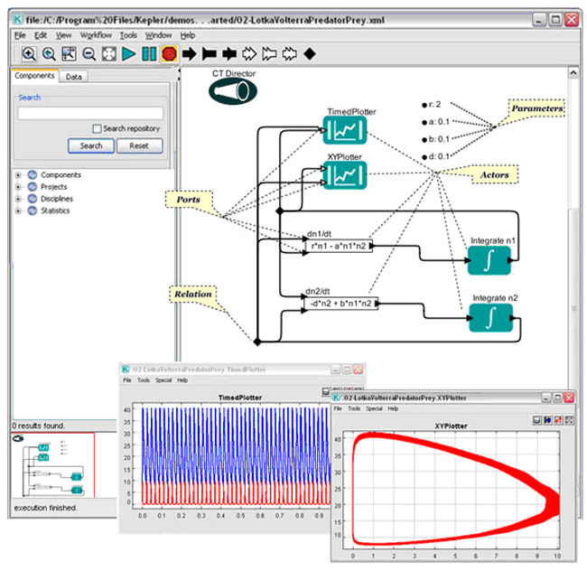
Kepler Example Workflows
https://kepler-project.org/users/sample-workflows

Slide 10
Galaxy
http://galaxyproject.org/Galaxy http://en.wikipedia.org/wiki/Galaxy_(computational_biology) is an open source scientific workflow system written in Python.
Workflow systems provide a means to build multi-step computational analyses akin to a recipe. They typically provide a graphical user interface for specifying what data to operate on, what steps to take, and what order to do them in.
Galaxy is also a data integration platform for biological data. It supports data uploads from the user's computer, by URL, and from many online resources (such as the UCSC Genome Browser, BioMart and InterMine).
Galaxy supports a range of widely used biological data formats, and translation between those formats. Galaxy provides a web interface to many text manipulation utilities, enabling researchers to do their own custom reformatting and manipulation without having to do any programming.
Galaxy Objects include Histories are computational analyses (recipes) run with specified input datasets, computational steps and parameters. Histories include all intermediate and output datasets as well. Datasets, workflows and pages are other objects

Slide 11
Swift
Apache license http://swift-lang.org/main/ is a scripting language approach to workflow as in
foreach protein in proteinList { runBLAST(protein); }
This is called Many task computing
Swift is easy: Short, simple scripts can do large-scale work. The same script runs on multicore computers, clusters, grids, clouds, and supercomputers.
Swift is parallel: it runs multiple programs concurrently as soon as their inputs are available, reducing the need for complex parallel programming.

Slide 12
Taverna
Taverna http://www.taverna.org.uk/ http://en.wikipedia.org/wiki/Taverna_workbench is an LGPL open source and domain-independent Workflow Management System – a suite of tools used to design and execute scientific workflows and aid in silico experimentation.
Well developed and robust system linking to tools like Bioconductor
Various service types available: WSDL-style and RESTful Web services, BioMart, BioMoby, SoapLab, R, Beanshell, Excel and csv spreadsheets
Taverna has been created by the myGrid team and is currently funded though FP7 projects BioVeL, SCAPE and Wf4Ever.
The Taverna tools include the Workbench (desktop client application), the Command Line Tool (for a quick execution of workflows from a terminal), the Server (for remote execution of workflows) and the Player (Web interface plugin for submitting workflows for remote execution). Taverna Online lets you create Taverna workflows from a Web browser.
Also featured in http://www.myexperiment.org/ workflow sharing environment

Slide 13
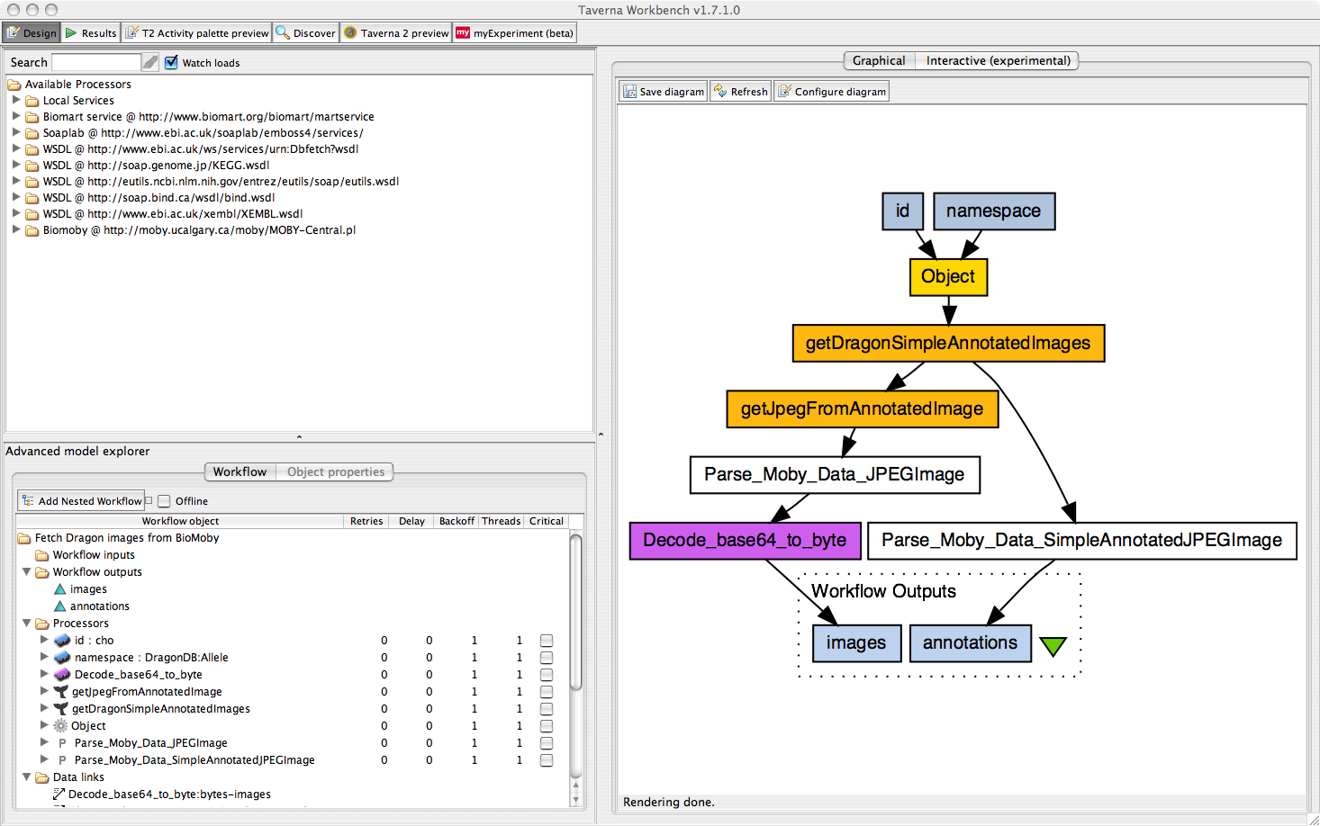
Taverna

Slide 14
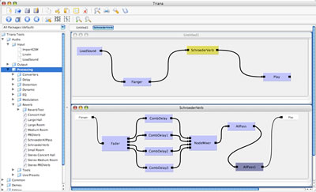
Triana
Triana Apache license http://www.trianacode.org/ from Cardiff termed a problem solving environment – an “old fashioned name”
It was one of two testbed applications for GridLab, a large EU funded project. The aim of GridLab was to develop a simple and robust grid application toolkit (GAT) enabling applications to exploit the power of the Grid.
TrianaCloud uses RabbitMQ to link modules together
Triana is a Java system with one implementation based on the Sun's JXTA protocols and distributed across many mobile devices
Generally built around distributed modules
Triana has a traditional GUI interface for linking components together
It can link to Pegasus

Slide 15
Trident
Apache license https://www.microsoft.com/mscorp/tc/trident.mspx http://tridentworkflow.codeplex.com/ Scientific Workflow Workbench is no longer active
Trident is a set of tools based on the Windows Workflow Foundation that addresses scientists’ need for a flexible, powerful way to analyze large, diverse datasets. It includes graphical tools for creating, running, managing, and sharing workflows. This central control present in many workflow systems but not obviously good.
Trident Workflow Composer provides graphical tools for creating workflows.
For large data sets, Trident can run multiple workflows in parallel on a Windows HPC Server 2008 cluster. It had “classic mistake” of a centralized controller
Trident Workflow Application - available in Windows Presentation Foundation and Silverlight versions - provides a simple way to run Trident workflows. The Microsoft Silverlight version of the Trident workflow application enables users to run workflows remotely using a Silverlight-enabled browser via Web services.
Trident is integrated with myExperiment - a workflow collaboration portal - so scientists can easily share their Trident workflows with colleagues.
Trident security model supports users and roles that allows scientists to control access rights to their workflows.
The Trident Registry maintains libraries of workflows and activities, workflow inputs and outputs, workflow versions, and associated data products; each user can have a personal workflow library and can share workflows with other users.
Trident Management Studio manages the Trident Registry and workflow execution, schedules workflows, and monitors workflow executions locally or remotely.

Slide 16
IPython
Scripting as in Swift is an important approach to workflow/orchestration
Several projects have used Python as the scripting language as have related (in nature of problem) System specification languages like Ansible
https://wiki.openstack.org/wiki/NovaOrchestration/WorkflowEngines
IPython notebook preserves provenance of activity
Taverna can be executed from inside Ipython http://www.pro-ibiosphere.eu/news/4654_the%20running%20of%20taverna%20workflows%20within%20an%20ipython%20notebook/

