Slide 1
Big Data Open Source Software and Projects ABDS in Summary XXVI: Layer 17 Part 2: Cloud
Data Science Curriculum
March 1 2015
Geoffrey Fox
gcf@indiana.edu
http://www.infomall.org
School of Informatics and Computing
Digital Science Center
Indiana University Bloomington

Slide 2
Functionality of 21 HPC-ABDS Layers
Message Protocols:
Distributed Coordination:
Security & Privacy:
Monitoring:
IaaS Management from HPC to hypervisors:
DevOps:
Interoperability:
File systems:
Cluster Resource Management:
Data Transport:
A) File management B) NoSQL C) SQL
In-memory databases&caches / Object-relational mapping / Extraction Tools
Inter process communication Collectives, point-to-point, publish-subscribe, MPI:
A) Basic Programming model and runtime, SPMD, MapReduce: B) Streaming:
A) High level Programming: B) Application Hosting Frameworks
Application and Analytics:
Workflow-Orchestration: Parts 1) Pre-Cloud 2) Cloud
Here are 21 functionalities. (including 11, 14, 15 subparts)
4 Cross cutting at top
17 in order of layered diagram starting at bottom

Slide 3
Previous workflow systems come from Grid community although they have been adapted to clouds Following systems are from more recent cloud specific goals

Slide 4
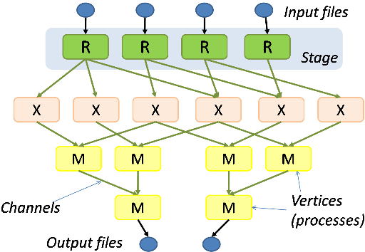
Microsoft Dryad
http://research.microsoft.com/en-us/projects/dryad/
A Dryad programmer writes several sequential programs and connects them using one-way channels. The computation is structured as a directed graph: programs are graph vertices, while the channels are graph edges. A Dryad job is a graph generator which can synthesize any directed acyclic graph. These graphs can even change during execution, in response to important events in the computation.
Dryad is quite expressive. It completely subsumes other computation frameworks, such as Google's map-reduce, or the relational algebra. Moreover, Dryad handles job creation and management, resource management, job monitoring and visualization, fault tolerance, re-execution, scheduling, and accounting.

Slide 5
Microsoft Naiad
Open Source http://microsoftresearch.github.io/Naiad/ http://research.microsoft.com/en-us/projects/naiad/
http://research.microsoft.com/apps/pubs/?id=201100
A new computational model, timely dataflow, underlies Naiad and captures opportunities for parallelism across a wide class of algorithms. This model enriches dataflow computation with timestamps that represent logical points in the computation and provide the basis for an efficient, lightweight coordination mechanism.
Many powerful high-level programming models can be built on Naiad’s low-level primitives, enabling such diverse tasks as streaming data analysis, iterative machine learning, and interactive graph mining. Naiad outperforms specialized systems in their target application domains, and its unique features enable the development of new high-performance applications.

Slide 6
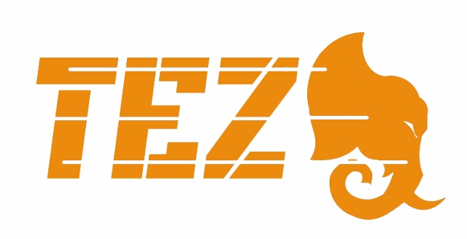
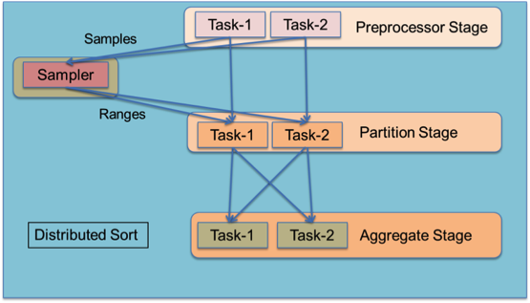
Apache Tez I
http://hortonworks.com/hadoop/tez/
Related to Llama (Yarn to Impala) http://cloudera.github.io/llama/
Tez from Hortonworks adds general workflow capabilities to Hadoop as seen earlier in MIcrosoft Dryad.
Tez models data processing as a dataflow graph with vertices in the graph representing application logic and edges representing movement of data.
Built to work with Yarn in mixed workload clusters
http://hortonworks.com/blog/apache-tez-a-new-chapter-in-hadoop-data-processing/
A rich dataflow definition API allows users to express complex query logic in an intuitive manner and it is a natural fit for query plans produced by higher-level declarative applications like Hive and Pig. As an example, the diagram shows how to model an ordered distributed sort using range partitioning.

Slide 7
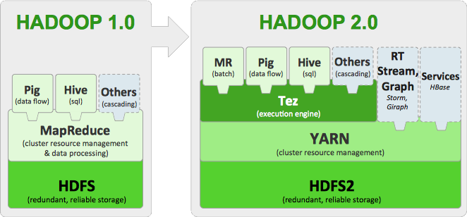
Apache Tez II

Slide 8
Google FlumeJava
http://pages.cs.wisc.edu/~akella/CS838/F12/838-CloudPapers/FlumeJava.pdf
FlumeJava is a Java library developed at Google to develop, test and run large scale data parallel pipelines in an efficient manner.
The data pipelines are specified using set of parallel operations available in the library. The library abstracts how the data is presented as in-memory or as file.
The data pipeline and the processing logic is written in Java. The library abstracts how the data processing happens, i.e weather local loop or map reduce job.
At the runtime these parallel operations are run as Map tasks, Reduce tasks, streaming computations etc.
FlumeJava uses defered evaluation to optimize the data flow between the parallel operations.
Google claims that they no longer uses direct Map Reduce implementation and instead they use FlumeJava to run their data parallel tasks
The project is not open source and is planned to be available to general public through Google Cloud platform as a SaaS
Part of Google Cloud Dataflow that also has Google Pub-Sub and Google MillWheel

Slide 9
Apache Crunch
https://crunch.apache.org/ runs on Hadoop or Spark
The Apache Crunch project develops and supports Java APIs that simplify the process of creating data pipelines on top of Apache Hadoop. The Crunch APIs are modeled after Google FlumeJava
One can compare with Apache Pig, Apache Hive, and Cascading.
Developer focused. Apache Hive and Apache Pig were built to make MapReduce accessible to data analysts with limited experience in Java programming. Crunch was designed for developers who understand Java and want to use MapReduce effectively in order to write fast, reliable applications that need to meet tight SLAs. Crunch is often used in conjunction with Hive and Pig; a Crunch pipeline written by the development can be processed by a diverse collection of Pig scripts and Hive queries written by analysts.
Minimal abstractions. Crunch pipelines provide a thin veneer on top of MapReduce. Developers have access to low-level MapReduce APIs whenever they need them. This mimimalism also means that Crunch is extremely fast, only slightly slower than a hand-tuned pipeline developed with the MapReduce APIs, and the community is working on making it faster all the time.
One of the goals of the project is portability, and the abstractions that Crunch provides are designed to ease the transition from Hadoop 1.0 to Hadoop 2.0 and to provide transparent support for future data processing frameworks that run on Hadoop, including Apache Spark and Apache Tez.
Flexible Data Model. Hive, Pig, and Cascading all use a tuple-centric data model that works best when your input data can be represented using a named collection of scalar values, much like the rows of a database table.
Crunch allows developers considerable flexibility in how they represent their data, which makes Crunch the best pipeline platform for developers working with complex structures like Apache Avro records or protocol buffers, geospatial and time series data, and data stored in Apache HBase tables.

Slide 10
Cascading Twitter Scalding
http://www.cascading.org/ open source with many subsidiary projects such as Twitter PyCascading (Python) and Scalding (Scala)
Java tuple data model
From Concurrent http://www.concurrentinc.com/ that offers commercial support
Supports Hadoop, Hive with Storm, Spark, Tez to come
It follows a ‘source-pipe-sink’ paradigm, where data is captured from sources, follows reusable ‘pipes’ that perform data analysis processes, where the results are stored in output files or ‘sinks’.
Pipes are created independent from the data they will process. Once tied to data sources and sinks, it is called a ‘flow’.
These flows can be grouped into a ‘cascade’, and the process scheduler will ensure a given flow does not execute until all its dependencies are satisfied.
Pipes and flows can be reused and reordered to support different business needs.

Slide 11
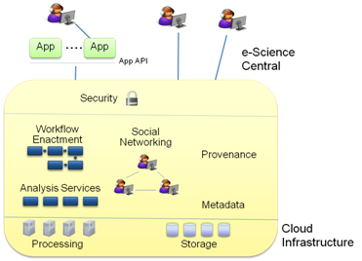
e-Science Central
http://www.esciencecentral.co.uk/
e-Science Central is a Science-as-a-Service platform that combines three emerging technologies — Software as a Service (so you only need a web browser to do your science), Social Networking (to encourage you to interact and create your communities) and Cloud Computing (to provide you with storage and computational power).
Using only a browser, you can upload your data, share it in a controlled way with your colleagues, and analyse the data using either a set of pre-defined services, or your own, which you can upload for execution and sharing. You can also record your progress in notebooks and publish your work on-line or conventionally.
Moreover, e-Science Central gives you a workflow editing and enactment tool to allow you automation of analysis through the browser.
Azure is typically backend cloud

Slide 12
Azure Data Factory
http://azure.microsoft.com/en-us/services/data-factory/
The Azure Data Factory service is a fully managed service for composing data storage, processing, and movement services into streamlined, scalable, and reliable data production pipelines.
Developers can use Data Factory to transform semi-structured, unstructured and structured data from on-premises and cloud sources into trusted information.
Developers build data-driven workflows (pipelines) that join, aggregate and transform data sourced from their on-premises, cloud-based and internet services, and set up complex data processing through simple JSON scripting.
The Azure Data Factory service provides monitoring and management of these pipelines at a glance with a rich visual experience offered through the Azure Preview Portal.
The information produced by pipelines can be easily consumed using BI and analytics tools, and other applications to reliably drive key business insights and decisions.
See http://azure.microsoft.com/en-us/documentation/articles/data-factory-introduction/

Slide 13
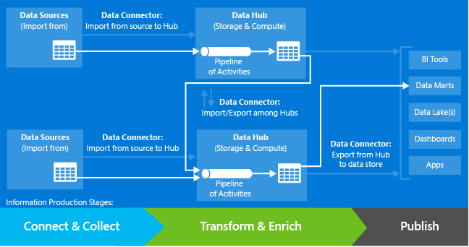
Application model of Azure Data Factory
Connect & Collect. In this stage, data from various data sources is imported into data hubs.
Transform & Enrich. In this stage, the collected data is processed.
Publish. In this stage, the data is published so that it can be consumed by BI tools, analytics tools, and other applications

Slide 14
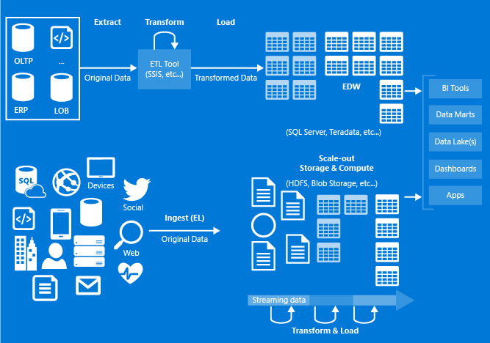
Azure Data Factory Application

Slide 15
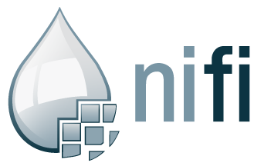
Apache NiFi
This is a new Apache Incubator project https://nifi.incubator.apache.org/ with software from the US National Security Agency
Not clear how it supports parallelism needed for Big Data;
It has typical dataflow model and features (not clearly special) are
Web-based user interface
Seamless experience for design, control, and monitoring
Highly configurable
Loss tolerant vs guaranteed delivery
Low latency vs high throughput
Dynamic prioritization
Flows can be modified at runtime
Back pressure
Data Provenance
Track dataflow from beginning to end
Designed for extension
Build your own processors and more
Enables rapid development and effective testing
Secure
SSL, SSH, HTTPS, encrypted content, etc...
Pluggable role-based authentication/authorization

Slide 16
Data Integration and Fusion

Slide 17
ETL – Data Integration and Fusion Data Integration and Fusion
Extract, Transform and Load (ETL) refers to a process in database usage and especially in data warehousing that:
Extracts data from homogeneous or heterogeneous data sources
Transforms the data for storing it in proper format or structure for querying and analysis purpose
Loads it into the final target (database, more specifically, operational data store, data mart, or data warehouse)
Most problems have disparate sources of data/information that need to be integrated on fused together
Integration and/or fusion often performed by workflows or orchestrations of other “atomic tools”
Also addressed at level 15A

Slide 18
3. Move data from external data sources into a highly horizontally scalable data store, transform it using highly horizontally scalable processing (e.g. Map-Reduce), and return it to the horizontally scalable data store (ELT)
Transform with Hadoop, Spark, Giraph …
Enterprise Data Warehouse
Data Storage: HDFS, Hbase
OLTP Database
Streaming Data
Web Services
ETL is Extract Load Transform
http://www.dzone.com/articles/hadoop-t-etl
Example from “data access patterns” #3

Slide 19
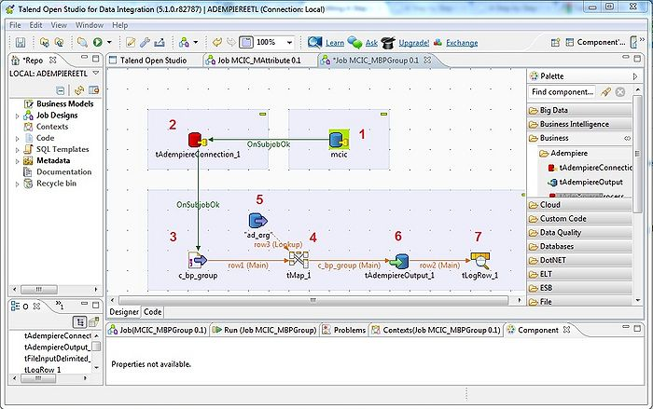
Talend
http://www.talend.com/
Talend is an open source software vendor that provides data integration & management, and enterprise application integration software and services.
Supports Master data management (MDM), which is a comprehensive method of enabling an enterprise to link all of its critical data to one file, called a master file, that provides a common point of reference.
When properly done, master data management streamlines data sharing among personnel and departments.
In addition, master data management can facilitate computing in multiple system architectures, platforms and applications.

Slide 20
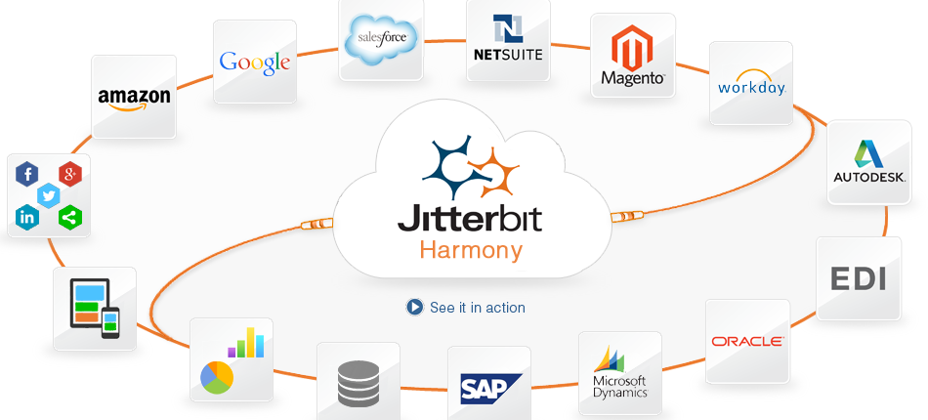
Jitterbit
Quickly connect to hundreds of applications
Complete integration lifecycle management
Use Jitterbit Automapper to intelligently map fields
Build powerful integration processes with the workflow designer
Add business logic with the built-in formula libraryhttp://www.jitterbit.com/
http://www.jitterbit.com/
Mix of lots of connectors and workflow

Slide 21
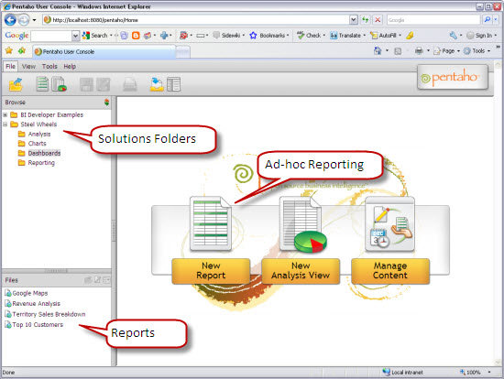
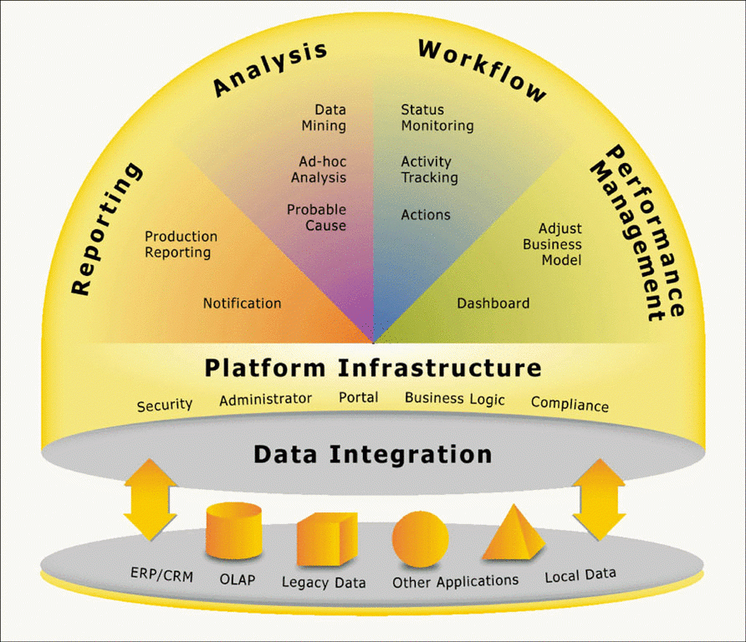
Pentaho
Pentaho Business Analytics is a suite of open source Business Intelligence (BI) products which provide data integration, OLAP services, reporting, dashboarding, data mining and ETL capabilities
Enterprise and Apache license community edition.

Slide 22
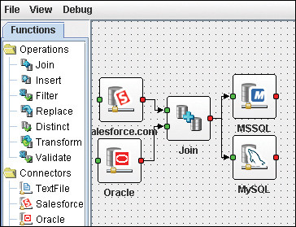
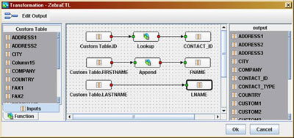
Apatar
http://www.apatarforge.org/
Apatar is an open source GPLv2.0 ETL (Extract-Transform-Load) and data integration software
There is a support company with same name http://www.apatar.com/
No longer very actively developed

