Slide 1
Big Data Open Source Software and Projects ABDS in Summary II: Layers 3 to 4
Data Science Curriculum
March 1 2015
Geoffrey Fox
gcf@indiana.edu
http://www.infomall.org
School of Informatics and Computing
Digital Science Center
Indiana University Bloomington

Slide 2
Functionality of 21 HPC-ABDS Layers
Message Protocols:
Distributed Coordination:
Security & Privacy:
Monitoring:
IaaS Management from HPC to hypervisors:
DevOps:
Interoperability:
File systems:
Cluster Resource Management:
Data Transport:
A) File management B) NoSQL C) SQL
In-memory databases&caches / Object-relational mapping / Extraction Tools
Inter process communication Collectives, point-to-point, publish-subscribe, MPI:
A) Basic Programming model and runtime, SPMD, MapReduce: B) Streaming:
A) High level Programming: B) Application Hosting Frameworks
Application and Analytics:
Workflow-Orchestration:
Here are 21 functionalities. (including 11, 14, 15 subparts)
4 Cross cutting at top
17 in order of layered diagram starting at bottom

Slide 3
Incommon, Eduroam
https://www.incommon.org/
In authentication, authorization, and accounting (AAA), identity management covers first two.
InCommon, operated by Internet2, federates the identity management of many research and higher education institutions
In 2014, InCommon's identity management federation serves 8 million end-users from 470 educational institutions and 33 government and not for profit entities. There are 207 (commercial) partners
This allows members of these institutions to access resources without registering separately for each of them
Incommon may integrate with Eduroam, which is a similar international activity.
Eduroam available at many University wifi offerings

Slide 4
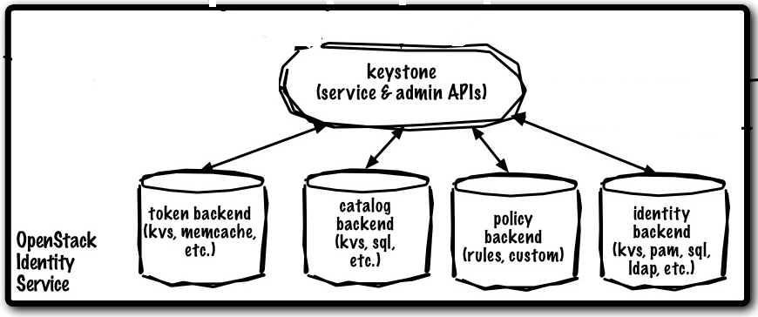
OpenStack Keystone
http://www.ibm.com/developerworks/cloud/library/cl-openstack-keystone/index.html
Keystone integrates the OpenStack functions for authentication, policy management, and catalog services, including registering all tenants and users, authenticating users and granting tokens for authorization, creating policies that span all users and services, and managing a catalog of service endpoints.
The core object of an identity-management system is the user — a digital representation of a person, system, or service using OpenStack services.
Users are often assigned to containers called tenants, which isolate resources and identity objects. A tenant can represent a customer, account, or any organizational unit.
Security policies are enforced with a role-based authorization engine. After a user has been authenticated, the next step is to determine the level of authorization. Keystone encapsulates a set of rights and privileges with a notion called a role. The tokens that the identity service issues include a list of roles that the authenticated user can assume. It is then up to the resource service to match the set of user roles with the requested set of resource operations and either grant or deny access.

Slide 5
Apache Sentry
http://sentry.incubator.apache.org/
Role based authorization designed to work with Cloudera Impala (used by Impala in its release) and Apache Hive
Originally called Cloudera Access and moved to Apache incubator in August 2013

Slide 6
LDAP
The Lightweight Directory Access Protocol (LDAP) is an open, vendor-neutral, industry standard application protocol for accessing and maintaining distributed directory information services over an Internet Protocol (IP) network.
i.e. it is a distributed database for metadata
Directory services play an important role in developing intranet and Internet applications by allowing the sharing of information about users, systems, networks, services, and applications throughout the network. As examples, directory services may provide any organized set of records, often with a hierarchical structure, such as a corporate email directory. Similarly, a telephone directory is a list of subscribers with an address and a phone number.
LDAP is specified in a series of Internet Engineering Task Force (IETF) Standard Track publications with latest specification as Version 3, published as RFC 4511.
A common usage of LDAP is to provide a "single sign on" where one password for a user is shared between many services, such as applying a company login code to web pages (so that staff log in only once to company computers, and then are automatically logged into the company intranet).
LDAP is based on a simpler subset of the standards contained within the X.500 standard
http://en.wikipedia.org/wiki/Lightweight_Directory_Access_Protocol
It has several implementations including open source OpenLDAP (started in 1998!) and the well known proprietary Microsoft Active Directory

Slide 7
SQRRL
Sqrrl http://sqrrl.com/ is a spin off company from NSA (National Security Agency) led by their staff who worked on Apache Accumulo and integrates it with Hadoop and Spark
It is designed to have good security but unique feature in this survey is its use in Big Data underlying Security
Here is Sqrrl Enterprise Big Data Security Analytics use case for incident handlers and responders.
It allows them to investigate suspicious behavior, pinpoint the actors involved, and assess impact to the organization.
Sqrrl consumes diverse cyber datasets, such as network traffic logs, identity context, external intelligence feeds, DNS capture, email/social media activity, and customer transactions.
These datasets are analyzed to detect suspicious behavior, and matches are visualized for deeper review. Access to sensitive data, such as PII (Personally Identifiable Information), can be restricted based on organizational roles.

Slide 8
Functionality of 21 HPC-ABDS Layers
Message Protocols:
Distributed Coordination:
Security & Privacy:
Monitoring:
IaaS Management from HPC to hypervisors:
DevOps:
Interoperability:
File systems:
Cluster Resource Management:
Data Transport:
A) File management B) NoSQL C) SQL
In-memory databases&caches / Object-relational mapping / Extraction Tools
Inter process communication Collectives, point-to-point, publish-subscribe, MPI:
A) Basic Programming model and runtime, SPMD, MapReduce: B) Streaming:
A) High level Programming: B) Application Hosting Frameworks
Application and Analytics:
Workflow-Orchestration:
Here are 21 functionalities. (including 11, 14, 15 subparts)
4 Cross cutting at top
17 in order of layered diagram starting at bottom

Slide 9
Apache Ambari
Apache Ambari is contributed by Hortonworks and has multiple cluster management and monitoring functions
Provisioning a Hadoop Cluster: Ambari includes an intuitive Web interface that allows one to easily provision, configure and test all the Hadoop services and core components and achieve a wizard-driven installation of Hadoop across any number of hosts.
Ambari also provides the powerful Ambari Blueprints API for automating cluster installations without user intervention.
Managing a Hadoop cluster: Ambari provides tools to simplify cluster management. The Web interface allows you to control the lifecycle of Hadoop services and components, modify configurations and manage the ongoing growth of your cluster.
Monitoring a Hadoop cluster: Ambari pre-configures alerts for watching Hadoop services and visualizes cluster operational data in a simple Web interface allowing one to monitor health of Hadoop installation.

Slide 10
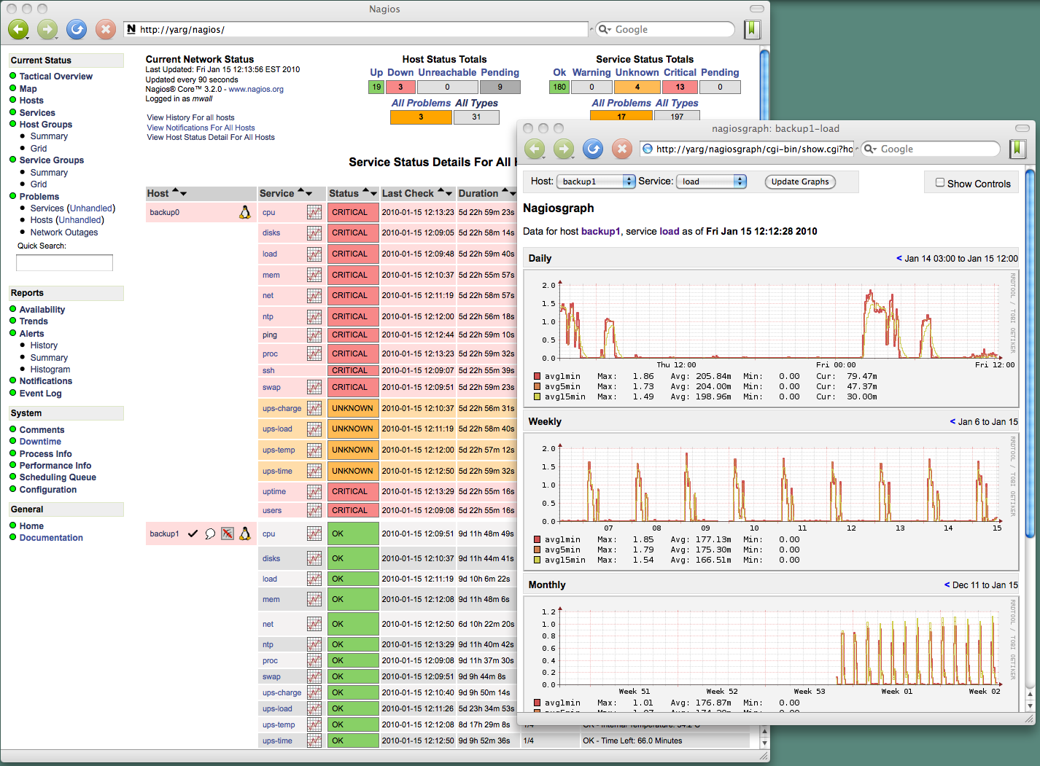
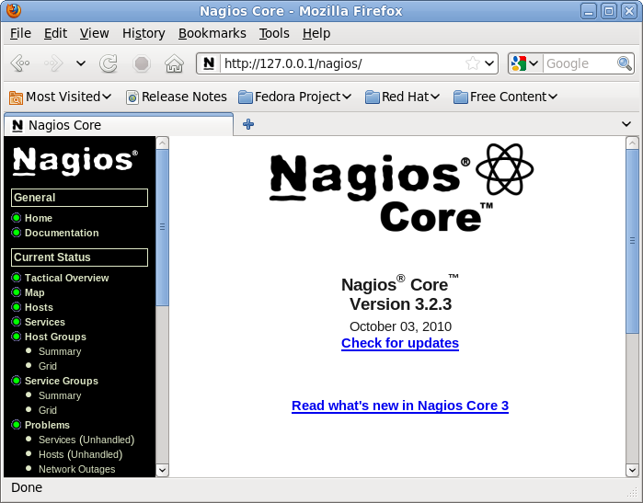
Nagios
Nagios http://www.nagios.org/ is an open source (GPL) computer system monitoring, network monitoring and infrastructure monitoring software application.
Nagios offers monitoring and alerting services for servers, switches, applications, and services.
It alerts the users when things go wrong and alerts them a second time when the problem has been resolved.
“core” is open source but there is a commercial (enterprise) version

Slide 11
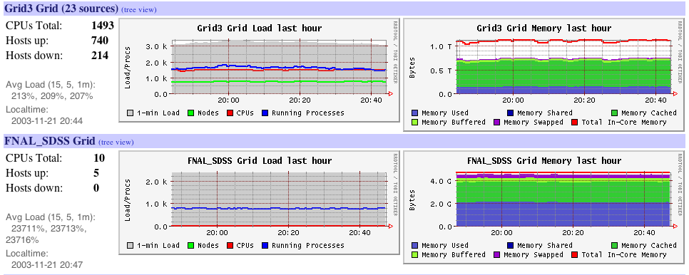
Ganglia
http://en.wikipedia.org/wiki/Ganglia_(software)
Ganglia is a BSD licensed scalable distributed system monitor tool for high-performance computing systems such as clusters and grids. It allows the user to remotely view live or historical statistics (such as CPU load averages or network utilization) for all machines that are being monitored.
It is based on a hierarchical design targeted at federations of clusters.
SDSC bundled Ganglia monitoring into their Rocks Installation Tool.
http://www.ibm.com/developerworks/library/l-ganglia-nagios-1/
Ganglia is more concerned with gathering metrics and tracking them over time while Nagios has focused on being an alerting mechanism.

Slide 12
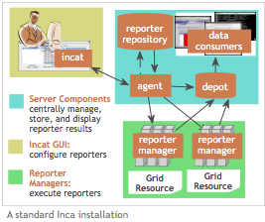
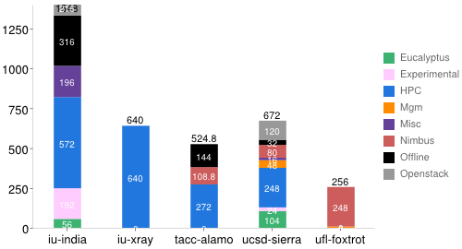
Inca Monitoring Tool
http://inca.sdsc.edu/ is an open source system from SDSC enabling user level monitoring with a powerful reporting mechanism.
Inca detects Grid (cluster) infrastructure problems by executing periodic, automated, user-level testing of Grid software and services.
It supports multiple “reporters” for different tests.
For example there were 196 Inca reporters available to test and measure aspects of FutureGrid systems. https://portal.futuregrid.org/tutorials/inca

