Slide 1
Big Data Open Source Software and Projects ABDS in Summary III: Layer 5-Part 1
Data Science Curriculum
March 5 2015
Geoffrey Fox
gcf@indiana.edu
http://www.infomall.org
School of Informatics and Computing
Digital Science Center
Indiana University Bloomington

Slide 2
Functionality of 21 HPC-ABDS Layers
Message Protocols:
Distributed Coordination:
Security & Privacy:
Monitoring:
IaaS Management from HPC to hypervisors: Part 1
DevOps:
Interoperability:
File systems:
Cluster Resource Management:
Data Transport:
A) File management B) NoSQL C) SQL
In-memory databases&caches / Object-relational mapping / Extraction Tools
Inter process communication Collectives, point-to-point, publish-subscribe, MPI:
A) Basic Programming model and runtime, SPMD, MapReduce: B) Streaming:
A) High level Programming: B) Application Hosting Frameworks
Application and Analytics:
Workflow-Orchestration:
Here are 21 functionalities. (including 11, 14, 15 subparts)
4 Cross cutting at top
17 in order of layered diagram starting at bottom

Slide 3
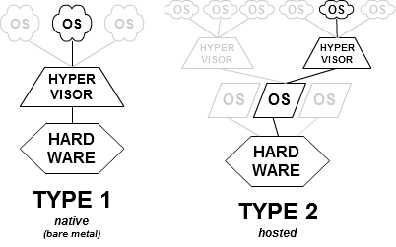
Xen
Xen http://en.wikipedia.org/wiki/Xen supports a form of type 1 virtualization known as paravirtualization, in which guests run a modified operating system. The guests are modified to use a special hypercall ABI, instead of certain architectural features.
Through paravirtualization, Xen can achieve high performance even on its host architecture (x86) which has a reputation for non-cooperation with traditional virtualization techniques
Xen was developed at the University of Cambridge but is now owned by Citrix
Responsibilities of the hypervisor include memory management and CPU scheduling of all virtual machines ("domains"), and for launching the most privileged domain ("dom0") - the only virtual machine which by default has direct access to hardware. From the dom0 the hypervisor can be managed and unprivileged domains ("domU") can be launched.

Slide 4
KVM, VirtualBox
KVM http://en.wikipedia.org/wiki/Kernel-based_Virtual_Machine is a GNU licensed type 2 virtualization infrastructure for the Linux kernel that turns it into a hypervisor, which was merged into the Linux kernel mainline in February 2007
It requires a processor with hardware virtualization extension.
Oracle VirtualBox https://www.virtualbox.org/ http://en.wikipedia.org/wiki/VirtualBox is another well known type 2 hypervisor with GPL2 license
Runs on many O/S

Slide 5
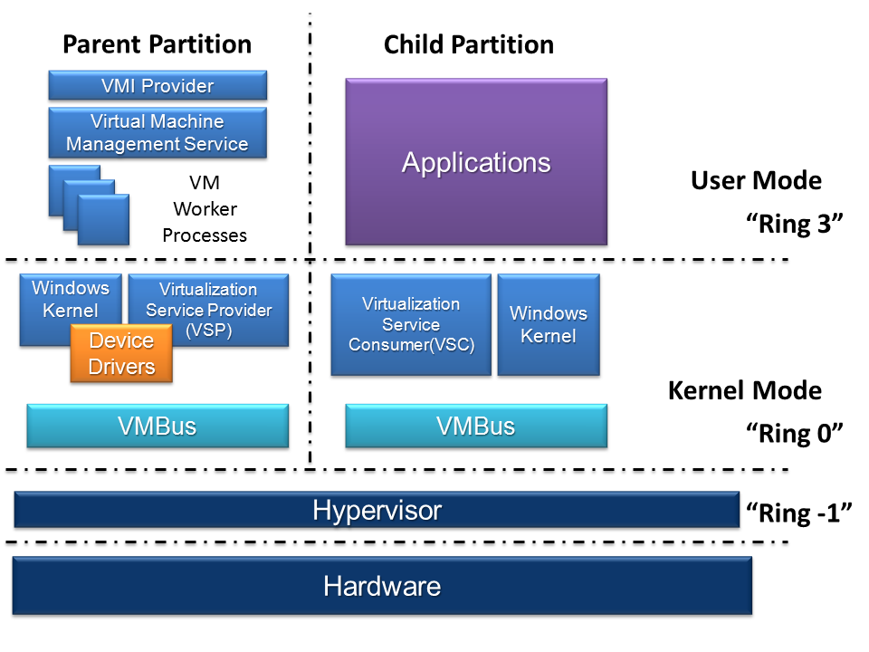
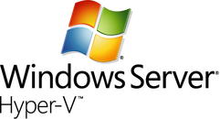
Hyper-V
Microsoft proprietary Hypervisor http://en.wikipedia.org/wiki/Hyper-V that supports Windows and some variants of Linux
There must be a parent partition running Windows Server

Slide 6
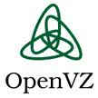
OpenVZ
OpenVZ is a type 2 Hypervisor http://openvz.org/Main_Page with GPL license
OpenVZ (Open VirtualiZation) or Open Virtuozzo is an operating system-level virtualization technology based on the Linux kernel and operating system. OpenVZ allows a physical server to run multiple isolated operating system instances, known as containers, Virtual Private Servers (VPSs), or Virtual Environments (VEs).
Docker works well with containers
OpenVZ is not true virtualization but really containerization like FreeBSD jails.
Technologies like VMware and Xen are more flexible in that they virtualize the entire machine and can run multiple operating systems and different kernel versions.
OpenVZ uses a single patched Linux kernel and therefore can run only Linux, all containers share the same architecture and kernel version. However, as it does not have the overhead of a true hypervisor, it is very fast and efficient.
The disadvantage with this approach is the single kernel. All guests must function with the same kernel version that the host uses.
LXC (LinuX Containers) and Linux-Vserver are similar technologies

Slide 7
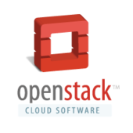
OpenStack
OpenStack, OpenNebula, CloudStack, Nimbus, Eucalyptus are all cloud or Virtual managers. They help users and system administers use virtual machines with various characteristics
The big commercial public clouds have equivalent proprietary systems
OpenStack http://en.wikipedia.org/wiki/OpenStack http://www.openstack.org/ is a free and open-source Apache Licensed software cloud computing software platform. Users primarily deploy it as an infrastructure as a service (IaaS) solution.
The technology consists of a series of interrelated projects (such as Heat in DevOps and Swift in Storage) that control pools of processing, storage, and networking resources throughout a data center—which users manage through a web-based dashboard, command-line tools, or a RESTful API.
OpenStack began in 2010 as a joint project of Rackspace Hosting and NASA. Currently, it is managed by the OpenStack Foundation, a non-profit corporate entity established in September 2012 to promote OpenStack software and its community. More than 200 companies have joined the project, including Arista Networks, AT&T, AMD, Avaya, Canonical, Cisco, Dell, EMC, Ericsson, Go Daddy, Hewlett-Packard, IBM, Intel, Mellanox, Mirantis, NEC, NetApp, Nexenta, Oracle, PLUMgrid, Red Hat, SUSE Linux, VMware and Yahoo!.
The OpenStack community collaborates around a six-month, time-based release cycle with frequent development milestones. During the planning phase of each release, the community gathers for the OpenStack Design Summit to facilitate developer working-sessions and to assemble plans.
The recent OpenStack Summit, in May 2014 in Atlanta, drew 4,500 attendees, a 50% increase from the Hong Kong Summit six months earlier

Slide 8
Apache CloudStack
http://cloudstack.apache.org/ http://en.wikipedia.org/wiki/Apache_CloudStack Has reputation for solid software but does not have the rabid adoption of OpenStack; unusual that Apache solution not most popular!
Came from Citrix via acquisitions
Features include
Built-in high-availability for hosts and VMs
AJAX web GUI for management
AWS API compatibility
Hypervisor agnostic (VMware, KVM, XenServer, Xen Cloud Platform (XCP) and Hyper-V)
Snapshot management
Usage metering
Network management (VLAN's, security groups)
Virtual routers, firewalls, load balancers
Multi-role support

Slide 9
Eucalyptus, Nimbus
Eucalyptus https://www.eucalyptus.com/ http://en.wikipedia.org/wiki/Eucalyptus_(software) was top academic project in 2009 and was commercialized and just recently purchased by Hewlett Packard
Eucalyptus had both commercial and Open source GPL3 tracks but latter was not developed as vigorously as other open source solutions
Perhaps first to offer AWS compatible interface
Apache licensed Nimbus http://en.wikipedia.org/wiki/Nimbus_(cloud_computing) http://www.nimbusproject.org/ was probably most effective academic cloud software after Eucalyptus was commercialized and before OpenStack became popular

