Slide 1
Big Data Open Source Software and Projects ABDS in Summary V: Layer 6 Part 1
Data Science Curriculum
March 5 2015
Geoffrey Fox
gcf@indiana.edu
http://www.infomall.org
School of Informatics and Computing
Digital Science Center
Indiana University Bloomington
Helped by Gregor von Laszewski

Slide 2
Functionality of 21 HPC-ABDS Layers
Message Protocols:
Distributed Coordination:
Security & Privacy:
Monitoring:
IaaS Management from HPC to hypervisors:
DevOps: Part 1
Interoperability:
File systems:
Cluster Resource Management:
Data Transport:
A) File management B) NoSQL C) SQL
In-memory databases&caches / Object-relational mapping / Extraction Tools
Inter process communication Collectives, point-to-point, publish-subscribe, MPI:
A) Basic Programming model and runtime, SPMD, MapReduce: B) Streaming:
A) High level Programming: B) Application Hosting Frameworks
Application and Analytics:
Workflow-Orchestration:
Here are 21 functionalities. (including 11, 14, 15 subparts)
4 Cross cutting at top
17 in order of layered diagram starting at bottom

Slide 3
Chef Ansible Puppet Salt
Chef Ansible Puppet Salt are system configuration managers. Scripts are used to define system and give you “Software Defined Infrastructure”
http://www.infoworld.com/article/2609482/data-center/review--puppet-vs--chef-vs--ansible-vs--salt.html
In Chef http://en.wikipedia.org/wiki/Chef_(software) user writes "recipes" that describe how Chef manages server applications (such as Apache HTTP Server, MySQL, or Hadoop) and how they are to be configured. These recipes describe a series of resources that should be in a particular state: packages that should be installed, services that should be running, or files that should be written. Chef makes sure each resource is properly configured and corrects any resources that are not in the desired state.
Chef can run in client/server mode, or in a standalone configuration named "chef-solo". In client/server mode, the Chef client sends various attributes about the node to the Chef server. The server uses Solr to index these attributes and provides an API for clients to query this information. Chef recipes can query these attributes and use the resulting data to help configure the node.
Traditionally, Chef is used to manage Linux but later versions support Microsoft Windows as well
There are free and supported paid versions

Slide 4
Examples of Chef use in class
We can call different recipes from the same cookbook to customize the nodes in our cluster uniquely:
{ "run_list": ["recipe[hadoop:: hadoop_hdfs_namenode]"]} versus { "run_list": ["recipe[hadoop:: hadoop_hdfs_datanode]"]}
We can pass information to set custom values in our configuration files:
"hadoop" => { "yarn_site" => {"yarn.resourcemanager.hostname" => “10.39.1.99”}}
Chef can even automate installations that require accepting terms:
"java" => { "oracle" => { "accept_oracle_download_terms" => true} }
Beyond installation, Chef can even start services running:
resources('service[hadoop-hdfs-namenode]').run_action(:start)

Slide 5
Chef Ansible Puppet Salt
http://en.wikipedia.org/wiki/Ansible_(software)
Ansible is a GNU license Python open-source software platform for configuring and managing computers. It combines multi-node software deployment, ad hoc task execution, and configuration management. It manages nodes over SSH and does not require any additional remote software (except Python 2.4 or later) to be installed on them.
Approach is built around modules, which work over JSON and standard output and can be written in any programming language. The system uses YAML to express reusable descriptions of systems.
The design goals of Ansible include:
Minimal in nature. Management systems should not impose additional dependencies on the environment.
Consistent.
Secure. Ansible does not deploy vulnerable agents to nodes. Only OpenSSH is required which is already critically tested.
Highly reliable. The idempotent resource model is applied to deployment to prevent side-effects from re-running scripts.
Low learning curve. Playbooks use an easy and descriptive language based on YAML.

Slide 6
Chef Ansible Puppet Salt
Apache license http://puppetlabs.com/puppet/puppet-open-source
http://en.wikipedia.org/wiki/Puppet_(software)
Puppet modules automate tasks such as:
installing and configuring Apache, plus configuring and managing a range of virtual host setups
managing APT source, key, and definitions
installing, configuring, and running NTP across a range of operating systems
managing system reboots on Windows
managing and configuring firewalls
installing and configuring MySQL
and much, much more.
Includes its own declarative language to describe system configuration

Slide 7
Chef Ansible Puppet Salt
Apache license Python http://en.wikipedia.org/wiki/Salt_(software) Salt originated from the need for high speed data collection and execution in system administration environments. The author of Salt, Thomas S Hatch, had previously created a number of in-house solutions for companies to solve the problem but found his and other open source solutions to be lacking.
Hatch decided to use the ZeroMQ messaging library to facilitate the high-speed requirements and built Salt using ZeroMQ for all networking layers.
See comparison at http://en.wikipedia.org/wiki/Comparison_of_open-source_configuration_management_software
Execution modules are the workhorse for Salt's functionality. The execution modules represent the functions that are available for direct execution from the remote execution engine. These modules contain the specific cross platform information used by Salt to manage portability, and constitute the core api of system level functions used by Salt systems.
State modules are the components that make up the backend for the Salt configuration management system. These modules execute the code needed to enforce, set up or change the configuration of a target system. Like other modules, more states become available when they are added to the states modules.
Grains constitute a system for detecting static information about a system and storing it in RAM for rapid gathering.
Renderer modules are used to render the information passed to the Salt state system. The renderer system is what makes it possible to represent Salt's configuration management data in any serializable format.
Returners: the remote execution calls made by Salt are detached from the calling system; this allows the return information generated by the remote execution to be returned to an arbitrary location. Management of arbitrary return locations is managed by the Returner Modules.
Runners are master side convenience applications executed by the salt-run command

Slide 8
Juju
Juju https://juju.ubuntu.com/ http://en.wikipedia.org/wiki/Juju_(software) from Ubuntu with GNU license in Python and Go (“improved C”) orchestrates software services and their provisioning defined by charms across multiple clouds
Charms can be written in any programming language that can be executed from the command line. A Charm is a collection of YAML configuration files and a selection of "hooks".
A hook is a naming convention to install software, start/stop a service, manage relationships with other charms, upgrade charms, scale charms, configure charms, etc.
Charms can have many properties. Charm helpers allow boiler-plate code to be automatically generated hence accelerating the creation of charms.
Juju's main strength is instant integration and scaling. Juju allows services to be instantly integrated via relationships.
By creating a relationship between, for instance, MySQL and WordPress, MySQL will share with WordPress any IPs, user, password and other configuration items.
This will enable WordPress to create tables and import data automatically. Relations allow the complexity of integrating services to be abstracted from the user.
Only Ubuntu servers supported

Slide 9
OpenStack Heat
Heat https://wiki.openstack.org/wiki/Heat is a Open source Python orchestration engine for common cloud environments managing the entire lifecycle of infrastructure and applications.
It creates “clouds” or “virtual clusters” not individual VM’s
A Heat template describes the infrastructure for a cloud application in a text file that is readable and writable by humans, and can be checked into version control, diffed, etc.
Infrastructure resources that can be described include: servers, floating IPs, volumes, security groups, users, etc.
Heat also provides an autoscaling service that integrates with OpenStack Ceilometer, so you can include a scaling group as a resource in a template.
Templates can also specify the relationships between resources (e.g. this volume is connected to this server).
This enables Heat to call out to the OpenStack APIs to create all of your infrastructure in the correct order to completely launch your application.
Heat manages the whole lifecycle of the application - when you need to change your infrastructure, simply modify the template and use it to update your existing stack. Heat knows how to make the necessary changes. It will delete all of the resources when you are finished with the application, too.
Heat primarily manages infrastructure, but the templates integrate well with software configuration management tools such as Puppet and Chef. The Heat team is working on providing even better integration between infrastructure and software.

Slide 10
Cobbler, Xcat, Razor
http://www.cobblerd.org/
LGPL license http://en.wikipedia.org/wiki/Cobbler_(software) Python based provisioning of bare-metal or hypervisor-based systems
Cobbler is a Linux provisioning server that facilitates and automates the network-based installation of multiple computer operating systems from a central point using services such as DHCP, TFTP, and DNS.
It can be configured for PXE, reinstallations, and virtualized guests using Xen, KVM or VMware. Cobbler interacts with the koan program for re-installation and virtualization support. koan and Cobbler use libvirt to integrate with different virtualization software. Cobbler is able to manage complex network scenarios like bridging on a bonded Ethernet link.
Xcat http://sourceforge.net/projects/xcat/ (Originally FutureGrid used this) is a rather specialized (developed by IBM) dynamic provisioning system
Used in Los Alamos Road Runner supercomputer
Razor http://puppetlabs.com/solutions/next-generation-provisioning cloud bare metal provisioning from EMC/puppet

Slide 11
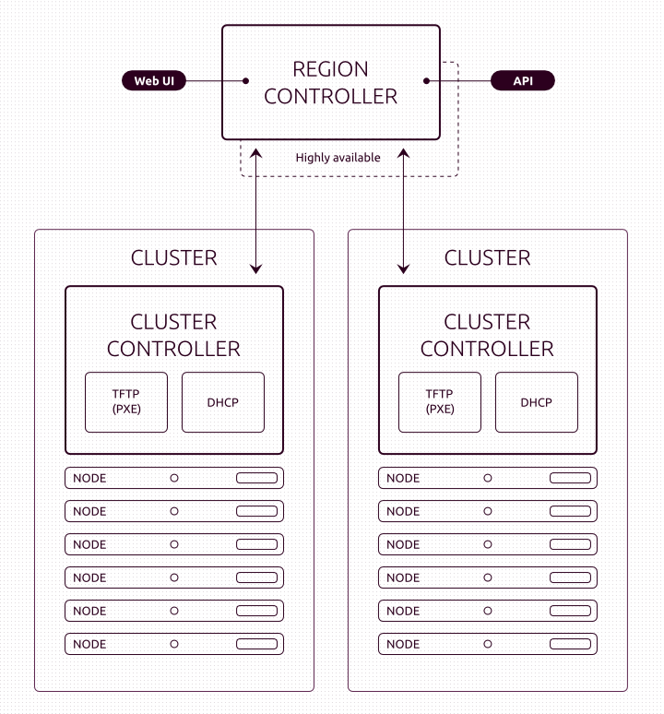
Ubuntu MaaS
Metal as a Service MaaS does bare metal provisioning in same fashion as cloud provisioning
Ubuntu JuJu uses hardware established by MaaS
Prepares hardware for OpenStack installation.
http://www.slideshare.net/openstackindia/maas-juju-introduction
https://maas.ubuntu.com/
Set up for a multiple cluster configuration

Slide 12
OpenStack Ironic
http://www.slideshare.net/enigmadragon/ironic
http://docs.openstack.org/developer/ironic/deploy/user-guide.html
Ironic is an OpenStack project which provisions physical hardware as opposed to virtual machines. Ironic provides several reference drivers which leverage common technologies like PXE and IPMI, to cover a wide range of hardware.
Ironic’s pluggable driver architecture also allows vendor-specific drivers to be added for improved performance or functionality not provided by reference drivers.
Ironic’s driver replaces the Nova “bare metal” driver (in Grizzly - Juno releases).
Ironic is available for use and is supported by the Ironic developers starting with the Juno release. It is officially integrated with OpenStack in the Kilo release.
See OpenStack on OpenStack or Triple O https://wiki.openstack.org/wiki/TripleO

Slide 13
OpenStack Ironic

Slide 14
Part of OpenStack Ironic TripleO is a program aimed at installing, upgrading and operating OpenStack clouds using OpenStack's own cloud facilities as the foundations - building on nova, neutron and heat to automate fleet management at datacentre scale (and scaling down to as few as 2 machines)
Crowbar is Tool from Dell for deploying OpenStack

Slide 15
Foreman
Foreman (also known as The Foreman) written in Ruby/Javascript is a GPL open source complete life cycle systems management tool for provisioning, configuring and monitoring of physical and virtual servers. Foreman has deep integration to configuration management software, specifically Puppet and Chef, which allows you to automate repetitive tasks, deploy applications and manage change to deployed servers.
The Foreman provides provisioning on bare-metal (through managed DHCP, DNS, TFTP, and PXE-based unattended installations), virtualization and cloud. The Foreman provides comprehensive, auditable interaction facilities including a web frontend, a command line interface, and a robust REST API.

Slide 16
Docker
Docker (written in Go – an improved C language) Apache open source license https://www.docker.com/ is a tool to package an application and its dependencies in a virtual Linux container
Docker uses resource isolation features of the Linux kernel such as cgroups and kernel namespaces to allow independent "containers" to run within a single Linux instance, avoiding the overhead of starting virtual machines.
Linux kernel's namespaces completely isolate an application's view of the operating environment, including process trees, network, user IDs and mounted file systems, while cgroups provide resource isolation, including the CPU, memory, block I/O and network.
Docker includes the libcontainer library as a reference implementation for containers, and builds on top of libvirt, LXC (Linux containers) and systemd-nspawn, which provide interfaces to the facilities provided by the Linux kernel
Can be linked to Chef/Puppet/Ansible/Salt

Slide 17
Boto
Compute
Elastic Compute Cloud (EC2)
Elastic MapReduce (EMR)
Auto Scaling
Kinesis
Content Delivery
CloudFront
Database
DynamoDB2
DynamoDB
Relational Data Services 2 (RDS)
Relational Data Services (RDS)
ElastiCache
Redshift
SimpleDB
Deployment and Management
CloudFormation
Elastic Beanstalk
Data Pipeline
Opsworks
CloudTrail
Identity & Access
Identity and Access Management (IAM)
Security Token Service (STS)
Application Services
Cloudsearch 2
Cloudsearch
Elastic Transcoder
Simple Workflow Service (SWF)
Simple Queue Service (SQS)
Simple Notification Service (SNS)
Simple Email Service (SES)
Monitoring
CloudWatch
CloudWatch Logs
Networking
Route 53
Virtual Private Cloud (VPC)
Elastic Load Balancing (ELB)
AWS Direct Connect
Payments & Billing
Flexible Payments Service (FPS)
Storage
Simple Storage Service (S3)
Amazon Glacier
Google Cloud Storage
Workforce
Mechanical Turk
Other
Marketplace Web Services
Support
https://boto.readthedocs.org is a complete Python Interface to all Amazon Cloud services

