Slide 1

Big Data Open Source Software and Projects
ABDS in Summary VI: Layer 6 Part 2
Data Science Curriculum
March 5 2015
Geoffrey Fox
gcf@indiana.edu
http://www.infomall.org
School of Informatics and Computing
Digital Science Center
Indiana University Bloomington
Helped by Gregor von Laszewski

Slide 2
Functionality of 21 HPC-ABDS Layers
Message Protocols:
Distributed Coordination:
Security & Privacy:
Monitoring:
IaaS Management from HPC to hypervisors:
DevOps: Part 2
Interoperability:
File systems:
Cluster Resource Management:
Data Transport:
A) File management
B) NoSQL
C) SQL
In-memory databases&caches / Object-relational mapping / Extraction Tools
Inter process communication Collectives, point-to-point, publish-subscribe, MPI:
A) Basic Programming model and runtime, SPMD, MapReduce:
B) Streaming:
A) High level Programming:
B) Application Hosting Frameworks
Application and Analytics:
Workflow-Orchestration:
Here are 21 functionalities. (including 11, 14, 15 subparts)
4 Cross cutting at top
17 in order of layered diagram starting at bottom

Slide 3
CloudMesh
Cloudmesh Open source http://cloudmesh.github.io/
is a SDDSaaS toolkit to support
  A software-defined distributed system encompassing virtualized and bare-metal infrastructure, networks, application, systems and platform software with a unifying goal of providing Computing as a Service.
  The creation of a tightly integrated mesh of services targeting multiple IaaS frameworks
  The ability to federate a number of resources from academia and industry. This includes existing FutureSystems infrastructure, Amazon Web Services, Azure, HP Cloud, Karlsruhe using several IaaS frameworks
  The creation of an environment in which it becomes easier to experiment with platforms and software services while assisting with their deployment and execution.
  The exposure of information to guide the efficient utilization of resources. (Monitoring)
  Support reproducible computing environments
  IPython-based workflow as an interoperable onramp
Cloudmesh exposes both hypervisor-based and bare-metal provisioning to users and administrators
Access through command line, API, and Web interfaces.

Slide 4
Building Blocks of Cloudmesh
Uses internally Libcloud and Cobbler
Celery Task/Query manager (AMQP - RabbitMQ)
MongoDB
Accesses via abstractions external systems/standards
OpenPBS, Chef
OpenStack (including tools like Heat), AWS EC2, Eucalyptus, Azure
Xsede user management (Amie) via Futuregrid
Implementing Docker, Slurm, OCCI, Ansible, Puppet
Evaluating Razor, Juju, Xcat (Original Rain used this), Foreman

Slide 5
Cloudmesh and SDDSaaS Stack for HPC-ABDS
Just examples from 150 components
IPython, Pegasus, Kepler, FlumeJava, Tez, Cascading
Orchestration
Mahout, MLlib, R
SaaS
HPC-ABDS at 4 levels
Hadoop, Giraph, Storm
PaaS
IaaS
OpenStack, Bare metal
NaaS
OpenFlow
BMaaS
Cobbler
Abstract
Interfaces removes tool dependency

Slide 6
Cloudmesh Functionality
Virtual Machine
Management
  IaaS Abstraction
Provisioning Management
  Rain
  Cloud Shifting
  Cloud Bursting
Experiment
Management
  Shell
  IPython
Information Services
  CloudMetrics
Accounting
  Internal
  External
Cloudmesh
User On-Ramp
Amazon, Azure, FutureSystems, Comet, XSEDE, ExoGeni, Other Science Clouds
Notes:
Due to its integrated services Cloudmesh provides the ability to be an onramp for other clouds.
It provides information services to various system level sensors to give access to sensor and utilization data. Internally, it can be used to optimize the system usage.
The provisioning experience from FutureGrid has taught us that we need to provide
the creation of new clouds (rain)
the repartitioning of resources between services (cloud shifting)
and the integration of external cloud resources in case of over provisioning (cloud bursting)
As we deal with many IaaS frameworks, we need an abstraction layer on top of the IaaS framework.
Experiment management is conducted with workflows controlled in shells, Python/iPython, as well as systems such as OpenStack's Heat.
Accounting is supported through additional services such as user management and charge rate management.
Not all features are yet implemented. Figure shows the main functionality that we target at this time to implement.

Slide 7

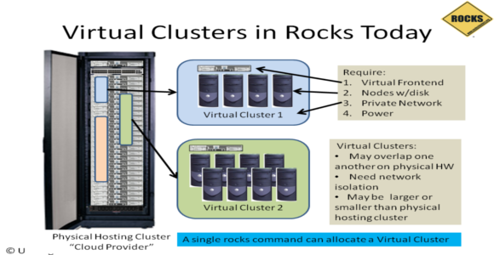
Rocks
Rocks Cluster Distribution http://www.rocksclusters.org/ http://en.wikipedia.org/wiki/Rocks_Cluster_Distribution is developed
at SDSC to automate deployment of real and virtual clusters.
Rocks was initially based on the Red Hat Linux distribution, however modern versions of Rocks were based on CentOS, with a modified Anaconda installer that simplifies mass installation onto many computers. Rocks includes many tools (such as MPI) which are not part of CentOS but are integral components that make a group of computers into a cluster.
Installations can be customized with additional software packages at install-time by using special user-supplied packages or Rolls.
The "Rolls" extend the system by integrating seamlessly and automatically into the management and packaging mechanisms used by base software, greatly simplifying installation and configuration of large numbers of computers. Over a dozen Rolls have been created, including the SGE roll, the Condor roll, the Lustre roll, the Java roll, and the Ganglia roll.

Slide 8
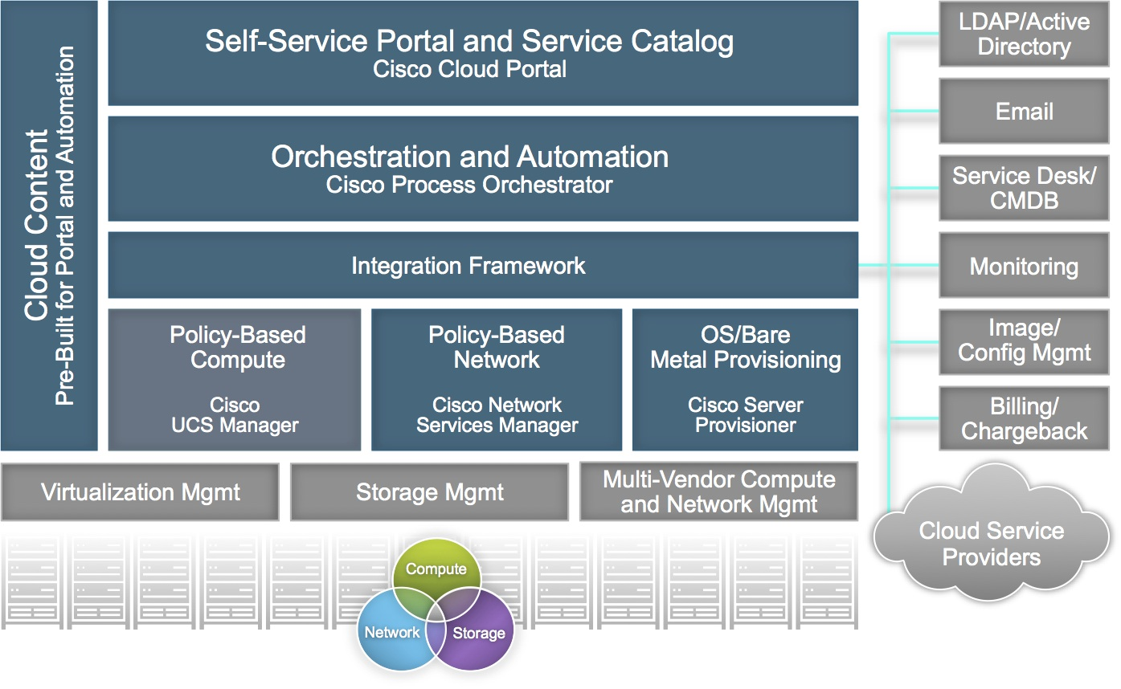
Cisco Intelligent Automation for Cloud I
http://blogs.cisco.com/datacenter/introducing-cisco-intelligent-automation-for-cloud-4-0
http://www.cisco.com/c/en/us/products/cloud-systems-management/intelligent-automation-cloud/index.html
Supports deployment on OpenStack, Amazon, vCloud, Bare-metal
Integrates Network as a Service

Slide 9
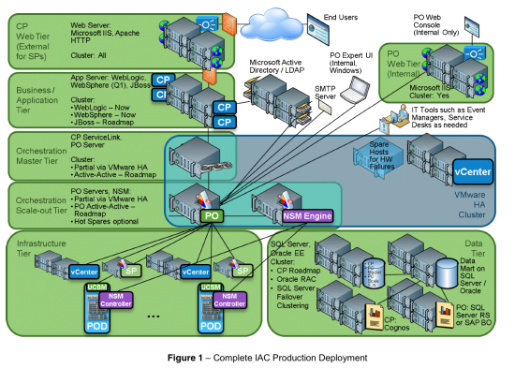
Cisco Intelligent Automation for Cloud II: Production Deployment

Slide 10
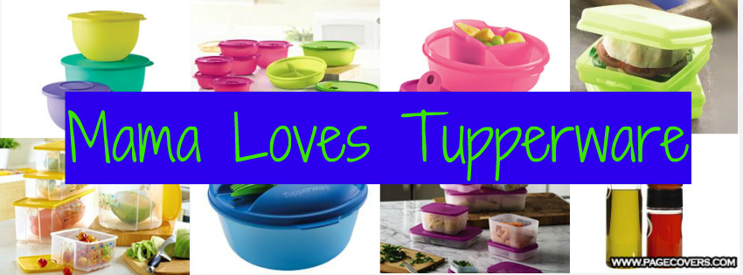
Facebook Tupperware
http://www.slideshare.net/Docker/aravindnarayanan-facebook140613153626phpapp02-37588997
Facebook uses containers not hypervisors to improve performance
Tupperware predates Docker

Slide 11
AWS OpsWorks I
http://aws.amazon.com/opsworks/
You define the stack's components by adding one or more layers.
A layer is basically a blueprint that specifies how to configure a
set of Amazon EC2 instances for a particular purpose, such as serving applications or hosting a database server. You assign each instance to at least one layer, which determines what packages are to be installed on the instance, how they are configured, whether the instance has an Elastic IP address or Amazon EBS volume, and so on.
AWS OpsWorks includes a set of built-in layers that support the following scenarios:
  Application server: Java App Server, Node.js App Server, PHP App Server, Rails App Server, Static Web Server
  Database server: Amazon RDS and MySQL
  Load balancer: Elastic Load Balancing, HAProxy
  Monitoring server: Ganglia
  In-memory key-value store: Memcached
If the built-in layers don't quite meet your requirements, you can customize or extend them by modifying packages' default configurations, adding custom Chef recipes to perform tasks such as installing additional packages, and more.
You can also customize layers to work with AWS services that are not natively supported, such as using Amazon RDS as a database server. If that's still not enough, you can create a fully custom layer, which gives you complete control over which packages are installed, how they are configured, how applications are deployed, and more.

Slide 12

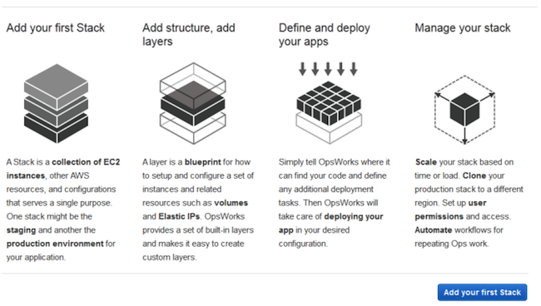
AWS
OpsWorks II

Slide 13
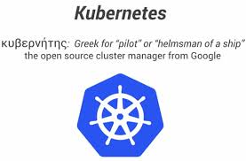
Google Kubernetes I
DevOps Cluster management for Docker
Kubernetes builds Google Container Engine, which is a hosted container management platform, that runs and manages Docker containers on Google Compute Engine virtual machines.
  Container-optimized Google Compute Engine images pre-install Debian, Docker, Kubernetes
Kubernetes is an open source container cluster manager. It schedules any number of container replicas across a group of node instances.
A master instance exposes the Kubernetes API, through which tasks are defined. Kubernetes spawns containers on nodes to handle the defined tasks.
The number and type of containers can be dynamically modified according to need. An agent (a kubelet) on each node instance monitors containers and restarts them if necessary.
Kubernetes is optimized for Google Cloud Platform,
but can run on any physical or virtual machine.

Slide 14
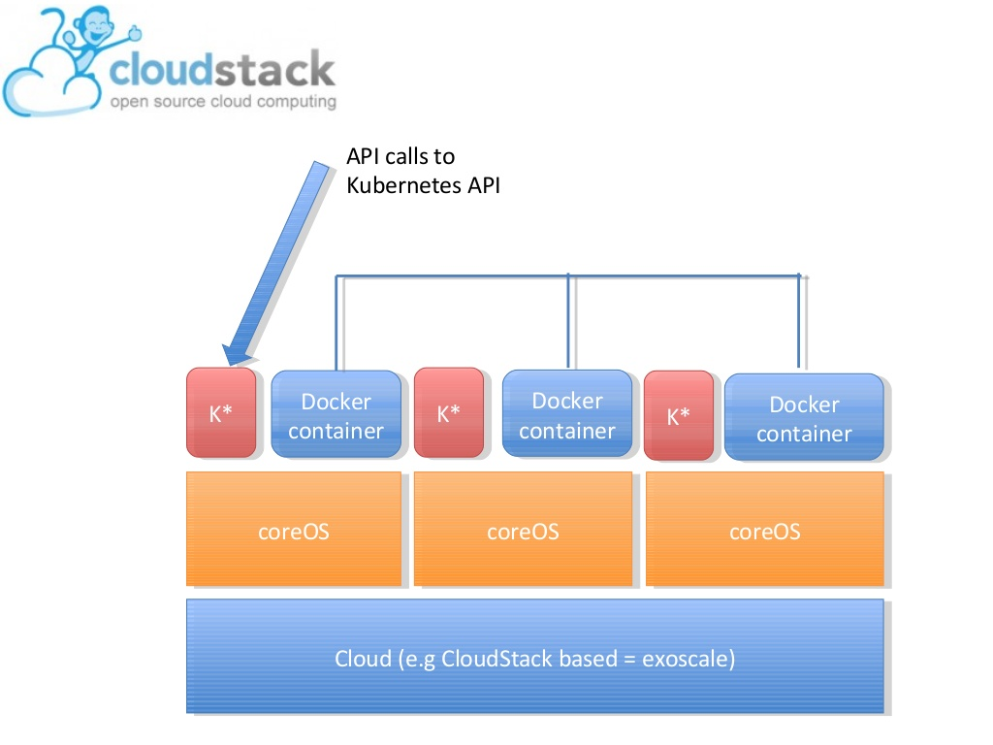
Google Kubernetes II
http://www.slideshare.net/sebastiengoasguen/kubernetes-on-cloudstack-with-coreos

Slide 15

Buildstep, Gitreceive
Used by Dokku (layer 15B) to support application hosting on Docker by understanding Heroku buildpacks and interfacing to Github
Buildstep uses Heroku's open source buildpacks and is responsible for building the base images that applications are built on. You can think of it as producing the "stack" for Dokku, to borrow a concept from Heroku.
Gitreceive is a project that provides you with a git user that you can push repositories to and so build systems with software in Github.

