Slide 1
Big Data Open Source Software and Projects HPC-ABDS in Summary VIII: Layer 8
Data Science Curriculum
March 5 2015
Geoffrey Fox
gcf@indiana.edu
http://www.infomall.org
School of Informatics and Computing
Digital Science Center
Indiana University Bloomington

Slide 2
Functionality of 21 HPC-ABDS Layers
Message Protocols:
Distributed Coordination:
Security & Privacy:
Monitoring:
IaaS Management from HPC to hypervisors:
DevOps:
Interoperability:
File systems:
Cluster Resource Management:
Data Transport:
A) File management B) NoSQL C) SQL
In-memory databases&caches / Object-relational mapping / Extraction Tools
Inter process communication Collectives, point-to-point, publish-subscribe, MPI:
A) Basic Programming model and runtime, SPMD, MapReduce: B) Streaming:
A) High level Programming: B) Application Hosting Frameworks
Application and Analytics:
Workflow-Orchestration:
Here are 21 functionalities. (including 11, 14, 15 subparts)
4 Cross cutting at top
17 in order of layered diagram starting at bottom

Slide 3
Hadoop HDFS
http://hadoop.apache.org/
Hadoop Distributed File System (HDFS) is a distributed file system intended for high-throughput access to large data sets on commodity hardware; modelled on Google File System GFS.
Data is stored in replicated fashion on same nodes that one uses for computing i.e. realizes goal of bringing computing to data
Key goals include:
fault tolerance
scalability
efficiency
reliability
With MapReduce, reduces the network I/O by moving processing tasks to the physical node where the data resides rather than moving data.
HDFS is a subproject of Apache Hadoop and is installed with Hadoop.

Slide 4
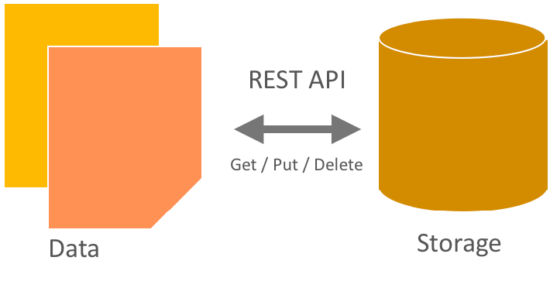
OpenStack Swift
http://docs.openstack.org/admin-guide-cloud/content/objectstorage_characteristics.html
This provides an Object Store similar to Amazon’s S3
The key characteristics of Swift are that:
All objects stored in Object Storage have a URL.
All objects stored are replicated 3✕ in as-unique-as-possible zones, which can be defined as a group of drives, a node, a rack, and so on.
All objects have their own metadata.
Developers interact with the object storage system through a RESTful HTTP API.
Object data can be located anywhere in the cluster.
The cluster scales by adding additional nodes without sacrificing performance, which allows a more cost-effective linear storage expansion than fork-lift upgrades.
Data doesn't have to be migrate to an entirely new storage system.
New nodes can be added to the cluster without downtime.
Failed nodes and disks can be swapped out without downtime.
It runs on industry-standard hardware, such as Dell, HP, and Supermicro.

Slide 5
Public Cloud Object Storage
Google Cloud Storage
https://cloud.google.com/products/cloud-storage/
is a fast, scalable and highly available object store.
Cloud storage can be used to store large amount of data that doesn’t require a schema. i.e images, video files
See http://aws.amazon.com/s3/ for Amazon equivalent and Azure Blob http://azure.microsoft.com/en-us/documentation/articles/storage-dotnet-how-to-use-blobs/#what-is for Azure equivalent

Slide 6
Facebook Haystack
Object Store for photos
Replaced NFS file system with one file per photo which had too much metadata
http://cse.unl.edu/~ylu/csce990/notes/HayStack_Facebook_ShakthiBachala.pptx
https://www.usenix.org/legacy/event/osdi10/tech/full_papers/Beaver.pdf
Facebook serves long tail so traditional cache and CDN (Content Delivery Network) did not perform well
Normal website had 99% CDN hit rate but Facebook has only around 80% CDN hit rate

Slide 7
f4: Facebook’s Warm BLOB Storage
https://www.youtube.com/watch?v=imlP3lxwGgQ
http://www.systemswemake.com/papers/fb-f4
Haystack was the primary storage system designed initially for Facebook’s Photos application. Its been around for almost 7 years by 2015.
Through this period it worked well through several optimizations such as reducing the number of disk seeks to read a BLOB to 1 almost always, fault tolerance through replication (replication factor of 3) across geographies and many more such optimizations.
While it has served well thus far, Facebook too has evolved during this period. As of Feb 2014 Haystack stored about 400 billion photos.
https://www.usenix.org/system/files/conference/osdi14/osdi14-paper-muralidhar.pdf
f4 described as a warm BLOB storage system because the request rate for its content is lower than that for content in hot store Haystack and thus is not as “hot.”
Warm is also in contrast with cold storage systems that reliably store data but may take days or hours to retrieve it, which is unacceptably long for user-facing requests.
f4 currently stores over 65PBs of logical BLOBs and reduces their effective-replication-factor from 3.6 to either 2.8 or 2.1. f4 provides low latency; is resilient to disk, host, rack, and datacenter failures; and provides sufficient throughput for warm BLOBs.
Note f4 only stores “warm” photos

Slide 8
OpenStack Cinder
https://wiki.openstack.org/wiki/Cinder
OpenStack (like commercial clouds) also offers conventional block storage as a file system accessed by Linux.
Cinder virtualizes pools of block storage devices and provides end users with a self service API http://developer.openstack.org/api-ref-blockstorage-v2.html to request and consume those resources without requiring any knowledge of where their storage is actually deployed or on what type of device.
This is similar to Amazon Elastic Block Storage EBS and Azure Files and Google Persistent Storage

Slide 9
Lustre
Lustre is a type of parallel distributed file system, generally used for large-scale cluster computing. The name Lustre is a portmanteau word derived from Linux and cluster. Lustre file system software http://en.wikipedia.org/wiki/Lustre_(file_system) is available under the GPL2 license and provides high performance file systems for computer clusters ranging in size from small workgroup clusters to large-scale, multi-site clusters.
Because Lustre file systems have high performance capabilities and open licensing, it is often used in supercomputers.
Lustre file systems are scalable and can be part of multiple computer clusters with tens of thousands of client nodes, tens of petabytes (PB) of storage on hundreds of servers, and more than a terabyte per second (TB/s) of aggregate I/O throughput.
This makes Lustre file systems a popular choice for businesses with large data centers, including those in industries such as meteorology, simulation, oil and gas, life science, rich media, and finance.
Lustre went through several host organizations with Oracle (from Sun), Whamcloud and Intel being the last three owners.

Slide 10
HDFS Data Parallel File System?
Block1
Replicate each block
File1
Block2
……
Breakup
BlockN
C
C
C
C
Data
Data
Data
Data
C
C
C
C
Data
Data
Data
Data
C
C
C
C
Data
Data
Data
Data
C
C
C
C
Data
Data
Data
Data
Block1
File1
Block2
……
Breakup
Replicate each block
BlockN
No archival storage and computing brought to data

Slide 11
Traditional File System like Lustre or Object Store?
S
Data
C
C
C
C
S
C
C
C
C
Archive
Data
S
C
C
C
C
Data
C
C
C
C
S
Data
Compute Cluster
Storage Nodes
Typically a shared file system (Lustre, NFS …) or object store (as in OpenStack Swift) used to support high performance computing
Big advantages in flexible computing on shared data but doesn’t “bring computing to data”
Object stores similar structure (separate data and compute) to this

Slide 12
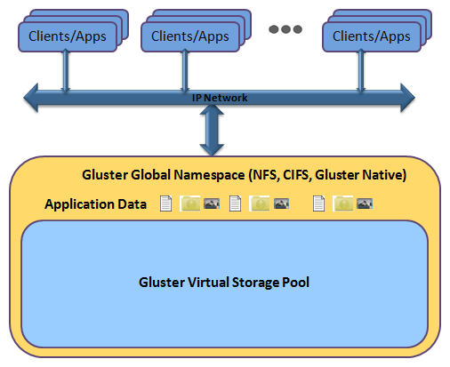
Gluster
http://www.gluster.org/ http://en.wikipedia.org/wiki/Gluster GlusterFS is an open source GPL, scalable distributed file system capable of scaling and handling thousands of clients. Red Hat currently owns company
Gluster name combined GNU and cluster.
GlusterFS clusters together storage building blocks over Infiniband RDMA or TCP/IP interconnect, aggregating disk and memory resources and managing data in a single global namespace.
For public cloud deployments, GlusterFS offers an Amazon Web Services (AWS) Amazon Machine Image (AMI), which is deployed on Elastic Compute Cloud (EC2) instances rather than physical servers and the underlying storage is Amazon’s Elastic Block Storage (EBS).
In this environment, capacity is scaled by deploying more EBS storage units, performance is scaled by deploying more EC2 instances, and availability is scaled by n-way replication between AWS availability zones

Slide 13
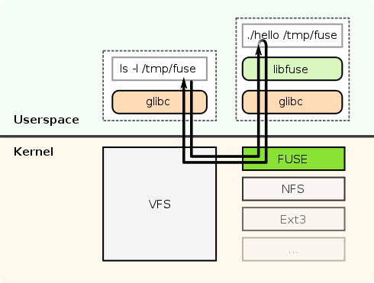
FUSE
Filesystem in Userspace (FUSE) http://fuse.sourceforge.net/ http://en.wikipedia.org/wiki/Filesystem_in_Userspace GPL/LGPL licensed is an operating system mechanism for Unix-like computer operating systems that lets non-privileged users create their own file systems without editing kernel code. This is achieved by running file system code in user space while the FUSE module provides only a "bridge" to the actual kernel interfaces.
The original, and commonly used implementation, is implemented as a loadable kernel module.
Used by GlusterFS
FUSE is particularly useful for writing virtual file systems.
Unlike traditional file systems that essentially save data to and retrieve data from disk, virtual filesystems do not actually store data themselves.
They act as a view or translation of an existing file system or storage device.

Slide 14
Ceph
Ceph http://en.wikipedia.org/wiki/Ceph_(software) http://ceph.com/ is a LGPL license software storage platform designed to present object, block, and file storage from a single distributed computer cluster.
Ceph is owned by Red Hat
Ceph's main goals are to be completely distributed without a single point of failure, scalable to the exabyte level, and freely-available. The data is replicated, making it fault tolerant
OBJECT STORAGE: Ceph provides seamless access to objects using native language bindings or radosgw, a REST interface that’s compatible with applications written for Amazon S3 and OpenStack Swift.
BLOCK STORAGE: Ceph’s RADOS Block Device (RBD) provides access to block device images that are striped and replicated across the entire storage cluster.
FILE SYSTEM: Ceph’s file system runs on top of the same object storage system that provides object storage and block device interfaces.
The Ceph metadata server cluster provides a service that maps the directories and file names of the file system to objects stored within RADOS clusters.
The metadata server cluster can expand or contract, and it can rebalance the file system dynamically to distribute data evenly among cluster hosts.
This ensures high performance and prevents heavy loads on specific hosts within the cluster.

Slide 15
IBM General Parallel File System GPFS
The proprietary General Parallel File System (GPFS) http://en.wikipedia.org/wiki/IBM_General_Parallel_File_System is a high-performance clustered file system developed by IBM. It can be deployed in shared-disk or shared-nothing distributed parallel modes.
GPFS-SNC where SNC stands for Shared Nothing Cluster was officially released with GPFS 3.5 in December 2012, and is now known as GPFS-FPO (File Placement Optimizer). This allows GPFS to use locally attached disks on a cluster of network connected servers rather than requiring dedicated servers with shared disks (e.g. using a SAN). GPFS-FPO can be used as a HDFS-compatible filesystem.
GPFS would typically be accessed by MPI-IO from compute cluster
Features of GPFS include
Distributed metadata, including the directory tree. There is no single "directory controller" or "index server" in charge of the filesystem.
Efficient indexing of directory entries for very large directories. Many filesystems are limited to a small number of files in a single directory (often, 65536 or a similar small binary number). GPFS does not have such limits.
Distributed locking. This allows for full Posix filesystem semantics, including locking for exclusive file access

Slide 16
GPFS v HDFS
It is interesting to compare GPFS with Hadoop's HDFS filesystem, which is designed to store similar or greater quantities of data on commodity hardware — that is, datacenters without RAID disks and a Storage Area Network (SAN).
HDFS also breaks files up into blocks, and stores them on different filesystem nodes.
HDFS does not expect reliable disks, so instead stores copies of the blocks on different nodes. The failure of a node containing a single copy of a block is a minor issue, dealt with by re-replicating another copy of the set of valid blocks, to bring the replication count back up to the desired number. In contrast, while GPFS supports recovery from a lost node, it is a more serious event, one that may include a higher risk of data being (temporarily) lost.
GPFS supports full Posix filesystem semantics. HDFS and GFS (Google File System) do not support full Posix compliance.
GPFS distributes its directory indices and other metadata across the filesystem. Hadoop, in contrast, keeps this on the Primary and Secondary Namenodes, large servers which must store all index information in-RAM.
GPFS breaks files up into small blocks. Hadoop HDFS likes blocks of 64 MB or more, as this reduces the storage requirements of the Namenode. Small blocks or many small files fill up a filesystem's indices fast, so limit the filesystem's size.

Slide 17
Global Federated File System GFFS
http://genesis2.virginia.edu/wiki/Main/GFFS XSEDE file system is part of Genesis II project at University of Virginia
The GFFS was born out of a need to access and manipulate remote resources such as file systems in a federated, secure, standardized, scalable, and transparent manner without requiring either data owners or applications developers and users to change how they store and access data in any way.
The GFFS accomplishes this by employing a global path-based namespace, e.g., /data/bio/file1.
Data in existing file systems, whether they are Windows file systems, MacOS file systems, AFS, Linux, or Lustre file systems can then be exported, or linked into the global namespace.
For example, a user could export a local rooted directory structure on their “C” drive, C:\work\collaboration-with-Bob, into the global namespace at /data/bio/project-Phil. Files and directories on the user’s “C” drive in \work\collaboration-with-bob would then, subject to access control, be accessible to users in the GFFS via the /data/bio/project-Bob path.

Slide 18
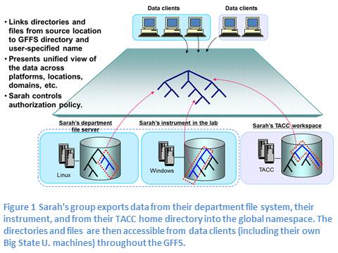
Global Federated File System GFFS

