Slide 1
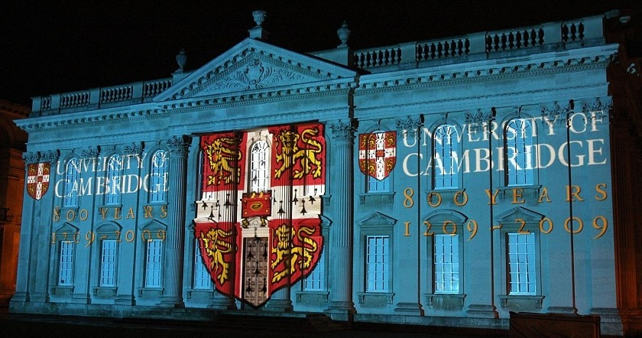
Big Data Overview for Twister2 Tutorial
Geoffrey Fox, January 10-11, 2019
gcf@indiana.edu, http://www.dsc.soic.indiana.edu/, http://spidal.org/
5th International Winter School on Big Data BigDat 2019
Cambridge, United Kingdom - January 7-11, 2019
Digital Science Center
Indiana University

Slide 2
Useful Links
Twister2 Tutorial https://twister2.gitbook.io/twister2/tutorial
BDEC2 https://www.exascale.org/bdec2

Slide 3
Underlying HPC Big Data Convergence Issues

Slide 4
Data and Model in Big Data and Simulations I
Need to discuss Data and Model as problems have both intermingled, but we can get insight by separating which allows better understanding of Big Data - Big Simulation “convergence” (or differences!)
The Model is a user construction and it has a “concept”, parameters and gives results determined by the computation. We use term “model” in a general fashion to cover all of these.
Big Data problems can be broken up into Data and Model
  For clustering, the model parameters are cluster centers while the data is set of points to be clustered
  For queries, the model is structure of database and results of this query while the data is whole database queried and SQL query
  For deep learning with ImageNet, the model is chosen network with model parameters as the network link weights. The data is set of images used for training or classification

Slide 5
Data and Model in Big Data and Simulations II
Simulations can also be considered as Data plus Model
  Model can be formulation with particle dynamics or partial differential equations defined by parameters such as particle positions and discretized velocity, pressure, density values
  Data could be small when just boundary conditions
  Data large with data assimilation (weather forecasting) or when data visualizations are produced by simulation
Big Data implies Data is large but Model varies in size
  e.g. LDA (Latent Dirichlet Allocation) with many topics or deep learning has a large model
  Clustering or Dimension reduction can be quite small in model size
Data often static between iterations (unless streaming); Model parameters vary between iterations
Data and Model Parameters are often confused in papers as term data used to describe the parameters of models.
Models in Big Data and Simulations have many similarities and allow convergence

Slide 6
HPC and/or Cloud 1.0 2.0 3.0
Cloud 1.0: IaaS PaaS
Cloud 2.0: DevOps
Cloud 3.0: Amin Vahdat from Google; Insight (Solution) as a Service from IBM; serverless computing
HPC 1.0 and Cloud 1.0 separate ecosystems
HPCCloud or HPC-ABDS: Take performance of HPC and functionality of Cloud (Big Data) systems
HPCCloud 2.0 Use DevOps to invoke HPC or Cloud software on VM, Docker, HPC infrastructure
HPCCloud 3.0 Automate Solution (Wisdom) as a Service using HPC-ABDS on “correct” infrastructure

Slide 7
Why Connect (“Converge”) Big Data and HPC
Two major trends in computing systems are
  Growth in high performance computing (HPC) with an international exascale initiative (China in the lead)
  Big data phenomenon with an accompanying cloud infrastructure of well publicized dramatic and increasing size and sophistication.
Note “Big Data” largely an industry initiative although software used is often open source
  So HPC labels overlaps with “research” e.g. HPC community largely responsible for Astronomy and Accelerator (LHC, Belle, BEPC ..) data analysis
Merge HPC and Big Data to get
  More efficient sharing of large scale resources running simulations and data analytics as HPCCloud 3.0
  Higher performance Big Data algorithms
  Richer software environment for research community building on many big data tools
  Easier sustainability model for HPC – HPC does not have resources to build and maintain a full software stack

Slide 8
Local and Global Machine Learning
Many applications use LML or Local machine Learning where machine learning (often from R or Python or Matlab) is run separately on every data item such as on every image
But others are GML Global Machine Learning where machine learning is a basic algorithm run over all data items (over all nodes in computer)
  maximum likelihood or χ² with a sum over the N data items – documents, sequences, items to be sold, images etc. and often links (point-pairs).
  GML includes Graph analytics, clustering/community detection, mixture models, topic determination, Multidimensional scaling, (Deep) Learning Networks
Note Facebook may need lots of small graphs (one per person and ~LML) rather than one giant graph of connected people (GML)

Slide 9
Convergence/Divergence Points for HPC-Cloud-Edge- Big Data-Simulation
Applications – Divide use cases into Data and Model and compare characteristics separately in these two components with 64 Convergence Diamonds (features).
  Identify importance of streaming data, pleasingly parallel, global/local machine-learning
Software – Single model of High Performance Computing (HPC) Enhanced Big Data Stack HPC-ABDS. 21 Layers adding high performance runtime to Apache systems HPC-FaaS Programming Model
  Serverless Infrastructure as a Service IaaS
Hardware system designed for functionality and performance of application type e.g. disks, interconnect, memory, CPU acceleration different for machine learning, pleasingly parallel, data management, streaming, simulations
  Use DevOps to automate deployment of event-driven software defined systems on hardware: HPCCloud 2.0
Total System Solutions (wisdom) as a Service: HPCCloud 3.0
Uses DevOps not discussed in this talk

Slide 10





NSF 1443054: CIF21 DIBBs: Middleware and High Performance Analytics Libraries for Scalable Data Science
Ogres Application Analysis
HPC-ABDS and HPC-FaaS Software
Harp and Twister2 Building Blocks
SPIDAL Data Analytics Library
Software: MIDAS
HPC-ABDS

Slide 11
Application Nexus of HPC, Big Data, Simulation Convergence
Use-case Data and Model
NIST Collection
Big Data Ogres
Convergence Diamonds
https://bigdatawg.nist.gov/

Slide 12

Original Use Case Template
26 fields completed for 51 areas
Government Operation: 4
Commercial: 8
Defense: 3
Healthcare and Life Sciences: 10
Deep Learning and Social Media: 6
The Ecosystem for Research: 4
Astronomy and Physics: 5
Earth, Environmental and Polar Science: 10
Energy: 1

Slide 13
51 Detailed Use Cases: Contributed July-September 2013
Covers goals, data features such as 3 V’s, software, hardware
Government Operation(4): National Archives and Records Administration, Census Bureau
Commercial(8): Finance in Cloud, Cloud Backup, Mendeley (Citations), Netflix, Web Search, Digital Materials, Cargo shipping (as in UPS)
Defense(3): Sensors, Image surveillance, Situation Assessment
Healthcare and Life Sciences(10): Medical records, Graph and Probabilistic analysis, Pathology, Bioimaging, Genomics, Epidemiology, People Activity models, Biodiversity
Deep Learning and Social Media(6): Driving Car, Geolocate images/cameras, Twitter, Crowd Sourcing, Network Science, NIST benchmark datasets
The Ecosystem for Research(4): Metadata, Collaboration, Language Translation, Light source experiments
Astronomy and Physics(5): Sky Surveys including comparison to simulation, Large Hadron Collider at CERN, Belle Accelerator II in Japan
Earth, Environmental and Polar Science(10): Radar Scattering in Atmosphere, Earthquake, Ocean, Earth Observation, Ice sheet Radar scattering, Earth radar mapping, Climate simulation datasets, Atmospheric turbulence identification, Subsurface Biogeochemistry (microbes to watersheds), AmeriFlux and FLUXNET gas sensors
Energy(1): Smart grid
Published by NIST as version 2 https://bigdatawg.nist.gov/_uploadfiles/NIST.SP.1500-3r1.pdf with common set of 26 features recorded for each use-case
26 Features for each use case Biased to science

Slide 14
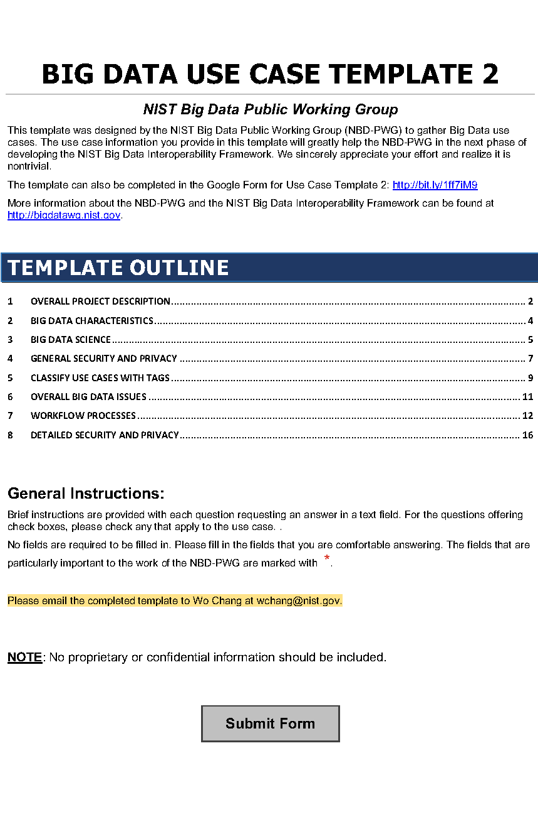
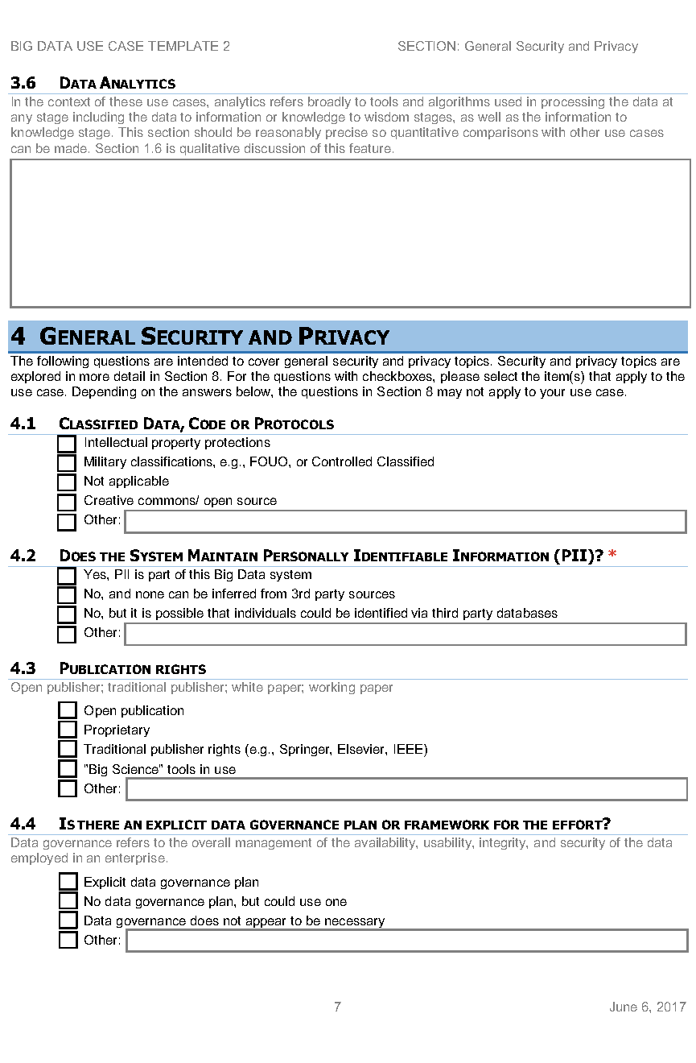
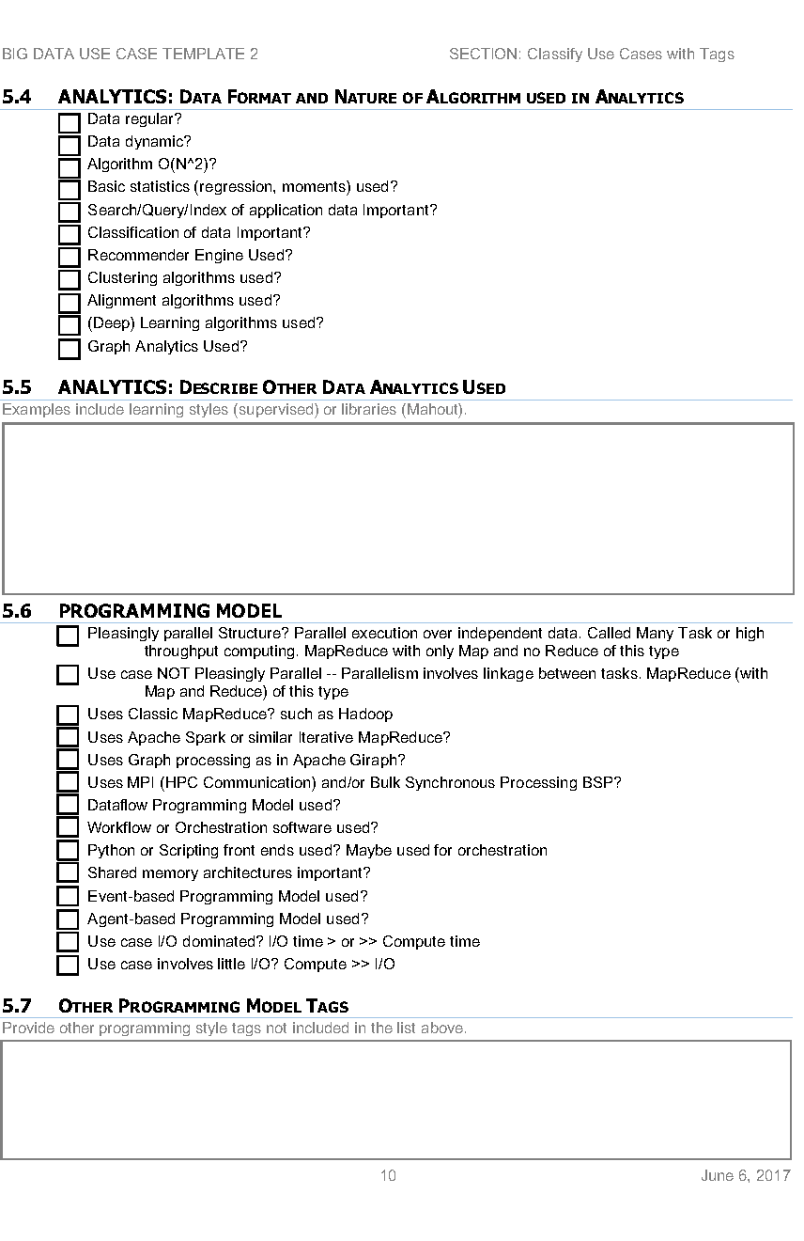
https://bigdatawg.nist.gov/_uploadfiles/M0621_v2_7345181325.pdf http://hpc-abds.org/kaleidoscope/survey/
Version 2 of Survey with Security and Tags

Slide 15

Part of Property Summary Table

Slide 16
51 Use Cases: What is Parallelism Over?
People: either the users (but see below) or subjects of application and often both
Decision makers like researchers or doctors (users of application)
Items such as Images, EMR, Sequences below; observations or contents of online store
  Images or “Electronic Information nuggets”
  EMR: Electronic Medical Records (often similar to people parallelism)
  Protein or Gene Sequences;
  Material properties, Manufactured Object specifications, etc., in custom dataset
  Modelled entities like vehicles and people
Sensors – Internet of Things
Events such as detected anomalies in telescope or credit card data or atmosphere
(Complex) Nodes in RDF Graph
Simple nodes as in a learning network
Tweets, Blogs, Documents, Web Pages, etc.
  And characters/words in them
Files or data to be backed up, moved or assigned metadata
Particles/cells/mesh points as in parallel simulations

Slide 17
Sample Features of 51 Use Cases I
PP (26) “All” Pleasingly Parallel or Map Only
MR (18) Classic MapReduce MR (add MRStat below for full count)
MRStat (7) Simple version of MR where key computations are simple reduction as found in statistical averages such as histograms and averages
MRIter (23) Iterative MapReduce or MPI (Flink, Spark, Twister)
Graph (9) Complex graph data structure needed in analysis
Fusion (11) Integrate diverse data to aid discovery/decision making; could involve sophisticated algorithms or could just be a portal
Streaming (41) Some data comes in incrementally and is processed this way
Classify (30) Classification: divide data into categories
S/Q (12) Index, Search and Query

Slide 18
Sample Features of 51 Use Cases II
CF (4) Collaborative Filtering for recommender engines
LML (36) Local Machine Learning (Independent for each parallel entity) – application could have GML as well
GML (23) Global Machine Learning: Deep Learning, Clustering, LDA, PLSI, MDS,
  Large Scale Optimizations as in Variational Bayes, MCMC, Lifted Belief Propagation, Stochastic Gradient Descent, L-BFGS, Levenberg-Marquardt . Can call EGO or Exascale Global Optimization with scalable parallel algorithm
Workflow (51) Universal
GIS (16) Geotagged data and often displayed in ESRI, Microsoft Virtual Earth, Google Earth, GeoServer etc.
HPC (5) Classic large-scale simulation of cosmos, materials, etc. generating (visualization) data
Agent (2) Simulations of models of data-defined macroscopic entities represented as agents

Slide 19
BDEC2 and NIST Use Cases
https://docs.google.com/document/d/1YBkdKP4TOXprNy9YOPAsfsFZey5r5jb71P7eQdfHgD8/edit?usp=sharing
https://docs.google.com/document/d/1iLijV2L0iqSlb4EI1XqrgvJu_9oGIjuUadcBl7H0rR0/edit?usp=sharing

Slide 20
53 NIST Use Cases for Research Space I
GOVERNMENT OPERATION
  1: Census 2010 and 2000—Title 13 Big Data
  2: NARA Accession, Search, Retrieve, Preservation
  3: Statistical Survey Response Improvement
  4: Non-Traditional Data in Statistical Survey Response Improvement (Adaptive Design)
  1-4 are related to social science survey problems and are “Classic Data+ML” with interesting algorithms (recommender engines) plus databases and important privacy issues which are present in research cases
COMMERCIAL
  5: Cloud Eco-System for Financial Industries NO
  6: Mendeley—An International Network of Research
  7: Netflix Movie Service NO
  8: Web Search NO
  9: Big Data Business Continuity and Disaster Recovery Within a Cloud Eco-System NO
  10: Cargo Shipping Edge Computing NO
  11: Materials Data for Manufacturing
  12: Simulation-Driven Materials Genomics
  6 is “Classic Data+ML” with Text Analysis (citation identification, topic models etc.)
  10 is DHL/Fedex/UPS and has no direct scientific analog. However, it is a good example of Edge computing system of a similar nature to the scientific research case.
  11 and 12 are material science covered in BDEC2 meeting

Slide 21
53 NIST Use Cases for Research Space II
DEFENSE
  13: Cloud Large-Scale Geospatial Analysis and Visualization
  14: Object Identification and Tracking from Wide-Area Large Format Imagery or Full Motion Video—Persistent Surveillance
  15: Intelligence Data Processing and Analysis
  13-15 are very similar to disaster response problems. They involve extensive “Classic Data+ML” for sensor collections and/or image processing. GIS and spatial analysis are important as in BDEC2 Pathology and Spatial Imagery talk. The geospatial aspect of applications means they are similar to earth science examples.
Color coding of use cases
NO means not similar to research application
Red means not relevant to BDEC2
Orange means related to BDEC2 Bloomington presentations
Black are unique use cases of relevance to BDEC2 but not presented at Bloomington
Purple are comments

Slide 22
Use Cases III: HEALTH CARE AND LIFE SCIENCES
16: Electronic Medical Record
17: Pathology Imaging/Digital Pathology
18: Computational Bioimaging
19: Genomic Measurements
20: Comparative Analysis for Metagenomes and Genome
21: Individualized Diabetes Management
22: Statistical Relational Artificial Intelligence for Health Care
23: World Population-Scale Epidemiological Study
24: Social Contagion Modeling for Planning, Public Health, and Disaster Management
25: Biodiversity and LifeWatch

Slide 23
Comments on Use Cases III
16 and 22 are “classic data + ML + database” based use cases using an important technique, understood by the community but not presented at BDEC2
17 came originally from Saltz’s group and was updated in his BDEC2 talk
18 describes biology image processing from many instruments microscopes, MRI and light sources. The latter was directly discussed at BDEC2 and the other instruments were implicit.
19 and 20 are well recognized as a distributed Big Data problems with significant computing. They were represented by Chandrasekaran’s presentation at BDEC2 which inevitably only covered part (gene assembly) of problem.
21 relies on “classic data + graph analytics” which was not discussed in BDEC2 meeting but is certainly actively pursued.
23 and 24 originally came from Marathe and were updated in his BDEC2 presentation on massive bio-social systems
25 generalizes BDEC2 talks by Taufer and Rahnemoonfar on ocean and land monitoring and sensor array analysis.

Slide 24
Use Cases IV: DEEP LEARNING AND SOCIAL MEDIA
26: Large-Scale Deep Learning
27: Organizing Large-Scale, Unstructured Collections of Consumer Photos NO
28: Truthy—Information Diffusion Research from Twitter Data
29: Crowd Sourcing in the Humanities as Source for Big and Dynamic Data
30: CINET—Cyberinfrastructure for Network (Graph) Science and Analytics
31: NIST Information Access Division—Analytic Technology Performance Measurements, Evaluations, and Standards
26 on deep learning was covered in great depth at the BDEC2 meeting
27 describes an interesting image processing challenge of geolocating multiple photographs which is not so far directly related to scientific data analysis although related image processing algorithms are certainly important
28-30 are “classic data + ML” use cases with a focus on graph and text mining algorithms not covered in BDEC2 but certainly relevant to the process
31 on benchmarking and standard datasets is related to BigDataBench talk at end of BDEC2 meeting and Fosters talk on a model database

Slide 25
53 NIST Use Cases for Research Space VI
THE ECOSYSTEM FOR RESEARCH
32: DataNet Federation Consortium
33: The Discinnet Process NO
34: Semantic Graph Search on Scientific Chemical and Text-Based Data
35: Light Source Beamlines
32 covers data management with iRODS which is well regarded by the community but not discussed in BDEC2.
33 is a Teamwork approach that doesn’t seem relevant to BDEC2
34 is a “classic data+ML” use case with a similar comments to 28-30
35 was covered with more advanced deep learning algorithms in Yager and Foster’s BDEC2 talks
ASTRONOMY AND PHYSICS
36: Catalina Real-Time Transient Survey: A Digital, Panoramic, Synoptic Sky Survey
37: DOE Extreme Data from Cosmological Sky Survey and Simulations
38: Large Survey Data for Cosmology
39: Particle Physics—Analysis of Large Hadron Collider Data: Discovery of Higgs Particle
40: Belle II High Energy Physics Experiment
36 to 38 are “Classic Data+ML” astronomy use cases related to BDEC2 SKA presentation and covering both archival and event detection cases. Use case 37 covers the integration of simulation data and observational data FOR ASTRONOMY; A TOPIC COVERED IN OTHER CASES AT BDEC2.
39 and 40 are “Classic Data+ML” use cases for accelerator data analysis. This was not covered in BDEC2 but is currently the largest volume scientific data analysis problem whose importance and relevance is well understood.

Slide 26
Use Cases VII: EARTH, ENVIRONMENTAL, AND POLAR SCIENCE
41: European Incoherent Scatter Scientific Association 3D Incoherent Scatter Radar System Big Radar instrument monitoring atmosphere.
42: Common Operations of Environmental Research Infrastructure
43: Radar Data Analysis for the Center for Remote Sensing of Ice Sheets
44: Unmanned Air Vehicle Synthetic Aperture Radar (UAVSAR) Data Processing, Data Product Delivery, and Data Services
45: NASA Langley Research Center/ Goddard Space Flight Center iRODS Federation Test Bed
46: MERRA Analytic Services (MERRA/AS) Instrument
47: Atmospheric Turbulence – Event Discovery and Predictive Analytics Imaging
48: Climate Studies Using the Community Earth System Model at the U.S. Department of Energy (DOE) NERSC Center
49: DOE Biological and Environmental Research (BER) Subsurface Biogeochemistry Scientific Focus Area
50: DOE BER AmeriFlux and FLUXNET Networks Sensor Networks
2-1: NASA Earth Observing System Data and Information System (EOSDIS) Instrument
2-2: Web-Enabled Landsat Data (WELD) Processing Instrument

Slide 27
Comments on Use Cases VII
41 43 44 are “Classic Data+ML” use cases involving radar data from different instruments-- specialized ground, vehicle/plane, satellite - not directly covered in BDEC2
2-1 and 2-2 are use cases similar to 41 43 and 44 but applied to EOSDIS and LANDSAT earth observations from satellites in multiple modalities.
42 49 and 50 are “Classic Data+ML” environmental sensor arrays that extend the scope of talks of Taufer and Rahnemoonfar at BDEC2. See also use case 25 above
45 to 47 describe datasets from instruments and computations relevant to climate and weather. It relates to BDEC2 talk by Denvil and Miyoshi. 47 discusses the correlation of aircraft turbulent reports with simulation datasets
48 is data analytics and management associated with climate studies as covered in BDEC2 talk by Denvil

Slide 28
Use Cases VIII: ENERGY
51: Consumption Forecasting in Smart Grids
51 is a different subproblem but in the same area as Pothen and Azad’s talk on the electric power grid at BDEC2. This is a challenging edge computing problem as a large number of distributed but correlated sensors
SC-18 BOF Application/Industry Perspective by David Keyes, King Abdullah University of Science and Technology (KAUST)
https://www.exascale.org/bdec/sites/www.exascale.org.bdec/files/SC18_BDEC2_BoF-Keyes.pdf
This is a presentation by David Keyes on seismic imaging for oil discovery and exploitation. It is “Classic Data+ML” for an array of sonic sensors

Slide 29
BDEC2 Use Cases I: Classic Observational Data plus ML
BDEC2-1: M. Deegan, Big Data and Extreme Scale Computing, 2nd Series (BDEC2) - Statement of Interest from the Square Kilometre Array Organisation (SKAO)
Environmental Science
BDEC2-2: M. Rahnemoonfar, Semantic Segmentation of Underwater Sonar Imagery based on Deep Learning
BDEC2-3: M. Taufer, Cyberinfrastructure Tools for Precision Agriculture in the 21st Century
Healthcare and Life sciences
BDEC2-4: J. Saltz, Multiscale Spatial Data and Deep Learning
BDEC2-5: R. Stevens, Exascale Deep Learning for Cancer
BDEC2-6: S. Chandrasekaran, Development of a parallel algorithm for whole genome alignment for rapid delivery of personalized genomics
BDEC2-7: M. Marathe, Pervasive, Personalized and Precision (P3) analytics for massive bio-social systems
Instruments include Satellites, UAV’s, Sensors (see edge examples), Light sources (X-ray MRI Microscope etc.), Telescopes, Accelerators, Tokomaks (Fusion), Computers (as in Control, Simulation, Data, ML Integration)

Slide 30
BDEC2 Use Cases II: Control, Simulation, Data, ML Integration
BDEC2-8: W. Tang, New Models for Integrated Inquiry: Fusion Energy Exemplar
BDEC2-9: O. Beckstein, Convergence of data generation and analysis in the biomolecular
simulation community
BDEC2-10: S. Denvil, From the production to the analysis phase: new approaches needed in climate modeling
BDEC2-11: T. Miyoshi, Prediction Science: The 5th Paradigm Fusing the Computational Science and Data Science (weather forecasting)
See also Marathe and Stevens talks
See also instruments under Classic Observational Data plus ML
Material Science
BDEC2-12: K. Yager, Autonomous Experimentation as a Paradigm for Materials Discovery
BDEC2-13: L. Ward, Deep Learning, HPC, and Data for Materials Design
BDEC2-14: J. Ahrens, A vision for a validated distributed knowledge base of material behavior at extreme conditions using the Advanced Cyberinfrastructure Platform
BDEC2-15: T. Deutsch, Digital transition of Material Nano-Characterization.

Slide 31
Comments on Control, Simulation, Data, ML Integration
Simulations often involve outside Data but always inside Data (from simulation itself). Fields covered include Materials (nano), Climate, Weather, Biomolecular, Virtual tissues (no use case written up)
We can see ML wrapping simulations to achieve many goals. ML replaces functions and/or ML guides functions
  Initial Conditions
  Boundary Conditions
  Data assimilation
  Configuration -- blocking, use of cache etc.
  Steering and Control
  Support multi-scale
  ML learns from previous simulations and so can predict function calls
Digital Twins are a commercial link between simulation and systems
There are fundamental simulations covered by laws of physics and growingly Complex System simulations with Bio (tissue) or social entities.

Slide 32
BDEC2 Use Cases III: Edge Computing
Smart City and Related Edge Applications
BDEC2-16: P. Beckman, Edge to HPC Cloud
BDEC2-17: G. Ricart, Smart Community CyberInfrastructure at the Speed of Life
BDEC2-18: T. El-Ghazawi, Convergence of AI, Big Data, Computing and IOT (ABCI)- Smart City as an Application Driver and Virtual Intelligence Management (VIM)
BDEC2-19: M. Kondo, The Challenges and opportunities of BDEC systems for Smart Cities
Other Edge Applications
BDEC2-20: A Pothen, High-End Data Science and HPC for the Electrical Power Grid
BDEC2-21: J. Qiu, Real-Time Anomaly Detection from Edge to HPC-Cloud
There are correlated edge devices such as power grid and nearby vehicles (racing, road). Also largely independent edge devices interacting via databases such as surveillance cameras

Slide 33
BDEC Use Cases IV
BDEC Ecosystem
BDEC2-22: I Foster, Learning Systems for Deep Science
BDEC2-23: W. Gao, BigDataBench: A Scalable and Unified Big Data and AI Benchmark Suite
Image-based Applications
One cross-cutting theme is understanding Generalized (light, sound, other sensors such as temperature, chemistry, moisture) Images with 2D, 3D spatial and time dependence
Modalities include Radar, MRI, Microscopes, Surveillance and other cameras, X-ray scattering, UAV hosted, and related non-optical sensor networks as in agriculture, wildfires, disaster monitoring and Oil exploration. GIS and geospatial properties are often relevant

Slide 34
3 Broad classes of Science Applications to drive “Next Generation Scientific Computing Platform”
B-1: Heterogeneous Distributed Edge to Cloud: Power Grid or Smart City (US-Ignite)
B-2: MLforHPC biomolecular, fusion, materials, epidemics, coarse-graining in multiscale problems
B-3: Bio and Light source and Astronomy Imaging including multi-source data/simulations

Slide 35
NIST Generic Data Processing Use Cases

Slide 36
10 Generic Data Processing Use Cases
Multiple users performing interactive queries and updates on a database with basic availability and eventual consistency (BASE = (Basically Available, Soft state, Eventual consistency) as opposed to ACID = (Atomicity, Consistency, Isolation, Durability) )
Perform real time analytics on data source streams and notify users when specified events occur
Move data from external data sources into a highly horizontally scalable data store, transform it using highly horizontally scalable processing (e.g. Map-Reduce), and return it to the horizontally scalable data store (ELT Extract Load Transform)
Perform batch analytics on the data in a highly horizontally scalable data store using highly horizontally scalable processing (e.g MapReduce) with a user-friendly interface (e.g. SQL like)
Perform interactive analytics on data in analytics-optimized database with 5A) Science
Visualize data extracted from horizontally scalable Big Data store
Move data from a highly horizontally scalable data store into a traditional Enterprise Data Warehouse (EDW)
Extract, process, and move data from data stores to archives
Combine data from Cloud databases and on premise data stores for analytics, data mining, and/or machine learning
Orchestrate multiple sequential and parallel data transformations and/or analytic processing using a workflow manager

Slide 37

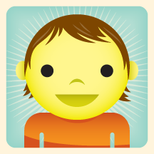

1. Multiple users performing interactive queries and updates on a database with basic availability and eventual consistency
First of ten access patterns from NIST Public Big Data Working Group. We will show more of these (but not all of them)
These tell you what we need to learn!
Analytics/Query
Programming
Data Store
Orchestration
Generate a SQL Query
Process SQL Query (RDBMS Engine, Hive, Hadoop, Drill)
Data Storage: RDBMS, HDFS, Hbase
Includes access to traditional ACID database
Data, Streaming, Batch …..

Slide 38
2. Perform real time analytics on data source streams and notify users when specified events occur
Specify filter
Filter Identifying Events
Fetch streamed Data
Post Selected Events
Streaming Data
Posted Data
Identified Events
Streaming Data
Streaming Data
Archive
Repository
Storm, Kafka, Hbase, Zookeeper

Slide 39
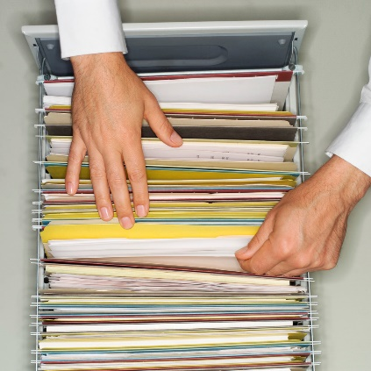
3. Move data from external data sources into a highly horizontally scalable data store, transform it using highly horizontally scalable processing (e.g. Map-Reduce), and return it to the horizontally scalable data store (ELT)
http://www.dzone.com/articles/hadoop-t-etl
Transform with Hadoop, Spark, Giraph …
Enterprise
Data
Warehouse
Data Storage: HDFS, Hbase
OLTP Database
Streaming Data
Web Services
ELT is Extract Load Transform

Slide 40
4. Perform batch analytics on the data in a highly horizontally scalable data store using highly horizontally scalable processing (e.g. MapReduce) with a user-friendly interface (e.g. SQL like)
SQL Query General Analytics
HCatalog
Hive
Mahout, R
Hadoop, Spark, Giraph, Pig …
Data Storage: HDFS, Hbase
Data, Streaming, Batch …..

Slide 41
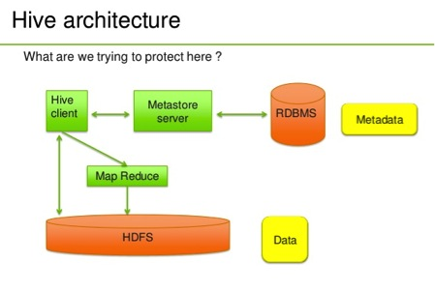
Hive Example
http://venublog.com/2013/07/16/hadoop-summit-2013-hive-authorization/

Slide 42
Access Pattern 5A. Perform interactive analytics on observational scientific data
Science Analysis Code, Mahout, R
Science Analysis Code, Mahout, R
Science Analysis Code, Mahout, R
Science Analysis Code, Mahout, R
Grid or Many Task Software, Hadoop, Spark, Giraph, Pig …
Grid or Many Task Software, Hadoop, Spark, Giraph, Pig …
Grid or Many Task Software, Hadoop, Spark, Giraph, Pig …
Grid or Many Task Software, Hadoop, Spark, Giraph, Pig …
Data Storage: HDFS, Hbase, File Collection
Data Storage: HDFS, Hbase, File Collection
Data Storage: HDFS, Hbase, File Collection
Data Storage: HDFS, Hbase, File Collection
Direct Transfer
Transport batch of data to primary analysis data system
Streaming Twitter data for Social Networking
Streaming Twitter data for Social Networking
Streaming Twitter data for Social Networking
Streaming Twitter data for Social Networking
Local Accumulate and initial computing
Local Accumulate and initial computing
Local Accumulate and initial computing
Local Accumulate and initial computing
Examples include LHC, Remote Sensing, Astronomy and Bioinformatics
Record Scientific Data in “field”
Record Scientific Data in “field”
Record Scientific Data in “field”
Record Scientific Data in “field”

Slide 43
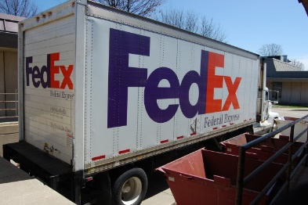
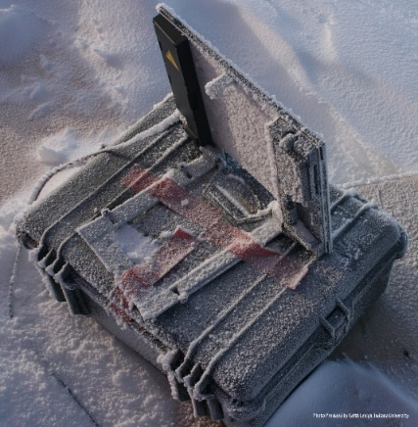
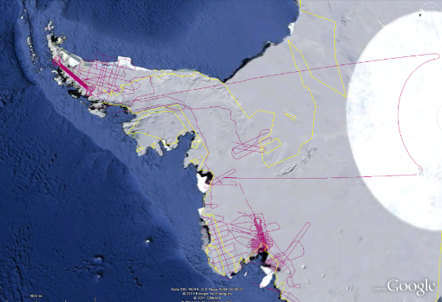

Polar Grid
Lightweight Cyberinfrastructure to support mobile Data gathering expeditions plus classic central resources (as a cloud)
BATCH MODE

Slide 44
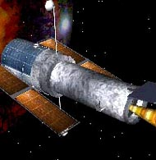
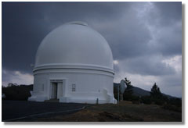
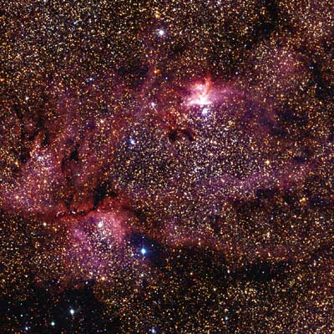
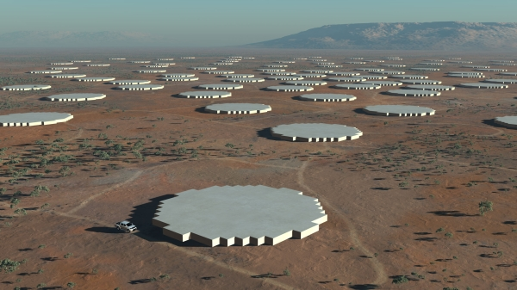
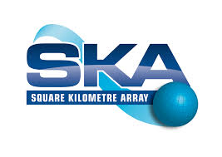
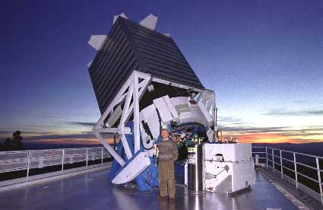
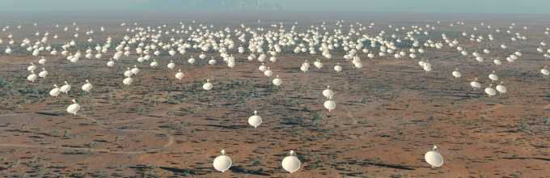
Tracking the Heavens
“The Universe is now being explored systematically, in a panchromatic way, over a range of spatial and temporal scales that lead to a more complete, and less biased understanding of its constituents, their evolution, their origins, and the physical processes governing them.”
Towards a National Virtual Observatory
Hubble Telescope
Palomar Telescope
Sloan Telescope
DISTRIBUTED LARGE INSTRUMENT MODE

Slide 45
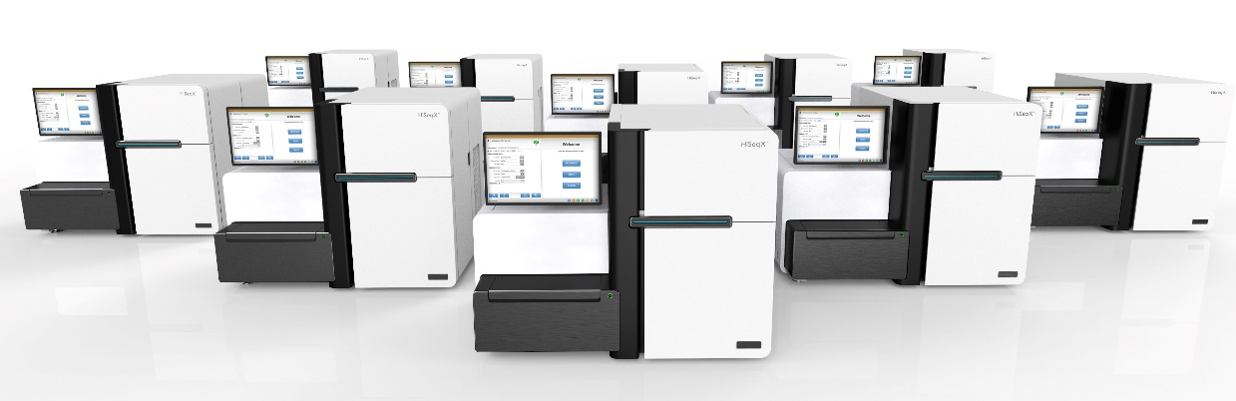
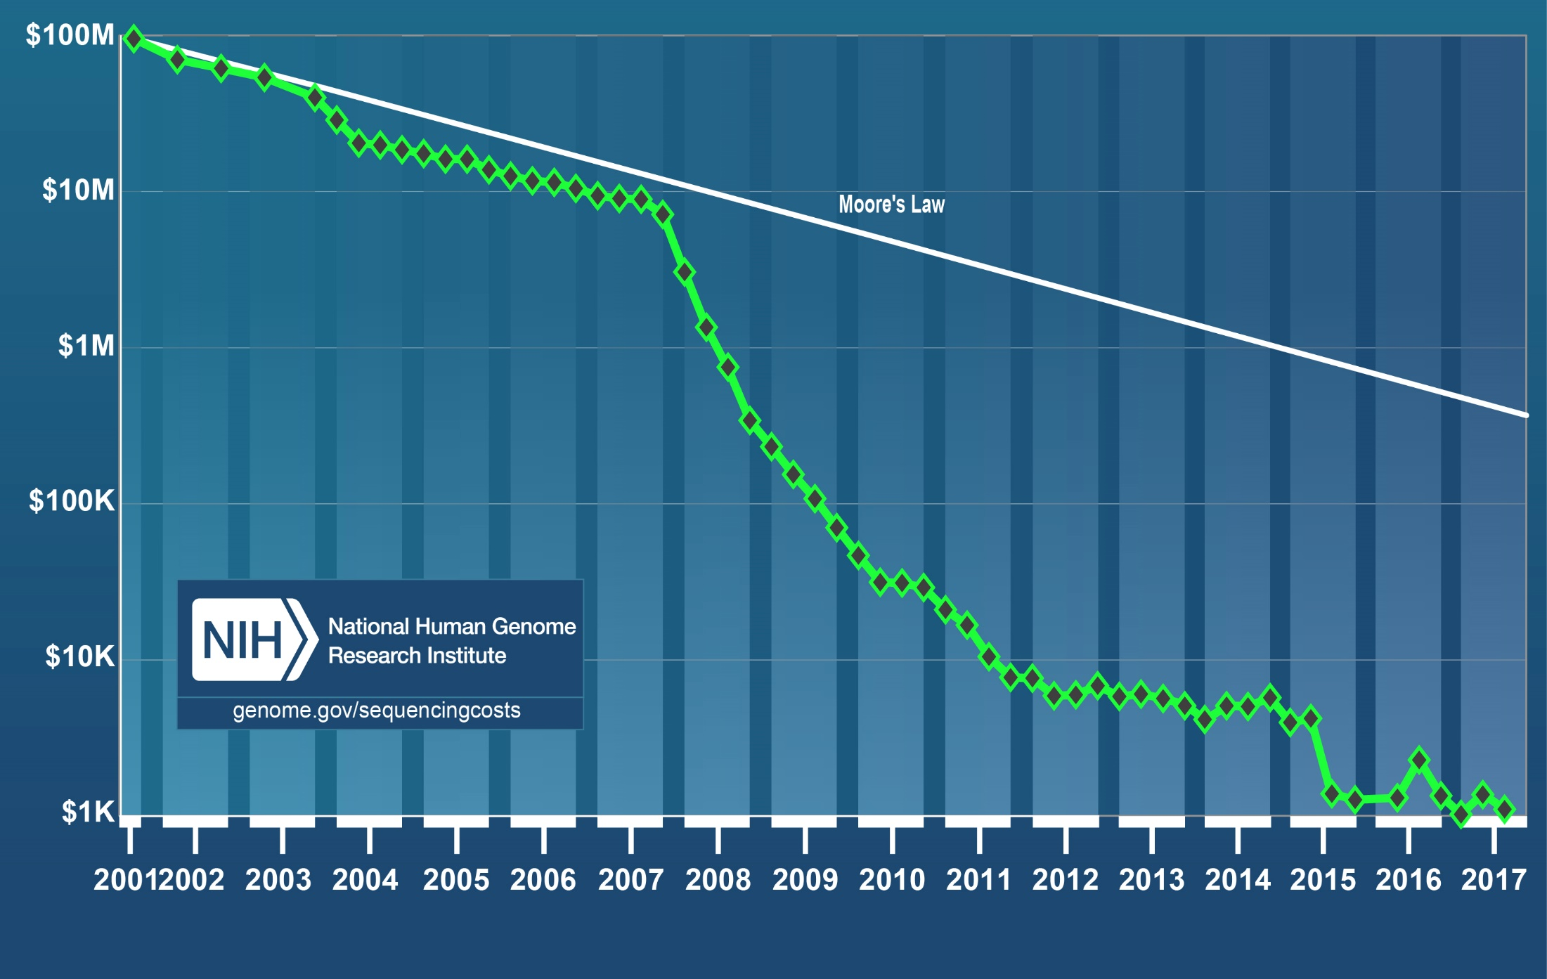
Genome Sequencing Costs
Illumina HiSeq X 10 can sequence 18,000 genomes per year at $1000 each. Produces 0.6 Terabases per day
https://www.genome.gov/sequencingcostsdata/
Note performance of sequencing levelled off since 2015
Cost per Genome
DISTRIBUTED “SMALL” INSTRUMENT MODE

Slide 46
10. Orchestrate multiple sequential and parallel data transformations and/or analytic processing using a workflow manager
This can be used for science by adding data staging phases as in case 5A
Nearly all workloads need to link multiple stages together. That is what workflow or orchestration does.
Technology like Hadoop is mainly aimed at individual stages
Specify Analytics Pipeline
Orchestration Layer (Workflow)
Analytic-3
(Visualize)
Analytic-2
Analytic-1
Hadoop, Spark, Giraph, Pig …
Data Storage: HDFS, Hbase

Slide 47
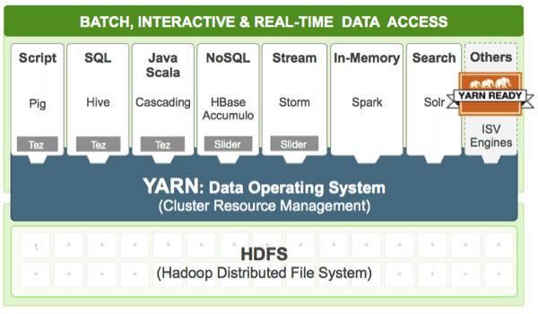
Example of Pattern 10 from Hortonworks
http://hortonworks.com/hadoop/yarn/

Slide 48
Other Benchmark Sets

Slide 49
7 Computational Giants of
NRC Massive Data Analysis Report
http://www.nap.edu/catalog.php?record_id=18374 Big Data Models?
G1: Basic Statistics e.g. MRStat
G2: Generalized N-Body Problems
G3: Graph-Theoretic Computations
G4: Linear Algebraic Computations
G5: Optimizations e.g. Linear Programming
G6: Integration e.g. LDA and other GML
G7: Alignment Problems e.g. BLAST

Slide 50
HPC (Simulation) Benchmark Classics
Linpack or HPL: Parallel LU factorization
for solution of linear equations; HPCG
NPB version 1: Mainly classic HPC solver kernels
  MG: Multigrid
  CG: Conjugate Gradient
  FT: Fast Fourier Transform
  IS: Integer sort
  EP: Embarrassingly Parallel
  BT: Block Tridiagonal
  SP: Scalar Pentadiagonal
  LU: Lower-Upper symmetric Gauss Seidel
Simulation Models

Slide 51
13 Berkeley Dwarfs
Dense Linear Algebra
Sparse Linear Algebra
Spectral Methods
N-Body Methods
Structured Grids
Unstructured Grids
MapReduce
Combinational Logic
Graph Traversal
Dynamic Programming
Backtrack and
Branch-and-Bound
Graphical Models
Finite State Machines
First 6 of these correspond to Colella’s original. (Classic simulations)
Monte Carlo dropped.
N-body methods are a subset of Particle in Colella.
Note a little inconsistent in that MapReduce is a programming model and spectral method is a numerical method.
Need multiple facets to classify use cases!
Largely Models for Data or Simulation

Slide 52
Classifying Use cases

Slide 53
Classifying Use Cases
The Big Data Ogres built on a collection of 51 big data uses gathered by the NIST Public Working Group where 26 properties were gathered for each application.
This information was combined with other studies including the Berkeley dwarfs, the NAS parallel benchmarks and the Computational Giants of the NRC Massive Data Analysis Report.
The Ogre analysis led to a set of 50 features divided into four views that could be used to categorize and distinguish between applications.
The four views are Problem Architecture (Macro pattern); Execution Features (Micro patterns); Data Source and Style; and finally the Processing View or runtime features.
We generalized this approach to integrate Big Data and Simulation applications into a single classification looking separately at Data and Model with the total facets growing to 64 in number, called convergence diamonds, and split between the same 4 views.
A mapping of facets into work of the SPIDAL project has been given.

Slide 54
The original 50 Ogres in 4 views
Processing
Data Source and Style
Problem Architecture (metapatterns)
Execution (micropatterns)

Slide 55
64 Features in 4 views for Unified Classification of Big Data and Simulation Applications
Both
Simulations
Analytics
(Model for Big Data)
(Nearly all Data)
(All Model)
(Mix of Data and Model)
(Nearly all Data+Model)

Slide 56
Convergence Diamonds and their 4 Views I
One view is the overall problem architecture or macropatterns which is naturally related to the machine architecture needed to support application.
  Unchanged from Ogres and describes properties of problem such as “Pleasing Parallel” or “Uses Collective Communication”
The execution (computational) features or micropatterns view, describes issues such as I/O versus compute rates, iterative nature and regularity of computation and the classic V’s of Big Data: defining problem size, rate of change, etc.
  Significant changes from ogres to separate Data and Model and add characteristics of Simulation models. e.g. both model and data have “V’s”; Data Volume, Model Size
  e.g. O(N²) Algorithm relevant to big data or big simulation model

Slide 57
Convergence Diamonds and their 4 Views II
The data source & style view includes facets specifying how the data is collected, stored and accessed. Has classic database characteristics
  Simulations can have facets here to describe input or output data
  Examples: Streaming, files versus objects, HDFS v. Lustre
Processing view has model (not data) facets which describe types of processing steps including nature of algorithms and kernels by model e.g. Linear Programming, Learning, Maximum Likelihood, Spectral methods, Mesh type,
  mix of Big Data Processing View and Big Simulation Processing View and includes some facets like “uses linear algebra” needed in both: has specifics of key simulation kernels and in particular includes facets seen in NAS Parallel Benchmarks and Berkeley Dwarfs
Instances of Diamonds are particular problems and a set of Diamond instances that cover enough of the facets could form a comprehensive benchmark/mini-app set
Diamonds and their instances can be atomic or composite

Slide 58
Convergence Diamonds
Problem Architecture View

Slide 59
Problem Architecture View (Meta or MacroPatterns)
Pleasingly Parallel – as in BLAST, Protein docking, some (bio-)imagery including Local Analytics or Machine Learning – ML or filtering pleasingly parallel, as in bio-imagery, radar images (pleasingly parallel but sophisticated local analytics)
Classic MapReduce: Search, Index and Query and Classification algorithms like collaborative filtering (G1 for MRStat in Features, G7)
Map-Collective: Iterative maps + communication dominated by “collective” operations as in reduction, broadcast, gather, scatter. Common datamining pattern
Map-Point to Point: Iterative maps + communication dominated by many small point to point messages as in graph algorithms
Map-Streaming: Describes streaming, steering and assimilation problems
Shared Memory: Some problems are asynchronous and are easier to parallelize on shared rather than distributed memory – see some graph algorithms
SPMD: Single Program Multiple Data, common parallel programming feature
BSP or Bulk Synchronous Processing: well-defined compute-communication phases
Fusion: Knowledge discovery often involves fusion of multiple methods.
Dataflow: Important application features often occurring in composite Ogres
Use Agents: as in epidemiology (swarm approaches) This is Model only
Workflow: All applications often involve orchestration (workflow) of multiple components
Most (11 of total 12) are properties of Data+Model
Notes:
Big dwarfs are Ogres
Implement Ogres in ABDS+

Slide 60
Note Problem and System both have Architecture and efficient execution says they must match
Global Machine Learning
2 important variants (software) of Iterative MapReduce and Map-Streaming
a) “In-place” HPC
b) Dataflow for model and data
Classic Cloud Workload
These 3 are focus of Twister2 but we need to preserve capability on first 2 paradigms

Slide 61
Relation of Problem and Machine Architecture
Problem is Model plus Data
In my old papers (especially book Parallel Computing Works!), I discussed computing as multiple complex systems mapped into each other
Problem → Numerical formulation → Software → Hardware
Each of these 4 systems has an architecture that can be described in similar language
One gets an easy programming model if architecture of problem matches that of Software
One gets good performance if architecture of hardware matches that of software and problem
So “MapReduce” can be used as architecture of software (programming model) or “Numerical formulation of problem”

Slide 62
Convergence Diamonds
Processing View

Slide 63
Diamond Facets in Processing (runtime) View I used in Big Data and Big Simulation
Pr-1M Micro-benchmarks ogres that exercise simple features of hardware such as communication, disk I/O, CPU, memory performance
Pr-2M Local Analytics executed on a single core or perhaps node
Pr-3M Global Analytics requiring iterative programming models (G5,G6) across multiple nodes of a parallel system
Pr-12M Uses Linear Algebra common in Big Data and simulations
  Subclasses like Full Matrix
  Conjugate Gradient, Krylov, Arnoldi iterative subspace methods
  Structured and unstructured sparse matrix methods
Pr-13M Graph Algorithms (G3) Clear important class of algorithms -- as opposed to vector, grid, bag of words etc. – often hard especially in parallel
Pr-14M Visualization is key application capability for big data and simulations
Pr-15M Core Libraries Functions of general value such as Sorting, Math functions, Hashing
Notes:
Big dwarfs are Ogres
Implement Ogres in ABDS+

Slide 64
Diamond Facets in Processing (runtime) View II used in Big Data
Pr-4M Basic Statistics (G1): MRStat in NIST problem features
Pr-5M Recommender Engine: core to many e-commerce, media businesses; collaborative filtering key technology
Pr-6M Search/Query/Index: Classic database which is well studied (Baru, Rabl tutorial)
Pr-7M Data Classification: assigning items to categories based on many methods
  MapReduce good in Alignment, Basic statistics, S/Q/I, Recommender, Classification
Pr-8M Learning of growing importance due to Deep Learning success in speech recognition etc..
Pr-9M Optimization Methodology: overlapping categories including
  Machine Learning, Nonlinear Optimization (G6), Maximum Likelihood or χ² least squares minimizations, Expectation Maximization (often Steepest descent), Combinatorial Optimization, Linear/Quadratic Programming (G5), Dynamic Programming
Pr-10M Streaming Data or online Algorithms. Related to DDDAS (Dynamic Data-Driven Application Systems)
Pr-11M Data Alignment (G7) as in BLAST compares samples with repository
Notes:
Big dwarfs are Ogres
Implement Ogres in ABDS+

Slide 65
Diamond Facets in Processing (runtime) View III used in Big Simulation
Pr-16M Iterative PDE Solvers: Jacobi, Gauss Seidel etc.
Pr-17M Multiscale Method? Multigrid and other variable resolution approaches
Pr-18M Spectral Methods as in Fast Fourier Transform
Pr-19M N-body Methods as in Fast multipole, Barnes-Hut
Pr-20M Both Particles and Fields as in Particle in Cell method
Pr-21M Evolution of Discrete Systems as in simulation of Electrical Grids, Chips, Biological Systems, Epidemiology. Needs Ordinary Differential Equation solvers
Pr-22M Nature of Mesh if used: Structured, Unstructured, Adaptive
Covers NAS Parallel Benchmarks and Berkeley Dwarfs
Notes:
Big dwarfs are Ogres
Implement Ogres in ABDS+

Slide 66
Convergence Diamonds
Execution View

Slide 67
Examples in Execution View EV
The Execution view is a mix of facets describing either data or model; PA was largely the overall Data+Model
EV-M14 is Complexity of model (O(N²) for N points) seen in the non-metric space models EV-M13 such as one gets with DNA sequences.
EV-M11 describes iterative structure distinguishing Spark, Flink, and Harp from the original Hadoop.
The facet EV-M8 describes the communication structure which is a focus of our research as much data analytics relies on collective communication which is in principle understood but we find that significant new work is needed compared to basic HPC releases which tend to address point to point communication.
The model size EV-M4 and data volume EV-D4 are important in describing the algorithm performance as just like in simulation problems, the grain size (the number of model parameters held in the unit – thread or process – of parallel computing) is a critical measure of performance.

Slide 68
View for Micropatterns or Execution Features
Performance Metrics; property found by benchmarking Diamond
Flops per byte; memory or I/O
Execution Environment; Core libraries needed: matrix-matrix/vector algebra, conjugate gradient, reduction, broadcast; Cloud, HPC etc.
Volume: property of a Diamond instance: a) Data Volume and b) Model Size
Velocity: qualitative property of Diamond with value associated with instance. Only Data
Variety: important property especially of composite Diamonds; Data and Model separately
Veracity: important property of applications but not kernels;
Model Communication Structure; Interconnect requirements; Is communication BSP, Asynchronous, Pub-Sub, Collective, Point to Point?
Is Data and/or Model (graph) static or dynamic?
Much Data and/or Models consist of a set of interconnected entities; is this regular as a set of pixels or is it a complicated irregular graph?
Are Models Iterative or not?
Data Abstraction: key-value, pixel, graph(G3), vector, bags of words or items; Model can have same or different abstractions e.g. mesh points, finite element, Convolutional Network
Are data points in metric or non-metric spaces? Data and Model separately?
Is Model algorithm O(N²) or O(N) (up to logs) for N points per iteration (G2)

Slide 69
Convergence Diamonds
Data Source and Style View

Slide 70
Examples in Data View DV
We can highlight DV-5 streaming where there is a lot of recent progress;
DV-9 categorizes our Biomolecular simulation application with data produced by an HPC simulation
DV-10 is Geospatial Information Systems covered by our spatial algorithms.
DV-7 provenance, is an example of an important feature that we are not covering.
The data storage and access DV-3 and D-4 is covered in our pilot data work.
The Internet of Things DV-8 (Edge computing) is a focus of our project and our recent streaming work relates to this and our addition of HPC to Apache Heron and Storm is an example of value of HPC-ABDS to IoT.

Slide 71
Data Source and Style View I
SQL NewSQL or NoSQL: NoSQL includes Document,
Column, Key-value, Graph, Triple store; NewSQL is SQL redone to exploit NoSQL performance
Other Enterprise data systems: 10 examples from NIST integrate SQL/NoSQL
Set of Files or Objects: as managed in iRODS and extremely common in scientific research
File systems, Object, Blob and Data-parallel (HDFS) raw storage: Separated from computing or colocated? HDFS v Lustre v. Openstack Swift v. GPFS
Archive/Batched/Streaming: Streaming is incremental update of datasets with new algorithms to achieve real-time response (G7); Before data gets to compute system, there is often an initial data gathering phase which is characterized by a block size and timing. Block size varies from month (Remote Sensing, Seismic) to day (genomic) to seconds or lower (Real time control, streaming)
  Streaming divided into categories overleaf
Notes:
Big dwarfs are Ogres
Implement Ogres in ABDS+

Slide 72
Data Source and Style View II
Streaming divided into 5 categories depending on event size and synchronization and integration
  Set of independent events where precise time sequencing unimportant.
  Time series of connected small events where time ordering important.
  Set of independent large events where each event needs parallel processing with time sequencing not critical
  Set of connected large events where each event needs parallel processing with time sequencing critical.
  Stream of connected small or large events to be integrated in a complex way.
Shared/Dedicated/Transient/Permanent: qualitative property of data; Other characteristics are needed for permanent auxiliary/comparison datasets and these could be interdisciplinary, implying nontrivial data movement/replication
Metadata/Provenance: Clear qualitative property but not for kernels as important aspect of data collection process
Internet of Things: 24 to 50 Billion devices on Internet by 2020
HPC simulations: generate major (visualization) output that often needs to be mined
Using GIS: Geographical Information Systems provide attractive access to geospatial data
Notes:
Big dwarfs are Ogres
Implement Ogres in ABDS+

Slide 73
Software Nexus
Application Layer On
Big Data Software Components for Programming and Data Processing On
HPC for runtime On
IaaS and DevOps Hardware and Systems

Slide 74
HPC-ABDS
Integrated wide range of HPC and Big Data technologies.
I gave up updating list in January 2016!

Slide 75
Components of Big Data Stack
Google likes to show a timeline; we can build on (Apache version of) this
2002 Google File System GFS ~HDFS (Level 8)
2004 MapReduce Apache Hadoop (Level 14A)
2006 Big Table Apache Hbase (Level 11B)
2008 Dremel Apache Drill (Level 15A)
2009 Pregel Apache Giraph (Level 14A)
2010 FlumeJava Apache Crunch (Level 17)
2010 Colossus better GFS (Level 18)
2012 Spanner horizontally scalable NewSQL database ~CockroachDB (Level 11C)
2013 F1 horizontally scalable SQL database (Level 11C)
2013 MillWheel ~Apache Storm, Twitter Heron (Google not first!) (Level 14B)
2015 Cloud Dataflow Apache Beam with Spark or Flink (dataflow) engine (Level 17)
Functionalities not identified: Security(3), Data Transfer(10), Scheduling(9), DevOps(6), serverless computing (where Apache has OpenWhisk) (5)
HPC-ABDS Levels in ()

Slide 76
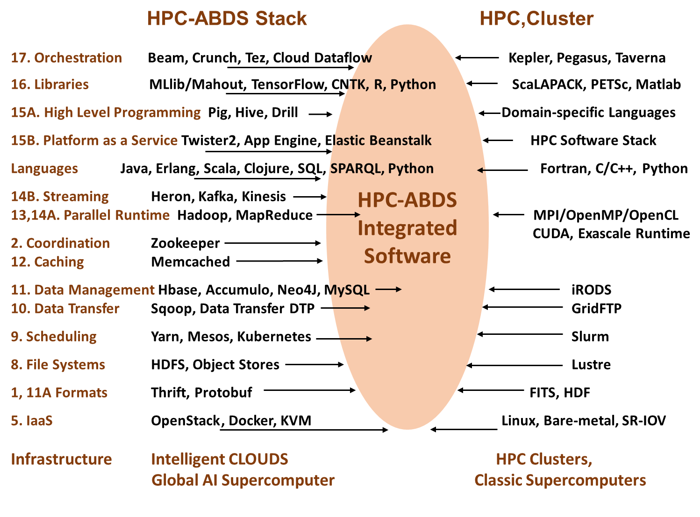
Different choices in software systems in Clouds and HPC. HPC-ABDS takes cloud software augmented by HPC when needed to improve performance
Uses 16 of 21HPC-ABDS layers plus languages

Slide 77
Functionality of 21 HPC-ABDS Layers
Message Protocols:
Distributed Coordination:
Security & Privacy:
Monitoring:
IaaS Management from HPC to hypervisors:
DevOps:
Interoperability:
File systems:
Cluster Resource Management:
Data Transport:
A) File management
B) NoSQL
C) SQL
In-memory databases & caches / Object-relational mapping / Extraction Tools
Inter process communication Collectives, point-to-point, publish-subscribe, MPI:
A) Basic Programming model and runtime, SPMD, MapReduce:
B) Streaming:
A) High level Programming:
B) Frameworks
Application and Analytics:
Workflow-Orchestration:
Lesson of large number (350). This is a rich software environment that HPC cannot “compete” with. Need to use and not regenerate except in special cases!
Note level 13 Inter process communication added

Slide 78
Using HPC-ABDS Layers I
Message Protocols
This layer is unlikely to directly visible in many applications as used in “underlying system”. Thrift and Protobuf have similar functionality and are used to build messaging protocols between components (services) of system
Distributed Coordination
Zookeeper is likely to be used in many applications as it is way that one achieves consistency in distributed systems – especially in overall control logic and metadata. It is for example used in Apache Storm to coordinate distributed streaming data input with multiple servers ingesting data from multiple sensors.
JGroups is less commonly used and is very different. It builds secure multi-cast messaging with a variety of transport mechanisms.
Security & Privacy
Security & Privacy is of course a huge area present implicitly or explicitly in all applications. It covers authentication and authorization of users and the security of running systems. In the Internet there are many authentication systems with sites often allowing you to use Facebook, Microsoft , Google etc. credentials. InCommon, operated by Internet2, federates research and higher education institutions, in the United States with identity management and related services.
LDAP is a simple database (key-value) forming a set of distributed directories recording properties of users and resources according to X.500 standard. It allows secure management of systems. OpenStack Keystone is a role-based authorization and authentication environment to be used in OpenStack private clouds.

Slide 79
Using HPC-ABDS Layers II
Monitoring:
Here Ambari is aimed at installing and monitoring Hadoop systems. Nagios and Ganglia are similar system monitors with ability to gather metrics and produce alerts. Inca is a higher level system allowing user reporting of performance of any sub system. Essentially all systems use monitoring but most users do not add custom reporting.
IaaS Management from HPC to hypervisors:
These technologies underlie all applications. The classic technology OpenStack manages virtual machines and associated capabilities such as storage and networking. The commercial clouds have their own solution and it is possible to move machine images between these different environments. As a special case there is “bare-metal” i.e. the null hypervisor. The DevOps technology Docker is playing an increasing role as a linux container and will be used in this course together with Kubernetes from level 6

Slide 80
Using HPC-ABDS Layers III
DevOps
This describes technologies and approaches that automate the deployment and installation of software systems and underlies “software-defined systems”. At IU, we integrate tools together in Cloudmesh – Libcloud, Cobbler, Chef, Docker, Slurm, Ansible, Puppet. Celery. We saw Docker earlier in 5 on last slide. Kubernetes is used to manage multiple Docker instances
Interoperability
This is both standards and interoperability libraries for services (Whirr), compute (OCCI), virtualization and storage (CDMI)
File systems
One will use files in most applications but the details may not be visible to the user. Maybe you interact with data at level of a data management system or an Object store (OpenStack Swift or Amazon S3). Most science applications are organized around files; commercial systems at a higher level.
Cluster Resource Management
You will certainly need cluster management in your application although often this is provided by the system and not explicit to the user. Yarn from Hadoop is gaining in popularity while Slurm is a basic HPC system as are Moab, SGE, OpenPBS while Condor also well known for scheduling of Grid applications. Mesos is similar to Yarn and is also becoming popular. Many systems are in fact collections of clusters as in data centers or grids. These require management and scheduling across many clusters; the latter is termed meta-scheduling.

Slide 81
Using HPC-ABDS Layers IV
Data Transport
Globus Online or GridFTP is dominant system in HPC community but this area is often not highlighted as often application only starts after data has made its way to disk of system to be used. Simple HTTP protocols are used for small data transfers while the largest ones use the “Fedex/UPS” solution of transporting disks between sites.
A) File management, B) NoSQL, C) SQL
This is a critical area for nearly all applications as it captures areas of file, object, NoSQL and SQL data management. The many entries in area testify to variety of problems (graphs, tables, documents, objects) and importance of efficient solution. Just a little while ago, this area was dominated by SQL databases and file managers.
In-memory databases&caches / Object-relational mapping / Extraction Tools
This is another important area addressing two points. Firstly conversion of data between formats and secondly enabling caching to put as much processing as possible in memory. This is an important optimization with Gartner highlighting this areas in several recent hype charts with In-Memory DBMS and In-Memory Analytics.

Slide 82
Using HPC-ABDS Layers V
Inter process communication Collectives, point-to-point, publish-subscribe, MPI
This describes the different communication models used by the systems in layers 13, 14) below. Results may be very sensitive to choices here as there are big differences from disk-based versus point to point (no disk) for Hadoop v. Harp (MPI)or the different latencies exhibited by publish-subscribe systems. I always recommend Pub-Sub systems like ActiveMQ or RabbitMQ for messaging.
A) Basic Programming model and runtime, SPMD, MapReduce, MPI
B) Streaming
A very important layer defining the cloud (HPC-ABDS) programming model. Includes Hadoop and related tools Spark, Twister, Stratosphere, Hama (iterative MapReduce); Giraph, Pregel, Pegasus (Graphs); Storm, S4, Samza (Streaming); Tez (workflow) and Yarn integration. Most applications use something here!
A) High level Programming
Components at this level are not required but are very interesting and we can expect great progress to come both in improving them and using them. Pig and Sawzall offer data parallel programming models; Hive, HCatalog, Shark, MRQL, Impala, and Drill support SQL interfaces to MapReduce, HDFS and Object stores

Slide 83
Using HPC-ABDS Layers VI
B) Frameworks
This is exemplified by Google App Engine and Azure (when it was called PaaS) but now there are many “integrated environments”.
Application and Analytics
This is the “business logic” of application and where you find machine learning algorithms like clustering. Mahout , MLlib , MLbase are in Apache for Hadoop and Spark processing; R is a central library from statistics community. There are many other important libraries where we mention those in deep learning (CompLearn Caffe), image processing (ImageJ), bioinformatics (Bioconductor) and HPC (Scalapack and PetSc). You will nearly always need these or other software at this level
Workflow-Orchestration
This layer implements orchestration and integration of the different parts of a job. These can be specified by a directed data-flow graph and often take a simple pipeline form illustrated in “access pattern” 10 discussed later. This field was advanced significantly by the Grid community and the systems are quite similar in functionality although their maturity and ease of use can be quite different. The interface is either visual (link programs as bubbles with data flow) or as an XML or program (Python) script.

Slide 84
Using “Apache” (Commercial Big Data) Data Systems for Science/Simulation
Pro: Use rich functionality and usability of ABDS (Apache Big Data Stack)
Pro: Sustainability model of community open source
Con (Pro for many commercial users): Optimized for fault-tolerance and usability and not performance
Feature: Naturally run on clouds and not HPC platforms
Feature: Cloud is logically centralized, physically distributed but science data typically distributed.
Question: how do science data analysis requirements differ from those commercially e.g. recommender systems heavily used commercially
Approach: HPC-ABDS using HPC runtime and tools to enhance commercial data systems (ABDS on top of HPC)
  Upper level software: ABDS
  Lower level runtime: HPC
  HPCCloud Hardware: HPC or classic cloud dependent on application requirements

Slide 85
Exemplar Software for a Big Data Environment
Functionality of ABDS and Performance of HPC
Workflow: Apache Beam, Crunch, Python or Kepler
Data Analytics: SPIDAL,Tensorflow, Mahout, R, ImageJ, Scalapack
Platform as a Service: Twister2
High level Programming: Hive, Pig
Batch Parallel Programming model: Hadoop, Spark, Giraph, Harp, MPI;
Streaming Programming model: Heron, Storm with Kafka or RabbitMQ
In-memory: Memcached
Data Management: Hbase, MongoDB, MySQL
Distributed Coordination: Zookeeper
Cluster Management: Yarn, Slurm
File Systems: HDFS, Object store (Swift), Lustre
DevOps: Cloudmesh, Chef, Puppet, Docker, Cobbler, Kubernetes
IaaS: Amazon, Azure, Docker,
Monitoring: Inca, Ganglia, Nagios

Slide 86
Comparison of Data Analytics with Simulation

Slide 87
Comparison of Data Analytics with Simulation I
Simulations (models) produce big data as visualization of results – they are data source
  Or consume often smallish data to define a simulation problem
  HPC simulation in (weather) data assimilation is data + model
Pleasingly parallel often important in both
Both are often SPMD and BSP
  Non-iterative MapReduce is major big data paradigm
  not a common simulation paradigm except where “Reduce” summarizes pleasingly parallel execution as in some Monte Carlos
Big Data often has large collective communication
  Classic simulation has a lot of smallish point-to-point messages
  Motivates MapCollective model
Simulations characterized often by difference or differential operators leading to nearest neighbor sparsity
  Some important data analytics can be sparse as in PageRank and “Bag of words” algorithms but many involve full matrix algorithm

Slide 88


“Force Diagrams” for macromolecules and Facebook

Slide 89
Comparison of Data Analytics with Simulation II
There are similarities between some graph problems and particle simulations with a particular cutoff force.
  Both are MapPoint-to-Point problem architecture
Note many big data problems are “long range force” (as in gravitational simulations) as all points are linked.
  Easiest to parallelize. Often full matrix algorithms
  e.g. in DNA sequence studies, distance δ(i, j) defined by BLAST, Smith-Waterman, etc., between all sequences i, j.
  Opportunity for “fast multipole” ideas in big data. See NRC report
Current Ogres/Diamonds do not have facets to designate underlying hardware: GPU v. Many-core (Xeon Phi) v. Multi-core as these define how maps processed; they keep type of MapReduce used unchanged; maybe should add to our features as ability to exploit vector or SIMD parallelism could be a model facet.

Slide 90
Comparison of Data Analytics with Simulation III
In image-based deep learning, neural network weights are block sparse (corresponding to links to pixel blocks) but can be formulated as full matrix operations on GPUs and MPI in blocks.
In HPC benchmarking, Linpack being challenged by a new sparse conjugate gradient benchmark HPCG, while I am diligently using non- sparse conjugate gradient solvers in clustering and Multi-dimensional scaling.
Simulations tend to need high precision and very accurate results – partly because of differential operators
Big Data problems often don’t need high accuracy as seen in trend to low precision (16 or 32 bit) deep learning networks
  There are no derivatives and the data has inevitable errors
Note parallel machine learning (GML not LML) can benefit from HPC style interconnects and architectures as seen in GPU-based deep learning
  So commodity clouds not necessarily best but modern clouds fine

Slide 91
Cloud Computing I: Wise words on Clouds
Containers

Slide 92
Gartner Remarks on Clouds
As they enters their second decade, Clouds have evolved from a disruptive technology to an expected and prevelant approach to traditional as well as next-generation IT.
  Despite its longevity, cloud computing still suffers from confusion, and long-standing and largely unimportant nontechnical concerns (for example, cost and governance) continue to muddle the opinions and approaches of CIOs, architects and cloud leaders.
  Enabled and fueled by the consumerization of IT, the cloud solutions that individuals and business units (through software as a serviceaaS) have brought into the enterprise are shifting the way IT organizations respond to the immediate and imminent demands of their users.
  A natural continued blurring is occurring in cloud computing. Infrastructure as a service (IaaS) and some PaaS capabilities are increasingly difficult to discern as separate functions.
  Pure public cloud and hosted private offerings are becoming increasingly similar, and higher levels of abstraction are masking more of the underlying details. This blurring will persist and will continue to challenge cloud clarity.

Slide 93
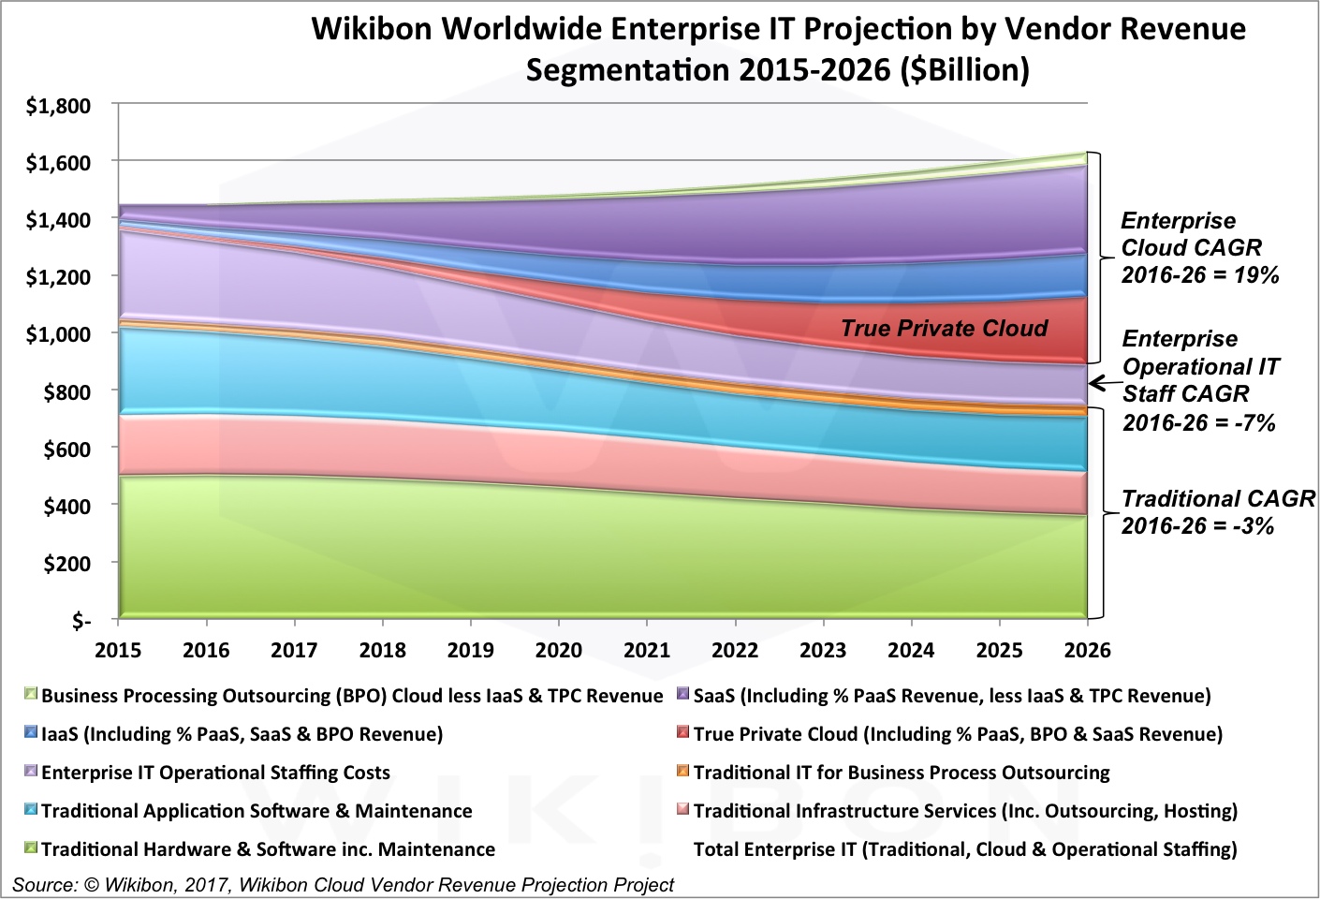
IT Growth by areas
https://www.forbes.com/sites/louiscolumbus/2017/04/29/roundup-of-cloud-computing-forecasts-2017

Slide 94
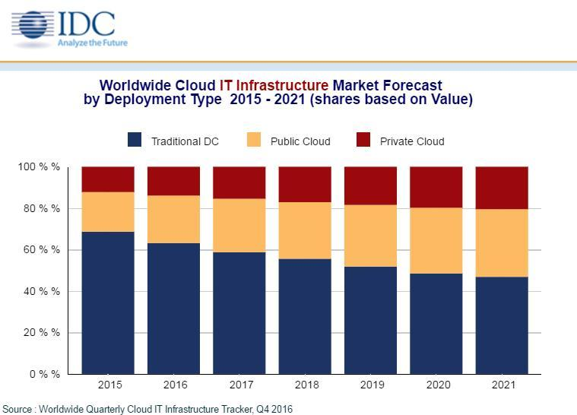
IT Infrastructure Trends
According to IDC, worldwide spending on public cloud computing will increase from $67B in 2015 to $162B in 2020 attaining a 19% CAGR.

Slide 95
Future Trends in IT: Containers, Serverless, Edge, Decentralization
By 2020, anything other than a cloud-only strategy for new IT initiatives will require justification at more than 30% of large enterprise organizations.
By 2018, 50% of the applications hosted in the public cloud will be considered mission-critical by the organizations that use them.
By 2021, more than half of global enterprises already using cloud today will adopt an all-in cloud strategy.
By 2018, 60% of enterprises will mandate container vulnerability scanning, up from less than 30% in 2016.
By 2019, 40% of container deployments will have adopted a whitelisting-based lockdown approach and deactivated runtime signature-based anti-malware scanning.
By 2019, 90% of enterprises will consider properly secured container deployments as secure as virtual machines, up from less than 20% in 2016.
Good choice of O/S critical for containers
Disable Antivirus and Adopt Application Control Whitelisting; WhiteListing lists allowed applications that have been tested
Security teams are often an inhibitor to innovation. Business, risk and security leaders must investigate the benefits of devolving security teams into the rest of the enterprise.

Slide 96
Containers and Serverless will dominate innovation
"Software is eating the world," and modern digital businesses that leverage software to analyze data and build applications are doing so rapidly, with agility and a heightened need for resiliency. CIOs and application leaders are under pressure to deliver software more quickly by building scalable platforms, architectures and processes that put delivery back into the hands of the developers.
New computing abstractions, such as Docker containers and serverless computing frameworks, are changing how and where enterprises consume server computing. IT leaders should align their use cases with appropriate computing abstractions to benefit from these innovations.
By 2020, more than 50% of global enterprises will be running containerized applications in production, which is an increase from fewer than 20% today.
By 2020, the leading serverless offerings will expand to support more general-use patterns and will emerge as a leading platform architecture for cloud-native application services.
Virtual machines and containers serve different enterprise needs, with containers gaining adoption for the agile development of cloud-native applications, and VMs remain the mainstay of traditional, monolithic applications

Slide 97
Why use Containers not Virtual Machines
By 2020, more than 50% of enterprises will run mission-critical, containerized cloud-native applications in production, up from less than 5% today.
All of the major public cloud IaaS providers now offer container as a service (CaaS).
When compared to VMs, containers offer three key benefits that have made them appealing to I&O leaders:
  Since they can run on a bare-metal infrastructure, containers can be operated more efficiently than VMs on single tenant server infrastructure.
  Because of their smaller resource footprint, containers can enable a much higher tenant density on a host.
  Containerized applications can be managed more effectively with less configuration drift, as it is possible to more easily redeploy services and automate their life cycle management.
Container adoption has rapidly expanded within enterprise IT in the past two years. This can be attributed to the rise of two key application deployment patterns:
  The rise of cloud native applications: applications that are being written in an abstracted way to take advantage of the native elasticity and programmability of cloud infrastructure.
  The growing interest in microservice architecture and the recognition that containers will be a foundational technology for enabling next-generation microservices-based applications.

Slide 98
Artificial Intelligence on the Data Center and for the Data Center
By 2020, 30% of data centers that fail to effectively apply artificial intelligence to support enterprise business will not be operationally and economically viable.
Need Machine Learning to run software defined computer infrastructure.
Artificial Intelligence will
  Monitor, probe and provide feedback on configuration, workload, capacity, security and connectivity.
  Track the environments of other systems in on-premises or in public cloud.
  Adapt to predetermined, defined overall business and IT performance objectives.
  Apply flexible configuration and composability principles to resource utilization and capacity.
  Maintain goal-directed system stability through periods of volatility and change

Slide 99
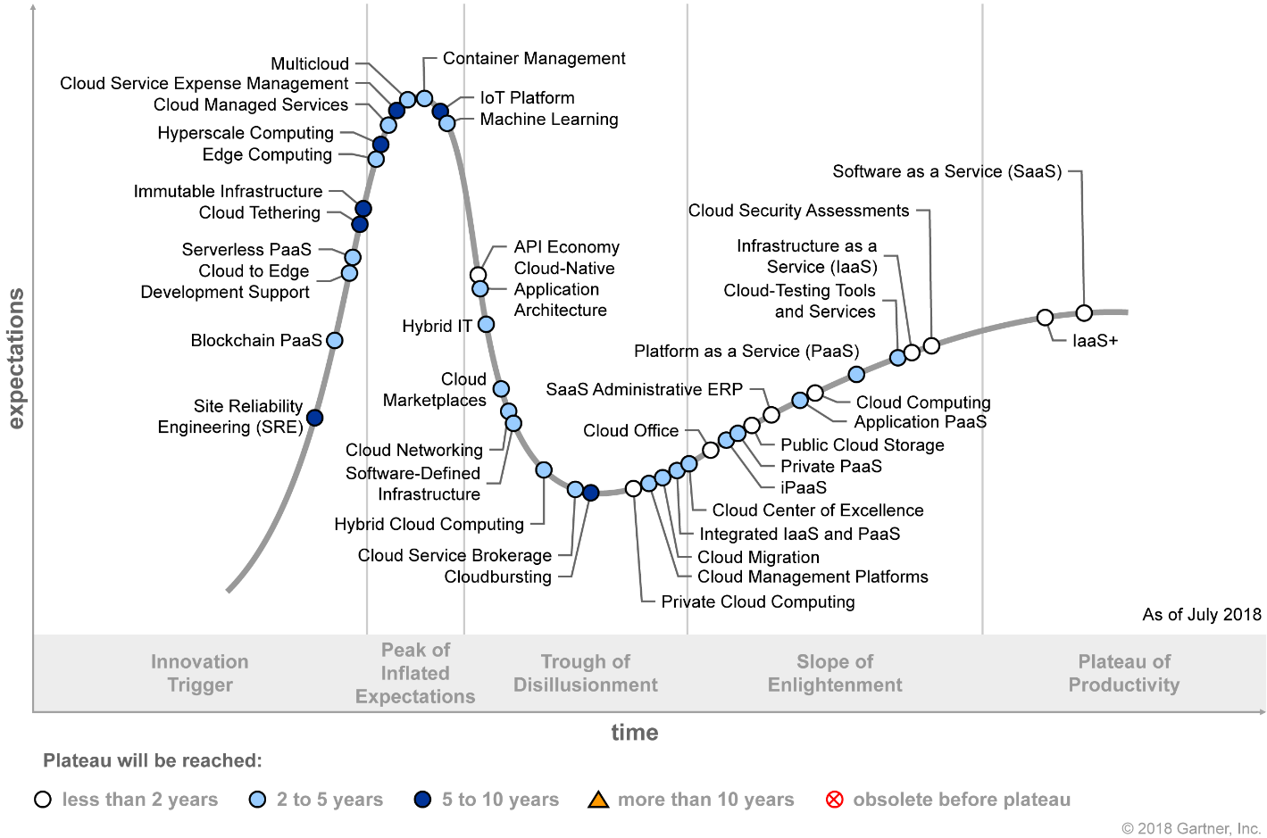
Gartner: Hype Cycle for Cloud Computing, 2017
Hyperscale computing is a set of architectural patterns for delivering scale-out IT capabilities at massive, industrialized scale. These patterns span all layers of the delivery of IT capabilities — data center facilities, hardware and system infrastructure, application infrastructure, and applications. Nonhyperscale components can be layered on top of hyperscale components, but the overall architecture is only "hyperscale" through the level where all components use a hyperscale architecture.
Transformational 5-20 years
Hype Cycle for Cloud Computing, 2018
Published: 31 July 2018
ID: G00340420
Analyst(s): David Smith, Ed Anderson

Slide 100
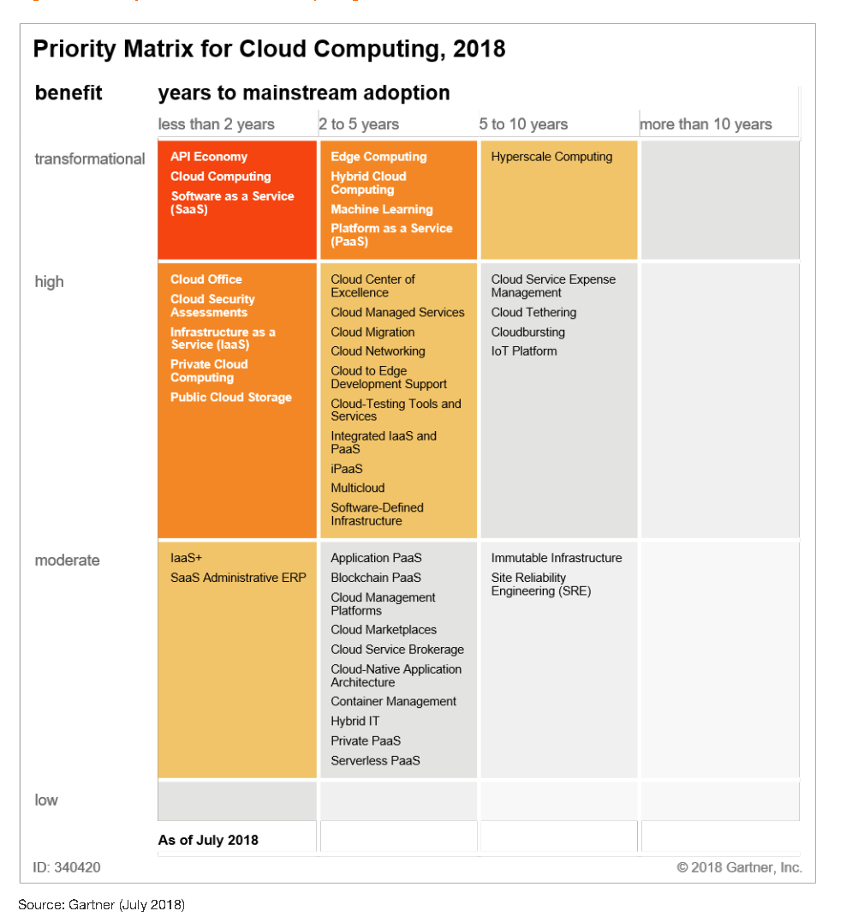
Gartner: Priority Matrix for Cloud Computing, 2018
Hype Cycle for Cloud Computing, 2018
Published: 31 July 2018
ID: G00340420
Analyst(s): David Smith , Ed Anderson

Slide 101
Cloud Computing II: Serverless and Function as a Service

Slide 102
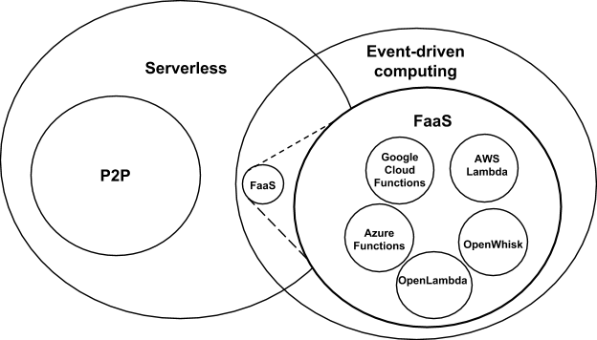
Event-Driven and Serverless Computing
Hopefully will change
Cloud-owner Provided Cloud-native platform for
Short-running, Stateless computation and
Event-driven applications which
Scale up and down instantly and automatically and
Charges for actual usage at a millisecond granularity
Note GridSolve was FaaS
See review http://dx.doi.org/10.13140/RG.2.2.15007.87206
Notes:
Short-running, Stateless computation may go away

Slide 103
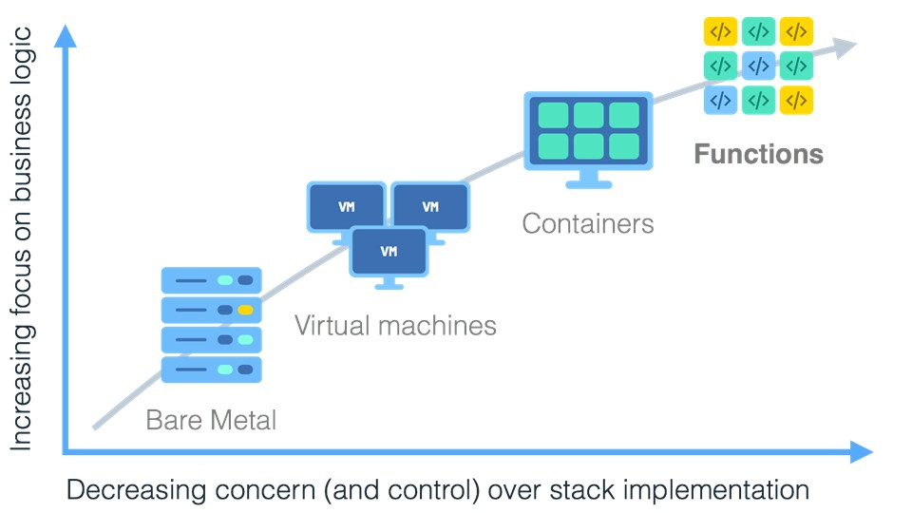
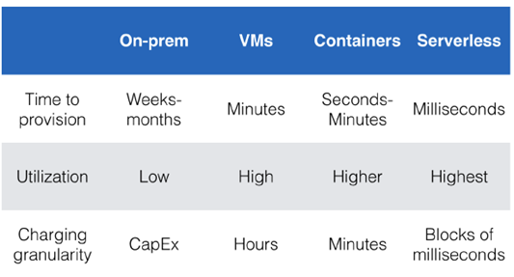
Serverless Computing and Function as a Service FaaS
When I use a cloud service like CosmosDB or Kinesis do I need to allocate a server and deploy a virtual machine?
  Of course not. Just configure it from the portal and use it.
What if I have a simple function that I want to run
every time I a particular “event” happens:
  a file in the file service is modified
  A specific external event is sent to a cloud event stream
  Somebody added a file to a Github repository.
  It is 2:00 pm.
What are my choices?
  Create a VM or container with my function and
  run it continuously.
  But I don’t want to pay for it when it is being idle.
  (Note typically minimum charge is for one hours use)
Implemented in AWS Lambda, Azure Functions,
Google Functions, IBM (Apache) OpenWhisk

Slide 104
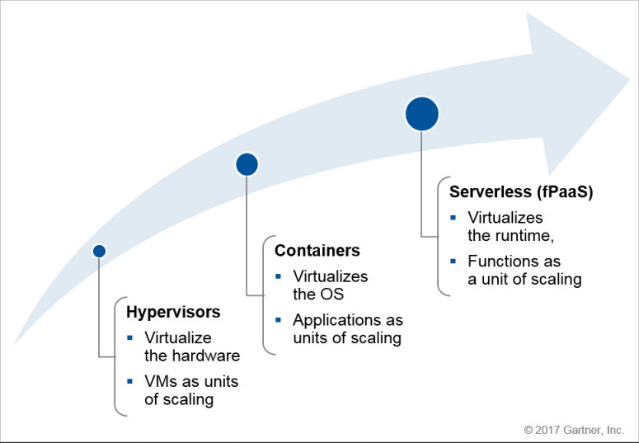
Gartner: The Evolution of Server Computing
Evolution of Server Computing: VMs to Containers to Serverless - Which to Use When?
Published: 26 June 2017 ID: G00325432
Analyst(s): Arun Chandrasekaran

Slide 105
Cloud Native and Microservices: The Benefits
Self managing infrastructure through automation: The Cloud Native practice goes beyond ad-hoc automation built on top of virtualisation platforms, instead it focuses on orchestration, management and automation of the entire infrastructure right upto the application tier.
Reliable infrastructure & application: Cloud Native practice ensures that it much easier to handle churn, replace failed components and even easier to recover from unexpected events & failures.
Deeper insights into complex applications: Cloud Native tooling provides visualisation for health management, monitoring and notifications with audit logs making applications easy to audit & debug
Security: Enable developers to build security into applications from the start rather than an afterthought.
More efficient use of resources: Containers are lighter in weight that full systems. Deploying applications in containers lead to increased resource utilisation.
Software teams have grown in size and the amount of applications and tools that a company needs to be build has grown 10x over last few years. Microservices break large complex applications into smaller pieces so that they can be developed, tested and managed independently. This enables single microservice to be updated or rolled-back without affecting other parts of the application. Also nowadays software teams are distributed and microservices enables each team to own a small piece with service contracts acting as the communication layer.

Slide 106
Serverless Computing I from Gartner
By 2020, 90% of serverless deployments will occur outside the purview of central IT organizations when supporting general-use patterns.
This is because rapid scalability, operational simplicity and true on-demand pricing have made serverless offerings popular with developers.
Still, at their current capabilities, serverless offerings are not yet a true substitute for VMs or containers for general purpose use cases. Instead, they are mostly used for event-driven use cases (such as batch computing and back-end services).
By 2022, two thirds of server workloads will be deployed off-premises. This is being driven by a wave of workload migration and new physical server investment by hosters and public cloud service providers.
While the number of deployed workloads will more than double by 2022, the definition of "on premises" will be challenged by the massive growth of edge computing. This will spawn an organic growth opportunity for hyperconverged and software-defined compute platforms.
Hyperconvergence is a type of infrastructure system with a software-centric architecture that tightly integrates compute, storage, networking and virtualization resources and other technologies from scratch in a commodity hardware box supported by a single vendor.
  IT leaders are inundated by what hyperconvergence means and the potential benefits, often by hype from the vendors.
  The integrated system — contrary to its identification with simplicity — actually puts a heavy burden of complexity on IT leaders who make strategic infrastructure decisions for IT corporate services, operations and development.

Slide 107
Serverless Computing II from Gartner
Serverless computing offers three primary benefits to developers:
  It supports running code without having to operate the infrastructure (such as servers, storage and network resources). This is highly appealing to developers, as it enhances their productivity and allows them to focus on code development without having to worry about the underlying infrastructure.
  It can enable easier horizontal scaling, due to the autoscaling properties of the back-end resources. Scalability now becomes a software design issue.
  Public cloud-hosted infrastructure as a service (IaaS) serverless frameworks allow for truly ondemand consumption, because there are no idle resources or orphaned VMs or containers. Consumers pay exactly for the duration during which the code (functions) will run.
The adoption of serverless computing in the enterprise is still quite nascent.
This is due to the immaturity of the technology for general purpose enterprise workloads, as well as the fact that a majority of workloads today are "request-driven" rather than "event-driven."
However, event-driven workloads will grow in importance as next generation front-ends will be driven by new technologies. These include IoT devices, AI-enabled user experience platforms (such as Amazon Alexa, Apple Siri or Google Now) and virtual reality applications.
  All of these will drive more event-driven, microservice architectures.
  The majority of these deployments will happen outside the purview of central IT

Slide 108
Clouds, HPC Clouds
Simulations, Big Data

Slide 109
Science Computing Environments
Grids federate resources as in EGI/OSG or enable convenient access to multiple backend systems including supercomputers
Large Scale Supercomputers – Multicore nodes linked by high performance low latency network
  Increasingly with GPU enhancement
  Suitable for highly parallel simulations
  MPI engines offer highest possible performance on closely coupled problems
High Throughput Systems such as European Grid Initiative EGI or Open Science Grid OSG typically aimed at pleasingly parallel jobs
  Can use “cycle stealing”
  Classic example is LHC data analysis
Use Services (SaaS)
  Portals make access convenient and
  Workflow integrates multiple processes into a single job
Synchronization/communication Performance Grids > Clouds > Classic HPC Systems
Clouds naturally execute effectively Grid workloads but are less clear for closely coupled HPC applications

Slide 110
Some Points to Make I
People ask me what is a cloud?
  Clouds are gradually having all possible capabilities (GPU, fast networks, KNL, FPGA)
  So all but largest supercomputing runs can be done on clouds
Interesting to distinguish 3 system deployments
  Pleasingly parallel: Master-worker: Big Data and Simulations
    Grid computing, long tail of science, was 20% in 1988- now much more
  Intermediate size (virtual) clusters of synchronized nodes run as pleasingly parallel components of a large machine: Big Data and Simulations
    Capacity computing, Deep Learning
  Giant (exascale) cluster of synchronized nodes: Only simulations
Parallel Computing Technology like MPI aimed at synchronized nodes
Grid computing technology and MapReduce aimed at pleasingly parallel or essentially unsynchronized computing

Slide 111
Some Points to Make II
Need to distinguish data intensive requirements
  Independent Event-based processing (present at start of most scientific data analysis)
    Pleasingly Parallel with often Local Machine Learning
  Database or data management functions
    MapReduce style
  Modest scale parallelism as in deep learning on modest cluster of GPU’s (64)
    Traditional small GPU Cluster <~ 16 nodes
  Large but not exascale scale parallelism with strong synchronization as in clustering of whole dataset (?10,000 cores)
    Traditional intermediate size HPC Cluster ~1024 nodes
    Global Machine Learning
There are issues like workflow in common across science, commercial, simulations, big data, clouds, HPC
Growing interest in use of public clouds in USA Universities
Must have Cloud or HPC Cloud interoperability with local resources (often an HPC or HTC Cluster)

Slide 112
Implications of Big Data Requirements
“Atomic” Job Size: Very large jobs are critical aspects of leading edge simulation, whereas much data analysis is pleasing parallel and involves many quite small jobs. The latter follows from event structure of much observational science.
  Accelerators produce a stream of particle collisions; telescopes, light sources or remote sensing a stream of images. The many events produced by modern instruments implies data analysis is a computationally intense problem but can be broken up into many quite small jobs.
  Similarly the long tail of science produces streams of events from a multitude of small instruments
Why use HPC machines to analyze data and how large are they? Some scientific data has been analyzed on HPC machines because the responsible organizations had such machines often purchased to satisfy simulation requirements. Whereas high end simulation requires HPC style machines, that is typically not true for data analysis; that is often done on HPC machines because they are available

Slide 113
Considerations on Big Data v. Clouds/HPC
“High Performance” seems natural for Big Data as this needs a lot of processing and HPC could do it faster?
Cons: But much big data processing involves I/O of distributed data and this dominates over computing accelerated by HPC
  Other problems (such as LHC data processing) are compute dominated but this is pleasingly parallel and so parallel computing and nifty HPC algorithms irrelevant
  Other problems (like basic databases) are essentially MapReduce and also do not have tight synchronization constraints addressed by HPC
Pros: Andrew Ng notes that a leading machine learning group must have both deep learning and HPC excellence.
  Some machine learning like topic modelling (LDA), clustering, deep learning, dimension reduction, graph algorithms involve Map-Collective or Map-Point to Point iterative structure and benefit from HPC
  HPC (MPI) often large factors (10-100) faster than Hadoop, Spark, Flink, Storm

Slide 114
Why HPC Cloud architectures?
Exascale simulations needed as have differential equation based models that need small space and time steps and this leads to numerical formulations that need the memory and compute power of an exascale machine to solve individual problems (capability computing)
Big data problems do not have differential operators and it is not obvious that you need a full exascale system to address a single Big Data problem
Rather you will be running lots of jobs that are sometimes pleasingly parallel/MapReduce (Cloud) and sometimes small to medium size HPC jobs which in aggregate are exascale (HPC Cloud) (capacity computing)
  Deep learning doesn’t exhibit massive parallelism due to stochastic gradient descent using small mini-batches of training data
  But deep learning does use small accelerator enhanced HPC clusters.
Note modest size clusters need all the software, hardware and algorithm expertise of HPC.
Systems designed for exascale HPC simulations, should be well suited for HPC cloud if I/O handled correctly (as it is in traditional clouds)
HPCCloud 2.0 uses DevOps to automate deployment on cloud or HPC
HPCCloud 3.0 uses SaaS to deliver Wisdom/Insight as a Service

Slide 115
Structure of Applications
Real-time (streaming) data is increasingly common in scientific and engineering research, and it is ubiquitous in commercial Big Data (e.g., social network analysis, recommender systems and consumer behavior classification)
  So far little use of commercial and Apache technology in analysis of scientific streaming data
Pleasingly parallel applications important in science (long tail) and data communities
Commercial-Science application differences: Search and recommender engines have different structure to deep learning, clustering, topic models, graph analyses such as subgraph mining
  Latter very sensitive to communication and can be hard to parallelize
  Search typically not as important in Science as in commercial use as search volume scales by number of users
Should discuss data and model separately
  Term data often used rather sloppily and often refers to model

Slide 116
Big Data and Simulation Difficulty in Parallelism
Size of Synchronization constraints
Loosely Coupled
Tightly Coupled
HPC Clouds: Accelerators
High Performance Interconnect
HPC Clouds/Supercomputers
Memory access also critical
Commodity Clouds
Size of Disk I/O
MapReduce as in scalable databases
Global Machine Learning
e.g. parallel clustering
Deep Learning
Graph Analytics e.g. subgraph mining
LDA
Pleasingly Parallel
Often independent events
Unstructured Adaptive Sparse
Current major Big Data category
Linear Algebra at core (often not sparse)
Structured Adaptive Sparse
Parameter sweep simulations
Largest scale simulations
Just two problem characteristics
There is also data/compute distribution seen in grid/edge computing
Exascale Supercomputers

Slide 117
Who uses What Software
HPC/Science use of Big Data Technology now: Some aspects of the Big Data stack are being adopted by the HPC community: Docker and Deep Learning are two examples.
Big Data use of HPC: The Big Data community has used (small) HPC clusters for deep learning, and it uses GPUs and FPGAs for training deep learning systems
Docker v. OpenStack(hypervisor): Docker (or equivalent) is quite likely to be the virtualization approach of choice (compared to say OpenStack) for both data and simulation applications. OpenStack is more complex than Docker and only clearly needed if you share at core level whereas large scale simulations and data analysis seem to just need node level sharing.
  Parallel computing almost implies sharing at node not core level
Science use of Big Data: Some fraction of the scientific community uses Big Data style analysis tools (Hadoop, Spark, Cassandra, Hbase ….)

Slide 118
Choosing Languages
Language choice C++, Fortran, Java, Scala, Python, R, Matlab needs thought. This is a mixture of technical and social issues.
Java Grande was a 1997-2000 activity to make Java run fast and web site still there! http://www.javagrande.org/
Basic Java now much better but object structure, dynamic memory allocation and Garbage collection have their overheads
Java virtual machine JVM dominant Big Data environment?
One can mix languages quite efficiently
  Java MPI as binding to C++ version excellent
Scripting languages Python, R, Matlab address different requirements than Java, C++ ….

Slide 119
HPCCloud and Summary of Big Data - Big Simulation Convergence
HPC-Clouds convergence? (easier than converging higher levels in stack)
Can HPC continue to do it alone?
Convergence Ogres/Diamonds
HPC-ABDS Software on differently optimized hardware infrastructure

Slide 120
HPCCloud Convergence Architecture
Running same HPC-ABDS software across all platforms but data management machine has different balance in I/O, Network and Compute from “model” machine
  Note data storage approach: HDFS v. Object Store v. Lustre style file systems is still rather unclear
The Model behaves similarly whether from Big Data or Big Simulation.
Data Management Model for Big Data
and Big Simulation
HPCCloud Capacity-style Operational Model matches hardware features with application requirements

Slide 121
Summary of Big Data HPC Convergence I
Applications, Benchmarks and Libraries
  51 NIST Big Data Use Cases, 7 Computational Giants of the NRC Massive Data Analysis, 13 Berkeley dwarfs, 7 NAS parallel benchmarks
  Unified discussion by separately discussing data & model for each application;
  64 facets– Convergence Diamonds -- characterize applications
  Characterization identifies hardware and software features for each application across big data, simulation; “complete” set of benchmarks (NIST)
Exemplar Ogre and Convergence Diamond Features
  Overall application structure e.g. pleasingly parallel
  Data Features e.g. from IoT, stored in HDFS ….
  Processing Features e.g. uses neural nets or conjugate gradient
  Execution Structure e.g. data or model volume
Need to distinguish data management from data analytics
Management and Search I/O intensive and suitable for classic clouds
  Science data has fewer users than commercial but requirements poorly understood
Analytics has many features in common with large scale simulations
  Data analytics often SPMD, BSP and benefits from high performance networking and communication libraries.
  Decompose Model (as in simulation) and Data (bit different and confusing) across nodes of cluster

Slide 122
Summary of Big Data HPC Convergence II
Software Architecture and its implementation
  HPC-ABDS: Cloud-HPC interoperable software: performance of HPC (High Performance Computing) and the rich functionality of the Apache Big Data Stack.
  Added HPC to Hadoop, Storm, Heron, Spark; could add to Beam and Flink
  Could work in Apache model contributing code in different ways
  One approach is an HPC project in Apache Foundation
HPCCloud runs same HPC-ABDS software across all platforms but “data management” nodes have different balance in I/O, Network and Compute from “model” nodes
  Optimize to data and model functions as specified by convergence diamonds rather than optimizing for simulation and big data
Convergence Language: Make C++, Java, Scala, Python (R) … perform well
Training: Students prefer to learn machine learning and clouds and need to be taught importance of HPC to Big Data
Sustainability: research/HPC communities cannot afford to develop everything (hardware and software) from scratch
HPCCloud 2.0 uses DevOps to deploy HPC-ABDS on clouds or HPC
HPCCloud 3.0 delivers Solutions as a Service

Slide 123
Conclusions
Can make use case collections to motivate benchmarks
  NIST and BDEC have templates
  Could helpfully fill in templates for benchmarks
Research applications have some similarities but many differences from commercial use cases
Increasing importance of integration of simulation and Machine Learning
Increasing importance of distributed Edge applications
Should benchmark dataflow and BSP style communication
Twister2 will combine Heron and Spark with built in HPC performance

