Slide 1

Development of the Nanoconfinement Science Gateway
Suresh Marru, Vikram Jadhao
Intelligent Systems Engineering
Gateway: https://nanoconfinement.sciencegateways.iu.edu/
Jadhao Lab: https://jadhaolab.engineering.indiana.edu/

Slide 2
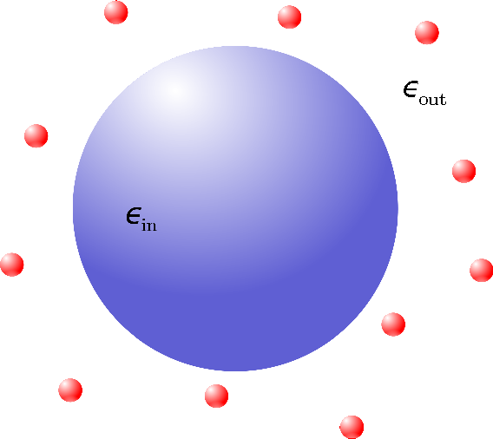
Self-assembly of Nanoparticles
Self-assembly of nanoparticles is important in design of advanced materials.
For charged nanoparticles self-assembly is governed by the distribution of ions between nanoparticles.

Slide 3
Computing distribution of ions accurately
CONFINEMENT FORMED BY NANOPARTICLES
For unpolarizable interfaces with no dielectric mismatch, standard MD produces good result.
For polarizable interfaces, advanced techniques like the novel application Car-Parrinello molecular dynamics (CPMD) is needed. Jadhao Lab has proposed this theory and current simulations build on this prior work.
Notes:
The distribution is defined by electro-static and entropic interactions between ions.
If nano particles has same di-eletric properties then you do MD. If you have different di-lectric then you need CPMD…The space is solution which is water in this case.
In general nano particles have different properties.
Ions represented by blue and green circles confined by nanoparticle surfaces
Surfaces are approximated as planar interfaces due to the size difference between ions and the assembling nanoparticles.
MD is based on newtons laws
CPMD is

Slide 4
Computing Specifications
Both standard MD and advanced CPMD are computationally intensive.
500 ions simulated using MD for 1 million time steps (one nano-second of real-time dynamics) takes 12 hours on a single processors.
CPMD also calculates induced charges and is 5 times slower than MD.
These challenges motivate the need for using OpenMP and MPI for code optimization.
Currently simulations run with OpenMP multi-processors leading to an acceleration of 10X.
Notes:
scaling and paralleling the simulation codes and effectively use local and national computing resources.

Slide 5
Why a new gateway?
Application-specific gateway built on top of a standard general purpose gateway framework.
Specialized gateway targeting soft matter researchers, physics, chemists, material engineers, chemical engineers.
While the MD parts can be built over general purpose software like LAMMPS, the CPMD is a new technique and will be available through the gateway.
This is an active research area and requires community at large to participate and iterate on improving the simulations.
All that feedback and method improvements and user support enables user-tested, user-informed, and user friendly tool to be deployed on nanoHUB (through the newly awarded Engineered nanoBIO node).
Notes:
LAMMPS like general purposes
Although the MD is also very tuned to the problem..and optimized it for

Slide 6
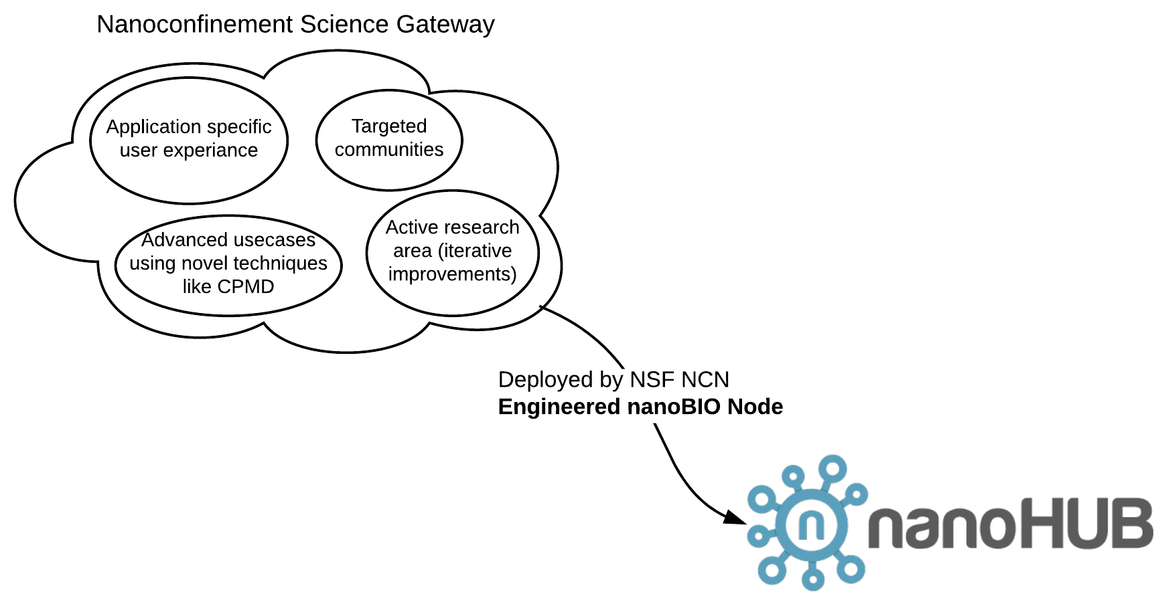

Slide 7
Goals of the nanoconfinement Science Gateway
To provide a web-based platform with sophisticated and user-friendly computing environment to engage with the nanoconfinement community by empowering them to launch and monitor simulations.
To enable users to explore the effects of nanoscale confinement on the distribution of ions
To build application-specific input generation, output visualization, and data production to study behavior of ions near nanoparticle surfaces and related material phenomena.
To aid in related computational tool development for deployment on nanoHUB based on iterative user feedback

Slide 8
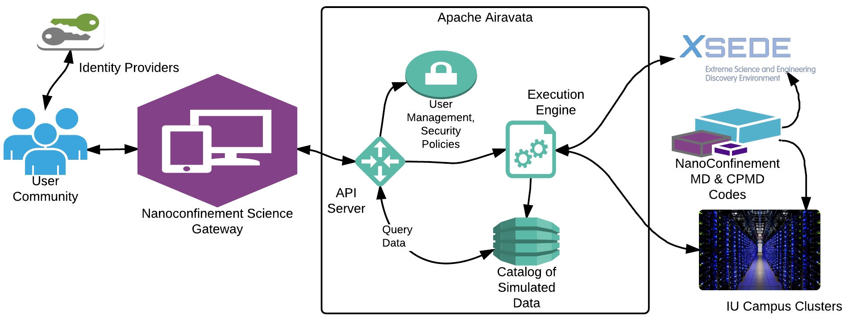
Gateway high level architecture

Slide 9
Gateway implementation details
Built over Apache Airavata Science Gateway framework.
Utilizes SciGaP Services (Airavata hosted cloud).
Users input two categories of parameters
  Physical Parameters (confinement width, ion valency, salt concentration, etc.)
  Simulation Job Parameters (simulation timestep, wall time limit, etc. )
Output: ionic distributions and movies of ion dynamics in confinement.

Slide 10
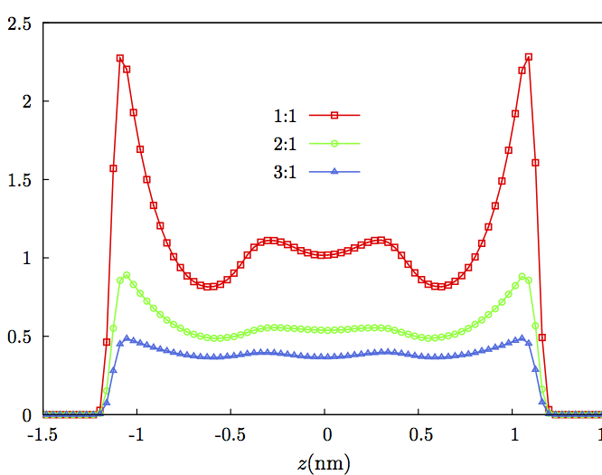
Sample output
Researcher’s view of a sample result on the gateway using the MD simulation: distributions of ions described by nz (in units of Molars) as a function of z (nm). Ions are confined by two surfaces at -1.5 nm and 1.5 nm. Different symbols denote ions of valencies 1, 2, and 3.

Slide 11
Current Status
Current codes with openMP parallelization for 16 threads lead to a run time of 1 hour for a mid-size candidate system of 500 ions simulated for 1 million time steps.
Work in progress to make the method more efficient by using MPI.
Extending the current output data download to browser based interactive visualizations within the gateway.
Currently focusing on CPU based resources on SDSC Comet and IU BigRed II clusters. Planning to explore other hardware to improve simulation run times.

Slide 12
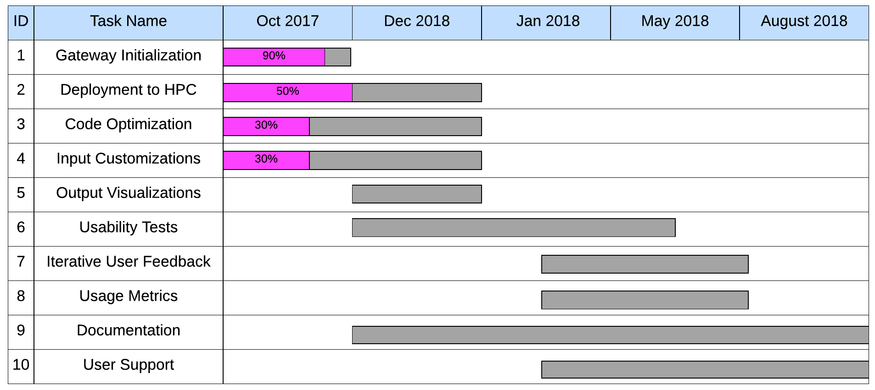
Road Map

Slide 13
Grant Acknowledgements
This work is partially supported by the National Science Foundation under:
  the Network for Computational Nanotechnology (NCN) Network for Computational Nanotechnology - Engineered nanoBIO Node through award 1720625
  Science Gateways Platform as a Service through award 1339774.
  Apache Airavata Project Management Committee
Computational Resources provided by:
  XSEDE Startup Allocation through Grant TG - DMR170089
  Big Red II supercomputer at Indiana University

Slide 14
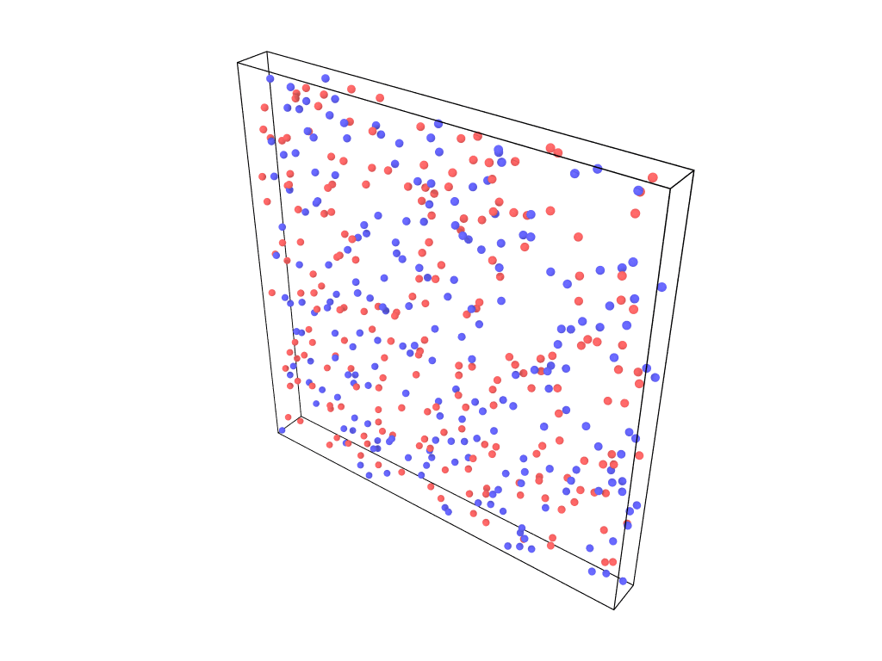
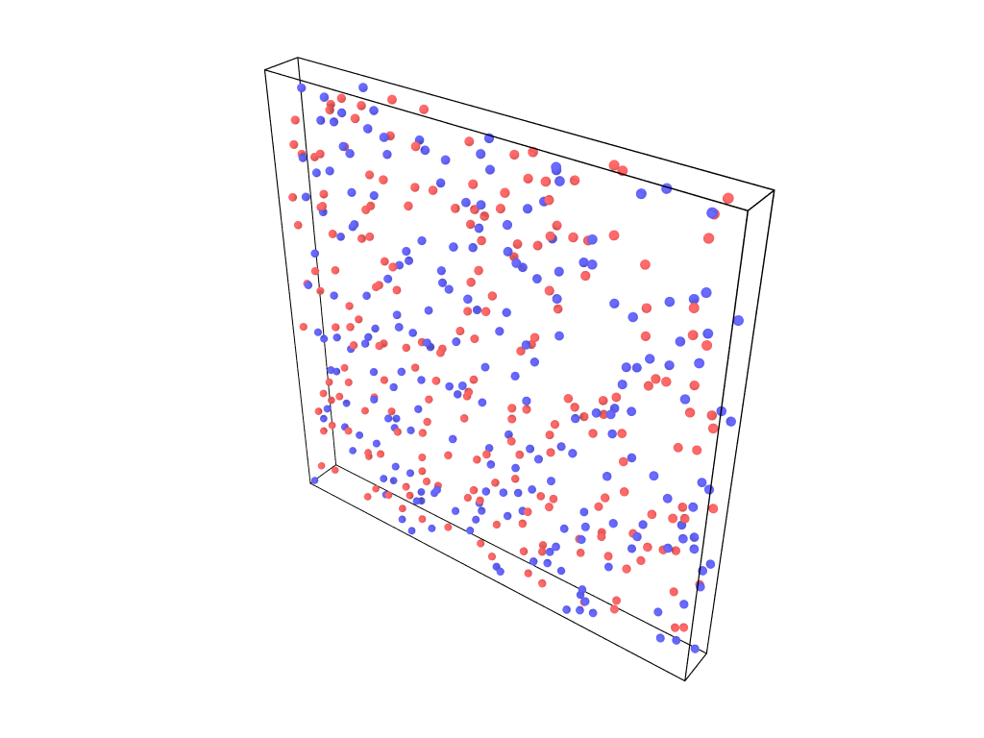
MD Simulation of confined ions
1:1 salt at 0.1 M
in water,
Initialize ions
Confining interface
Compute Forces
Move ions
Confining interface

