Slide 1
SPIDAL Java High Performance Data Analytics with Java on Large Multicore HPC Clusters
Biocomplexity Institute of Virginia Tech
May 16th, 2016
Saliya Ekanayake
sekanaya@indiana.edu
https://github.com/DSC-SPIDAL | http://saliya.org

Slide 2
High Performance?
64x Ideal (if life was so fair!)
40x Speedup with SPIDAL Java
We’ll discuss today
Typical Java with Threads and MPI
Typical Java with All MPI
48 Nodes
Intel Haswell HPC Cluster with 24 core nodes and 40Gbps Infiniband
128 Nodes

Slide 3
Before We Proceed
The Big Data Landscape
Pleasingly Parallel
Parallelization over items
E.g. BLAST, protein docking, and local analytics
Classic MapReduce
E.g. search, index and query, and classification
Map Collective
Iterative maps + collective communications
E.g. PageRank, MDS, and clustering
Map Point-to-Point
Iterative maps + point-to-point communications
E.g. graph algorithms
Shared Memory
E.g. Applications in MineBench
Map Streaming
Maps with streaming data
E.g. Processing sensor data from robots
Input
Input
Map and
communicate
Brokers
Input
Maps
Map
Map
Map
Shared Memory
Output
Reduce
Collective

Slide 4
Before We Proceed
There’s More
Is that all?
The Big Data Landscape
Pleasingly Parallel
Parallelization over items
E.g. BLAST, protein docking, and local analytics
Classic MapReduce
E.g. search, index and query, and classification
Map Collective
Iterative maps + collective communications
E.g. PageRank, MDS, and clustering
Map Point-to-Point
Iterative maps + point-to-point communications
E.g. graph algorithms
Map Streaming
Maps with streaming data
E.g. Processing sensor data from robots
Shared Memory
E.g. Applications in MineBench
Agents — 11(M)
Pleasingly Parallel — 1
Classic MapReduce — 2
Map-Collective — 3
Map Point-to-Point — 4
Map Streaming — 5
Shared Memory — 6
Single Program Multiple Data — 7
Bulk Synchronous Parallel — 8
Fusion — 9
Dataflow — 10
Workflow — 12
Problem Architecture
Input
Input
Map and
communicate
Brokers
Input
Maps
Map
Map
Map
Shared Memory
Output
Reduce
Collective

Slide 5
There’s Even More
Geospatial Information System
Shared / Dedicated / Transient / Permanent
Archived/Batched/Streaming – S1, S2, S3, S4, S5
HPC Simulations
Internet of Things
Metadata/Provenance
Data Source and Style View
10D
9
8D
HDFS/Lustre/GPFS
7D
Enterprise Data Model
6D
Files/Objects
SQL/NoSQL/NewSQL
5D
Agents — 11(M)
Spectral Methods
Data Search/Query/Index
4D
Multiscale Method
Recommender Engine
Global (Analytics/Informatics/Simulations)
N-body Methods
Data Classification
Local (Analytics/Informatics/Simulations)
Iterative PDE Solvers
Linear Algebra Kernels/Many subclasses
Dataflow — 10
Particles and Fields
Base Data Statistics
Micro-benchmarks
Workflow — 12
Nature of mesh if used
Learning
Graph Algorithms
Data Alignment
Evolution of Discrete Systems
Streaming Data Algorithms
Core Libraries
Optimization Methodology
Visualization
Bulk Synchronous Parallel — 8
Pleasingly Parallel — 1
Classic MapReduce — 2
Map-Collective — 3
Map Point-to-Point — 4
Map Streaming — 5
Shared Memory — 6
Single Program Multiple Data — 7
Fusion — 9
3D
2D
1D
Execution View
Problem Architecture
Pleasingly Parallel
Convergence Diamonds Views and Facets
1
2
3
D
4
M
4
D
5
D
6
M
6
7
M
8
D
9
M
9
D
10
M
10
M
11
D
12
M
12
D
13
M
13
M
14
Classic MapReduce
Map-Collective
22
M
21
M
20
M
19
M
18
M
17
M
16
M
11
M
10
M
9
M
8
M
7
M
6
M
5
M
4
M
15
M
14
M
13
M
12
M
Map Point-to-Point
Single Program Multiple Data
3
M
2
M
1
M
Simulation (Exascale) Processing Diamonds
Big Data Processing Diamonds
Bulk Synchronous Parallel
Map Streaming
1
Shared Memory
2
Processing View
Performance Metrics
3
Dynamic = D / Static = S
$O\left(N^{2}\right)$ = NN / $O(N)$ = N
Dynamic = D / Static = S
Data Volume
Model Abstraction
Model Size
Data Velocity
Data Variety
Model Variety
Veracity
Communication Structure
Data Abstraction
4
Iterative / Simple
Flops per Byte/Memory IO/Flops per watt
Regular = R / Irregular = I Data
Data Metric = M / Non-Metric = N
Data Metric = M / Non-Metric = N
5
Regular = R / Irregular = I Model
Execution Environment; Core libraries
6
64 Features in 4 views
Includes both Big Data and simulation applications
7
Dataflow
Fusion
8
Workflow
9
Agents
10
11M
Problem Architecture View
12

Slide 6
The Take Away: Big Data Is Diverse
BigDataBench
42 benchmarks targeting Internet services in 5 application domains
HiBench
Evaluates Hadoop and its ecosystem against a few micro-benchmarks and real applications
Graph500
Breadth first search (BFS) kernel on graph data
BigBench
End-to-end benchmark carrying 30 workloads against a synthetic retailer model
LinkBench
Benchmark to evaluate Facebook’s graph serving capabilities
MineBench
15 data mining applications covering 5 application areas
BG Benchmark
Benchmarks data stores for social interactive read/write actions satisfying a given service level agreement (SLA)
Berkeley Big Data Benchmark
A few relational queries against Redshift, Hive, SparkSQL, Impala, and Stinger/Tez
TPCx-HS
Vendor neutral Hadoop sort benchmark from TPC-BD working group
Yahoo Cloud Serving Benchmark (YCSB)
Evaluates a mix of read/write operations against PNUTS, BigTable, HBase, Cassandra, and Sharded MySQL
CloudSuite
A suite of benchmarks covering scale-out services like data analytics, data caching, data serving, graph analytics, media streaming, etc.
And more …

Slide 7
The Rest of the Title
Data Analytics → Java → Large Multicore → HPC Clusters
Global communication compared to local point-to-point in scientific applications
Large data sizes
Improving performance requires systematic study over many factors.
Big data + cloud is the norm, but not always
Data analytics demand significant computation and communication
Fast interconnect and large
memory are ideal.
Eco system of big data software
Interoperable
Typically, not used in HPC, but can give comparative performance to C/C++ (see this Google query)
Core counts of 24 to 36 per node such as Intel Haswell
Multiple NUMA zones per node
Efficient exploitation of cores is non-trivial: how many processes vs threads?

Slide 8
SPIDAL Java
Scalable Parallel Interoperable Data Analytics Library (SPIDAL)
Available at https://github.com/DSC-SPIDAL
Users’ guide (in progress) at Global Machine Learning with DSC-SPIDAL
Includes Multidimensional Scaling (MDS) and Clustering Applications
DA-MDS
Y. Ruan and G. Fox, "A Robust and Scalable Solution for Interpolative Multidimensional Scaling with Weighting," eScience (eScience), 2013 IEEE 9th International Conference on, Beijing, 2013, pp. 61-69. doi: 10.1109/eScience.2013.30
DA-PWC
Fox, G. C. Deterministic annealing and robust scalable data mining for the data deluge. In Proceedings of the 2nd International Workshop on Petascal Data Analytics: Challenges and Opportunities, PDAC ’11, ACM (New York, NY, USA, 2011), 39–40.
DA-VS
Fox, G., Mani, D., and Pyne, S. Parallel deterministic annealing clustering and its application to lc-ms data analysis. In Big Data, 2013 IEEE International Conference on (Oct 2013), 665–673.
MDSasChisq
General MDS implementation using LevenbergMarquardt algorithm
Levenberg, K. A method for the solution of certain non-linear problems in least squares. Quarterly Journal of Applied Mathmatics II, 2 (1944), 164–168.)

Slide 9
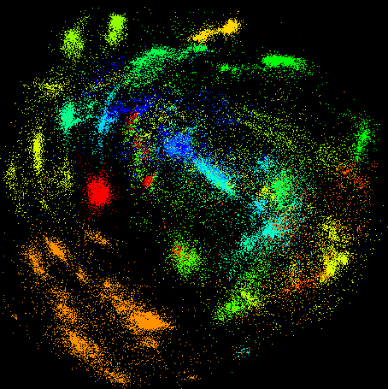
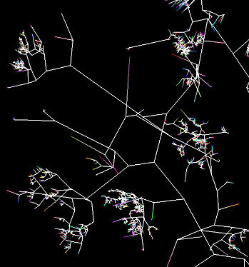
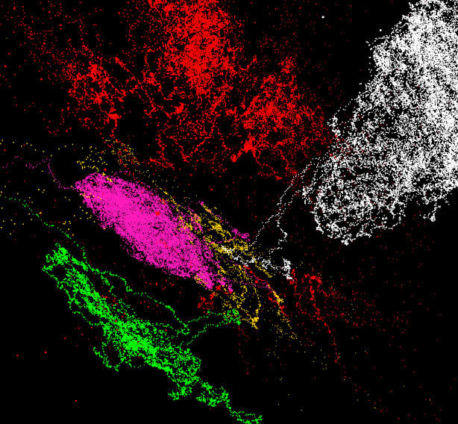
SPIDAL Java Applications
DA-MDS
Gene Sequence Clustering and Visualization
Results at WebPlotViz and Million Sequence Project
https://spidal-gw.dsc.soic.indiana.edu/public/resultsets/991946447
https://spidal-gw.dsc.soic.indiana.edu/public/resultsets/795366853
A few snapshots
Sequence File
Pairwise Alignment
3D Plot
DA-PWC
100,000 fungi sequences
3D phylogenetic tree
3D plot of vector data

Slide 10
SPIDAL Java Applications
Stocks Data Analysis
Time series view of stocks
E.g. with 1 year moving window
https://spidal-gw.dsc.soic.indiana.edu/public/timeseriesview/825496517

Slide 11
Performance Challenges
Intra-node Communication
Exploiting Multicore NUMA Nodes
Overhead of Garbage Collection
Cost of Heap Allocated Objects
Cache and Memory Access

Slide 12
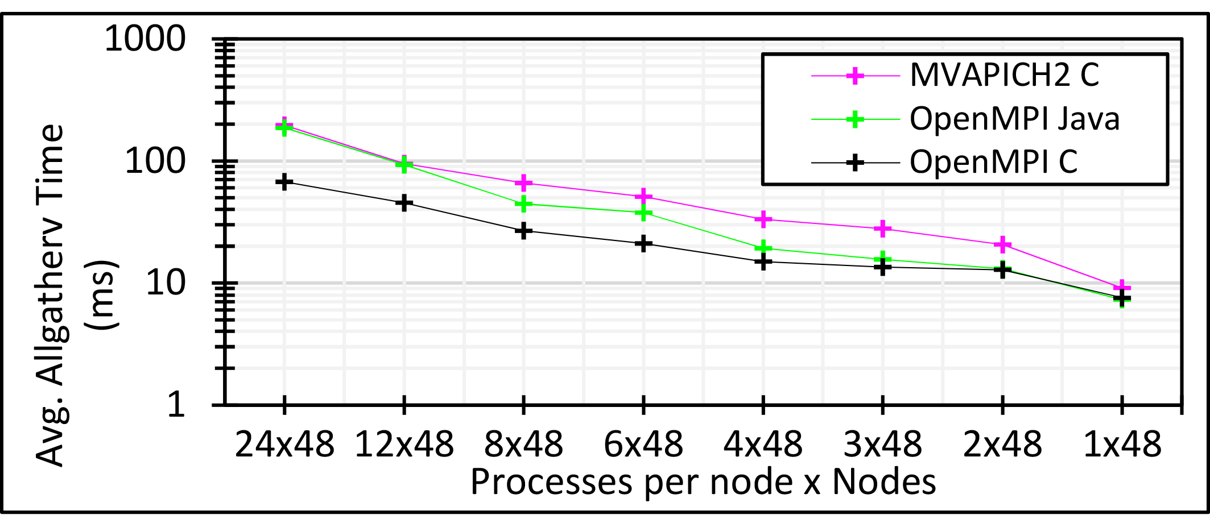
Performance Challenges
Intra-node Communication [1/3]
Large core counts per node – 24 to 36
Data analytics use global collective communication – Allreduce, Allgather, Broadcast, etc.
HPC simulations, in contrast, typically, uses local communications for tasks like halo exchanges.
Identical message size per node, yet 24 MPI is ~10 times slower than 1 MPI
Suggests #ranks per node should be 1 for the best performance
But how to exploit all available cores?
3 million double values distributed uniformly over 48 nodes

Slide 13
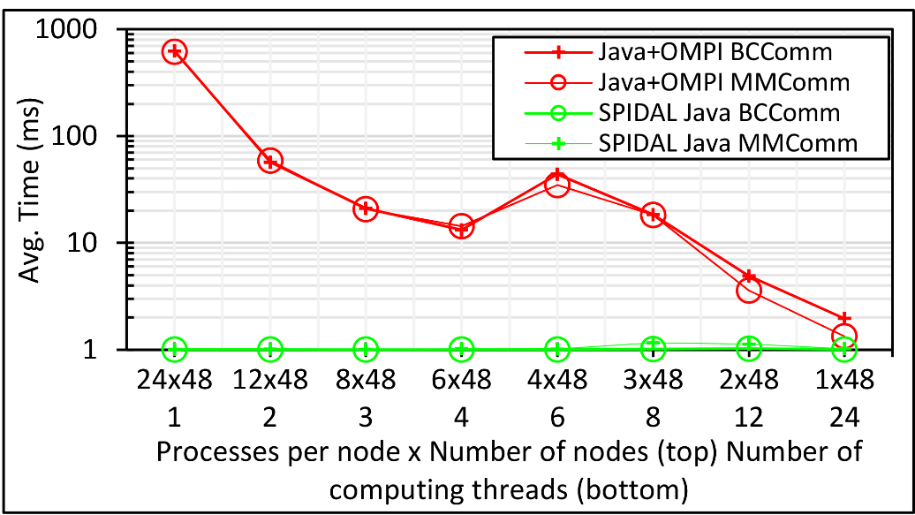
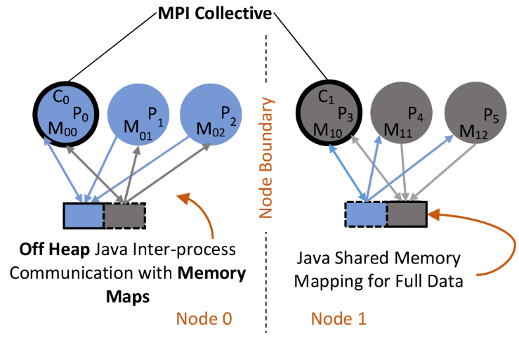
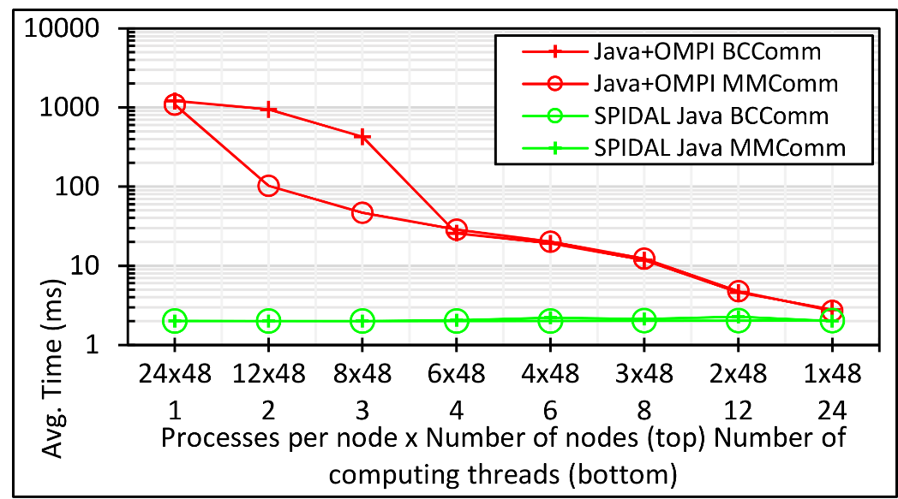
Performance Challenges
Intra-node Communication [2/3]
Solution: Shared memory (Note. SM between processes)
Use threads? → didn’t work well (explained shortly)
Processes with shared memory communication
Custom implementation in SPIDAL Java outside of MPI framework
100K DA-MDS Run Communication
Only 1 rank per node participates in the MPI collective call
Others exchange data using shared memory maps
200K DA-MDS Run Communication

Slide 14
Performance Challenges
Intra-node Communication [3/3]
Heterogeneity support
Nodes with 24 and 36 cores
Automatically detects configuration and allocates memory maps
Implementation
Custom shared memory implementation using OpenHFT’s Bytes API
Supports collective calls necessary within SPIDAL Java

Slide 15
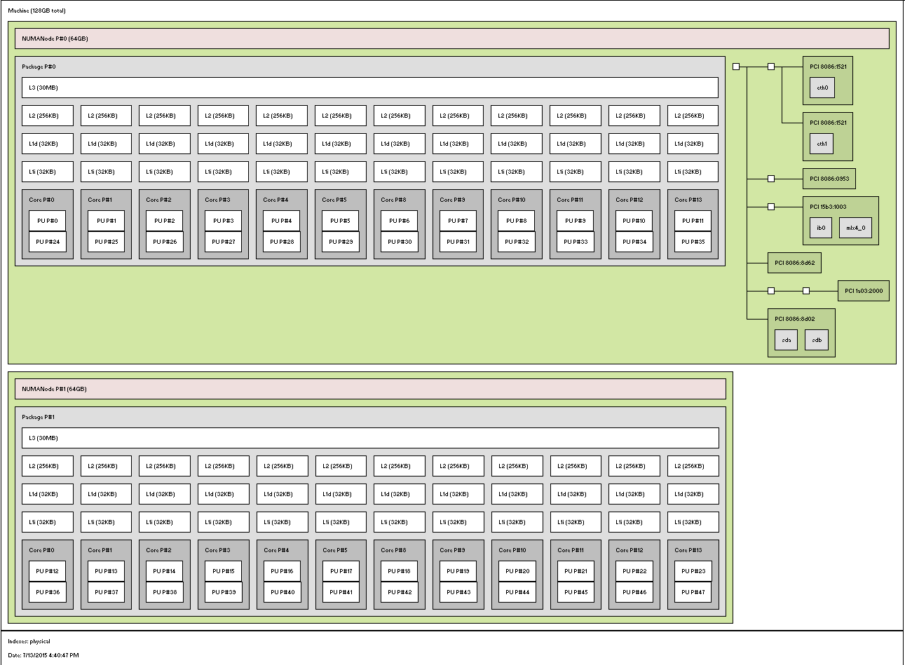
Performance Challenges
Exploiting Multicore NUMA Nodes [1/4]
Large #Cores per Node
E.g. 1 Node in Juliet HPC cluster
2 Sockets
12 Cores each
2 Hardware threads per core
L1 and L2 per core
L3 shared per socket
Which approach is better?
All processes → 1 proc per core
1 Process multiple threads
Other TxP combination
What about thread binding?
1 Core – 2 HTs
Socket 0
Socket 1

Slide 16
Performance Challenges
Exploiting Multicore NUMA Nodes [2/4]
All processes with one per core gave the best performance (the least variation in timing among tasks)
1 Process with 24 threads had the poorest performance
12 threads over 2 processes could be made to match the best performance (not easy – discussed next)
Other patterns didn’t help
Pinning threads to cores is *important*
Java threads can be pinned using OpenHFT thread affinity library
P0
P1
P2
P3
P4
P5
P6
P7
Note. If not for SPIDAL Java’s shared memory communication, MPI cost would be so high making this (all procs) the poorest choice.
C0
C1
C2
C3
C4
C5
C6
C7
Socket 0
Socket 1
P0
T0
T1
T2
T3
T4
T5
T6
T7
C0
C1
C2
C3
C4
C5
C6
C7
Socket 0
Socket 1
P0
P1
T0
T1
T2
T3
T0
T1
T2
T3
C0
C1
C2
C3
C4
C5
C6
C7
Socket 0
Socket 1

Slide 17
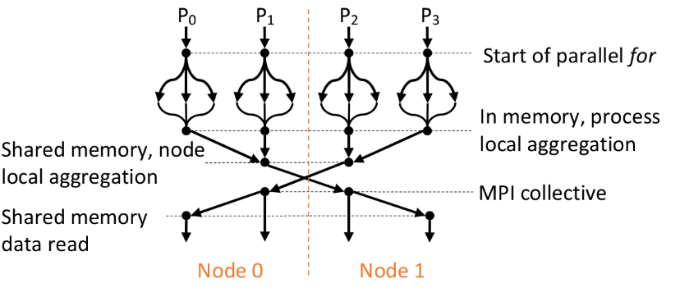
Performance Challenges
Exploiting Multicore NUMA Nodes [3/4]
Suggested thread model in literature → fork-join regions within a process
Thread wake up and scheduling overhead accumulates over iterations and significant (~5%)
True for Java threads as well as OpenMP in C/C++ (see https://github.com/esaliya/JavaThreads and https://github.com/esaliya/CppStack/tree/master/omp2/letomppar)
Also, global data shows higher TLB misses in perf stats.
Long running threads with local data could match the performance of all procs (next).
process
Iterations
Prev. Optimization

Slide 18
Performance Challenges
Exploiting Multicore NUMA Nodes [4/4]
Fork-join (FJ) vs. long running threads (LRT)
DA-MDS has a LRT branch for giving similar performance as processes with threads
FJ worker threads context switch between parallel and serial regions: adds overhead.
LRT replicate serial work, but has no context switch overhead.
Synchronization constructs in LRT need to keep threads busy to avoid releasing CPU resources.
In FJ, MPI communication, typically, happens within master thread after a parallel region.
In LRT, thread 0 may participate in MPI after synchronization construct, while others busy wait on results.
What about global vs local data?
Serial work
Non-trivial parallel work
Busy thread synchronization

Slide 19
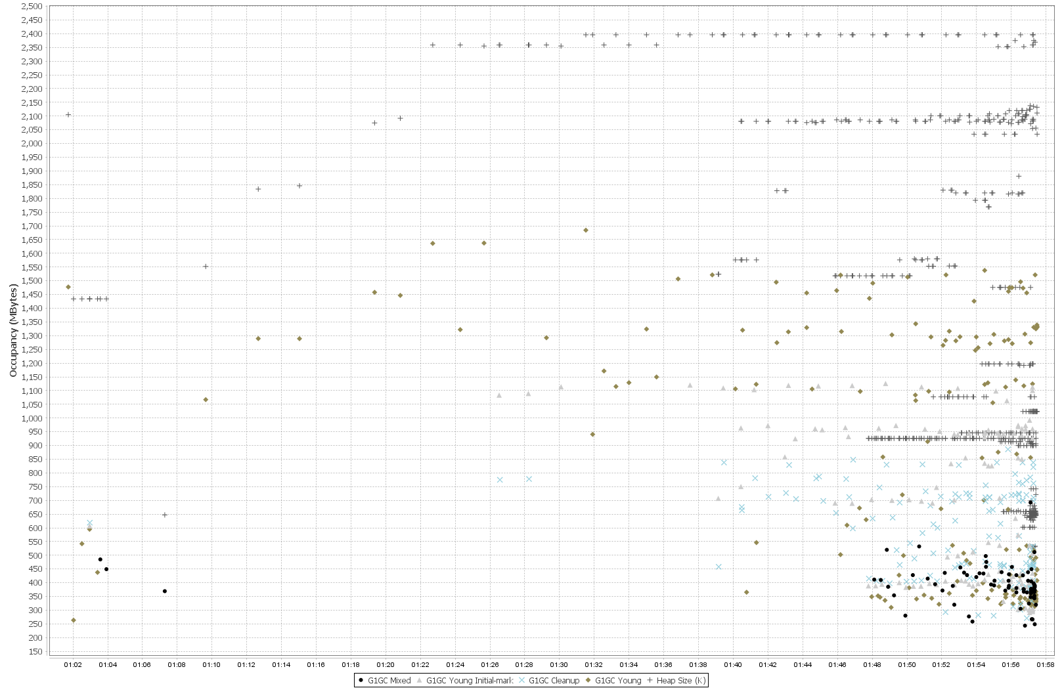
Performance Challenges
Heap size per process reaches –Xmx (2.5GB) early in the computation
Garbage Collection
“Stop the world” events are expensive
Especially, for parallel processes with collective communications
Typical OOP → allocate – use – forget
Original SPIDAL code produced frequent garbage of small arrays
Solution: Zero-GC using
Static allocation and reuse
Off-heap static buffers (more on next slide)
Advantage
No GC – obvious
Scale to larger problem sizes
E.g. Original SPIDAL code required 5GB (x 24 = 120 GB per node) heap per process to handle 200K MDS. Optimized code use < 1GB heap to finish within the same timing.
Note. Physical memory is 128GB, so with optimized SPIDAL can now do 1 million point MDS within hardware limits.
Frequent GC
Heap size per process is well below (~1.1GB) of –Xmx (2.5GB)
Virtually no GC activity with the optimized code

Slide 20
Performance Challenges
I/O with Heap Allocated Objects
Java-to-native I/O creates copies of objects in heap
Otherwise can’t guarantee object’s memory location due to GC
Too expensive
Solution: Off-heap buffers (memory maps)
Initial data loading → significantly faster than Java stream API calls
Intra-node messaging → gives the best performance
MPI inter-node communications
Cache and Memory Access
Nested data structures are neat, but expensive
Solution: Contiguous memory with 1D arrays over 2D structures
Indirect memory references are costly
Also, adopted from HPC
Blocked loops and loop ordering

Slide 21
Evaluation
HPC Cluster
128 Intel Haswell nodes with 2.3GHz nominal frequency
96 nodes with 24 cores on 2 sockets (12 cores each)
32 nodes with 36 cores on 2 sockets (18 cores each)
128GB memory per node
40Gbps Infiniband
Software
Java 1.8
OpenHFT JavaLang 6.7.2
Habanero Java 0.1.4
OpenMPI 1.10.1
Application: DA-MDS
Computations grow $O\left(N^{2}\right)$
Communication global and is $O(N)$

Slide 22
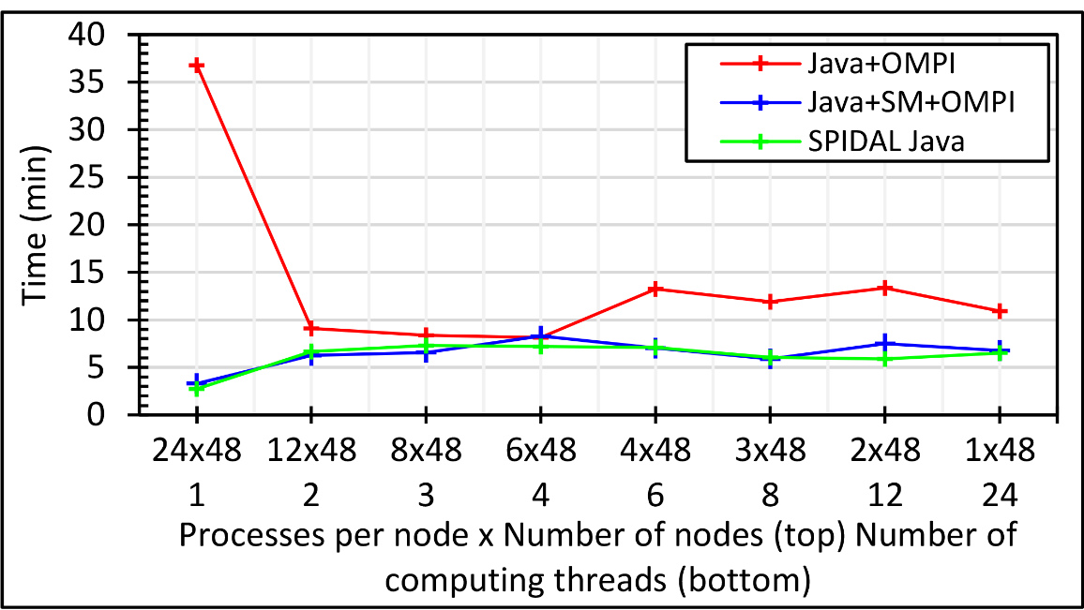
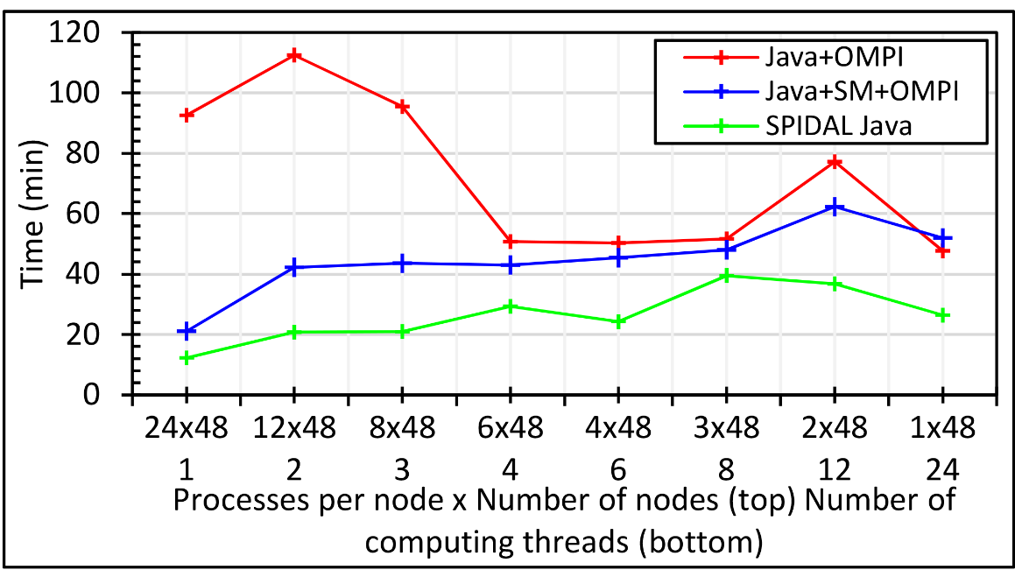
1152 Total Parallelism across 48 nodes
All combinations of 24 way parallelism per node
LHS is all processes
RHS is all internal threads and MPI across nodes
100K
DA-MDS
With SM communications in SPIDAL, processes outperform threads (blue line)
Other optimizations further improves performance (green line)
200K
DA-MDS
400K
DA-MDS

Slide 23
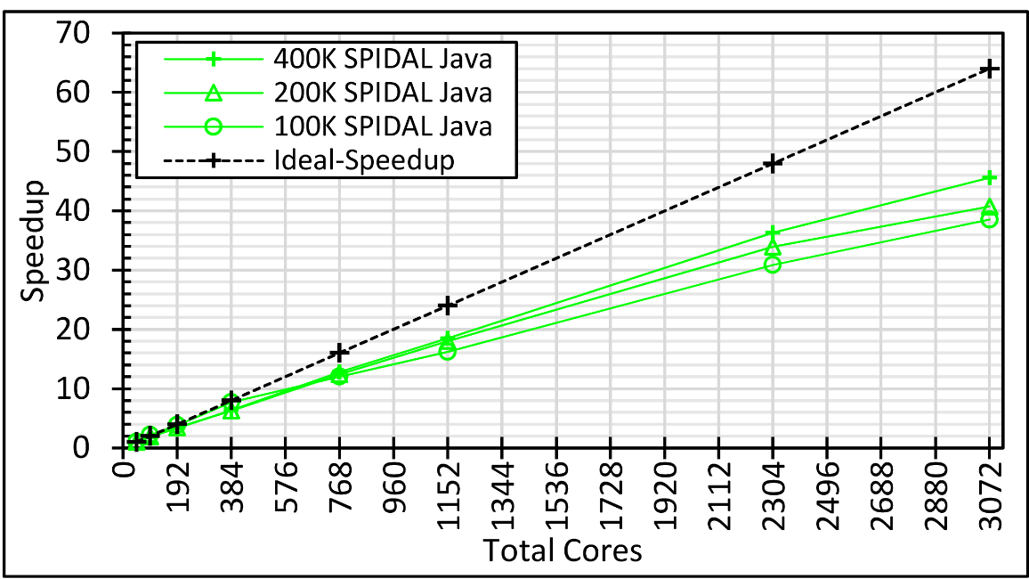
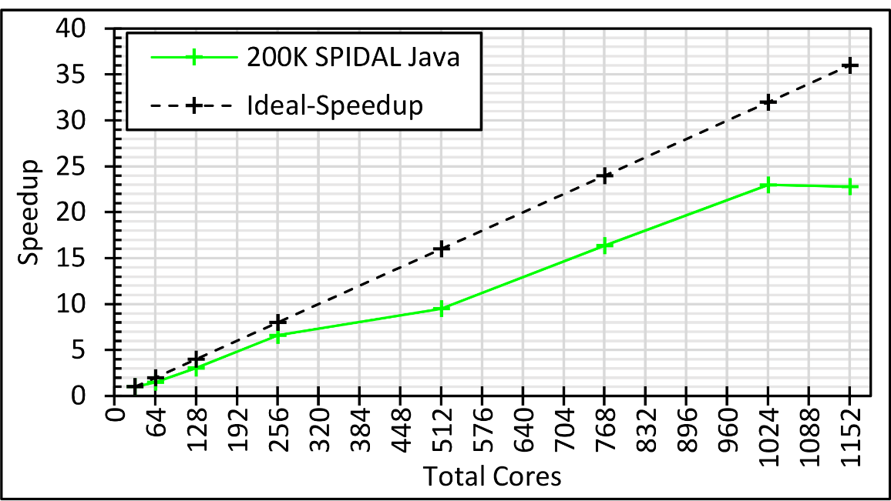
Speedup for varying data sizes
All processes
LHS is 1 proc per node across 48 nodes
RHS is 24 procs per node across 128 nodes (ideal 64x speedup)
Larger data sizes show better speedup
(400K – 45x, 200K – 40x, 100K – 38x)
Speedup on 36 core nodes
All processes
LHS is 1 proc per node across 32 nodes
RHS is 36 procs per node across 32 nodes (ideal 36x speedup)
Speedup plateaus around 23x after 24 way parallelism per node

Slide 24
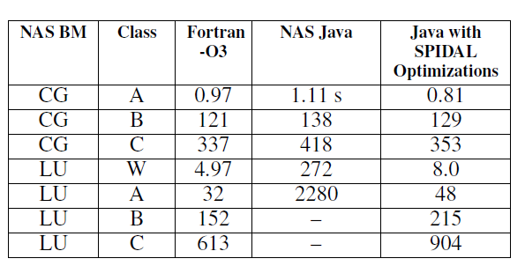
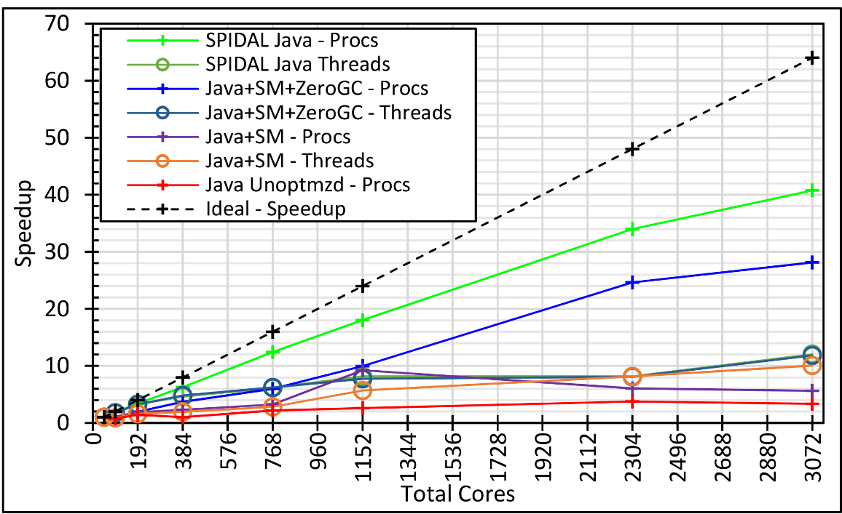
Java, is it worth it? – YES!
Also, with JIT some cases in MDS are better than C
48 Nodes
128 Nodes
The effect of different optimizations on speedup

Slide 25
Thank you!

