Slide 1
Towards a Systematic Study of Big Data Performance and Benchmarking
Saliya Ekanayake
Ph.D Dissertation Defense
September 28th, 2016
Committee in Charge:
Professor Geoffrey C. Fox, Chairperson
Professor Andrew Lumsdaine, Associate Professor Judy Qiu, Professor Haixu Tang

Slide 2
Towards a Systematic Study of Big Data Performance and Benchmarking
Towards a Systematic Study of Big Data Performance and Benchmarking
Towards a Systematic Study of Big Data Performance and Benchmarking
Towards a Systematic Study of Big Data Performance and Benchmarking
Towards a Systematic Study of Big Data Performance and Benchmarking
Notes:
Let’s look at the title one more time. Obviously, it talks about Big Data, but Big Data means many things to many people, so specifically it talks about Performance; and Benchmarking. And it talks about a Systematic Study meaning we’ll methodically look at several applications and frameworks in this research.

Slide 3
Big Data
Simple queries over scale-out data storages.
Still the dominant representation of Big Data in commercial use cases¹.
E.g. Google MapReduce on GFS and Apache Hadoop on HDFS.
Complex queries – parallel machine learning. ← emphasized in this research
Sensitive to performance variations.
Includes real time analytics – twitter feed, stocks data.
Frameworks beyond MapRedce – Spark, Flink, Storm, Harp
High-Level languages.
Java is dominant; Scala, Python, and C++ to follow.
Ecosystem of open source software – over 350 packages in ABDS².
Convergence with HPC³.
HPC technologies can improve performance oriented Big Data use cases.
1 https://www.qubole.com/resources/solution/best-use-cases-for-big-data-analytics
2 http://hpc-abds.org/kaleidoscope/
3 http://dsc.soic.indiana.edu/publications/HPCBigDataConvergence.pdf
Notes:
Let’s look at Big Data.

Slide 4
Performance and Benchmarking
Performance factors.
Thread models.
Affinity.
Communication mechanisms.
Other factors of high-level languages
Garbage collection, serialization/deserialization, memory references and cache, data read/write
Parallel machine learning.
Dense matrix operations.
Collective communications. ← contrast to scientific simulations
Nested iterations.
Performance optimizations.
Significant performance improvement over previous factors.
Benchmark classification
Introduce Convergence Diamonds (CDs) classification

Slide 5
Systematic Study
Performance scaling,
Over many cores within a node.
Across nodes.
With varying data sizes.
Multiple applications
DA-MDS, K-Means, DA-PWC, and MDSasChisq
Frameworks
MPI, Flink, and Spark

Slide 6
What to Expect in Upcoming Slides
64x Ideal (if life was so fair!)
>40x Speedup with optimizations
We’ll discuss today
Hybrid Threads and MPI
All-MPI approach
48 Nodes
Intel Haswell HPC Cluster with 24 core nodes and 40Gbps Infiniband
128 Nodes

Slide 7
Programming Models
Task
Task
Task
Shared Memory (SM).
Pthreads, Java threads.
OpenMP, Habanero Java (HJ).
Distributed Memory (DM).
Message Passing Interface (MPI).
Hadoop, Twister, Harp
Hybrid of SM and DM.
MPI+{OpenMP,HJ}.
Dataflow.
Hybrid of SM and DM.
Spark, Flink.
Task
Task
Task
Local Address Space
Local Address Space
Local Address Space
Shared Global Address Space
DM
SM
Task
...
Task
Task
...
Task
Shared Global Address Space
Task
Shared Global Address Space
Task
Data
Task
Task
Data
Task
Task
Local Address Space
Local Address Space
Dataflow
Hybrid
Notes:
A quick look at the available programming models.

Slide 8
SPIDAL Java: Parallel Machine Learning
Scalable Parallel Interoperable Data Analytics Library (SPIDAL)
Available in GitHub https://github.com/DSC-SPIDAL
DA-MDS¹
Weighted multidimensional scaling using deterministic annealing
DA-PWC²
Pairwise clustering using deterministic annealing
DA-VS³
Clustering in vector space deterministic annealing
Also supports Elkan’s K-Means⁴ clustering
MDSasChisq⁵
General multidimensional scaling using Levenberg-Marquardt⁶ algorithm
Supports distance transformations such as 4D, square root of 4D
K-Means
1 http://cgl.soic.indiana.edu/publications/WDA-SMACOF_v1.02.pdf
2 http://grids.ucs.indiana.edu/ptliupages/publications/pdac24g-fox.pdf
3 http://cgl.soic.indiana.edu/publications/Clusteringv1.pdf
4 http://users.cecs.anu.edu.au/~daa/courses/GSAC6017/kmeansicml03.pdf
5 https://github.com/DSC-SPIDAL/MDSasChisq/tree/working
6 https://www.jstor.org/stable/43633451

Slide 9
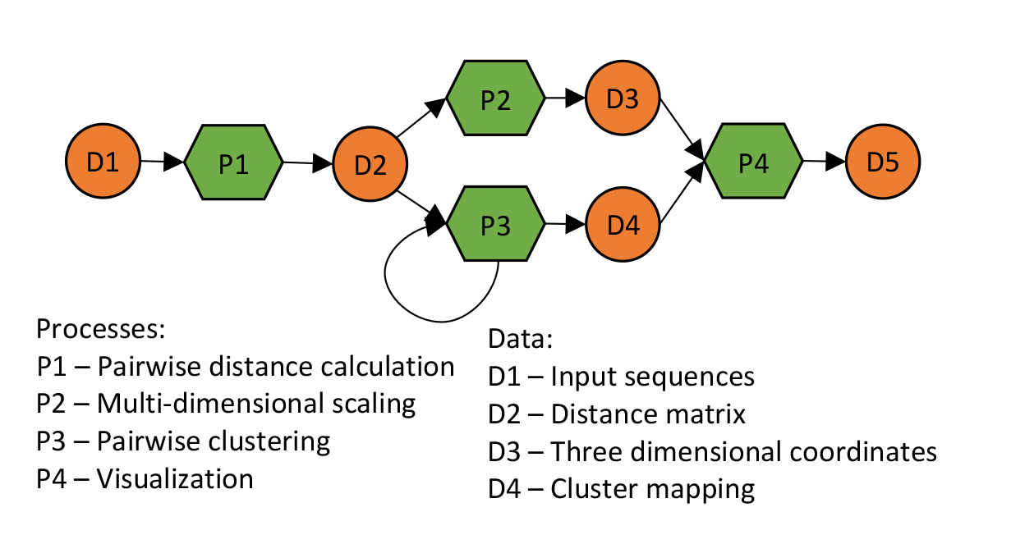
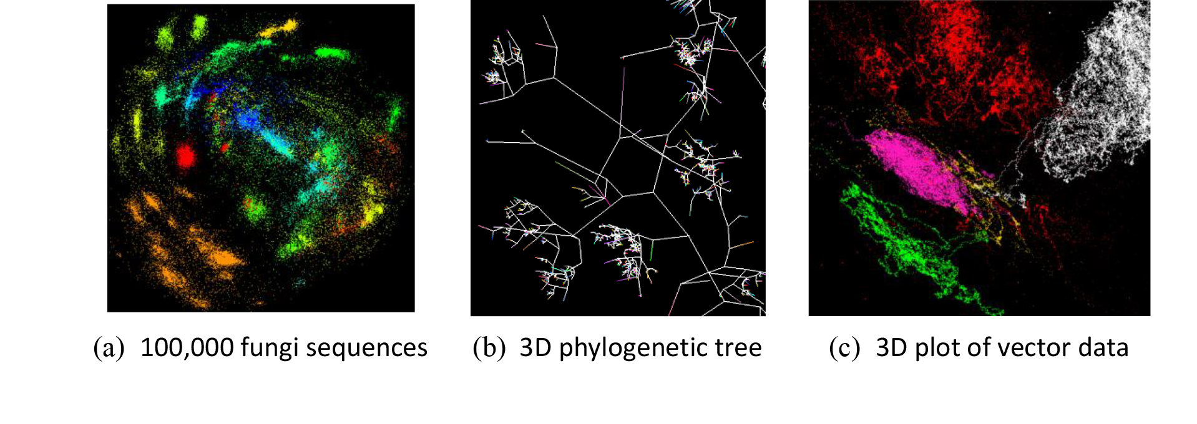
SPIDAL Java Use Cases
Gene sequence clustering.
Find sequence groups with similar properties.
DA-MDS to produce a 3D plot.
DA-PWC to cluster sequences.
3D phylogenetic trees.
WebPviz visualizer.

Slide 10
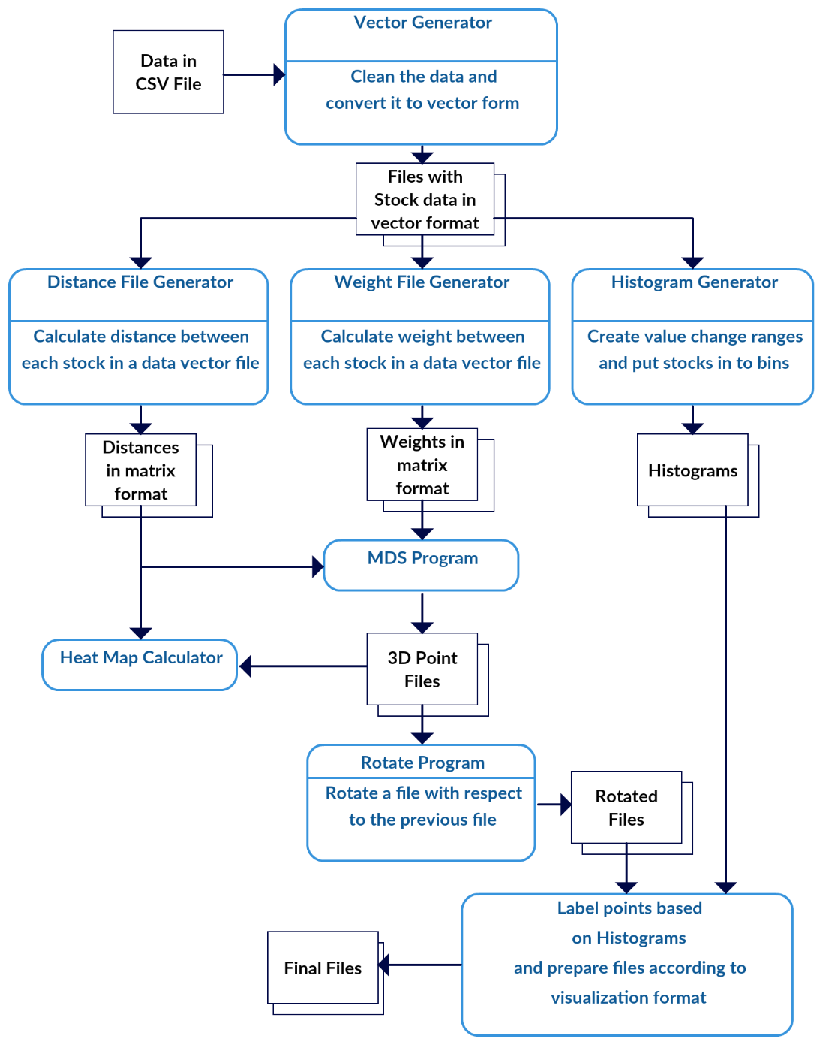
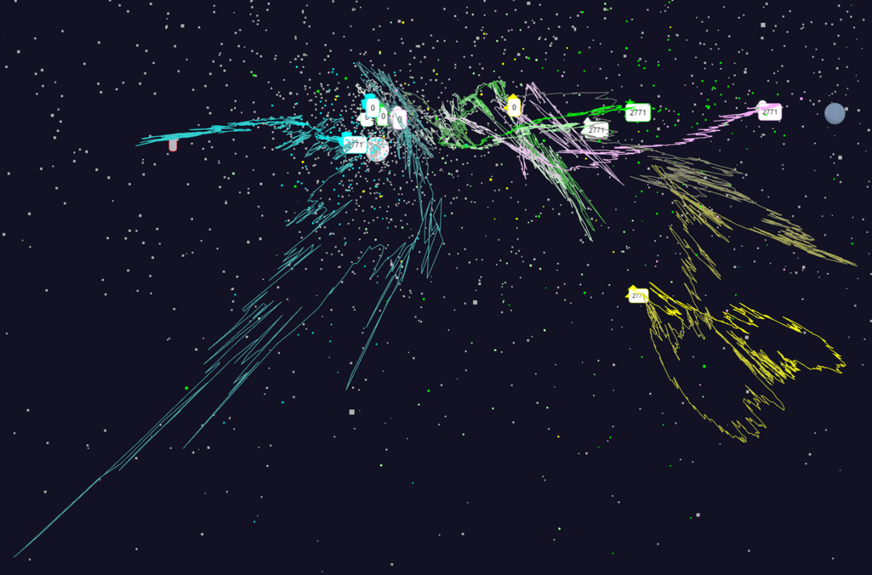
SPIDAL Java Use Cases
Stocks data analysis.
Supun Kamburugamuve, PulasthiWickramasinghe, Saliya Ekanayake, Chathuri Wimalasena, Milinda Pathirage, and Geoffrey Fox. Tsmap3d: Browser visualization of high dimensional time series data. http://dsc.soic.indiana.edu/publications/tsmap3d.pdf, 2016.
Analyze the movement of stock values over 11 years with 1 year window and 1 day sliding interval.

Slide 11
Performance Factors
Thread models. (p49)
Threads and processes affinity. (p52)
Communication mechanisms. (p53)
Other factors of high-level languages (p58-61)
Garbage collection
Serialization/Deserialization
Memory references and cache
Data read/write

Slide 12
Thread Models
LRT-FJ
Long Running Threads – Fork Join (LRT-FJ).
Serial work followed by parallel regions.
A long running thread pool handles parallel tasks.
Threads sleep after parallel work.
Serial work
Non-trivial parallel work
Long Running Threads – Bulk Synchronous Parallel (LRT-BSP).
Resembles the classic BSP model of processes.
A long running thread pool similar to FJ.
Threads occupy CPUs always – “hot” threads.
LRT-BSP
LRT-FJ vs. LRT-BSP.
High context switch overhead in FJ.
BSP replicates serial work but reduced overhead.
Implicit synchronization in FJ.
BSP use explicit busy synchronizations.
Serial work
Non-trivial parallel work
Busy thread synchronization

Slide 13
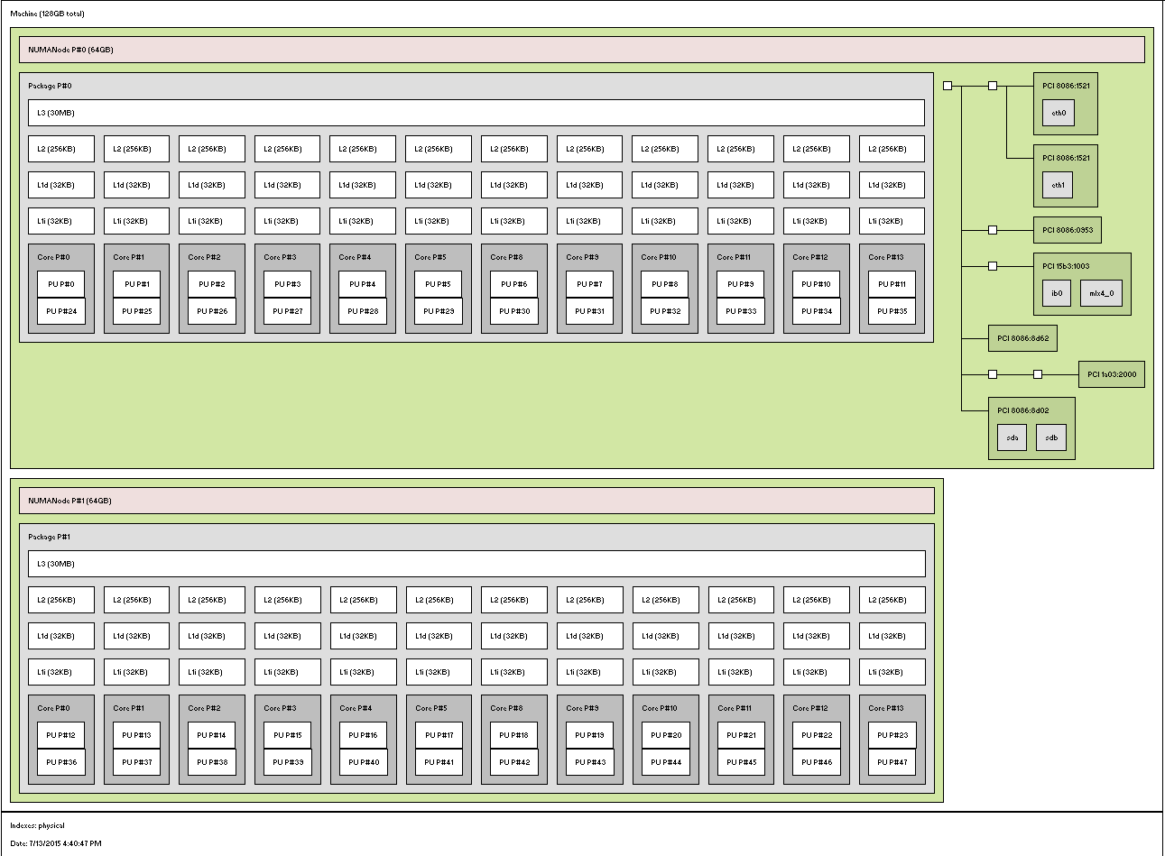
Thread Models
Non-Uniform Memory Access (NUMA) and threads
E.g. 1 node in Juliet HPC cluster
2 Intel Haswell sockets, 12 (or 18) cores each
2 hyper-threads per core
Separate L1,L2 and shared L3
Which approach is better?
All-processes
All-threads
12 threads x 2 processes
Other combinations
Where to place threads?
Node, socket, core
12 cores
1 Core – 2 HTs
Socket 0
Intel QPI
2 sockets
Socket 1

Slide 14
Affinity
P0
P1
P3
P4
C0
C1
C2
C3
C4
C5
C6
C7
2x4 CI
Socket 0
Socket 1
Six affinity patterns
E.g. 2x4
Two threads per process
Four processes per node
Assume two 4 core sockets
P0,P1
P2,P3
Threads Affinity | Processes Affinity
 | Cores | Socket | None (All)
Inherit | CI | SI | NI
Explicit per core | CE | SE | NE
C0
C1
C2
C3
C4
C5
C6
C7
2x4 SI
Socket 0
Socket 1
P0,P1,P2,P3
C0
C1
C2
C3
C4
C5
C6
C7
2x4 NI
Socket 0
Socket 1
P0
P1
P3
P4
C0
C1
C2
C3
C4
C5
C6
C7
2x4 CE
Socket 0
Socket 1
P0,P1
P2,P3
C0
C1
C2
C3
C4
C5
C6
C7
2x4 SE
Worker thread
Socket 0
Socket 1
Background thread (GC and other JVM threads)
P0,P1,P2,P3
Process
C0
C1
C2
C3
C4
C5
C6
C7
2x4 NE
Socket 0
Socket 1

Slide 15
A Quick Peek into Performance
No thread pinning and FJ
Threads pinned to cores and FJ
No thread pinning and BSP
Threads pinned to cores and BSP
K-Means 10K performance on 16 nodes

Slide 16
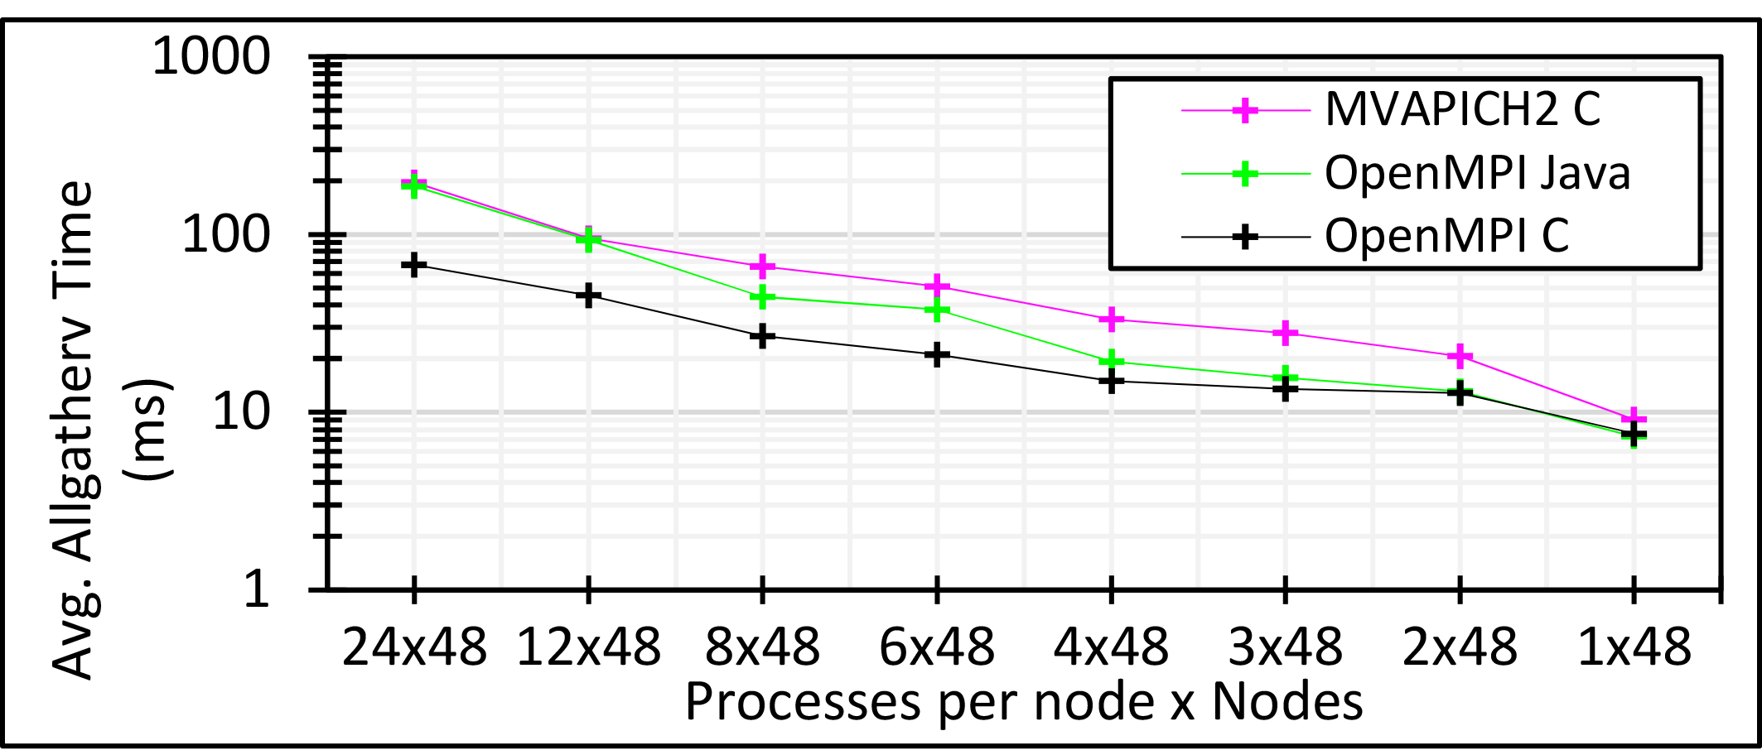
Communication Mechanisms
Collective communications are expensive.
Allgather, allreduce, broadcast.
Frequently used in parallel machine learning
E.g.
Identical message size per node, yet 24 MPI is ~10 times slower than 1 MPI
Suggests #ranks per node should be 1 for the best performance
How to reduce this cost?
3 million double values distributed uniformly over 48 nodes

Slide 17
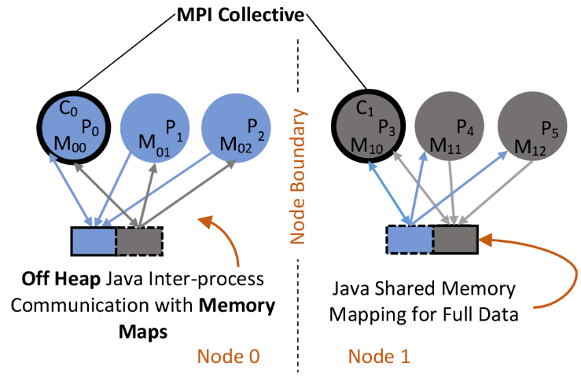
Communication Mechanisms
Shared Memory (SM) for intra-node communication.
Custom Java implementation in SPIDAL.
Uses OpenHFT’s Bytes API.
Reduce network communications to the number of nodes.
Heterogeneity support
Java SM architecture

Slide 18
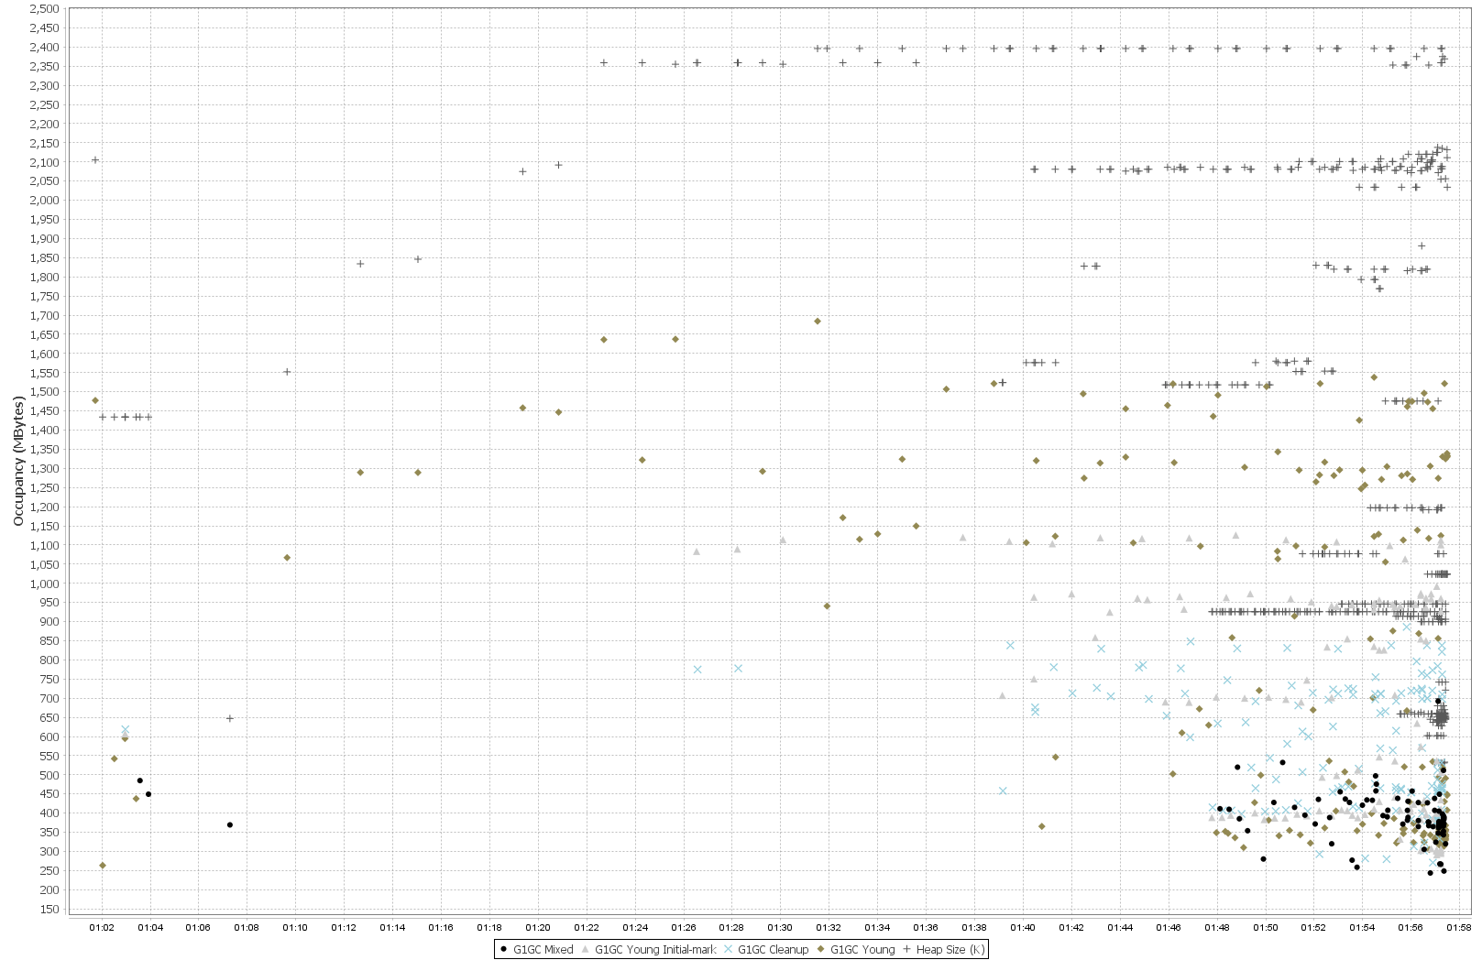
Other Factors
Heap size per process reaches –Xmx (2.5GB) early in the computation
Garbage Collection (GC)
“Stop the world” events are expensive.
Especially, for parallel machine learning.
Typical OOP → allocate – use – forget.
Original SPIDAL code produced frequent garbage of small arrays.
Solutions.
Unavoidable, but can be reduced.
Static allocation.
Object reuse.
Advantage.
Less GC – obvious.
Scale to larger problem sizes.
E.g. Original SPIDAL code required 5GB (x 24 = 120 GB per node) heap per process to handle 200K DA-MDS. Optimized code use < 1GB heap to finish within the same timing.
Note. Physical memory is 128GB, so with optimized SPIDAL can now do 1 million point MDS within hardware limits.
Frequent GC
Heap size per process is well below (~1.1GB) of –Xmx (2.5GB)
Virtually no GC activity after optimizing

Slide 19
Other Factors
Serialization/Deserialization.
Default implementations are verbose, especially in Java.
Kryo is by far the best in compactness.
Off-heap buffers are another option.
Memory references and cache.
Nested structures are expensive.
Even 1D arrays are preferred over 2D when possible.
Adopt HPC techniques – loop ordering, blocked arrays.
Data read/write.
Stream I/O is expensive for large data
Memory mapping is much faster and JNI friendly in Java
Native calls require extra copies as objects move during GC.
Memory maps are in off-GC space, so no extra copying is necessary

Slide 20
Performance Evaluation
K-Means Clustering
MPI Java and C – LRT-FJ and LRT-BSP
Flink K-Means
Spark K-Means
DA-MDS
MPI Java – LRT-FJ and LRT-BSP
DA-PWC
MPI Java – LRT-FJ
MDSasChisq
MPI Java – LRT-FJ
HPC Cluster
128 Intel Haswell nodes with 2.3GHz nominal frequency
96 nodes with 24 cores on 2 sockets (12 cores each)
32 nodes with 36 cores on 2 sockets (18 cores each)
128GB memory per node
40Gbps Infiniband
Software
RHEL 6.8
Java 1.8
OpenHFT JavaLang 6.7.2
Habanero Java 0.1.4
OpenMPI 1.10.1

Slide 21
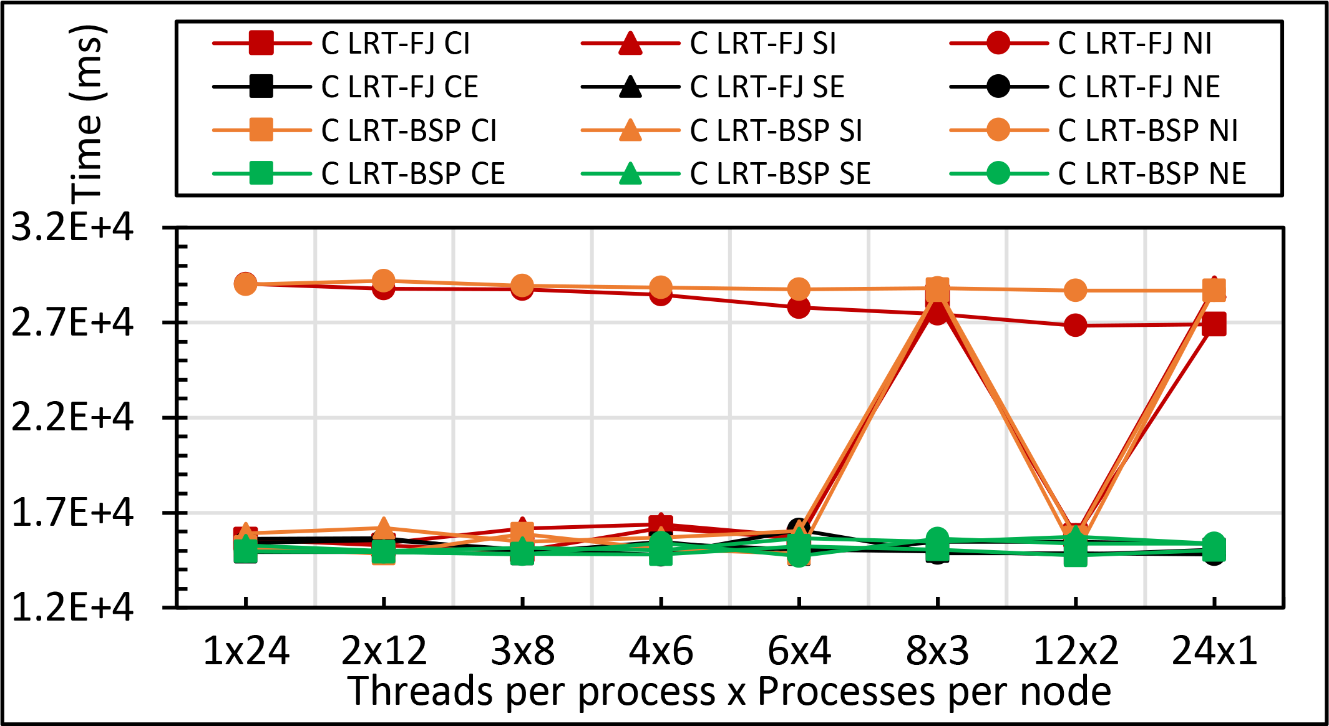
K-Means Clustering
Java K-Means 1 mil points and 1k centers performance on 16 nodes for LRT-FJ and LRT-BSP with varying affinity patterns over varying threads and processes.
C K-Means 1 mil points and 1k centers performance on 16 nodes for LRT-FJ and LRT-BSP with varying affinity patterns over varying threads and processes.
Java MPI+HJ
C MPI+OpenMP

Slide 22
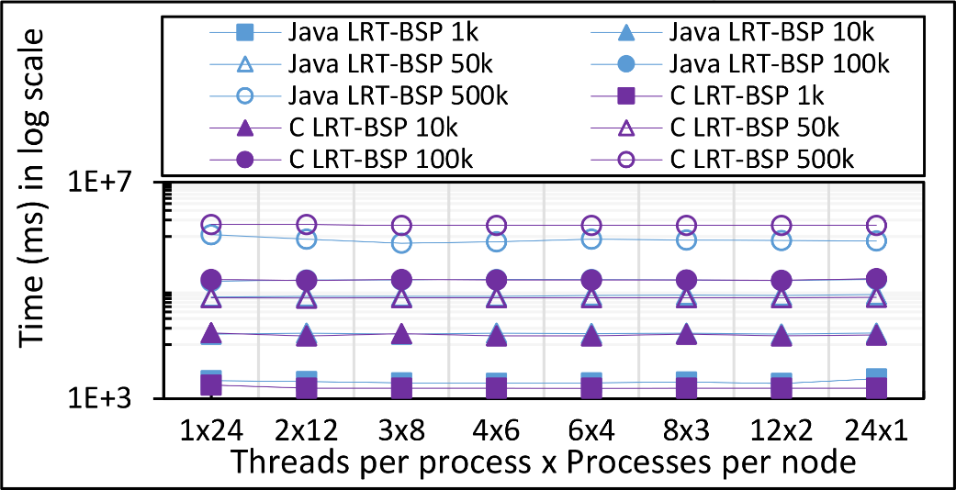
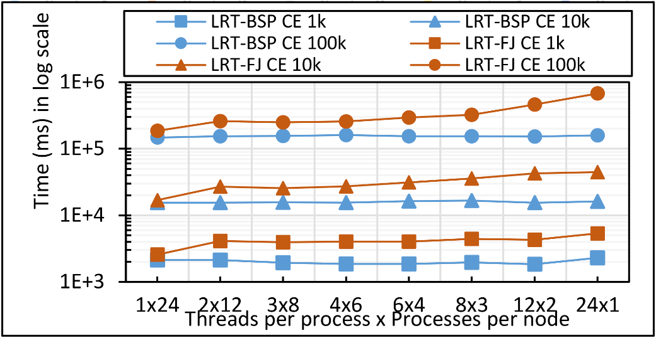
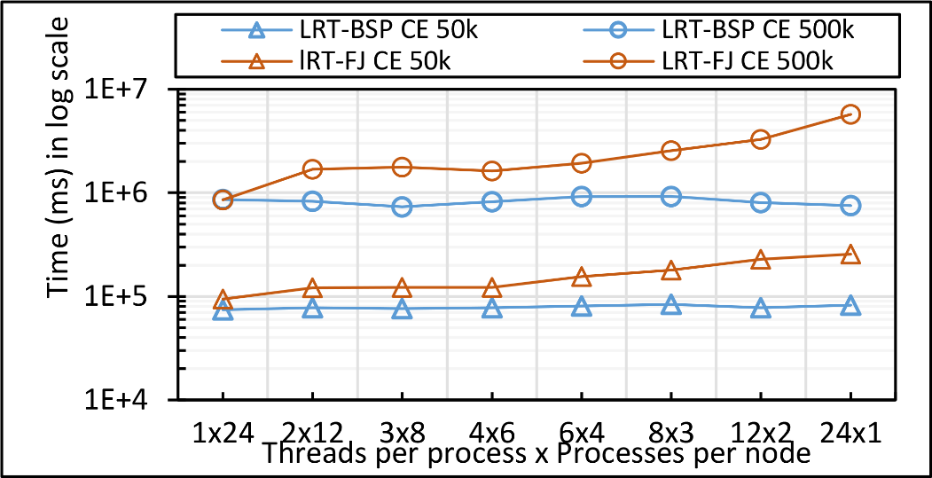
K-Means Clustering
Java K-Means LRT-BSP affinity CE vs NE performance for 1mil points with 1k,10k,50k,100k, and 500k centers on 16 nodes over varying threads and processes.
Java vs C K-Means LRT-BSP affinity CE performance for 1 mil points with 1k,10k,50k,100k, and 500k centers on 16 nodes over varying threads and processes.
Java K-Means 1 mil points with 1k,10k, and 100k centers performance on 16 nodes for LRT-FJ and LRT-BSP over varying threads and processes. The affinity pattern is CE.
Java K-Means 1 mil points with 50k, and 500k centers performance on 16 nodes for LRT-FJ and LRT-BSP over varying threads and processes. The affinity pattern is CE.
Notes:
1. The gap between different data sizes follow O(N)

Slide 23
K-Means Clustering
All-Procs.
#processes = total parallelism.
Each pinned to a separate core.
Balanced across the two sockets.
Threads internal.
1 process per node, pinned to T cores, where T = #threads.
Threads pinned to separate cores.
Threads balanced across the two sockets.
Hybrid
2 processes per node, pinned to T cores.
Total parallelism = Tx2 where T is 8 or 12.
Threads pinned to separate cores and balanced across the two sockets.
Java and C K-Means 1 mil points with 100k centers performance on 16 nodes for LRT-FJ and LRT-BSP over varying intra-node parallelisms. The affinity pattern is CE.

Slide 24
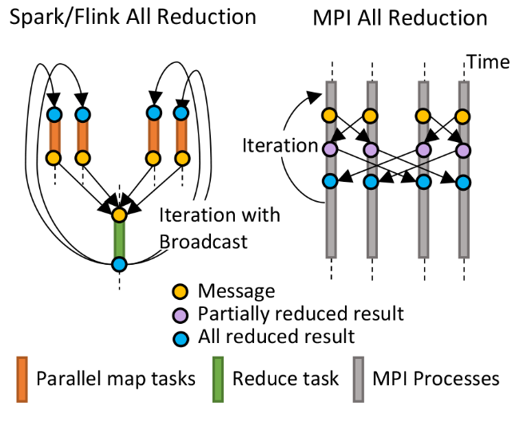
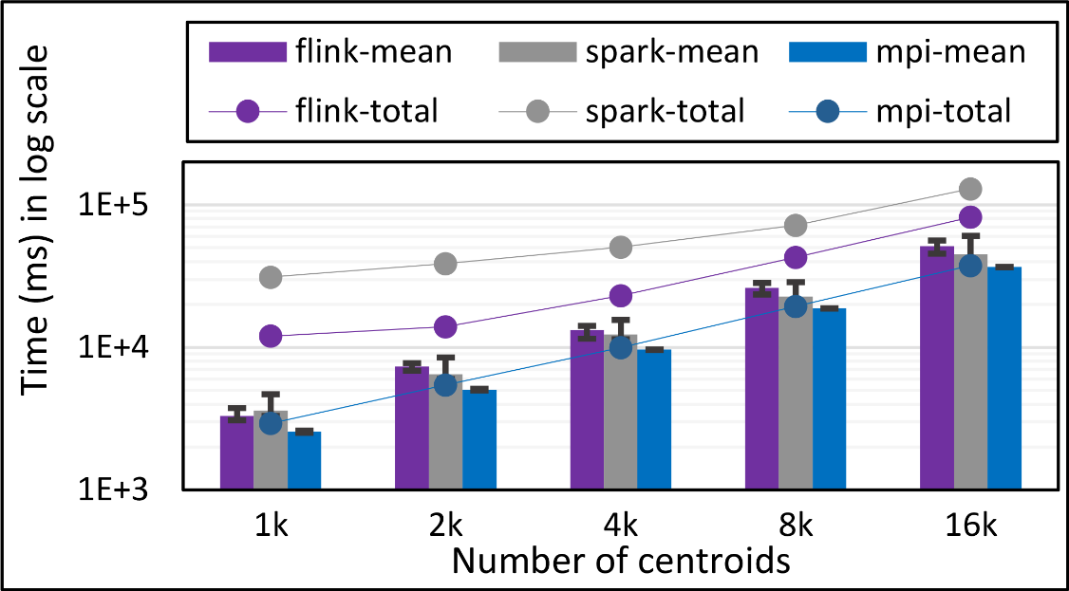
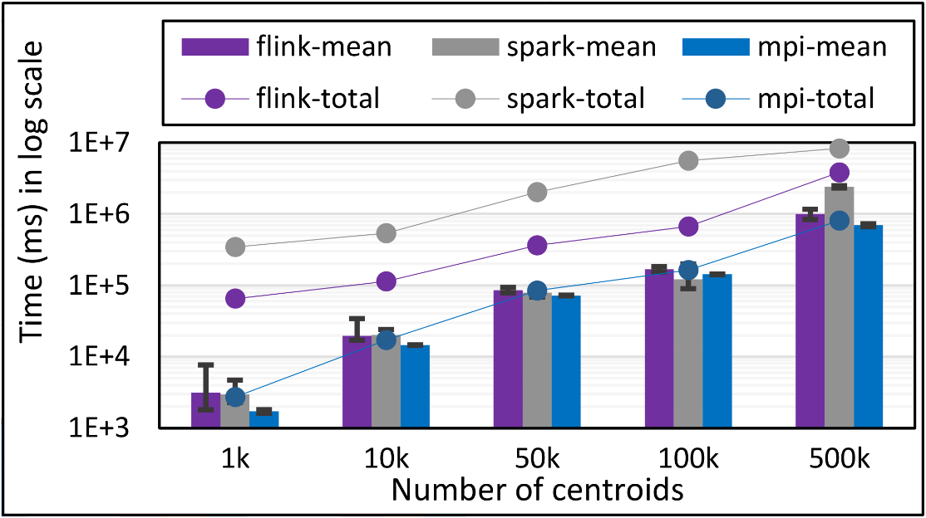
K-Means Clustering
Flink and Spark
Data Set <Points>
Data Set <Initial Centroids>
Map (nearest centroid calculation)
Reduce (update centroids)
Data Set <Updated Centroids>
Broadcast
K-Means total and compute times for 100k 2D points and
1k,2k,4k,8k, and 16k centroids for Spark, Flink, and MPI Java LRT-BSP CE. Run on 1 node as 24x1.
K-Means total and compute times for 1 million 2D points and 1k,10,50k,100k, and 500k centroids for Spark, Flink, and MPI Java LRT-BSP CE. Run on 16 nodes as 24x1.
Notes:
Note the differences in communication architectures
Note times are in log scale
Bars indicate compute only times, which is similar across these frameworks
Overhead is dominated by communications in Flink and Spark

Slide 25
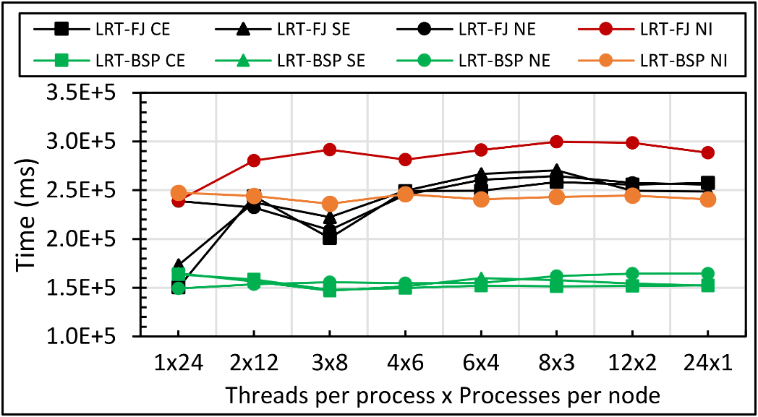
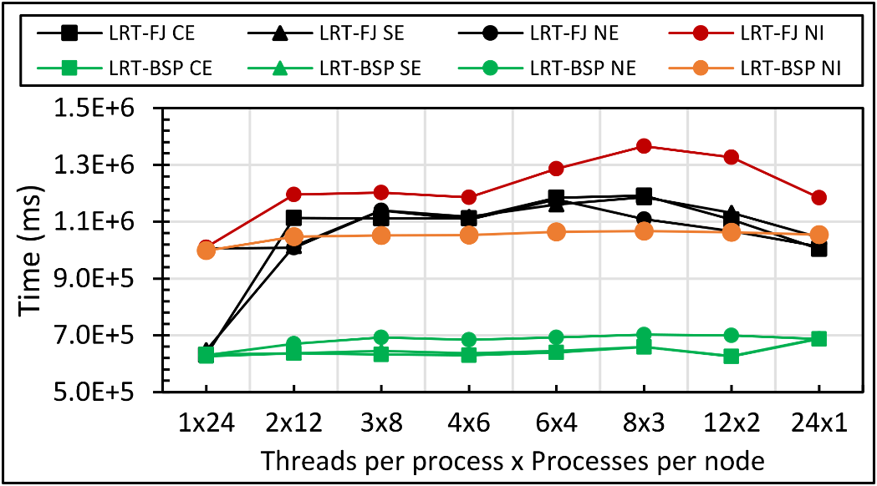
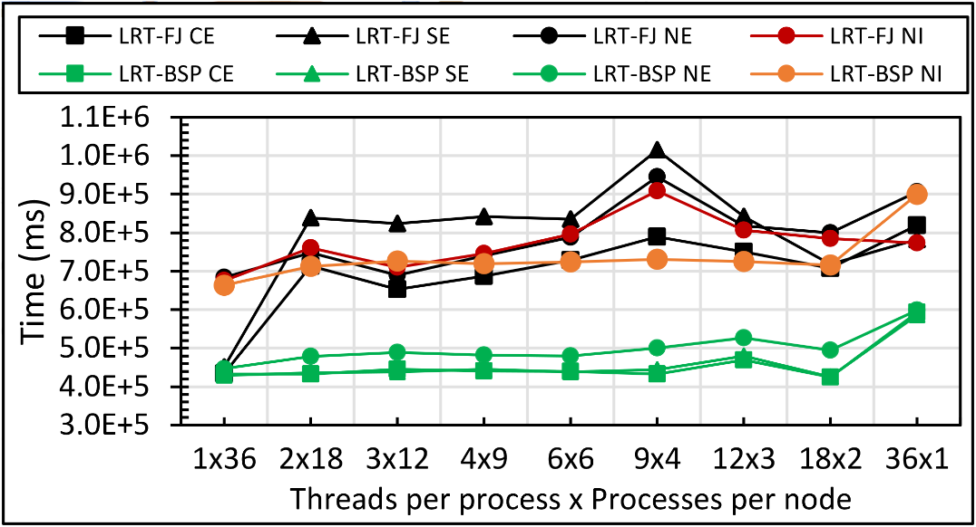
DA-MDS
Java DA-MDS 50k on 16 of 24-core nodes
Java DA-MDS 50k on 16 of 36-core nodes
Java DA-MDS 100k on 16 of 24-core nodes
Java DA-MDS 100k on 16 of 36-core nodes

Slide 26
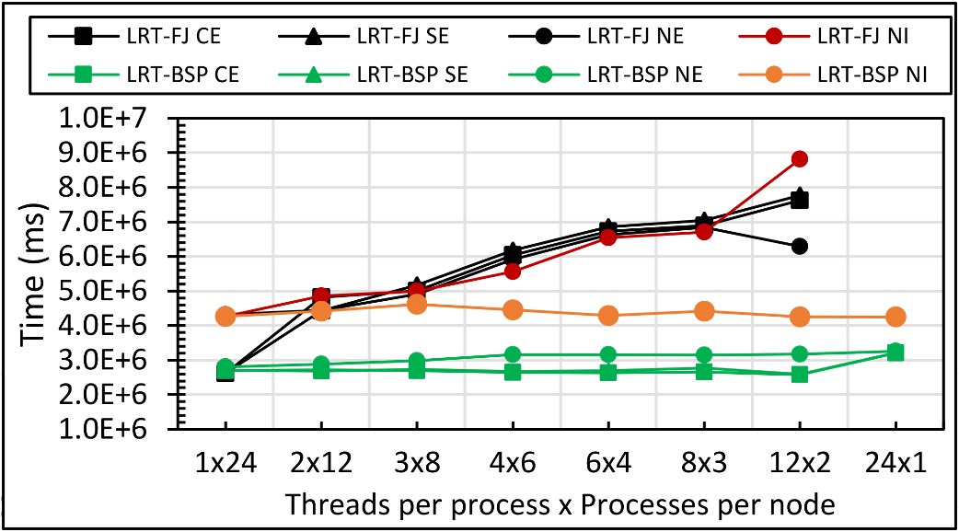
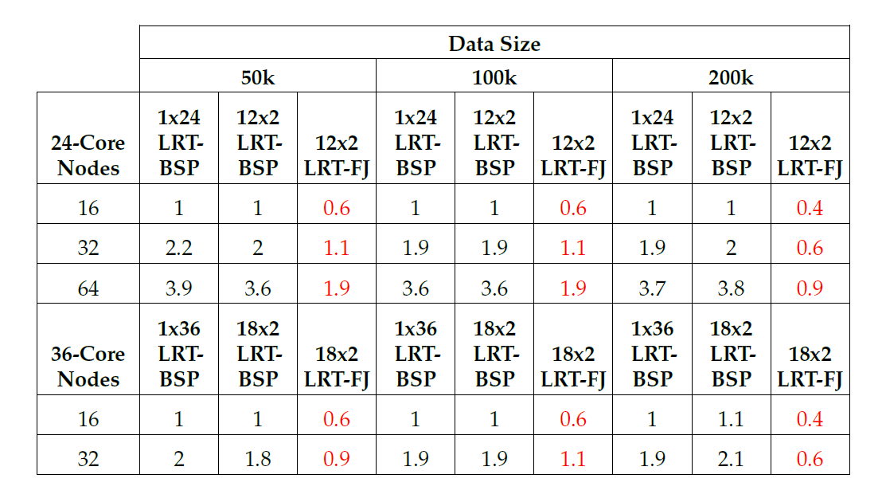
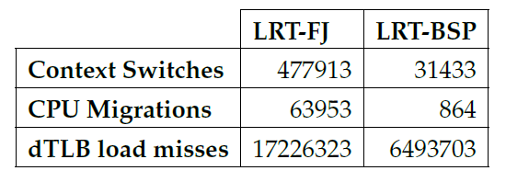
DA-MDS
Java DA-MDS 200k on 16 of 24-core nodes
Java DA-MDS 200k on 16 of 36-core nodes
15x
74x
2.6x
Linux perf statistics for DA-MDS run of 18x2 on 32 nodes. Affinity pattern is CE.
Java DA-MDS speedup comparison for LRT-FJ and LRT-BSP

Slide 27
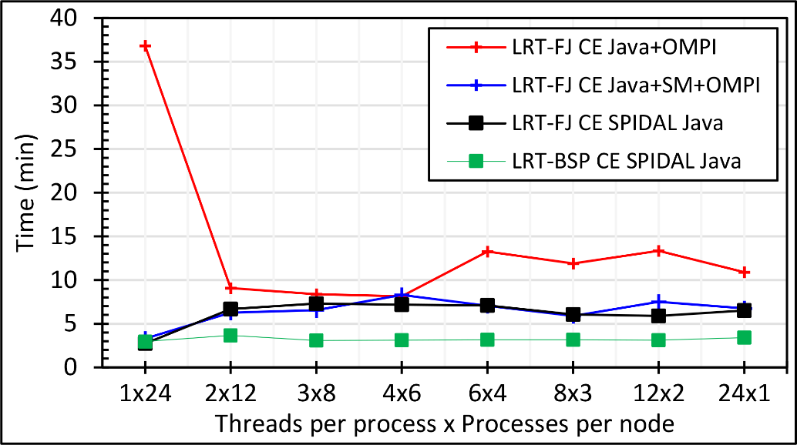
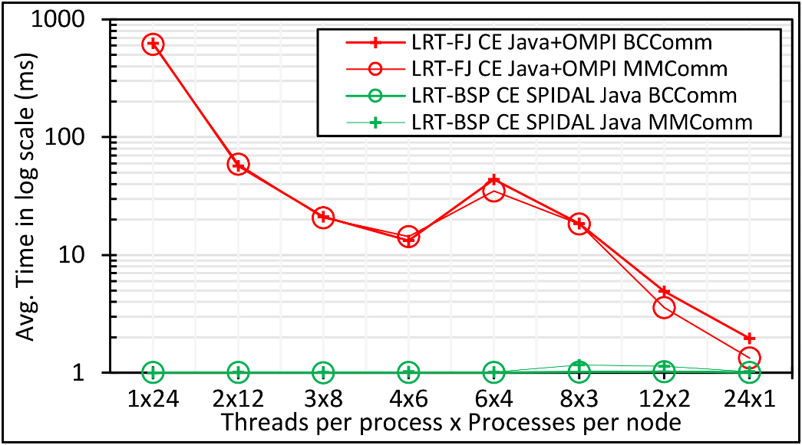
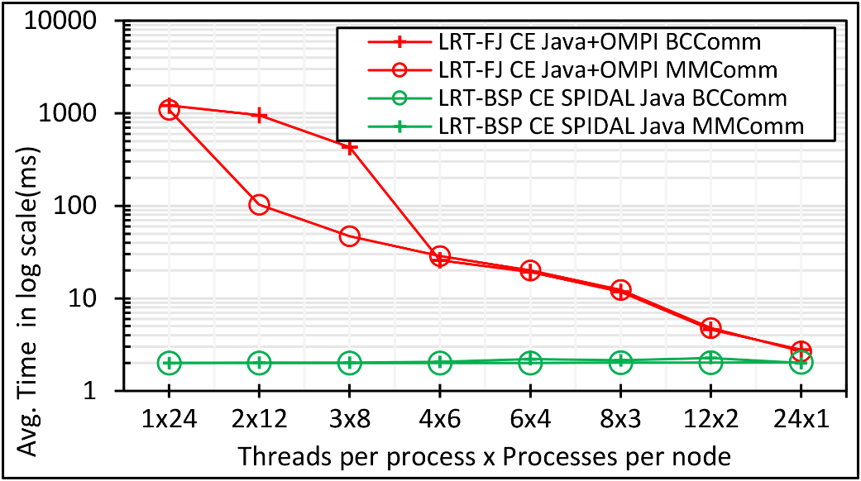
DA-MDS
Java DA-MDS 100k on 48 of 24-core nodes
Java DA-MDS 200k on 48 of 24-core nodes
Java DA-MDS 100k communication on 48 of 24-core nodes
Java DA-MDS 200k communication on 48 of 24-core nodes
Notes:
Note. Linear increase in communication time when going from 100k to 200k with shared memory communication.

Slide 28
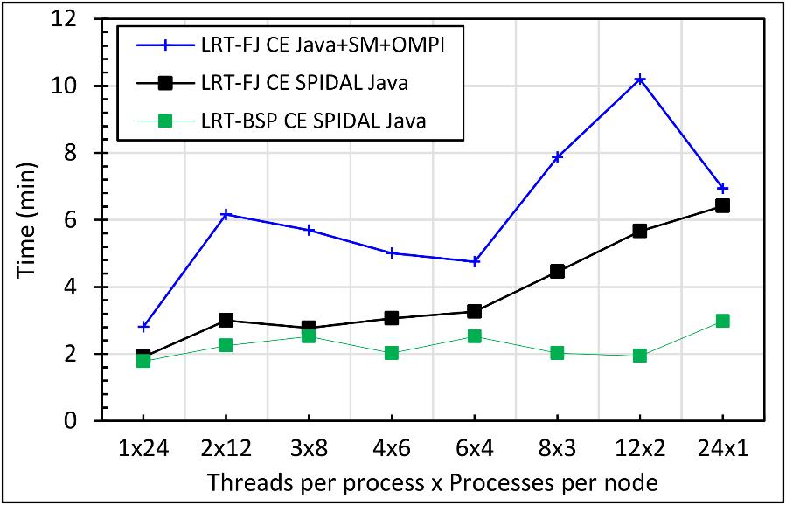
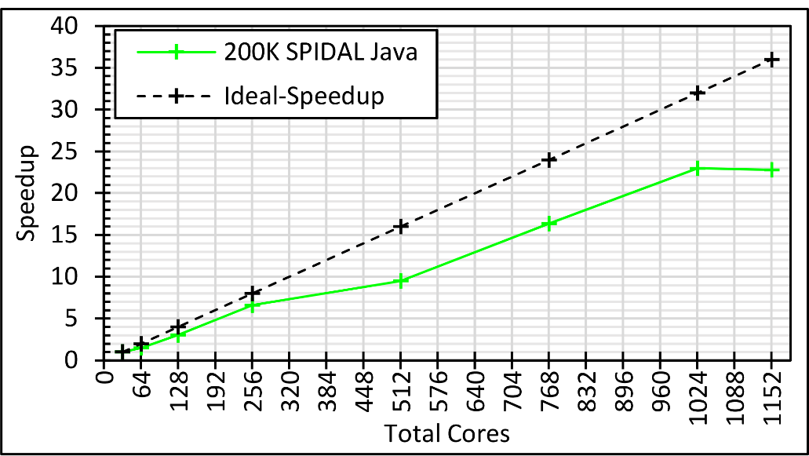
DA-MDS
Java DA-MDS 400k on 48 of 24-core nodes
Java DA-MDS speedup with varying data sizes
Java DA-MDS speedup on 36-core nodes
Notes:
Note. 400K LRT-FJ CE could NOT be done due to reaching memory limits

Slide 29
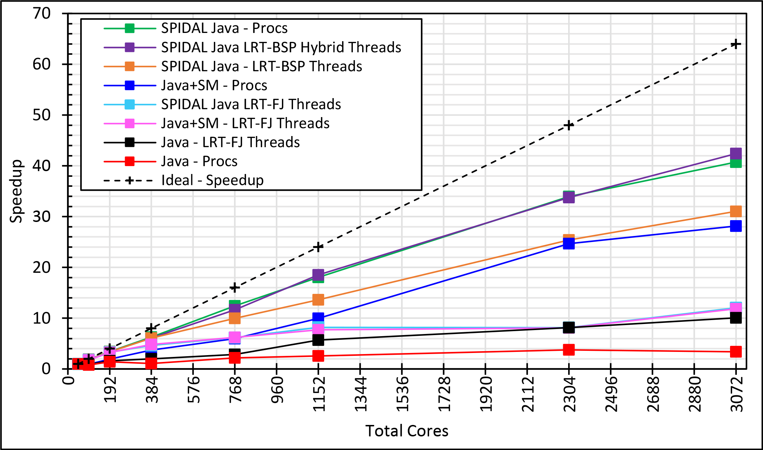
DA-MDS
64x Ideal (if life was so fair!)
>40x Speedup with optimizations
Hybrid Threads and MPI
All-MPI approach
48 Nodes
Java DA-MDS speedup
128 Nodes

Slide 30
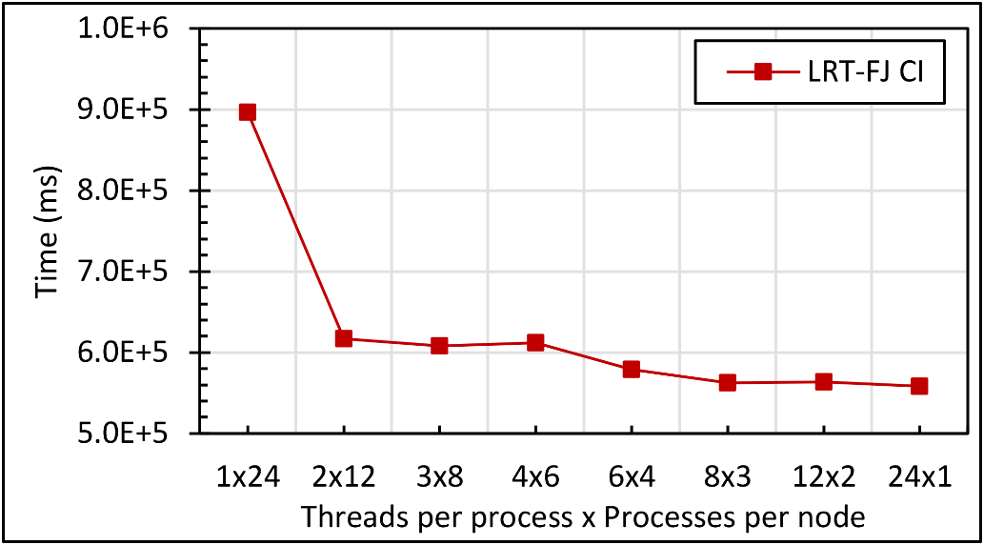
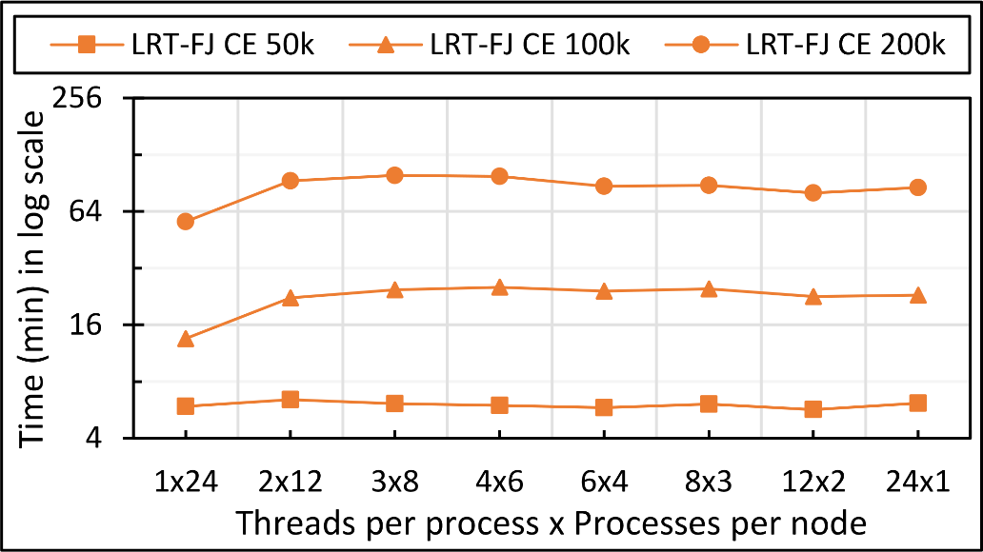
MDSasChisq and DA-PWC
Java MDSasChisq performance on 32 of 24-core nodes
Java MDSasChisq speedup on 32 of 24-core nodes
Java DA-PWC performance on 32 of 24-core nodes
Notes:
Note. 400K LRT-FJ CE could NOT be done due to reaching memory limits

Slide 31
Related Work
Technical Improvements.
Hadoop 1 → Hadoop 2.
Storm → Heron.
Spark 1 → Spark 2 (Project Tungsten¹).
Flink.
Twister and Harp from IU.
Guillermo et al. on Java message passing².
Benchmarks.
BigDataBench, TPC-xHS, HiBench, Graph500, BigBench, MineBench, LinkBench, BG Benchmark, SparkBench, YCSB, Berkeley Big Data Benchmark, CloudSuite
Baru et al. guidelines³.
Component vs. end-to-end, applications, data sources, scaling, metrics.
1 https://databricks.com/blog/2015/04/28/project-tungsten-bringing-spark-closer-to-bare-metal.html
2 http://www.des.udc.es/~gltaboada/papers/taboada_scp11preprint.pdf
3 http://clds.ucsd.edu/sites/clds.sdsc.edu/files/WBDB-TPCTC-V011.pdf
Notes:
What about Performance and Benchmarking?

Slide 32
Benchmark Classification
BigDataBench.
Represents a workload as a vector of 45 micro-architectural-level metrics.
E.g. perf metrics – cache misses, dTLB misses, etc.
PCA to remove correlated metrics.
K-Means to cluster workloads.
Center finding to identify representative workloads.
Convergence Diamonds.
Extension to Ogres.
Geoffrey C. Fox, Shantenu Jha, Judy Qiu, and Andre Luckow. Towards an Understanding of Facets and Exemplars of Big Data Applications. In Proceedings of the 20 Years of Beowulf Workshop on Honor of Thomas Sterling’s 65th Birthday, Beowulf ’14, pages 7–16, New York, NY, USA, 2015. ACM.
Pattern-based approach – similar to Berkeley Dwarfs.
4 dimensions.
Problem Architecture View (PAV), Execution View (EV), Data Source and Style View (DSSV), Processing View (PV).
64 features.

Slide 33
Geospatial Information System
Shared / Dedicated / Transient / Permanent
Archived/Batched/Streaming – S1, S2, S3, S4, S5
HPC Simulations
Internet of Things
Metadata/Provenance
10D
Data Source and Style View
(nearly all data)
9
8D
HDFS/Lustre/GPFS
7D
Enterprise Data Model
6D
Files/Objects
SQL/NoSQL/NewSQL
Global (Analytics/Informatics/Simulations)
5D
Linear Algebra Kernels/Many subclasses
Local (Analytics/Informatics/Simulations)
Spectral Methods
Data Search/Query/Index
4D
Multiscale Method
Recommender Engine
N-body Methods
Data Classification
Micro-benchmarks
Iterative PDE Solvers
Base Data Statistics
Particles and Fields
Learning
Graph Algorithms
Nature of mesh if used
Data Alignment
Evolution of Discrete Systems
Streaming Data Algorithms
Core Libraries
Optimization Methodology
Visualization
3D
2D
1D
Pleasingly Parallel
Convergence Diamonds Views and Facets
2
1
3
D
4
M
4
D
5
D
6
M
6
7
M
8
D
9
M
9
D
10
M
10
M
11
D
12
M
12
D
13
M
13
M
14
Classic MapReduce
Map-Collective
22
M
21
M
20
M
19
M
18
M
17
M
16
M
11
M
10
M
9
M
8
M
7
M
6
M
5
M
4
M
15
M
14
M
13
M
12
M
Map Point-to-Point
Single Program Multiple Data
3
M
2
M
1
M
Simulation (Exascale) Processing Diamonds
Big Data Processing Diamonds
Bulk Synchronous Parallel
Map Streaming
1
Shared Memory
2
3
Performance Metrics
Dynamic = D / Static = S
$O\left(N^{2}\right)$ = NN / $O(N)$ = N
Dynamic = D / Static = S
Data Volume
Model Abstraction
Model Size
Data Velocity
Data Variety
Model Variety
Veracity
Communication Structure
Data Abstraction
4
Iterative / Simple
Processing View
(all model)
Regular = R / Irregular = I Data
Data Metric = M / Non-Metric = N
Data Metric = M / Non-Metric = N
5
Regular = R / Irregular = I Model
Flops per Byte/Memory IO/Flops per watt
Execution Environment; Core libraries
6
Fusion
7
Dataflow
8
Workflow
9
Agents
10
Problem Architecture View
(nearly all data+model)
11M
Execution View
(mix of model and data)
12

Slide 34
The Four Dimensions
Problem Architecture View (PAV).
Describes the overall structure of the problem.
Execution View (EV).
Lists facets related to the execution of an application, such as performance metrics.
Data Source and Style View (DSSV).
Describes data of the application. This is more relevant to Big Data applications than to scientific applications.
Processing View (PV).
Facets of the application model separated for Big Data and Big Simulations.

Slide 35
Description of Facets
Problem Architecture View.
Pleasingly Parallel (PAV-1).
Indicates the processing of a collection of independent events, e.g. applying an image-processing operation in parallel over a collection of images.
Classic MapReduce (PAV-2).
Independent calculations (maps) followed by a final reduction step, e.g. WordCount from Big Data.
Map-Collective (PAV-3).
Independent calculations (maps) with collective communications. For example, parallel machine learning is dominated by collectives such as scatter, gather, and reduce.
Map Point-to-Point (PAV-4).
Independent computations with point-to-point communications. Graph analytics and simulations often employ local neighbor communications.
Map Streaming (PAV-5).
Independent tasks with streaming data. This is seen in recent approaches to processing real-time data.
Shared Memory (PAV-6).
In CDs we do not consider pure SM architectures but look at hybrids of SM and other DM models.

Slide 36
Description of Facets
Execution View (EV).
EV D4, D5, D6.
Represents 3V’s out of the usual 4V’s of Big Data.
EV M4.
An application whether Big Data or Big Simulation can be broken up into data plus model. This facet identifies the size of the model, which is an important factor in application’s performance.
EV M8.
Identifies the type and structure of communication such as collective, point-to-point, or pub/sub. This is another important aspect in performance.
EV M11.
Identifies the iterative nature of applications, which is common in parallel machine learning.
EV M14.
The complexity of the model.

Slide 37
Description of Facets
Data Source and Style View (DSSV).
Streaming (DSSV-D5).
The streaming data has a lot of recent progress, especially within the Big Data community.
HPC Simulations (DSSV-D9).
Identifies data that is generated as output of another program. In all of Scalable Parallel Interoperable Data Analytics Library (SPIDAL) analytics, the input to DA-MDS and DA-PWC comes in this form.
Processing View (PV).
Local (Analytics/Informatics/Simulations) (PV-M2).
Identifies models dealing with only local data like those of neighbors.
Global (Analytics/Informatics/Simulations) (PV-M3)
Represents models with global data synchronizations. For example, parallel machine learning typically requires global knowledge at each step.
PV 4M through 11M.
Facets for Big Data models.
PV 16M through 22M.
Facets for Big Simulation models.

Slide 38
Conclusions
Parallel machine learning is important in Big Data analytics.
Big Data on HPC is growing.
Performance depends on many factors.
Thread models, affinity, and communication are dominant.
Java and other high-level languages.
Big Data frameworks provide elegant programming models
Possibilities to improve performance of the implementations.
Systematic study of performance is necessary.
Over cores, nodes, data sizes.
The need for classification schemes.
CDs can be further extended.

Slide 39
Thank you!

