Slide 1
Java Thread and Process Performance for Parallel Machine Learning on Multicore HPC Clusters
IEEE BigData 2016
December 5-8, Washington D.C.
Saliya Ekanayake
Supun Kamburugamuve |Pulasthi Wickramasinghe|Geoffrey Fox

Slide 2
Performance on Multicore HPC Clusters
64x Ideal (if life was so fair!)
>40x Speedup with optimizations
We’ll discuss today
Hybrid Threads and MPI
All-MPI approach
48 Nodes
Multidimensional Scaling (MDS) on Intel Haswell HPC Cluster with 24 core nodes and 40Gbps Infiniband
128 Nodes

Slide 3
Performance Factors
Thread models.
Affinity
Communication.
Other factors of high-level languages.
Garbage collection
Serialization/Deserialization
Memory references and cache
Data read/write

Slide 4
Thread Models
LRT-FJ
Long Running Threads – Fork Join (LRT-FJ).
Serial work followed by parallel regions.
A long running thread pool handles parallel tasks.
Threads sleep after parallel work.
Serial work
Non-trivial parallel work
Long Running Threads – Bulk Synchronous Parallel (LRT-BSP).
Resembles the classic BSP model of processes.
A long running thread pool similar to FJ.
Threads occupy CPUs always – “hot” threads.
LRT-BSP
LRT-FJ vs. LRT-BSP.
High context switch overhead in FJ.
BSP replicates serial work but reduced overhead.
Implicit synchronization in FJ.
BSP use explicit busy synchronizations.
Serial work
Non-trivial parallel work
Busy thread synchronization

Slide 5
Affinity
P0
P1
P3
P4
C0
C1
C2
C3
C4
C5
C6
C7
2x4 CI
Socket 0
Socket 1
Six affinity patterns
E.g. 2x4
Two threads per process
Four processes per node
Assume two 4 core sockets
P0,P1
P2,P3
Threads Affinity | Processes Affinity
 | Cores | Socket | None (All)
Inherit | CI | SI | NI
Explicit per core | CE | SE | NE
C0
C1
C2
C3
C4
C5
C6
C7
2x4 SI
Socket 0
Socket 1
P0,P1,P2,P3
C0
C1
C2
C3
C4
C5
C6
C7
2x4 NI
Socket 0
Socket 1
P0
P1
P3
P4
C0
C1
C2
C3
C4
C5
C6
C7
2x4 CE
Socket 0
Socket 1
P0,P1
P2,P3
C0
C1
C2
C3
C4
C5
C6
C7
2x4 SE
Worker thread
Socket 0
Socket 1
Background thread (GC and other JVM threads)
P0,P1,P2,P3
Process (JVM)
C0
C1
C2
C3
C4
C5
C6
C7
2x4 NE
Socket 0
Socket 1

Slide 6
A Quick Peek into Performance
No thread pinning and FJ
Threads pinned to cores and FJ
No thread pinning and BSP
Threads pinned to cores and BSP
K-Means 10K performance on 16 nodes

Slide 7
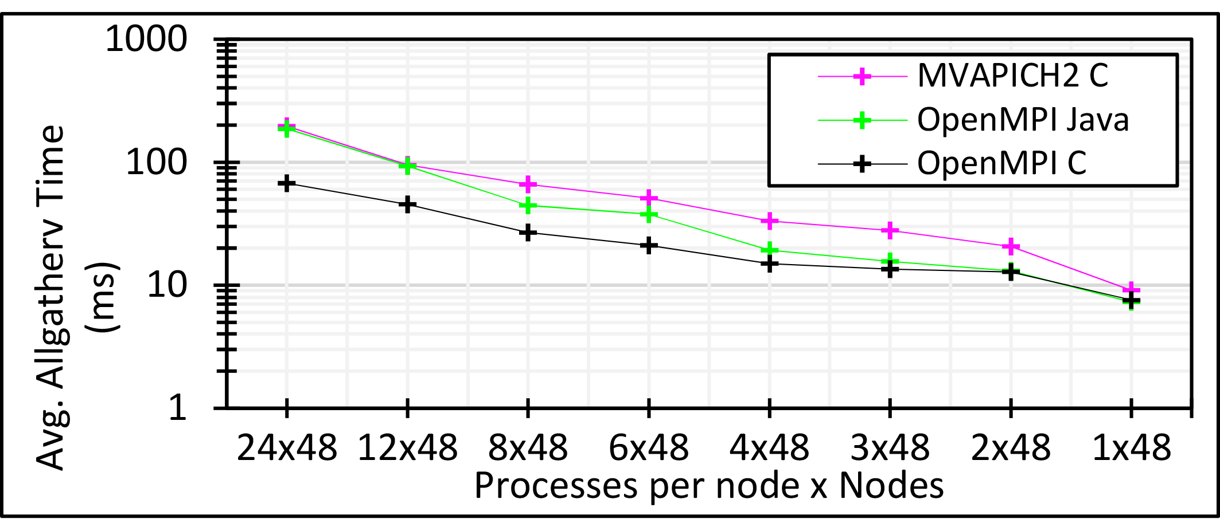
Communication Mechanisms
Collective communications are expensive.
Allgather, allreduce, broadcast.
Frequently used in parallel machine learning
E.g.
Identical message size per node, yet 24 MPI is ~10 times slower than 1 MPI
Suggests #ranks per node should be 1 for the best performance
How to reduce this cost?
3 million double values distributed uniformly over 48 nodes

Slide 8
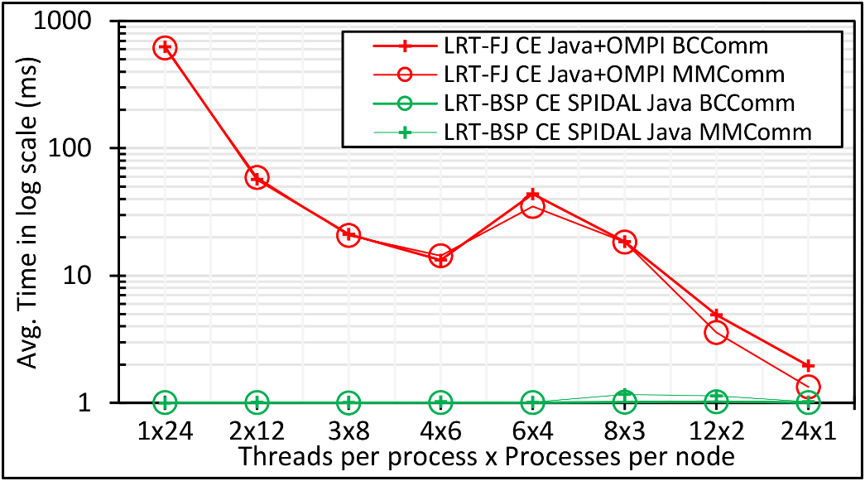
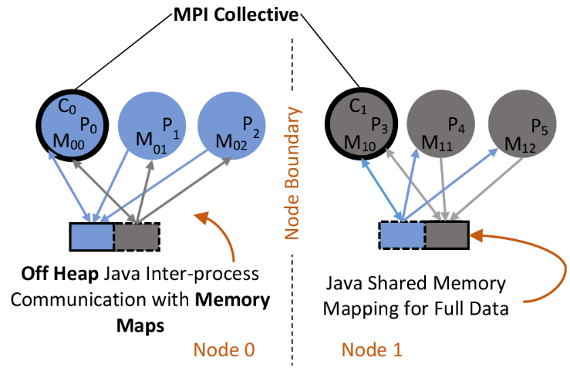
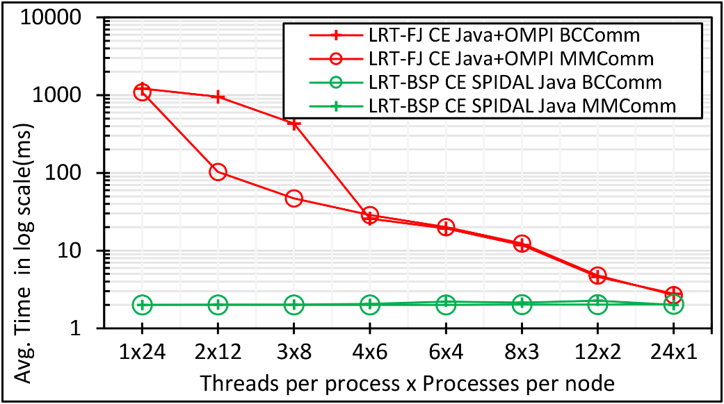
Communication Mechanisms
Shared Memory (SM) for inter-process communication (IPC).
Custom Java implementation in SPIDAL.
Uses OpenHFT’s Bytes API.
Reduce network communications to the number of nodes.
Java DA-MDS 100k communication on 48 of 24-core nodes
Java DA-MDS 200k communication on 48 of 24-core nodes
Java SM architecture

Slide 9
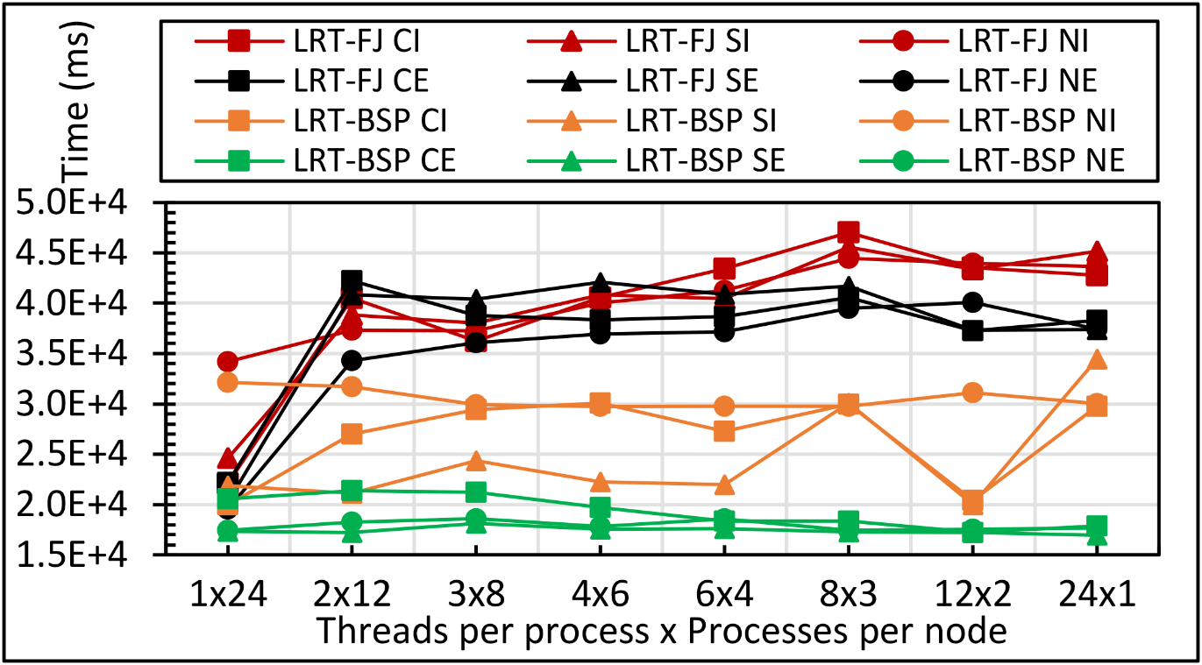
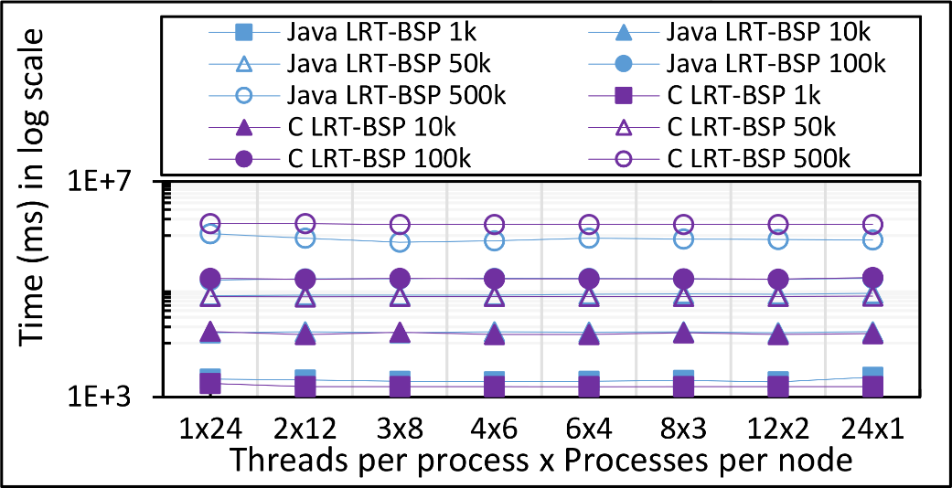
Performance: K-Means
Java K-Means 1 mil points and 1k centers performance on 16 nodes for LRT-FJ and LRT-BSP with varying affinity patterns over varying threads and processes.
Java vs C K-Means LRT-BSP affinity CE performance for 1 mil points with 1k,10k,50k,100k, and 500k centers on 16 nodes over varying threads and processes.

Slide 10
Performance: K-Means
Java LRT-BSP
－{All Procs, Threads Internal, Hybrid}
C
All-Procs.
#processes = total parallelism.
Each pinned to a separate core.
Balanced across the two sockets.
Threads internal.
1 process per node, pinned to T cores, where T = #threads.
Threads pinned to separate cores.
Threads balanced across the two sockets.
Hybrid
2 processes per node, pinned to T cores.
Total parallelism = Tx2 where T is 8 or 12.
Threads pinned to separate cores and balanced across the two sockets.
Java and C K-Means 1 mil points with 100k centers performance on 16 nodes for LRT-FJ and LRT-BSP over varying intra-node parallelisms. The affinity pattern is CE.

Slide 11
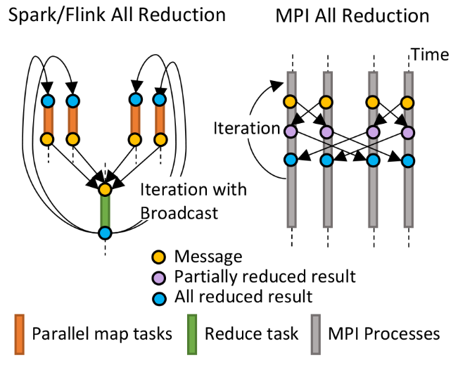
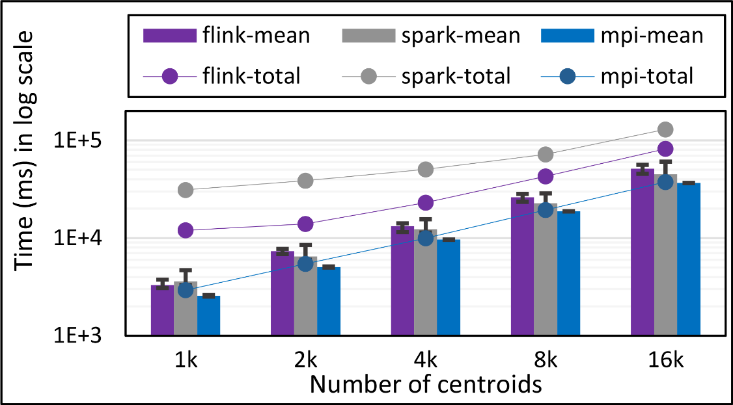
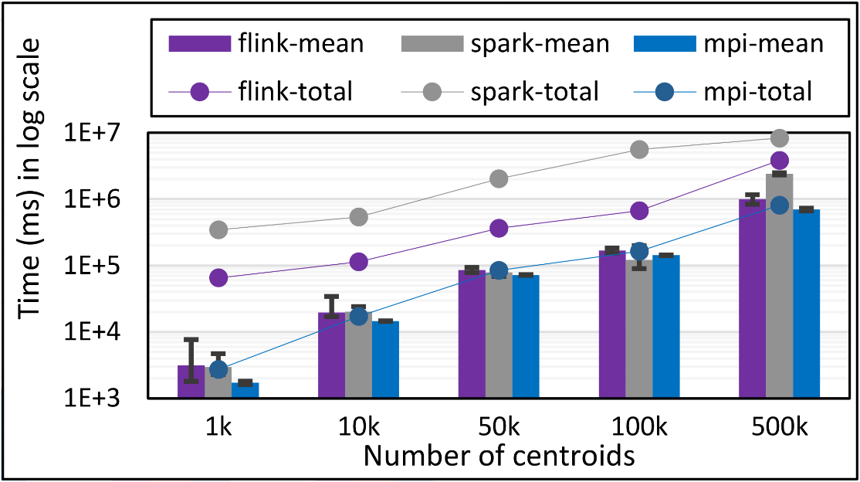
K-Means Clustering
Flink and Spark
Data Set <Points>
Data Set <Initial Centroids>
Map (nearest centroid calculation)
Reduce (update centroids)
Data Set <Updated Centroids>
Broadcast
K-Means total and compute times for 100k 2D points and
1k,2k,4k,8k, and 16k centroids for Spark, Flink, and MPI Java LRT-BSP CE. Run on 1 node as 24x1.
K-Means total and compute times for 1 million 2D points and 1k,10,50k,100k, and 500k centroids for Spark, Flink, and MPI Java LRT-BSP CE. Run on 16 nodes as 24x1.
Notes:
Note the differences in communication architectures
Note times are in log scale
Bars indicate compute only times, which is similar across these frameworks
Overhead is dominated by communications in Flink and Spark

Slide 12
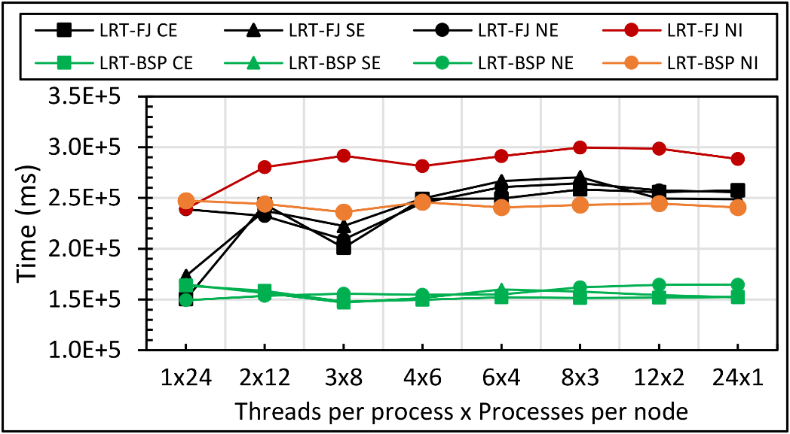
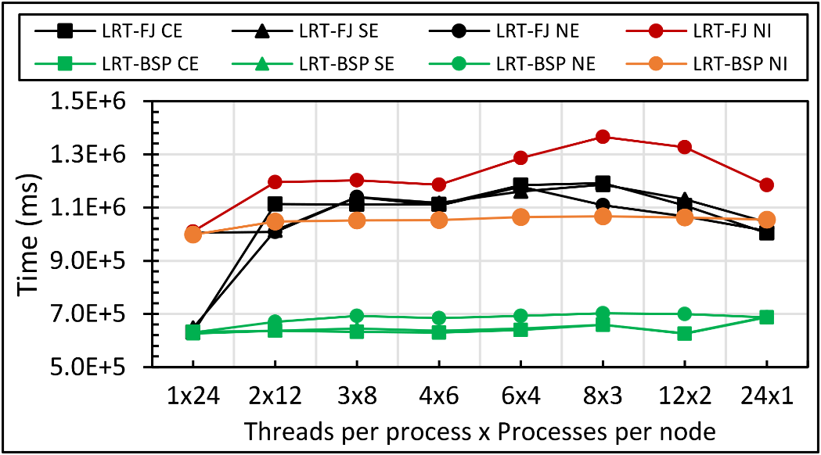
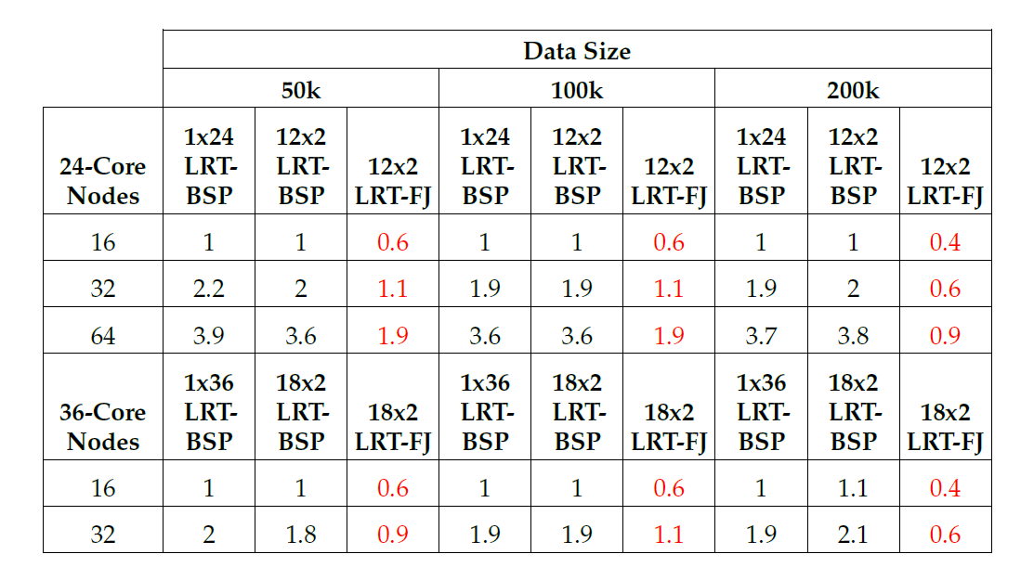
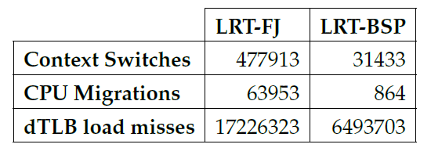
Performance: Multidimensional Scaling
Java DA-MDS 50k on 16 of 24-core nodes
Java DA-MDS 100k on 16 of 24-core nodes
15x
74x
2.6x
Linux perf statistics for DA-MDS run of 18x2 on 32 nodes. Affinity pattern is CE.
Java DA-MDS speedup comparison for LRT-FJ and LRT-BSP

Slide 13
Performance: Multidimensional Scaling
64x Ideal (if life was so fair!)
>40x Speedup with optimizations
Hybrid Threads and MPI
All-MPI approach
48 Nodes
Multidimensional Scaling (MDS) on Intel Haswell HPC Cluster with 24 core nodes and 40Gbps Infiniband
128 Nodes

Slide 14
Acknowledgement
Grants: NSF CIF21 DIBBS 1443054 and NSF RaPyDLI 1415459
Digital Science Center (DSC) at Indiana University
Network Dynamics and Simulation Science Laboratory (NDSSL) at Virginia Tech
Thank you!

Slide 15
Backup Slides

Slide 16
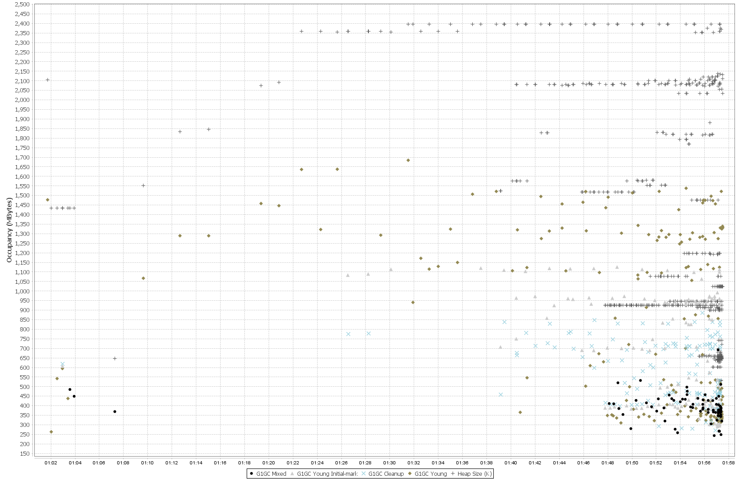
Other Factors
Heap size per process reaches –Xmx (2.5GB) early in the computation
Garbage Collection (GC)
“Stop the world” events are expensive.
Especially, for parallel machine learning.
Typical OOP → allocate – use – forget.
Original SPIDAL code produced frequent garbage of small arrays.
Solutions.
Unavoidable, but can be reduced.
Static allocation.
Object reuse.
Advantage.
Less GC – obvious.
Scale to larger problem sizes.
E.g. Original SPIDAL code required 5GB (x 24 = 120 GB per node) heap per process to handle 200K DA-MDS. Optimized code use < 1GB heap to finish within the same timing.
Note. Physical memory is 128GB, so with optimized SPIDAL can now do 1 million point MDS within hardware limits.
Frequent GC
Heap size per process is well below (~1.1GB) of –Xmx (2.5GB)
Virtually no GC activity after optimizing

Slide 17
Other Factors
Serialization/Deserialization.
Default implementations are verbose, especially in Java.
Kryo is by far the best in compactness.
Off-heap buffers are another option.
Memory references and cache.
Nested structures are expensive.
Even 1D arrays are preferred over 2D when possible.
Adopt HPC techniques – loop ordering, blocked arrays.
Data read/write.
Stream I/O is expensive for large data
Memory mapping is much faster and JNI friendly in Java
Native calls require extra copies as objects move during GC.
Memory maps are in off-GC space, so no extra copying is necessary

