Slide 1

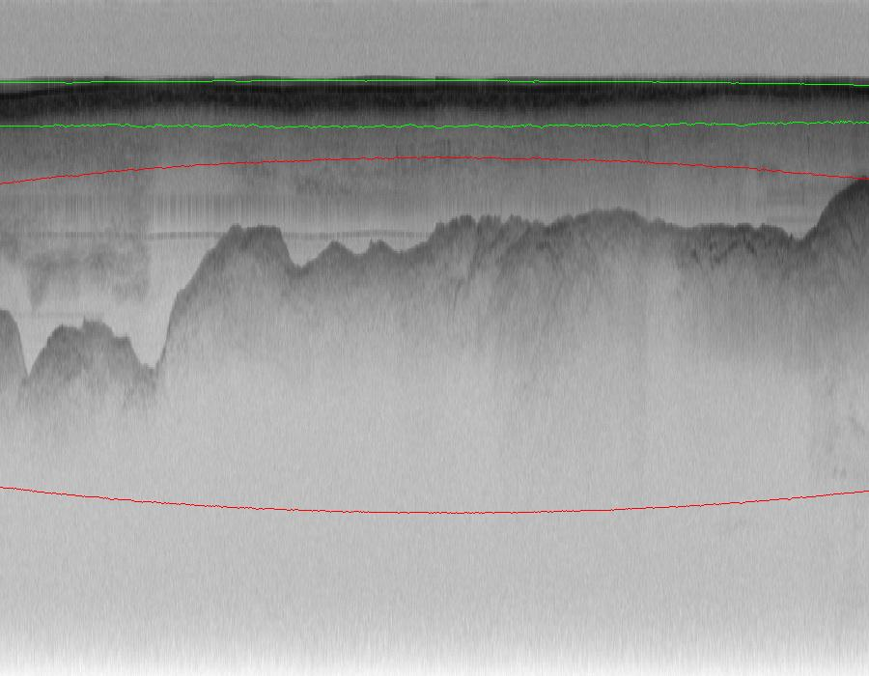
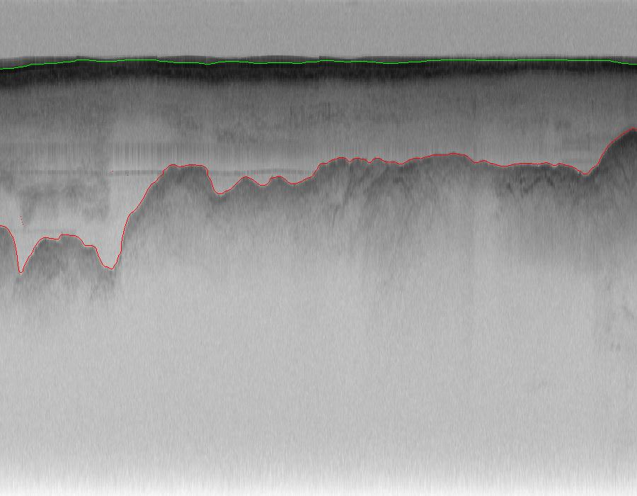
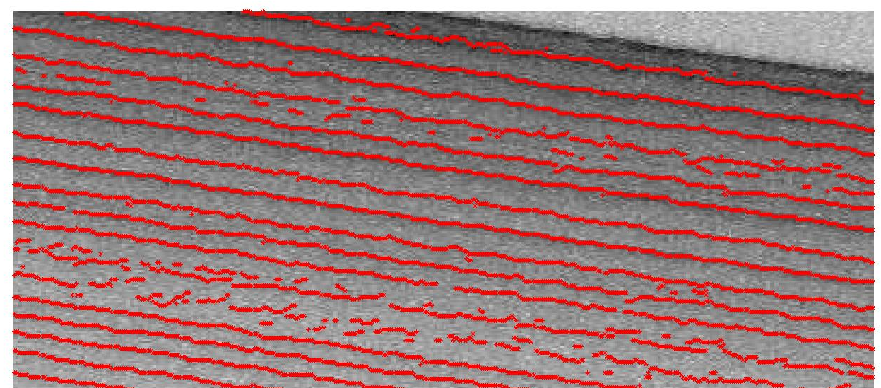
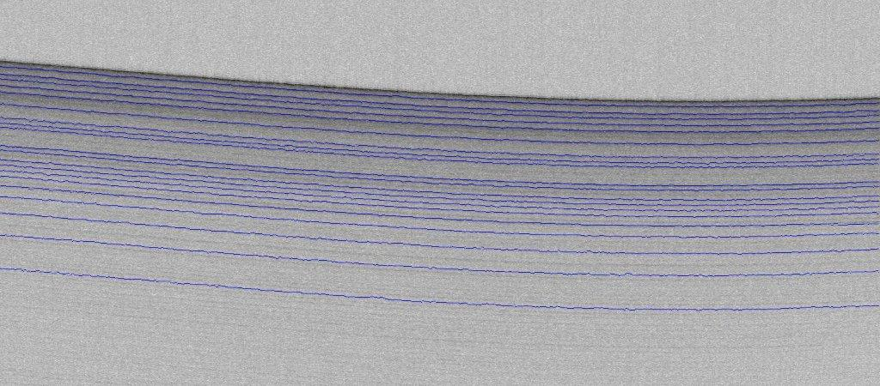
Techniques for Estimating Layers from Polar Radar Imagery
Jerome E. Mitchell, Geoffrey C. Fox, and David J. Crandall :: CReSIS NSF Site Visit :: School of Informatics and Computing, Indiana University – Bloomington, Indiana, 47403 USA
Active Contours (Snakes) [1]
(for near surface internal layers )
Edge Detection
Canny edge detection uses linear filtering with a Gaussian kernel to smooth noise and to compute the edge strength and direction for each pixel in the smoothed image.
Candidate edge pixels are identified through non-maximal suppression. In this process, the edge strength of each candidate edge pixel is set to zero if its edge strength is not larger than the edge strength of the two adjacent pixels in the gradient direction. Two edge strength thresholds on the edge magnitude is applied using hysteresis.
All candidate edge pixels below the lower threshold are labeled as non-edges while all pixels above the low threshold, which can be connected to any pixel above the high threshold are labeled as edge pixels.
Classification of Curve Points
In Steger’s curve point classification, curvilinear structures in a 2D image are modeled as curves s(t), which exhibit a characteristic 1D line profile. The direction perpendicular to s’(t) can be n(t).
The 1D line profile of a curve point is characterized by a vanishing first derivative and the largest absolute value is the second derivative. Thus, a curve point has a first derivative in the direction n(t), which vanishes and the second directional should be a large absolute value.
A pixel in an image is classified as a curve point if the first derivative along n(t) vanishes within a unit square centered around the pixel.
Active Contours (Snakes)
In active contours, a snake is defined as an energy minimization spline, which deforms to minimize the energy.
Internal energy, which represent the tension and rigidity while the external energy attracts the snake to the target object.
The parameters α, β, and γ as coefficients of each term represents weighting functions
Active Contours (Level Sets) [2]
(for bedrock and surface layers)
The level set method is used as a segmentation approach for propagating a contour to object boundaries using properties of an image. Earlier applications have employed level sets to identify edges, but more recently, it has focused on detecting textures, shapes, and colors in an image.
A level set, briefly described in image processing, is a 1D curve embedded in a 2D space. This space defines the level set function, where every point is closest in distance to the boundary.
For each layer, an ellipse was manually initialized, so its zero level set contained the boundary of interest. In order to evolve the contour a partial differential equation (Hamilton Jacobi) used the curvature and magnitude of the gradient for deforming the boundary over time.
We also used a cost function, which served for stopping the contour’s movement when the gradient was maximum at layer boundaries.
As the level set function evolved with time, the shape from an ellipse to the exact bedrock and surface topologies (shown in Results)
Numeral instabilities, such as sharp and shapes may occur, which led to computational inaccuracies and an improper result. To avoid this problem, we used reinitialization to reshape the embedding function periodically after a number of iterations The parameters α, β, and γ as coefficients of each term represents weighting functions
Probabilistic Graphical Model [3]
(for bedrock and surface Layers)
Identify K = 2 layer boundaries in each column of a m x n radar image. L_{ij} represent the row coordinate of layer boundary i in column j
Probabilistic Formulation
The problem of layer detection is posed as a probabilistic graphical model based on the following assumptions:
Image characteristics determined by local layer boundaries
2. Variables in L exhibit a Markov property with respect to their local neighbors
Inference
Finding L, which maximizes P(L | I) involves inference on a Markov Random Field. Estimate the full joint distribution using Gibbs sampling
Gibbs sampling approximates the joint distribution by iteratively sampling from the conditional distribution
Layer location determined by the mean posterior samples, which approximates the expectation of the joint distribution
Confidence Intervals
Confidence intervals provide quality control for label accuracy in distinguishing between bedrock and surface boundaries
  2.5% and 97.5% of the posterior sample determine a 95% interval
    94.7% of surface boundaries and 78.1% of bedrock boundaries are within confidence intervals
Figure 1: Canny Edge Detector of Near Surface Internal Layer Surface
Figure 1: (Left) Initialization of ellipse and (Right) Detected bedrock/surface layers
Figure 2: Steger’s Curve Point Classification
References
[1] Jerome E. Mitchell, David Crandall, Geoffrey C. Fox, and John D. Paden, “A Semi-Automated Approach for Estimating Near Surface Internal Layers from Snow Radar Imagery, International Geoscience and Remote Sensing Symposium (IGARSS), 2010
[2] Jerome E. Mitchell, David J. Crandall, Geoffrey C. Fox, Maryam Rahnemoonfar, and John D. Paden, A Semi-Automated Approach for Estimating Bedrock and Surface Layers from Multichannel Coherent Radar Depth Sounder Imagery, 2013
[3] Stefan Lee, Jerome Mitchell, David Crandall, and Geoffrey Fox, Estimating Bedrock and Surface Layer Boundaries and Confidence Intervals in Ice Sheet Radar Imagery using MCMC, 2014
Figure 3: Detected bedrock/surface layers along with confidence intervals
Acknowledgements
This work was supported in part by the National Science Foundation (CNS-0723054, OCI-0636361, IIS-1253549, ANT-0424589) and by a NASA Earth and Space Science Fellowship (NNX13AN82H). Thanks to the Center for the Re- mote Sensing of Ice Sheets (CReSIS) for providing datasets.
Figure 3: Detected Near Surface Internal Layers

