Slide 1


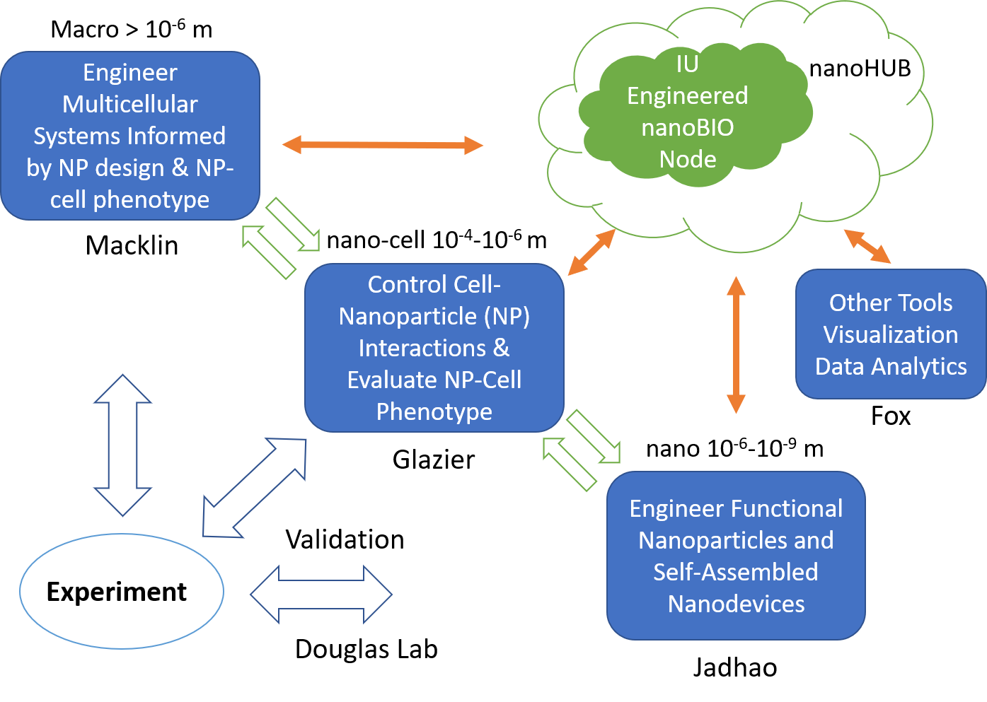
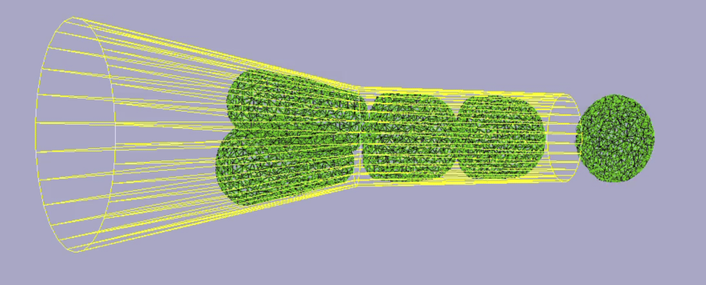
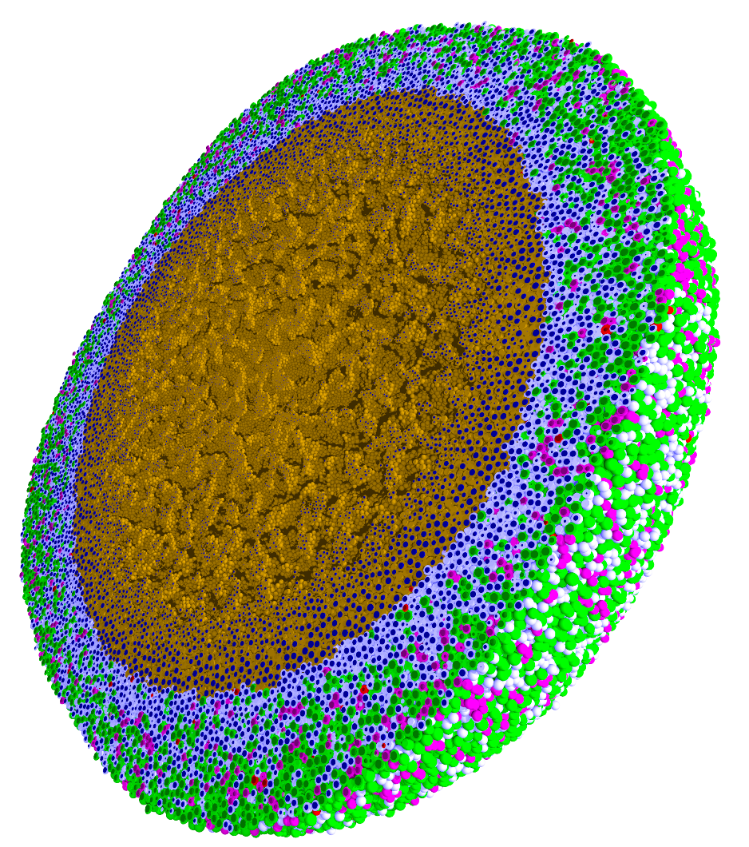
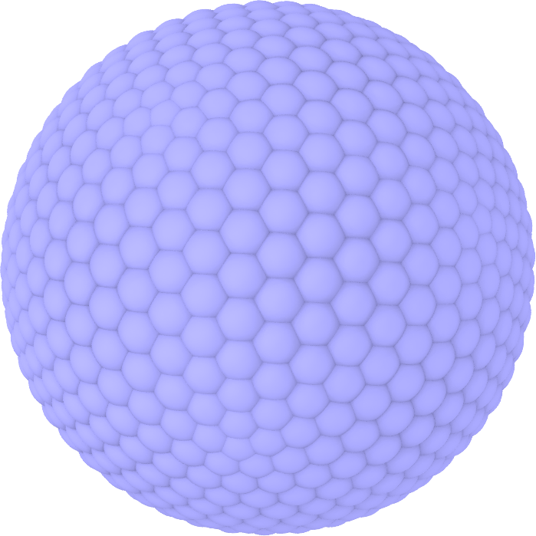
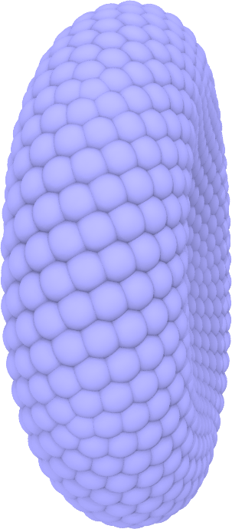
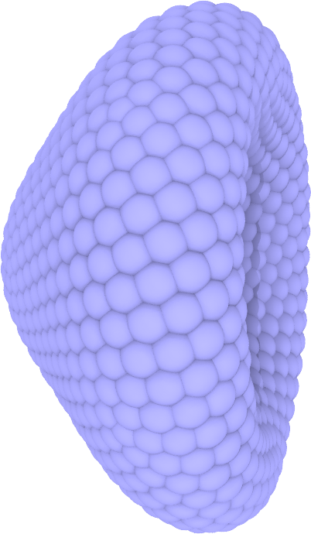
Engineered nanoBIO Node
Engineered
Indiana University, Intelligent Systems Engineering and Chemistry
Purdue University, Science Gateways Community Institute
Center Vision: The Engineered nanoBIO node at Indiana University (IU) will develop a powerful set of integrated computational nanotechnology tools that facilitate the discovery of customized, efficient, and safe nanoscale devices for biological applications. Applications and Frameworks will be deployed and supported on nanoHUB.
Research:
Workforce Development:
Multi-Scale
Integrated
NP-Cell Simulator: Nanoparticle-mediated mechanical and chemical cellular response behaviors
Integration with education: ISE (Intelligent Systems Engineering) as a new department developing courses from scratch (67 defined in first 2 years)
Undergraduate and masters programs in ISE that have required strong computing, modeling, simulation, machine learning and information technology core. Tracks include
  Nanoengineering
  Bioengineering
Research Experiences for Undergraduates both in summer and throughout year
Annual engineered nanoBIO workshop for outreach to minority-serving institutions & other communities
Summer Camps for Middle and High School Students
Online (nanoHUB and YouTube) courses with accessible content on nano and bioengineering
PhysiCell: 3D physics-based agent model simulator for >10⁶ cells
NP Shape Lab: Bioapplication-specific design of NP shape
Innovation Ecosystem
Culture of Inclusion:
Deployment of Apps and Frameworks enable us to address the needs of the targeted nanotech and biotech communities
nanoHUB and XSEDE integration
Social media to recruit new users (users developing new tools from our frameworks and end users of apps)
User tested, user informed, user friendly tool development
Commitment to working with diversity in invited speakers, new faculty and outreach
Working with Dr. Linda Hayden at HBCU Elizabeth City State University and the Science Gateway Institute
ISE’s culture of inclusion bringing together diverse research communities

