Slide 1

Data Mining Runtime Software and Algorithms
BigDat 2015: International Winter School on Big Data
Tarragona, Spain, January 26-30, 2015
January 26 2015
Geoffrey Fox
gcf@indiana.edu
http://www.infomall.org
School of Informatics and Computing
Digital Science Center
Indiana University Bloomington

Slide 2
Parallel Data Analytics
Streaming algorithms have interesting differences but
“Batch” Data analytics is “just parallel computing” with usual features such as SPMD and BSP
Static Regular problems are straightforward but
Dynamic Irregular Problems are technically hard and high level approaches fail (see High Performance Fortran HPF)
  Regular meshes worked well but
  Adaptive dynamic meshes did not although “real people with MPI” could parallelize
Using libraries is successful at either
  Lowest: communication level
  Higher: “core analytics” level
Data analytics does not yet have “good regular parallel libraries”

Slide 3
Iterative MapReduce
Implementing HPC-ABDS
Judy Qiu, Bingjing Zhang, Dennis Gannon, Thilina Gunarathne

Slide 4
Why worry about Iteration?
Key analytics fit MapReduce and do NOT need improvements – in particular iteration. These are
  Search (as in Bing, Yahoo, Google)
  Recommender Engines as in e-commerce (Amazon, Netflix)
  Alignment as in BLAST for Bioinformatics
However most datamining like deep learning, clustering, support vector requires iteration and cannot be done in a single Map-Reduce step
  Communicating between steps via disk as done in Hadoop implenentations, is far too slow
  So cache data (both basic and results of collective computation) between iterations.

Slide 5
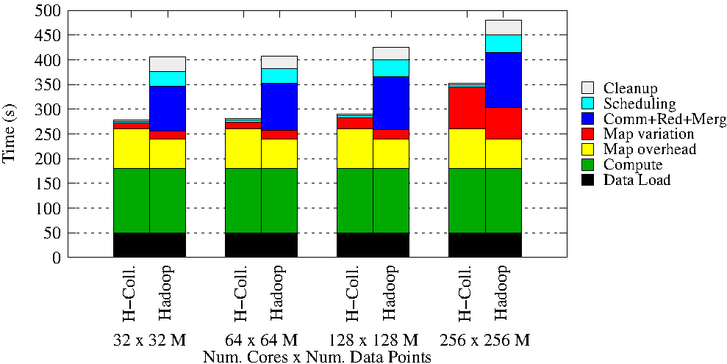
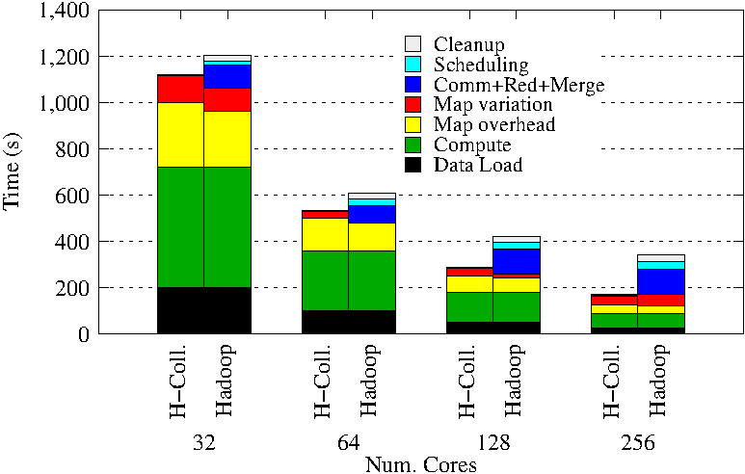
Using Optimal “Collective” Operations
Twister4Azure Iterative MapReduce with
enhanced collectives
  Map-AllReduce primitive and MapReduce-MergeBroadcast
Test on Hadoop (Linux) for Strong and Weak Scaling on K-means for up to 256 cores
Hadoop vs H-Collectives Map-AllReduce.
500 Centroids (clusters). 20 Dimensions. 10 iterations.

Slide 6
Kmeans and (Iterative) MapReduce
Shaded areas are computing only where Hadoop on HPC cluster is fastest
Areas above shading are overheads where T4A smallest and T4A with AllReduce collective have lowest overhead
Note even on Azure Java (Orange) faster than T4A C# for compute

Slide 7
Harp Design
Parallelism Model
Architecture
MapReduce Model
Map-Collective or Map-Communication Model
M
M
M
M
MapReduce Applications
Map-Collective
or Map-Communication Applications
M
M
M
M
Application
Shuffle
Harp
Optimal Communication
MapReduce V2
R
R
Framework
Resource Manager
YARN

Slide 8
Features of Harp Hadoop Plugin
Hadoop Plugin (on Hadoop 1.2.1 and Hadoop 2.2.0)
Hierarchical data abstraction on arrays, key-values and graphs for easy programming expressiveness.
Collective communication model to support various communication operations on the data abstractions (will extend to Point to Point)
Caching with buffer management for memory allocation required from computation and communication
BSP style parallelism
Fault tolerance with checkpointing

Slide 9
WDA SMACOF MDS (Multidimensional Scaling) using Harp on IU Big Red 2
Parallel Efficiency: on 100-300K sequences
Best available MDS (much better than that in R)
Java
Harp (Hadoop plugin)
Cores =32 #nodes
Conjugate Gradient (dominant time) and Matrix Multiplication

Slide 10
Increasing Communication
Identical Computation
Mahout and Hadoop MR – Slow due to MapReduce
Python slow as Scripting; MPI fastest
Spark Iterative MapReduce, non optimal communication
Harp Hadoop plug in with ~MPI collectives

Slide 11
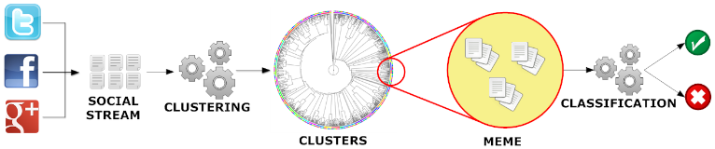
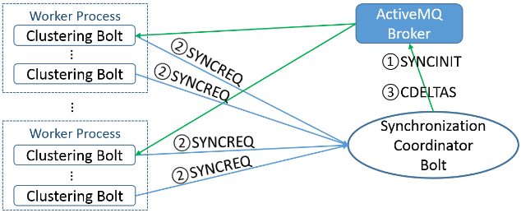
Parallel Tweet Clustering with Storm
Judy Qiu and Xiaoming Gao
Storm Bolts coordinated by ActiveMQ to synchronize parallel cluster center updates – add loops to Storm
2 million streaming tweets processed in 40 minutes; 35,000 clusters
Sequential
Parallel – eventually 10,000 bolts

Slide 12
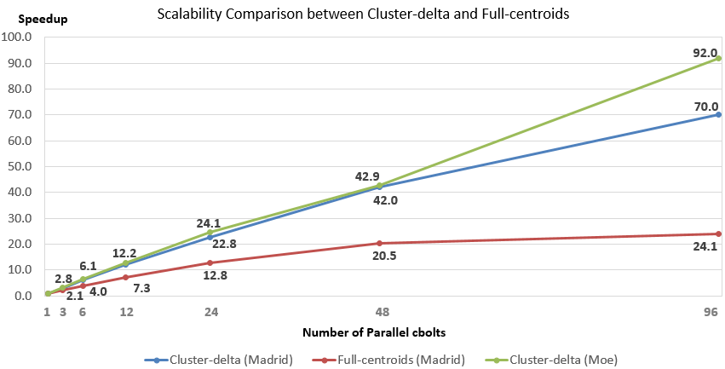
Parallel Tweet Clustering with Storm
Speedup on up to 96 bolts on two clusters Moe and Madrid
Red curve is old algorithm;
green and blue new algorithm
Full Twitter – 1000 way parallelism
Full Everything – 10,000 way parallelism

Slide 13
Data Analytics in SPIDAL

Slide 14
Analytics and the DIKW Pipeline
Data goes through a pipeline
Raw data → Data → Information → Knowledge → Wisdom → Decisions
Each link enabled by a filter which is “business logic” or “analytics”
We are interested in filters that involve “sophisticated analytics” which require non trivial parallel algorithms
  Improve state of art in both algorithm quality and (parallel) performance
Design and Build SPIDAL (Scalable Parallel Interoperable Data Analytics Library)
Data
Information
Analytics
Information
Knowledge
More Analytics

Slide 15
Strategy to Build SPIDAL
Analyze Big Data applications to identify analytics needed and generate benchmark applications
Analyze existing analytics libraries (in practice limit to some application domains) – catalog library members available and performance
  Mahout low performance, R largely sequential and missing key algorithms, MLlib just starting
Identify big data computer architectures
Identify software model to allow interoperability and performance
Design or identify new or existing algorithm including parallel implementation
Collaborate application scientists, computer systems and statistics/algorithms communities

Slide 16
Machine Learning in Network Science, Imaging in Computer Vision, Pathology, Polar Science, Biomolecular Simulations
Algorithm | Applications | Features | Status | Parallelism
Graph Analytics
Community detection | Social networks, webgraph | Graph . | P-DM | GML-GrC
Subgraph/motif finding | Webgraph, biological/social networks |  | P-DM | GML-GrB
Finding diameter | Social networks, webgraph |  | P-DM | GML-GrB
Clustering coefficient | Social networks |  | P-DM | GML-GrC
Page rank | Webgraph |  | P-DM | GML-GrC
Maximal cliques | Social networks, webgraph |  | P-DM | GML-GrB
Connected component | Social networks, webgraph |  | P-DM | GML-GrB
Betweenness centrality | Social networks | Graph, Non-metric, static | P-Shm | GML-GRA
Shortest path | Social networks, webgraph |  | P-Shm
Spatial Queries and Analytics
Spatial relationship based queries | GIS/social networks/pathology informatics | Geometric | P-DM | PP
Distance based queries |  |  | P-DM | PP
Spatial clustering |  |  | Seq | GML
Spatial modeling |  |  | Seq | PP
GML Global (parallel) ML
GrA Static GrB Runtime partitioning

Slide 17
Some specialized data analytics in SPIDAL
Algorithm | Applications | Features | Status | Parallelism
Core Image Processing
Image preprocessing | Computer vision/pathology informatics | Metric Space Point Sets, Neighborhood sets & Image features | P-DM | PP
Object detection & segmentation |  |  | P-DM | PP
Image/object feature computation |  |  | P-DM | PP
3D image registration |  |  | Seq | PP
Object matching |  | Geometric | Todo | PP
3D feature extraction |  |  | Todo | PP
Deep Learning
Learning Network, Stochastic Gradient Descent | Image Understanding, Language Translation, Voice Recognition, Car driving | Connections in artificial neural net | P-DM | GML
aa
PP Pleasingly Parallel (Local ML)
Seq Sequential Available
GRA Good distributed algorithm needed
Todo No prototype Available
P-DM Distributed memory Available
P-Shm Shared memory Available

Slide 18
Some Core Machine Learning Building Blocks
Algorithm | Applications | Features | Status | //ism
DA Vector Clustering | Accurate Clusters | Vectors | P-DM | GML
DA Non metric Clustering | Accurate Clusters, Biology, Web | Non metric, O(N²) | P-DM | GML
Kmeans; Basic, Fuzzy and Elkan | Fast Clustering | Vectors | P-DM | GML
Levenberg-Marquardt Optimization | Non-linear Gauss-Newton, use in MDS | Least Squares | P-DM | GML
SMACOF Dimension Reduction | DA- MDS with general weights | Least Squares, O(N²) | P-DM | GML
Vector Dimension Reduction | DA-GTM and Others | Vectors | P-DM | GML
TFIDF Search | Find nearest neighbors in document corpus | Bag of “words” (image features) | P-DM | PP
All-pairs similarity search | Find pairs of documents with TFIDF distance below a threshold
 |  |  | Todo | GML
Support Vector Machine SVM | Learn and Classify | Vectors | Seq | GML
Random Forest | Learn and Classify | Vectors | P-DM | PP
Gibbs sampling (MCMC) | Solve global inference problems | Graph | Todo | GML
Latent Dirichlet Allocation LDA with Gibbs sampling or Var. Bayes | Topic models (Latent factors) | Bag of “words” | P-DM | GML
Singular Value Decomposition SVD | Dimension Reduction and PCA | Vectors | Seq | GML
Hidden Markov Models (HMM) | Global inference on sequence models | Vectors | Seq | PP & GML

Slide 19
Parallel Data Mining

Slide 20
Remarks on Parallelism I
Most use parallelism over items in data set
  Entities to cluster or map to Euclidean space
Except deep learning (for image data sets)which has parallelism over pixel plane in neurons not over items in training set
  as need to look at small numbers of data items at a time in Stochastic Gradient Descent SGD
  Need experiments to really test SGD – as no easy to use parallel implementations tests at scale NOT done
  Maybe got where they are as most work sequential

Slide 21
Remarks on Parallelism II
Maximum Likelihood or χ² both lead to structure like
Minimize sum ∑_{items=1}^{N} (Positive nonlinear function of unknown parameters for item i)
All solved iteratively with (clever) first or second order approximation to shift in objective function
  Sometimes steepest descent direction; sometimes Newton
  11 billion deep learning parameters; Newton impossible
  Have classic Expectation Maximization structure
  Steepest descent shift is sum over shift calculated from each point
SGD – take randomly a few hundred of items in data set and calculate shifts over these and move a tiny distance
  Classic method – take all (millions) of items in data set and move full distance

Slide 22
Remarks on Parallelism III
Need to cover non vector semimetric and vector spaces for clustering and dimension reduction (N points in space)
MDS Minimizes Stress
σ(X) = Σ_{i<j=1}^{N} weight(i,j) (δ(i, j) - d(X_{i} , X_{j}))²
Semimetric spaces just have pairwise distances defined between points in space δ(i, j)
Vector spaces have Euclidean distance and scalar products
  Algorithms can be O(N) and these are best for clustering but for MDS O(N) methods may not be best as obvious objective function O(N²)
  Important new algorithms needed to define O(N) versions of current O(N²) – “must” work intuitively and shown in principle
Note matrix solvers all use conjugate gradient – converges in 5-100 iterations – a big gain for matrix with a million rows. This removes factor of N in time complexity
Ratio of #clusters to #points important; new ideas if ratio >~ 0.1

Slide 23
Structure of Parameters
Note learning networks have huge number of parameters (11 billion in Stanford work) so that inconceivable to look at second derivative
Clustering and MDS have lots of parameters but can be practical to look at second derivative and use Newton’s method to minimize
Parameters are determined in distributed fashion but are typically needed globally
  MPI use broadcast and “AllCollectives”
  AI community: use parameter server and access as needed

Slide 24
Robustness from Deterministic Annealing
Deterministic annealing smears objective function and avoids local minima and being much faster than simulated annealing
Clustering
  Vectors: Rose (Gurewitz and Fox) 1990
  Clusters with fixed sizes and no tails (Proteomics team at Broad)
  No Vectors: Hofmann and Buhmann (Just use pairwise distances)
Dimension Reduction for visualization and analysis
  Vectors: GTM Generative Topographic Mapping
  No vectors SMACOF: Multidimensional Scaling) MDS (Just use pairwise distances)
Can apply to HMM & general mixture models (less study)
  Gaussian Mixture Models
  Probabilistic Latent Semantic Analysis with Deterministic Annealing DA-PLSA as alternative to Latent Dirichlet Allocation for finding “hidden factors”

Slide 25
More Efficient Parallelism
The canonical model is correct at start but each point does not really contribute to each cluster as damped exponentially by exp( - (X_{i}- Y(k))² /T )
For Proteomics problem, on average only 6.45 clusters needed per point if require (X_{i}- Y(k))² /T ≤ ~40 (as exp(-40) small)
So only need to keep nearby clusters for each point
As average number of Clusters ~ 20,000, this gives a factor of ~3000 improvement
Further communication is no longer all global; it has nearest neighbor components and calculated by parallelism over clusters
Claim that ~all O(N²) machine learning algorithms can be done in O(N)logN using ideas as in fast multipole (Barnes Hut) for particle dynamics
  ~0 use in practice

Slide 26
SPIDAL Examples

Slide 27
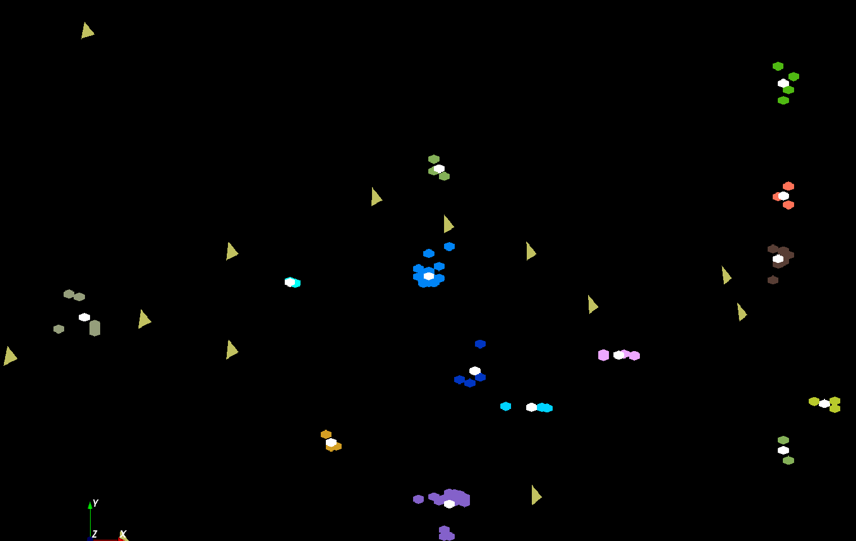
The brownish triangles are stray peaks outside any cluster.
The colored hexagons are peaks inside clusters with the white hexagons being determined cluster center
Fragment of 30,000 Clusters
241605 Points

Slide 28
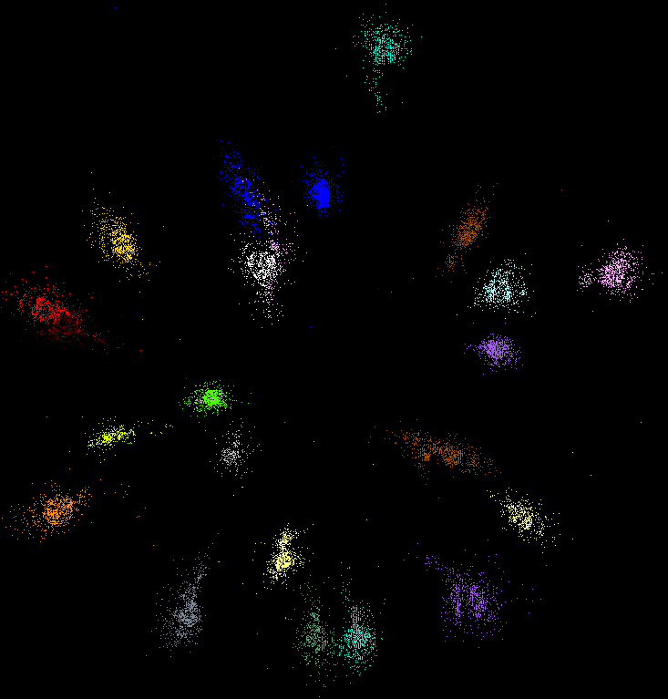
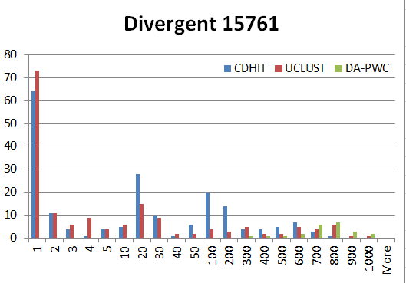
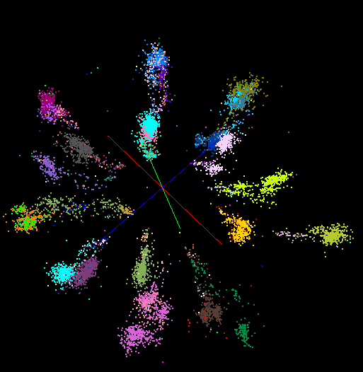
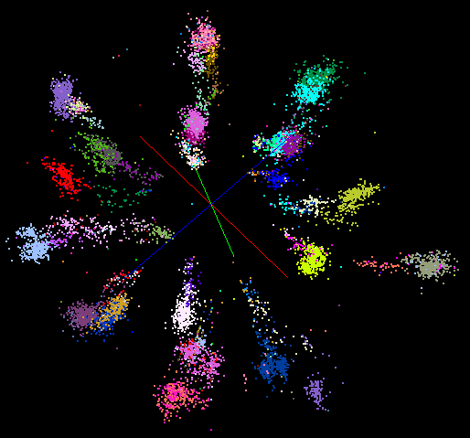
“Divergent” Data Sample
23 True Sequences
DA-PWC
UClust
CDhit
Divergent Data Set UClust (Cuts 0.65 to 0.95)
DAPWC 0.65 0.75 0.85 0.95
Total # of clusters 23 4 10 36 91
Total # of clusters uniquely identified 23 0 0 13 16
(i.e. one original cluster goes to 1 uclust cluster )
Total # of shared clusters with significant sharing 0 4 10 5 0
(one uclust cluster goes to > 1 real cluster)
Total # of uclust clusters that are just part of a real cluster 0 4 10 17(11) 72(62)
(numbers in brackets only have one member)
Total # of real clusters that are 1 uclust cluster 0 14 9 5 0
but uclust cluster is spread over multiple real clusters
Total # of real clusters that have 0 9 14 5 7
significant contribution from > 1 uclust cluster

Slide 29

Protein Universe Browser for COG Sequences with a few illustrative biologically identified clusters

Slide 30
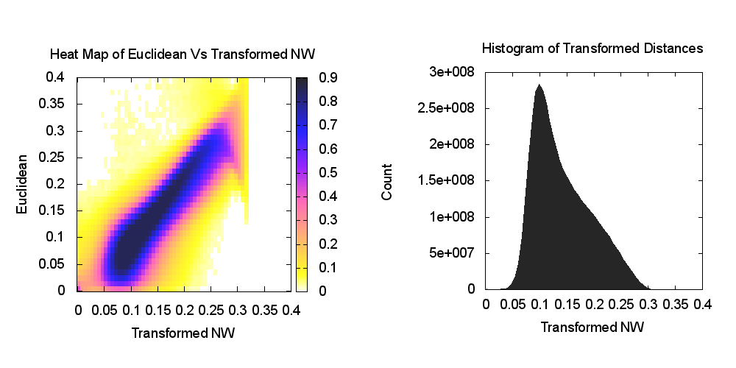
Heatmap of biology distance (Needleman-Wunsch) vs 3D Euclidean Distances
If d a distance, so is f(d) for any monotonic f. Optimize choice of f

Slide 31
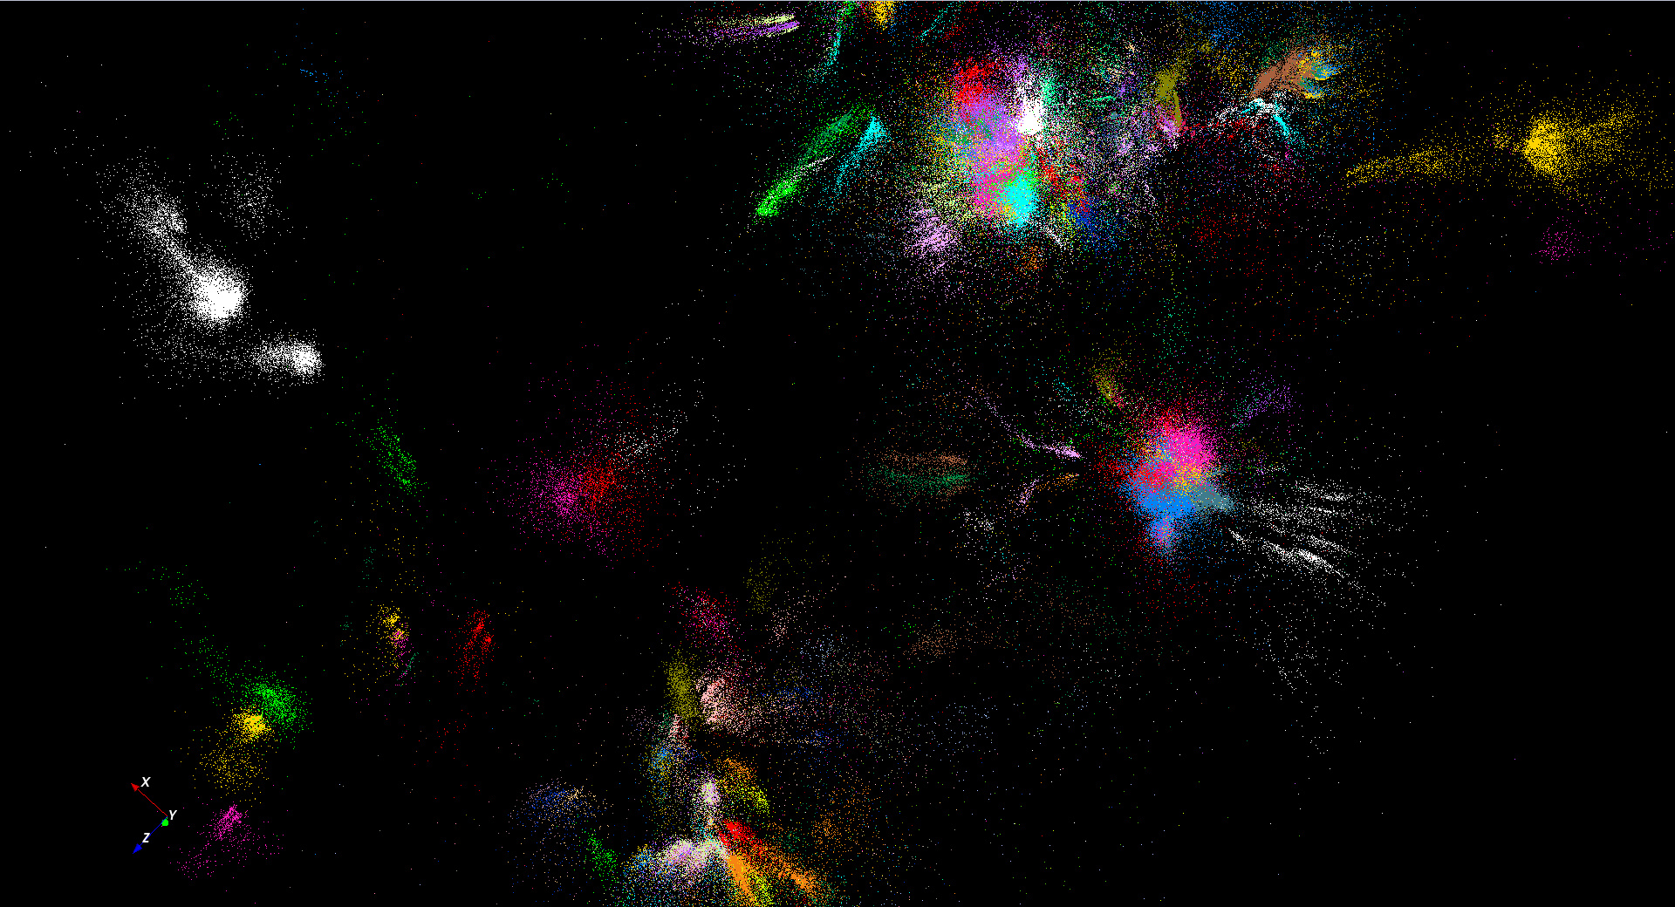
446K sequences
~100 clusters

Slide 32
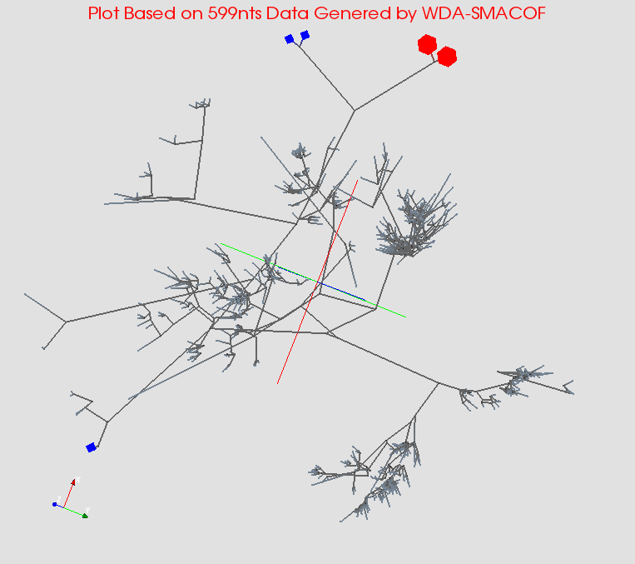
MDS gives classifying cluster centers and existing sequences for Fungi nice 3D Phylogenetic trees

Slide 33
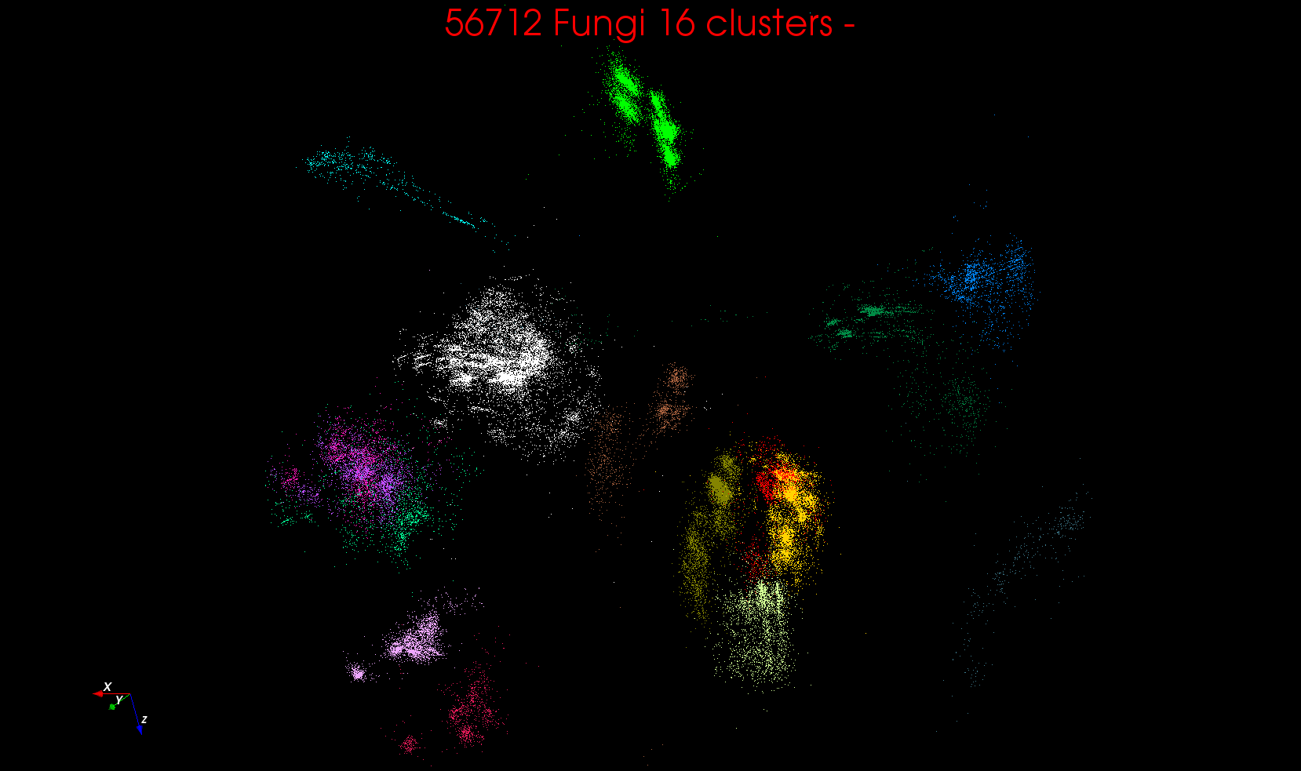
“clean” sample of 446K
O(N²) green-green and purple-purple interactions have value but green-purple are “wasted”
O(N²) interactions between green and purple clusters should be able to represent by centroids as in Barnes-Hut.
Hard as no Gauss theorem; no multipole expansion and points really in 1000 dimension space as clustered before 3D projection

Slide 34
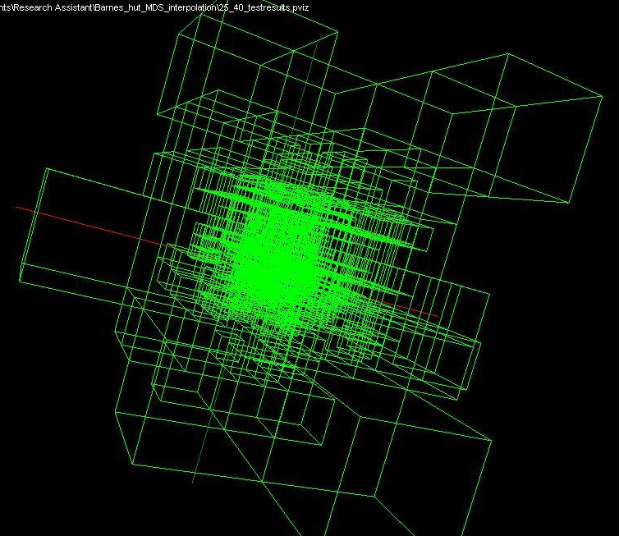
Use Barnes Hut OctTree, originally developed to make O(N²) astrophysics O(NlogN), to give similar speedups in machine learning

Slide 35
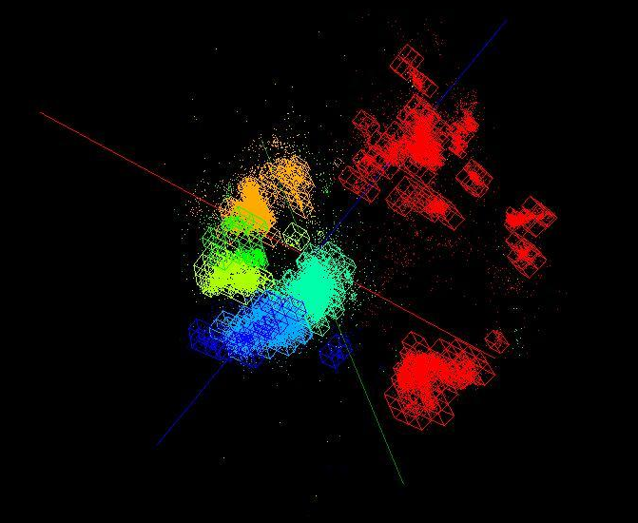
OctTree for 100K sample of Fungi
We use OctTree for logarithmic interpolation (streaming data)

Slide 36
Algorithm Challenges
See NRC Massive Data Analysis report
O(N) algorithms for O(N²) problems
Parallelizing Stochastic Gradient Descent
Streaming data algorithms – balance and interplay between batch methods (most time consuming) and interpolative streaming methods
Graph algorithms – need shared memory?
Machine Learning Community uses parameter servers; Parallel Computing (MPI) would not recommend this?
  Is classic distributed model for “parameter service” better?
Apply best of parallel computing – communication and load balancing – to Giraph/Hadoop/Spark
Are data analytics sparse?; many cases are full matrices
BTW Need Java Grande – Some C++ but Java most popular in ABDS, with Python, Erlang, Go, Scala (compiles to JVM) …..

Slide 37
Some Futures
Always run MDS. Gives insight into data
  Leads to a data browser as GIS gives for spatial data
Claim is algorithm change gave as much performance increase as hardware change in simulations. Will this happen in analytics?
  Today is like parallel computing 30 years ago with regular meshs. We will learn how to adapt methods automatically to give “multigrid” and “fast multipole” like algorithms
Need to start developing the libraries that support Big Data
  Understand architectures issues
  Have coupled batch and streaming versions
  Develop much better algorithms
Please join SPIDAL (Scalable Parallel Interoperable Data Analytics Library) community

Slide 38
Java Grande

Slide 39
Java Grande
We once tried to encourage use of Java in HPC with Java Grande Forum but Fortran, C and C++ remain central HPC languages.
  Not helped by .com and Sun collapse in 2000-2005
The pure Java CartaBlanca, a 2005 R&D100 award-winning project, was an early successful example of HPC use of Java in a simulation tool for non-linear physics on unstructured grids.
Of course Java is a major language in ABDS and as data analysis and simulation are naturally linked, should consider broader use of Java
Using Habanero Java (from Rice University) for Threads and mpiJava or FastMPJ for MPI, gathering collection of high performance parallel Java analytics
  Converted from C# and sequential Java faster than sequential C#
So will have either Hadoop+Harp or classic Threads/MPI versions in Java Grande version of Mahout

Slide 40
Performance of MPI Kernel Operations
Pure Java as in FastMPJ slower than Java interfacing to C version of MPI

Slide 41
Java Grande and C# on 40K point DAPWC Clustering
Very sensitive to threads v MPI
C# Hardware 0.7 performance Java Hardware
C#
Java
64 Way parallel
128 Way parallel
256 Way
parallel
TXP
Nodes
Total

Slide 42
Java and C# on 12.6K point DAPWC Clustering
Time hours
Java
C#
#Threads x #Processes per node
# Nodes
Total Parallelism
C# Hardware 0.7 performance Java Hardware
#Threads x #Processes per node
1x1
1x2
2x1
1x4
2x2
4x1
1x8
2x4
4x2
8x1

