Slide 1
OpenQuake Infomall
ACES Meeting Maui
May 4 2011
Geoffrey Fox
gcf@indiana.edu
http://www.infomall.org http://www.futuregrid.org
Director, Digital Science Center, Pervasive Technology Institute
Associate Dean for Research and Graduate Studies, School of Informatics and Computing
Indiana University Bloomington
Notes:
SALSA is
Service Aggregated Linked Sequential Activities

Slide 2
Important Trends
Data Deluge in all fields of science
Multicore implies parallel computing important again
  Performance from extra cores – not extra clock speed
  GPU enhanced systems can give big power boost
Clouds – new commercially supported data center model replacing compute grids (and your general purpose computer center)
Light weight clients: Sensors, Smartphones and tablets accessing and supported by backend services in cloud
Commercial efforts moving much faster than academia in both innovation and deployment
Split between Exascale Computing and Clouds although dependent on similar technologies

Slide 3
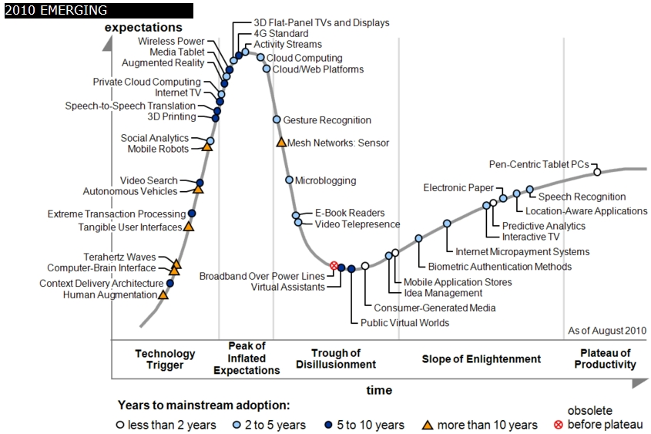
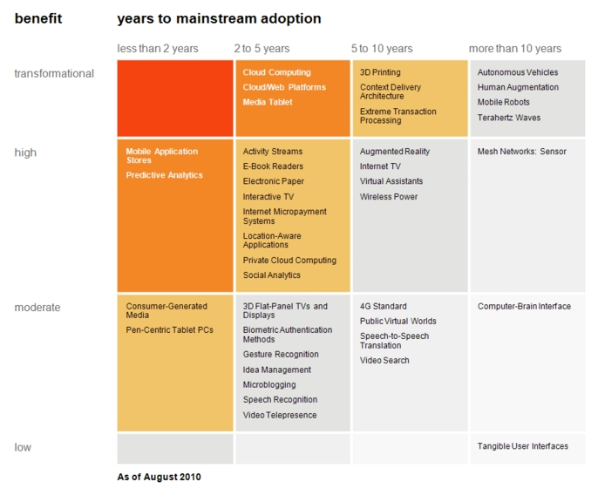

Transformational
High
Moderate
Low
Gartner 2009 Hype Curve
Clouds, Web2.0
Service Oriented Architectures
Cloud Computing
Cloud Web Platforms
Media Tablet

Slide 4
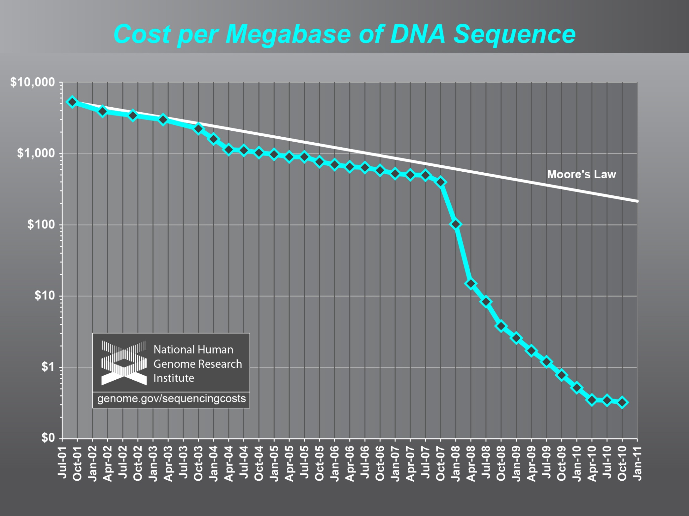

Slide 5



Data Centers Clouds &
Economies of Scale
Range in size from “edge” facilities to megascale.
Economies of scale
  Approximate costs for a small size center (1K servers) and a larger, 50K server center.
2 Google warehouses of computers on the banks of the Columbia River, in The Dalles, Oregon
Such centers use 20MW-200MW
(Future) each with 150 watts per CPU
Save money from large size, positioning with cheap power and access with Internet
Technology | Cost in small-sized Data Center | Cost in Large Data Center | Ratio
Network | $95 per Mbps/ month | $13 per Mbps/ month | 7.1
Storage | $2.20 per GB/ month | $0.40 per GB/ month | 5.7
Administration | ~140 servers/ Administrator | >1000 Servers/ Administrator | 7.1
Each data center is
11.5 times
the size of a football field

Slide 6
Clouds and Jobs
Clouds are a major industry thrust with a growing fraction of IT expenditure that IDC estimates will grow to $44.2 billion direct investment in 2013 while 15% of IT investment in 2011 will be related to cloud systems with a 30% growth in public sector.
Gartner also rates cloud computing high on list of critical emerging technologies with for example “Cloud Computing” and “Cloud Web Platforms” rated as transformational (their highest rating for impact) in the next 2-5 years.
Correspondingly there is and will continue to be major opportunities for new jobs in cloud computing with a recent European study estimating there will be 2.4 million new cloud computing jobs in Europe alone by 2015.
Cloud computing is an attractive for projects focusing on workforce development. Note that the recently signed “America Competes Act” calls out the importance of economic development in broader impact of NSF projects

Slide 7
















X as a Service
SaaS: Software as a Service imply software capabilities
(programs) have a service (messaging) interface
  Applying systematically reduces system complexity to being linear in number of components
  Access via messaging rather than by installing in /usr/bin
IaaS: Infrastructure as a Service or HaaS: Hardware as a Service – get your computer time with a credit card and with a Web interface
PaaS: Platform as a Service is IaaS plus core software capabilities on which you build SaaS
Cyberinfrastructure is “Research as a Service”
Other Services
Clients

Slide 8
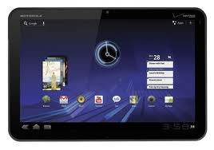

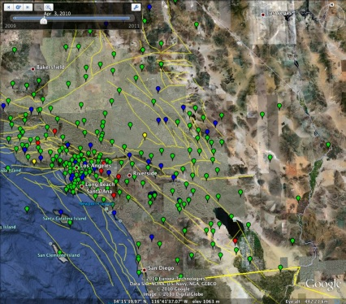


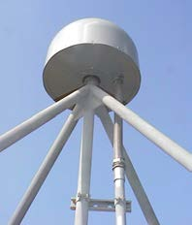
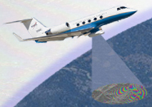
Sensors as a Service
Cell phones are important sensor
Sensors as a Service
Sensor Processing as a Service (MapReduce)

Slide 9
OpenQuake Infomall
ACES Cloud Environment enabling sharing of data and services in the cloud
Data (sensors), simulations, data analysis, mining tools become services
  Open source or just binary services with well defined interfaces
Standard tools from Perl to Kepler allow you to build workflows or mash-ups linking these together
Search interface for mail, twitter, blogs, documents in Earthquake arena
Web 2.0 facilities as in Youtube and Flicker to upload documents, images, video
Collaboration tools such as Google docs, Facebook …

Slide 10
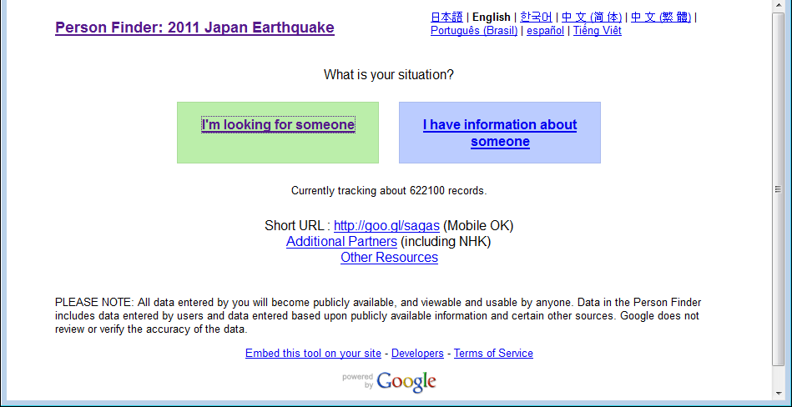
http://japan.person-finder.appspot.com/?lang=en

Slide 11
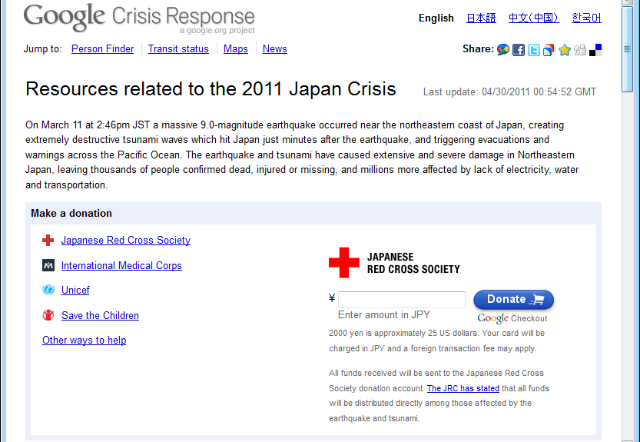
http://www.google.com/crisisresponse/japanquake2011.html

Slide 12
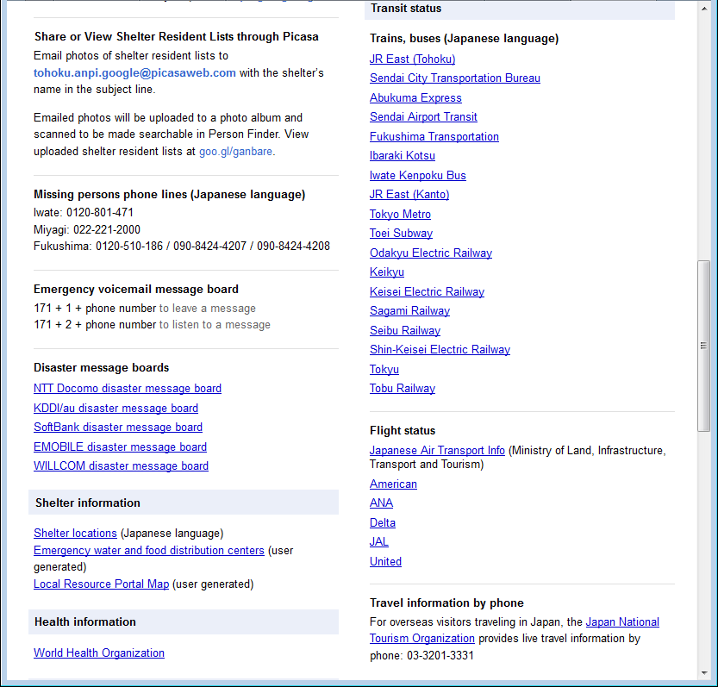

Slide 13
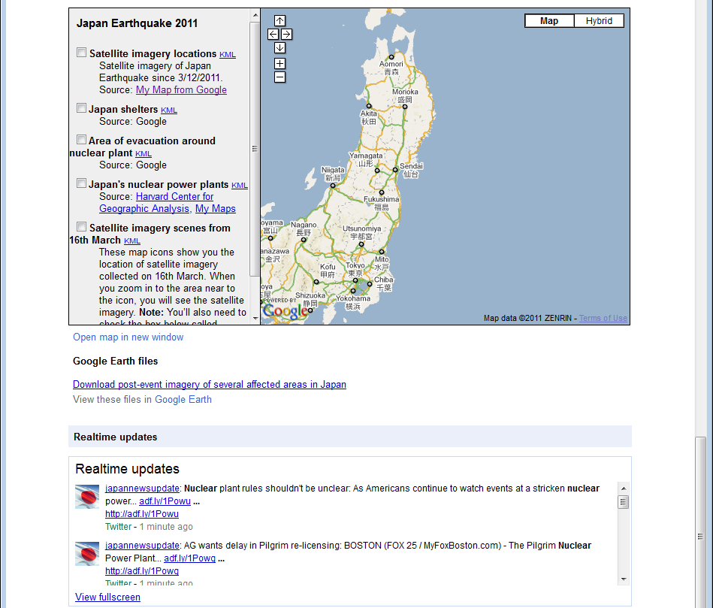

Slide 14
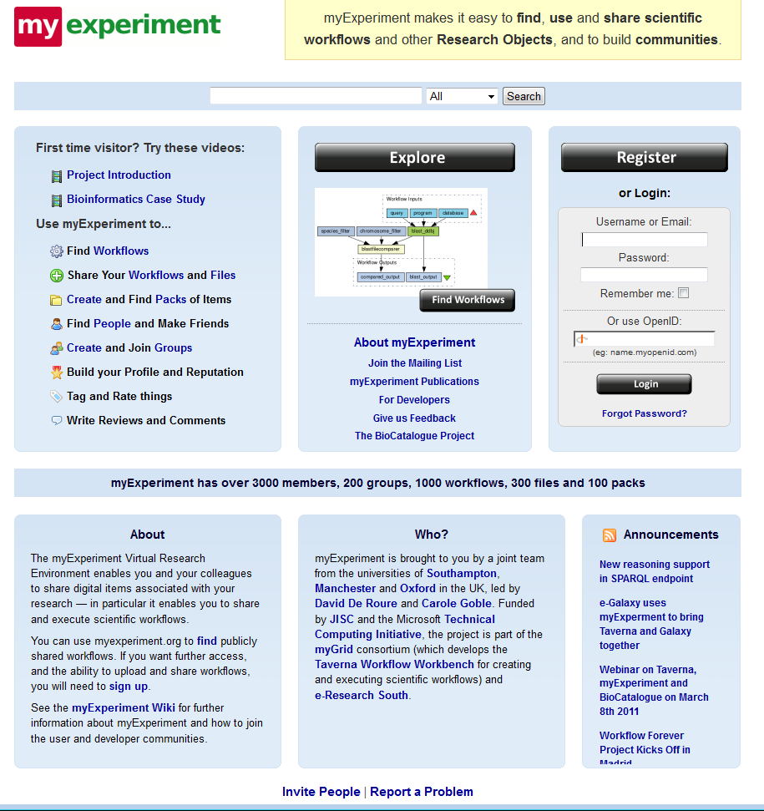
MyExperiment mainly biology and Taverna workflow

Slide 15
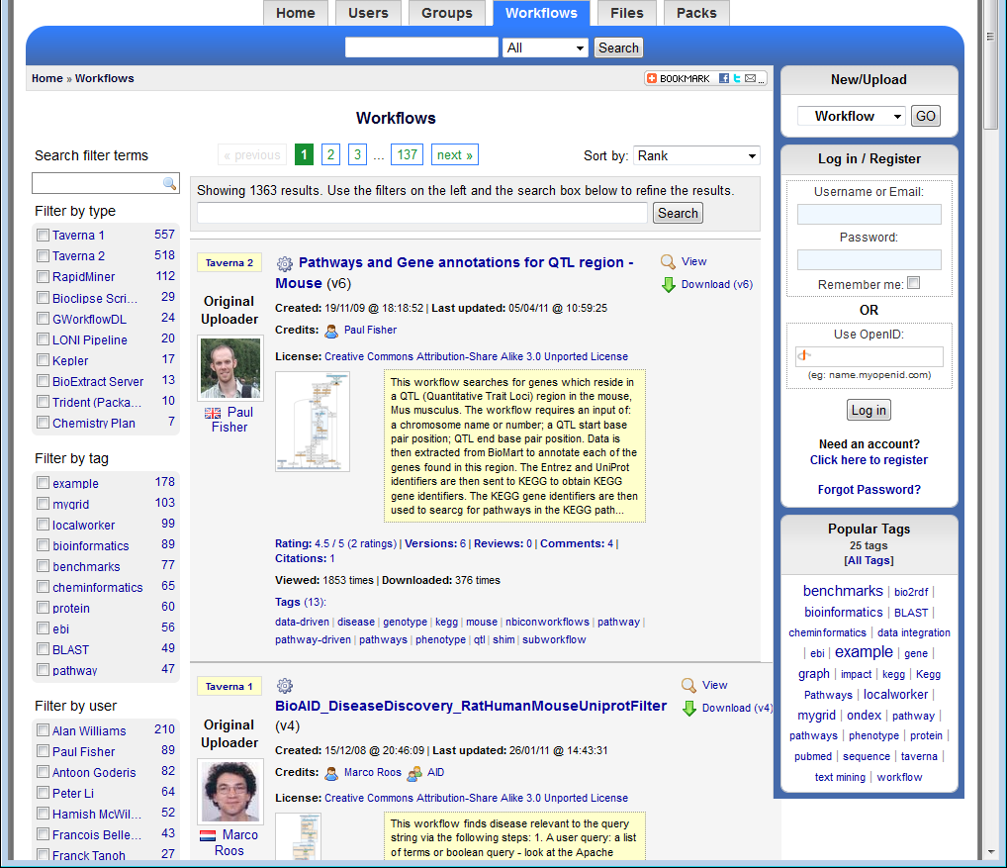
myexperiment

Slide 16
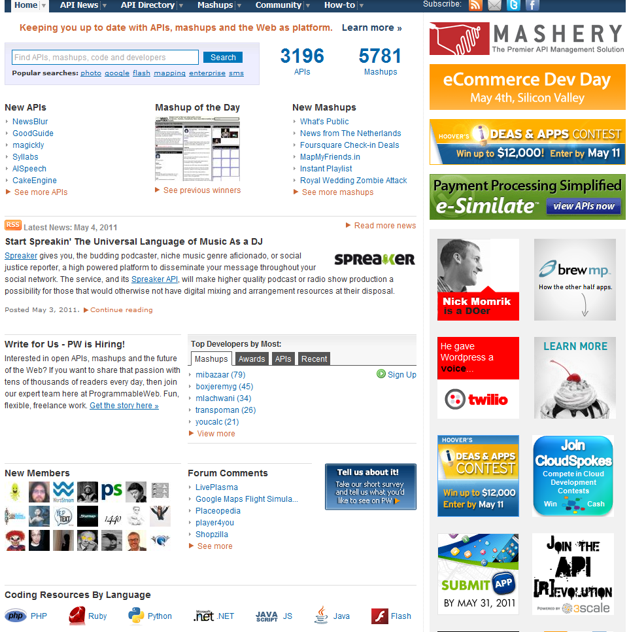
http://www.programmableweb.com/

Slide 17
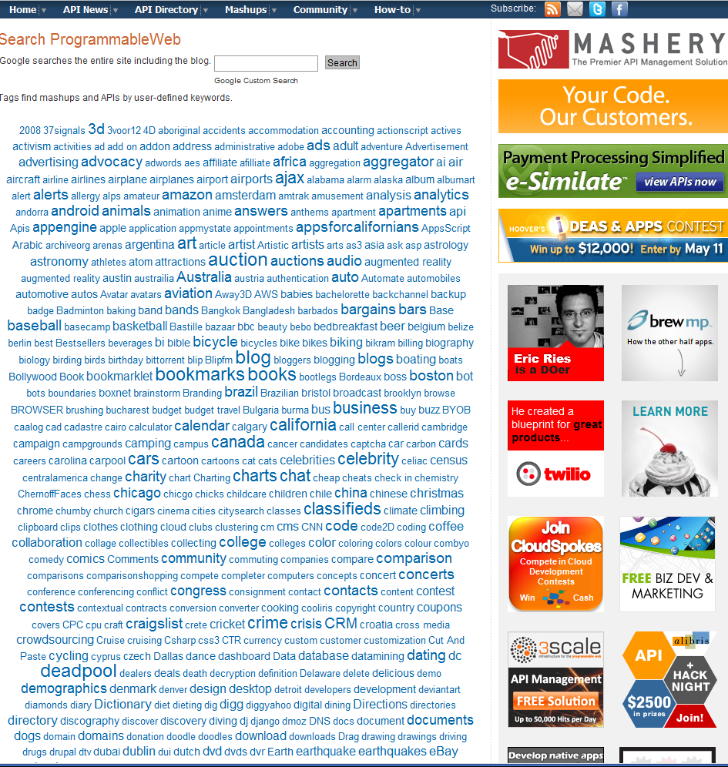
http://www.programmableweb.com/

Slide 18
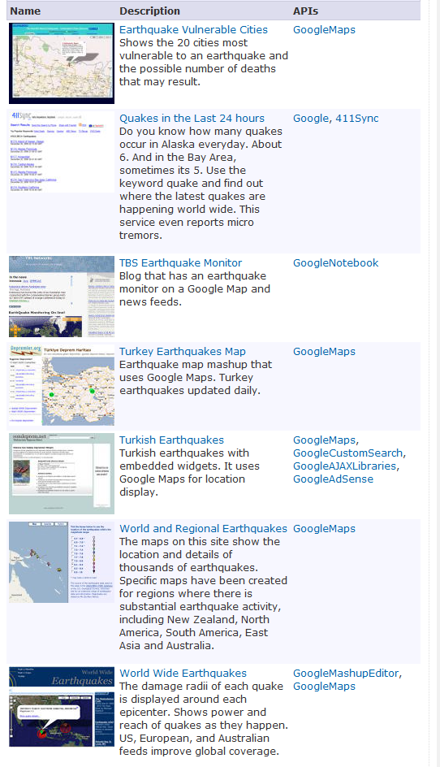
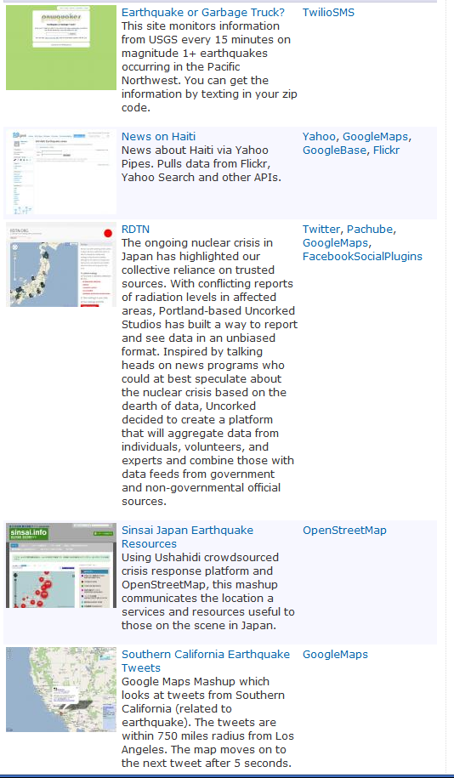
http://www.programmableweb.com/

Slide 19
Tools in the OpenQuake Infomall
Data archives
Real-time data links
Data Analysis
Data mining
Simulations
Visualizations
Workflow(s)
Manage use of OpenQuake Infomall
  So all results are reproducible

Slide 20
Interoperability
Workflow composes this
Clouds are execution environment
Each unit is a Service (SaaS)
Portal is interface
Need standards to allow multiple data and multiple services to interoperate
Data Source
Data Analysis
Data
Standards
Pattern Recognition
Simulation
Visualization

Slide 21
Questions for OpenQuake Infomall
This is real and not a toy!
  Probably a model of future throughout science
Choice of collaboration tools can be hard
  Everybody likes a different one
  Should use commercial solutions embedded in a custom web environment
Need agreement to build “Earthquake Software as a Service”
Need to define critical data and tool Interfaces
Decide what scientists does and what government/Google/Microsoft does – don’t compete
Nontrivial effort to build web site

