Slide 1
Event-Based Infrastructure for Reconciling Distributed Annotation Records
Ahmet Fatih Mustacoglu
amustaco@cs.indiana.edu
Advisor: Prof. Geoffrey C. Fox

Slide 2
Outline
Introduction
Motivations and research issues
Architecture
Event-Based Infrastructure and Hybrid Consistency Framework (EBIHCF)
Measurements and Analysis
Conclusions
Contributions and Future Works

Slide 3
Online Collaboration
Rapid development of annotation tools and services
Aimed at fostering online collaboration and sharing between users and communities:
Bookmarking Tools supports annotation using keywords called tags and sharing
e.g. del.icio.us
Tools for annotation and sharing of scholarly publications
Connotea
Citeulike
Bibsonomy
Social Networking Tools(MySpace)
Video Sharing and annotation
e.g. YouTube
Notes:
YouTube integration in future and face book is different

Slide 4
Tools for Annotation and Sharing Publications
They are used for:
Collecting data and metadata
Annotating data
Sharing papers
Limitations of these tools:
Different and limited metadata storage
Need to enter same entry to each tool
No timing information for updated records
Lack of ability to transfer data between tools
Lack of services to extract and import data into a repository
Lack of services to upload data from a repository

Slide 5
Motivations
Numerous annotation tools, different and limited metadata storage
Multiple instances of metadata about the same document
No time-stamp info for updated records
Causing inconsistencies
Lack of interoperability between annotation sites
Applying service-based architecture to annotation systems
Using existing tools and their services with added capabilities for scientific research
Management of metadata coming from different sources
Missing services
Upload and extract metadata from/to a repository

Slide 6
Research Issues I
Need an infrastructure to manage metadata
Dealing with metadata coming from several sources
Issues with using annotation tools and their services with added capabilities
Extract and upload data to/from tools
More metadata support for documents
Providing communication between annotation tools
Issues with document tracking and access to previous versions of documents
Consistency Enforcement
Issues with maintaining consistency between copies of a record stored at various annotation tools

Slide 7
Research Issues II
Scalability
Increased input to be processed
Increased message rate per second
Flexibility and Extensibility
Interoperable with other clients
Ease of integrating an annotation tool
Performance
The number of integrated annotation tools
Best consistency interval period
Notes:
How to provide efficient metadata management while keeping them synchronized

Slide 8
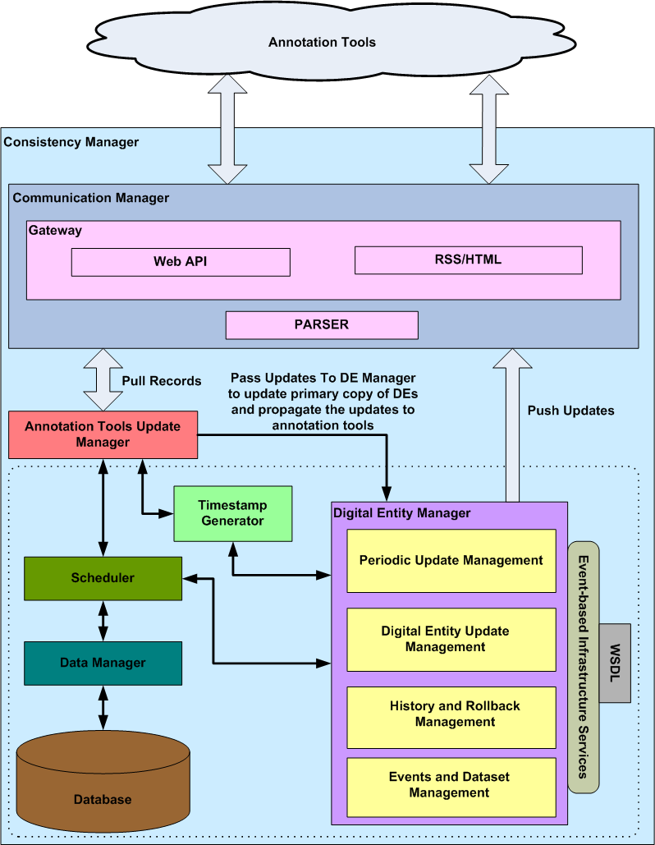
Event-based Infrastructure and Hybrid Consistency Framework (EBIHCF)

Slide 9
Event-based Infrastructure and Hybrid Consistency Framework
Key Concepts:
Distributed Annotation Record (DAR): Collection of metadata stored at an annotation tool.
Digital Entity (DE): A digital collection of metadata for a citation stored in a system database forms a primary copy of a DAR.
Event: A time-stamped action on a digital entity
Major Events:
Insertion or deletion of a digital entity
Minor Events:
Modifications to an existing digital entity

Slide 10
Event-based Infrastructure and Hybrid Consistency Framework
Representation of metadata of documents coming from various sources as events
Major and minor events
More metadata support than current annotation tools
Ability to access and rollback to previous versions of documents
Supports integrated annotation tools and search tools for scientific research
Using annotation tools’ existing services with added capabilities
Using online popular search tools to collect metadata
Provides communication among annotation tools
Service-enabled architecture
Keeps records located annotation tools and a system database synchronized with each other
Adopting time-based and strict consistency approaches

Slide 11
Event-based Infrastructure and Hybrid Consistency Framework (EBIHCF)

Slide 12
Communication Manager
Responsible for providing communication between annotation tools and update manager and digital entity manager via gateways
e.g. Connotea gateway
Utilizes a gateway for each annotation tool, and a parser
Retrieve records in XML format
Parse and pass records to update manager
Post updates coming from digital entity manager to annotation tools

Slide 13
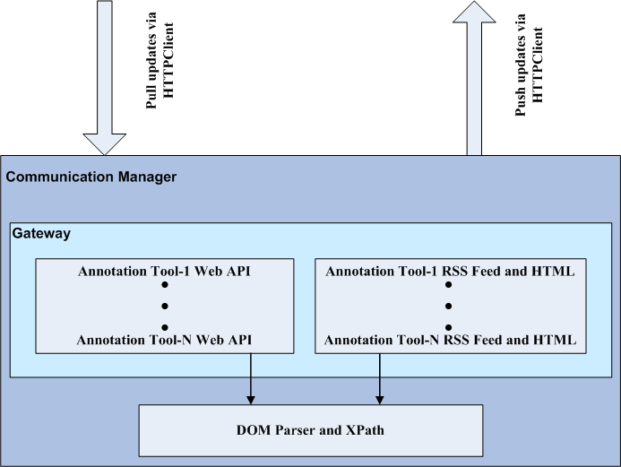
Communication Manager

Slide 14
Gateway
Interface between event-based infrastructure and hybrid consistency framework and an annotation tool
Provides extensibility
A gateway needs to be deployed for each annotation tool that need to be integrated into the system
Annotation Tools
EBIHCF
Gateways
EBIHCF Modules

Slide 15
Event-based Infrastructure and Hybrid Consistency Framework (EBIHCF)

Slide 16
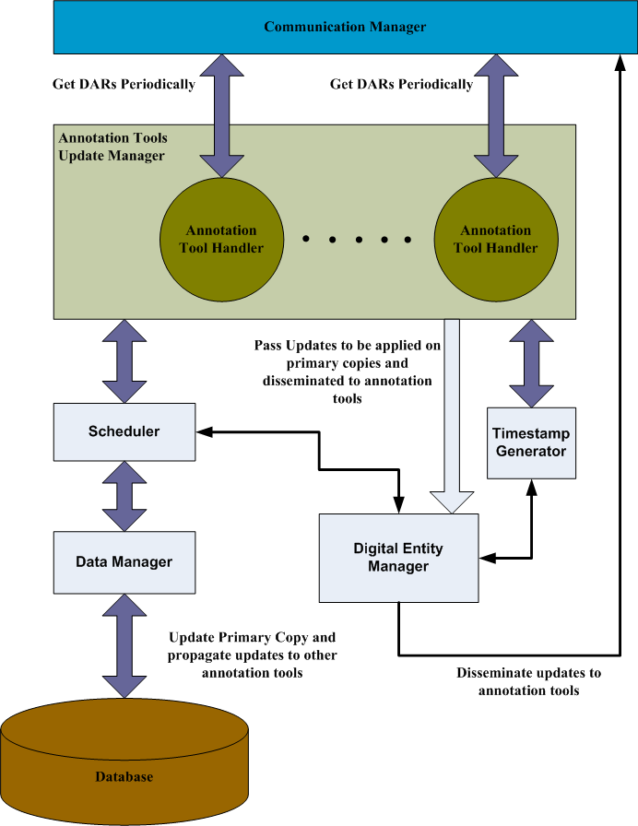
Annotation Tools Update Manager
Responsible for:
Retrieving the records from annotation tools periodically (Time-based consistency approach by pulling records)
Finding out the updates
Passing the updates to Digital Entity Manager so that they can be applied on the primary copy of each record
Pre-retrieval of existing records (caching)
Notes:
Finding out the updates based on annotation tools priority

Slide 17
Event-based Infrastructure and Hybrid Consistency Framework (EBIHCF)

Slide 18
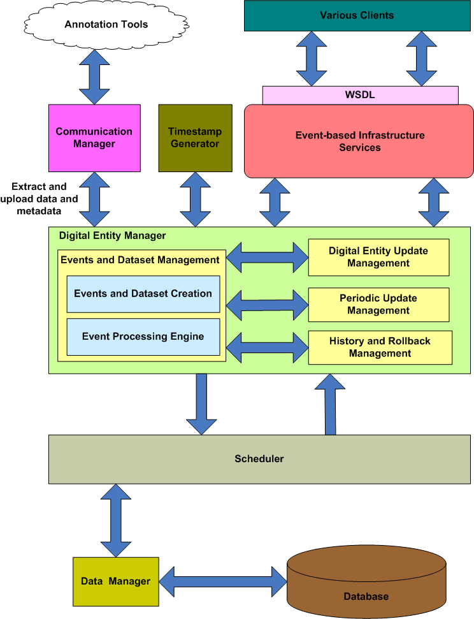
Digital Entity Manager
Responsible for:
Events and dataset creation
Event Processing
Manages updates made on the primary copy of a digital entity
Updates primary copy located on a system database
Pass updates to the Communication Manager (Strict consistency by pushing updates immediately)
Handles periodic update management
Deals with history and rollback management of a digital entity

Slide 19
Summary of Event-Based Infrastructure and Hybrid Consistency Framework
Event-based infrastructure supports
Representation of metadata coming from different sources as events with additional metadata support
Communication between annotation tools
Annotation tools and search tools for scientific research with added capabilities
Access and rollback to any versions of records
Easy access to its services via service calls by various clients
Hybrid Consistency Framework adopts
Time based consistency mechanism (pull approach)
Primary-copy based strict consistency mechanism (push approach)

Slide 20
Benchmarks
System Performance
Investigation of the processing times associated with the increased # of annotation tools
Investigation of the best consistency interval period and its improved results
Scalability
System behavior for the increased minor events (updates)
System behavior for the increased message rate
Consistency Maintenance
Cost of consistency maintenance for carrying out the updates in primary copy (push)
Cost of consistency maintenance for carrying out the updates from annotation tools (pull)

Slide 21
Benchmark - Environments
Machine Configurations
Cluster Node gf6 and gf8.ucs.indiana.edu
Processor | Intel® XeonTM CPU (2.40GHz)
RAM | 2 GB total
OS | GNU/Linux (kernel release 2.4.22)
We have used:
Java 2 Standard Edition compiler with version 1.5.0_12. The maximum heap size of Java Virtual Machine (JVM) to1024MB
Apache Tomcat Server with version 5.0.28
Apache Axis technology with version 1.2

Slide 22
Benchmarks - Performance I
The goal is to investigate
The processing times related to the increased number of annotation tools
The best consistency interval period
Every measurement is observed 100 times.
Notes:
maximum number of annotation tools that can be supported by the proposed system without performance degradation

Slide 23
Benchmark I- Performance II
Average processing time is 154,662msec for 100 tools.
It takes around 2.57min to complete periodic update operation for 100 tools. So, the best consistency interval period for 100 tools is 2.57 min.
We were able to create max of 1400 threads to represent annotation tools in gf8
Notes:
154,662msec for 100 tools. It takes around 2.57min to complete periodic update operation for 100 tools. So, the best consistency interval period for 100 tools is 2.57 min.

Slide 24
Benchmark I- Performance III
Average processing time is 92,232msec for 100 tools.
It takes around 1.53min to complete periodic update operation for 100 tools. So, the best consistency interval period for 100 tools is 1.53 min.
Pre-retrieval (caching) expedites the consistency maintenance execution time by decreasing the access time.

Slide 25
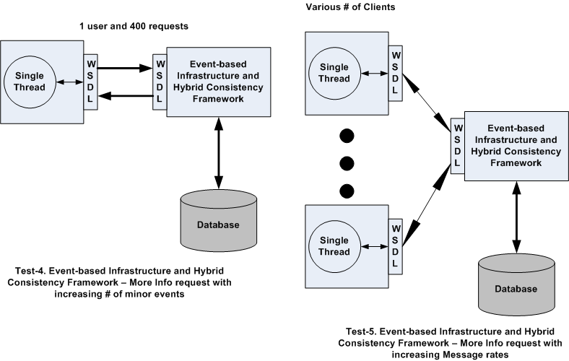
Benchmark II- Scalability I
The goal is to investigate the scalability of Event-based Hybrid Consistency Framework implementation
Measure the round trip time for standard operations like MoreInfo while the number of minor events are increased
Measure the round trip time for standard operations like MoreInfo while the message rate increases

Slide 26
Benchmark II- Scalability II
Increasing the # of minor events causes the round trip time to increase linearly as expected.

Slide 27
Benchmark II- Scalability III
While # of requests exceeds 80 simultaneous messages per second, the system Performance starts to decrease.
The system is able to scale to increasing message rate and performs well.
Notes:
Each major event has 10 minor events (updates) to be processed

Slide 28
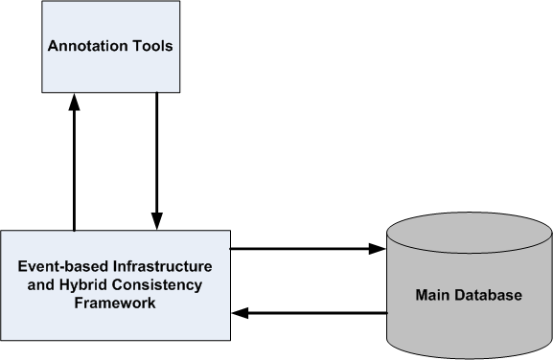
Benchmark III- Consistency Maintenance I
The goal is to investigate the cost of our Hybrid Consistency Framework.
The cost of consistency maintenance in terms of the time required to carry out updates at the primary-copy holder
The cost of consistency maintenance in terms of the time required to carry out updates at the annotation tools

Slide 29
Benchmark III-Consistency Maintenance II
154 major and 10 minor events exist in the database, and there is a new update on a DE.
Overhead of consistency enforcement is around 0.18 - 0.45 sec for propagating the update to 1 or 2 tools.
There is a small amount of linear increase in the cost of consistency enforcement associated with the increased number of annotation tools.
Notes:
the cost of consistency enforcement in terms of the time required to carry out updates at the primary-copy holder

Slide 30
Benchmark III-Consistency Maintenance III
154 major and 10 minor events exist in the database and 10 updates coming from each tool.
Overhead of consistency enforcement is around 6-7 sec for 1 or 2 tools.
There is a small amount of linear increase in the cost of consistency enforcement associated with the increased number of annotation tools.
Notes:
the cost of consistency enforcement in terms of the time required to carry out updates at the annotation tools

Slide 31
Contributions
System research
Identifying the circumstances where this architecture has advantages
An Event-based Infrastructure
Service-enabled architecture
Efficient, scalable, and modular
Separation of events as minor and major events
Handling various types of metadata coming from several sources
Flexibility to access previous versions of a document
Hybrid Consistency Framework
Adopting Strict Consistency via primary copy based approach
Adopting Time based consistency via pull-based approach
Comprehensive benchmarks to evaluate the scalability, performance and consistency maintenance for the prototype system
System software
Internet Documentation and Integration of Metadata (IDIOM)
Event-Based Infrastructure and Hybrid Consistency Framework for IDIOM

Slide 32
Future Works
Compaction of increased number of minor events into a major event to reduce processing time
Supporting video collaboration tools
YouTube
Integration of other academic collaboration and publication tools into EBIHCF
e.g. Bibsonomy integration
From a single storage of metadata to distributed storages

Slide 33
Publications
Book Chapters
Web 2.0 for Grids and e-Science; Geoffrey C. Fox, Rajarshi Guha, Donald F. McMullen, Ahmet Fatih Mustacoglu, Marlon E. Pierce, Ahmet E. Topcu, David J. Wild. Published by Springer, 2007 - Grid Enabled Remote Instrumentation (Chapter: Web 2.0 for Grids and e-Science)
Publications
Hybrid Consistency Framework for Distributed Annotation Records in a Collaborative Environment; Ahmet Fatih Mustacoglu and Geoffrey Fox
Web 2.0 for E-Science Environments Keynote Presentation; Geoffrey C. Fox, Marlon E. Pierce, Ahmet Fatih Mustacoglu, Ahmet E. Topcu
Integration of Collaborative Information Systems in Web 2.0; Ahmet E. Topcu, Ahmet Fatih Mustacoglu, Geoffrey Fox, Aurel Cami
SRG: A Digital Document-Enhanced Service Oriented Research Grid; Geoffrey Fox, Ahmet Fatih Mustacoglu, Ahmet E. Topcu, Aurel Cami
AJAX Integration Approach for Collaborative Calendar-Server Web Services; Ahmet Fatih Mustacoglu, Geoffrey Fox
A Novel Event-Based Consistency Model for Supporting Collaborative Cyberinfrastructure Based Scientific Research; Ahmet Fatih Mustacoglu, Ahmet E. Topcu, Aurel Cami, Geoffrey Fox
iCalendar (RFC2445) Compatible Collaborative Calendar-Server Services; Ahmet Fatih Mustacoglu, Wenjun Wu, Geoffrey Fox

