Slide 1
Integrating the Apache Stack with HPC for Big Data
AGU Session: Leveraging Enabling Technologies and Architectures to Enable Data Intensive Science II
Moscone Convention Center, San Francisco
December 16 2014
Geoffrey Fox, Judy Qiu, Shantenu Jha
gcf@indiana.edu
http://www.infomall.org
School of Informatics and Computing
Digital Science Center
Indiana University Bloomington

Slide 2
NIST Big Data Initiative
Led by Chaitin Baru, Bob Marcus, Wo Chang

Slide 3
NBD-PWG (NIST Big Data Public Working Group) Subgroups & Co-Chairs
There were 5 Subgroups - Note mainly industry
Requirements and Use Cases Sub Group
  Geoffrey Fox, Indiana U.; Joe Paiva, VA; Tsegereda Beyene, Cisco
Definitions and Taxonomies SG
  Nancy Grady, SAIC; Natasha Balac, SDSC; Eugene Luster, R2AD
Reference Architecture Sub Group
  Orit Levin, Microsoft; James Ketner, AT&T; Don Krapohl, Augmented Intelligence
Security and Privacy Sub Group
  Arnab Roy, CSA/Fujitsu Nancy Landreville, U. MD Akhil Manchanda, GE
Technology Roadmap Sub Group
  Carl Buffington, Vistronix; Dan McClary, Oracle; David Boyd, Data Tactics
See http://bigdatawg.nist.gov/usecases.php
and http://bigdatawg.nist.gov/V1_output_docs.php

Slide 4

Use Case Template
26 fields completed for 51 areas
Government Operation: 4
Commercial: 8
Defense: 3
Healthcare and Life Sciences: 10
Deep Learning and Social Media: 6
The Ecosystem for Research: 4
Astronomy and Physics: 5
Earth, Environmental and Polar Science: 10
Energy: 1

Slide 5
51 Detailed Use Cases: Contributed July-September 2013
Covers goals, data features such as 3 V’s, software, hardware
26 Features for each use case
Biased to science
http://bigdatawg.nist.gov/usecases.php
https://bigdatacoursespring2014.appspot.com/course (Section 5)
Government Operation(4): National Archives and Records Administration, Census Bureau
Commercial(8): Finance in Cloud, Cloud Backup, Mendeley (Citations), Netflix, Web Search, Digital Materials, Cargo shipping (as in UPS)
Defense(3): Sensors, Image surveillance, Situation Assessment
Healthcare and Life Sciences(10): Medical records, Graph and Probabilistic analysis, Pathology, Bioimaging, Genomics, Epidemiology, People Activity models, Biodiversity
Deep Learning and Social Media(6): Driving Car, Geolocate images/cameras, Twitter, Crowd Sourcing, Network Science, NIST benchmark datasets
The Ecosystem for Research(4): Metadata, Collaboration, Language Translation, Light source experiments
Astronomy and Physics(5): Sky Surveys including comparison to simulation, Large Hadron Collider at CERN, Belle Accelerator II in Japan
Earth, Environmental and Polar Science(10): Radar Scattering in Atmosphere, Earthquake, Ocean, Earth Observation, Ice sheet Radar scattering, Earth radar mapping, Climate simulation datasets, Atmospheric turbulence identification, Subsurface Biogeochemistry (microbes to watersheds), AmeriFlux and FLUXNET gas sensors
Energy(1): Smart grid

Slide 6
Features of 51 Use Cases I
PP (26) “All” Pleasingly Parallel or Map Only
MR (18) Classic MapReduce MR (add MRStat below for full count)
MRStat (7) Simple version of MR where key computations are simple reduction as found in statistical averages such as histograms and averages
MRIter (23) Iterative MapReduce or MPI (Spark, Twister)
Graph (9) Complex graph data structure needed in analysis
Fusion (11) Integrate diverse data to aid discovery/decision making; could involve sophisticated algorithms or could just be a portal
Streaming or DDDAS (41) data comes in incrementally and is processed this way. Area I expect a lot of progress
Classify (30) Classification: divide data into categories
S/Q (12) Index, Search and Query

Slide 7
Features of 51 Use Cases II
CF (4) Collaborative Filtering for recommender engines
LML (36) Local Machine Learning (Independent for each parallel entity) – application could have GML as well
GML (23) Global Machine Learning: Deep Learning, Clustering, LDA, PLSI, MDS,
  Large Scale Optimizations as in Variational Bayes, MCMC, Lifted Belief Propagation, Stochastic Gradient Descent, L-BFGS, Levenberg-Marquardt . Can call EGO or Exascale Global Optimization with scalable parallel algorithm
Workflow (51) Universal
GIS (16) Geotagged data and often displayed in ESRI, Microsoft Virtual Earth, Google Earth, GeoServer etc.
HPC (5) Classic large-scale simulation of cosmos, materials, etc. generating (visualization) data
Agent (2) Simulations of models of data-defined macroscopic entities represented as agents

Slide 8
Big Data Patterns – the Ogres

Slide 9
HPC Benchmark Classics
Linpack or HPL: Parallel LU factorization for solution of linear equations
NPB version 1: Mainly classic HPC solver kernels
  MG: Multigrid
  CG: Conjugate Gradient
  FT: Fast Fourier Transform
  IS: Integer sort
  EP: Embarrassingly Parallel
  BT: Block Tridiagonal
  SP: Scalar Pentadiagonal
  LU: Lower-Upper symmetric Gauss Seidel

Slide 10
Patterns (Ogres) modelled on
13 Berkeley Dwarfs
Dense Linear Algebra
Sparse Linear Algebra
Spectral Methods
N-Body Methods
Structured Grids
Unstructured Grids
MapReduce
Combinational Logic
Graph Traversal
Dynamic Programming
Backtrack and Branch-and-Bound
Graphical Models
Finite State Machines
The Berkeley dwarfs and NAS Parallel Benchmarks are perhaps two best known approaches to characterizing Parallel Computing Uses Cases / Kernels / Patterns
Note dwarfs somewhat inconsistent as for example MapReduce is a programming model and spectral method is a numerical method.
No single comparison criterion and so need multiple facets!

Slide 11
7 Computational Giants of NRC Massive Data Analysis Report
G1: Basic Statistics (termed MRStat later as suitable for simple MapReduce implementation)
G2: Generalized N-Body Problems
G3: Graph-Theoretic Computations
G4: Linear Algebraic Computations
G5: Optimizations e.g. Linear Programming
G6: Integration (Called GML Global Machine Learning Later)
G7: Alignment Problems e.g. BLAST

Slide 12
First set of Ogre Facets
Facets I: The features just discussed (PP, MR, MRStat, MRIter, Graph, Fusion, Streaming (DDDAS), Classify, S/Q, CF, LML, GML, Workflow, GIS, HPC, Agents)
Facets II: Some broad features familiar from past like
BSP (Bulk Synchronous Processing) or not?
SPMD (Single Program Multiple Data) or not?
Iterative or not?
Regular or Irregular?
Static or dynamic?,
communication/compute and I-O/compute ratios
Data abstraction (array, key-value, pixels, graph…)

Slide 13
Core Analytics Facet I
Map-Only
  Pleasingly parallel - Local Machine Learning
MapReduce: Search/Query/Index
  Summarizing statistics as in LHC Data analysis (histograms) (G1)
  Recommender Systems (Collaborative Filtering)
  Linear Classifiers (Bayes, Random Forests)
Alignment and Streaming (G7)
  Genomic Alignment, Incremental Classifiers
Global Analytics: Nonlinear Solvers (structure depends on objective function) (G5,G6)
  Stochastic Gradient Descent SGD and approximations to Newton’s Method
  Levenberg-Marquardt solver

Slide 14
Core Analytics Facet II
Global Analytics: Map-Collective (See Mahout, MLlib) (G2,G4,G6)
  Often use matrix-matrix,-vector operations, solvers (conjugate gradient)
  Clustering (many methods), Mixture Models, LDA (Latent Dirichlet Allocation), PLSI (Probabilistic Latent Semantic Indexing)
  SVM and Logistic Regression
  Outlier Detection (several approaches)
  PageRank, (find leading eigenvector of sparse matrix)
  SVD (Singular Value Decomposition)
  MDS (Multidimensional Scaling)
  Learning Neural Networks (Deep Learning)
  Hidden Markov Models
Graph Analytics (G3)
  Structure and Simulation (Communities, subgraphs/motifs, diameter, maximal cliques, connected components, Betweenness centrality, shortest path)
Linear/Quadratic Programming, Combinatorial Optimization, Branch and Bound (G5)

Slide 15
HPC-ABDS
Integrating High Performance Computing with Apache Big Data Stack
Shantenu Jha, Judy Qiu, Andre Luckow

Slide 16
There are a lot of Big Data and HPC Software systems
Challenge! Manage environment offering these different components

Slide 17
Maybe a Big Data Initiative would include
We don’t need 266 software packages so can choose e.g.
Workflow: IPython, Pegasus or Kepler (replaced by tools like Crunch, Tez?)
Data Analytics: Mahout, R, ImageJ, Scalapack
High level Programming: Hive, Pig
Parallel Programming model: Hadoop, Spark, Giraph (Twister4Azure, Harp), MPI;
Streaming: Storm, Kapfka or RabbitMQ (Sensors)
In-memory: Memcached
Data Management: Hbase, MongoDB, MySQL or Derby
Distributed Coordination: Zookeeper
Cluster Management: Yarn, Slurm
File Systems: HDFS, Lustre
DevOps: Cloudmesh, Chef, Puppet, Docker, Cobbler
IaaS: Amazon, Azure, OpenStack, Libcloud
Monitoring: Inca, Ganglia, Nagios

Slide 18
Big Data ABDS HPC, Cluster
Orchestration Crunch, Tez, Cloud Dataflow Kepler, Pegasus
Libraries Mllib/Mahout, R, Python Matlab, Scalapack, PETSc
High Level Programming Pig, Hive, Drill Domain-specific Languages
Platform as a Service App Engine, BlueMix, Elastic Beanstalk XSEDE Software Stack
Languages Java, Erlang, SQL, SparQL Fortran, C/C++
Streaming Storm, Kafka, Kinesis
Parallel Runtime MapReduce MPI/OpenMP/OpenCL
Coordination Zookeeper
Caching Memcached
Data Management Hbase, Neo4J, MySQL iRODS
Data Transfer Sqoop GridFTP
Scheduling Yarn Slurm
File Systems HDFS, Object Stores Lustre
Formats Thrift, Protobuf FITS, HDF
Virtualization Openstack Docker, SR-IOV
Infrastructure CLOUDS SUPERCOMPUTERS
HPC-ABDS
Integrated Software

Slide 19
Harp Plug-in to Hadoop
Make ABDS high performance – do not replace it!
Work of Judy Qiu and Bingjing Zhang.
Left diagram shows architecture of Harp Hadoop Plug-in that adds high performance communication, Iteration (caching) and support for rich data abstractions including key-value
Alternative to Spark, Giraph, Flink, Reef, Hama etc.
Right side shows efficiency for 16 to 128 nodes (each 32 cores) on WDA-SMACOF dimension reduction dominated by conjugate gradient
WDA-SMACOF is general purpose dimension reduction

Slide 20
Cloud DIKW based on HPC-ABDS to integrate streaming and batch Big Data
System Orchestration / Dataflow / Workflow
Archival Storage – NOSQL like Hbase
Batch Processing (Iterative MapReduce)
Analytics
Raw Data
Data
Information
Knowledge
Wisdom
Decisions
Analytics
Streaming Processing (Iterative MapReduce)
Storm
Storm
Storm
Storm
Storm
Storm
Pub-Sub
Internet of Things (Smart Grid)

Slide 21
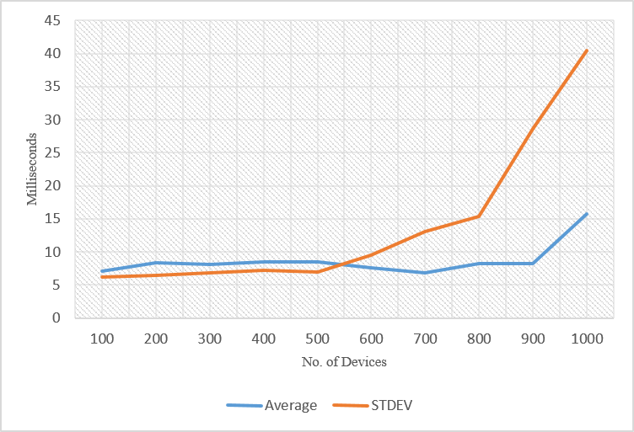
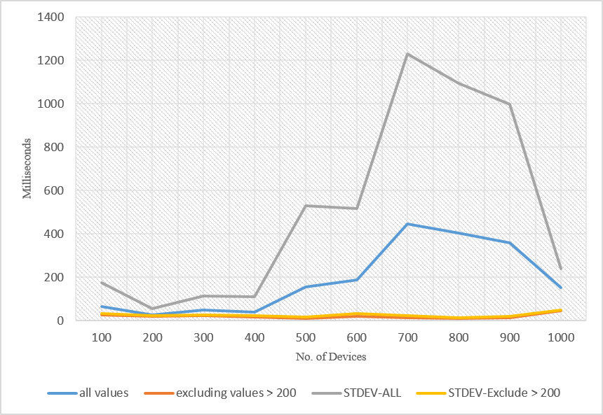
Varying number of Devices –
Kafka
Varying number of Devices- RabbitMQ

Slide 22
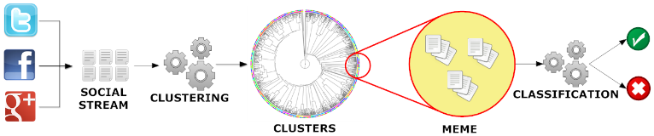
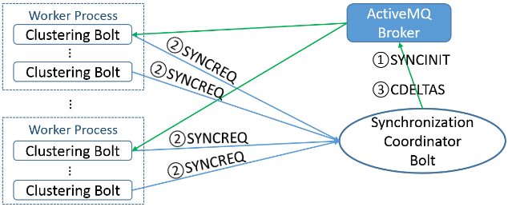
Parallel Tweet Clustering with Storm
Judy Qiu and Xiaoming Gao
Storm Bolts coordinated by ActiveMQ to synchronize parallel cluster center updates – add loops to Storm
2 million streaming tweets processed in 40 minutes; 35,000 clusters
Sequential
Parallel – eventually 10,000 bolts

Slide 23
Data Science at Indiana University

Slide 24
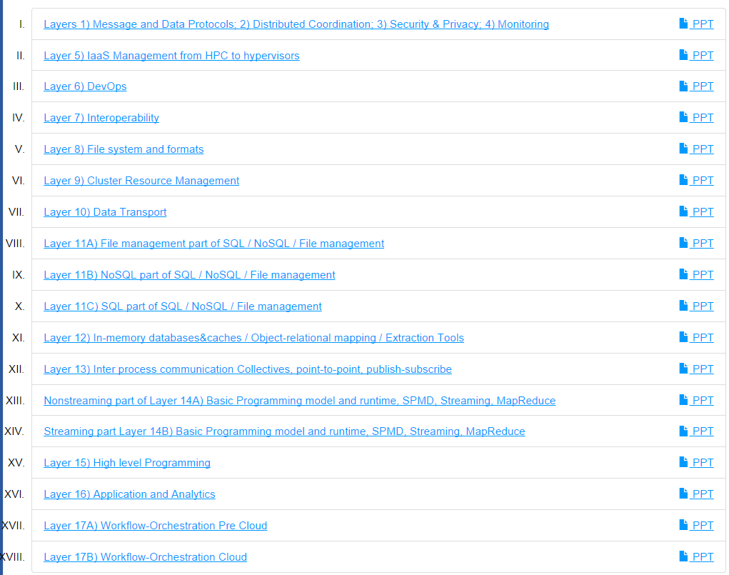
6 hours of Video describing 266 technologies from online class

Slide 25
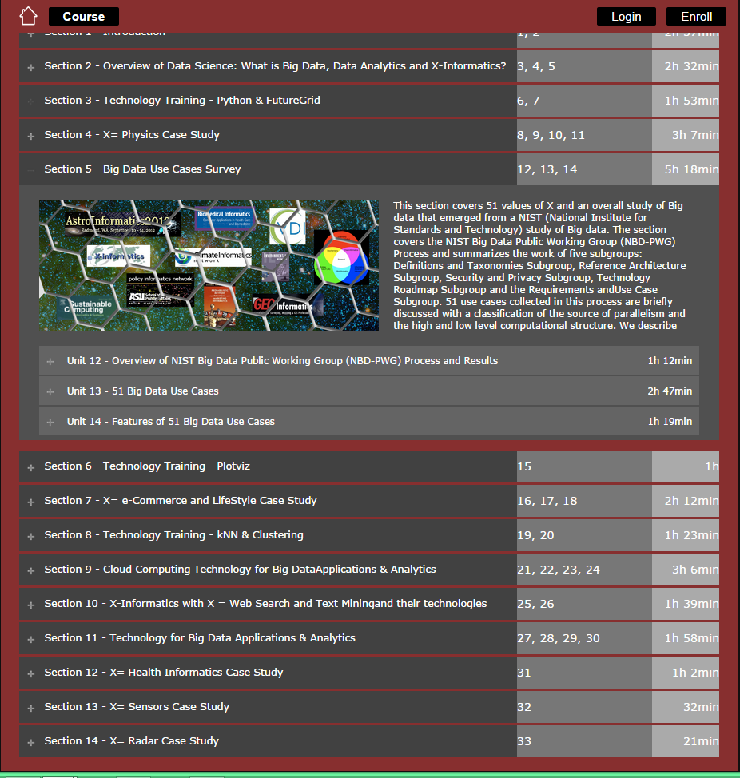
5 hours of video on 51 use cases
Online classes in Data Science Certificate /Masters
Prettier as Google Course Builder

Slide 26
IU Data Science Masters Features
Fully approved by University and State October 14 2014
Blended online and residential
Department of Information and Library Science, Division of Informatics and Division of Computer Science in the Department of Informatics and Computer Science, School of Informatics and Computing and the Department of Statistics, College of Arts and Science, IUB
30 credits (10 conventional courses)
Basic (general) Masters degree plus tracks
  Currently only track is “Computational and Analytic Data Science ”
  Other tracks expected
A purely online 4-course Certificate in Data Science has been running since January 2014 (Technical and Decision Maker paths)
A Ph.D. Minor in Data Science has been proposed.

Slide 27

McKinsey Institute on Big Data Jobs
Decision maker and Technical paths
There will be a shortage of talent necessary for organizations to take advantage of big data. By 2018, the United States alone could face a shortage of 140,000 to 190,000 people with deep analytical skills as well as 1.5 million managers and analysts with the know-how to use the analysis of big data to make effective decisions.
At SOIC@IU, Informatics/ILS aimed at 1.5 million jobs. Computer Science covers the 140,000 to 190,000
http://www.mckinsey.com/mgi/publications/big_data/index.asp.

Slide 28
Lessons / Insights
Proposed classification of Big Data applications with features and kernels for analytics
Data intensive algorithms do not have the well developed high performance libraries familiar from HPC
Global Machine Learning or (Exascale Global Optimization) particularly challenging
Develop SPIDAL (Scalable Parallel Interoperable Data Analytics Library)
  New algorithms and new high performance parallel implementations
Integrate (don’t compete) HPC with “Commodity Big data” (Google to Amazon to Enterprise Data Analytics)
  i.e. improve Mahout; don’t compete with it
  Use Hadoop plug-ins rather than replacing Hadoop
Enhanced Apache Big Data Stack HPC-ABDS has >266 members with HPC opportunities at Resource management, Storage/Data, Streaming, Programming, monitoring, workflow layers.

Slide 29
EXTRAS

Slide 30
Integrating the Apache Stack with HPC for Big Data
There is perhaps a broad consensus as to important issues in practical parallel computing as applied to large scale simulations; this is reflected in supercomputer architectures, algorithms, libraries, languages, compilers and best practice for application development. However, the same is not so true for data intensive computing, even though commercially clouds devote much more resources to data analytics than supercomputers devote to simulations.
We look at a sample of over 50 big data applications to identify characteristics of data intensive applications and to deduce needed runtime and architectures. We suggest a big data version of the famous Berkeley dwarfs and NAS parallel benchmarks and use these to identify a few key classes of hardware/software architectures. Our analysis builds on combining HPC and ABDS the Apache big data software stack that is well used in modern cloud computing. Initial results on clouds and HPC systems are encouraging.
We propose the development of SPIDAL - Scalable Parallel Interoperable Data Analytics Library -- built on system aand data abstractions suggested by the HPC-ABDS architecture. We discuss how it can be used in several application areas including Polar Science.

Slide 31
Bob Marcus Pictures of Data Flow
2. Perform real time analytics on data source streams and notify users when specified events occur
Specify filter
Filter Identifying Events
Post Selected Events
Streaming Data
Fetch streamed Data
Streaming Data
Posted Data
Identified Events
Streaming Data
Archive
Repository
Storm, Kafka, Hbase, Zookeeper

Slide 32
Data Processing Facet: Illustrated by Typical Science Case

Slide 33
System Architecture

Slide 34
4 Forms of MapReduce
(1) Map Only
(2) Classic MapReduce
(3) Iterative Map Reduce or Map-Collective
(4) Point to Point or Map-Communication
Input
Input
Iterations
Input
map
map
map
Local
reduce
reduce
Output
Graph
PP | MR MRStat | MRIter | Graph, HPC
BLAST Analysis Local Machine Learning Pleasingly Parallel | High Energy Physics (HEP) Histograms Distributed search Recommender Engines | Expectation maximization Clustering e.g. K-means Linear Algebra, PageRank | Classic MPI PDE Solvers and Particle Dynamics Graph Problems
MapReduce and Iterative Extensions (Spark, Twister) |  |  | MPI, Giraph
Integrated Systems such as Hadoop + Harp with Compute and Communication model separated
Correspond to First 4 Big Data Architectures

Slide 35
Useful Set of Analytics Architectures
Pleasingly Parallel: including local machine learning as in parallel over images and apply image processing to each image
- Hadoop could be used but many other HTC, Many task tools
Classic MapReduce including search, collaborative filtering and motif finding implemented using Hadoop etc.
Map-Collective or Iterative MapReduce using Collective Communication (clustering) – Hadoop with Harp, Spark …..
Map-Communication or Iterative Giraph: (MapReduce) with point-to-point communication (most graph algorithms such as maximum clique, connected component, finding diameter, community detection)
  Vary in difficulty of finding partitioning (classic parallel load balancing)
Large and Shared memory: thread-based (event driven) graph algorithms (shortest path, Betweenness centrality) and Large memory applications

Slide 36
Parallel Data Analytics Issues

Slide 37
Remarks on Parallelism I
Most use parallelism over items in data set
  Entities to cluster or map to Euclidean space
Except deep learning (for image data sets)which has parallelism over pixel plane in neurons not over items in training set
  as need to look at small numbers of data items at a time in Stochastic Gradient Descent SGD
  Need experiments to really test SGD – as no easy to use parallel implementations tests at scale NOT done
  Maybe got where they are as most work sequential
Maximum Likelihood or χ² both lead to structure like
Minimize sum ∑_{items=1}^{N} (Positive nonlinear function of unknown parameters for item i)
All solved iteratively with (clever) first or second order approximation to shift in objective function
  Sometimes steepest descent direction; sometimes Newton
  11 billion deep learning parameters; Newton impossible
  Have classic Expectation Maximization structure
  Steepest descent shift is sum over shift calculated from each point
SGD – take randomly a few hundred of items in data set and calculate shifts over these and move a tiny distance
  Classic method – take all (millions) of items in data set and move full distance

Slide 38
Remarks on Parallelism II
Need to cover non vector semimetric and vector spaces for clustering and dimension reduction (N points in space)
MDS Minimizes Stress
σ(X) = Σ_{i<j=1}^{N} weight(i,j) (δ(i, j) - d(X_{i} , X_{j}))²
Semimetric spaces just have pairwise distances defined between points in space δ(i, j)
Vector spaces have Euclidean distance and scalar products
  Algorithms can be O(N) and these are best for clustering but for MDS O(N) methods may not be best as obvious objective function O(N²)
  Important new algorithms needed to define O(N) versions of current O(N²) – “must” work intuitively and shown in principle
Note matrix solvers all use conjugate gradient – converges in 5-100 iterations – a big gain for matrix with a million rows. This removes factor of N in time complexity
Ratio of #clusters to #points important; new ideas if ratio >~ 0.1

Slide 39
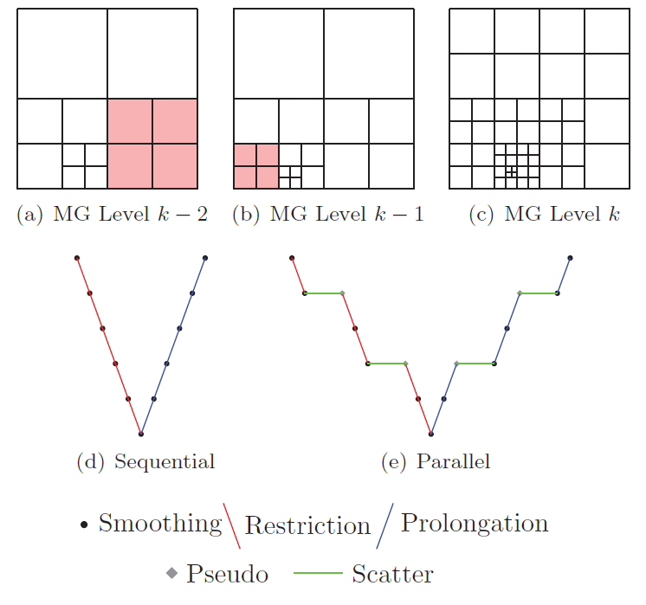
When is a Graph “just” a Sparse Matrix?
Most systems are built of connected entities which can be considered a graph
  See multigrid meshes
  Particle dynamics
PageRank is a graph
algorithm or “just”
sparse matrix
multiplication
to implement power
method of finding
leading eigenvector

Slide 40


“Force Diagrams” for macromolecules and Facebook

Slide 41
Algorithm Challenges
See NRC Massive Data Analysis report
O(N) algorithms for O(N²) problems
Parallelizing Stochastic Gradient Descent
Streaming data algorithms – balance and interplay between batch methods (most time consuming) and interpolative streaming methods
Graph algorithms
Machine Learning Community uses parameter servers; Parallel Computing (MPI) would not recommend this?
  Is classic distributed model for “parameter service” better?
Apply best of parallel computing – communication and load balancing – to Giraph/Hadoop/Spark
Are data analytics sparse?; many cases are full matrices
BTW Need Java Grande – Some C++ but Java most popular in ABDS, with Python, Erlang, Go, Scala (compiles to JVM) …..

Slide 42
Benchmark Suite in spirit of NAS Parallel Benchmarks or Berkeley Dwarfs

Slide 43
Benchmarks across Facets
Classic Database: TPC benchmarks
NoSQL Data systems: store, index, query (e.g. on Tweets)
Hard core commercial: Web Search, Collaborative Filtering (different structure and defer to Google!)
Streaming: Gather in Pub-Sub(Kafka) + Process (Apache Storm) solution (e.g. gather tweets, Internet of Things)
Pleasingly parallel (Local Analytics): as in initial steps of LHC, Astronomy, Pathology, Bioimaging (differ in type of data analysis)
“Global” Analytics: Deep Learning, SVM, Clustering, Multidimensional Scaling, Graph Community finding (~Clustering) to Shortest Path (? Shared memory)
Workflow linking above

