Slide 1
Subglacial bed topography using machine learning and geostatistical analysis applied to 2D and 3D radar sounding
John Paden¹, Victor Berger¹, Mohanad Al-Ibadi¹, Shane Chu¹, Mingze Xu²,
David Crandall², Geoffrey Fox²
¹Center for Remote Sensing of Ice Sheets, University of Kansas, USA,
²School of Informatics, Computing, and Engineering, Indiana University, USA,
AGU 2018
Dec 13, 2018

Slide 2
Outline
2D and 3D Imagery Overview
Machine Learning Algorithms
  Viterbi
  Tree Reweighted Sequential TRW-S
  Deep Neural Network
Results and Discussion
  2014 OIB P3 Canadian Arctic Archipelago
  2018 OIB P3 Examples

Slide 3
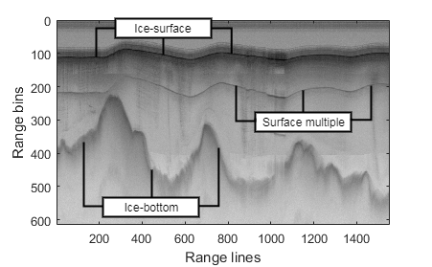
2D Image
(Vertical Along-track Profile)
Horizontal axis:
along-flight
Vertical axis:
depth dimension
Contains information about the depth of the ice “targets” in the nadir direction
Interested in tracking ice-bottom and internal layers
Avoid surface multiple and surface clutter
High dynamic range due to signal loss in ice

Slide 4
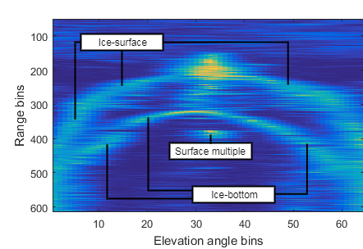
3D imagery
Horizontal axis:
cross-track dimension
Vertical axis:
depth dimension
In/Out Screen:
Along-flight
3D is a sequence of “slice” images like that shown here.
Contains information about the depth of the ice “targets” in the nadir direction
Interested in tracking ice-bottom and internal layers
Notes:
We divide the FIELD OF VIEW (-60 to 60 degrees) in 64 bins

Slide 5
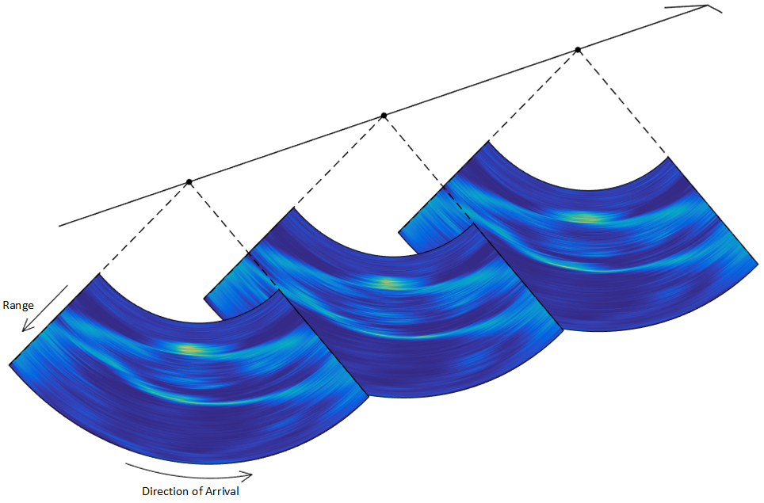
3D imagery
Images are in the synthetic aperture radar tomographic cylindrical coordinate system.
The correct geometric proportions are shown here.
Sequence of three image “slices”

Slide 6
Viterbi and TRW-S Belief Propagation
In applying the Viterbi and TRW-S BP algorithms, we ssume that the layering can be described by a pairwise graphical model.
Transition (binary) probability from one column to the next
Unary probability which represents the marginal probability of each pixel being the pixel the layer passes through).
Transition probabilities are set to create a smooth surface
Marginal probabilities are account for image intensity (bright pixels are more likely), distance from ice margin (ice tends to be thinner next to the margin), and user provided ground truth.

Slide 7
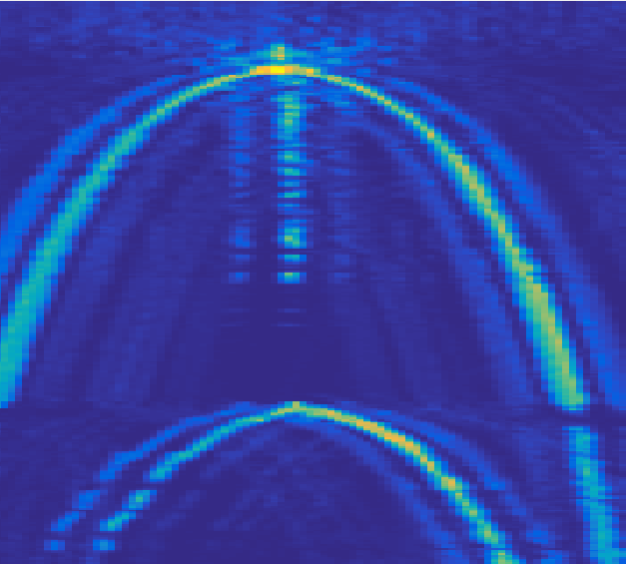
Viterbi and TRW-S Belief Propagation
Layer is single valued (no folding allowed)
2D images form a chain: can only go forwards or backwards.

Slide 8
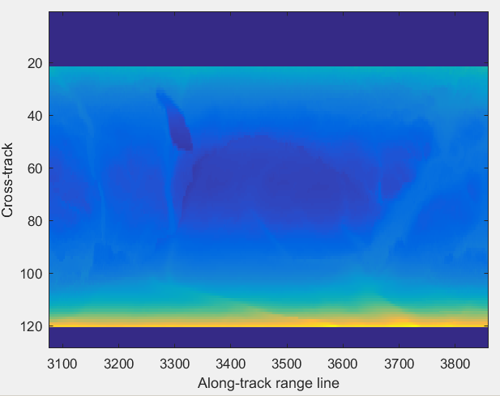
Viterbi and TRW-S Belief Propagation

Slide 9
Viterbi and TRW-S Belief Propagation
Viterbi is very fast for non-loopy graphs and provides an exact solution
TRW-S is slower, but can handle loopy graphs
Supervised learning is used to determine transition and unary probabilities.
Downside: TRW-S is leveraged to create the training set. Although manual ground control is added to produce a correct solution, the results are likely biased towards TRW-S and we have not accounted for this yet.

Slide 10
Deep Neural Network
The probabilistic graphical model requires making decisions about what features are important and how to determine probabilities.
The neural network approach automatically learns the feature representations that are necessary to produce good results.
Requires a training set to make any progress (useless without training).

Slide 11
Deep Neural Network
Automatically finds surface and bottom simultaneously.
  Viterbi and TRW-S are given the surface from a DEM such as Arctic DEM or REMA.
The current Neural Network algorithm does not make use of any additional “evidence” besides the image itself (ice mask and user inputs are used with the Viterbi and TRW-S approaches).

Slide 12
Deep Neural Network

Slide 13
Results and Discussion
2D image tracking error results (in range bins)
Error is automated result compared to the ground truth (operator tracked).
Error units are range bins (pixel count).
Error | Viterbi [7] | MCMC [8] | Level-sets [9] | Viterbi [10]
Mean | 43.1 | 37.4 | 6.6 | 6.0
Median | 14.4 | 9.1 | 2.1 | 1.0
3D image tracking error results (in range bins)
Error | Original Viterbi [7] | Original TRW-S [8] | Viterbi [10] | TRW-S [10] | NN [10]
Mean | 12.1 | 9.7 | 9.8 | 5.1 | 8.1
Median | 2.0 | 2.0 | 1.0 | 0.0 | *
Notes:
Results for our implementations of the two algorithms, as well as results for previously published solutions.

Slide 14
3D Cross Overs
A. Consistent
Crossover Example
B. Inconsistent
Crossover Example

Slide 15
2D Results
Surface Multiple Suppression

Slide 16
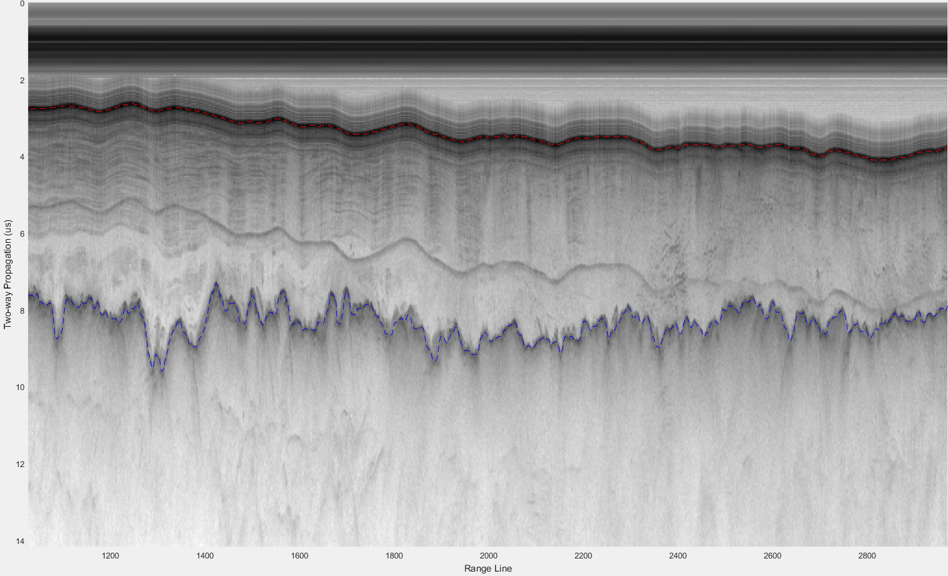
Notes:
2D

Slide 17
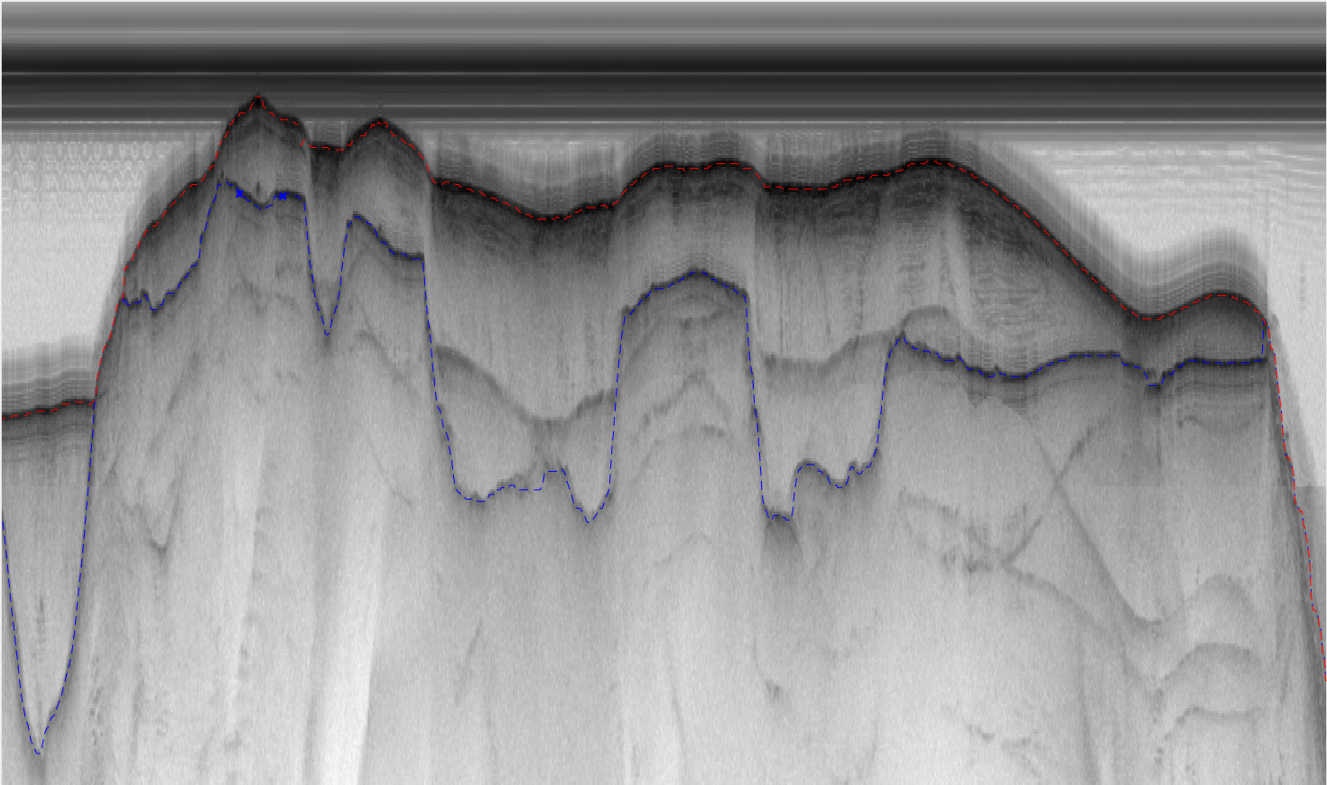
Notes:
2D

Slide 18
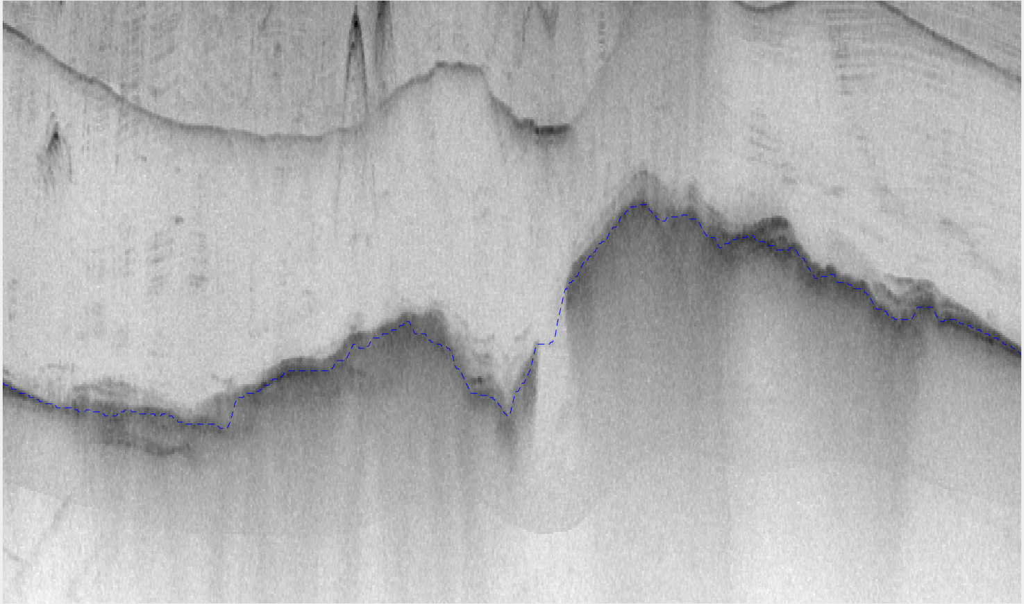
Notes:
2D

Slide 20
3D Examples

Slide 21
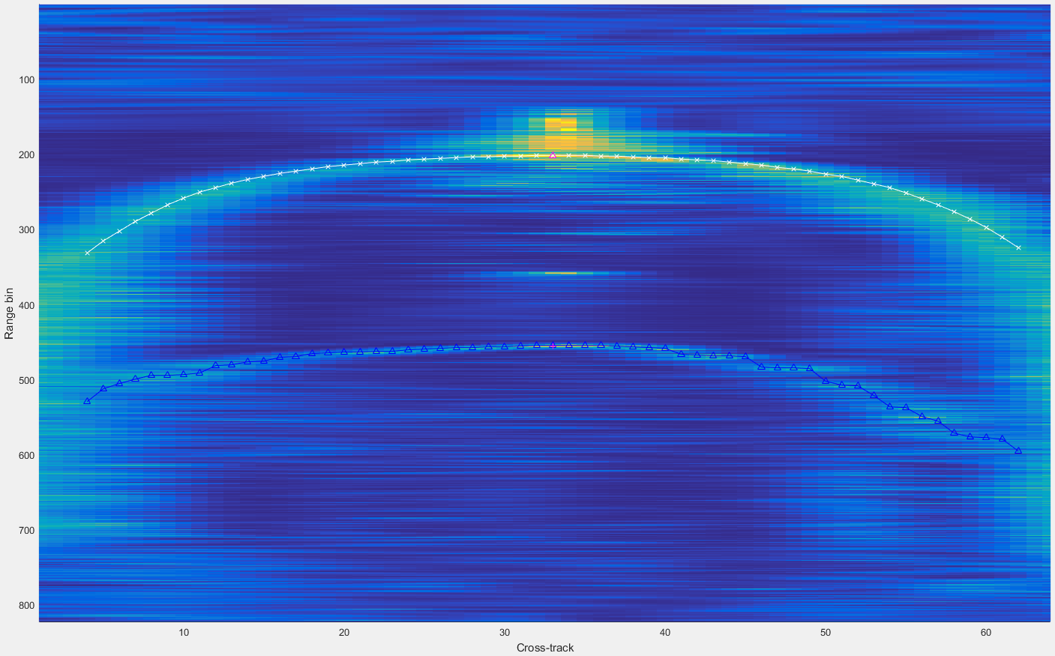
Notes:
3D

Slide 22
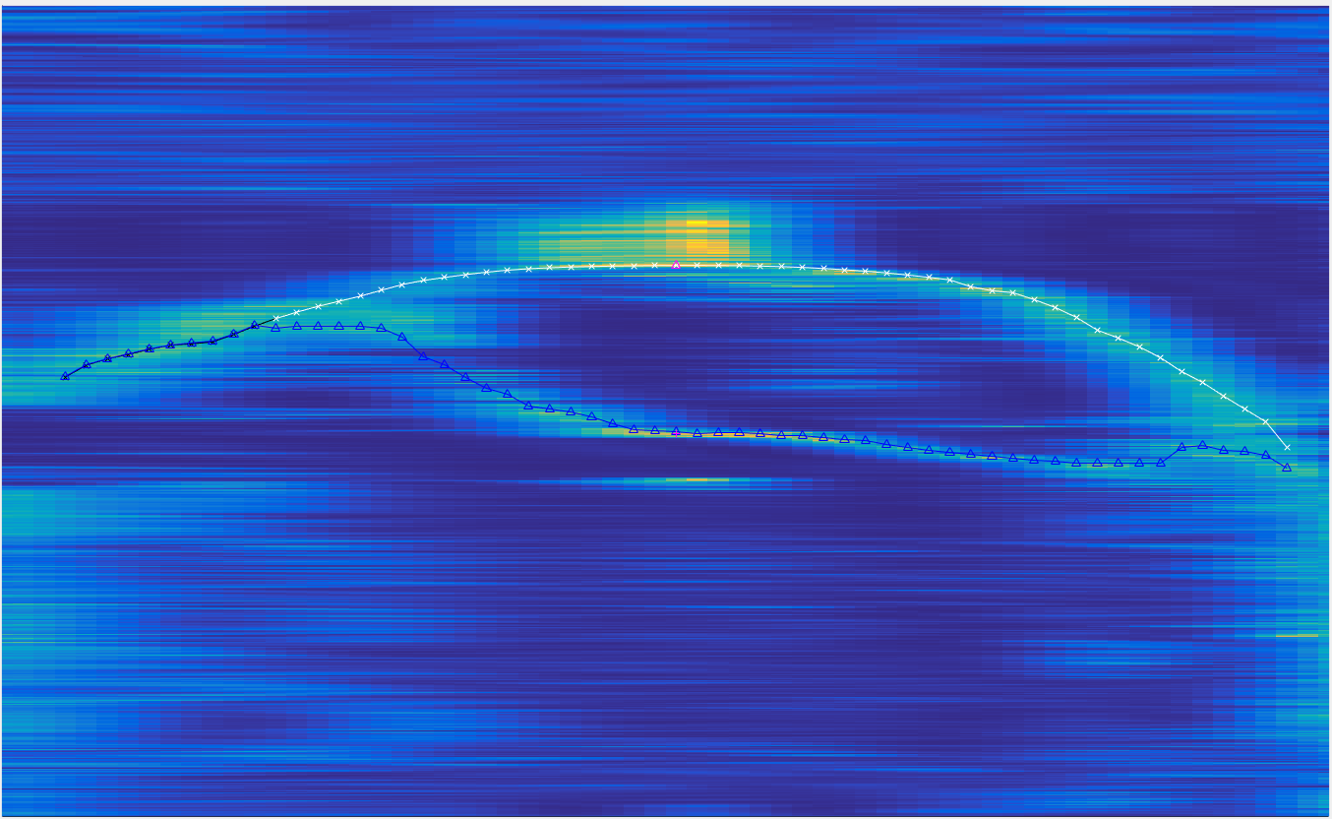
Notes:
3D

Slide 23
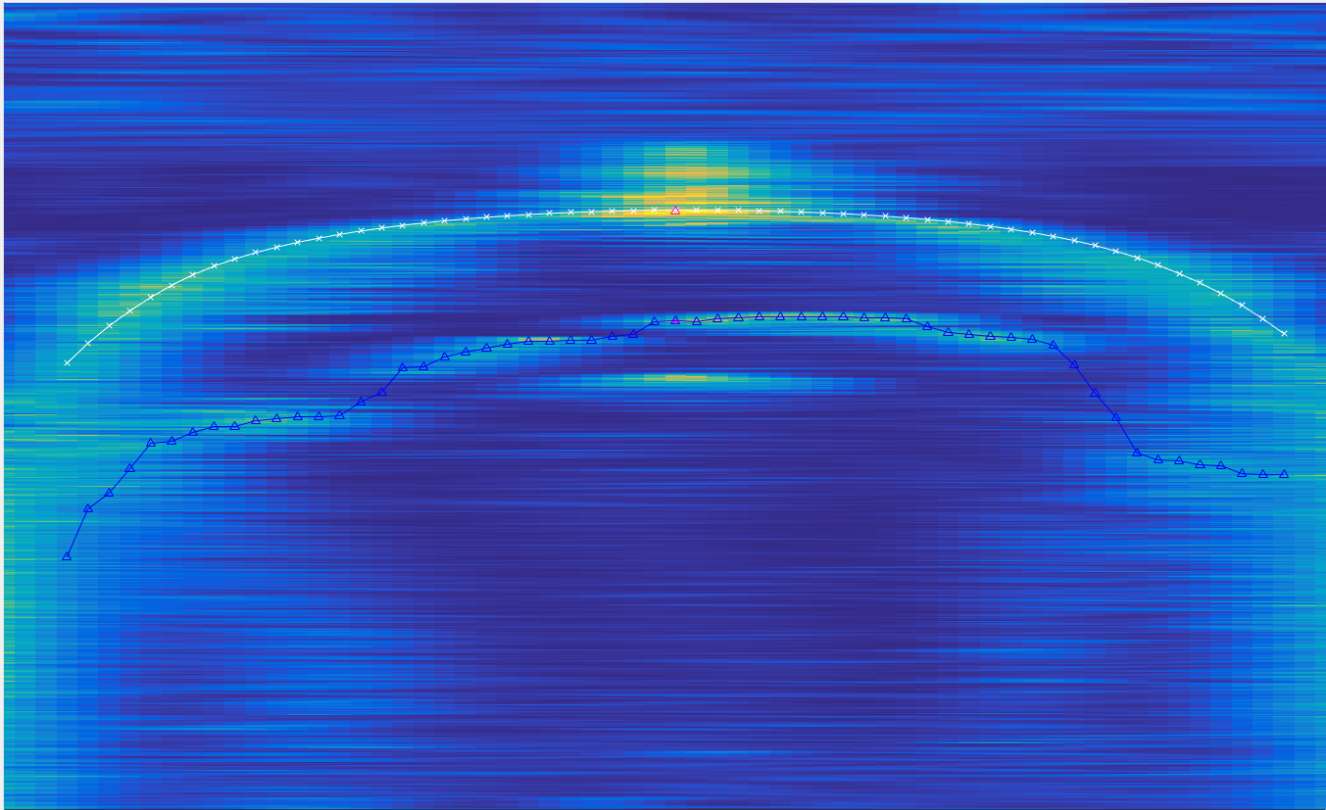
Notes:
3D

Slide 24
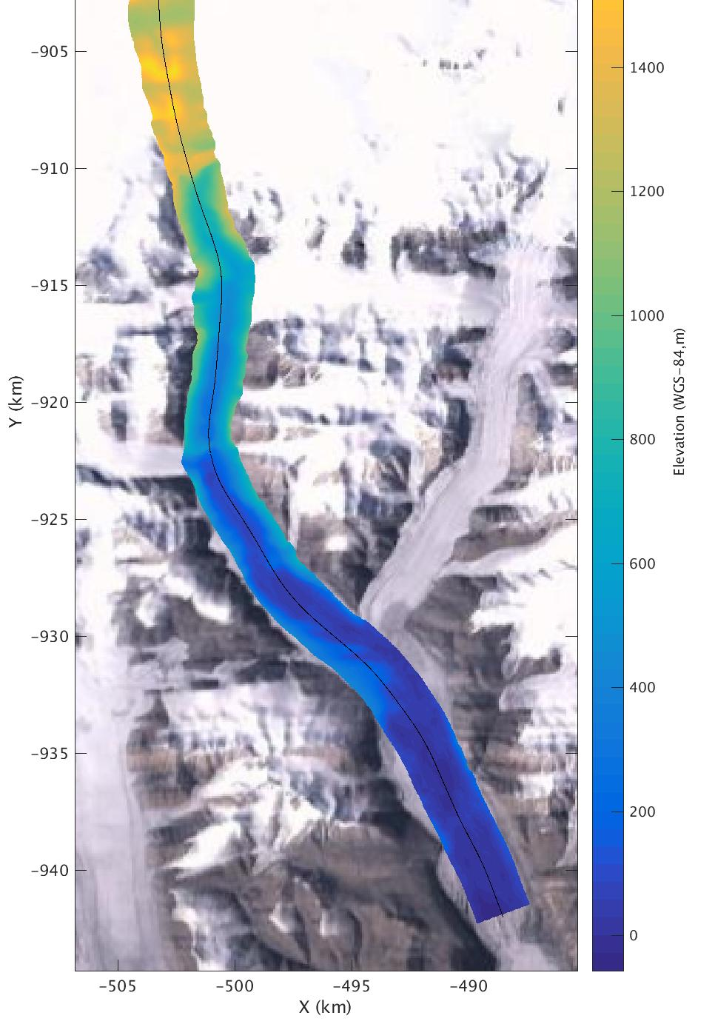
Notes:
DEM

Slide 25
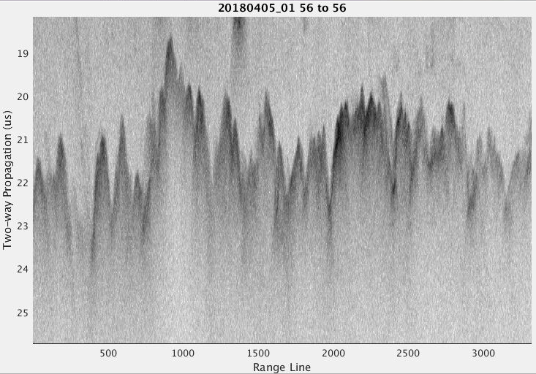
2018 Arctic P3 OIB (North)

Slide 26
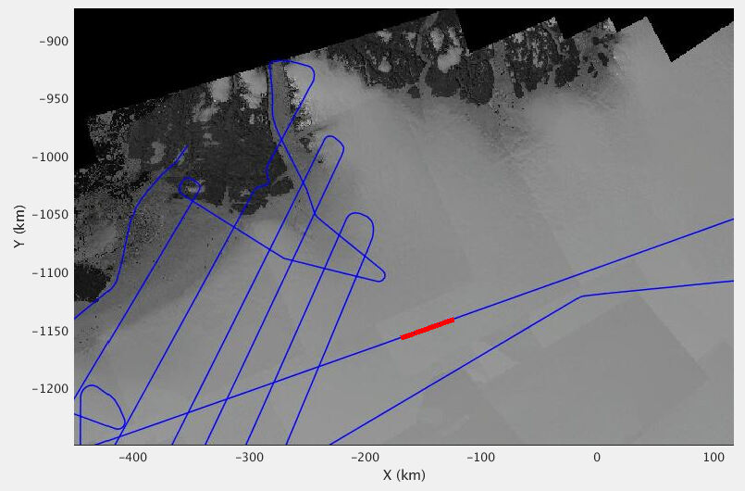
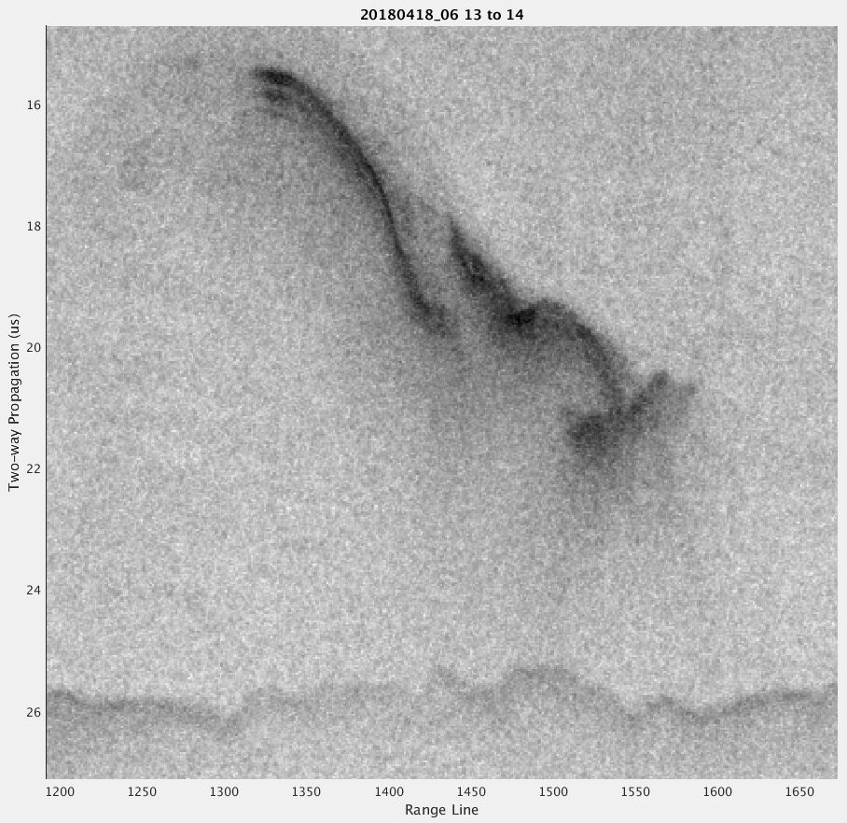
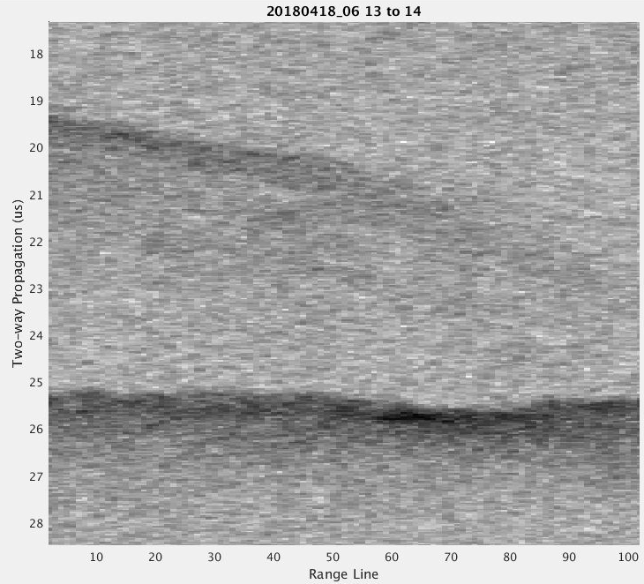
Englacial Targets
(2018 Arctic P3 OIB)
2
1

Slide 27
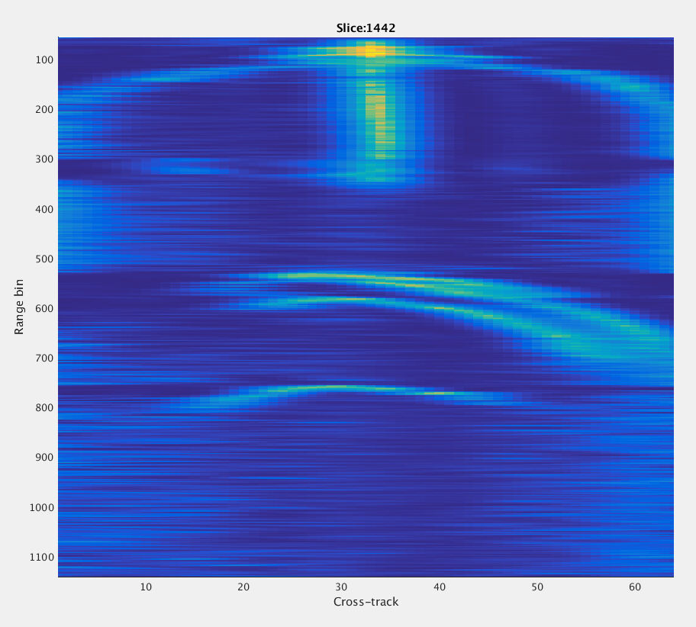
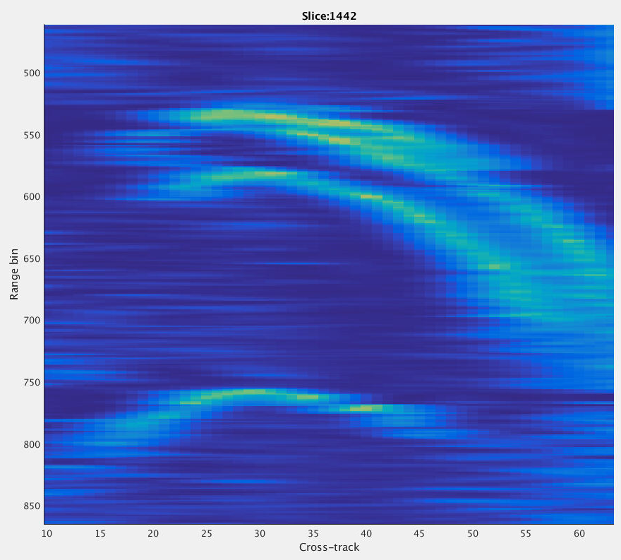
Englacial Targets

Slide 28
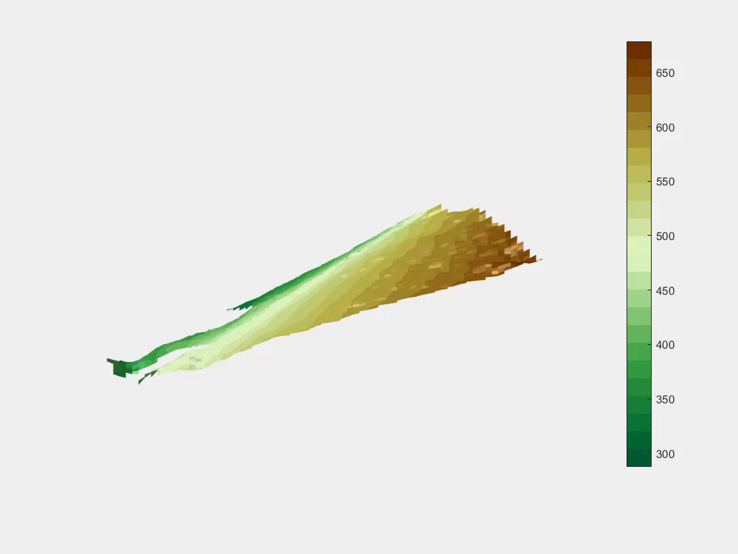
Englacial Target 1
Backscatter is strong: not likely to be a specular reflection that would forward scatter the radar pulse.
Volume scattering from basal debris entrainment is a candidate.

Slide 29
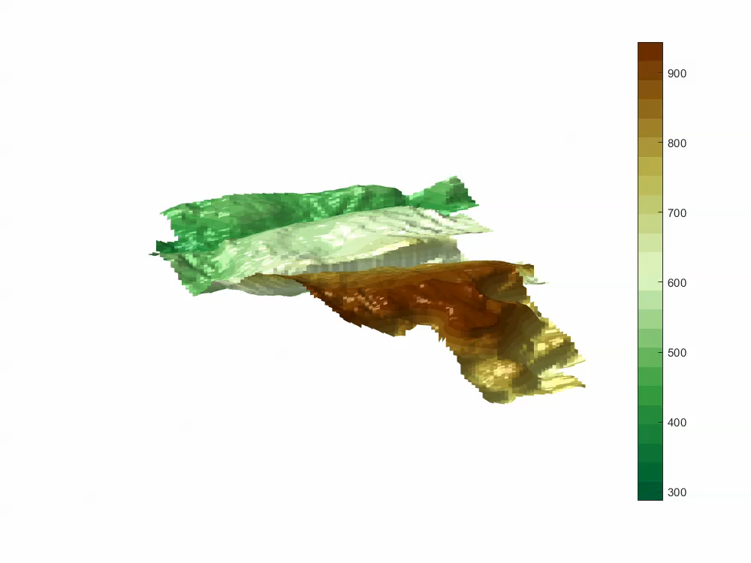
Englacial Target 2

Slide 30
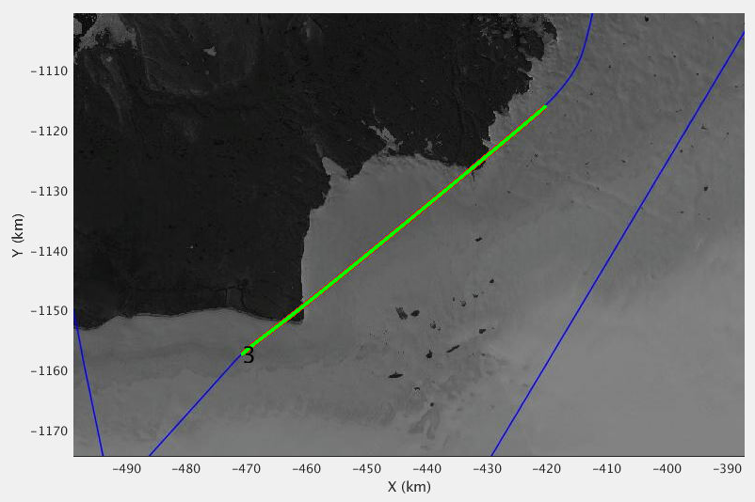
Impact Crater
(High Altitude 20000 ft AGL Ping Pong Mode)

Slide 32
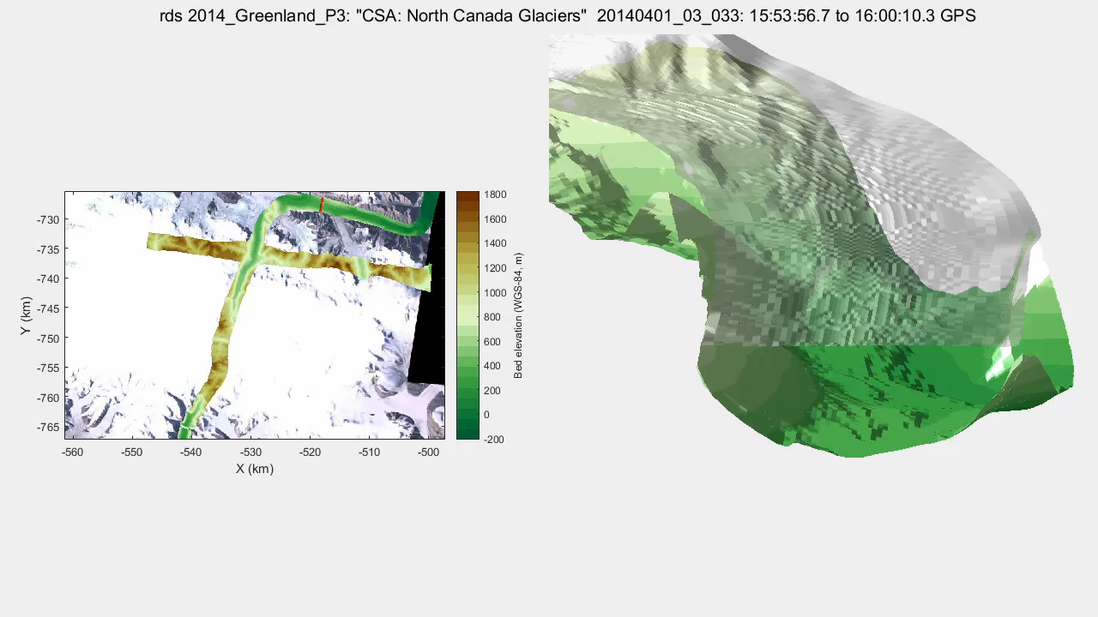
Acknowledgements
All authors were supported in part by NSF (1443054). Victor Berger, Mohanad Al-Ibadi, Shane Chu, and John Paden also acknowledge support from NASA Operation IceBridge (NNX16AH54G). ArcticDEM was provided by the Polar Geospatial Center under NSF OPP awards 1043681, 1559691 and 1542736.
THANK YOU!
QUESTIONS?
Notes:
Movie

Slide 33
References
[1] F. Rodríguez-Morales, et. al., “Advanced Multifrequency Radar Instrumentation for Polar Research,” IEEE Trans. Geoscience and Remote Sensing, vol. 52, no. 5, May 2014
[2] J. Paden, T. Akins, D. Dunson, C. Allen, P. Gogineni, “Ice-Sheet Bed 3-D Tomography,” J. Glac., vol.56, no.195, pp. 3-11, 2010.
[3] S. Gogineni, et. al., “Bed topography of Jakobshavn Isbræ, Greenland, and Byrd Glacier, Antarctica,” J. Glac., vol. 60, no. 223, pp. 813–833, 2014.
[4] P. Fretwell, et. al., Bedmap2: improved ice bed, surface and thickness datasets for Antarctica, The Cryo., 7, 375–393, 2013.
[5] W. Liu, K. Purdon, T. Stafford, J. Paden and X. Li, “Open Polar Server (OPS) – An Open Source Spatial Data Infrastructure for the Cryosphere Community”, ISPRS Int. J. Geo-Info., 2016, 5(32).
[6] V. Kolmogorov, “Convergent tree-reweighted message passing for energy minimization,” Transactions on Pattern Analysis and Machine Intelligence, vol.28, no. 10, pp. 1568–1583, 2006.
[7] D. J. Crandall, G. C. Fox and J. D. Paden, "Layer-finding in radar echograms using probabilistic graphical models," Proceedings of the 21st International Conference on Pattern Recognition (ICPR2012), Tsukuba, 2012, pp. 1530-1533.
[8] S. Lee, J. Mitchell, D. Crandall, G. Fox, “Estimating bedrock and surface layer boundaries and confidence intervals in ice sheet radar imagery using MCMC,” International Conference on Image Processing (ICIP), 2014, pp. 111–115.
[9] M. Rahnemoonfar, G. C. Fox, M. Yari and J. Paden, "Automatic Ice Surface and Bottom Boundaries Estimation in Radar Imagery Based on Level-Set Approach," in IEEE Trans. Geosci. Remote Sens., vol. 55, no. 9, pp. 5115-5122, Sept. 2017.
[10] Berger et al., IGARSS 2018
[11] Xu et al., WACV 2018

