Slide 1
High-Performance AI: A View from Systems and Frameworks
(Supercomputer & AI Workshop, SC18)
Judy Qiu, Bo Peng, Sahil Styagi, Chathura Widanage
Indiana University
Dallas, November 16, 2018

Slide 2
Outline
AI: Challenges and Opportunities
System Research for AI
Recent work

Slide 3
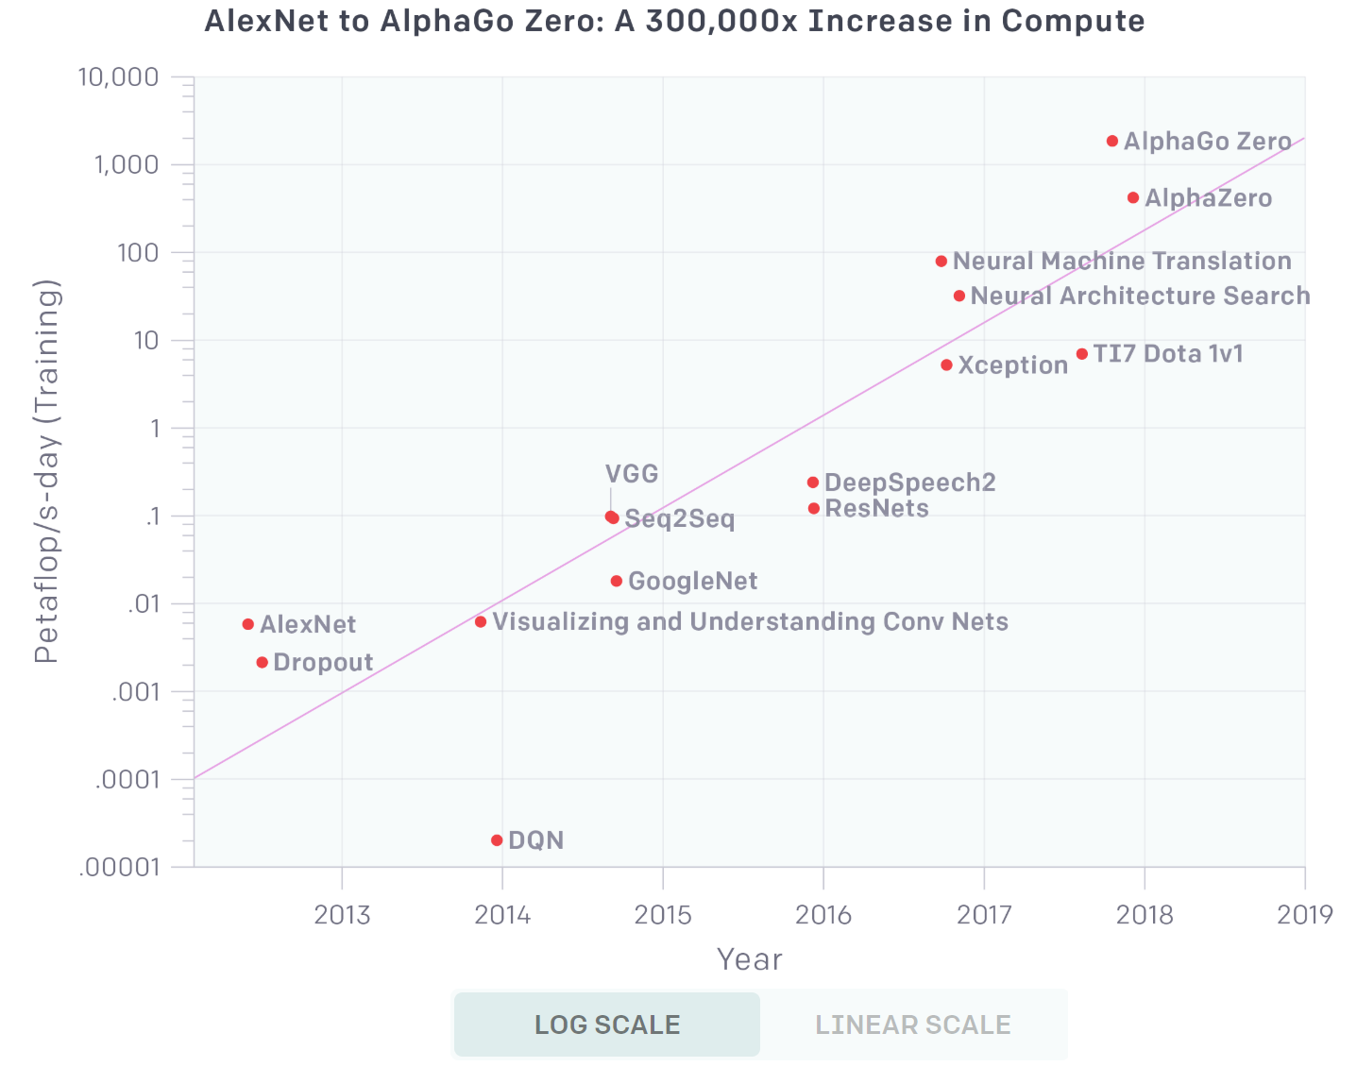
As AI progresses, systems are far outside todays capabilities
A petaflop/s-day (pfs-day) consists of performing 10¹⁵neural net operations per second for one day, or a total of about 10²⁰operations (from OpenAI).

Slide 4
Challenges of Design in Computer Architecture
New Algorithms vs. Processors being developed at different rate
30 months
Chips and Production Cycle
3-6 moths
Algorithms and Changes

Slide 5
Gap between AI and Systems Research
No. of Publications 4960 vs 243

Slide 6
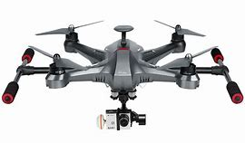
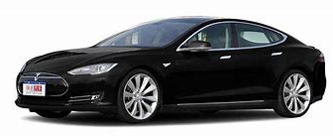
Gap between AI Research and Real World Application
CVPR
NIPS
ICCV
KDD
ICML
Small dataset
High accuracy
No latency consideration
No energy consideration
Large domain specific dataset
Large real-time application
Limit on energy consumption
Budge on System Cost

Slide 7
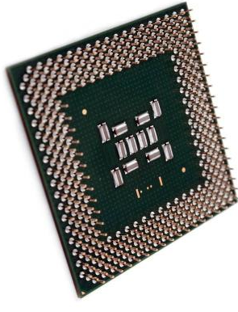
Gap between AI Algorithm and System Architecture
Existing system architecture lacks support of AI Algorithms
The design of AI algorithms lacks system considerations
Micro Architecture
Instructions
System Software
Software Framework

Slide 8
Outline
AI: Challenges and Opportunities
System Research for AI
Our Recent Work

Slide 9
Needing Benchmark to Evaluate of AI Workload
Benchmark Suites | Evaluation
SPEC CPU | Single Processor Processing Capability
SPEC POWER | Energy Consumption
TPC | Task Processing
SPLASH，SPEC MPI | Parallelization
NAS Parallel Benchmarks (NPB) | CFD Parallelization
BigBench | Big Data Applications
CloudSuite | Cloud Applications
MobileBench | Mobile (Cellular Phone) and Applications
Existing Benchmark focuses on single processor specifications, and lacks of online, parallel, energy consumption and AI workload evaluations.

Slide 10
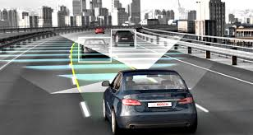
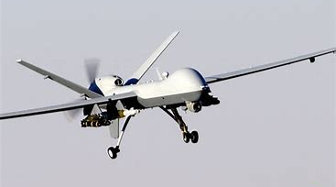
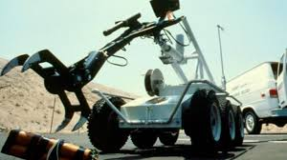
New Requirement on System for Dynamic Workload
Low Latency
Self-driving car、Robot/un-manned control are real-time applications that are challenging, due to strict time constraints and complex computation.

Slide 11
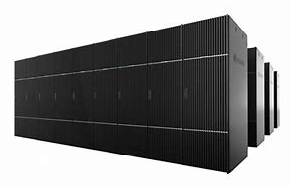
Architecture Requirements based on AI Workload
High Throughput
Cloud AI engine with high throughput and QoS
Deep Learning Training and a lot of Inference
News and Tweets
Machine Translation
Image Search
Intelligent Transportation
Voice Recognition and Virtual Assistant
Advertisement and Recommender

Slide 12
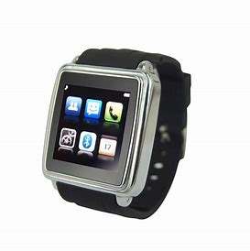
New System Design based on Dynamic Workload
Low Energy Utilization
Deep Learning Computation is a challenge to the energy consumption for mobile and embedded systems.
Energy Consumption indicates device sustainability and usage

Slide 13
Challenge of System Architecture and Design
Different Applications and Processors
Low latency，low energy consumption，low throughput
Low latency, high throughput, not sensitive to energy
High throughput, low latency, not sensitive to energy
Low latency, high compatibility, low energy consumption

Slide 14
Lower Computation Complexity with Approximate Computing Models
Approximate Computing on AI Processor
Meeting application requirements but lowering precision
Reducing computation and memory access intensity
Achieving high performance, low power and low latency requirement

Slide 15
Architectures that support different length and data types
Support different length and data types
Computing capability increases when lower accuracy
Double Precision
Data type
Single Precision
Half Precision
8 bits floating point
1 binary digit
Computing capability
Impact of Performance on Register, Processor, Memory, Data Structure, Data Transfer

Slide 16
AI Frameworks and Architecture of AI/Machine Learning

Slide 17
运行时技术
云端计算加速器的抢占式调度
动态监视加速器和PCIe总线并调度任务的运行时系统，在满足用户应用程序的QoS同时，最大化加速器利用率。
推理应用
价格昂贵的加速器利用率低

Slide 18
Outline
AI: Challenges and Opportunities
System Research for AI
Our Recent Work

Slide 19
Real-Time Anomaly Detection from Edge to HPC-Cloud
Intro & Preliminary Results

Slide 20
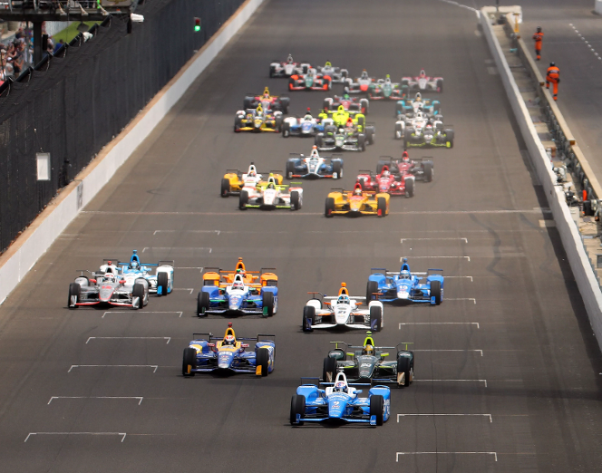
IndyCar
The IndyCar Series is a major open-wheel racing format in North America. The series' premier event is the Indianapolis 500, held each May.
Computing Systems and Data analytics is critical to the sport, both in improving the performance of the team to make it faster and in helping the race control to make it safer.

Slide 21
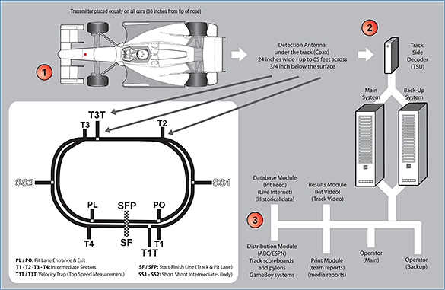
Timing and Score Data
Transmitter placed equally on all cars (35 inches from tip of nose)
Sensors in the cars and under the track.
Antenna and communication system.
Telemetry data (including the many performance information of the cars like speed, gear, brake, throttle,etc) stream into the on-site computer system in a real-time fasion.
Detection Antenna
under the track (Coax)
24 inches wide – up to 65 feet across
¾ inch below the surface
Track Side Decoder
(TSU)
Main System
Back-up System
Database Module
(Pit Feed)
(Live Internet)
(Historical data)
Results Module
(Pit Video)
(Track VIdeo)
SS2
SS1
Distribution Module
(ABC/ESPN)
Track scoreboards and pylons
Gameboy Systems
Operator
(Main)
PL/PO: Pit Lane Entrance & Exit
T1-T2-T3-T4: Intermediate Sectors
T1T/T3T: Velocity Trap (Top Speed Measurement)
SF/SFP: Start Finish Line (Track & Pit Lane)
SS1-SS2: Short Shoot Intermediators (Indy)
Print Module
(team reports)
(media reports)
Operator
(Backup)

Slide 22
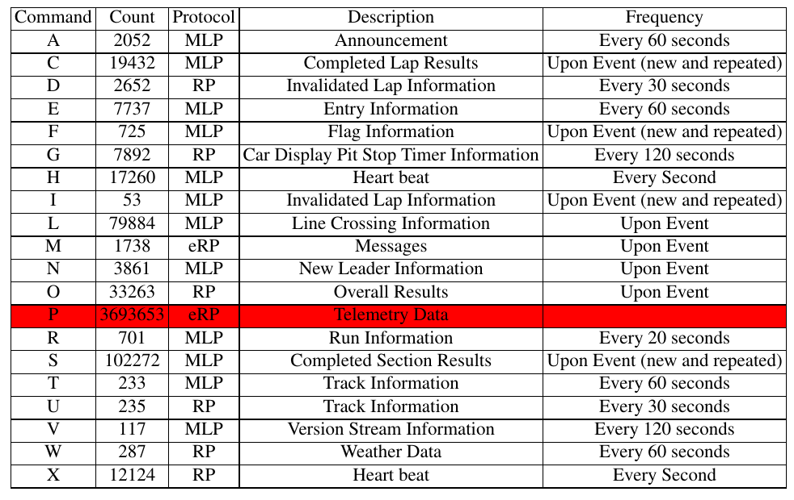
Dataset
The INDYCAR Timing system supports retrieving timing data from the primary timing system – serial or sequential data feed for live data and report querying for historical or archived data.
The Results Protocol is designed to deliver more detailed results information through the use of a single record command.
Example: one Indianapolis 500 car race on the 28th of May 2017 which contained 750 MB of data and total of 3986170 records.

Slide 23
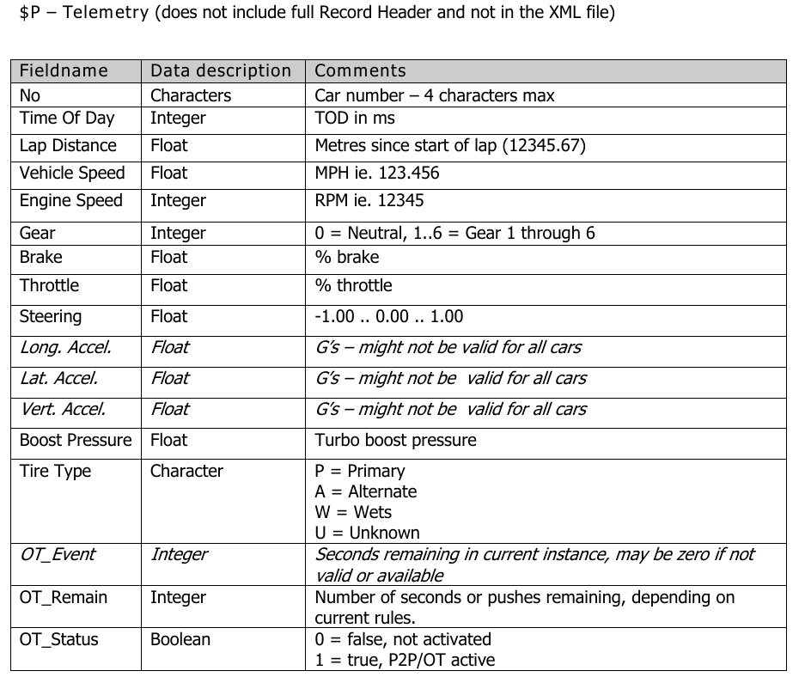
Telemetry Data
Telemetry is a radio device that relays information such as engine, tire, steering and throttle performance to team engineers in the pit box. The team can monitor car and driver activity to ensure the car is performing properly.
During a race, IndyCar Series teams use telemetry to gather data live from their cars as they formulate their race strategy. In the IndyCar Series, teams receive their data from their own on-board systems as well as from the league’s Timing & Scoring operation.

Slide 24
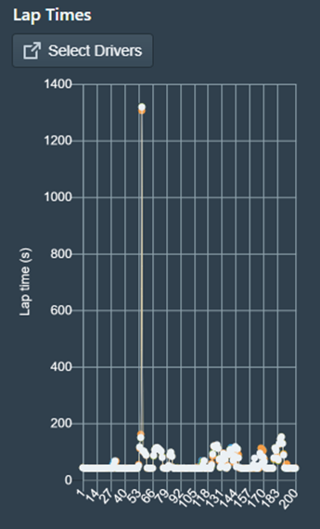
SIMULATION
https://goo.gl/WRet7Q

Slide 25
Problem
Real-time data analysis is in need
"We want to know if it’s an expected event or a minor deviation that we need to be worried about. It helps race control people. "
" And we want to know the data corresponding to
the anomaly; when car got into problems
what kind of event it is and what is causing it."

Slide 26
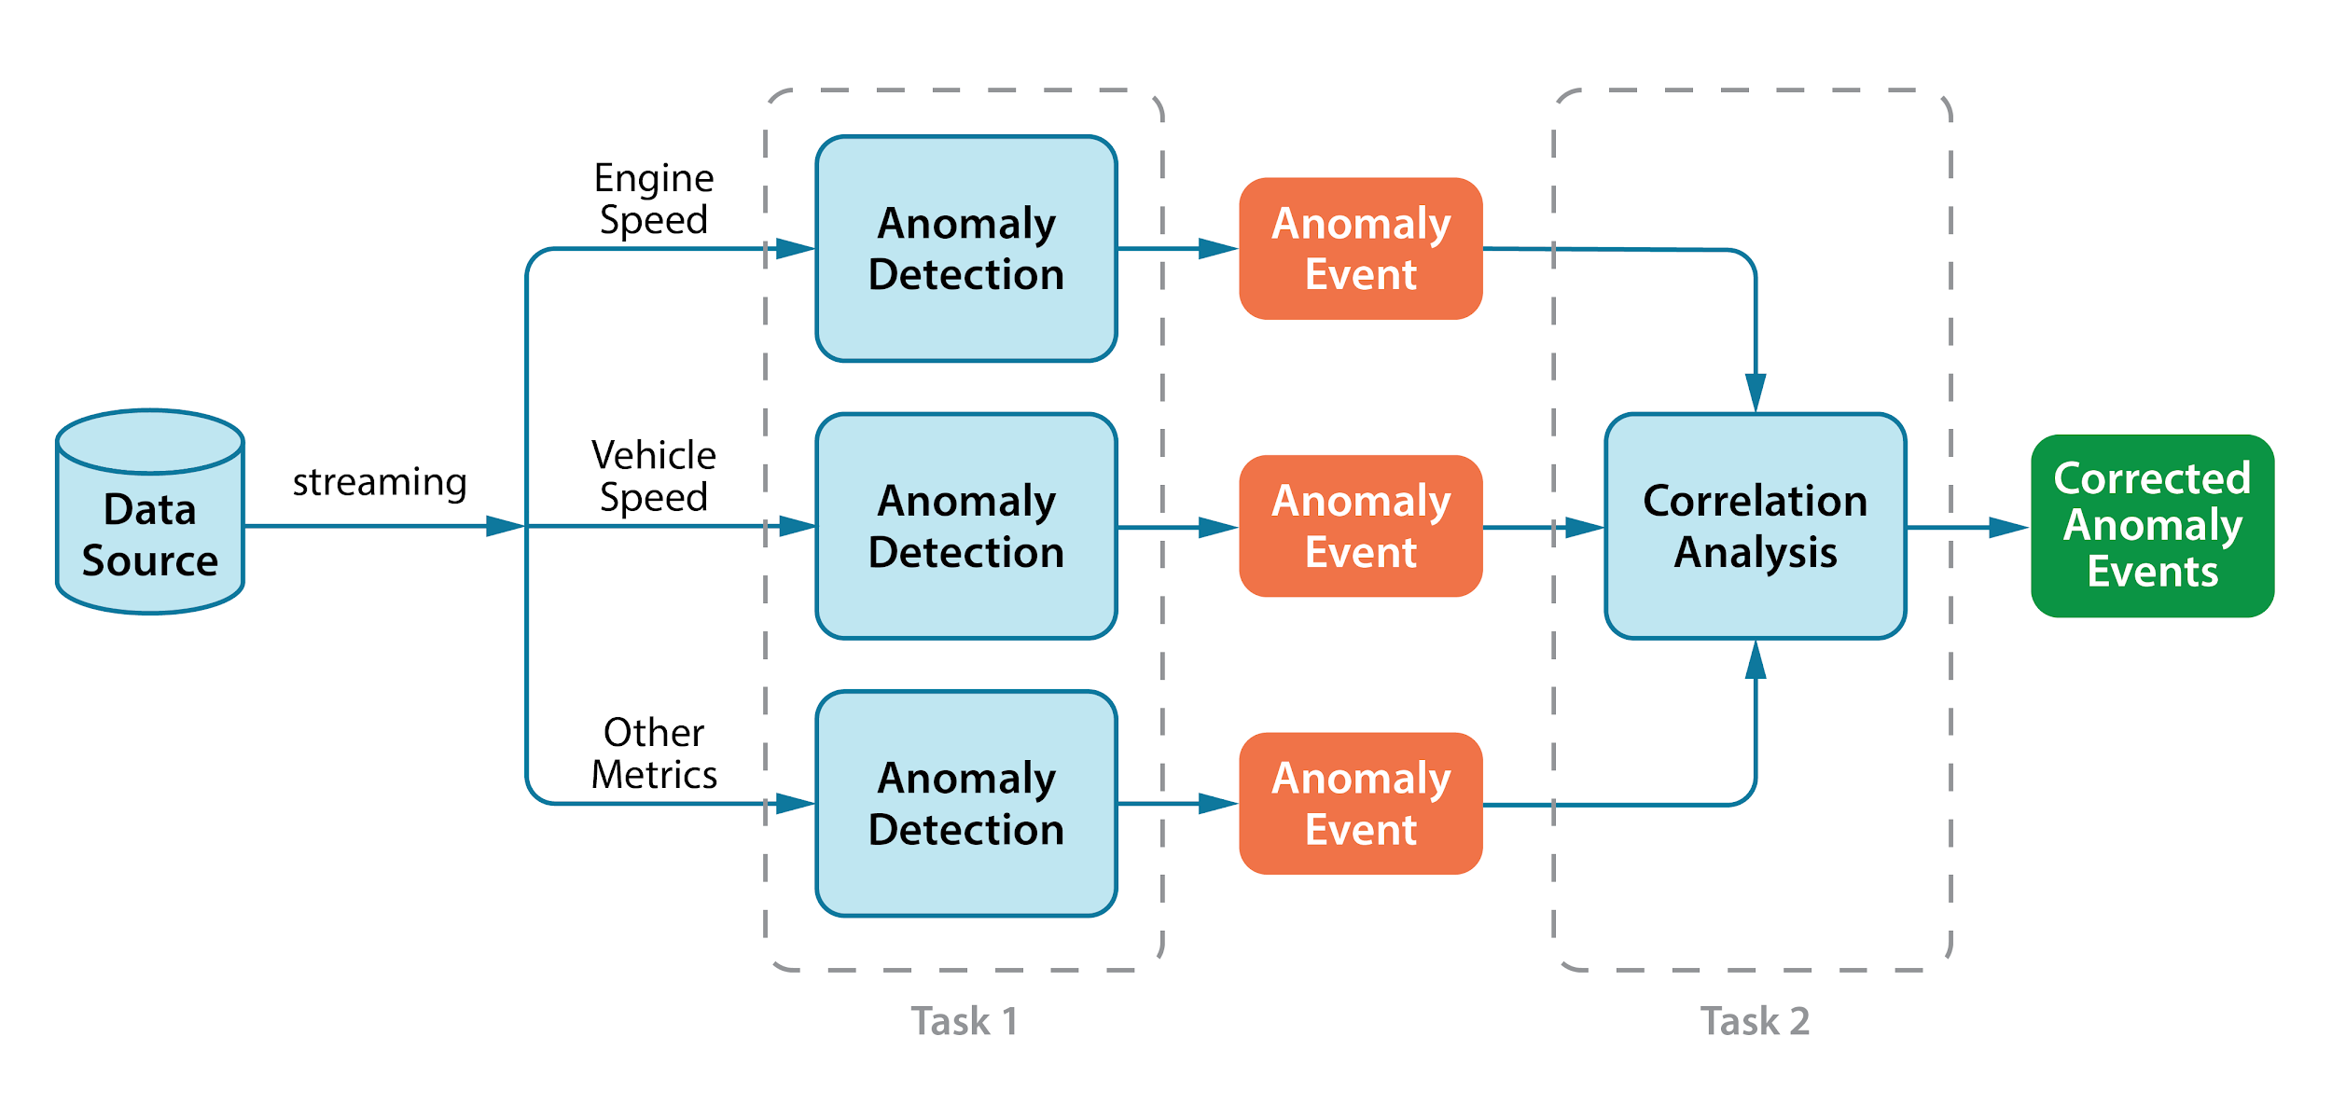
Tasks
Anomaly Detection: Learning algorithms themselves can only find the abnormal pattern in the data with best efforts under predefined assumption of what is “normal”.
Correlation Analysis: Learning algorithms can find out the “events” from data and mine correlation relationship among the events.

Slide 27
Preliminary Results
Dataset
One of the Indianapolis 500 car races on the 28th of May 2017, which consists of 750 MB of data and a total of 3986170 records in the log file.
Approach
Hierarchical Temporal Memory (HTM) algorithm, a state-of-the-art online algorithm to detect anomaly in real-time data source.

Slide 28
HTM neuron model
Streaming Data Analysis

Slide 29
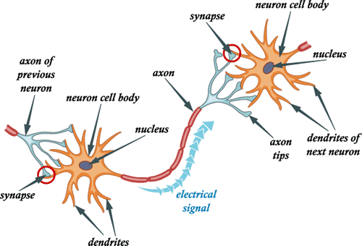
Axon, Dendrite and Synapse
Neurons have specialized projections called dendrites and axons.
Dendrites bring information to the cell body and axons take information away from the cell body.
Information from one neuron flows to another neuron across a synapse. The synapse contains a small gap separating neurons.

Slide 30
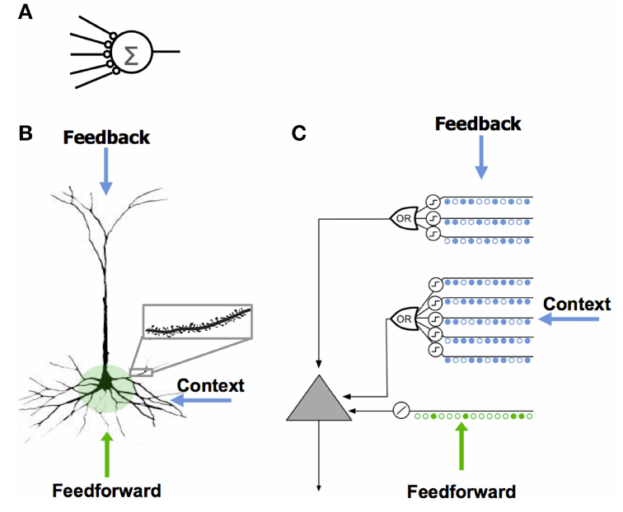
Hierarchical Temporal Memory(HTM)
The neuron model used in most artificial neural networks has a few synapses and no dendrites
Different source of input: feedforward, feedback and context
HTM sequence memory models dendrites with an array of coincident detectors each with a set of synapses

Slide 31
HTM
Hierarchical Temporal Memory (HTM) is a machine learning technology that aims to capture the structural and algorithmic properties of the neocortex.
HTM models neurons, which are arranged in columns, in layers, in regions, and in a hierarchy. In this regard HTMs are a new form of neural network.
HTM consists of a layer of HTM neurons organized into a set of columns.
It models high-order sequences (sequences with long-term dependencies) using a composition of two separate sparse representations(spatial and temporal).
When receiving the next input, the network uses the difference between predicted input and the actual input to update its synaptic connections.
HTMs are online learning and prediction machines that can be applied to many types of problems.

Slide 32
Anomaly Detection Based on HTM
The input time series x_{t} are fed to the HTM component. It models temporal patterns in a(x_{t}) and output a prediction in π(x_{t}).
Then by building a statistical model on the prediction error, π(x_{t}) - a(x_{t-1}), anomaly likelihood score can be calculated on x_{t}.

Slide 33
Anomaly Detection
Detection algorithm used has the capability to detect certain type of anomaly in few seconds ahead of the time.

Slide 34
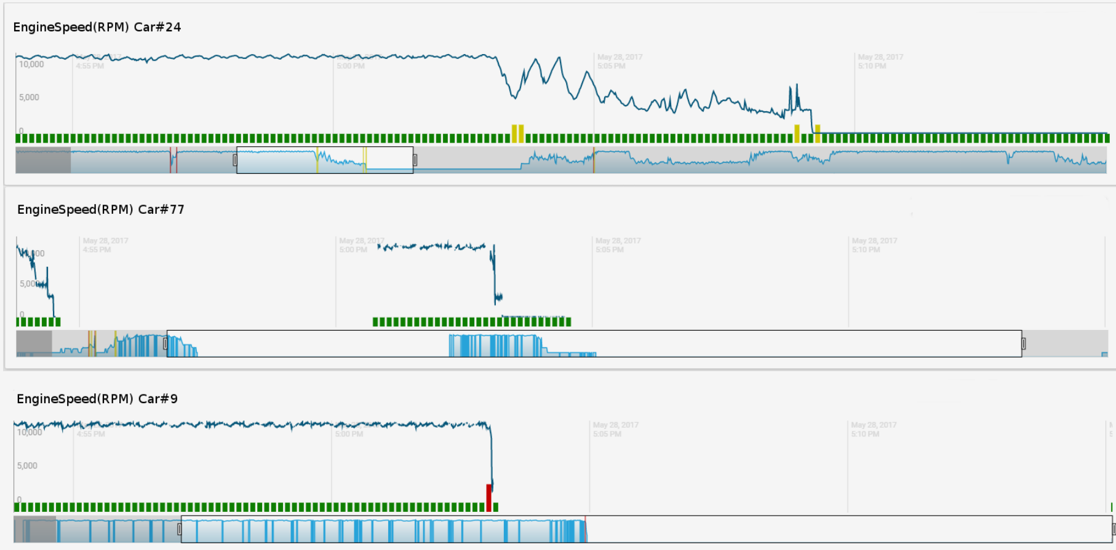
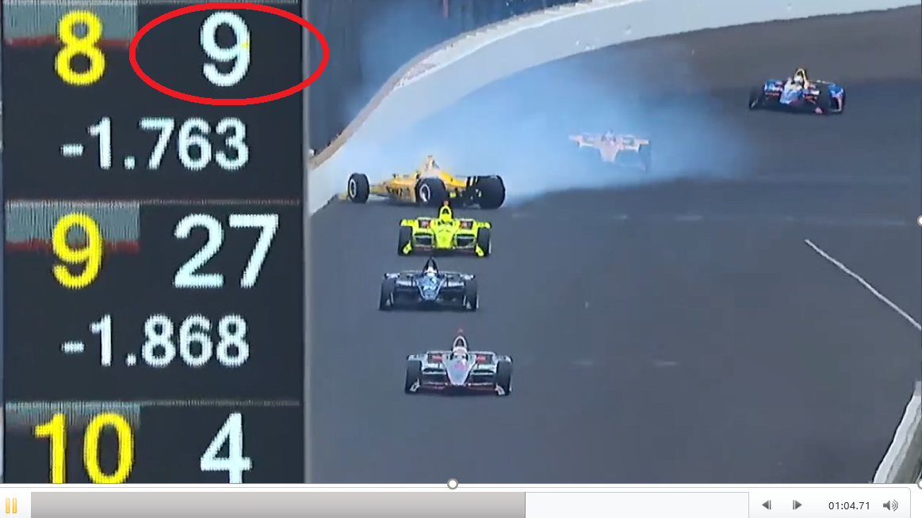
Correlation Analysis
The anomaly occurs around 15:03 pm, where the RPM of car #9 totally disappeared. In fact, car #9 got totaled due to a collision with car #77. The others cars, including car #24, all slowed down after the crash.
Correlation of “events” among different cars: #9 #77 and #24

Slide 35
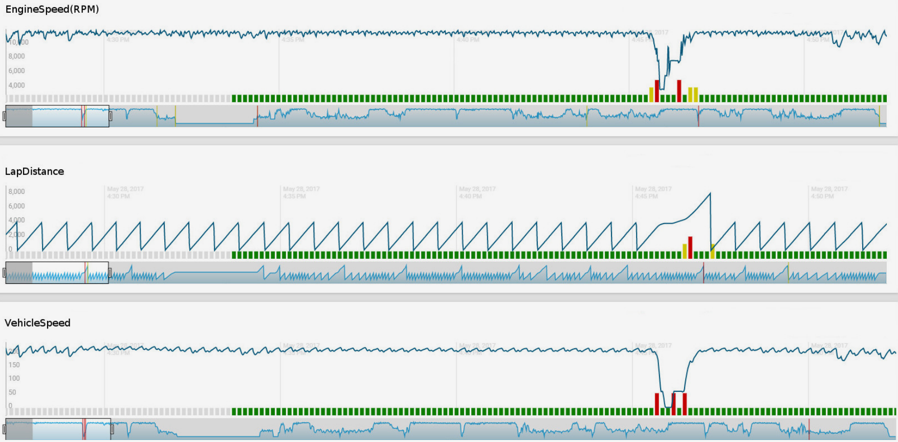
Correlation Analysis
Correlation of “metrics” for one car #11.

Slide 36
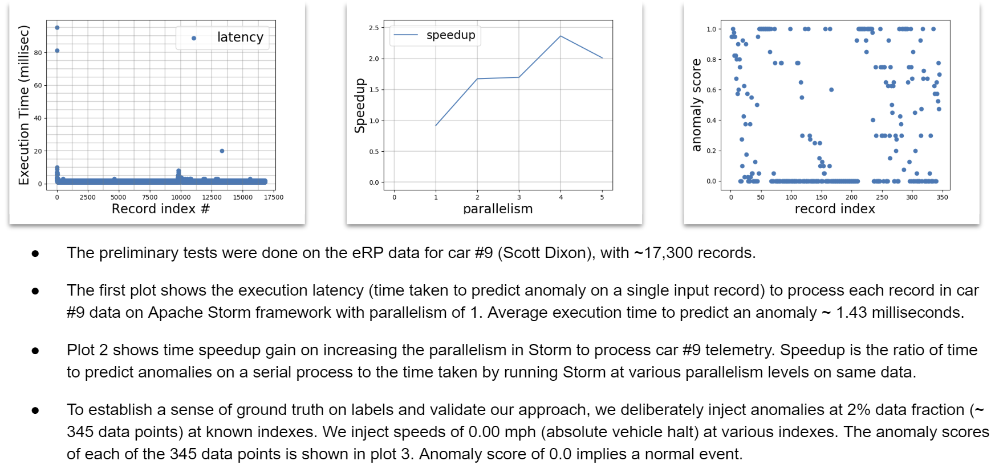
Validation

Slide 37
Future Work
DATASET
ACCURACY &
EFFICIENCY
INTERPRETATION
?
Collaborate with the domain experts, to build the anomaly dataset by human annotation.
Real-time anomaly detection is challenging, both accuracy and efficiency need to be improved.
Correlation analysis provide a list of 'related' events. However, correlation does not imply casual relation. We need to collaborate with domain experts to interpret the results.

Slide 38
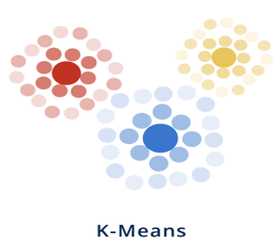
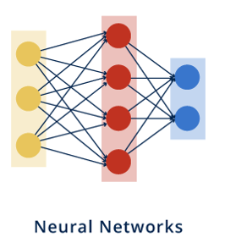
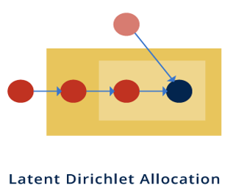
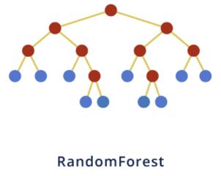
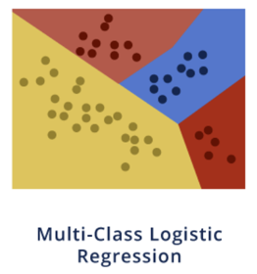
Data Analytics and Machine Learning
Harp/Harp-DAAL is an HPC-Cloud convergence framework that aims to automate ML as a service for both ease of use and scalability. Harp is designed to cover a full range of data-intensive computation from pleasingly parallel to machine learning and simulation.

Slide 39
Open Source Github Website (https://dsc-spidal.github.io/harp)

Slide 40
Acknowledgements
We gratefully acknowledge support from NSF, IU and Intel Parallel Computing Center (IPCC) Grant.
Langshi Cheng , Bo Peng , Supun Kamburugamuve, Chathura Widanage, Sahil Tyagi, Miao Jiang, Selahattin Akkas,
Andrey Nikolaev, Egor Smirnov, Dayle Smith, Lisa Smith
Intelligent Systems Engineering
School of Informatics and Computing
Indiana University

