Slide 1
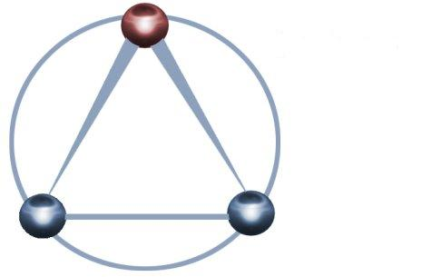
Distributed Clouds for
Scalable Collaborative Sensor-Centric Grid
Applications
For
AMSA TO 4 Sensor Grid
Final Presentation
By
Anabas, Inc. & Indiana University
May 9, 2012

Slide 2
Outline
Background
Motivation
Objective
Research Effort
Research Results
Lessons Learned
Recommendations

Slide 3
Background
SCGMMS was designed to enable sensor-centric support for Multi-Layered Sensing to provide timely, actionable, trusted and relevant situation awareness to decision-makers at all levels of command.
Multi-Layered Sensing is characterized by the integration of distributed, heterogeneous sensors and sensing systems for seamless collaboration and data exchange.
Earlier research demonstrated SCGMMS for Grid of Grids and Sensor Grid.
Motivation
A motivation for current work is to evaluate the coupling of Clouds with scalable Sensor Grids and applications.

Slide 4
Objective
To exploit modern distributed cloud computing architectures and infrastructures for scalable collaborative sensor-centric applications.
Note on Terminology
Grids are distributed – Sensors form a Grid
Clouds are logically a “single entity” and are used to control sensors
Clouds might in fact be made from distributed components but that is hidden from you

Slide 5
Research Effort
Identify certain sensor grid application requirements
Types of cloud infrastructures
Methodology
Experimental setup

Slide 6
Recap of earlier demonstrative sensor grid application
To identify certain application requirements
Rich collaborative client supports UDOP
Some preliminarily supported sensor services
  RFID
  GPS
  Webcam
  Quakesim modeling and simulation
  Lego Mindstorm NXT Sensors
    Ultrasonic
    Sound
    Light
    Touch
    Gyroscope
    Compass
    Accelerometer

Slide 7
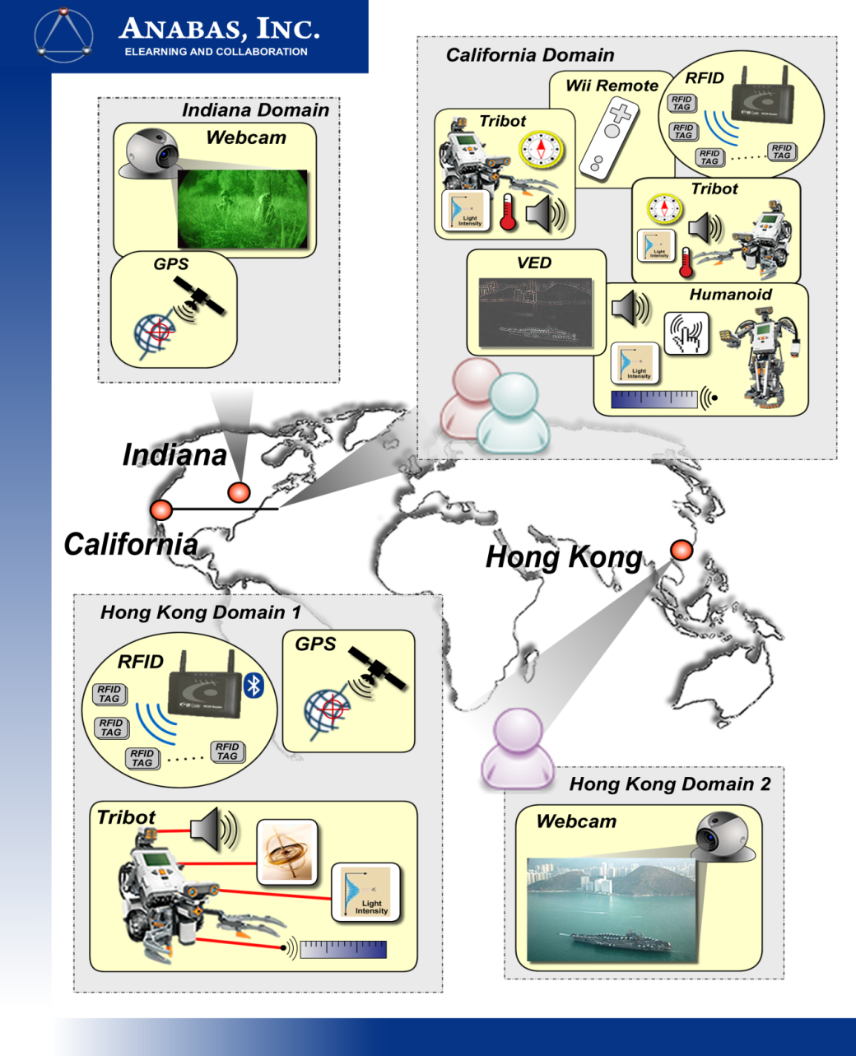
Recap of earlier demonstrative sensor grid application

Slide 8
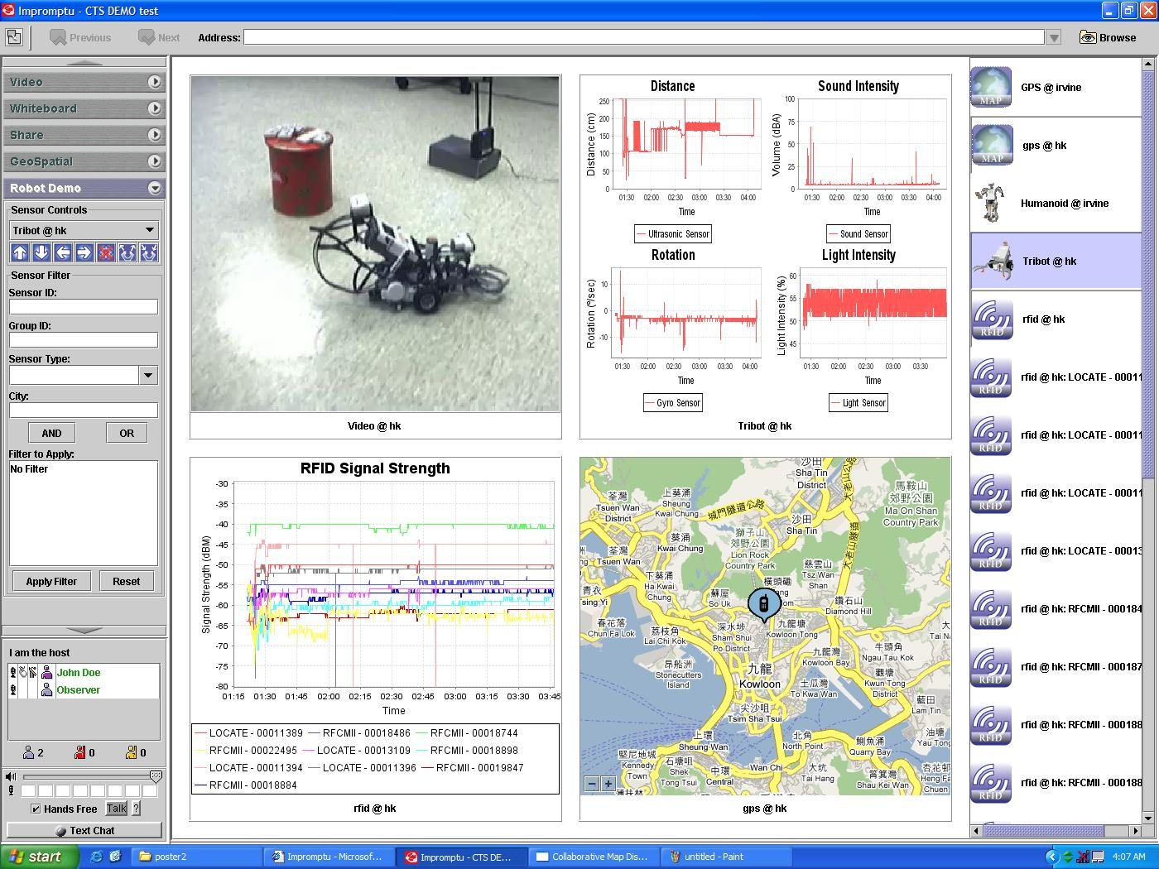
Recap of earlier demonstrative sensor grid application

Slide 9
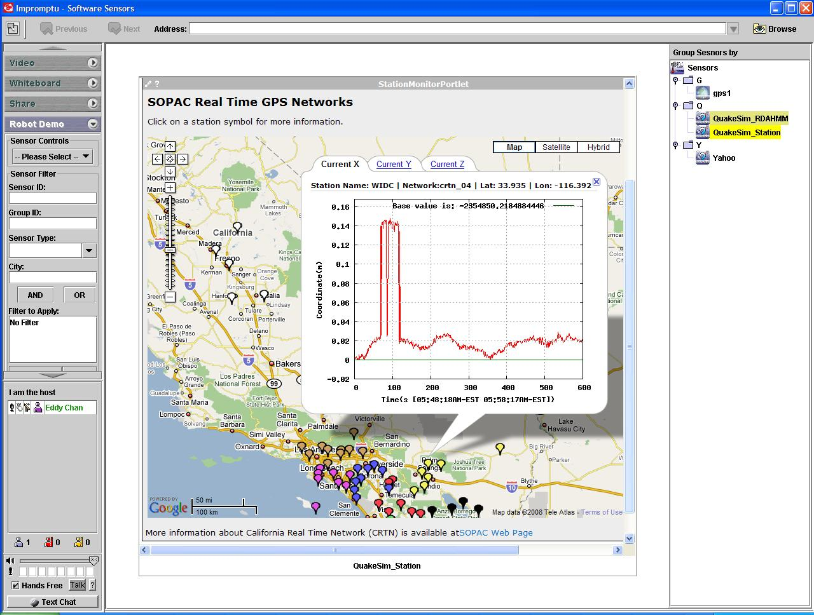
Recap of earlier demonstrative sensor grid application
Integrating modeling and simulation systems with real-time and archived GPS sensor streams.

Slide 10
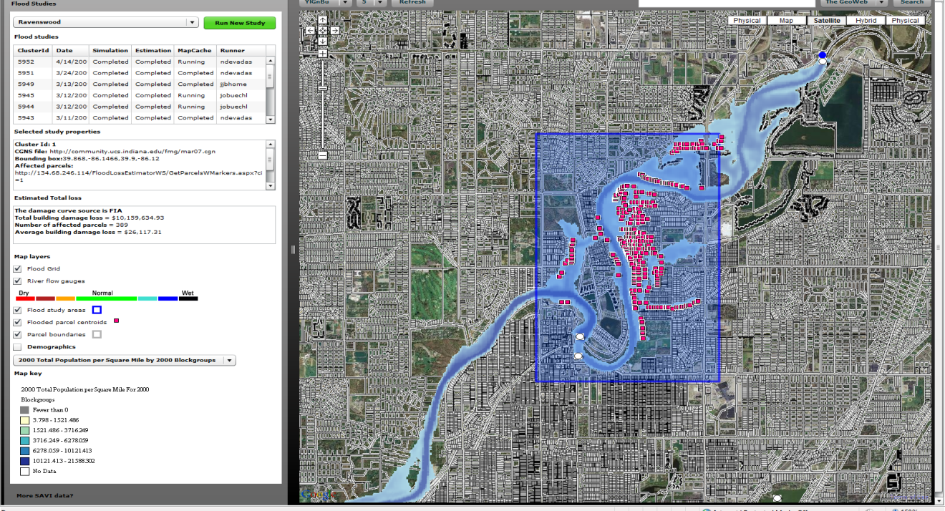
Applicability of sensor grid to other M&S applications
Flood emergency - managing flood modeling workflow. The map shows a flood simulation for a section of the
White River in Indianapolis.

Slide 11
Internet of Things and the Cloud
It is projected that there will soon be 50 billion devices on the Internet. Most will be small sensors that send streams of information into the cloud where it will be processed and integrated with other streams and turned into knowledge that will help our lives in a million small and big ways.
It is not unreasonable for us to believe that we will each have our own cloud-based personal agent that monitors all of the data about our life and anticipates our needs 24x7.
The cloud will become increasing important as a controller of and resource provider for the Internet of Things.
As well as today’s use for smart phone and gaming console support, “smart homes” and “ubiquitous cities” build on this vision and we could expect a growth in cloud supported/controlled robotics.
Natural parallelism over “things”

Slide 12

  Internet of Things: Sensor Grids
  A pleasingly parallel example on Clouds
  A sensor (“Thing”) is any source or sink of time series
    In the thin client era, smart phones, Kindles, tablets, Kinects, web-cams are sensors
    Robots, distributed instruments such as environmental measures are sensors
    Web pages, Googledocs, Office 365, WebEx are sensors
    Ubiquitous Cities/Homes are full of sensors
    They have IP address on Internet
  Sensors – being intrinsically distributed are Grids
  However natural implementation uses clouds to consolidate and control and collaborate with sensors
  Sensors are typically “small” and have pleasingly parallel cloud implementations

Slide 13








Sensors as a Service
Output Sensor
Sensors as a Service
Sensor Processing as a Service (could use
MapReduce)
A larger sensor ………

Slide 14
Applicability of sensor grid for M&S applications
An M&S application scenario that includes a mixture of real-time sensors, computationally intense
modeling services and real-time GPS and other data services.

Slide 15


Slide 16
Observations of an earlier sensor grid application
Dominated by the use of messaging systems
Use the same messaging system NaradaBrokering for managing streams of several varieties:
  Audio/Video streams for shared collaboration and visualization
  - Command streams for remotely controlling NXT mobile sensors
  GPS streams for geo-spatial intelligence
  RFID streams for tracking, touch and intrusion detection
  Quakesim modeling & simulation streams
All sensor streams are operationally real-time and continuous
Video stream requires low latency and packet drop, high bandwidth
Audio stream requires very low jitter, latency and packet drop
Command, GPS and RFID streams requires low latency
Quakesim stream requires high computing power
Other M&S streams could possibly require high computing power and bandwidth

Slide 17
Typical types of Cloud Infrastructures
Public Cloud – e.g. Web-scale Amazon EC2
Hosted on huge data centers and shared by the public
Customers outsource their infrastructure
Not generally feasible for mission-critical applications
Community Cloud – e.g. National-scale FutureGrid
Shares infrastructure among several organizations
Coming from specific COI
With common concerns
Private Cloud – Organization/Departmental-scale
Solely operated by a single organization
Hybrid Cloud
Composition of 2 or more clouds that remain unique entities
Integrated together at some levels

Slide 18



Hybrid Clouds
Community Cloud
Private
Internal
Cloud
Public Cloud

Slide 19
Choices for Private Clouds
Commercially there is VMware but in research arena, most popular are:
  Eucalyptus
  Nimbus
  OpenNebula (Europe)
  OpenStack

Slide 20
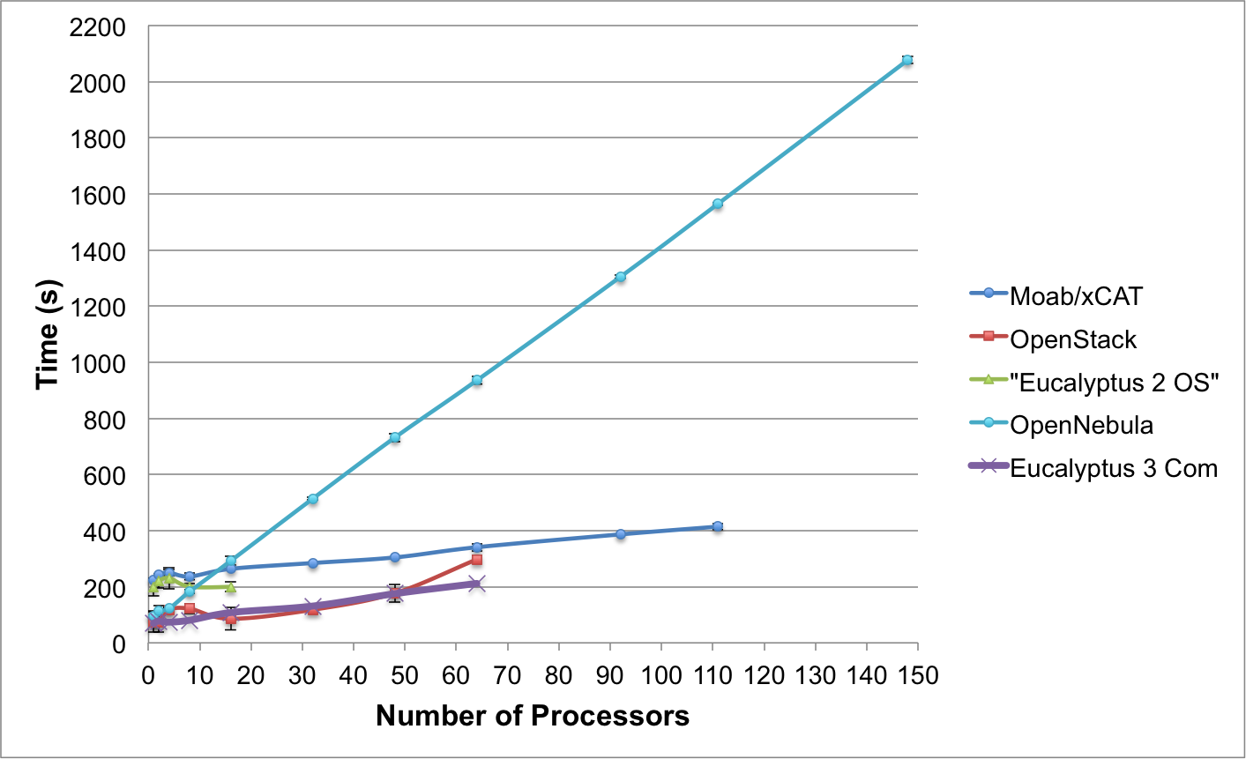
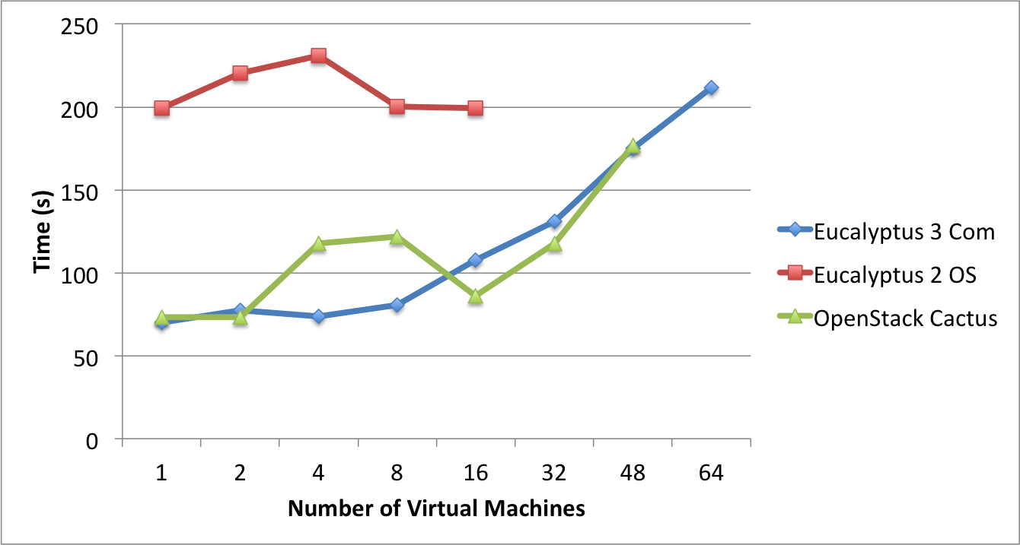
Templated Dynamic Provisioning
Abstract Specification of image mapped to various HPC and Cloud environments
OpenNebula
Parallel provisioning now supported
Moab/xCAT HPC – high as need reboot before use
Essex replaces Cactus
Current Eucalyptus 3 commercial while version 2 Open Source

Slide 21
Some Research Challenges – I
Design algorithms that can exploit/tolerate cloud features
  Elastic access to resources
  Use few large messages – not lots of small ones
  Fault tolerant
  Use library of roles and appliances
  Exploit platforms (queues, tables) and XaaS
Classify and measure performance of these algorithms/applications
Improve performance of clouds
Many security issues
Understand needed standards
Helped by Manish Parashar

Slide 22
Some Research(&D) Challenges – II
Improve MapReduce so it
  Offers HPC Cloud interoperability
  Polymorphic reductions (collectives) exploiting all types of networks
  Supports scientific data and algorithms
Develop storage model to support cloud computing enhanced data repositories
Understand federation of multiple clouds and support of hybrid algorithms split across clouds (e.g. for security or geographical reason)
  Private clouds are not likely to be on huge scale of public clouds
  Cloud bursting important federated system (private + public)
Bring commercial cloud PaaS to HPC and academic clouds
Fault tolerance, high availability, energy efficiency (green clouds)
Train people for the 14 million cloud jobs expected by 2015
Helped by Manish Parashar

Slide 23
Methodology to measure performance, scalability and reliability characteristics of different cloud types:
Use standard network performance tools at the network level
Use the IU NaradaBrokering system, which supports many practical communication protocols, to gather data at the message level
Use the Anabas sensor-centric grid framework to enable measuring data at the collaboration applications level

Slide 24
An Overview of FutureGrid
A national-scale experimental testbed
Supports scientific communities to perform large-scale research running on virtual machines (VM) or bare metal.
Supports IaaS environments including Eucalyptus, Nimbus and OpenStack
Supports KVM, Xen and bare metal virtualization
Both support AWS-compliant, EC2-based web service interface.
Eucalyptus supports AWS storage-compliant service.
Nimbus supports saving of customized-VMs to Nimbus image repository.

Slide 25
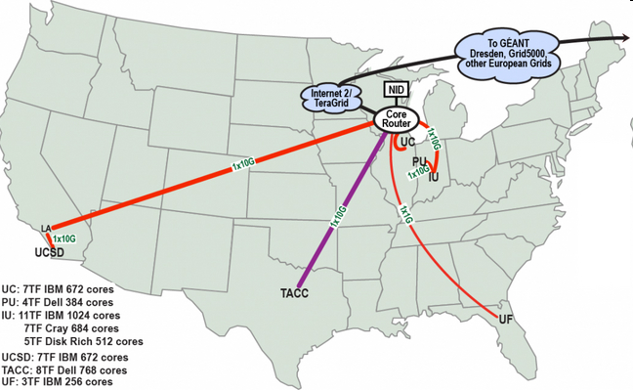
Overview of FutureGrid

Slide 26
General Experimental Setup Using Nimbus & Eucalyptus
We use four of FutureGrid’s clusters
  Hotel (Nimbus at University of Chicago)
  Foxtrot (Nimbus at University of Florida)
  India (Eucalyptus at Indiana University)
  Sierra (Eucalyptus at UCSD)
Distributed cloud scenarios are
  either pairs of clouds, or
  a group of four clouds
In Nimbus cloud each instance uses 2-cores with 12 GB RAM in a CentOS VM
In Eucalyptus clouds we use m1.xlarge instances. Each m1.xlarge instance is roughly equivalent to a 2-core Intel Xeon X5570 with 12 GB RAM

Slide 27
Network Level Measurement
We run two types of experiments:
Using iperf to measure bi-directional throughput on pairs of cloud instances, one instance on each cloud in the pairs.
Using ping in conjunction with iperf to measure packet loss and round-trip latency under loaded and unloaded network on pairs of cloud instances, one instance on each cloud in the pairs .

Slide 28
Network Level - Throughput

Slide 29
Network Level – Packet Loss Rate
Instance Pair
Unloaded
Packet Loss Rate
Loaded (32 iperf connections)
Packet Loss Rate
India-Sierra
0%
0.33%
India-Hotel
0%
0.67%
India-Foxtrot
0%
0%
Sierra-Hotel
0%
0.33%
Sierra-Foxtrot
0%
0%
Hotel-Foxtrot
0%
0.33%

Slide 30
Network Level
Round-trip Latency Due to VM
Round-trip Latency Due to OpenStack VM
Number of iperf connections = 0 Ping RTT = 0.58 ms

Slide 31
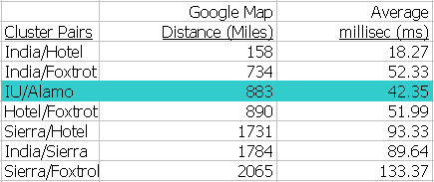
Network Level
– Round-trip Latency Due to Distance

Slide 32
Network Level – Ping RTT with 32 iperf connections
Lowest RTT measured between two FutureGrid clusters.

Slide 33
Network Level – Ping RTT with 32 iperf connections
Longest RTT measured between two FutureGrid clusters.

Slide 34
Message Level Measurement
We run a 2-cloud distributed experiment.
Use Nimbus clouds on Foxtrot and Hotel
A NaradaBrokering (NB) broker runs on Foxtrot
Use simulated participants for single and multiple video conference session(s) on Hotel
Use NB clients to generate video traffic patterns instead of using Anabas Impromptu multipoint conferencing platform for large scale and practical experimentation.
Single video conference session has up to 2,400 participants
Up to 150 video conference sessions with 20 participants each

Slide 35
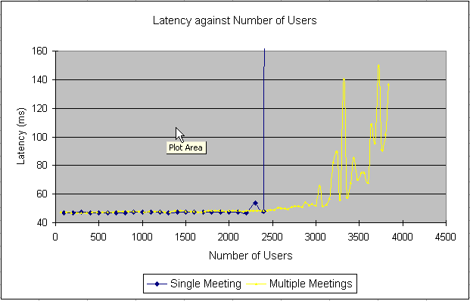
Messages Level Measurement
– Round-trip Latency

Slide 36
Message Level Measurement
The average inter-cloud round-trip latency incurred between Hotel and Foxtrot in a single video conference session with up to 2,400 participants is about 50 ms.
Average round-trip latency jumps when there are more than 2,400 participants in a single session.
Message backlog is observed at the broker when there are more than 2,400 participants in a single session.
Average round-trip latency can be maintained at about 50 ms with 150 simultaneous sessions, each with 20 participants. An aggregate total of 3,000 participants.
Multiple smaller sessions allow NB broker to balance its work better.
Limits shown are due to use of single broker and not of the system.

Slide 37
Collaborative Sensor-Centric Application Level Measurement
We report initial observations of an application using the Anabas collaborative sensor-centric grid framework.
Use virtual GPS sensors to stream information to a sensor-centric grid at a rate of 1 message per second.
A sensor-centric application consumes all the GPS sensor streams and computes latency and jitter.
We run two types of experiments
A single VM in a cloud to establish a baseline - India
In 4 clouds – India, Hotel, Foxtrot, Sierra – each with a single VM

Slide 38
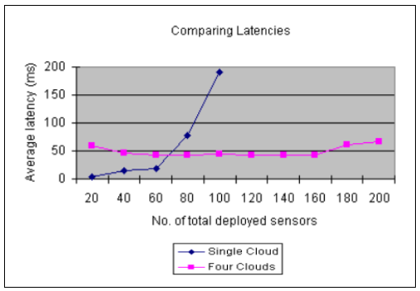
Collaborative Sensor-Centric
Application Level – Round-trip Latency

Slide 39

Collaborative Sensor-Centric
Application Level – Jitter

Slide 40
Collaborative Sensor-Centric Application Level Measurement
Observations:
In the case of of a single VM in a cloud, we could stretch to support 100 virtual GPS sensors, with critically low idle CPU at 7% and un-used RAM at 1 GB. Not good for long running applications or simulations. The average round-trip latency and jitter grow rapidly beyond 60 sensors.
In the case of using four geographically distributed clouds of two different types to run a total of 200 virtual GPS sensors, average round-trip latency and jitter remain quite stable. Average idle CPU at about 35% level which enables more predictable latency and jitter for real-world operations and suitable for long running simulations or applications.

Slide 41
Preliminary Results on FutureGrid
Network Level Measurement
FutureGrid can sustain at least 1 Gbps inter-cloud throughput and is a reliable network with low packet loss rate.
Message Level Measurement
FutureGrid can sustain a throughput close to its implemented capacity of 1 Gbps between Foxtrot and Hotel.
The multiple video conference sessions shows clouds can support publish and subscribe brokers effectively.
Note the limit around 3,000 participants in the figure was reported as 800 in earlier work, showing any degradation in server performance from using clouds is more than compensated by improved server performance.
Collaborative Sensor-Centric Application Level Measurement
Distributed clouds has an encouraging potential to support scalable collaborative sensor-centric applications that have stringent throughput, latency, jitter and reliability requirements.

Slide 42
A Brief Overview of Amazon EC2
A web-scale commercial public cloud infrastructure.
Amazon EC2 interface is the de-facto compatibility standard
Global distributed clouds in California, Oregon, Virginia, Ireland, Brazil, Japan and Singapore.
Supports Xen virtualization.

Slide 43
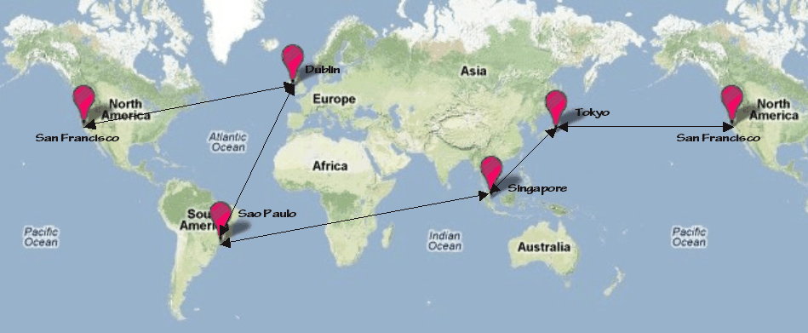
Measurement of Round-trip Latency, Data Loss Rate, Jitter
Five Amazon EC2 clouds selected: California, Tokyo, Singapore, Sao Paulo, Dublin

Slide 44
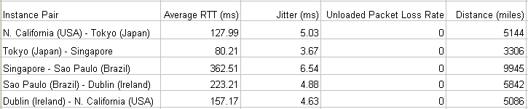
Measurement of Round-trip Latency, Data Loss Rate, Jitter
Five Amazon EC2 clouds selected: California, Tokyo, Singapore, Sao Paulo, Dublin
Web-scale inter-cloud network characteristics

Slide 45
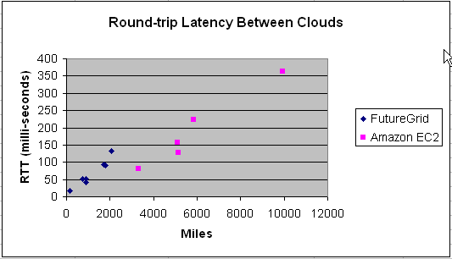
Measured Web-scale and National-scale Inter-Cloud Latency
Inter-cloud latency is proportional to distance between clouds.

Slide 46
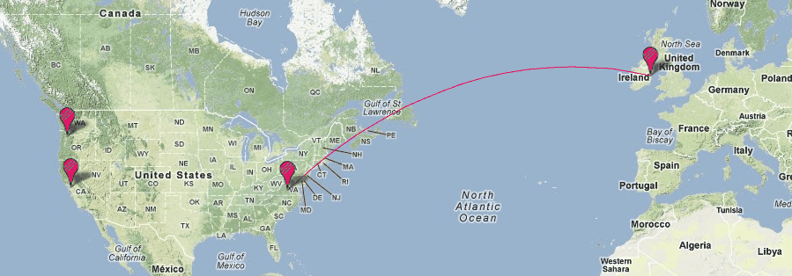
Recap of Earlier Measured EC2 Inter-Cloud Throughput
Data based on one instance-pair.

Slide 47
Recap of Earlier Measured EC2 Inter-Cloud Throughput
Bi-directional throughput between any 2 FutureGrid clouds ranges from 900 to 1,400 mbps.
Amazon’s US-East and EU-West inter-cloud sustains a throughput of 126 mbps at 128 Iperf connection in one
instance pair, and about 500 mbps for 4 instance-pairs. It is noted that the maximum sustainable throughput
had not been reached in our EC2 experiments.

Slide 48

Preliminary Hybrid Clouds Experiment
Scalability & Interoperability
FutureGrid Cloud
Private Clouds
OpenStack(PU)
3 private clouds
FutureGrid Cloud
Alamo OpenStack (UT)
88 VMs
Sierra Nimbus (UCSD)
11 VMs
Foxtrot Nimbus (UFL)
10 VMs
Public Cloud
Amazon EC2 (N. Virginia)
1 VM
Private Cloud
Amazon EC2
Public Cloud

Slide 49
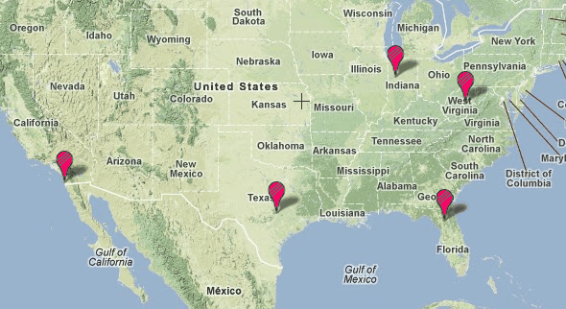
Distributed Hybrid Clouds Experiment
Private Clouds
EC2 Cloud
FutureGrid Sierra
FutureGrid Alamo
FutureGrid Foxtrot
A hybrid cloud setup including private, community and public cloud infrastrutures,
using 113 virtual machines in five distributed clusters.

Slide 50
Scaling Up Computing Resources For Message-based Applications
SCGMMS-type sensor grid application boils down to independent message-capable service components interacting via messages.
Current state of interfaces and procedures supporting the launching and monitoring of virtual machines is tedious even for the case of a single cloud region by a single cloud provider.
Intended to scale up a large number of virtual machines for the purposes of understanding and illustrating the acquisition of increasingly more on-demand computing resources and to observe reliability of continuous communication using messages among distributed, heterogeneous cloud environments.
Developed an NB application called SensorDataStreamer that streams 256 bytes of data per second to an NB server, and SensorApp that subscribes to the published data stream.

Slide 51
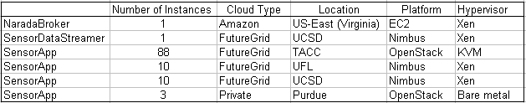
Hybrid Cloud Experiment
Over 1.6 million 256-byte messages communicated over a 4-hour
duration among 113 distributed heterogeneous cloud instances in
a hybrid cloud setting.

Slide 52
Lessons Learned
By design the many experiments we performed lead to some useful insights -
Latency: Cloud technologies naturally introduce additional software overhead. We show that cloud VM adds negligible software overhead. Latency is dominated by distance between sensor services and sensor applications.
Bandwidth: National-scale FutureGrid and Web-scale Amazon EC2 offer on-demand bandwidth capacity that is better than 100 mbps LAN, allowing bandwidth-demanding sensor streams to be served effectively and timely.
Reliability: Network characteristics observed indicate very low packet loss rate and jitter making cloud infrastructures reasonable for best-effort delivery sensor applications.

Slide 53
Lessons Learned (cont’d)
Scalability: Our results show one could scale up from 1 instance (roughly 2-core Xeon X5570 with 12 GB RAM) to 111 instances (roughly 222 cores of Xeon X5570 with 1.32 TB RAM) of various virtual machines and use the computing resource for the tasks on hand. Procedural and operational inconvenience aside, cloud technology and system could be a natural fit for scalable sensor grid applications, many of which are dynamic in nature.
Interoperability: Large scale sensor grid applications in the real-world is heterogeneous and distributed in nature. Systems must be able to support global deployment and heterogeneity by design. Message-based interfaces like that used by SCGMMS is a key to address heterogeneity and global deployment. We have shown clouds are well-suited for scalable message-based systems and applications.

Slide 54
Recommendations
NaradaBrokering has served our studies excellently. Newer systems such as the Apache ActiveMQ is an on-going project that incorporates latest technologies and open-source support. It is worth evaluating other supported message systems.
Dynamically scaling sensor cloud/grid to support on-demand workload will increase the value of SCGMMS for AMSA-type applications.
Look at Big data and Modeling and Simulation services linked to Sensor Grid
Sensor Cloud is an attractive architecture for planning and other not immediate real time robot services

Slide 55
Acknowledgments
We thank Bill McQuay, formerly of AFRL, Geoffrey Fox and Ryan Hartman of Indiana University and Gary Whitted of Ball Aerospace for their important support of the work.
This material is based on work supported in part by the National Science Foundation under Grant No. 0910812 to Indiana University for “FutureGrid: An Experimental, High-Performance Grid Test-bed.” Other partners in the FutureGrid project include U. Chicago, U. Florida, U. Southern California, U. Texas at Austin, U. Tennessee at Knoxville, U. of Virginia.

