Slide 1
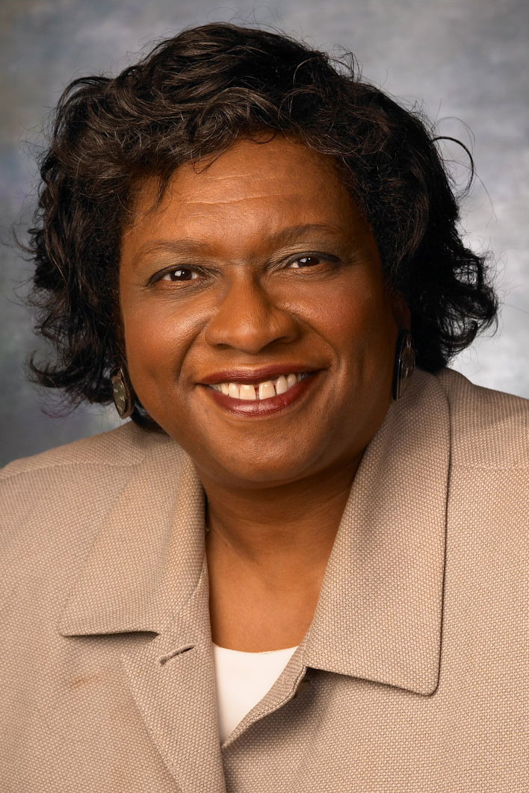
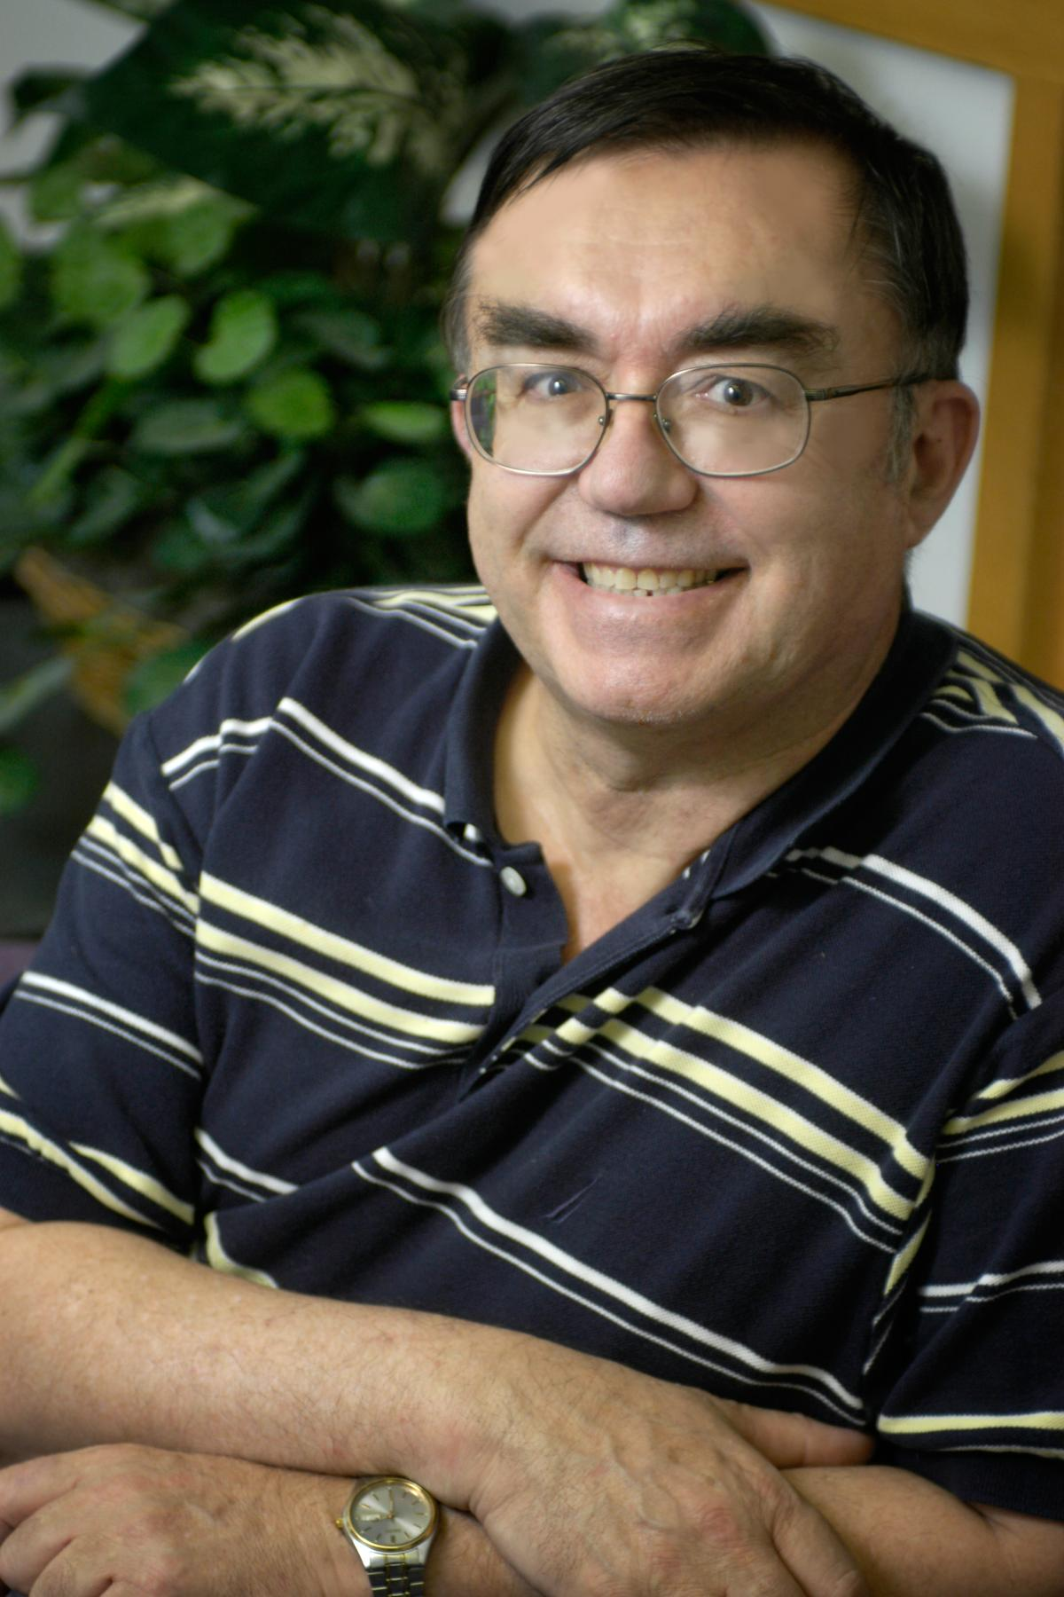
REU Site: Arctic and Antarctic Project (AaA-REU) with Research Experience for Teachers (RET) Component
The REU Site: Arctic and Antarctic CReSIS (AaA-REU) program will involve 75 undergraduates over a three-year period with five pre-service RET students each year. This project is a continuation of the REU Site program that has operated at Elizabeth City State University and other CReSIS (Center for Remote Sensing of the Ice Sheets) institutions since 2010. The site is co-funded by the Department of Defense in partnership with the NSF REU program. The vision for this project is driven by the compelling need to draw on the integration of polar research and education to attract a diverse pool of talented students into polar-related careers.
The AaA-REU project would be interdisciplinary in focus and will make innovative, cost-effective use of cyberinfrastructure. The project builds upon existing partnerships in polar science, engineering, education, and cyberinfrastructure -- partnerships that provide access to extensive CReSIS resources under the direction of an experienced team of educators and researchers. It is expected that the demographics of the participants would reflect the exciting minority percentages that were realized during the past CReSIS-REU award.
The REU Site: Arctic and Antarctic Project (AaA-REU) with Research Experience for Teachers (RET) Component continues work under NSF grant 0944255 to promote the professional development of minority undergraduate students through participation in ocean and marine science research. Undergraduates are chosen from a national selection. Each is assigned to a specific research team where they will work closely with the faculty. In addition, seminars, lunch meetings, and social functions will be organized to facilitate undergraduate interaction. The project is conducted for eight weeks during each summer from 2014-2016, with on-line mentoring and follow-up during academic year. Students who are in those groups traditionally under-represented in science are particularly urged to apply. No fieldwork is associated with this coordinating activity. Fieldwork details can be found under the research team.
2015
Tatyana Matthews, Elizabeth City State University
Investigating the Security Risks and Vulnerabilities of an Android System
Tori Wilbon, Elizabeth City State University
Omar Owens, Winston-Salem State University
Exploring Learning Algorithms for Layer Identification
Maya Smith, Winston-Salem State University
Anthony Scott, Winston-Salem State University
Analyzing Stock Data using Multi-Dimensional Scaling
2014
Tatyana Matthews, Elizabeth City State University
Apache Big Data Stack
Nigel Pugh, Elizabeth City State University
Tori Wilbon, Elizabeth City State University
Evaluating the Performance of MPI Java in FutureGRID
Khaliq Satchell, Elizabeth City State University
PlotViz: The Next Visualization Tool in Bioinformatics
Jefferson Ridgeway IV, Elizabeth City State University
Django for Cloudmesh
Derek Morris, Elizabeth City State University
Analyzing the Security Infrastructure of the Android Operating System
2013
Ya'Shonti Bridgers (RET), Elizabeth City State University
X-Informatics MOOC: Web Development and Design
Dorias Brown, Spelman College
Donquel Davis, Winston-Salem State University
Zazie Lumpkin, Spelman College
Estimating Surface and Bedrock Layers in Polar Radar Imagery using Active Contours
Justin Deloatch, Elizabeth City State University
Utilizing HUBzero to Create an Educational Hub for CReSIS Educational Data Sets
Derek Morris Jr., Elizabeth City State University
From 0 to 100: Cloud Computing for the Non-Programmer
2012
Joseph Jackson, Mississippi Valley State University
Multidimensional Scaling Visualizing Gene Sequencing Data
Brandi Smith, Mississippi Valley State University
Analysis of Breast Cancer Cells Using Parallel Programming
Ya'Shonti Bridgers, Elizabeth City State University
Designing a Curriculum for Communicating Parallel and Distributed Computing Concepts to Underserved Communities
2011
Jean Bevins, Elizabeth City State University
Michael Austin, Elizabeth City State University
Testing Windows Azure Cloud Computer Service Efficiency
Joyce Bevins, Elizabeth City State University
Autumn Luke, Elizabeth City State University
Analyzing MapReduce Frameworks Hadoop and Twister
Chartese Jones, Mississippi Valley State University
Sequential Order Matrix Computation and Parallel Matrix Multiplication
Joseph Jackson, Mississippi Valley State University
The Evaluation of Bio Sequence Clustering Algorithms in a High-Performance Computing Environment
JerNettie Burney, Elizabeth City State University
Robyn Evans, Elizabeth City State University
A Comparison of Job Duration Utilizing High Performance Computing on a Distributed Grid
Lakesha Wells, Hampton University
Web Interfaces for Bio Sequence Desktop Analysis
Franshetta Hibbler, Mississippi Valley State University
Tracking High-Performance Bio Sequence Clustering Jobs Using Common Web Interfaces
Michael Koch, Elizabeth City State University
Hybrid Cloud Security: Replication and Direction of Sensitive Data Blocks
2010
Jean Bevins, Elizabeth City State University
Security Module for the SALSA Portal
Joyce Bevins, Elizabeth City State University
Data Clustering Analysis and Visualization
Michael Austin, Elizabeth City State University
Robyn Evans, Elizabeth City State University
Nadirah Cogbill, Elizabeth City State University
JerNettie Burney, Elizabeth City State University
Visualization of Ice Sheet Elevation Data Using Google Earth & Python Plotting Libraries
Dr. Linda B. Hayden
Director of the Elizabeth City State University Center of Excellence in Remote Sensing Education and Research
Dr. Geoffrey Fox
Indiana University Bloomington
Distinguished Professor of Computer Science and Informatics and Physics
I would also like to create a poster on the IU/ECSU Research Experience for Undergraduates program. It will take me until Monday to do so.
Jeff please attempt a first draft of the poster using ppt.
Show image of Dr. Fox and one of me
Statement on the AaA REU program objectives
List of all IU student past participants , their institutions and research titles
CReSIS, IU and ECSU logos
image of Jerome with the 2014 REU students located at http://nia.ecsu.edu/reuomps2014/teams-iu.html

