Slide 1
Advanced Remarks on Optimization
David Crandall, Geoffrey Fox
Indiana University Bloomington
SPIDAL Video Presentation
September 25, 2018

Slide 2
Imaging Applications: Remote Sensing, Pathology, Spatial Systems
Both Pathology/Remote sensing working on 2D moving to 3D images
Each pathology image could have 10 billion pixels, and we may extract a million spatial objects per image and 100 million features (dozens to 100 features per object) per image. We often tile the image into 4K x 4K tiles for processing. We develop buffering-based tiling to handle boundary-crossing objects. For each typical study, we may have hundreds to thousands of pathology images
Remote sensing aimed at radar images of ice and snow sheets; as data from aircraft flying in a line, we can stack radar 2D images to get 3D
2D problems need modest parallelism “intra-image” but often need parallelism over images
3D problems need parallelism for an individual image
Use Optimization algorithms to support applications (e.g. Markov Chain, Integer Programming, Bayesian Maximum a posteriori, variational level set, Euler-Lagrange Equation)
Classification (deep learning convolution neural network, SVM, random forest, etc.) will be important

Slide 3
Imaging applications
Many scientific domains now collect large scale image data, e.g.
  Astronomy: wide-area telescope data
  Ecology, meteorology: Satellite imagery
  Biology, neuroscience: Live-cell imaging, MRIs, …
  Medicine: X-ray, MRI, CT, …
  Physics, chemistry: electron microscopy, …
  Earth science: Sonar, satellite, radar, …
Challenge has moved from collecting data to analyzing it
  Large scale (number of images or size of images) overwhelming for human analysis
  Recent progress in computer vision makes reliable automated image analysis feasible

Slide 4
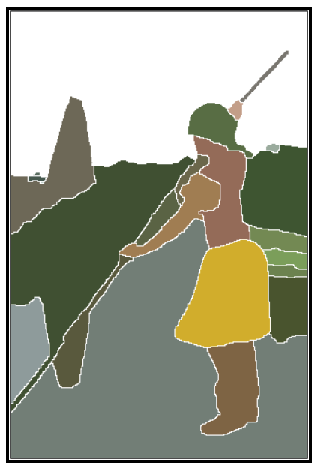
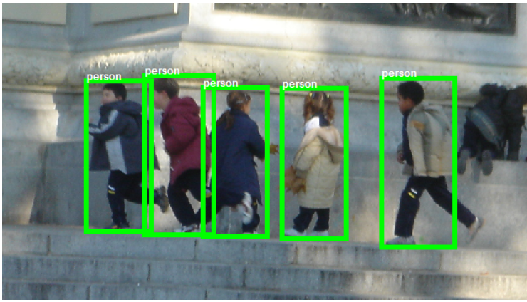
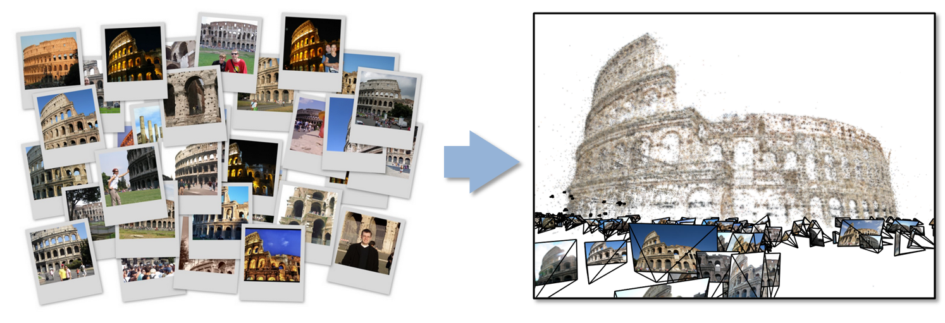
Key image analysis problems
Many names for similar problems; most fall into:
  Segmentation: Dividing image into homogeneous regions
  Detection, recognition: Finding and identifying important structures and their properties
  Reconstruction: Inferring properties of a data source from noisy, incomplete observations (e.g. removing noise from an image, estimating 3d structure of scene from multiple images)
  Matching and alignment: Finding correspondences between images
Most of these problems can be thought of as image pre-processing followed by model fitting
Arbelaez 2011
Dollar 2012
Crandall 2013

Slide 5
SPIDAL image abstractions
SPIDAL has or will have support for imaging at several levels of abstractions:
  Low-level: image processing (e.g. filtering, denoising), local/global feature extraction
  Mid-level: object detection, image segmentation, object matching, 3D feature extraction, image registration
  Application level: radar informatics, polar image analysis, spatial image analysis, pathology image analysis

Slide 6
SPIDAL model-fitting abstractions
Most image analysis relies on some form of model fitting:
  Segmentation: fitting parameterized regions (e.g. contiguous regions) to an image
  Object detection: fitting object model to an image
  Registration and alignment: fitting model of image transformation (e.g. warping) between multiple images
  Reconstruction: fitting prior information about the visual world to observed data
Usually high degree of noise and outliers, so not a simple matter of e.g. linear regression or constraint satisfaction!
Instead involves defining an energy function or error function, and finding minima of that error function

Slide 7
SPIDAL model-fitting abstractions
SPIDAL has or will have support for model fitting at several levels of abstractions:
  Low-level: grid search, Viterbi, Forward-Backward, Markov Chain Monte Carlo (MCMC) algorithms, deterministic simulated annealing, gradient descent
  Mid-level: Support Vector Machine learning, Random Forest learning, K-means, vector clustering, Latent Dirichlet Allocation
  Application level: Spatial clustering, image clustering

Slide 8
General Optimization Problem I
Have a function E that depends on up to billions of parameters
Can always make optimization as minimization
Often E guaranteed to be positive as sum of squares
“Continuous Parameters” – e.g. Cluster centers
  Expectation Maximization
“Discrete Parameters” – e.g. Assignment problems
  Genetic Algorithms

Slide 9
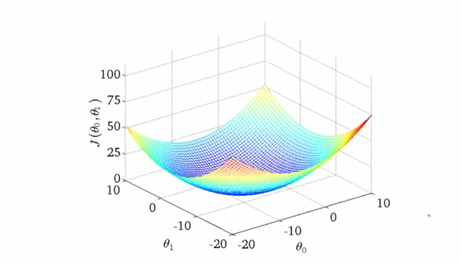
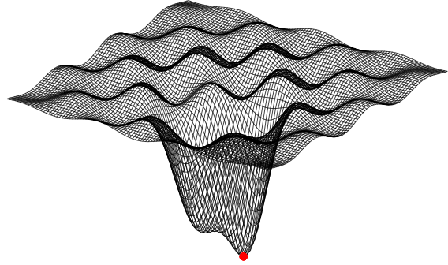
Energy minimization (optimization)
Very general idea: find parameters of a model that minimize an energy (or cost function), given a set of data
  Global minima easy to find if energy function is simple (e.g. convex)
  Energy function usually has unknown number & distribution of local minima; global minimum very difficult to find
  Many algorithms tailored to cost functions for specific applications, usually some heuristics to encourage finding “good” solutions, rarely theoretical guarantees. High computation cost.
  Remember deterministic annealing
- Arman Bahl

Slide 10
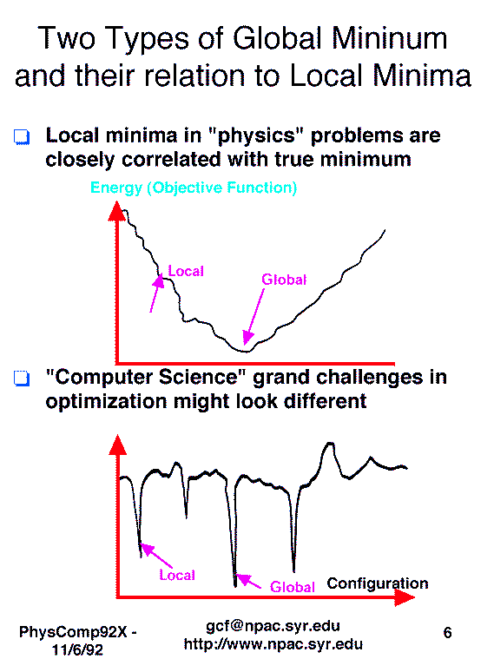

Slide 11
Common energy minimization cases
Parameter space: Continuous vs. Discrete
Energy functions with particular forms, e.g.:
  χ² or least squares Minimization
  Hidden Markov Model: chain of observable and unobservable variables. Each unknown variable is a (nondeterministic) function of its observable variable, and the two unobservables before and after.
  Markov Random Field: generalization of
  HMM, each unobservable variable is a
  function of a small number of neighboring
  unobservables.
  Free Energy or smoothed functions

Slide 12
General Optimization Problem II
Some methods just use function evaluations
Faster to calculate methods – Calculate first but not second Derivatives
  Expectation Maximization
  Steepest Descent always gets stuck but always decreases E; many incredibly clever methods here
Note that one dimension – line searches – very easy
Fastest to converge Methods – Newton’s method with second derivatives
  Typically diverges in naïve version and gives very different shifts from steepest descent
  For least squares, second derivative of E only needs first derivatives of components
  Unrealistic for many problems as too many parameters and cannot store or calculate second derivative matrix
Constraints
  Use penalty functions

Slide 13
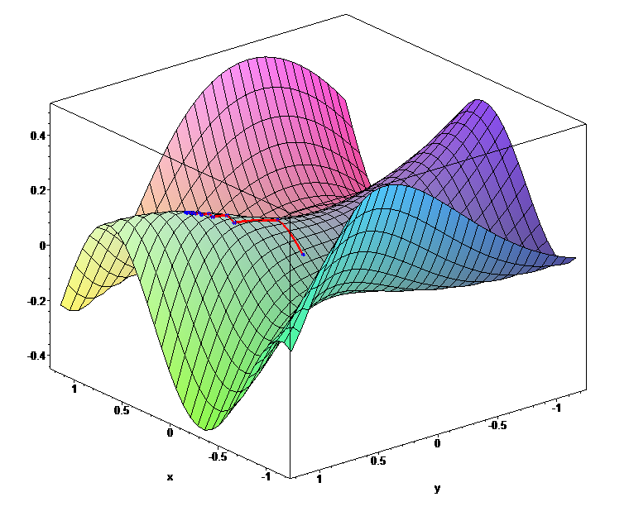
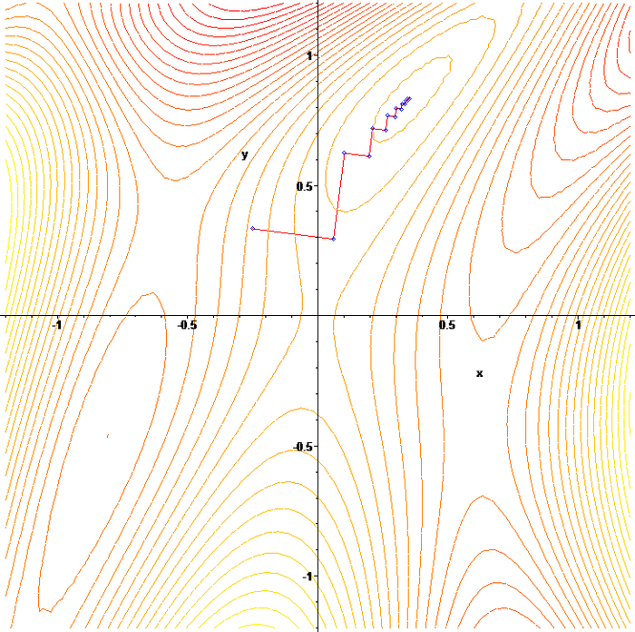
Continuous optimization
Most techniques rely on gradient descent, “hill-climbing” (or “hill-descending”!
  E.g. Newton’s method with various heuristics to escape local minima
Support in SPIDAL
  Levenberg-Marquardt
  Deterministic annealing
  Custom methods as in neural networks or SMACOF for MDS

Slide 14
SPIDAL Algorithms – Optimization I
Manxcat: Levenberg Marquardt Algorithm for non-linear χ² optimization with sophisticated version of Newton’s method calculating value and derivatives of objective function. Parallelism in calculation of objective function and in parameters to be determined. Complete – needs SPIDAL Java optimization
Viterbi algorithm, for finding the maximum a posteriori (MAP) solution for a Hidden Markov Model (HMM). The running time is O(n*s^2) where n is the number of variables and s is the number of possible states each variable can take. We will provide an "embarrassingly parallel" version that processes multiple problems (e.g. many images) independently; parallelizing within the same problem not needed in our application space. Needs Packaging in SPIDAL
Forward-backward algorithm, for computing marginal distributions over HMM variables. Similar characteristics as Viterbi above. Needs Packaging in SPIDAL

Slide 15
Comparing some Optimization Methods
Levenberg Marquardt: relevant for continuous problems solved by Newton’s method
Imagine diagonalizing second derivative matrix; problem is the host of small eigenvalues corresponding to ill determined parameter combination (over fitting)
  Add Q (say 0.1 maximum eigenvalue) to all eigenvalues. Dramatically reduce ill determined shifts; leave well determined roughly unchanged
  Lots of empirical heuristics
This contrasts with deterministic annealing which smooths function to remove local minima as does use of statistics philosophy of a priori probability as in LDA
Levenberg Marquardt is NOT relevant to dominant methods involving steepest descent as that direction is already in direction of largest eigenvalues
  Steepest Descent: Shift proportional to eigenvalue
  Newtons Method: Shift proportional to 1/eigenvalue

Slide 16
Levenberg Marquardt Problem Illustrated

Slide 17
Discrete optimization support in SPIDAL
Grid search: trivially parallelizable but inefficient
Viterbi and Forward-Backward: efficient exact algorithms for Maximum A Posteriori (MAP) and marginal inference using dynamic programming, but restricted to Hidden Markov Models.
Loopy Belief Propagation: approximate algorithm for MAP inference on Markov Random Field models. No optimality or even convergence guarantees, but applicable to a general class of models.
Tree ReWeighted Message Passing (TRW): approximate algorithm for MAP inference on some MRFs. Computes bounds that often give meaningful measure of quality of solution (with respect to unknown global minimum).
Markov Chain Monte Carlo: approximate algorithms for graphical models including HMMs, MRFs, and Bayes Nets in general.

Slide 18
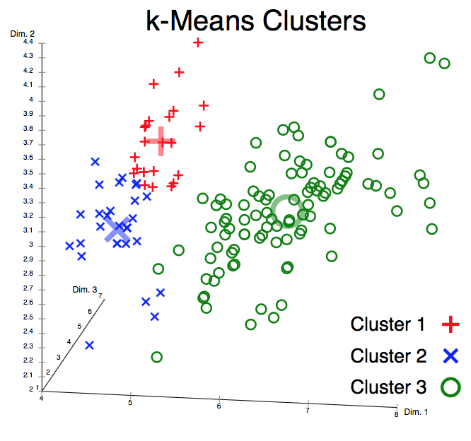
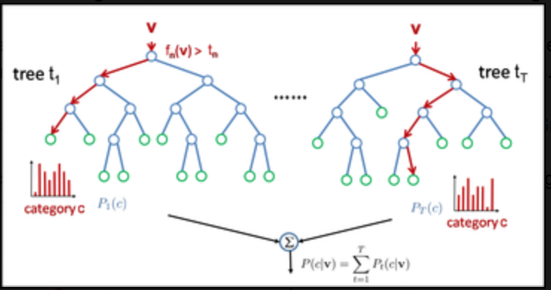
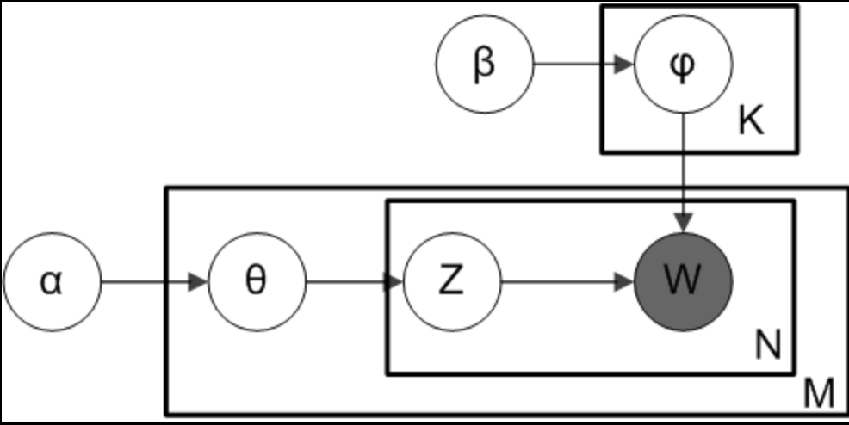
Higher-level model fitting
Clustering: K-means, vector clustering
Topic modeling: Latent Dirichlet Allocation
Machine learning: Random Forests, Support Vector Machines
Applications: spatial clustering, image clustering
Plate notation for smoothed LDA
Random Forest

Slide 19
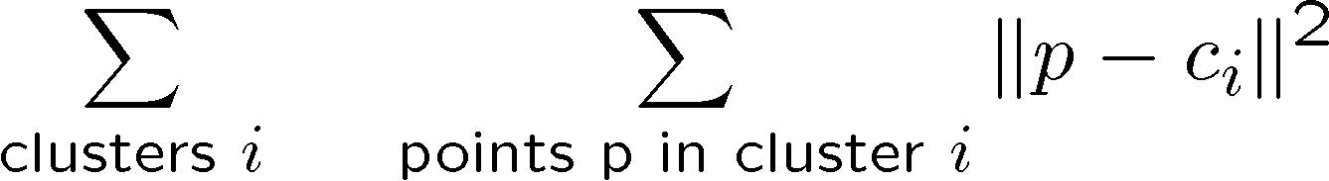
K-means clustering
…

Slide 20
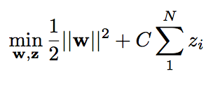

SVM learning
such that

Slide 21
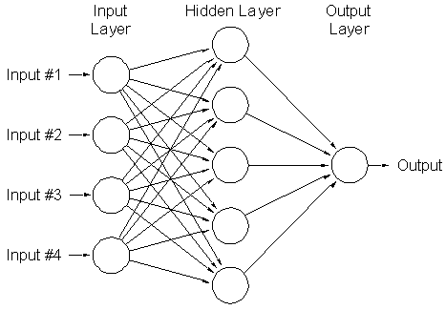
Training (deep) neural networks

Slide 22
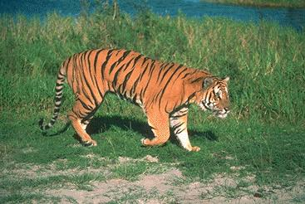
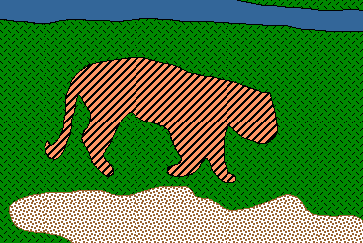
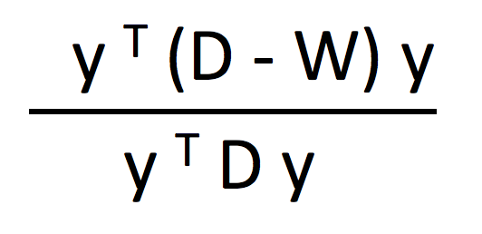
Image segmentation
q
  min
  y
  such that y_{i}∈{1,b}
w_{pq}
p

Slide 23
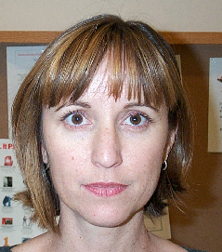


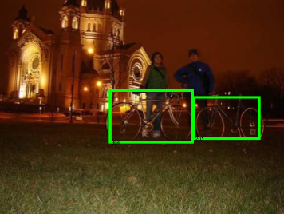
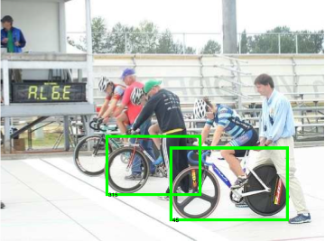
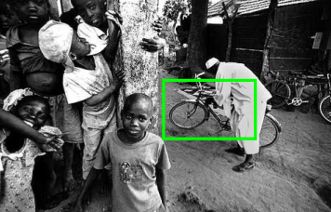
Object recognition
  max
  L

Slide 24
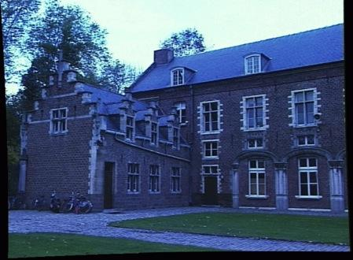
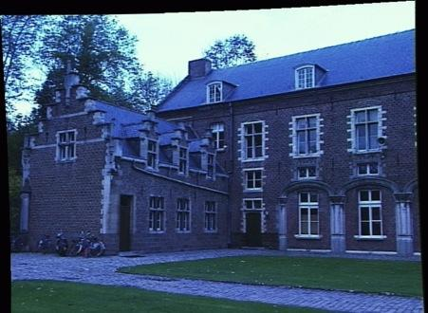
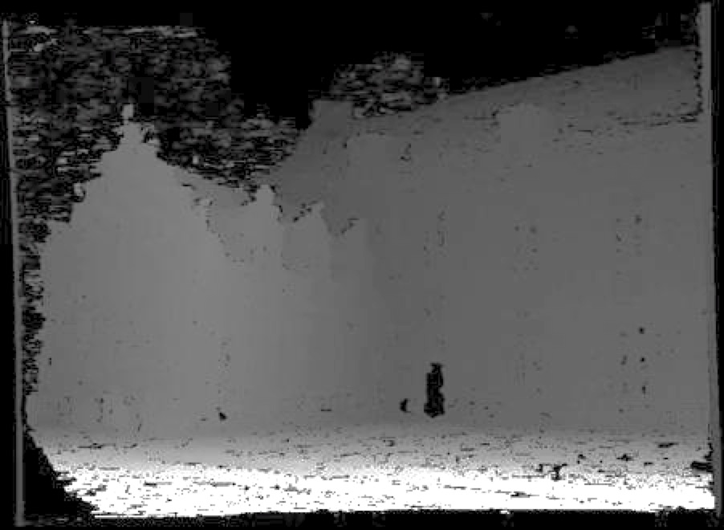
Stereo

Slide 25





3D reconstruction

