Slide 1
Event-Based Infrastructure for Reconciling Distributed Annotation Records
Ahmet Fatih Mustacoglu
amustaco@cs.indiana.edu
Advisor: Prof. Geoffrey C. Fox

Slide 2
Outline
Introduction
Motivations and research issues
Architecture
  Event-Based Infrastructure
Measurements and Analysis
Conclusions
  Contributions and Future Works

Slide 3
Online Collaboration
Rapid development of annotation tools and services
Aimed at fostering online collaboration and sharing between users and communities:
  Bookmarking Tools supports annotation using keywords called tags and sharing
    e.g. del.icio.us
  Tools for annotation and sharing of scholarly publications
    Connotea
    Citeulike
    BibSonomy
  Social Networking Tools
    e.g. MySpace, and Facebook
  Video Sharing and annotation
    e.g. YouTube
Notes:
YouTube integration in future and face book is different

Slide 4
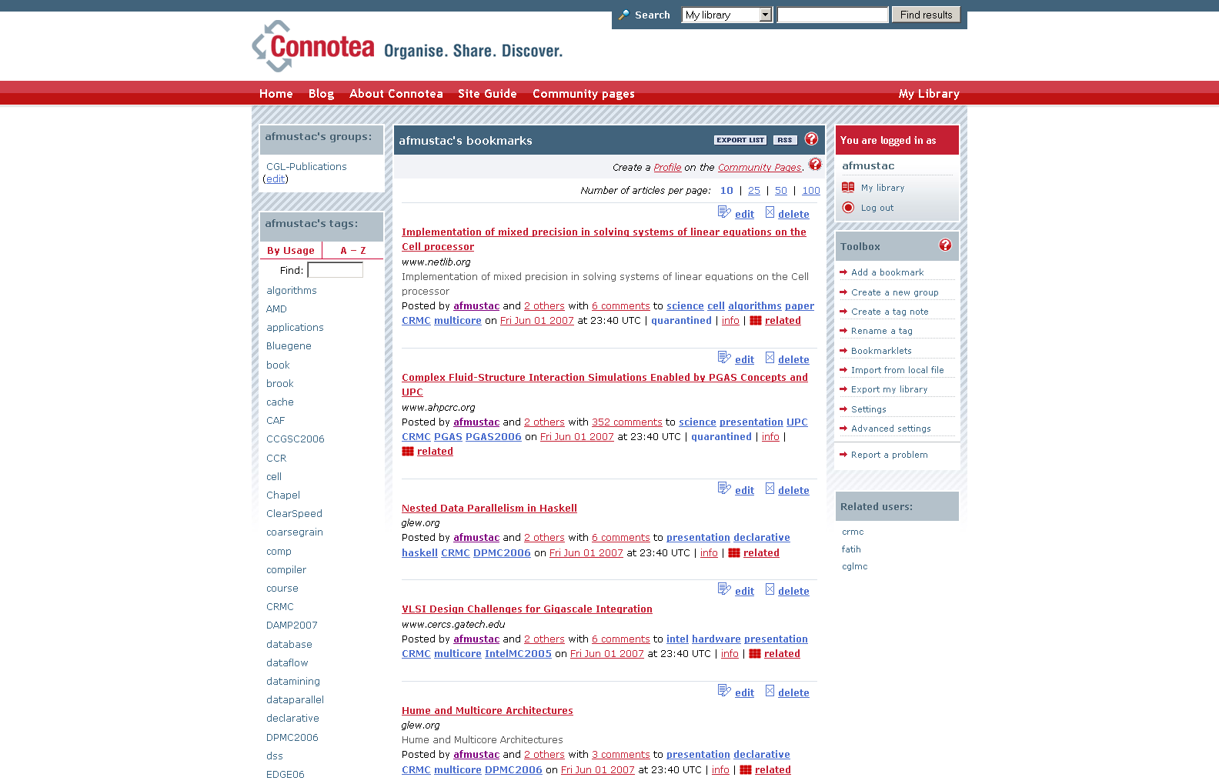

Slide 5
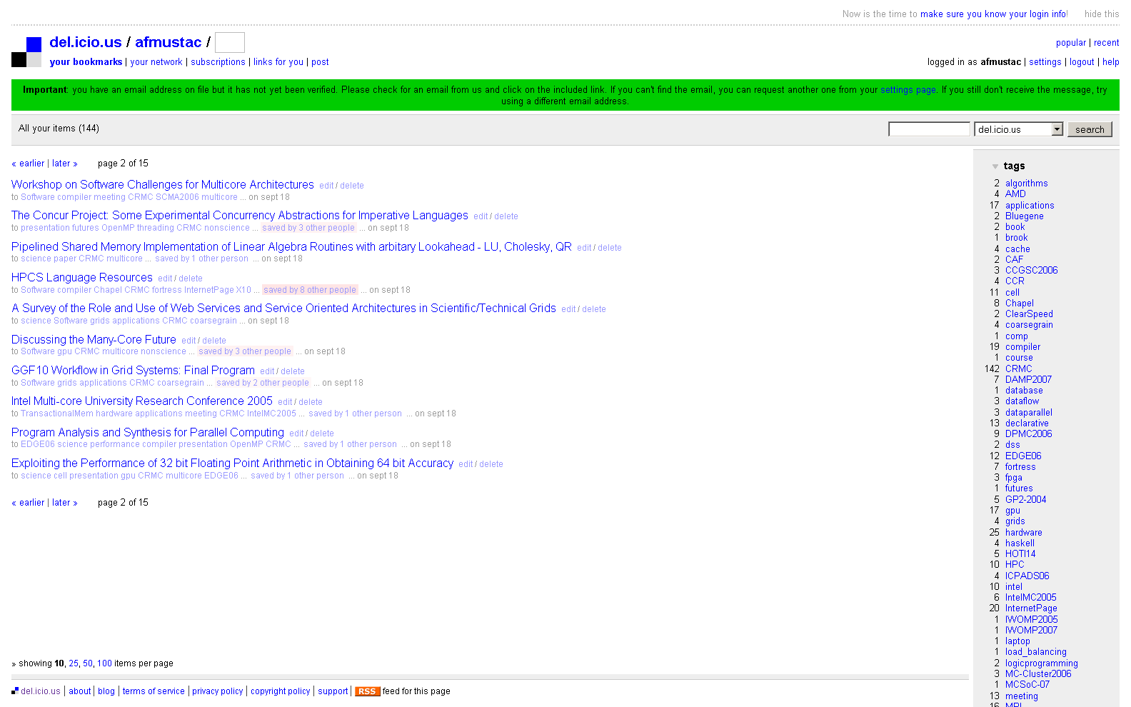

Slide 6
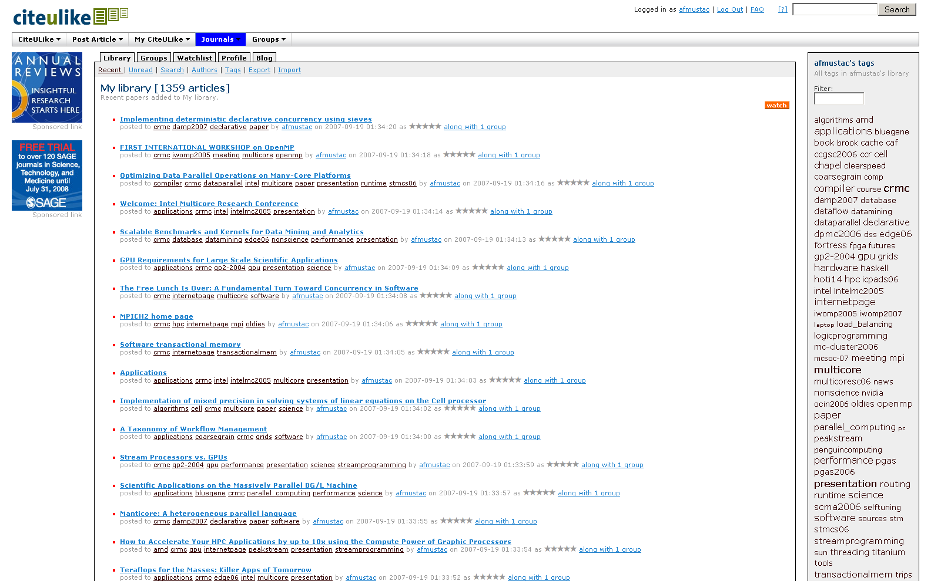

Slide 7
CVS (Concurrent Versions System)
Version control system
  Keeps old versions of files
Several users can work on a file collaboratively
It has centralized communication mechanism
Uses optimistic replication approach
  Each user has a copy of a file in their private space
  Conflicts are resolved either automatically or manually

Slide 8
WOOKI
P2P Wiki system
Replaces the centralized architecture of a current Wiki system with a P2P network of wiki servers.
Ensures eventual consistency among replicas via optimistic replication approach
Implemented in Java as servlets in a Tomcat and available from: http://p2pwiki.loria.fr/

Slide 9
Motivations
Various annotation tools, different and limited metadata storage
  Multiple instances of metadata about the same document
No time-stamp info for updated records
  Causing inconsistencies
Lack of interoperability between annotation sites
  Applying service-based architecture to annotation systems
Unification and Federation of major annotation tools to use them with added capabilities for scientific research
  Management of metadata coming from different sources
  Adding missing services
    Upload and extract metadata from/to a repository

Slide 10
Research Issues I
Need an infrastructure to manage metadata
  How to deal with metadata coming from several sources?
  Issues with using annotation tools and their services with added capabilities
    Extract and upload data to/from tools
  More metadata support for documents
  How to provide communication between annotation tools?
  Issues with document tracking and access to previous versions of documents
Consistency Enforcement
  How to maintain consistency between copies of a record stored at various annotation tools?

Slide 11
Research Issues II
Unification
    How to combine different annotation tools under the same umbrella?
Federation
  How to federate major annotation tools?
Scalability
  System behavior for increased message rate per second
Flexibility and Extensibility
  Interoperable with other clients
  Ease of integrating an annotation tool
Notes:
How to provide efficient metadata management while keeping them synchronized

Slide 12
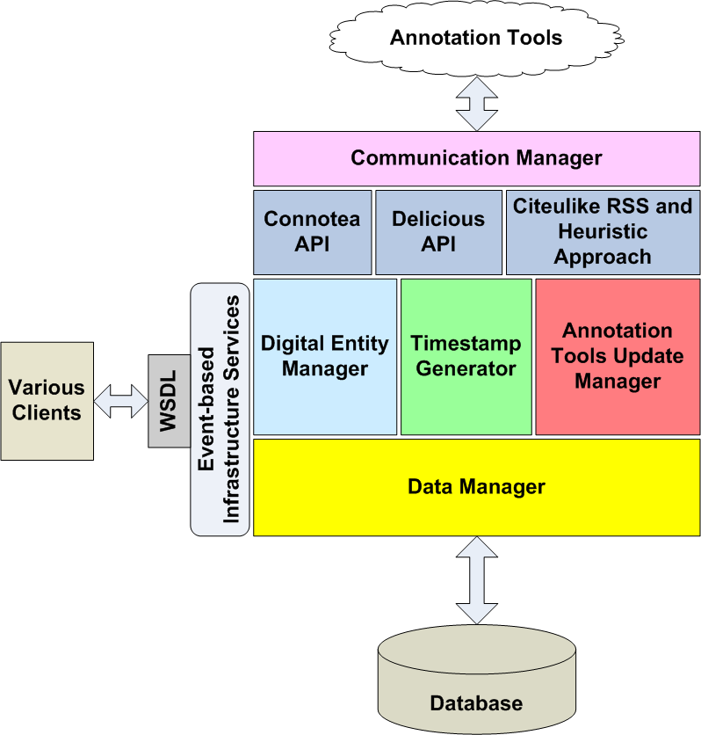
Event-based Infrastructure and Consistency Enforcement Architecture

Slide 13
KEY CONCEPTS
Distributed Annotation Record (DAR): Collection of metadata stored at an annotation tool.
Digital Entity (DE): A digital collection of metadata for a citation stored in a system database forms a primary copy of a DAR.
Event: A time-stamped action on a digital entity
  Major Events:
    Insertion or deletion of a digital entity
  Minor Events:
    Modifications to an existing digital entity

Slide 14
Communication Manager
Responsible for providing communication between annotation tools and update manager and digital entity manager via gateways
  e.g. Connotea gateway
Utilizes a gateway for each annotation tool, and a parser
  Retrieve records in XML format
  Parse and pass records to update manager
  Post updates coming from digital entity manager to annotation tools

Slide 15
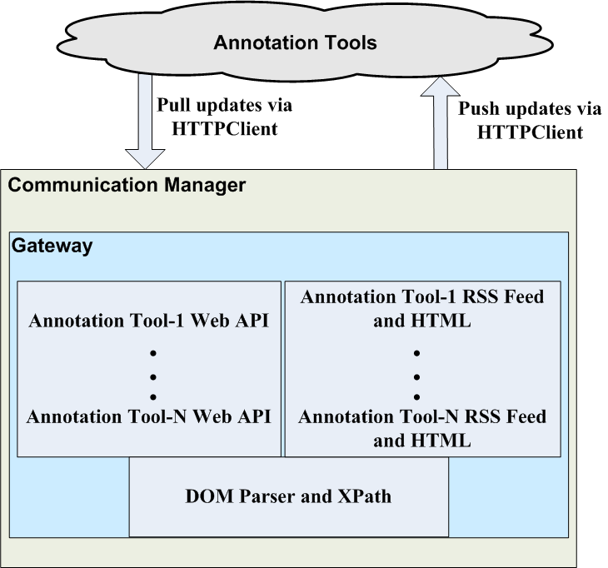
Communication Manager

Slide 16
Gateway
Interface between Event-based Infrastructure (EBI) and each annotation tool
Provides extensibility
A gateway needs to be deployed for each annotation tool that need to be integrated into the system
Annotation Tools
EBI
Gateways
EBI Modules
HTTP

Slide 17
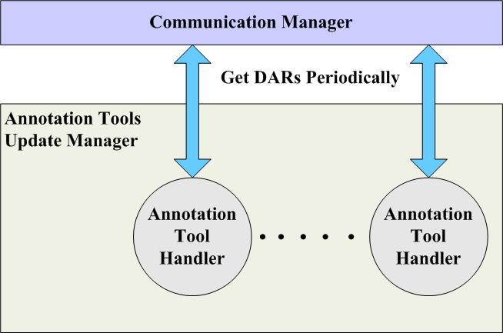
Annotation Tools Update Manager
Responsible for:
  Retrieving the records from annotation tools periodically (Pulls records periodically as defined in the policy)
  Finding out the updates
  Passing the updates to Digital Entity Update Manager so that they can be applied on the primary copy of each record
Notes:
Finding out the updates based on annotation tools priority

Slide 18
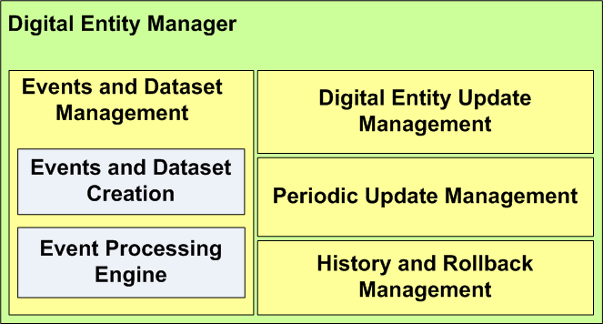
Digital Entity Manager
Responsible for:
  Events and dataset creation
  Event Processing
Manages updates made on the primary copy of a digital entity
  Updates primary copy located on a system database
  Pass updates to the Communication Manager (Maintain consistency by pushing updates to replicas)
Handles periodic update management
Deals with history and rollback management of a digital entity

Slide 19
Key Design Features
Representation of metadata of documents coming from various sources as events
  Major and minor events
  More metadata support than major current annotation tools
  Ability to access and rollback to previous versions of documents
Unification and Federation of Social Bookmarking Tools and support for web-based academic search tools for scientific research
  Using annotation tools’ existing services with added capabilities
  Using online popular search tools to collect metadata
  Provides communication among annotation tools
Leveraging interoperability via service-enabled architecture
Keeps records located at annotation tools and a system database consistent with each other
  Adopting optimistic replication approach
Notes:
Connotea, Delicious, and Citeulike

Slide 20
Use Cases
Collaborative Tagging
  Updating or assigning keywords to records
Collecting and managing citation metadata
  Obtaining metadata about a publication through online scholarly search tools or annotation tools
Unification and Federation of Connotea, Citeulike and Delicious annotation tools
  Providing schema and communication among them
Tracking updates to documents
  Rolling back to previous states
Building versions of documents based on
  Users, groups, or all events

Slide 21
Benchmarks and Environments
Message rate scalability investigation
  MoreInfo operation
    With DB Access
    With Memory Utilization
  Update DE operation
We have used:
  Java 2 Standard Edition compiler with version 1.5.0_12. The maximum heap size of Java Virtual Machine (JVM) to1024MB
  Apache Tomcat Server with version 5.0.28
  Apache Axis technology with version 1.2

Slide 22
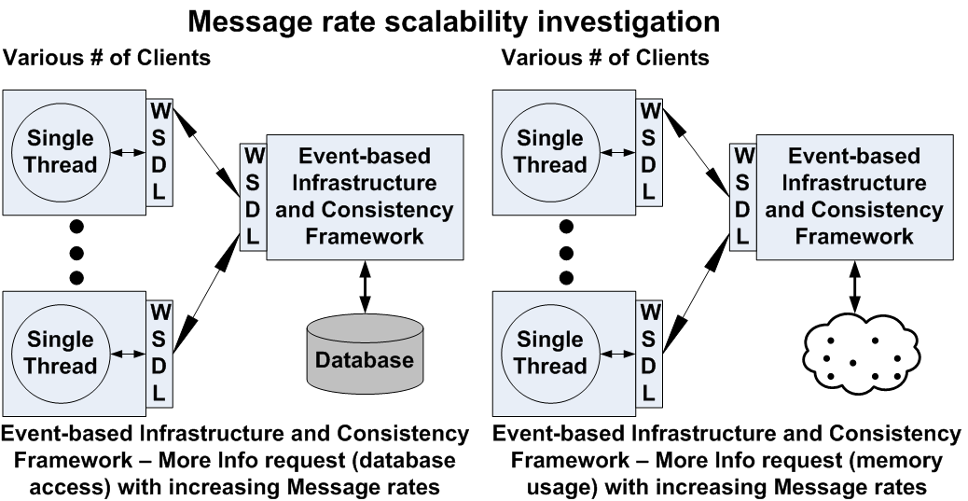
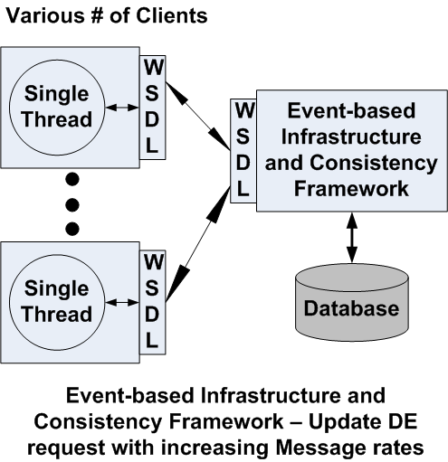

Slide 23
Message rate scalability investigation-I
Notes:
DB Utilization

Slide 24
Message rate scalability investigation-II
Notes:
Each major event has 10 minor events (updates) to be processed

Slide 25

Overheads Calculations for Updating Memory and DB
* Time units are in millisecond

Slide 26
Message rate scalability investigation-III

Slide 27
Contributions - I
System research
  Event-based Infrastructure
    Unification, Federation and Interoperability of Connotea, Delicious and Citeulike annotation tools
    Strategies for increasing performance and scalability via in top-to bottom approach and memory utilization
    Handling various types of metadata coming from several sources
    Flexibility to access previous versions of a document
    Adopting optimistic replication approach to maintain consistency
    Comprehensive benchmarks to evaluate the scalability of the prototype system
System software
  An implementation of Event-based Infrastructure of Internet Documentation and Integration of Metadata (IDIOM) system
  An implementation of consistency maintenance mechanism for Internet Documentation and Integration of Metadata (IDIOM) system

Slide 28
Future Works
Applying Event-based Infrastructure to broader range of application use cases
  Supporting video collaboration tools (e.g. YouTube)
  Social networking (e.g. Facebook)
Machine learning techniques
Unification and Federation of other academic collaboration and publication tools into EBI
  e.g. BibSonomy
From a single storage of metadata to distributed storages

Slide 29
Publications
Book Chapters
  Web 2.0 for Grids and e-Science; Geoffrey C. Fox, Rajarshi Guha, Donald F. McMullen, Ahmet Fatih Mustacoglu, Marlon E. Pierce, Ahmet E. Topcu, David J. Wild. Published by Springer, 2007 - Grid Enabled Remote Instrumentation (Chapter: Web 2.0 for Grids and e-Science)
Publications
  Hybrid Consistency Framework for Distributed Annotation Records in a Collaborative Environment; Ahmet Fatih Mustacoglu and Geoffrey Fox
  Web 2.0 for E-Science Environments Keynote Presentation; Geoffrey C. Fox, Marlon E. Pierce, Ahmet Fatih Mustacoglu, Ahmet E. Topcu
  Integration of Collaborative Information Systems in Web 2.0; Ahmet E. Topcu, Ahmet Fatih Mustacoglu, Geoffrey Fox, Aurel Cami
  SRG: A Digital Document-Enhanced Service Oriented Research Grid; Geoffrey Fox, Ahmet Fatih Mustacoglu, Ahmet E. Topcu, Aurel Cami
  AJAX Integration Approach for Collaborative Calendar-Server Web Services; Ahmet Fatih Mustacoglu, Geoffrey Fox
  A Novel Event-Based Consistency Model for Supporting Collaborative Cyberinfrastructure Based Scientific Research; Ahmet Fatih Mustacoglu, Ahmet E. Topcu, Aurel Cami, Geoffrey Fox
  iCalendar (RFC2445) Compatible Collaborative Calendar-Server Services; Ahmet Fatih Mustacoglu, Wenjun Wu, Geoffrey Fox

Slide 30
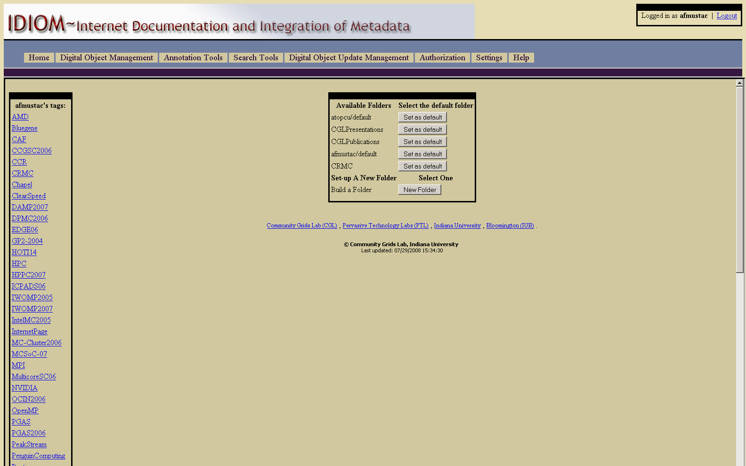
IDIOM-I

Slide 31
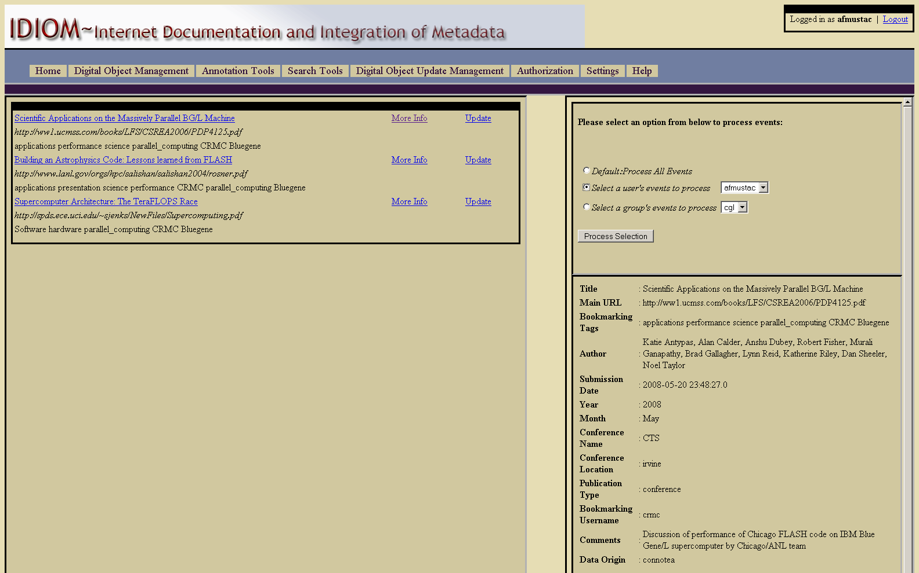
IDIOM-II

Slide 32
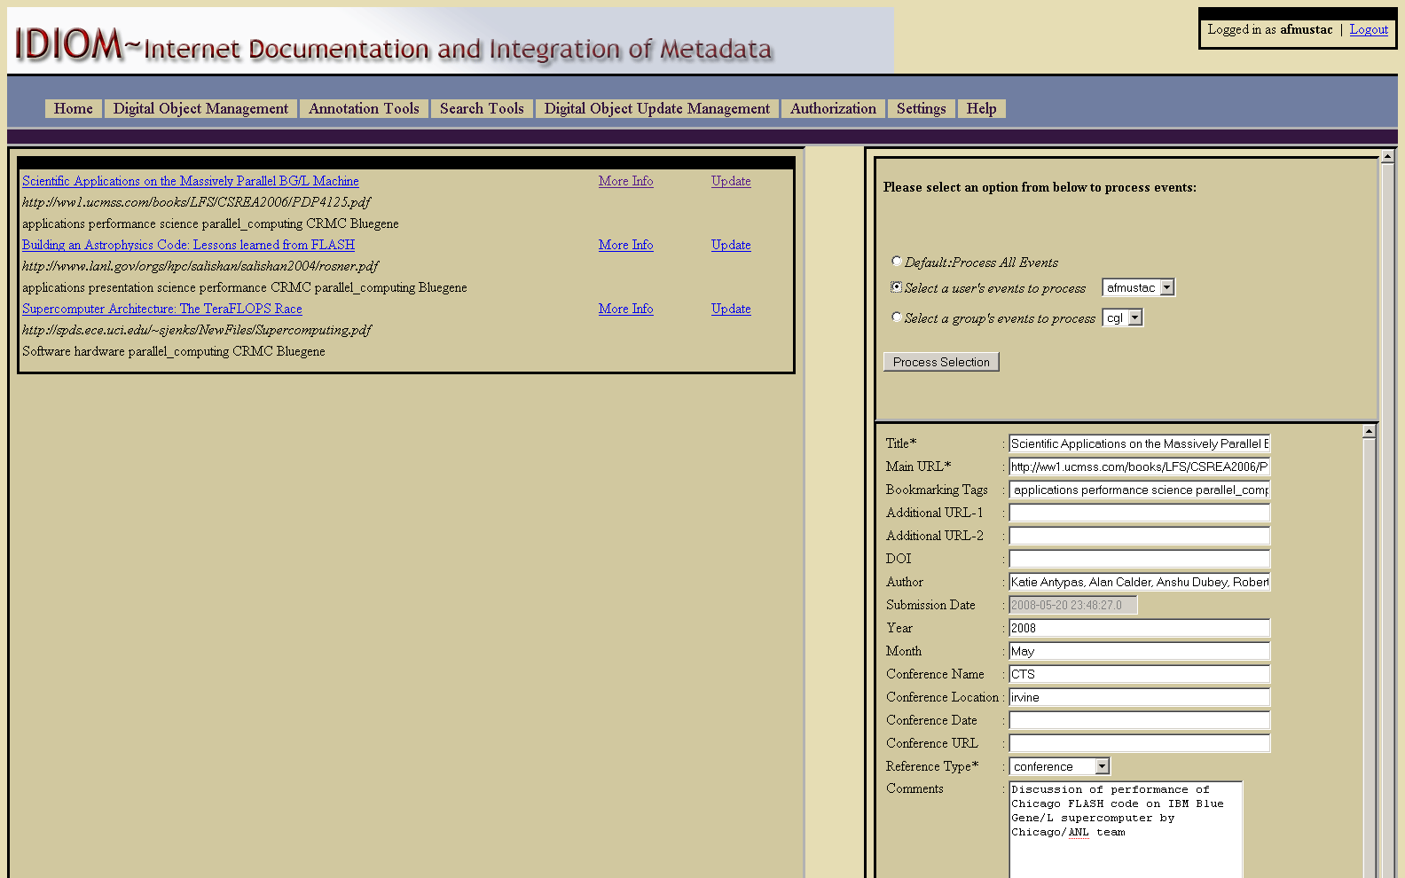
IDIOM-III

Slide 33
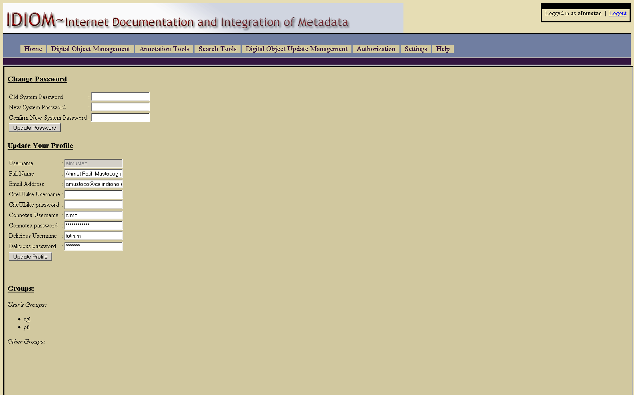
IDIOM-IV

