Slide 1
AI or Machine (actually Deep) Learning and Cyberinfrastructure (HPC)
Geoffrey Fox, Shantenu Jha, October 16, 2019 BDEC2, 2019 San Diego, California, USA
gcf@indiana.edu, http://www.dsc.soic.indiana.edu/, http://spidal.org/

Slide 2
Next Generation of Cyberinfrastructure: Application Requirements
Four clear classes of applications are
Classic Big Data Analytics as in the analysis of LHC data, SKA, Light sources, health, NASA and environmental data.
Cloud-Edge applications which certainly overlap with a) as data in many fields comes from the edge
Integration of ML and Data analytics with simulations. “learning everywhere”,
Classic simulations which are addressed excellently by DoE exascale program and although our focus is Big Data, one should consider this application area as we need to integrate simulations with data analytics and ML (Machine Learning) -- item a) above
BDEC covers a) b) c)

Slide 3
BDEC Applications Discussed in Recent Zoom Meetings
Classic Big Data Analytics.
Miguel Vazquez Workflow/Biology
Mehrotra Observation of Meteors, Real time alets from Earth observing satellites
Cloud-Edge.
Ricart US Ignite
Sweeney Light Source Experiments
Mehrotra Connecting wind tunnels to backend computers
Kurowski Portals/workflow
Integration of ML and Data analytics with simulations.
Tang Fusion
Fox, Jha Learning Everywhere
Miguel Vazquez Workflow/Biology
Sweeney Student interns, ExaLearn
Mehrotra Analysis of NASA supercomputer operation
Kurowski Portals/workflow
Essentially all BDEC talks naturally fit in these broad categories

Slide 4
HPCforML and MLforHPC
Technical aspects of converging HPC and Machine Learning
HPCforML
Parallel high performance ML algorithms
High Performance Spark, Hadoop, Storm
8 scenarios for MLforHPC
Illustrate a few scenarios
Research Issues

Slide 5
Dean at NeurIPS
DECEMBER 2017
ML for optimizing parallel computing (load balancing)
Learned Index Structure
ML for Data-center Efficiency
ML to replace heuristics and user choices (Autotuning)

Slide 6
Implications of Machine Deep Learning for Systems and Systems for Machine Deep Learning
We could replace “Systems” by “Cyberinfrastructure” or by “HPC””
I use HPC as we are aiming at systems that support big data or big simulations and almost by (my) definition should naturally involve HPC.
So we get ML for HPC and HPC for ML
HPC for ML is very important but has been quite well studied and understood
It makes data analytics run much faster
ML for HPC is transformative both as a technology and for application progress enabled
If it is ML for HPC running ML, then we have the creepy situation of the AI supercomputer improving itself
ML operationally DL at the moment!

Slide 7
MLforHPC (ML for Systems) in detail
MLforHPC can be further subdivided into several categories:
MLafterHPC: ML analyzing results of HPC as in trajectory analysis and structure identification in biomolecular simulations. Well established and successful
MLControl: Using simulations (with HPC) and ML in control of experiments and in objective driven computational campaigns. Here simulation surrogates are very valuable to allow real-time predictions. Very Promising
MLAutotuning: Using ML to configure (autotune) ML or HPC simulations.
MLaroundHPC: Using ML to learn from simulations and produce learned surrogates for the simulations or parts of simulations. The same ML wrapper can also learn configurations as well as results. Most Important.
Note ML impacts science/theory/algorithms not just the cyberinfrastructure

Slide 8
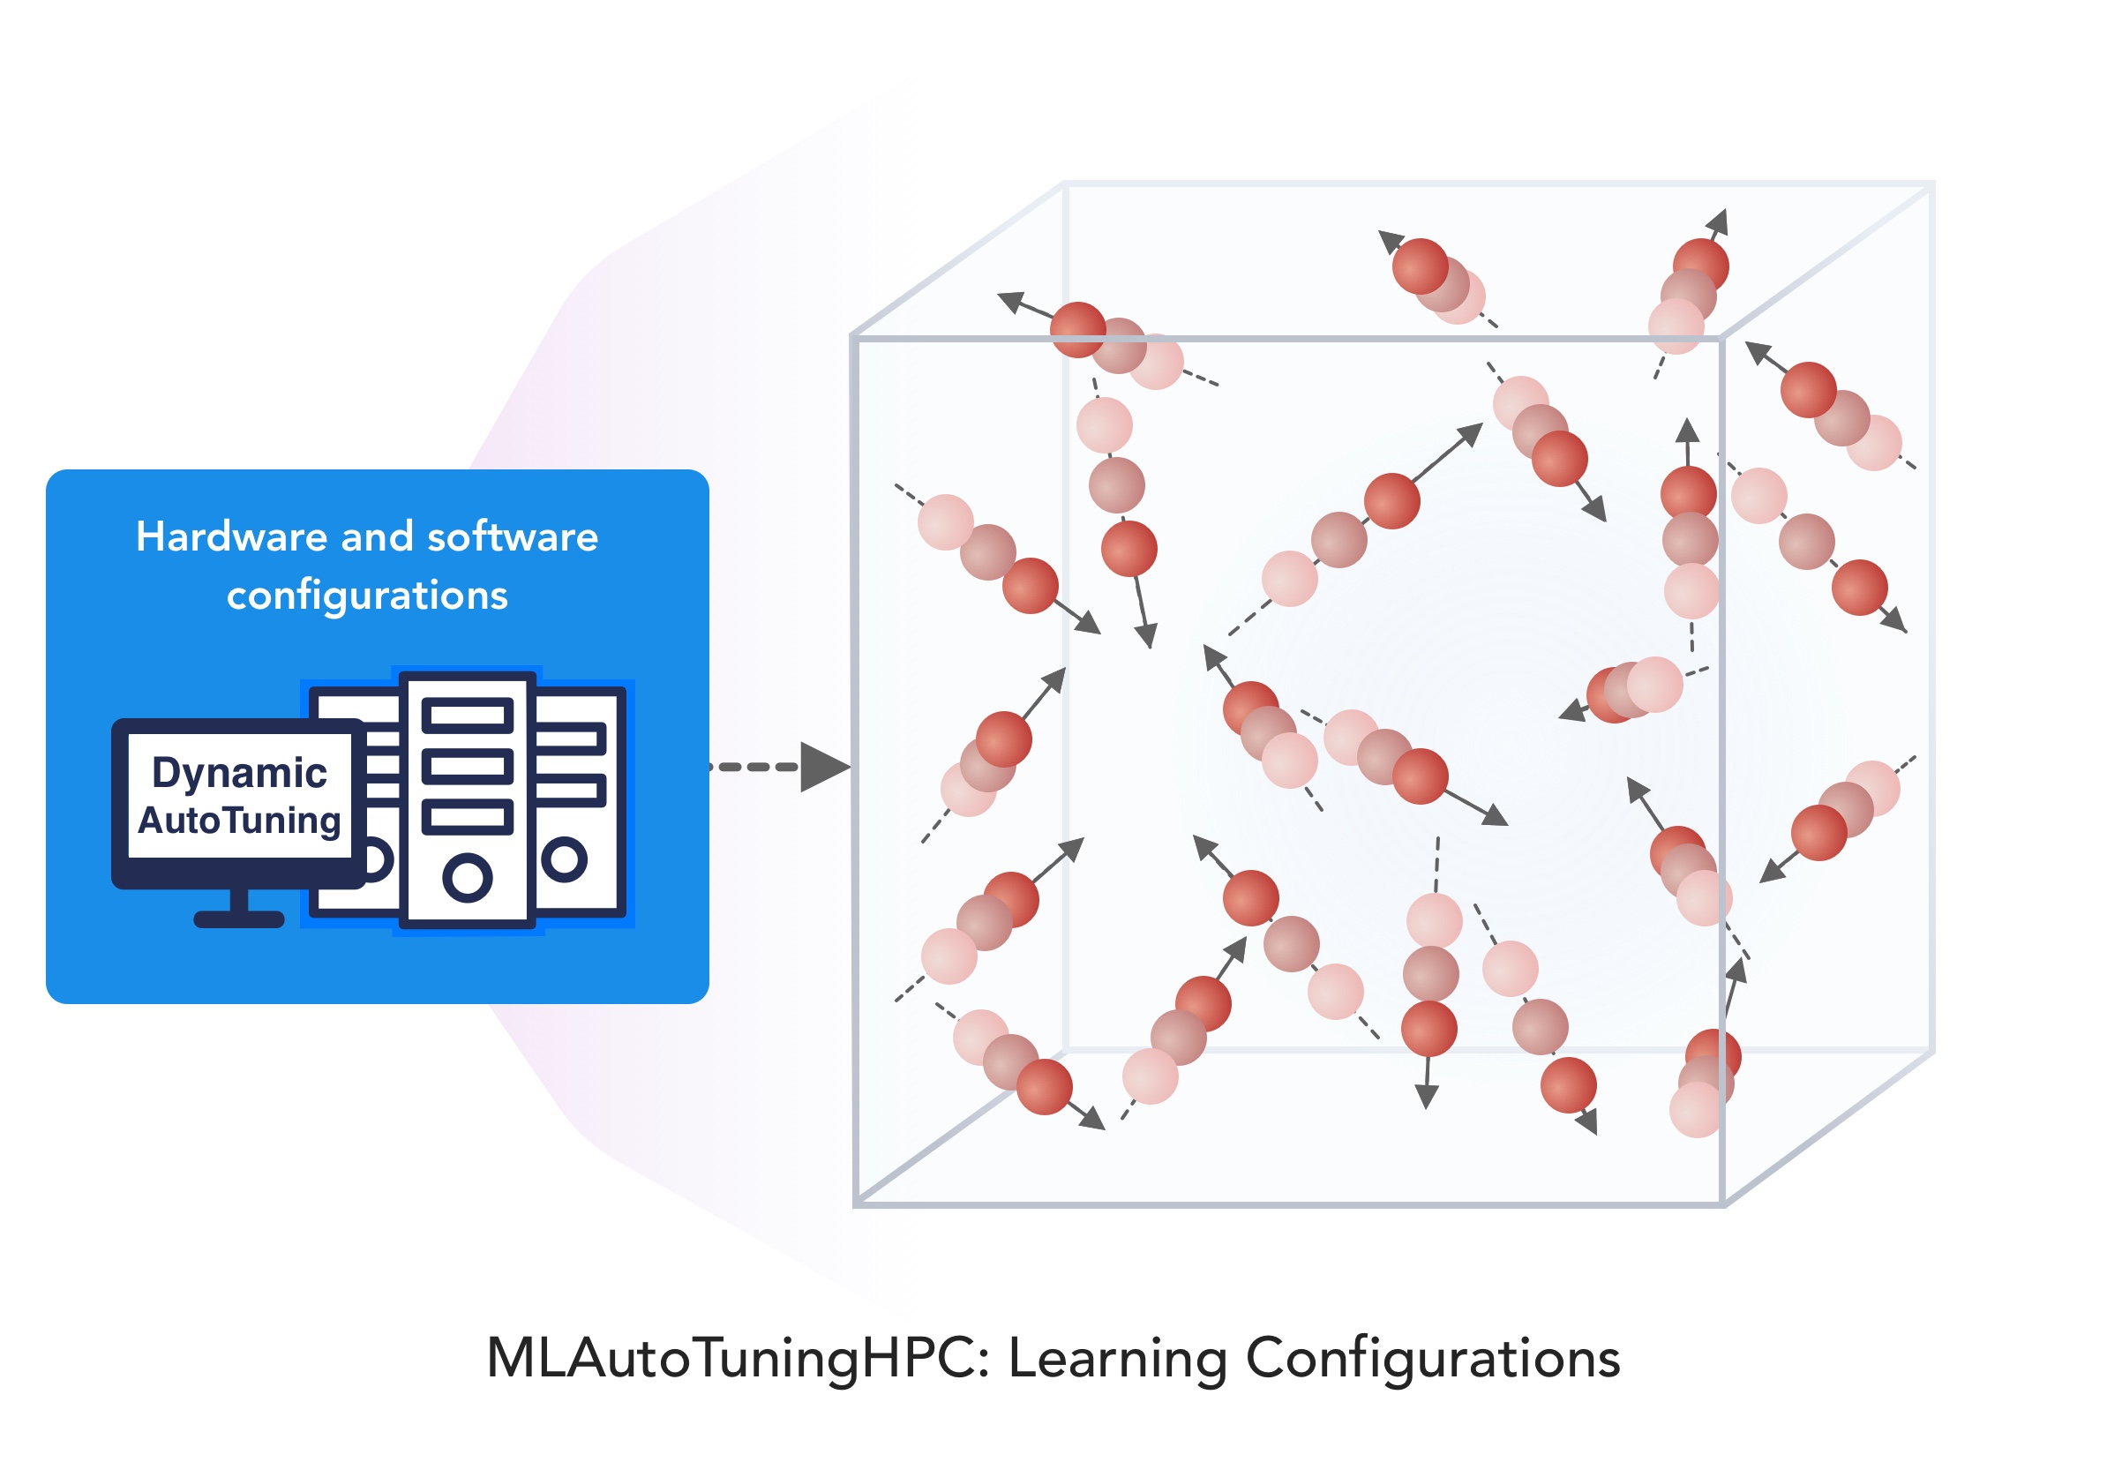
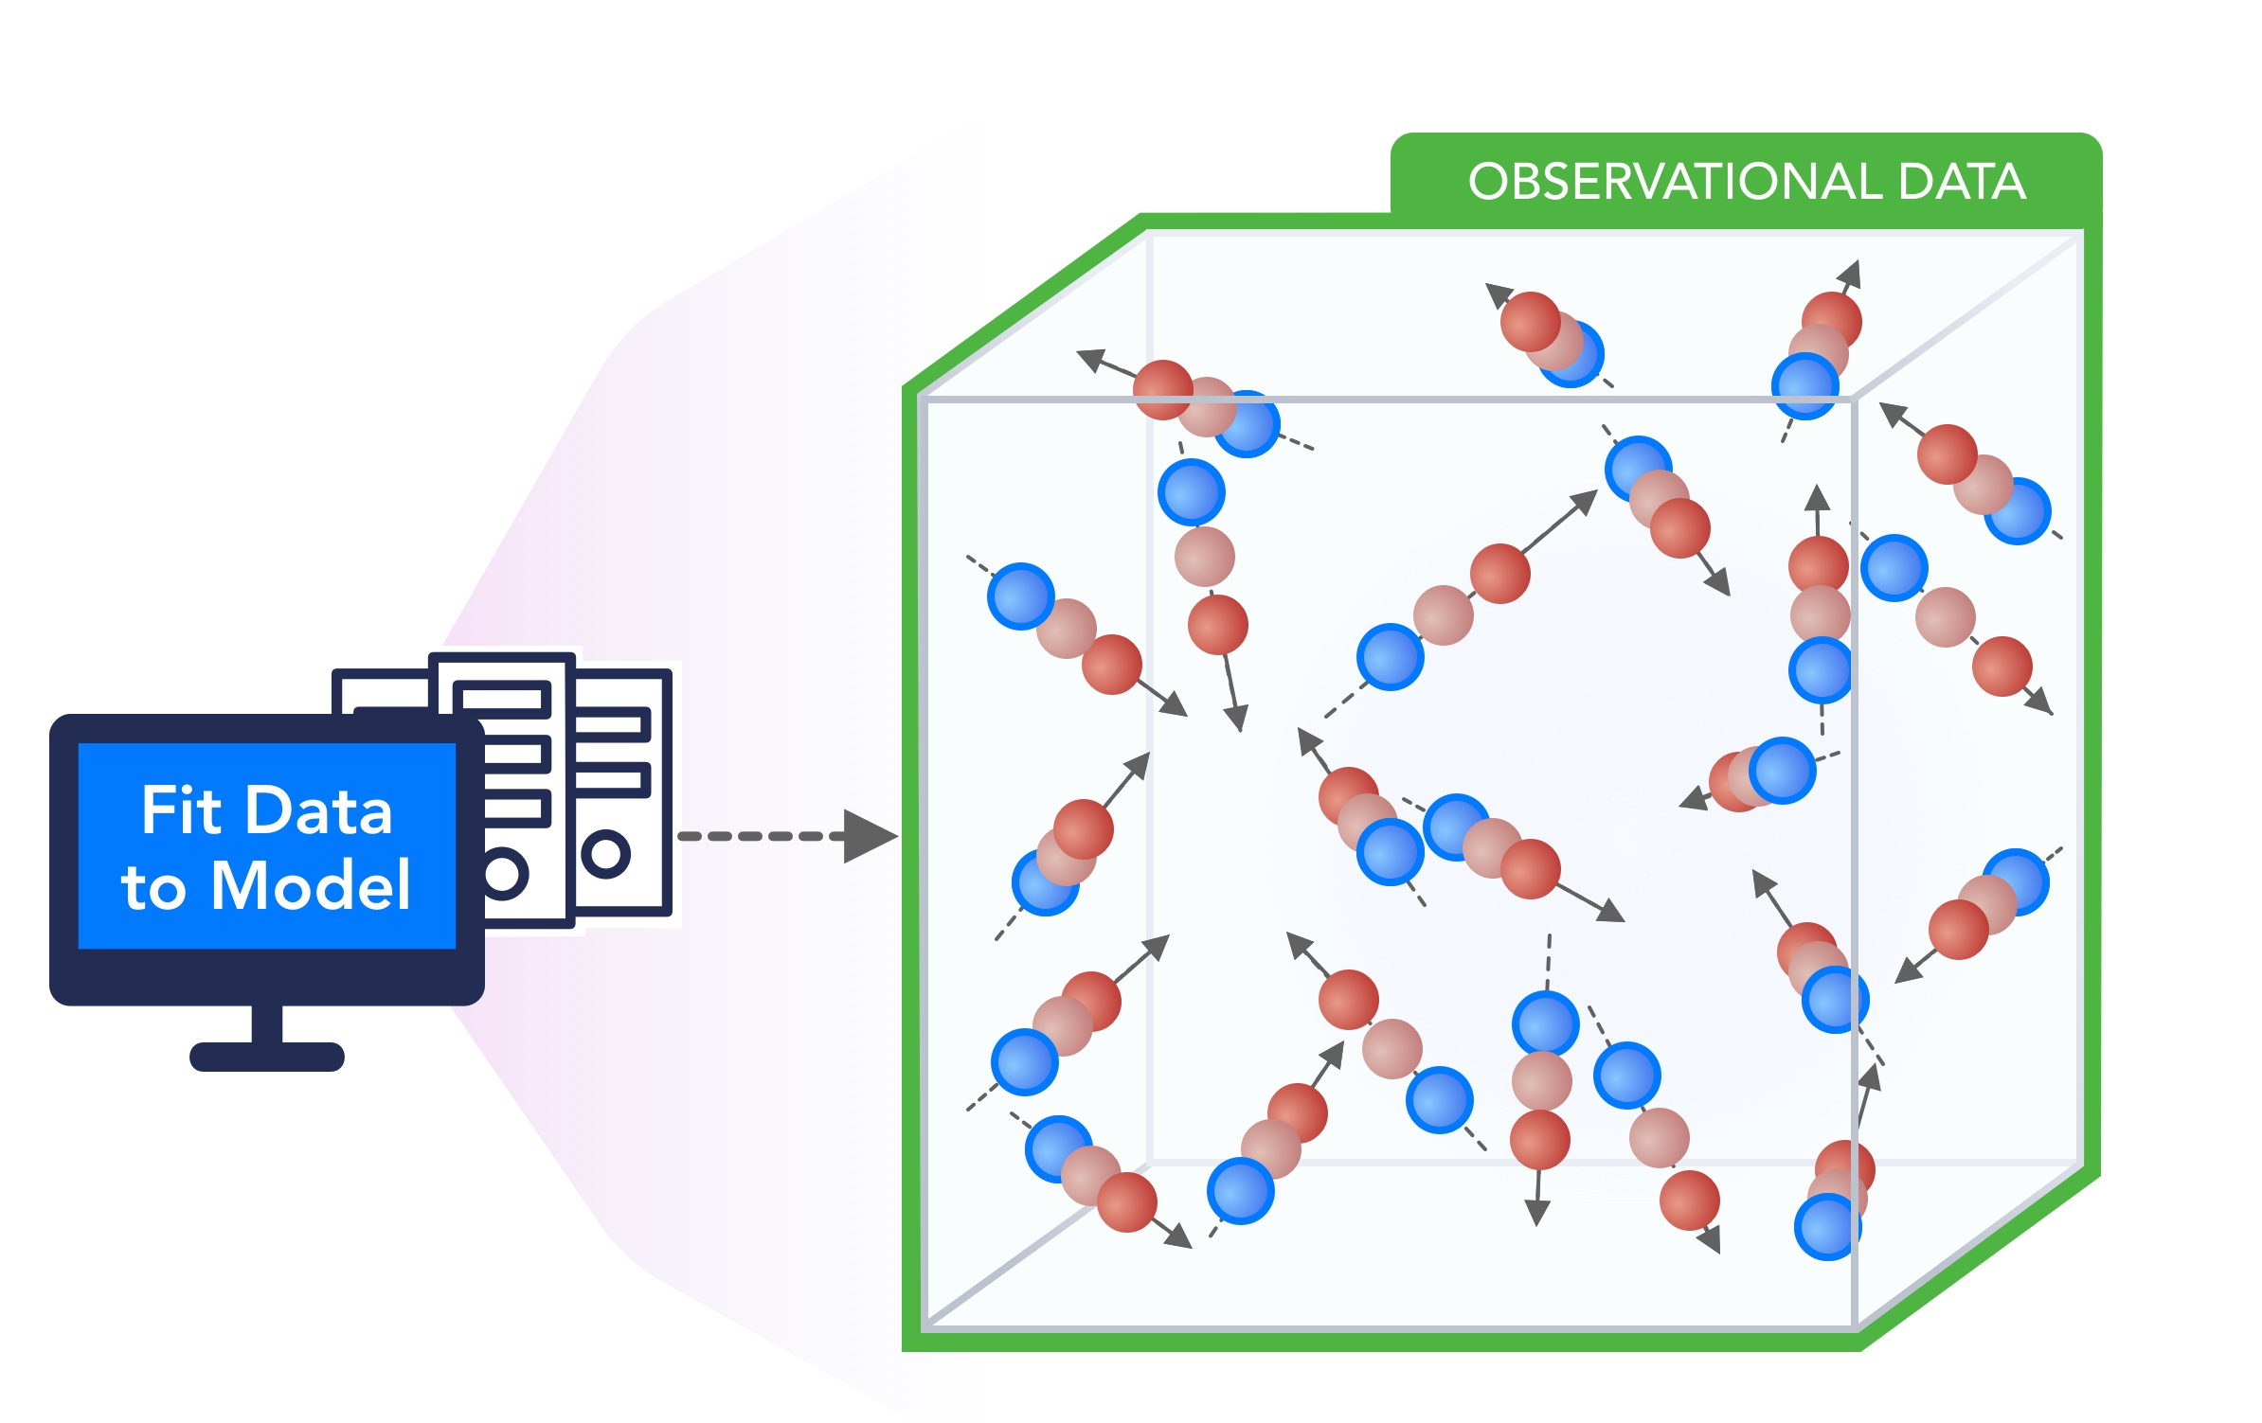
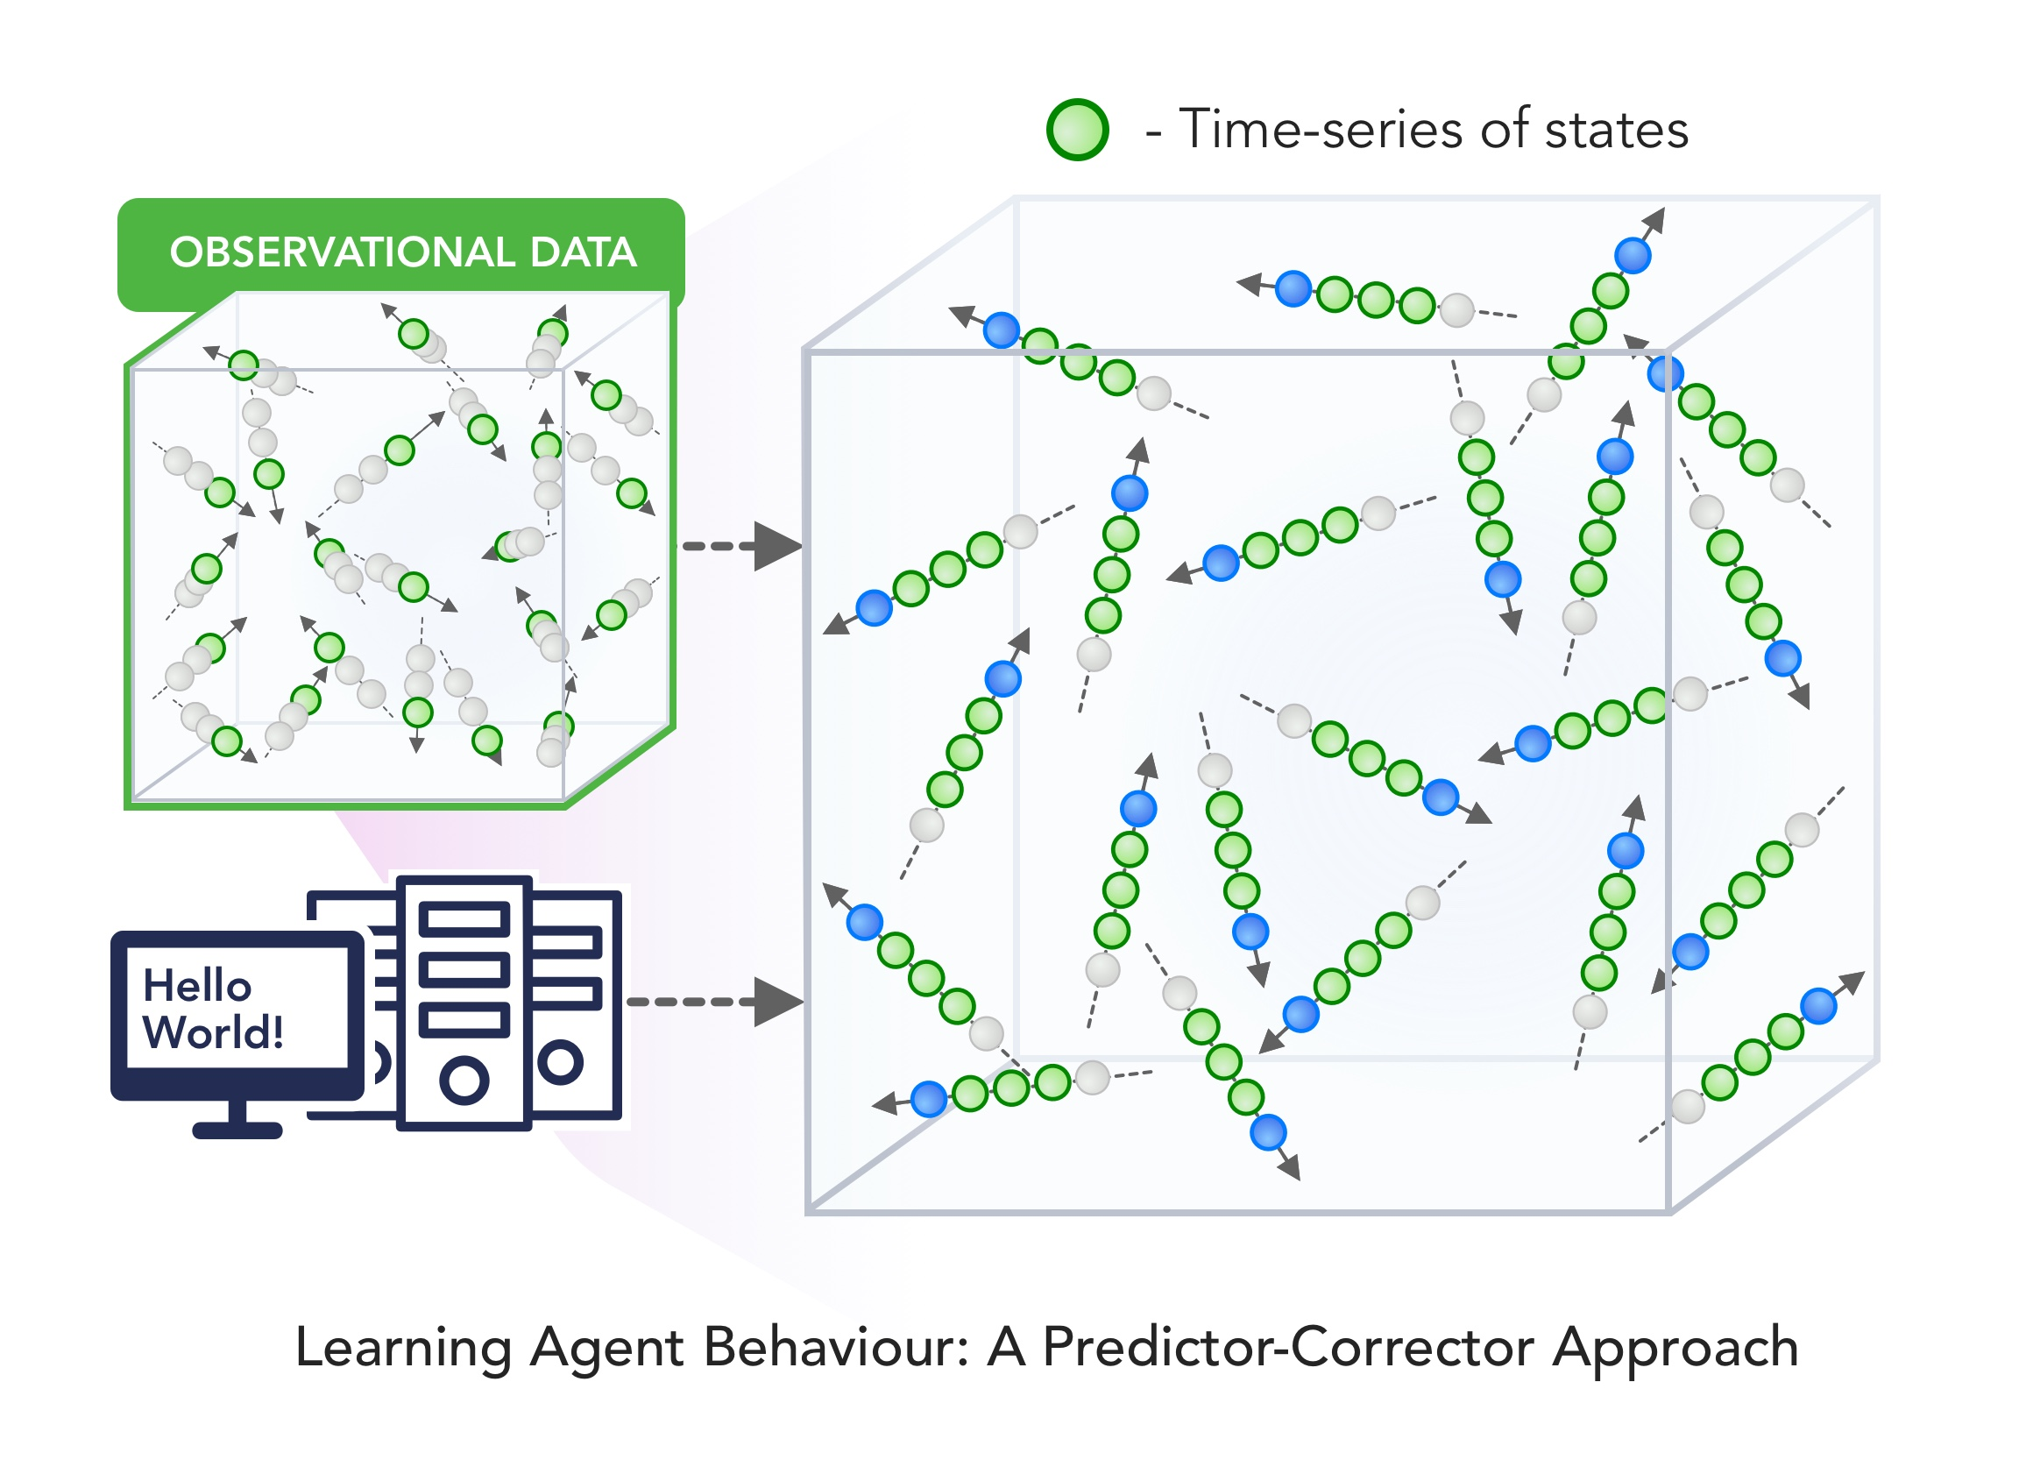
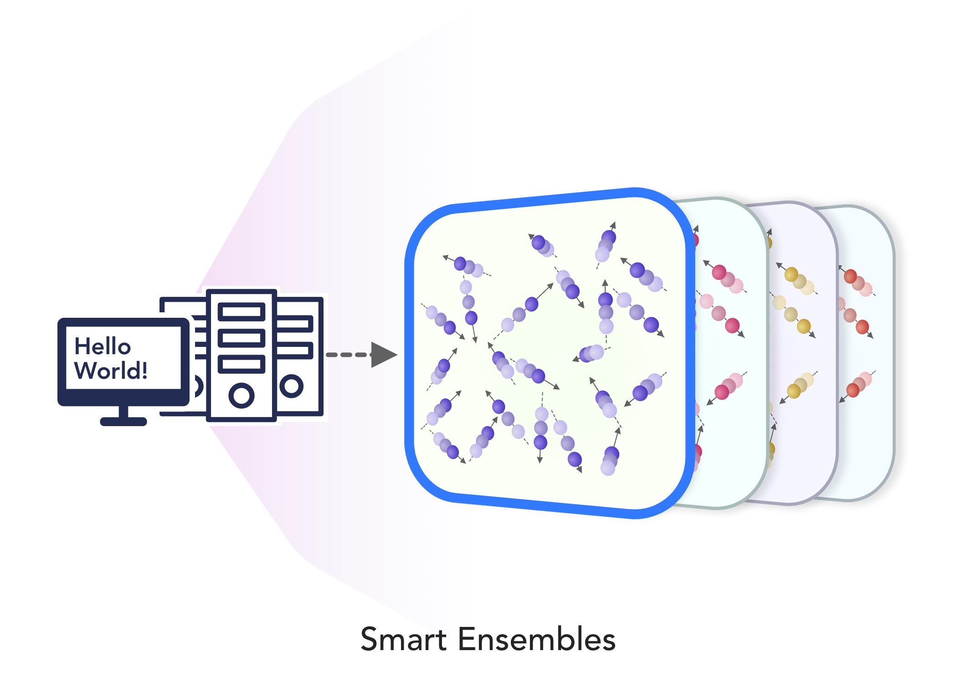
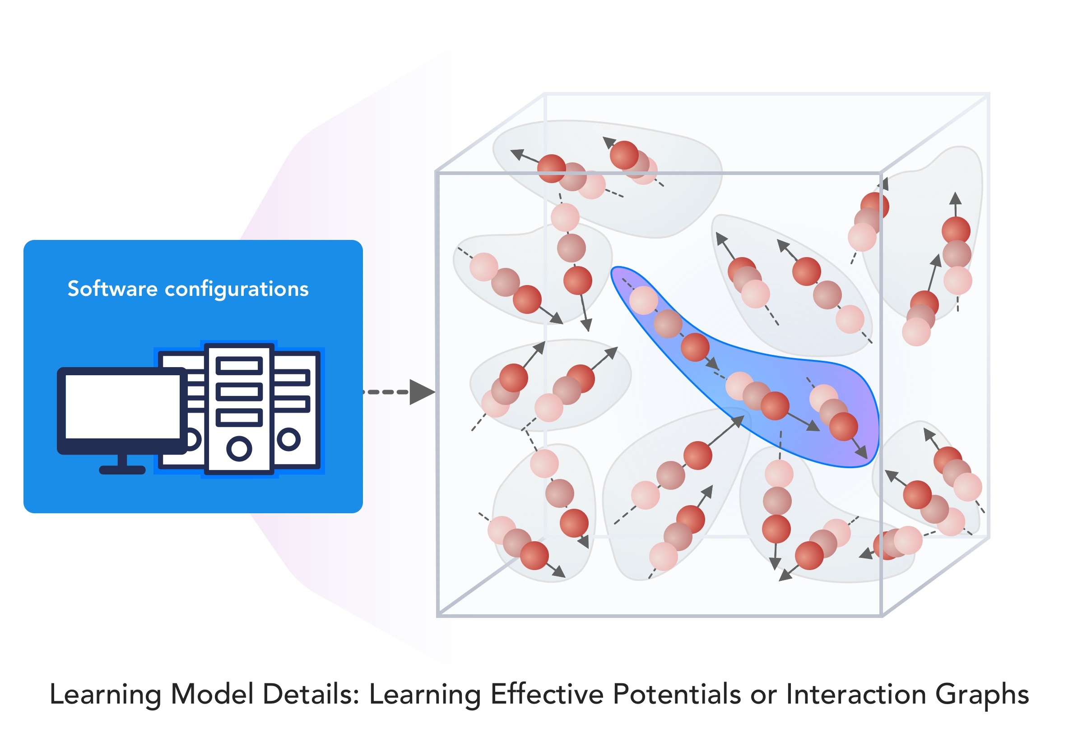
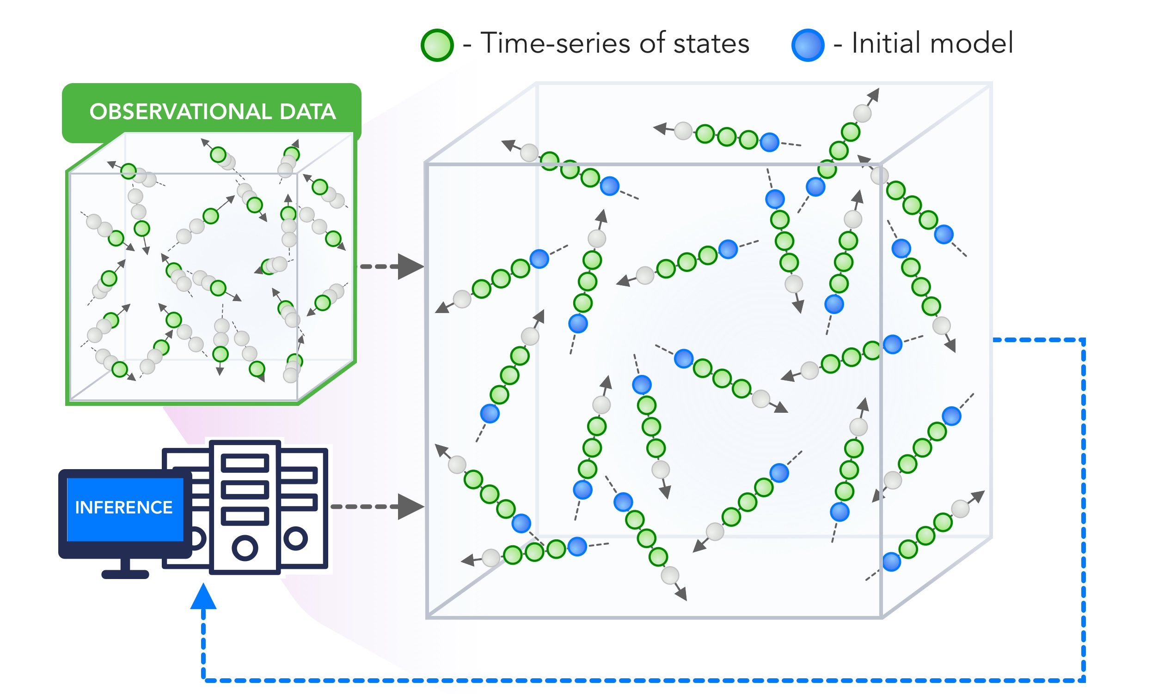
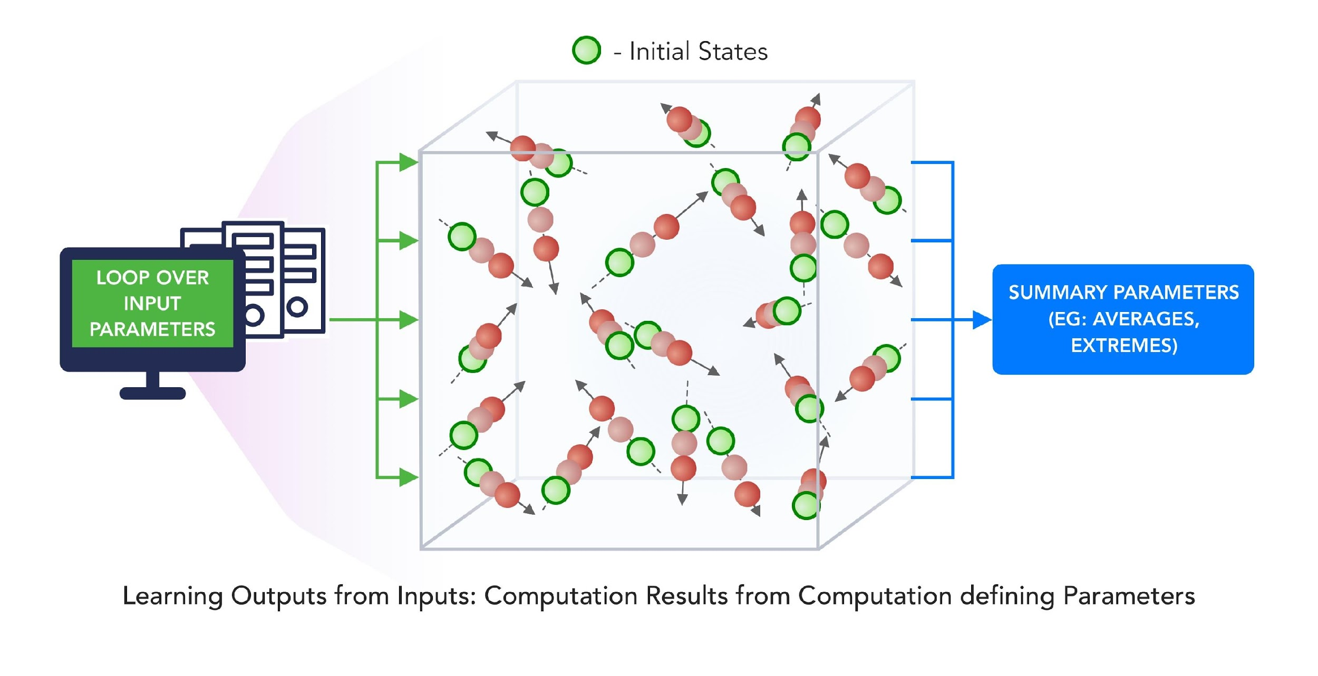
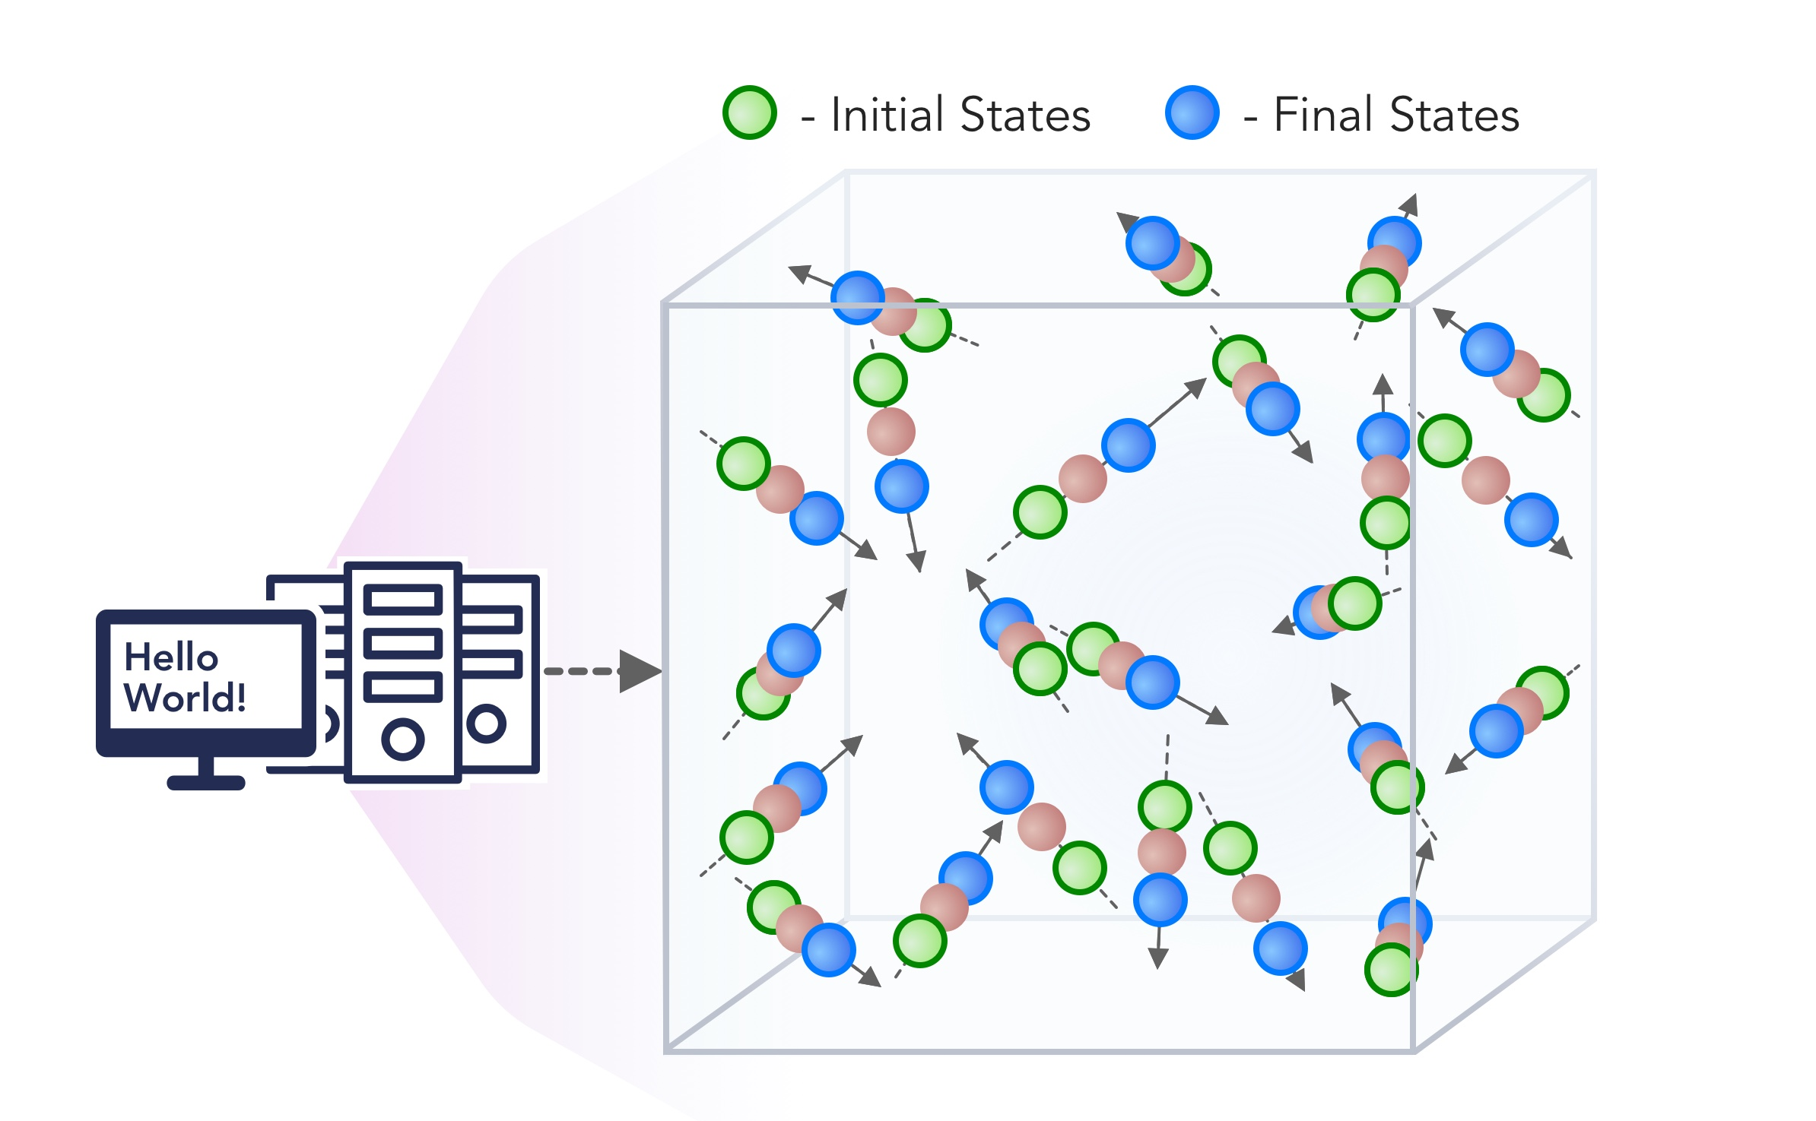
1. Improving Simulation with Configurations and Integration of Data
1.1 MLAutotuningHPC – Learn configurations
1.2 MLAutotuningHPC – Learn models from data
1.3 MLaroundHPC: Learning Model Details (ML based data assimilation)
2. Learn Structure, Theory and Model for Simulation
2.1 MLAutotuningHPC – Smart ensembles
2.2 MLaroundHPC: Learning Model Details (coarse graining, effective potentials)
2.3 MLaroundHPC: Improve Model or Theory
3. Learn Surrogates for Simulation
3.1 MLaroundHPC: Learning Outputs from Inputs (parameters)
3.2 MLaroundHPC: Learning Outputs from Inputs (fields)
https://arxiv.org/abs/1909.13340
https://arxiv.org/abs/1909.02363
INPUT
OUTPUT
100 refs classified in 8 classifications

Slide 9
1. Improving Simulation with Configurations and Integration of Data 1.1 MLAutoTuningHPC: Learning Configurations
This is classic Autotuning and one optimizes some mix of performance and quality of results with the learning network inputting the configuration parameters of the computation.
This includes initial values and also dynamic choices such as block sizes for cache use, variable step sizes in space and time.
It can also include discrete choices as to the type of solver to be used.

Slide 10
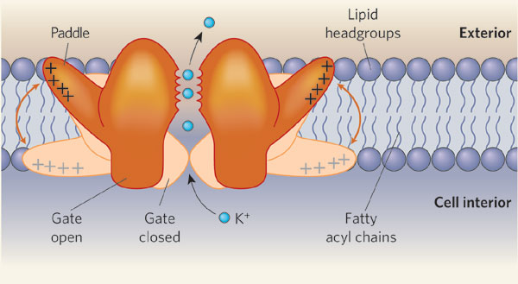
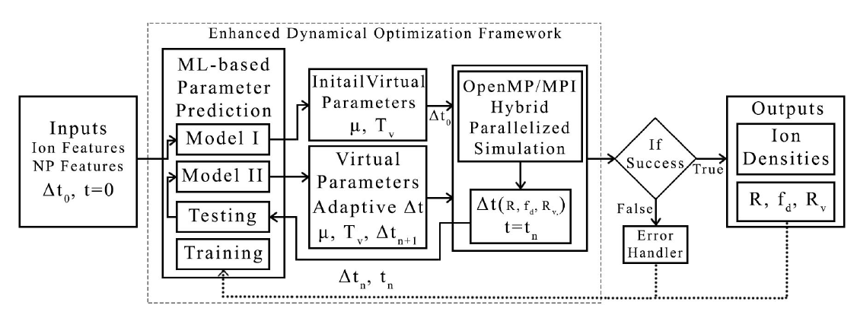
MLAutoTuningHPC: Learning Configurations by Parameter Auto-tuning in Molecular Dynamics Simulations: Efficient Dynamics of Ions near Polarizable Nanoparticles (NPs)
Integration of machine learning (ML) methods for parameter prediction for MD simulations by demonstrating how they were realized in MD simulations of ions near polarizable NPs.
Note ML used at start and end of simulation blocks
JCS Kadupitiya,
Geoffrey Fox,
Vikram Jadhao
ML-Based Simulation Configuration
Inference I
Inference I
Inference II
Inference II
Testing
Testing
Training
Training

Slide 11
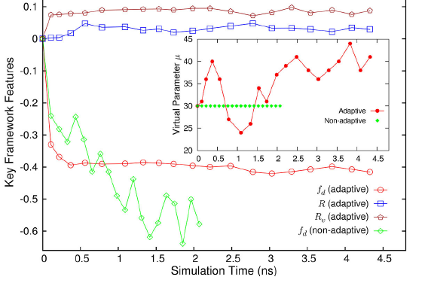
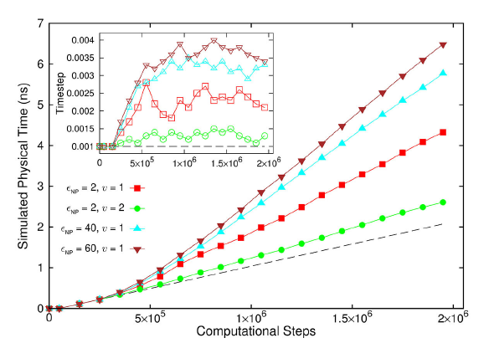
Results for Nanosimulation MLAutotuning
Key characteristics of simulated system showing greater stability for ML enabled adaptive approach.
Auto-tuning of parameters generated accurate dynamics of ions for 10 million steps while improving the stability.
Integrated with ML-enhanced framework with hybrid OpenMP/MPI
Maximum speedup of 3 from MLAutoTuning and a maximum speedup of 600 from the combination of ML and parallel computing.
Quality of simulation measured by time simulated per step with increasing use of ML enhancements. (Larger is better).
Inset is timestep used

Slide 12
3. MLforHPC Learn Surrogates for Simulation 3.1 MLaroundHPC: Learning Outputs from Inputs:
a) Computation Results from Computation defining Parameters
Here one just feeds in a modest number of meta-parameters that the define the problem and learn a modest number of calculated answers.
This presumably requires fewer training samples than “fields from fields” and is main use of MLaroundHPC so far
Can mix simulations and observations
Operationally same as SimulationTrainedML but with a different goal: In SimulationTrainedML the simulations are performed to directly train an AI system rather than the AI system being added to learn a simulation.

Slide 13
MLaroundHPC: Learning Outputs from Inputs (parameters) High Performance Surrogates of nanosimulations
An example of Learning Outputs from Inputs: Computation Results from Computation defining Parameters
Employed to extract the ionic structure in electrolyte solutions confined by planar and spherical surfaces.
Written with C++ and accelerated with hybrid MPI-OpenMP.
MLaroundHPC successfully learns desired features associated with the output ionic density that are in excellent agreement with the results from explicit molecular dynamics simulations.
Will be deployed on nanoHUB for education (an attractive use of surrogates)

Slide 14
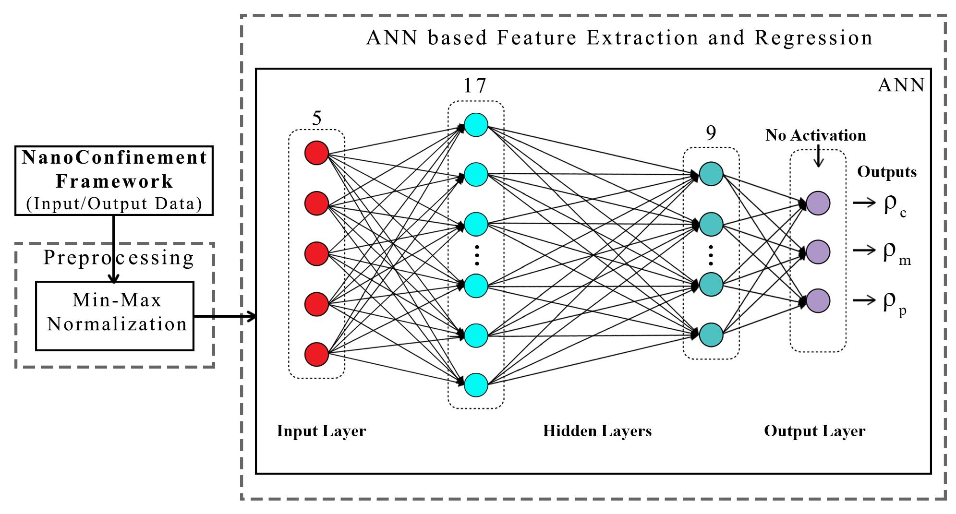
ANN for Regression
Dataset having 6,864 simulation configurations was created for training and testing (0.7:0.3) the ML model.
Note learning network quite small
ANN was trained to predict three continuous variables; Contact density ρ_{c} , mid-point (center of the slit) density ρ_{m} , and peak density ρ_{p}
TensorFlow, Keras and Sklearn libraries were used in the implementation
Adam optimizer, xavier normal distribution, mean square loss function, dropout regularization.
JCS Kadupitiya,
Geoffrey Fox,
Vikram Jadhao

Slide 15
Parameter Prediction in Nanosimulation
ANN based regression model predicted Contact density ρ_{c} , mid-point (center of the slit) density ρ_{m} , and peak density ρ_{p} accurately with a success rate of 95:52% (MSE ~ 0:0000718), 92:07% (MSE ~ 0:0002293), and 94:78% (MSE ~ 0:0002306) respectively, easily outperforming other non-linear regression models
Success means within error bars (2 sigma) of Molecular Dynamics Simulations

Slide 16
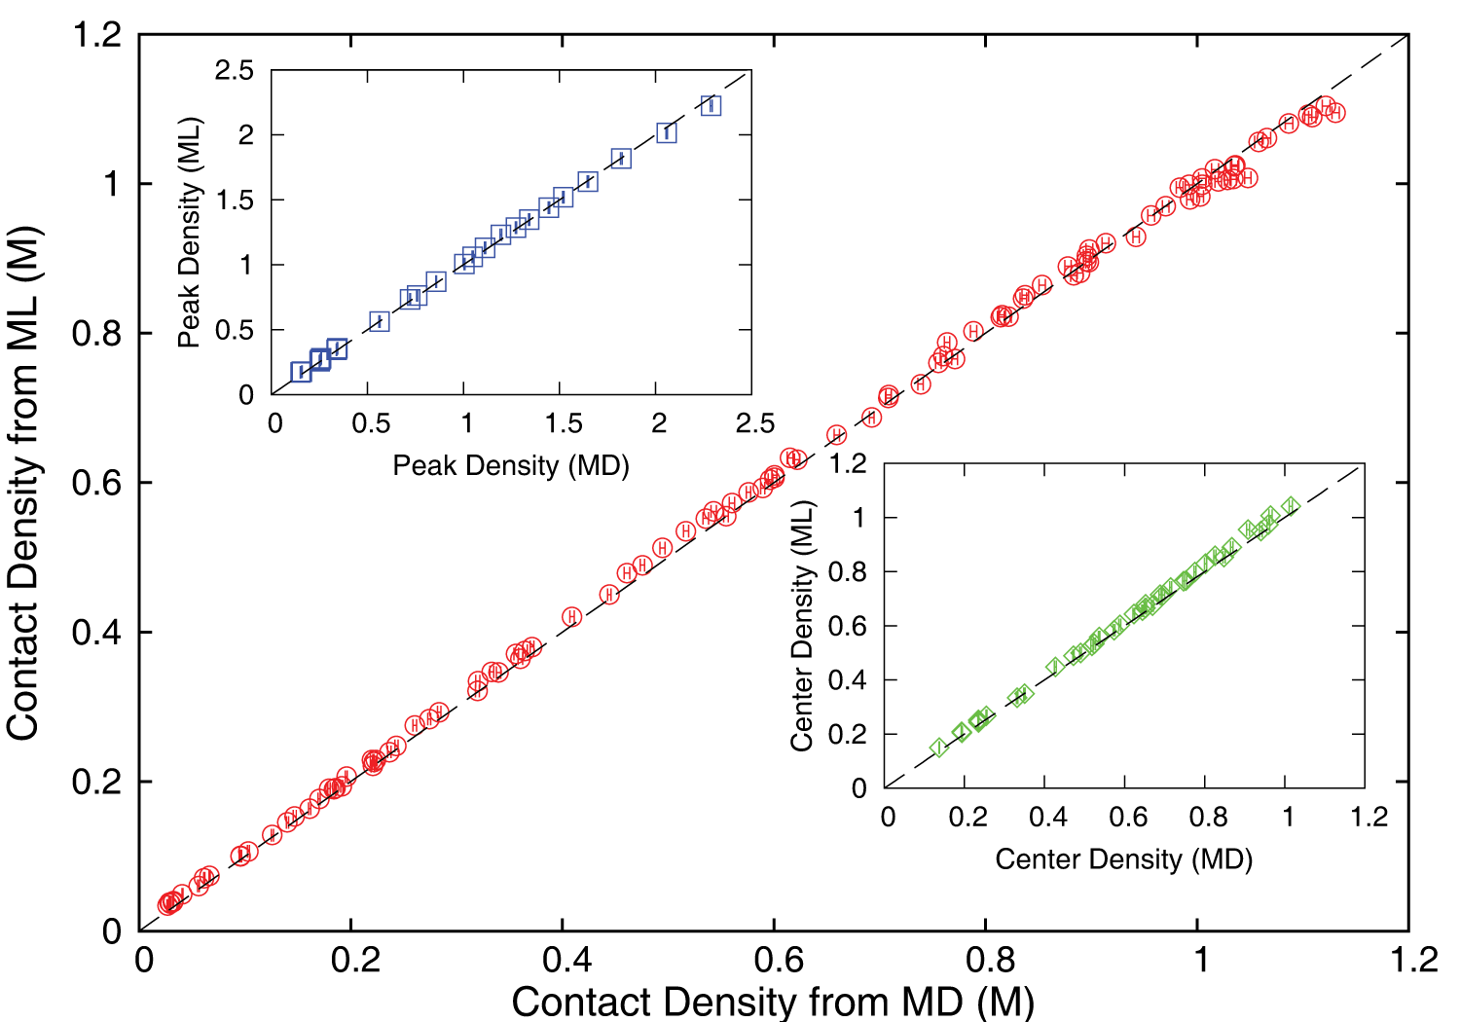
Accuracy comparison between ML predictions and MD simulation results
ρ_{c ,} ρ_{m} and ρ_{p} predicted by the ML model were found to be in excellent agreement with those calculated using the MD method; correlated data from both approaches fall on the dashed lines which indicate perfect correlation.

Slide 17
Speedup of MLaroundHPC
T_{seq} is sequential time
T_{train} time for a (parallel) simulation used in training ML
T_{learn} is time per point to run machine learning
T_{lookup} is time to run inference per instance
N_{train} number of training samples
N_{lookup} number of results looked up
Becomes T_{seq}/T_{train} if ML not used
Becomes T_{seq}/T_{lookup} (10⁵ in our case) if inference dominates (will overcome end of Moore’s law and win the race to zettascale)
Another factor as inferences uses one core; parallel simulation 128 cores
Speedup is strong (not weak with problem size increasing to improve performance) scaling as size fixed
N_{train} is 7K to 16K in our work

Slide 18
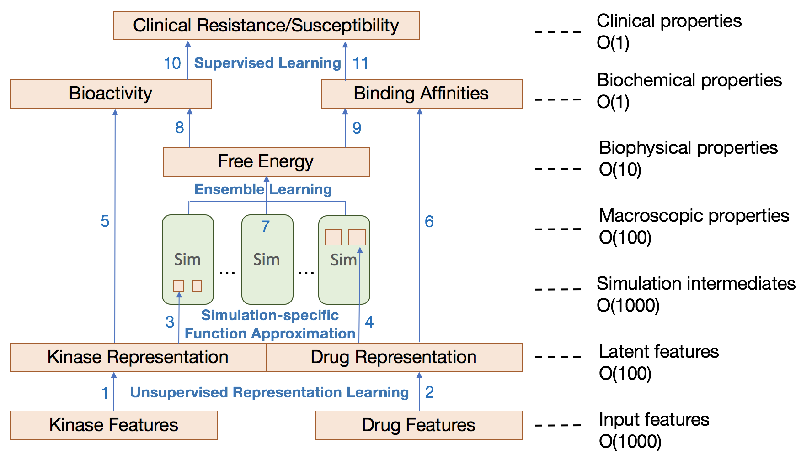
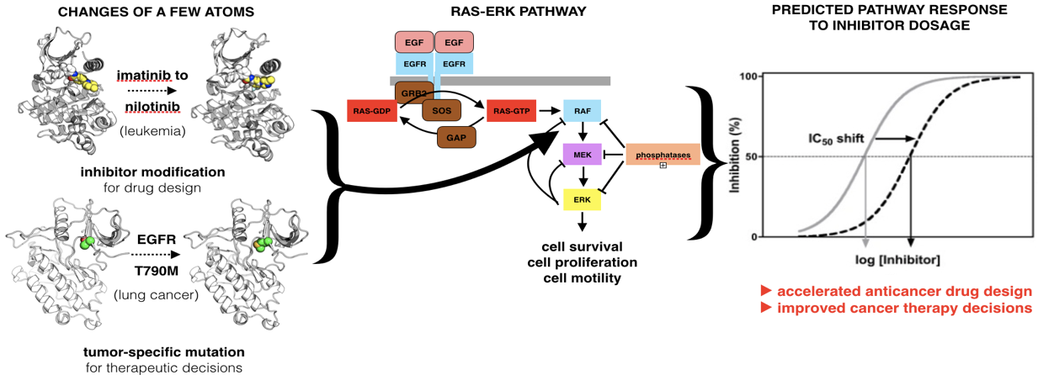
Examination of the therapeutic effectiveness of Kinase ML at multiple levels and points in the discovery process
CANDLE-INSPIRE
Kinase effectiveness workflow with number of features of relevance at each stage
Ensemble simulations and DL training samples

Slide 19
INSILICO MEDICINE USED CREATIVE AI TO DESIGN POTENTIAL DRUGS IN JUST 21 DAYS
September 4 2019 News Item
Map Drug (Material) Structure to Drug (Material) Properties
Hong Kong-based Insilico Medicine sent shockwaves through the pharma industry after publishing research in Nature Biotechnology that proves its AI-powered drug discovery system was capable of producing at least one potential treatment for fibrosis in less than a month's time.
The system bucks the standard brute-force approach for AI drug development, which involves screening millions of potential molecular structures looking for a viable fit, in favor of a Deep Reinforcement Learning algorithm that can imagine potential protein structures based on existing research and certain preprogrammed design criteria.
Insilico's system initially produced 30,000 possible designs, which the research team whittled down to six that were synthesized in the lab, with one design eventually tested on mice to promising results.
Insilico's AI-powered research process could offer a massive push forward for the pharmaceutical industry, which faces increasingly high drug development costs. In just a handful of weeks and for approximately $150,000, Insilico delivered what typically takes pharmaceutical companies $2.6 billion over seven years.

Slide 20
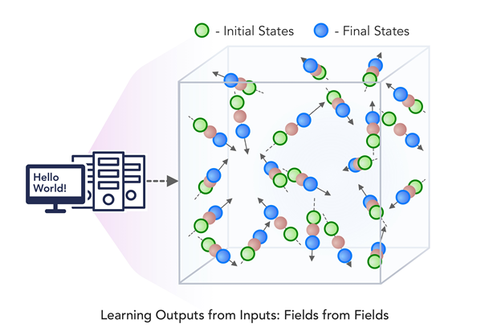
3. MLforHPC Learn Surrogates for Simulation 3.2 MLaroundHPC: Learning Outputs from Inputs:
b) Fields from Fields
Here one feeds in initial conditions and the neural network learns the result where initial and final results are fields
In simple cases, it is shown that you can learn Newton’s laws and their numerical approximation
Unclear how far but probably generalizes

Slide 21
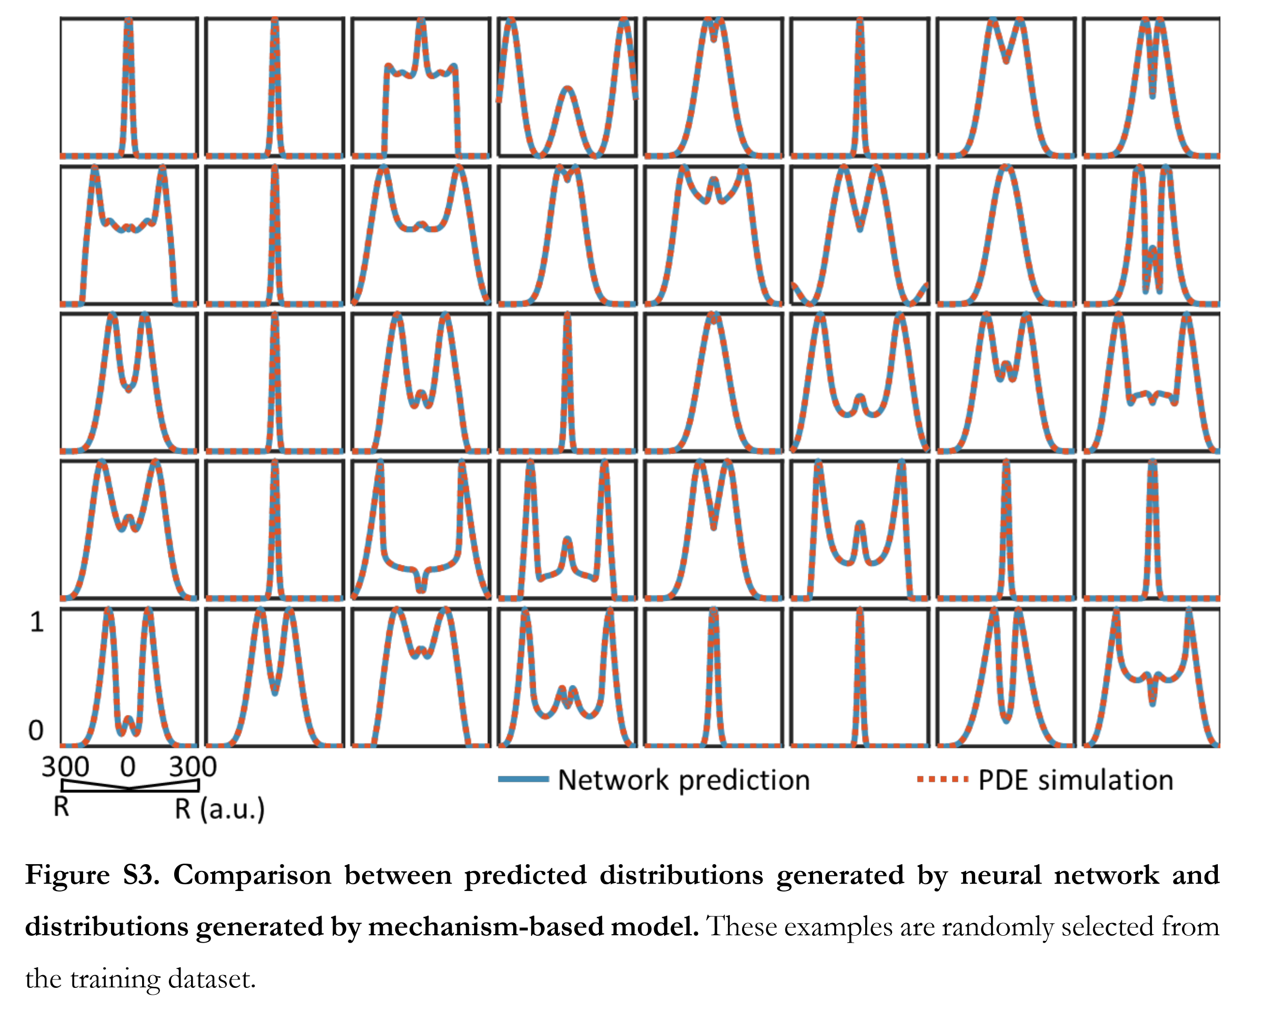
Fields from Parameters Recent paper “Massive computational acceleration by using neural networks to emulate mechanism based biological models” uses 501 LSTM units to represent a one-dimensional grid of values which is output of a two-dimensional gene circuit simulation which only depends on radius.

Slide 22
One way to think about this
We are solving PDE’s or sets of coupled ODE’s
Typically we solve iteratively New Values = (Operator) Previous Values
Classic applied math tells you nifty difference equations and spectral methods to represent Operator numerically
Deep Learning learns the operator from classic numerics or observational data or their combination
Inference is New Values = (DL Operator) Previous Values
This new nonlinear trained DL operator can allow much larger time steps, incorporate variations in parameters etc.
DL Operator is the new theory (Newton’s laws) of science
High order approximations used to be very sensitive to noise and one was taught to avoid but ANN are the opposite – very robust
See DL operator for Lennard Jones Potential in two LSTM layers!
Newton’s laws for this have 2-4 parameters

Slide 23
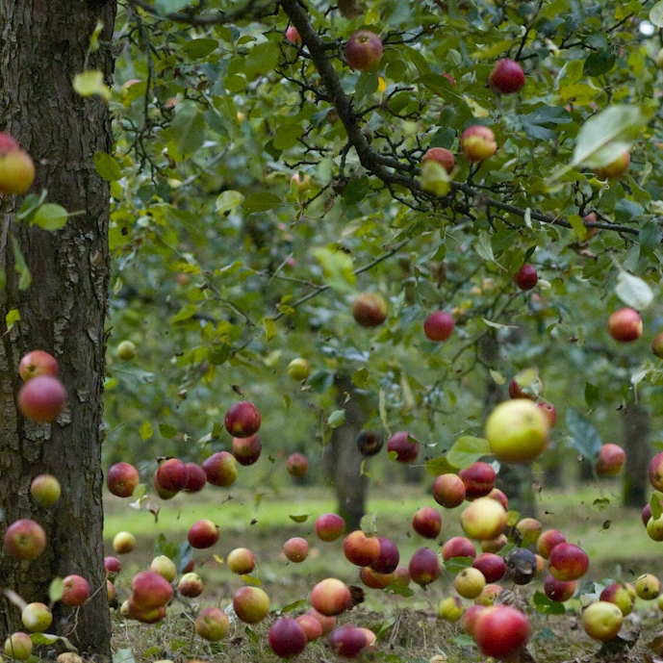
Learning how Apples Fall I
DL for motion of a particle in Lennard Jones potential
Tensorflow model summary:
Layer (type) Output Shape Param #
=================================================================
lstm (LSTM) (None, 5, 32) 4352
_________________________________________________________________
dropout (Dropout) (None, 5, 32) 0
_________________________________________________________________
lstm_1 (LSTM) (None, 32) 8320
_________________________________________________________________
dropout_1 (Dropout) (None, 32) 0
_________________________________________________________________
dense (Dense) (None, 1) 33
=================================================================
Total params: 12,705
12,705 trained parameters in 2 layers (LSTM) plus final all to 1 layer
71,060 training samples (a lot of apples)
90 minutes training on a K80 GPU
Or F=ma? 1D ODE solved by Verlet
Work with Kadupitiya and Jadhao
(earlier Simple Harmonic Oscillator has 116,610 parameters. You can be pretty free with parameters as robust)

Slide 24
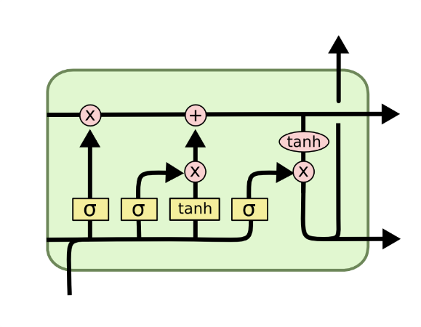
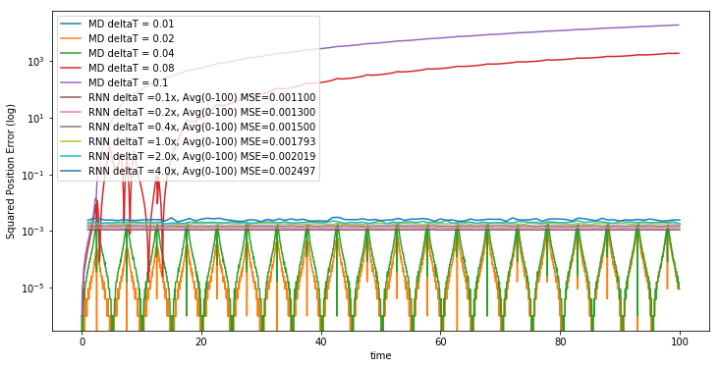
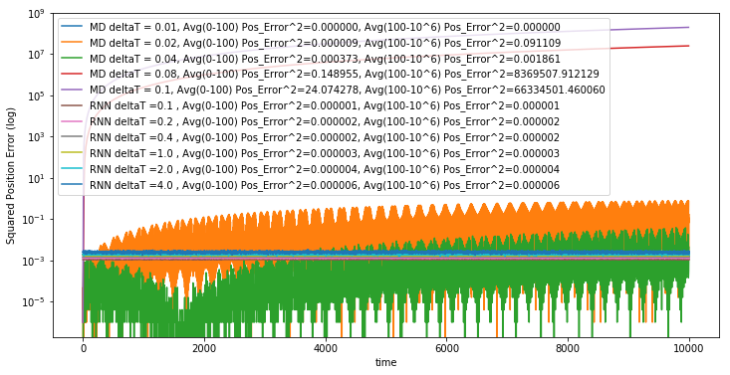
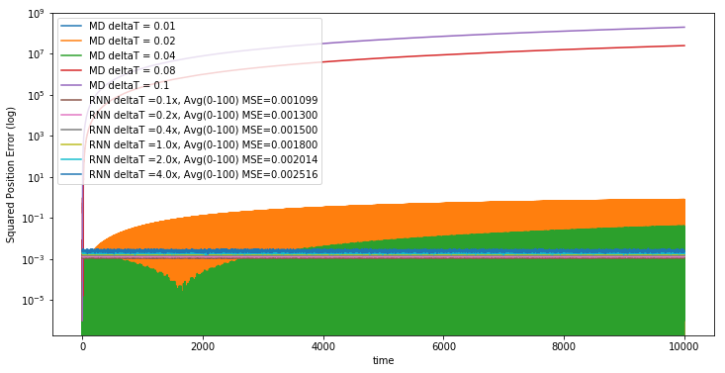
Learning how Apples Fall II
LSTM Cell
System trained up to t=100; network used up to t=10,000
Will look at multiparticle systems learning O(N^2) potential
Plots show error for MD and LSTM for different time steps. LSTM upto t=4
LSTM allows reliable large time steps; learns potential and differential operator
Compared to classic numerics has LOTS of parameters, statistical averaging (32 initial LSTM’s only differ in randomized initial conditions) and nonlinear activation nodes
Time
Time
Size of error

Slide 25
2. Learn Structure, Theory and Model for Simulation 2.1 MLAutoTuningHPC: Smart Ensembles
Here we choose the best set of collective coordinates to achieve some computation goal
Such as exploring special states – proteins are folding
Or providing the most efficient training set with defining parameters spread well over the relevant phase space.
Deep Learning (e.g. autoencoders) replacing other machine learning approaches to find collective coordinates

Slide 26
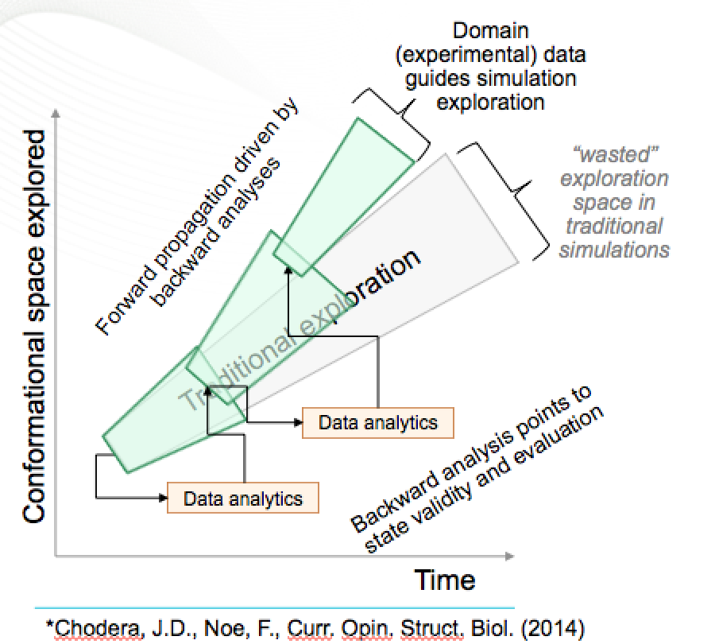
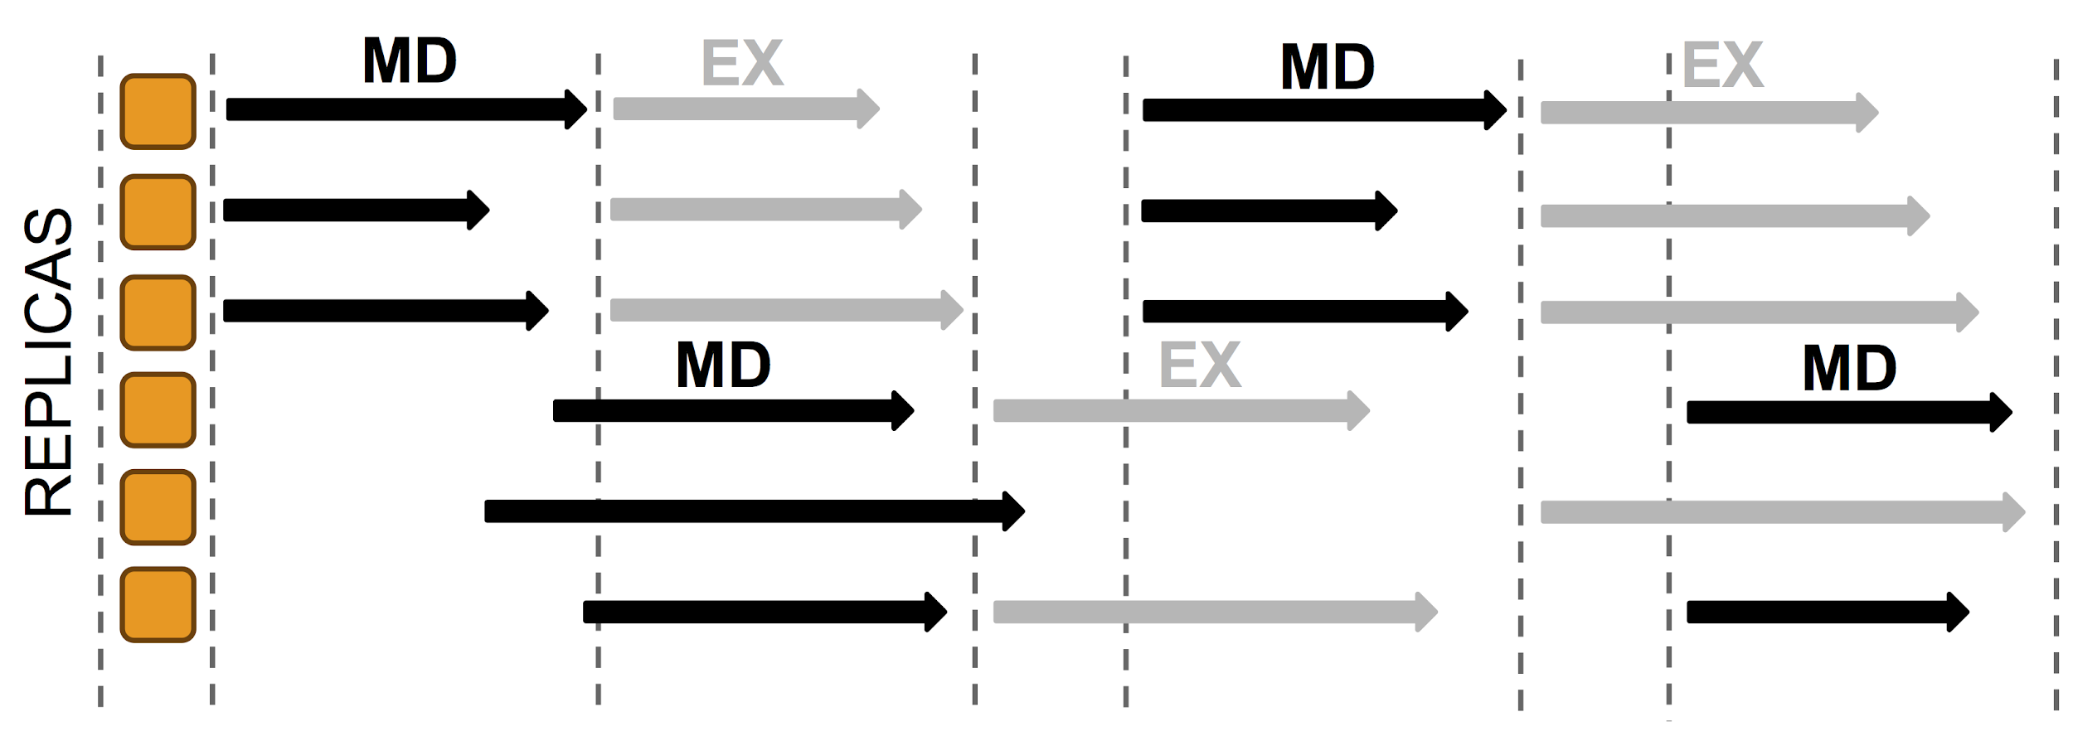
ML based enhanced sampling of Phase Space
Run ensembles of shortish runs rather than one long run
Traditional approach uses replica exchanges
In Markov State Model for biomolecular simulations , phase space is determined by clustering trajectories (not deep learning) and mapping space with these clusters and their transition
Most recent method uses deep learning autoencoders to find collective coordinates to map out space and move quickly. (DL replaces ML)

Slide 27
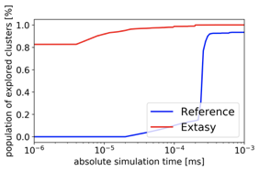
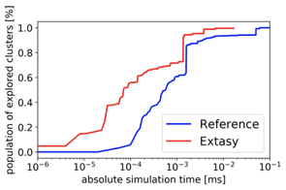
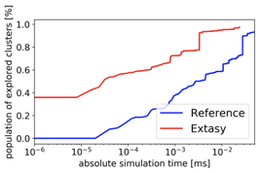
Adaptive Sampling Using non-DL ML (Clustering)
Red line % phase space with clustering
Blue is % with hard core MD
Below phase space explored in top two collective coordinates; ML finds new regions

Slide 28
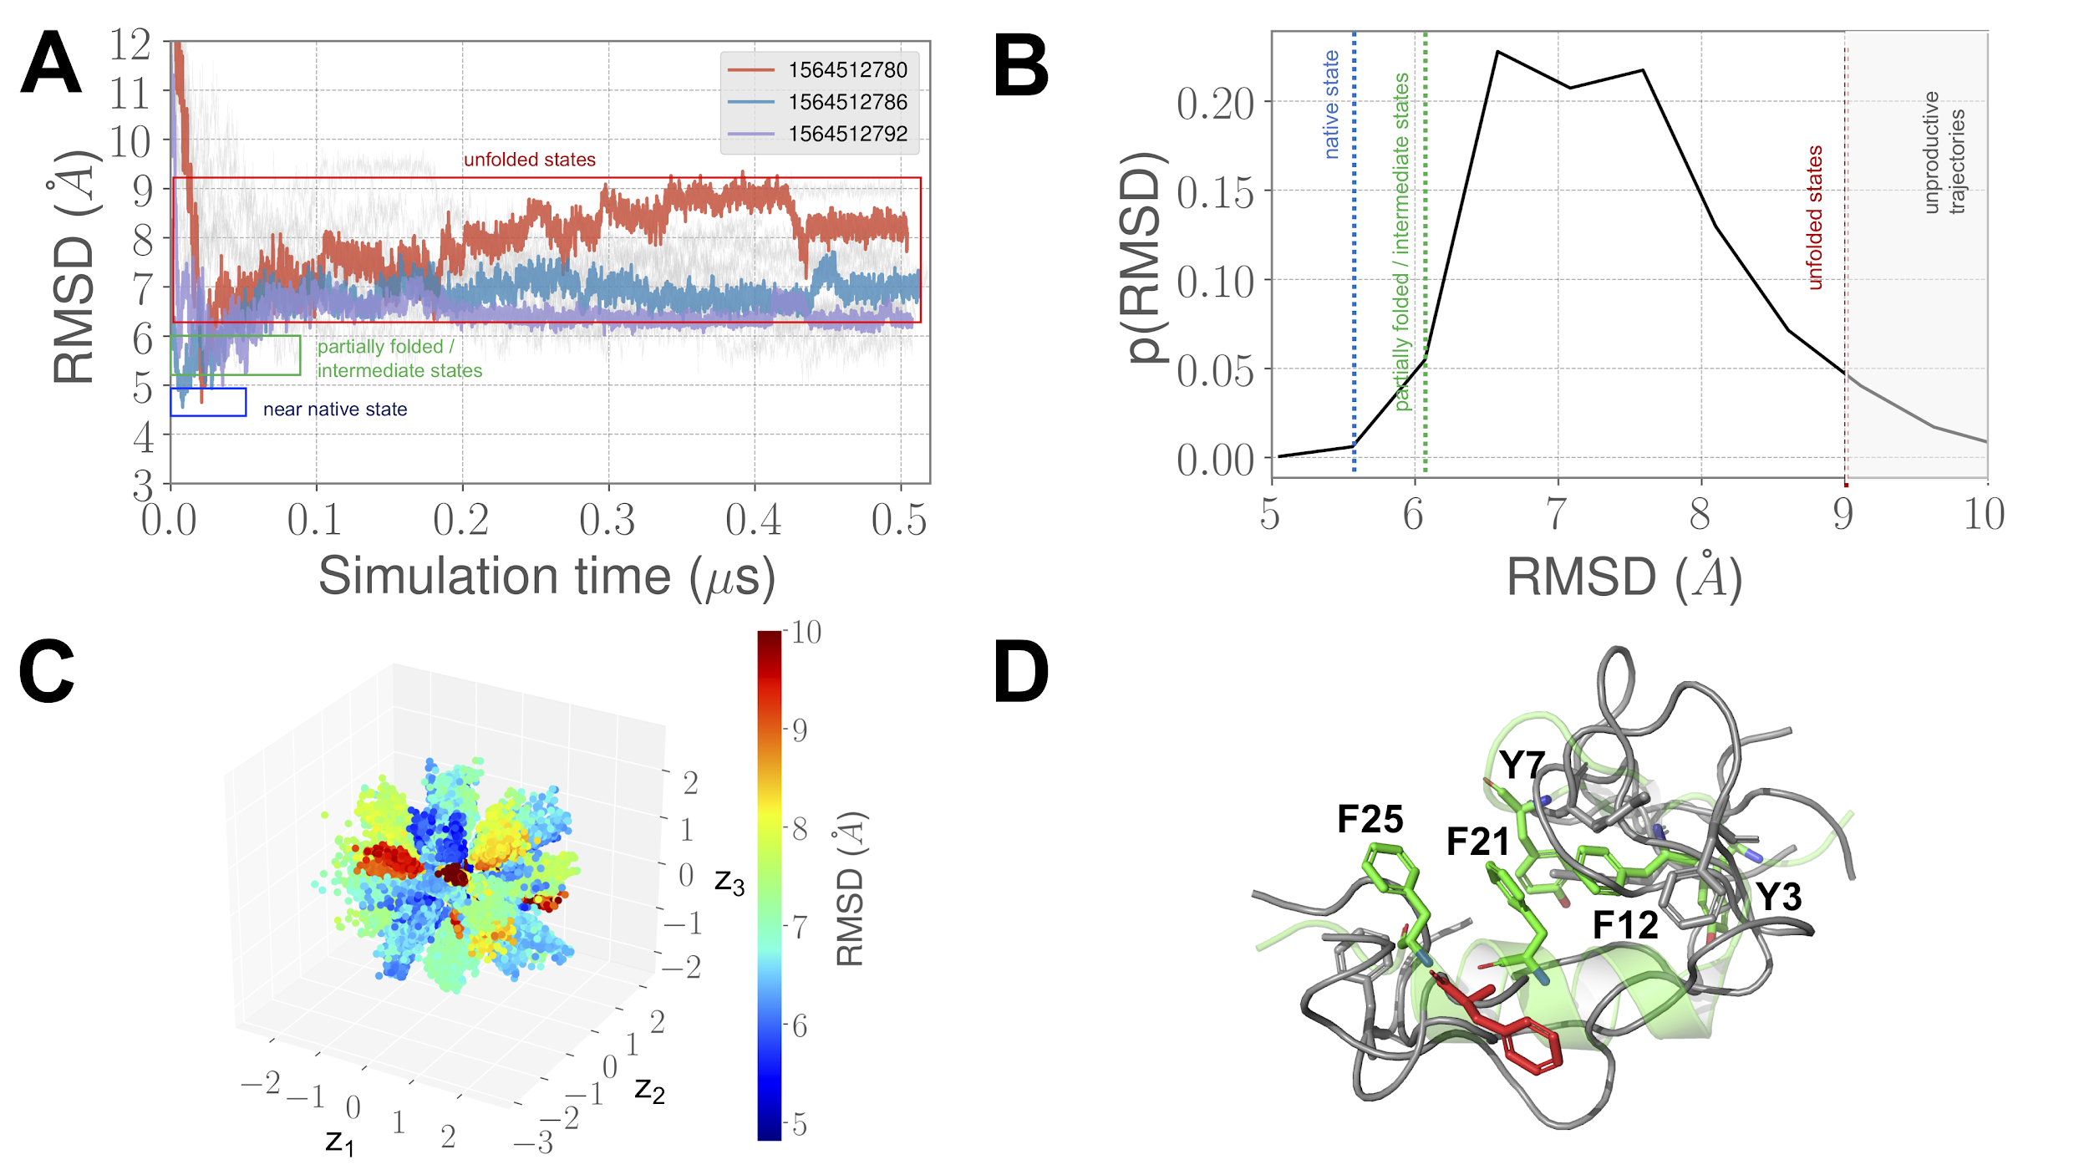
CVAE Convolutional Variational Autoencoder driven Ensemble-MD
For BBA: 20X improvement
Shantenu Jha Collaboration with ANL: see https://arxiv.org/pdf/1908.00496.pdf

Slide 29
1. Improving Simulation with Configurations and Integration of Data 1.3 MLaroundHPC: Learning Model Details (ML for Data Assimilation)
a) Learning Agent Behavior One has a a set of cells as agents modeling a virtual tissue and use ML to learn both parameters and dynamics of cells replacing detailed computations by ML surrogates. As there can be millions to billions of such agents the performance gain can be huge as each agent uses same learned model.
b) Predictor-Corrector approach Take the case where data is a video or high dimensional (spatial extent) time series. Now one time steps models and at each step optimize the parameters to minimize divergence between simulation and ground truth data. E.g. produce a generic model organism such as an embryo. Take this generic model as a template and learn the different adjustments for particular individual organisms.
Current state of the art (Ride Hailing!!) expresses spatial structure as a convolutional neural net and time dependence as recurrent neural net (LSTM)

Slide 30
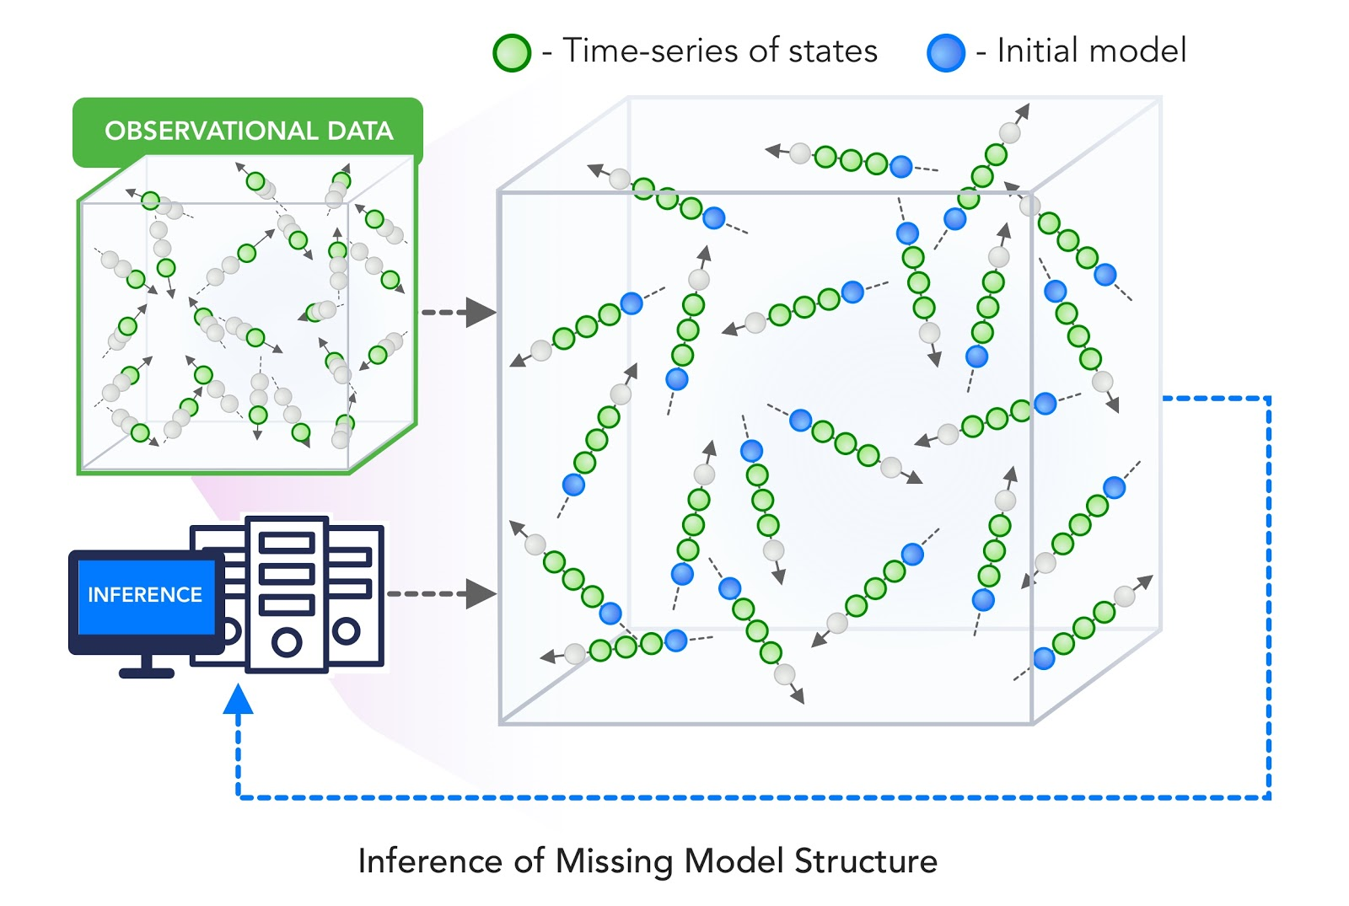
2. Learn Structure, Theory and Model for Simulation 2.3 MLaroundHPC: Learning Model Details - Inference of Missing Model Structure
This imagines a future where AI will essentially be able to derive theories from data, or more practically a mix of data and models.
This is especially promising in agent based models which often contain phenomenological approaches such as the predictor-corrector method of 1.3. We expect that will take the results of such assimilation and effective potentials and interactions and use them as the master model or theory for future research.

Slide 31
Putting it all Together Simulating Biological Organisms (with James Glazier @IU)
Learning Model (Agent) Behavior Replace components by learned surrogates (Reaction Kinetics Coupled ODE’s)
All steps use MLAutotuning
Smart Ensembles
Predictor-Corrector

Slide 32
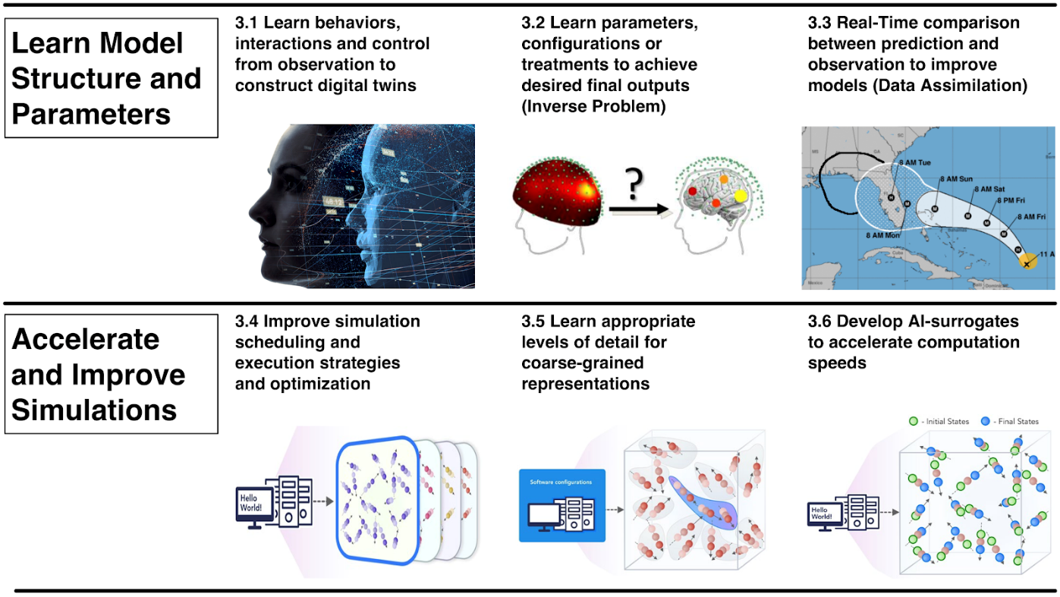
Engineering Health: Digital twin based Personalized Medicine
Data Assimilation can customize generic models for each patient
Surrogates for cell models can give huge performance increase (as inference used so often so training amortized) as in other agent-based models
AI-Assisted Development of digital twins for immunotherapies (using the body’s own immune cells to kill cancers rather than chemotherapies) using data generated from organoid cultures of patient-derived cancer cells.
AI-Assisted Deployment of Digital Twins for Diagnosis, Prognosis and Treatment Optimization of Diabetic Retinopathy (DR):

Slide 33
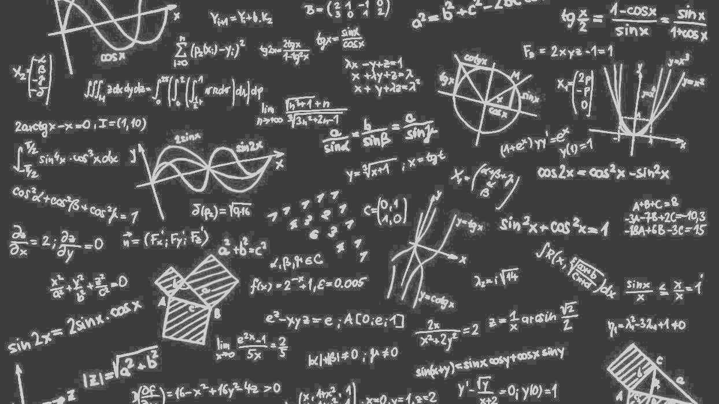
Complete Systems HPCforML
Parallel Big Data Analytics in some ways like parallel Big Simulation
Twister2 Implements HPCforML as HPC-ABDS and supports MLforHPC

Slide 34
Next Generation of Cyberinfrastructure: Compute and Data patterns
The application classes a) to d) will all have needs in the four capabilities
Parallel simulations;
Data Management;
Data analytics;
Streaming
But the proportion of these will differ in the four classes
ML-HPC Integration case c) is particularly hard as it intermixes all of them in a dynamic heterogeneous fashion.
A system for class c) could be able to run the other classes as it will have “everything” but a “c” system may not be the most cost-effective for applications of other classes.
Classic Big Data
Cloud-Edge
HPCforML. MLforHPC
Classic Simulations

Slide 35
Next Generation of Cyberinfrastructure: Remarks on Deep Learning
We expect growing use of deep learning (DL) replacing older machine learning methods and DL will appear in many different forms such as Perceptrons, Convolutional NN's, Recurrent NN's, Graph Representational NN's, Autoencoders, Variational Autoencoder, Transformers, Generative Adversarial Networks, and Deep Reinforcement Learning.
For industry, growth in reinforcement learning is increasing the computational requirements of systems. However, it is hard to predict the computational complexity, parallelizability, and algorithm structure for DL even just 3 years out.
Note we always have the training and inference phases for DL and these have very different system needs.
Training will give large often parallel jobs; Inference will need a lot of small tasks.
Note in parallel DL, one MUST change both batch size and # training epochs as one scales to larger systems (in fixed problem size case) and this is implicit in MLPerf results; this may change with more model parallelism
Parallel Computing Failed again!!

Slide 36
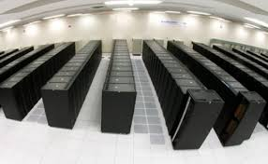
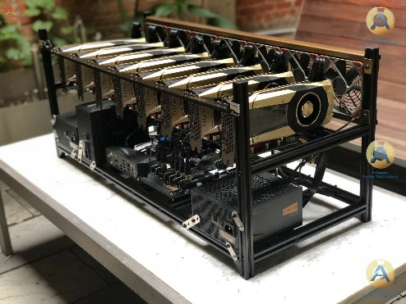
AI as a Service
GPU’s and perhaps TPU’s are both AI and simulation accelerators; but new generation of AI accelerators may be useless for simulations?
Need to shield computer architectures and users from changes in AI implementations
One approach is to offer AI as a service implemented as Function as a Service
Event-based FaaS offers attractive computing model and low latency
Mix of NVMe and fast communication channels to minimize data transfer and other overheads in accessing AI Service
Can change to new hardware/software/algorithm transparently
AI as a service
Broker
Simulation as a service
NVMe as a service

Slide 37
Computer Science Issues
What computations can be assisted by what ML in which of 8 scenarios
Not known how large training set needs to be.
What is performance of different DL (ML) choices in compute time and capability
Little or no study of either predicting errors or in fact of getting floating point numbers from deep learning.
What can we do with zettascale computing?
Redesign all algorithms so they can be DL-assisted
There ought to be important analogies between time series and this area (as simulations are 4D time series?)
Dynamic interplay (of data and control) between simulations and ML seems likely but not clear at present
Interesting load balancing issues if in parallel case some points learnt using surrogates and some points calculated from scratch

