Slide 1
Big Data and Extreme-scale Computing
BDEC2 “Common Digital Continuum Platform for Big Data and Extreme Scale Computing” with first meeting BDEC2-1 November 28-30, 2018 Bloomington Indiana USA
Evening Reception on November 28 followed by two days of work
Meeting focus “Defining application requirements for a Common Digital Continuum Platform for Big Data and Extreme Scale Computing”
Record of meeting with white papers, presentations, recordings https://docs.google.com/document/d/1Gipxn2YKckjDHyPG2tNKqSeenEL7AxX6cB43YPtCpQA/edit?usp=sharing http://www.exascale.org/bdec/
Next meetings: February 19-21 Kobe, Japan (with a focus on platform) followed by two in Europe, one in USA and one in China.

Slide 2
Structure of Bloomington Meeting BDEC2-1
BDEC2 has 6 International meetings spread over 2 years developing a community driven Digital Continuum platform supporting Science and Engineering data research spanning HPC, Clouds, simulations, data analytics (Common Digital Continuum Platform for Big Data and Extreme Scale Computing)
First meeting had a focus on application requirements but kicked off other key parts of BDEC2 and included working groups on
Applications and Requirements
Platform architecture/design and
Community (Academia, Government, Industry, Open Source, .org’s) building
It included overview talks expanding on initial talks at BoF discussing overall issues and regional (Asia, Europe, US) perspectives on Digital Continuum.
There were two rounds of breakouts to start off working groups
35 white papers were submitted; many of these were presented with 40 talks at BDEC2-1
We planned working group activities with some virtual meetings in between the 6 in-person events
The application working group has held 5 zooms with 12-15 attendees each before Kobe.

Slide 3
Dan Reed -- HPC and the Digital Continuum
Why us? • No one else is creating software services specifically for science • Otherwise, we must adapt/adopt other solutions
Why now? • HPC, streaming data, and AI are the future • We need to act rather than react
Why fusion? • Integration will enable new science • It’s more than workflows, containers, and libraries

Slide 4
Manish Parashar: Transforming Science through Cyberinfrastructure: Envisioning a Cyberinfrastructure Continuum
NSF 10 Big Ideas
Harnessing the Data Revolution (HDR): Many Dimensions of Data Investments at NSF is a convergence accelerator NSF 19-549
DCL: Scalable Cyberinfrastructure to Accelerate Data-Driven Science and Engineering Research (NSF 18-076 DCL)
Networking, Campus CI as the fundamental layer and underpinning of the CI Continuum – CC* (NSF 19-533), IRNC, CICI
Advanced Computing Systems & Services: Adapting to the Rapid Evolution of Science and Engineering Research (NSF 19-534)
Exploring Clouds for Acceleration of Science (E-CAS)

Slide 5
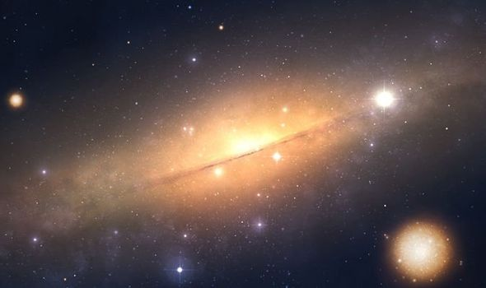
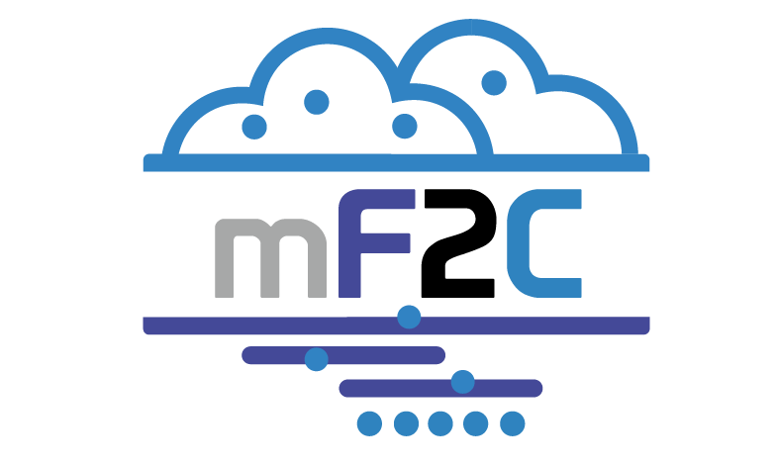
Rosa Badia: European perspective
European Open Science Cloud
International LOFAR telescope demonstrator “Universe gets BIGGER as LOFAR telescope scientists discover 300,000 MORE galaxies” Feb 19 2019
PRACE scientific case
Recurring core part of Nobel Prizes in Physics & Chemistry
Saving billions with better weather forecasting
Batteries & supercapacitors
Improving human health with genomics, personalized medicine
3-4% better fuel efficiency of aircraft & wind turbines every year
Disrupting communication, transportation and manufacturing
Design of future materials from scratch based on desired properties
Artificial intelligence, machine learning, sensors, open data
Edge to cloud projects and other initiatives
mf2c – smart fog hub use case

Slide 6
Satoshi Matsuoka: Japan Flagship 2020 Post K Supercomputer
Arm system with upto 100x K performance e
Society 5.0 Apps
Co-Design with 9 Application areas
Convergence of HPC and AI
Acceleration of Simulation with AI
AI replacing simulation
Acceleration of AI with HPC

Slide 7
Haohuan FU (China): Big Data and Extreme Computing: Look Back and Look Ahead
Climate Science has a Big Data Challenge!

Slide 8
Topics of White Papers and Application Talks
Pathology
Genome Alignment
Network Science
Climate
Weather; Data Assimilation
Electrical Power Grid
Real time race car monitoring
Precision Agriculture
UAV and Environmental monitoring
Square Kilometer Array
Light Sources & Experiment Control
Interface of Machine Learning, Simulation and Observation
Biomolecular Simulations
Material Science
Fusion
Smart Cities
Edge and Fog Computing
Continuum Platform:
Modern Clouds, workflow, HPC, Data Transport, Benchmarking

Slide 9
BDEC2-1 Platform Presentations Edge, Cyberinfrastructure and Cloud Technologies
M. Beck, Glimpsing a Yottascale Data Ecosystem when the Fog Lifts (the Edge is the Computer)
U. Ramachandran, Elevating the Edge to be a Peer of the Cloud (using the Fog)
G. Antoniu, The Sigma Data Processing Architecture: Leveraging Future Data for Extreme-Scale Data Analytics to Enable High-Precision Decisions
R. Badia, Workflow environments for advanced cyberinfrastructure platforms
M.Tsuji, Toward integration of multi-SPMD programming model and advanced cyberinfrastructure platform
C. Costa, Converged Ecosystem for Data Analytics and Extreme-Scale Computing
D. Gannon, Pathways to Convergence – An Additional Scenario
T. Hanawa, Advanced Cyberinfrastructure Platform Design
O. Tatebe, Memory-Storage Hierarchy
T. Kosar, OneDataShare: A Universal Data Sharing Building Block for Data-Intensive Applications

Slide 10
BDEC2 Application Working Group Strategy
BDEC2 is designing a new platform that will be firmly rooted by the requirements across a broad range of future-looking applications in science and engineering.
One goal of the BDEC2 is to discover and document those requirements that cover multiple use cases so we can use shared cyberinfrastructure.
We tackle by collecting individual cases by several mechanisms including white papers and presentations at our plenary meetings.
We find common requirements by dividing the use cases into a few (eventually 3-6) broad buckets.
Experts on individual case cases contribute the documentation of their use case and an analysis of the common and special features if use cases in each bucket.
The members of the platform group will be challenged to support the key features of each bucket.
We intend to demonstrate the new platform with a set of international demonstration projects tackling a well-chosen exemplar in each bucket.

Slide 11
Document Somehow
Challenge Platform
Use Case 1
Buckets of Use Cases
Demos
Use Case 2
Use Case 3
Big Data Analytics
Benchmarks
Use Case
Categorize in many ways
Chosen App(s)
HPC and ML
Use Case
Use Case N-2
Edge to Cloud
Use Case N-1
Use Case N

Slide 12
Use case Survey based on NIST Big Data Survey https://docs.google.com/document/d/1ALUtR4DlonUZcxo8Lj_A7nbIdRsJcnQ-iVxEy0grzxA/edit?usp=sharing Sample of the most basic fields. Form has more optional fields NIST had 54 use cases https://bigdatawg.nist.gov/_uploadfiles/NIST.SP.1500-3r1.pdf Overall Features Detailed Features
Use Case Title
Use Case Contacts
​Use Case URL(s)
Pictures and Diagrams?
​Actors / Stakeholders
​Summary of Use Case and its Solution
Use Case Description
Data Source, Volume, Velocity
Data Analytics and Computational Methods
Computer Systems Infrastructure
Key words and Tags for classification
Security and Privacy Issues

Slide 13
BDEC2 Bucket 1: Classic Observational Data plus ML
Astronomy
BDEC2App-1: M. Deegan, Big Data and Extreme Scale Computing, 2nd Series (BDEC2App) - Statement of Interest from the Square Kilometre Array Organisation (SKAO)
Environmental Science
BDEC2App-2: M. Rahnemoonfar, Semantic Segmentation of Underwater Sonar Imagery based on Deep Learning
BDEC2App-3: M. Taufer, Cyberinfrastructure Tools for Precision Agriculture in the 21st Century
Healthcare and Life sciences
BDEC2App-4: J. Saltz, Multiscale Spatial Data and Deep Learning
BDEC2App-5: R. Stevens, Exascale Deep Learning for Cancer
BDEC2App-6: S. Chandrasekaran, Development of a parallel algorithm for whole genome alignment for rapid delivery of personalized genomics
BDEC2App-7: M. Marathe, Pervasive, Personalized and Precision (P3) analytics for massive bio-social systems

Slide 14
Comments on Bucket 1
SC BOF included Oil prospecting use case from David Keyes
Instruments include Satellites, UAV’s, Sensors (see edge examples), Light sources (X-ray MRI Microscope etc.), Telescopes, Accelerators, Tokomaks (Fusion), Computers (as in Control, Simulation, Data, ML Integration)
Image-based Applications
One cross-cutting theme is understanding Generalized (light, sound, other sensors such as temperature, chemistry, moisture) Images with 2D, 3D spatial and time dependence
Modalities include Radar, MRI, Microscopes, Surveillance and other cameras, X-ray scattering, UAV hosted, and related non-optical sensor networks as in agriculture, wildfires, disaster monitoring and Oil exploration. GIS and geospatial properties are often relevant

Slide 15
BDEC2 Bucket 2: Control, Simulation, Data, ML Integration
BDEC2App-8: W. Tang, New Models for Integrated Inquiry: Fusion Energy Exemplar
BDEC2App-9: O. Beckstein, Convergence of data generation and analysis in the biomolecular simulation community
BDEC2App-10: S. Denvil, From the production to the analysis phase: new approaches needed in climate modeling
BDEC2App-11: T. Miyoshi, Prediction Science: The 5th Paradigm Fusing the Computational Science and Data Science (weather forecasting) See also Marathe and Stevens talks
Material Science
BDEC2App-12: K. Yager, Autonomous Experimentation as a Paradigm for Materials Discovery
BDEC2App-13: L. Ward, Deep Learning, HPC, and Data for Materials Design
BDEC2App-14: J. Ahrens, A vision for a validated distributed knowledge base of material behavior at extreme conditions using the Advanced Cyberinfrastructure Platform
BDEC2App-15: T. Deutsch, Digital transition of Material Nano-Characterization.

Slide 16
Comments on Control, Simulation, Data, ML Integration
Simulations often involve outside Data but always inside Data (from simulation itself). Fields covered include Materials (nano), Climate, Weather, Biomolecular, Virtual tissues (no use case written up)
We can see ML wrapping simulations to achieve many goals. ML replaces functions and/or ML guides functions
Initial Conditions
Boundary Conditions
Data assimilation
Configuration -- blocking, use of cache etc.
Steering and Control
Support multi-scale
ML learns from previous simulations and so can predict function calls
Digital Twins are a commercial link between simulation and systems
There are fundamental simulations covered by laws of physics and growingly Complex System simulations with Bio (tissue) or social entities.

Slide 17
MLforHPC and HPCforML
We distinguish between different interfaces for ML/DL and HPC.
HPCforML: Using HPC to execute and enhance ML performance, or using HPC simulations to train ML algorithms (theory guided machine learning), which are then used to understand experimental data or simulations.
HPCrunsML: Using HPC to execute ML with high performance
SimulationTrainedML: Using HPC simulations to train ML algorithms, which are then used to understand experimental data or simulations.
MLforHPC: Using ML to enhance HPC applications and systems See review at http://dsc.soic.indiana.edu/publications/Learning_Everywhere.pdf
MLautotuning: Using ML to configure (autotune) ML or HPC simulations.
MLafterHPC: ML analyzing results of HPC, e.g., trajectory analysis in biomolecular simulations
MLaroundHPC: Using ML to learn from simulations and produce learned surrogates for the simulations. The same ML wrapper can also learn configurations as well as results
MLControl: Using simulations (with HPC) in control of experiments and in objective driven computational campaigns, where simulation surrogates allow real-time predictions.

Slide 18
BDEC2 Bucket 3: Edge Computing
Smart City and Related Edge Applications
BDEC2App-16: P. Beckman, Edge to HPC Cloud
BDEC2App-17: G. Ricart, Smart Community CyberInfrastructure at the Speed of Life
BDEC2App-18: T. El-Ghazawi, Convergence of AI, Big Data, Computing and IOT (ABCI)- Smart City as an Application Driver and Virtual Intelligence Management (VIM)
BDEC2App-19: M. Kondo, The Challenges and opportunities of BDEC systems for Smart Cities
Other Edge Applications
BDEC2App-20: A Pothen, High-End Data Science and HPC for the Electrical Power Grid
BDEC2App-21: J. Qiu, Real-Time Anomaly Detection from Edge to HPC-Cloud There are correlated edge devices such as power grid and nearby vehicles (racing, road). Also largely independent edge devices interacting via databases such as surveillance cameras

Slide 19
BDEC2 Remaining Talks crossed all categories
BDEC Ecosystem
BDEC2App-22: I. Foster, Learning Systems for Deep Science (Central Hub for wisdom including models)
BDEC2App-23: W. Gao, BigDataBench: A Scalable and Unified Big Data and AI Benchmark Suite (later meeting at IEEE Big Data December 2018 – also involved MLPerf)

Slide 20
Conclusions of 5 Application Working Group Virtual Meetings
They are documented – with links to recordings – at https://docs.google.com/document/d/1ppWfyIX5XogmBka2PkxDTb8DQN0gQhMJ2ITtUgeG0gs/edit?usp=sharing
Agreement on the three buckets as being roughly reasonable
Documented discussion on details of of application classes (such as the edge) and common services
Discussion on the relation between 23 BDEC2Apps and the 54 NIST use cases and application (bucket) classification is consistent
Point discussions such as synergy between astronomy and pathology as an image-based “Bucket 1 Application”
No agreed next step; review results from Kobe to see what to do!

