Slide 1
Big Data Panel
Workshop on Big Data Foundations In conjunction with: 22nd International Conference on High Performance Computing (HiPC), Bengaluru, India
Geoffrey Fox December 16, 2015
gcf@indiana.edu
http://www.dsc.soic.indiana.edu/, http://spidal.org/ http://hpc-abds.org/kaleidoscope/
Department of Intelligent Systems Engineering
School of Informatics and Computing, Digital Science Center
Indiana University Bloomington

Slide 2
Panel Questions
1) What is HPC's role in Big Data computing? High performance and conversely Big Data brings sustainability and functionality to HPC
2) What are the new and exciting developments in the programming stack, application requirements, and design of large scale infrastructure for Big Data? HPC-ABDS
3) What are some of the flagship Big Data applications (current and future) that Big Data research in India should focus on? Streaming http://streamingsystems.org/
4) What initiatives should be taken up by the government, academia, and industry in India to train and develop the next generation of data science professionals? Free and accessible sources of big data are hard to come by. The agencies and companies that have such Big data, do not currently share data. What ideas can be pursued to address this data unlocking problem? Data Science; largest IT masters at IU next semester (359). Work as a community to get benchmark/educational datasets

Slide 3
High Performance Computing Apache Big Data Software Stack
Meet-up Community
Spark 107,000 in 233 groups
Storm 9,400
Hadoop 40,000 and installed in 32% of company data systems 2013
Amazon: all dead!
Green implies HPC Integration

Slide 4
Big Data and (Exascale) Simulation Convergence I
Our approach to Convergence is built around two ideas that avoid addressing the hardware directly as with modern DevOps technology it isn’t hard to retarget applications between different hardware systems.
Rather we approach Convergence through applications and software. This talk has described the Convergence Diamonds Convergence that unify Big Simulation and Big Data applications and so allow one to more easily identify good approaches to implement Big Data and Exascale applications in a uniform fashion. This is summarized on Slides III and IV
The software approach builds on the HPC-ABDS High Performance Computing enhanced Apache Big Data Software Stack concept described in Slide II (http://dsc.soic.indiana.edu/publications/HPC-ABDSDescribed_final.pdf, http://hpc-abds.org/kaleidoscope/ )
This arranges key HPC and ABDS software together in 21 layers showing where HPC and ABDS overlap. It for example, introduces a communication layer to allow ABDS runtime like Hadoop Storm Spark and Flink to use the richest high performance capabilities shared with MPI Generally it proposes how to use HPC and ABDS software together.

Slide 5
Things to do for Big Data and (Exascale) Simulation Convergence III
Converge Applications: Separate data and model to classify Applications and Benchmarks across Big Data and Big Simulations to give Convergence Diamonds with many facets
Indicated how to extend Big Data Ogres to Big Simulations by looking separately at model and data in Ogres
Diamonds will have five views or collections of facets: Problem Architecture; Execution; Data Source and Style; Big Data Processing; Big Simulation Processing
Facets cover data, model or their combination – the problem or application
Note Simulation Processing View has similarities to old parallel computing benchmarks

Slide 6
Things to do for Big Data and (Exascale) Simulation Convergence IV
Convergence Benchmarks: we will use benchmarks that cover the facets of the convergence diamonds i.e. cover big data and simulations;
As we separate data and model, compute intensive simulation benchmarks (e.g. solve partial differential equation) will be linked with data analytics (the model in big data)
IU focus SPIDAL (Scalable Parallel Interoperable Data Analytics Library) with high performance clustering, dimension reduction, graphs, image processing as well as MLlib will be linked to core PDE solvers to explore the communication layer of parallel middleware
Maybe integrating data and simulation is an interesting idea in benchmark sets
Convergence Programming Model
Note parameter servers used in machine learning will be mimicked by collective operators invoked on distributed parameter (model) storage
E.g. Harp as Hadoop HPC Plug-in
There should be interest in using Big Data software systems to support exascale simulations
Streaming solutions from IoT to analysis of astronomy and LHC data will drive high performance versions of Apache streaming systems

Slide 7
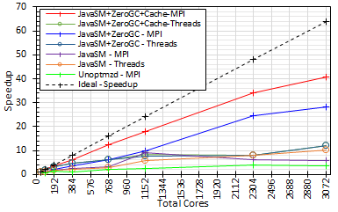
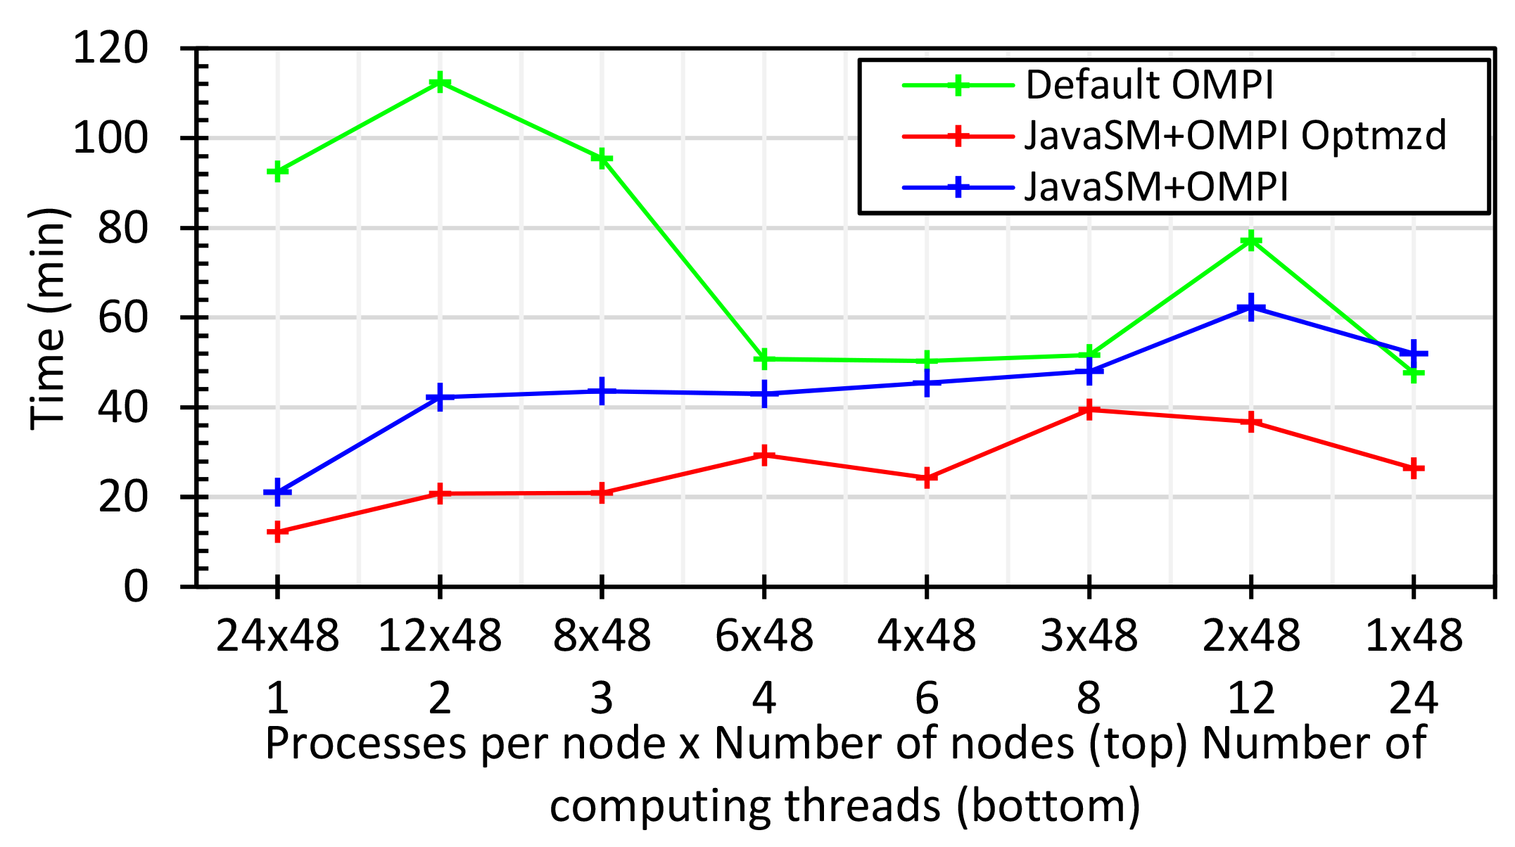
Java MPI performs better than Threads 128 24 core Haswell nodes
200K Dataset Speedup

Slide 8
Things to do for Big Data and (Exascale) Simulation Convergence V
Converge Language: Make Java run as fast as C++ (Java Grande) for computing and communication – see pre vious slide
Surprising that so much Big Data work in industry but basic high performance Java methodology and tools missing
Needs some work as no agreed OpenMP for Java parallel threads
OpenMPI supports Java but needs enhancements to get best performance on needed collectives (For C++ and Java)
Convergence Language Grande should support Python, Java (Scala), C/C++ (Fortran)

