Slide 1
Bioinformatics on Cloud Cyberinfrastructure
Bio-IT
April 14 2011
Geoffrey Fox
gcf@indiana.edu
http://www.infomall.org http://www.futuregrid.org
Director, Digital Science Center, Pervasive Technology Institute
Associate Dean for Research and Graduate Studies, School of Informatics and Computing
Indiana University Bloomington

Slide 2
Abstract
Clouds offer computing on demand plus important platforms capabilities including MapReduce and Data Parallel File systems.
This talk will look at public and private clouds for large scale sequence processing characterizing performance and usability
As well as FutureGrid, an NSF facility supporting such studies.
Work of SALSA Group led by Professor Judy Qiu

Slide 3
Philosophy of
Clouds and Grids
Clouds are (by definition) commercially supported approach to large scale computing
  So we should expect Clouds to replace Compute Grids
  Current Grid technology involves “non-commercial” software solutions which are hard to evolve/sustain
  Maybe Clouds ~4% IT expenditure 2008 growing to 14% in 2012 (IDC Estimate)
Public Clouds are broadly accessible resources like Amazon and Microsoft Azure – powerful but not easy to customize and perhaps data trust/privacy issues
Private Clouds run similar software and mechanisms but on “your own computers” (not clear if still elastic)
  Platform features such as Queues, Tables, Databases currently limited
Services still are correct architecture with either REST (Web 2.0) or Web Services
Clusters are still critical concept for MPI or Cloud software

Slide 4
Cloud Computing:
Infrastructure and Runtimes
Cloud infrastructure: outsourcing of servers, computing, data, file space, utility computing, etc.
  Handled through Web services that control virtual machine lifecycles.
Cloud runtimes or Platform: tools (for using clouds) to do data-parallel (and other) computations.
  Apache Hadoop, Google MapReduce, Microsoft Dryad, Bigtable, Chubby and others
  MapReduce designed for information retrieval but is excellent for a wide range of science data analysis applications
  Can also do much traditional parallel computing for data-mining if extended to support iterative operations
  MapReduce not usually on Virtual Machines

Slide 5
Authentication and Authorization: Provide single sign in to both FutureGrid and Commercial Clouds linked by workflow
Workflow: Support workflows that link job components between FutureGrid and Commercial Clouds. Trident from Microsoft Research is initial candidate
Data Transport: Transport data between job components on FutureGrid and Commercial Clouds respecting custom storage patterns
Program Library: Store Images and other Program material (basic FutureGrid facility)
Blob: Basic storage concept similar to Azure Blob or Amazon S3
DPFS Data Parallel File System: Support of file systems like Google (MapReduce), HDFS (Hadoop) or Cosmos (dryad) with compute-data affinity optimized for data processing
Table: Support of Table Data structures modeled on Apache Hbase/CouchDB or Amazon SimpleDB/Azure Table. There is “Big” and “Little” tables – generally NOSQL
SQL: Relational Database
Queues: Publish Subscribe based queuing system
Worker Role: This concept is implicitly used in both Amazon and TeraGrid but was first introduced as a high level construct by Azure
MapReduce: Support MapReduce Programming model including Hadoop on Linux, Dryad on Windows HPCS and Twister on Windows and Linux
Software as a Service: This concept is shared between Clouds and Grids and can be supported without special attention
Web Role: This is used in Azure to describe important link to user and can be supported in FutureGrid with a Portal framework
Components of a Scientific Computing Platform

Slide 6
MapReduce
Data Partitions
Map(Key, Value)
A hash function maps the results of the map tasks to reduce tasks
Reduce(Key, List<Value>)
Reduce Outputs
Implementations (Hadoop – Java; Dryad – Windows) support:
  Splitting of data
  Passing the output of map functions to reduce functions
  Sorting the inputs to the reduce function based on the intermediate keys
  Quality of service

Slide 7






MapReduce “File/Data Repository” Parallelism
Map = (data parallel) computation reading and writing data
Reduce = Collective/Consolidation phase e.g. forming multiple global sums as in histogram
Instruments
Iterative MapReduce
Map Map Map Map
Reduce Reduce Reduce
Communication
Reduce
Portals
/Users
Disks
Map₁
Map₂
Map₃

Slide 8

All-Pairs Using DryadLINQ
125 million distances
4 hours & 46 minutes
Calculate Pairwise Distances (Smith Waterman Gotoh)
Calculate pairwise distances for a collection of genes (used for clustering, MDS)
Fine grained tasks in MPI
Coarse grained tasks in DryadLINQ
Performed on 768 cores (Tempest Cluster)
Moretti, C., Bui, H., Hollingsworth, K., Rich, B., Flynn, P., & Thain, D. (2009). All-Pairs: An Abstraction for Data Intensive Computing on Campus Grids. IEEE Transactions on Parallel and Distributed Systems , 21, 21-36.

Slide 9
Hadoop VM Performance Degradation
Perf. Degradation = (T_{vm} – T_{baremetal})/T_{baremetal}
15.3% Degradation at largest data set size

Slide 10
Cap3 Performance with
Different EC2 Instance Types
Notes:
Instance Type CPU Cores Memory Local Disk Space Cost per hour
Small 1 1.7 GB 250 GB 0.12$
Medium 2 3.5 GB 500 GB 0.24$
Large 4 7 GB 1000 GB 0.48$
Extra Large 8 15 GB 2000 GB 0.96$

Slide 11
Cap3 Cost
Notes:
This is just the cost for the compute instances. In addition to this, there will be minor charges for the data storage for EMR & AzureMR. Also there will be additional minor charges for the queue service and table service for AzureMR.
Cost presented here are amortized for the actual time (time/3600 * num_instances * instance_price_per_hour), assuming the remaining time of the instance hour have been put to useful work.
Note: EMR & Hadoop-EC2 requires one extra node to act as the master node (included in the cost calculation)

Slide 12
SWG Cost
Notes:
This is just the cost for the compute instances. In addition to this, there will be minor charges for the data storage for EMR & AzureMR. Also there will be additional minor charges for the queue service and table service for AzureMR.
Cost presented here are amortized for the actual time (time/3600 * num_instances * instance_price_per_hour), assuming the remaining time of the instance hour have been put to useful work.
Note: EMR & Hadoop-EC2 requires one extra node to act as the master node (included in the cost calculation)

Slide 13
Smith Waterman:
Daily Effect

Slide 14
Grids MPI and Clouds
Grids are useful for managing distributed systems
  Pioneered service model for Science
  Developed importance of Workflow
  Performance issues – communication latency – intrinsic to distributed systems
  Can never run large differential equation based simulations or datamining
Clouds can execute any job class that was good for Grids plus
  More attractive due to platform plus elastic on-demand model
  MapReduce easier to use than MPI for appropriate parallel jobs
  Currently have performance limitations due to poor affinity (locality) for compute-compute (MPI) and Compute-data
  These limitations are not “inevitable” and should gradually improve as in July 13 2010 Amazon Cluster announcement
  Will probably never be best for most sophisticated parallel differential equation based simulations
Classic Supercomputers (MPI Engines) run communication demanding differential equation based simulations
  MapReduce and Clouds replaces MPI for other problems
  Much more data processed today by MapReduce than MPI (Industry Informational Retrieval ~50 Petabytes per day)

Slide 15
Fault Tolerance and MapReduce
MPI does “maps” followed by “communication” including “reduce” but does this iteratively
There must (for most communication patterns of interest) be a strict synchronization at end of each communication phase
  Thus if a process fails then everything grinds to a halt
In MapReduce, all Map processes and all reduce processes are independent and stateless and read and write to disks
  As 1 or 2 (reduce+map) iterations, no difficult synchronization issues
Thus failures can easily be recovered by rerunning process without other jobs hanging around waiting
Re-examine MPI fault tolerance in light of MapReduce
  Twister interpolates between MPI and MapReduce

Slide 16
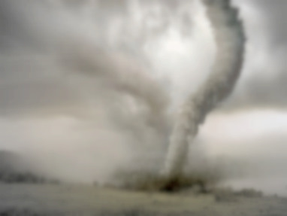
Twister v0.9
March 15, 2011
  New Interfaces for Iterative MapReduce Programming
  http://www.iterativemapreduce.org/
SALSA Group
Bingjing Zhang, Yang Ruan, Tak-Lon Wu, Judy Qiu, Adam Hughes, Geoffrey Fox, Applying Twister to Scientific Applications, Proceedings of IEEE CloudCom 2010 Conference, Indianapolis, November 30-December 3, 2010
Twister4Azure to be released May 2011
MapReduceRoles4Azure available now at
http://salsahpc.indiana.edu/mapreduceroles4azure/

Slide 17

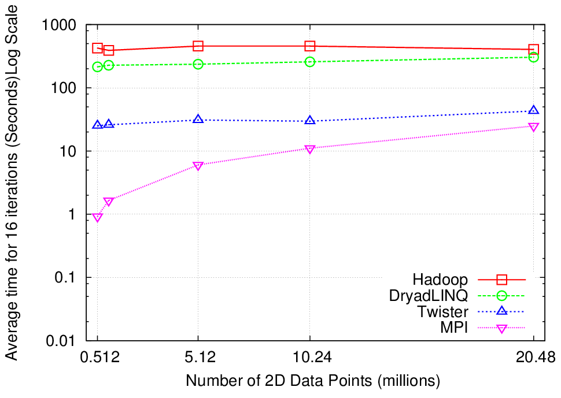
K-Means Clustering
Compute the distance to each data point from each cluster center and assign points to cluster centers
map
map
Time for 20 iterations
reduce
Compute new cluster
centers
User program
Compute new cluster centers
Iteratively refining operation
Typical MapReduce runtimes incur extremely high overheads
  New maps/reducers/vertices in every iteration
  File system based communication
Long running tasks and faster communication in Twister enables it to perform close to MPI

Slide 18


Twister
Pub/Sub Broker Network
Map Worker
M
Worker Nodes
R
Reduce Worker
Streaming based communication
Intermediate results are directly transferred from the map tasks to the reduce tasks – eliminates local files
Cacheable map/reduce tasks
  Static data remains in memory
Combine phase to combine reductions
User Program is the composer of MapReduce computations
Extends the MapReduce model to iterative computations
D
D
MR
Driver
User
Program
M
M
M
M
D
MRDeamon
R
R
R
R
Data Read/Write
Communication
Data Split
File System
Iterate
Static
data
Configure()
User Program
Map(Key, Value)
δ flow
Reduce (Key, List<Value>)
Combine (Key, List<Value>)
Different synchronization and intercommunication mechanisms used by the parallel runtimes
Close()

Slide 19

Performance of Pagerank using
ClueWeb Data (Time for 20 iterations)
using 32 nodes (256 CPU cores) of Crevasse

Slide 20
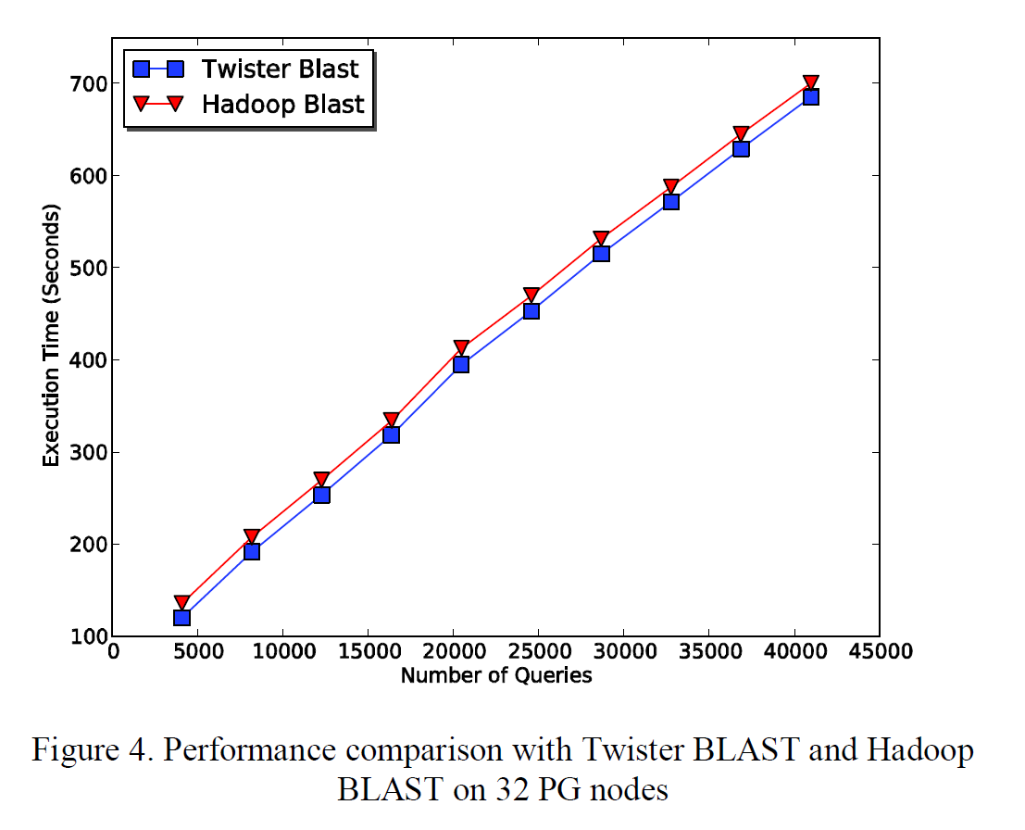
Twister-BLAST vs.
Hadoop-BLAST Performance

Slide 21
Twister4Azure early results

Slide 22
Twister4Azure
Architecture

Slide 23
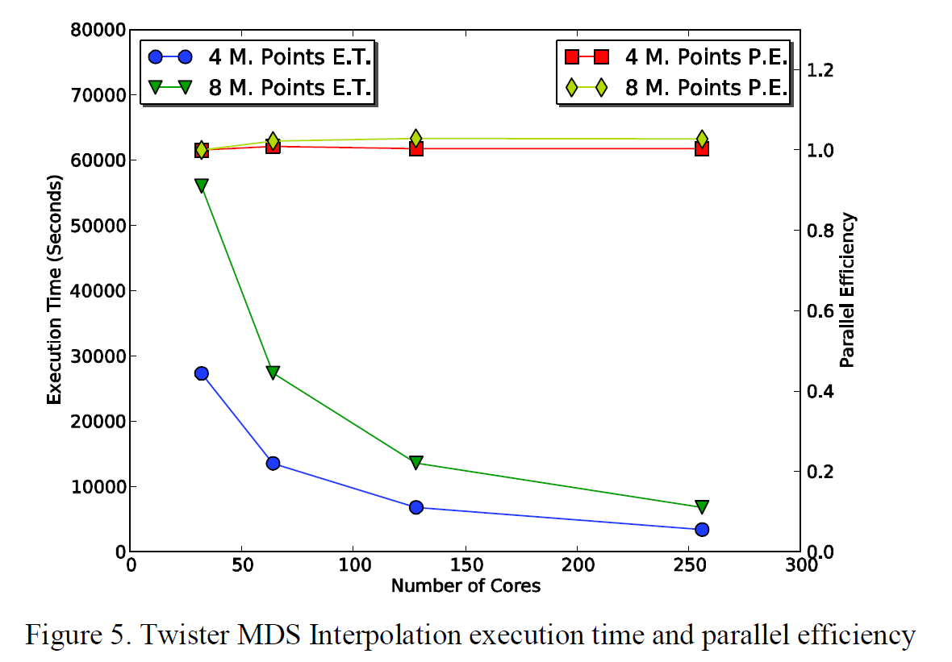
Twister Multidimensional Scaling MDS Interpolation Performance Test

Slide 24
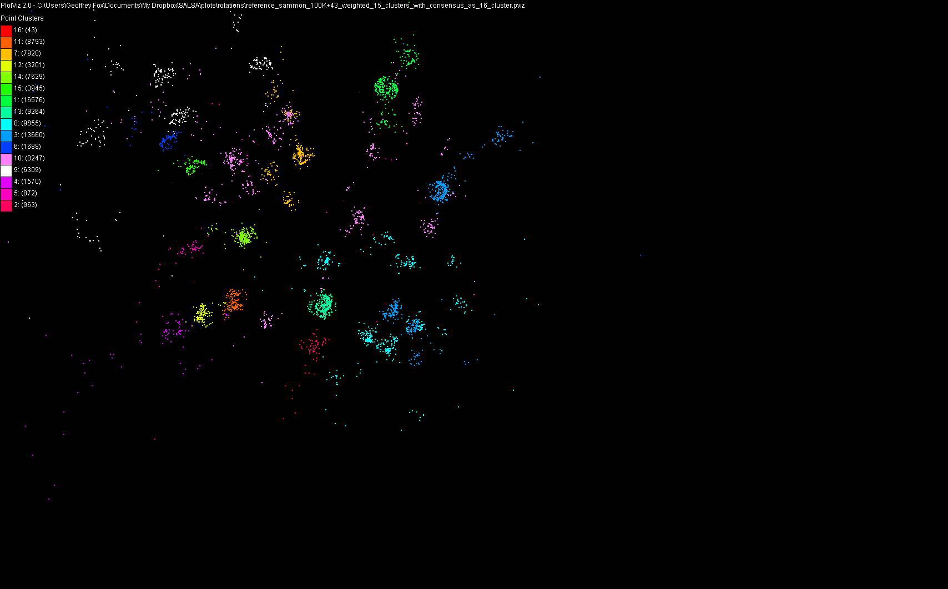
100,043 Metagenomics Sequences

Slide 25
Scaling MDS in Cloud
MDS makes clustering quality very clear
MDS scales like O(N²) and 100,000 points can take several hours on a 1000 cores
Using Twister on Azure and ordinary clusters to run combination of MDS and interpolated MDS which scales like N
Aim to process 20 million points for both MDS and clustering

Slide 26
US Cyberinfrastructure Context
There are a rich set of facilities
  Production TeraGrid facilities with distributed and shared memory
  Experimental “Track 2D” Awards
    FutureGrid: Distributed Systems experiments cf. Grid5000
    Keeneland: Powerful GPU Cluster
    Gordon: Large (distributed) Shared memory system with SSD aimed at data analysis/visualization
  Open Science Grid aimed at High Throughput computing and strong campus bridging

Slide 27
FutureGrid key Concepts I
FutureGrid is an international testbed modeled on Grid5000
Supporting international Computer Science and Computational Science research in cloud, grid and parallel computing (HPC)
  Industry and Academia
  Note much of current use Education, Computer Science Systems and Biology/Bioinformatics
The FutureGrid testbed provides to its users:
  A flexible development and testing platform for middleware and application users looking at interoperability, functionality, performance or evaluation
  Each use of FutureGrid is an experiment that is reproducible
  A rich education and teaching platform for advanced cyberinfrastructure (computer science) classes

Slide 28

FutureGrid key Concepts II
Rather than loading images onto VM’s, FutureGrid supports Cloud, Grid and Parallel computing environments by dynamically provisioning software as needed onto “bare-metal” using Moab/xCAT
  Image library for MPI, OpenMP, Hadoop, Dryad, gLite, Unicore, Globus, Xen, ScaleMP (distributed Shared Memory), Nimbus, Eucalyptus, OpenNebula, KVM, Windows …..
Growth comes from users depositing novel images in library
FutureGrid has ~4000 (will grow to ~5000) distributed cores with a dedicated network and a Spirent XGEM network fault and delay generator
Image1
Image2
…
ImageN
Choose
Load
Run

Slide 29
Dynamic Provisioning Results
Number of nodes
Time elapsed between requesting a job and the jobs reported start time on the provisioned node. The numbers here are an average of 2 sets of experiments.

Slide 30
FutureGrid Partners
Indiana University (Architecture, core software, Support)
Purdue University (HTC Hardware)
San Diego Supercomputer Center at University of California San Diego (INCA, Monitoring)
University of Chicago/Argonne National Labs (Nimbus)
University of Florida (ViNE, Education and Outreach)
University of Southern California Information Sciences (Pegasus to manage experiments)
University of Tennessee Knoxville (Benchmarking)
University of Texas at Austin/Texas Advanced Computing Center (Portal)
University of Virginia (OGF, Advisory Board and allocation)
Center for Information Services and GWT-TUD from Technische Universtität Dresden. (VAMPIR)
Red institutions have FutureGrid hardware

Slide 31

FutureGrid: a Grid/Cloud/HPC Testbed
NID: Network Impairment Device
Private
Public
FG Network

Slide 32
5 Use Types for FutureGrid
~110 approved projects over last 8 months
Training Education and Outreach
  Semester and short events; promising for non research intensive universities
Interoperability test-beds
  Grids and Clouds; Standards; Open Grid Forum OGF really needs
Domain Science applications
  Life sciences highlighted
Computer science
  Largest current category (> 50%)
Computer Systems Evaluation
  TeraGrid (TIS, TAS, XSEDE), OSG, EGI
Clouds are meant to need less support than other models; FutureGrid needs more user support …….

Slide 33
Some Current FutureGrid projects I
Project | Institution | Details
Educational Projects
VSCSE Big Data | IU PTI, Michigan, NCSA and 10 sites | Over 200 students in week Long Virtual School of Computational Science and Engineering on Data Intensive Applications & Technologies
LSU Distributed Scientific Computing Class | LSU | 13 students use Eucalyptus and SAGA enhanced version of MapReduce
Topics on Systems: Cloud Computing CS Class | IU SOIC | 27 students in class using virtual machines, Twister, Hadoop and Dryad
Interoperability Projects
OGF Standards | Virginia, LSU, Poznan | Interoperability experiments between OGF standard Endpoints
Sky Computing | University of Rennes 1 | Over 1000 cores in 6 clusters across Grid’5000 & FutureGrid using ViNe and Nimbus to support Hadoop and BLAST demonstrated at OGF 29 June 2010

Slide 34
Some Current FutureGrid projects II
Domain Science Application Projects
Combustion | Cummins | Performance Analysis of codes aimed at engine efficiency and pollution
Cloud Technologies for Bioinformatics Applications | IU PTI | Performance analysis of pleasingly parallel/MapReduce applications on Linux, Windows, Hadoop, Dryad, Amazon, Azure with and without virtual machines
Computer Science Projects
Cumulus | Univ. of Chicago | Open Source Storage Cloud for Science based on Nimbus
Differentiated Leases for IaaS | University of Colorado | Deployment of always-on preemptible VMs to allow support of Condor based on demand volunteer computing
Application Energy Modeling | UCSD/SDSC | Fine-grained DC power measurements on HPC resources and power benchmark system
Evaluation and TeraGrid/OSG Support Projects
Use of VM’s in OSG | OSG, Chicago, Indiana | Develop virtual machines to run the services required for the operation of the OSG and deployment of VM based applications in OSG environments.
TeraGrid QA Test & Debugging | SDSC | Support TeraGrid software Quality Assurance working group
TeraGrid TAS/TIS | Buffalo/Texas | Support of XD Auditing and Insertion functions

Slide 35

Typical FutureGrid Performance Study
Linux, Linux on VM, Windows, Azure, Amazon Bioinformatics

Slide 36

OGF’10 Demo from Rennes
SDSC
Rennes
Grid’5000 firewall
UF
Lille
UC
Sophia
ViNe provided the necessary inter-cloud connectivity to deploy CloudBLAST across 6 Nimbus sites, with a mix of public and private subnets.

Slide 37
Education & Outreach on FutureGrid
Build up tutorials on supported software
Support development of curricula requiring privileges and systems destruction capabilities that are hard to grant on conventional TeraGrid
Offer suite of appliances (customized VM based images) supporting online laboratories
Supported ~200 students in Virtual Summer School on “Big Data” July 26-30 with set of certified images – first offering of FutureGrid 101 Class; TeraGrid ‘10 “Cloud technologies, data-intensive science and the TG”; CloudCom conference tutorials Nov 30-Dec 3 2010
Experimental class use fall semester at Indiana, Florida and LSU; follow up core distributed system class Spring at IU
Offering ADMI (HBCU CS depts) Summer School on Clouds and REU program at Elizabeth City State University

Slide 38
Software Components
Portals including “Support” “use FutureGrid” “Outreach”
Monitoring – INCA, Power (GreenIT)
Experiment Manager: specify/workflow
Image Generation and Repository
Intercloud Networking ViNE
Virtual Clusters built with virtual networks
Performance library
Rain or Runtime Adaptable InsertioN Service for images
Security Authentication, Authorization,
Note Software integrated across institutions and between middleware and systems Management (Google docs, Jira, Mediawiki)
Note many software groups are also FG users
“Research”
Above and below
Nimbus OpenStack Eucalyptus

Slide 39
FutureGrid Viral Growth Model
Users apply for a project
Users improve/develop some software in project
This project leads to new images which are placed in FutureGrid repository
Project report and other web pages document use of new images
Images are used by other users
And so on ad infinitum ………
Please bring your nifty software up on FutureGrid!!

Slide 40
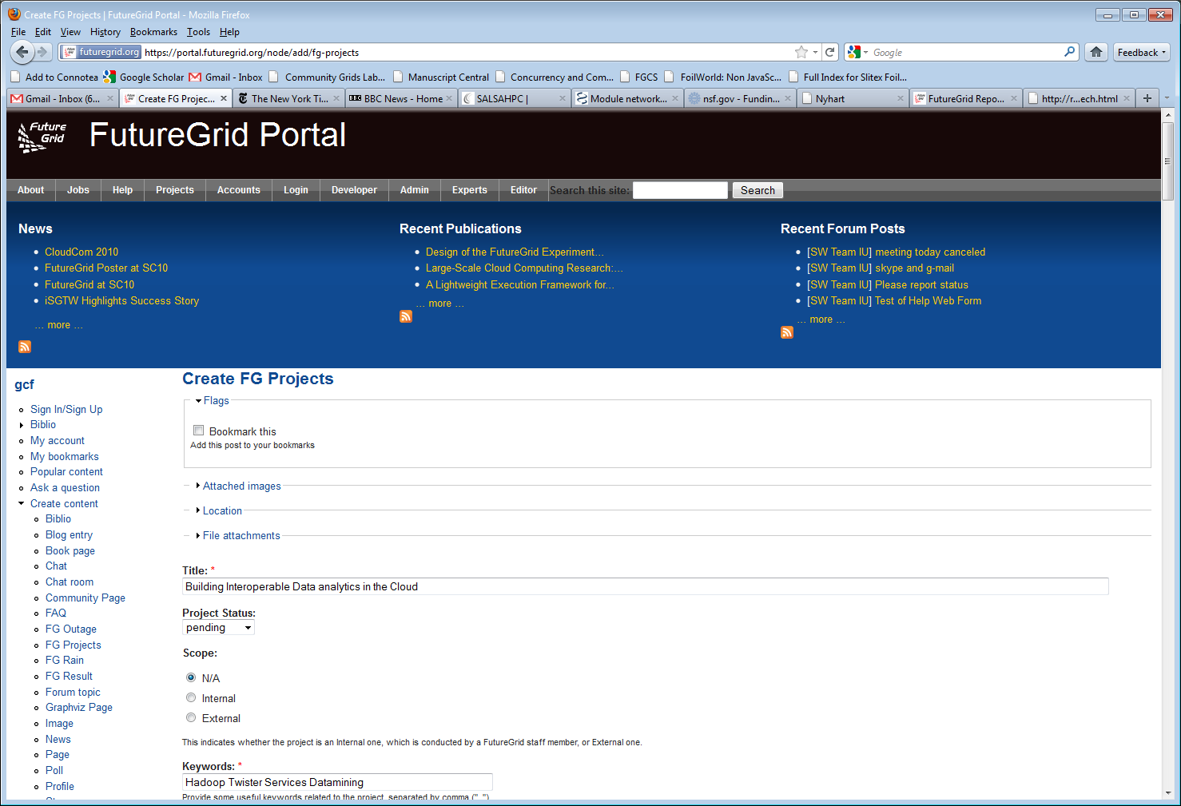
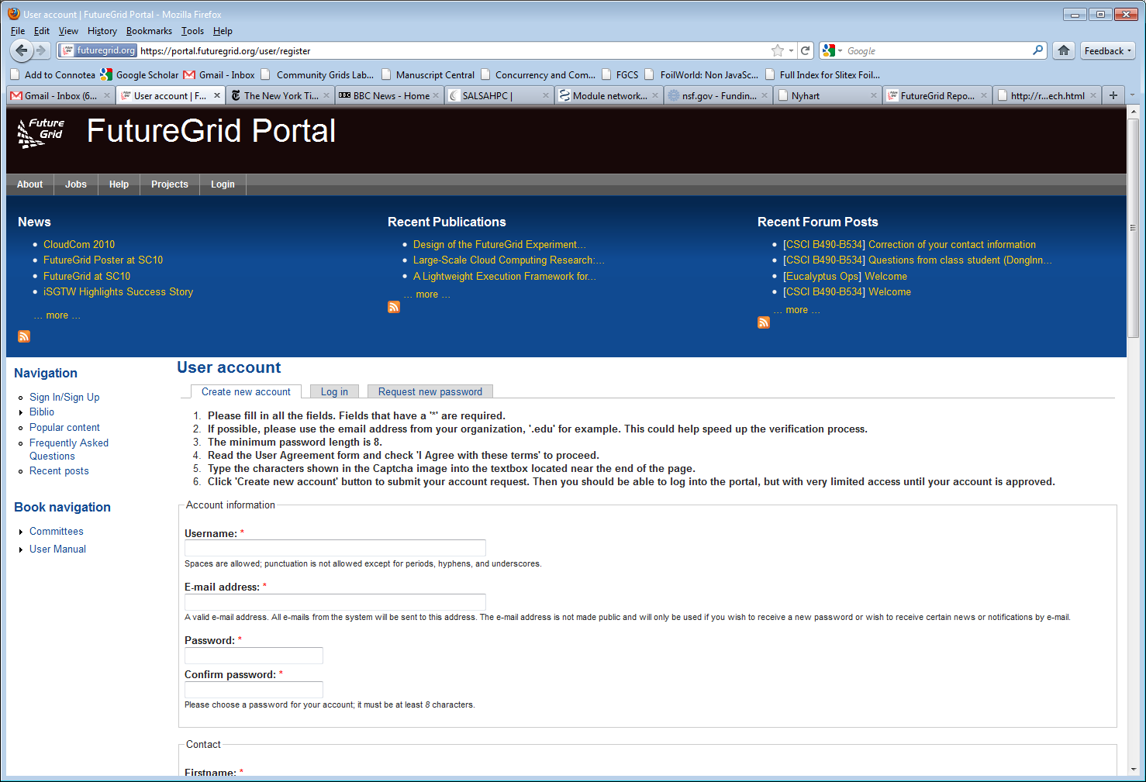
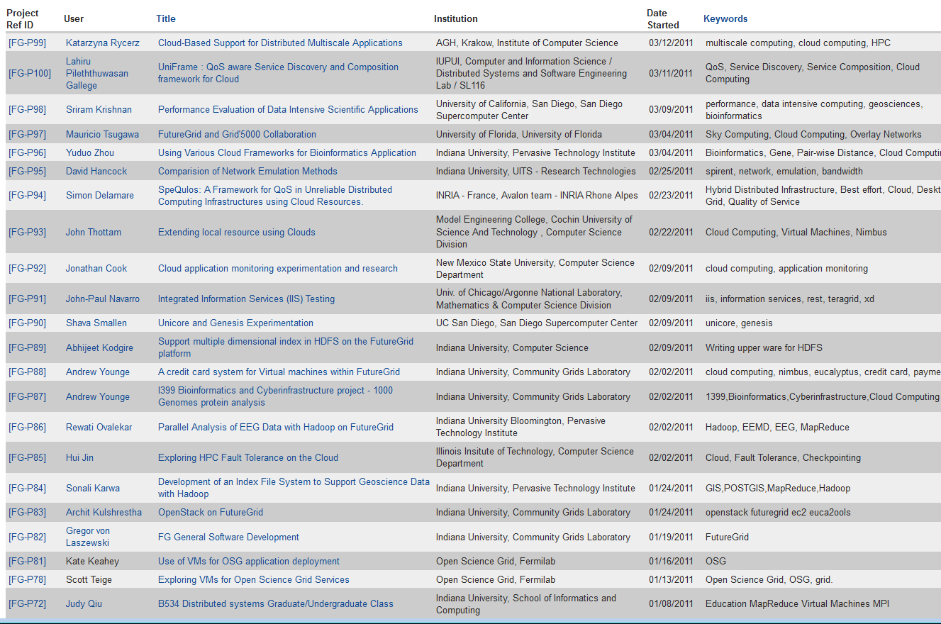
Create a Portal Account and apply for a Project

