Slide 1
Basic Kmeans Clustering and Optimization
March 2019
Geoffrey Fox
gcf@indiana.edu
http://www.infomall.org
School of Informatics, Computing and Engineering
Digital Science Center
Indiana University Bloomington

Slide 2
Kmeans Clustering
http://en.wikipedia.org/wiki/Kmeans

Slide 3
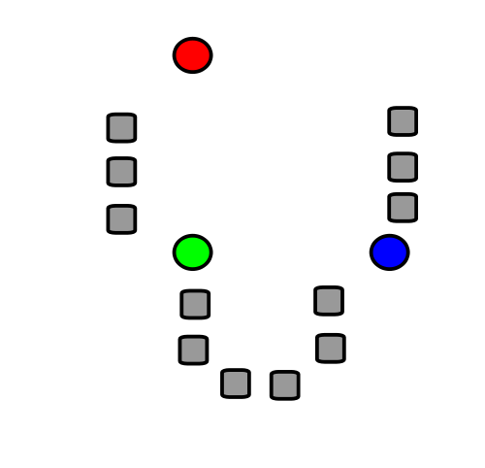
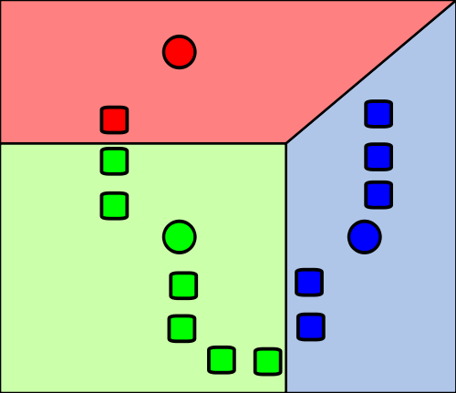
1) k initial "means" (in this case k=3) are randomly generated within the data domain (shown in color).
2) k clusters are created by associating every observation with the nearest mean. The partitions here represent the Voronoi diagram generated by the means.
Wikipedia

Slide 4
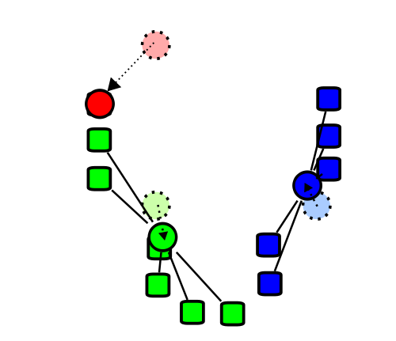
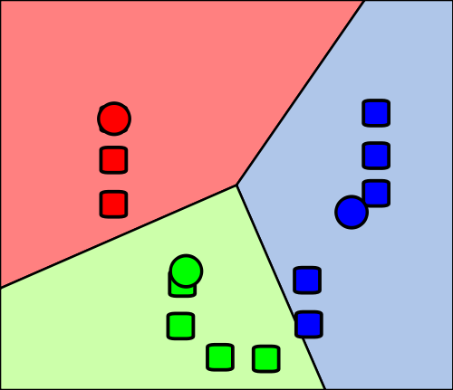
4) Steps 2 and 3 are repeated until convergence has been reached.
But red and green centers (circles) are clearly in wrong place!!! (stars added by me about right for centers)
3) The centroid of each of the k clusters becomes the new mean.
Wikipedia

Slide 5
Clustering of Recommender System Example

Slide 6
A small Example
This uses a Dating data of 1000 points in 3 dimensions with a rating of 3 categories assigned to points. Comes from “Machine Learning in Action” by Peter Harrington
https://github.com/pbharrin/machinelearninginaction/blob/master/Ch02/datingTestSet2.txt
Compares original labelling of points with a fresh clustering into 3 clusters (using deterministic annealing advanced method in paper but k means similar)
Fresh clustering has centers marked
The 1000 points are identically placed in side by side pictures
The plots are projected to 2 dimensions

Slide 7
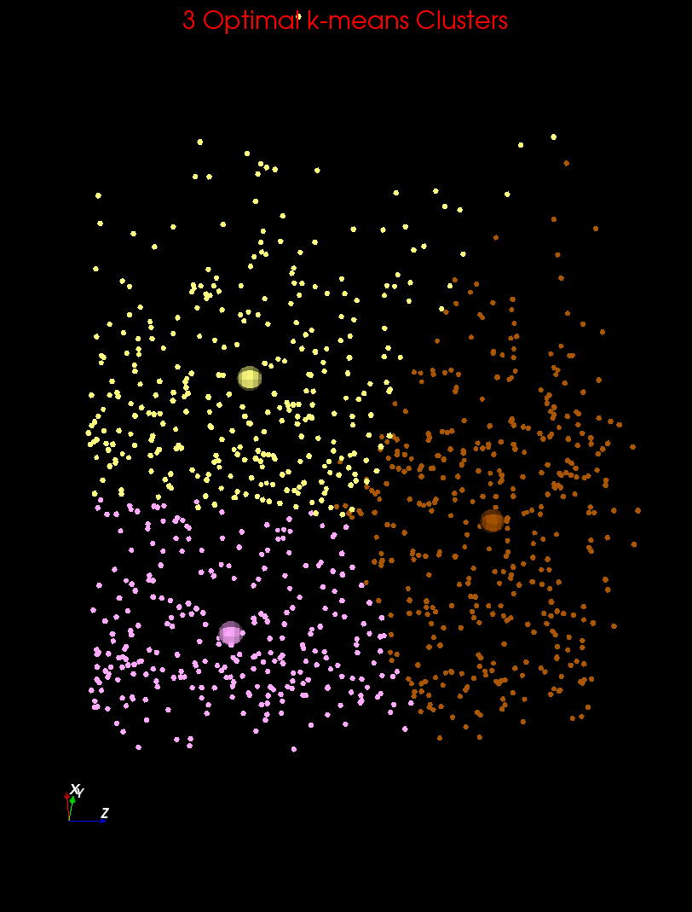
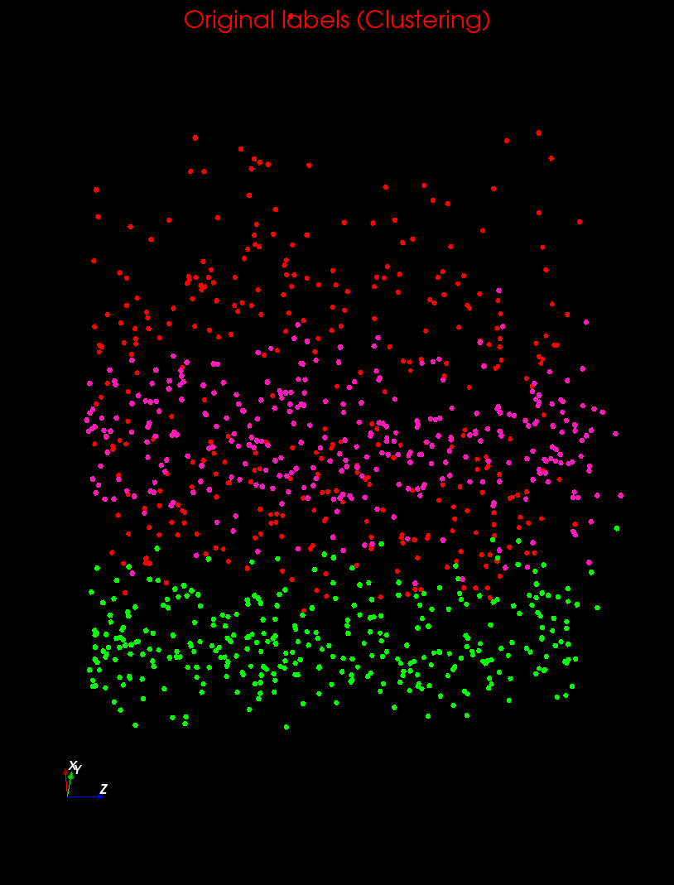
Clustering v User Rating I

Slide 8
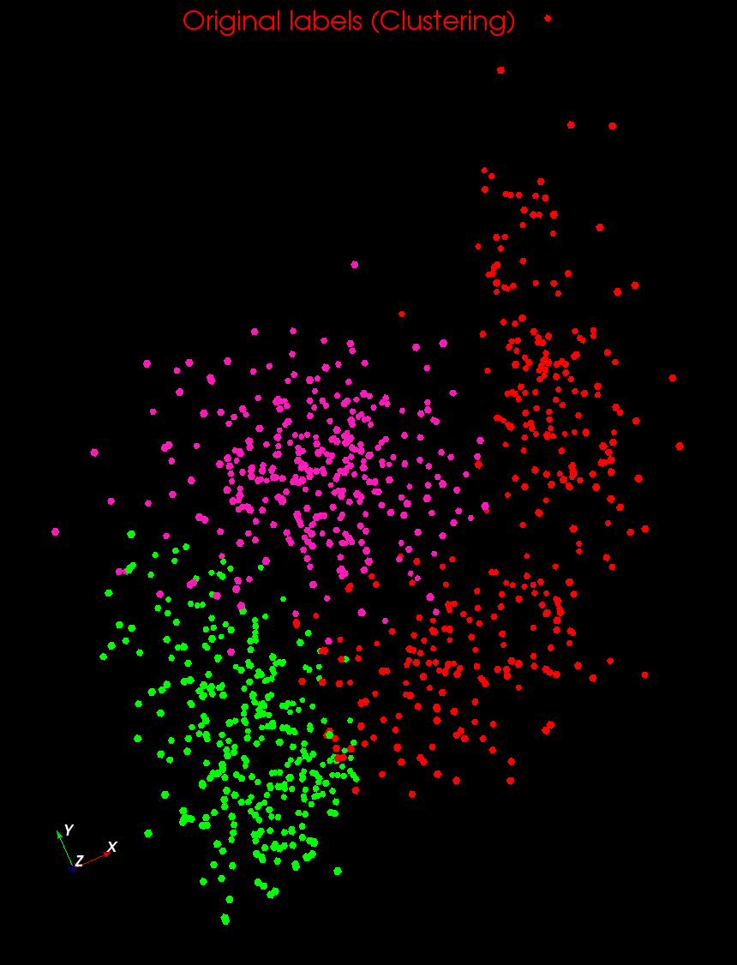
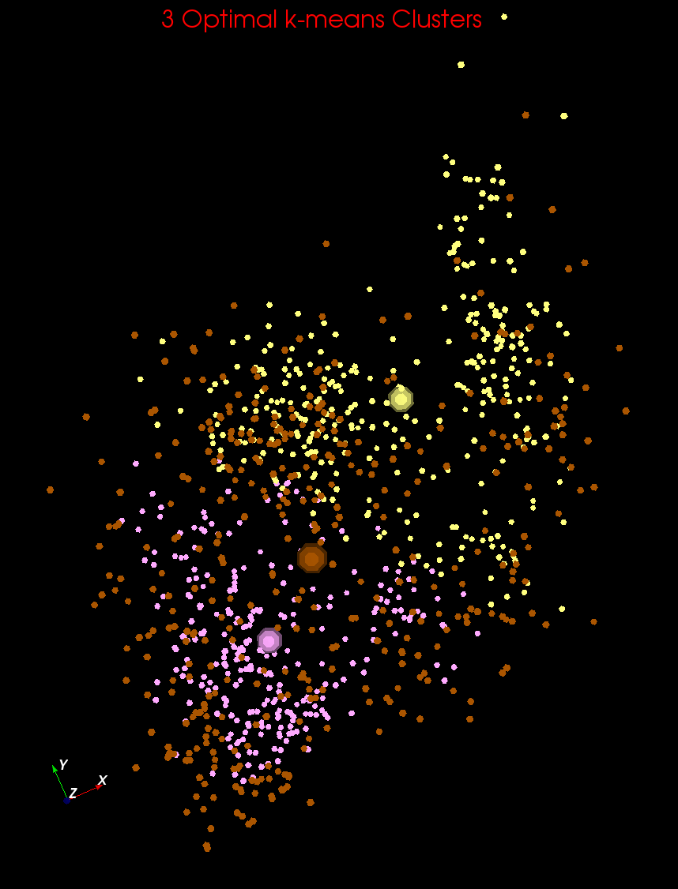
Clustering v User Rating II

Slide 9
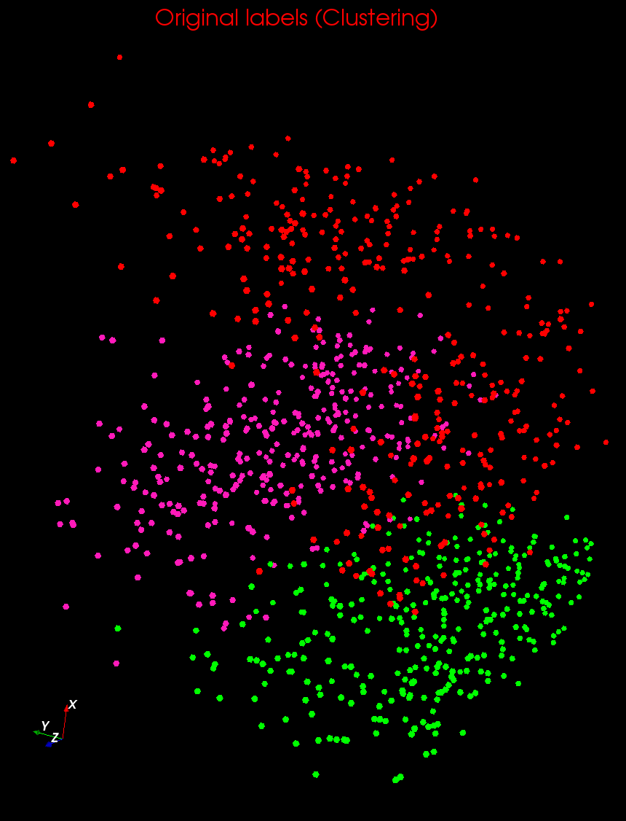
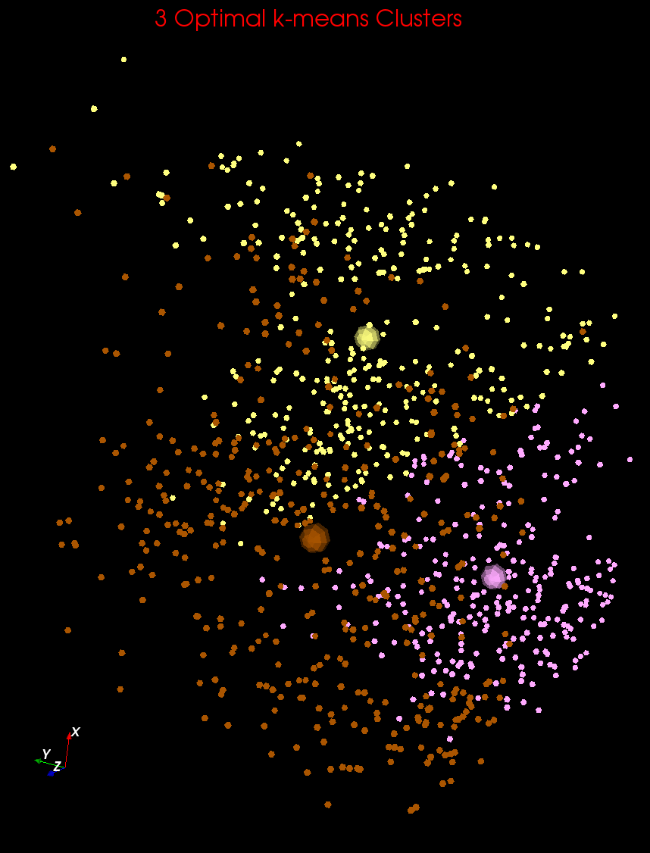
Clustering v User Rating III

Slide 10
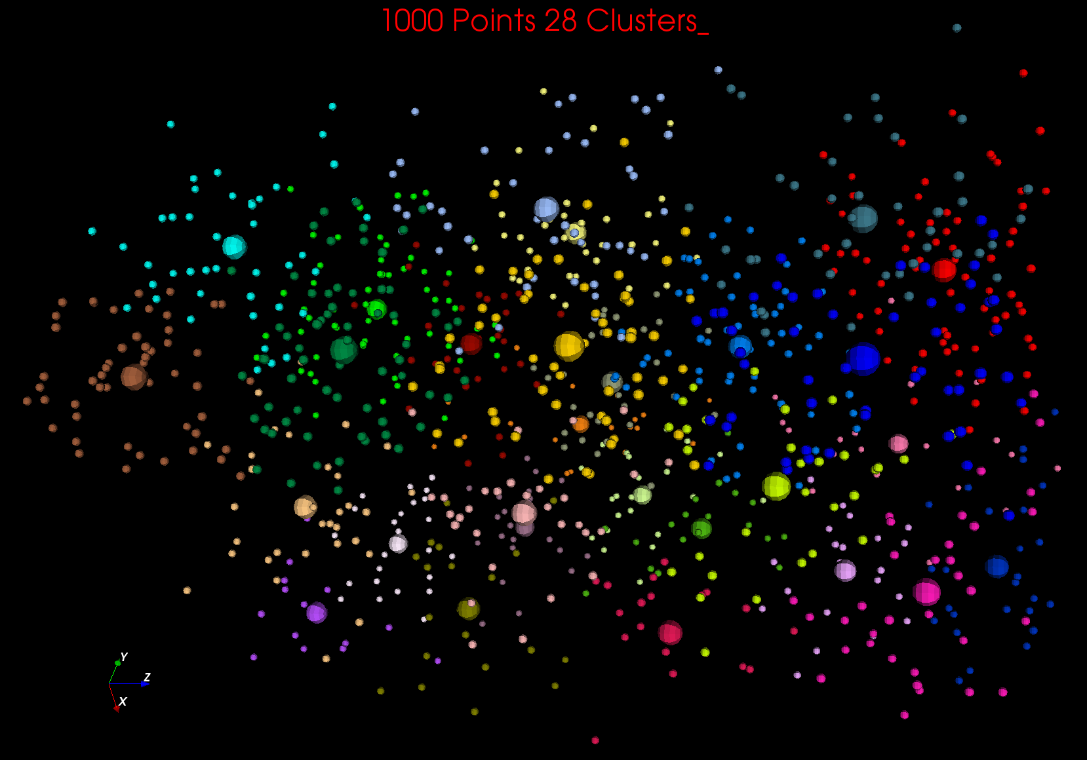

Slide 11
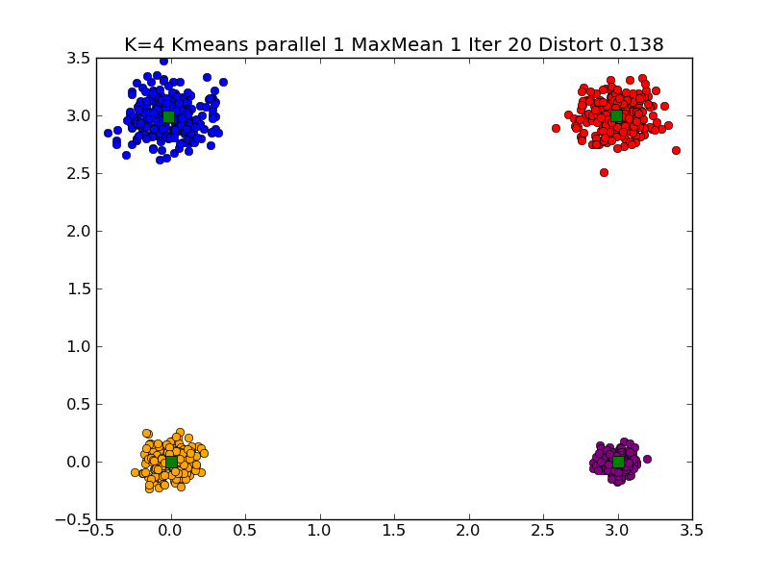
Typical K=4 Small Clustering

Slide 12
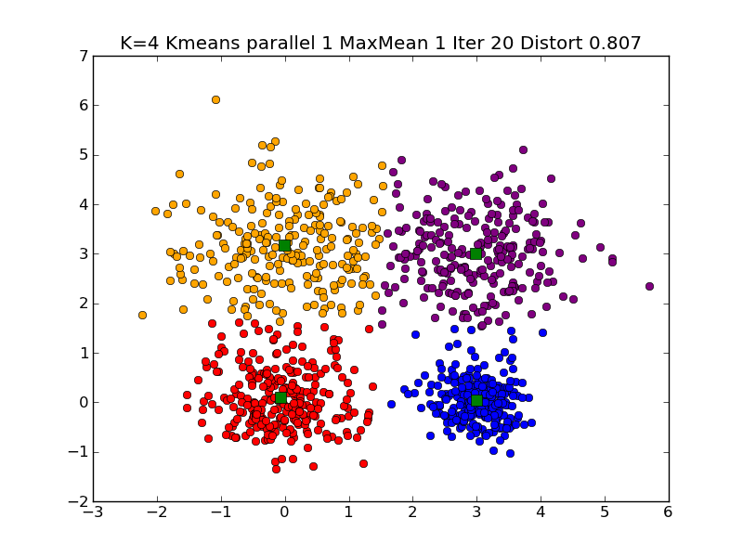
Typical K=4 Very Large Clustering

Slide 13
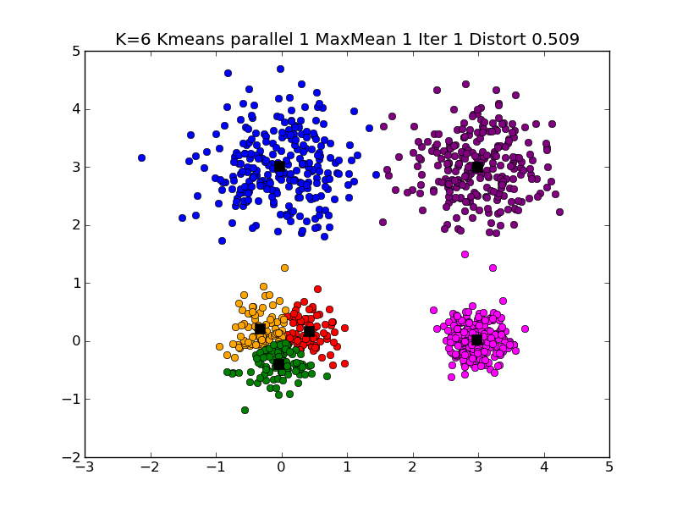
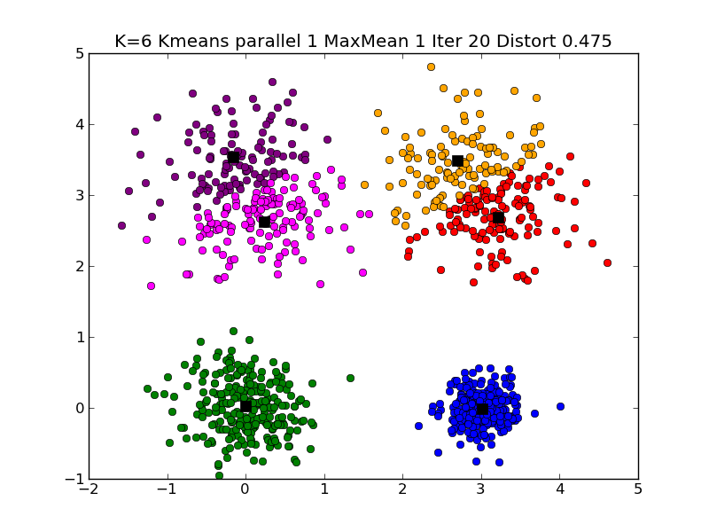
Typical K=6 Large Clustering

Slide 14
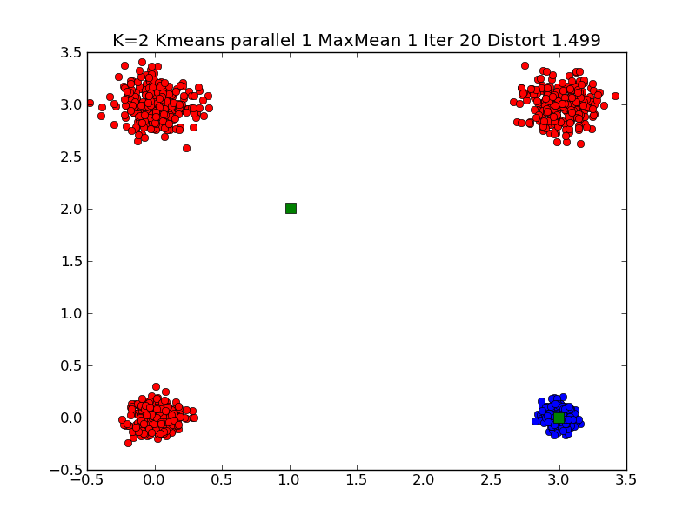
Note Symmetry related solutions
A second look at a different solution of K=2 Small Clustering

Slide 15
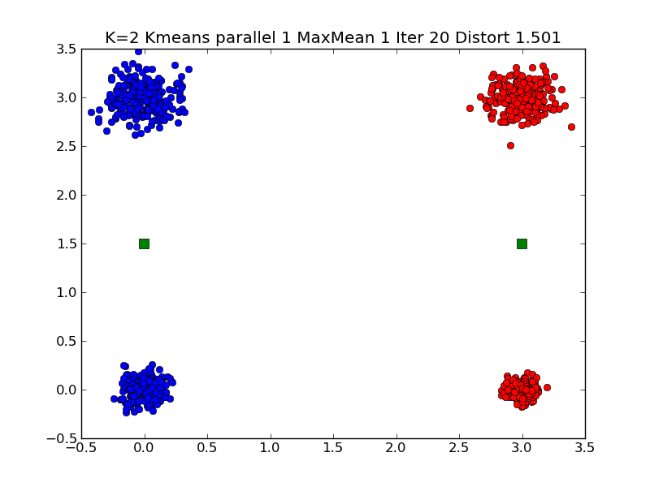
Typical K=2 Small Clustering

Slide 16
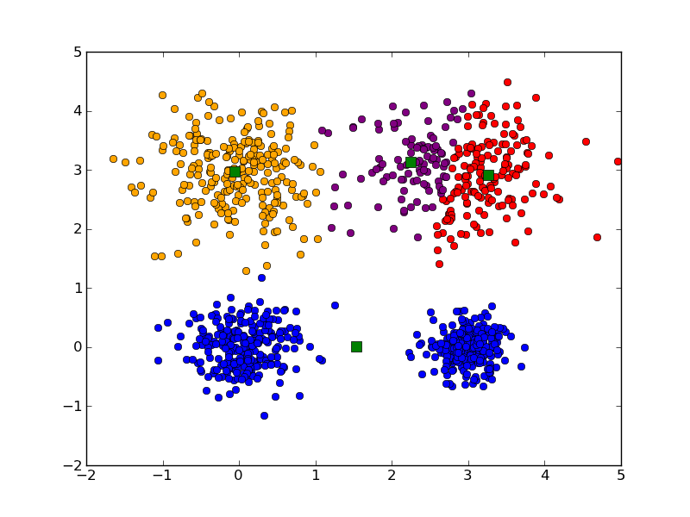
Messy K=4 large Clustering

Slide 17
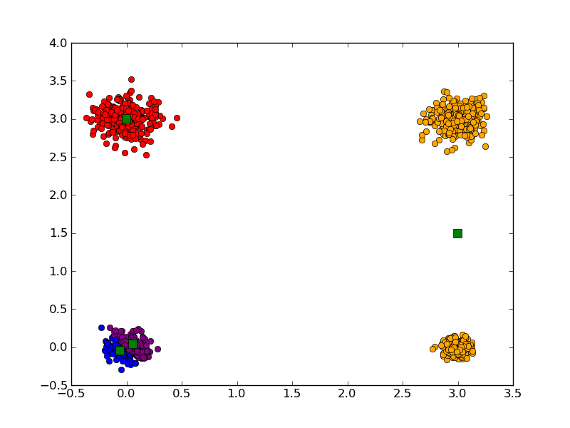
Messy K=4 Small Clustering

Slide 18
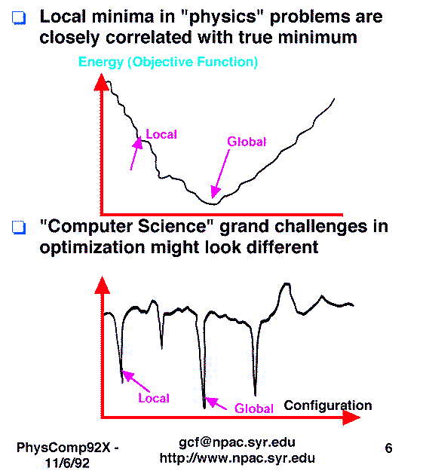
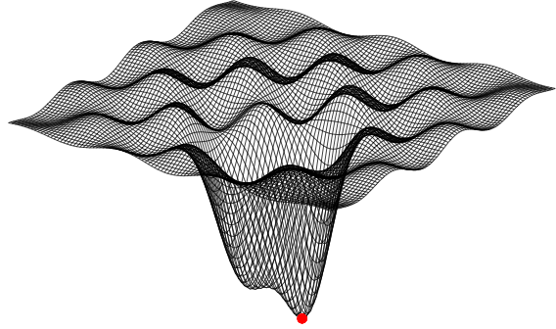
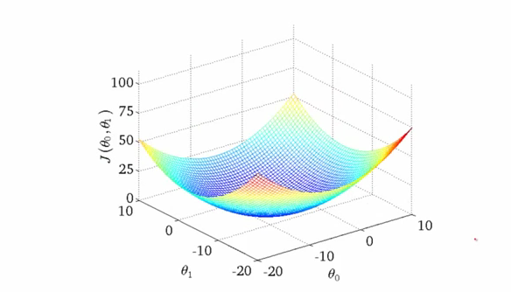
Local Optima in Clustering

Slide 19
Getting the wrong answer
Remember all things in life – including clustering – are optimization problems
Lets say it’s a minimization (change sign if maximizing)
k means always ends at a minimum but maybe a local minimum out of which small changes are stable
We will see examples of false minima later in course in Kmeans with Python lesson
Initial Position
Unhappiness
Local Minimum Wrong Answer
Real Minimum
Center Positions

Slide 20
Annealing
Physics systems find true lowest energy state if you anneal i.e. you equilibrate at each temperature as you cool
Allow atoms to move around
If system cools too fast it finds a false minima
Corresponds to fuzzy algorithms

Slide 21
Annealing
Objective Function
Fixed Temperature – false minima
T3
Annealing -- correct minima
T3
T2
T2
T3 < T2 < T1
T1
T1
Configuration – Center Positions Y(k)

Slide 22
Greedy Algorithms
Many algorithms like k Means are greedy
They consist of iterations
Each iterations makes the step that most obviously minimizes function
Set of short term optima; not always global optima
Same is true of life (politics, wall street)

Slide 23
General Optimization Problem
Have a function E that depends on up to billions of parameters
Can always make optimization as minimization
Often E guaranteed to be positive as sum of squares
“Continuous Parameters” – e.g. Cluster centers
Expectation Maximization
“Discrete Parameters” – e.g. Assignment problems
Genetic Algorithms
Some methods just use function evaluations
Safest methods – Calculate first but not second Derivatives
Expectation Maximization
Steepest Descent always gets stuck but always decreases E
One dimension – line searches – very easy
Fastest Methods – Newton’s method with second derivatives
Always diverges in naïve version
For least squares, second derivative of E only needs first derivatives of components
Constraints
Use penalty functions

Slide 24
Some Examples
Clustering. Optimize position of clusters to minimize least squares sum of (particle position – center position)²
Analysis of CReSIS snow layer data. Optimize continuous layers to reproduce observed radar data
Dimension reduction MDS. Assign 3D position to each point to minimize least sum of (original distance – Euclidean distance)² for each point pair
Web Search. Find web pages that are “nearest your query”
Recommender Systems. Find movies (Netflix), books (Amazon) etc. that you want and which will cause you to spend as much money on site that originator will get credit
Deep learning: Optimize classification (learning of features) of faces etc.
Distances in “funny spaces” often important

Slide 25
Distances in Funny Spaces I
In user-based collaborative filtering, we can think of users in a space of dimension N where there are N items and M users.
Let i run over items and u over users
Then each user is represented as a vector U_{i}(u) in “item-space” where ratings are vector components. We are looking for users u u’ that are near each other in this space as measured by some distance between U_{i}(u) and U_{i}(u’)
If u and u’ rate all items then these are “real” vectors but almost always they each only rates a small fraction of items and the number in common is even smaller
The “Pearson coefficient” is just one distance measure that can be used
Only sum over i rated by u and u’
Last.fm uses this for songs as does Amazon, Netflix

Slide 26
Distances in Funny Spaces II
In item-based collaborative filtering, we can think of items in a space of dimension M where there are N items and M users.
Let i run over items and u over users
Then each item is represented as a vector R_{u}(i) in “user-space” where ratings are vector components. We are looking for items i i’ that are near each other in this space as measured by some distance between R_{u}(i) and R_{u}(i’)
If i and i’ rated by all users then these are “real” vectors but almost always they are each only rated by a small fraction of users and the number in common is even smaller
The “Cosine measure” is just one distance measure that can be used
Only sum over users u rating both i and i’

Slide 27
Distances in Funny Spaces III
In content based recommender systems, we can think of items in a space of dimension M where there are N items and M properties.
Let i run over items and p over properties
Then each item is represented as a vector P_{p}(i) in “property-space” where values of properties are vector components. We are looking for items i i’ that are near each other in this space as measured by some distance between P_{p}(i) and R_{p}(i’)
Properties could be “reading age” or “character highlighted” or “author” for books
Properties can be genre or artist for songs and video
Properties can characterize pixel structure for images used in face recognition, driving etc.
Pandora uses this for songs (Music Genome) as does Amazon, Netflix

Slide 28
Do we need “real” spaces?
Much of AI analysis involves “points”
Events in particle physics analysis
Users (people) or items (books, jobs, music, other people)
These points can be thought of being in a “space” or “bag”
Set of all books
Set of all physics reactions
Set of all Internet users
However as in recommender systems where a given user only rates some items, we don’t know “full position”
However we can nearly always define a useful distance d(a,b) between points
Always d(a,b) >= 0
Usually d(a,b) = d(b,a)
Rarely d(a,b) + d(b,c) >= d(a,c) Triangle Inequality

Slide 29
Using Distances
The simplest way to use distances is “nearest neighbor algorithms” – given one point, find a set of points near it – cut off by number of identified nearby points and/or distance to initial point
Here point is either user or item
Another approach is divide space into regions (topics, latent factors) consisting of nearby points
This is clustering
Also other algorithms like Gaussian mixture models or Latent Semantic Analysis or Latent Dirichlet Allocation which use a more sophisticated model

Slide 30
Clustering in General

Slide 31
Purpose of Clustering
This is used in several somewhat different ways
First is taking a set of points in a space and divide into distinct groups with (clear) separation
Second is dividing points into neighboring points but not groups that are separate
There are also latent factor and mixture models which use a different definition of cluster that adds probabilities
These are used to group “items” together in content based approaches
Further one has methods/applications that work in
Real vector spaces
Spaces in which there are no vectors but some or all of distances defined

Slide 32
Clusters v. Regions
Lymphocytes 4D
Pathology 54D
In Lymphocytes clusters are distinct; DA useful
In Pathology, clusters divide space into regions and sophisticated methods like deterministic annealing are probably unnecessary

Slide 33
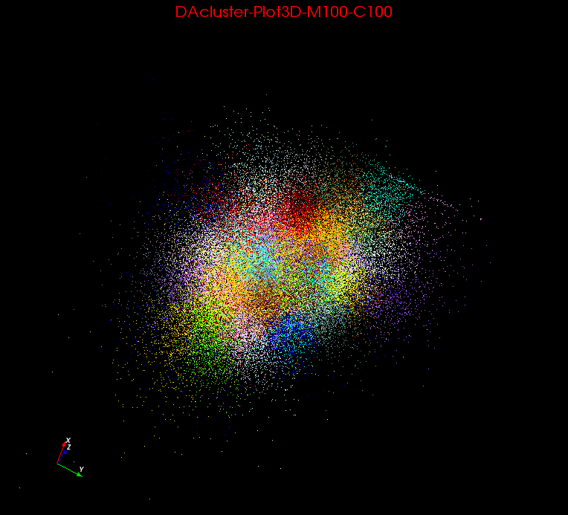
“Clustering in Pathology Images”
Originally 54 features. 8 or 100 clusters

Slide 34
Heuristics
http://en.wikipedia.org/wiki/Heuristics

Slide 35
Heuristics (Wikipedia)
In computer science, artificial intelligence, and mathematical optimization, a heuristic is a technique designed for solving a problem more quickly when classic methods are too slow, or for finding an approximate solution when classic methods fail to find any exact solution. This is achieved by trading optimality, completeness, accuracy, and/or precision for speed.
Results about NP-hardness in theoretical computer science make heuristics the only viable option for a variety of complex optimization problems that need to be routinely solved in real-world applications.
Clustering is NP hard although collaborative filtering is just “hard” and computationally intractable for real time use
Roughly NP hard means only (known) exact algorithms are exponential and not polynomial in time to solve

Slide 36
Heuristics II
Collaborative Filtering (user based) is O(MN) for M customers and N items which is polynomial
Clustering is harder to estimate as we don’t have an exact algorithm
There is combinatorial estimate K^{M} where we loop over K assignments for each of M items (K number of clusters)
This is exponential
Note many real world problems are intrinsically “inexact” as
Don’t have exact data
Don’t have exact problem
So heuristics are often/usually just fine and IMHO exponential behavior (NP hard from previous slide) is not so difficult in practice

