Slide 1
BDEC Perspectives on AI Benchmarking
Geoffrey Fox, Shantenu Jha, November 19, 2019 AIBench: Toward a Comprehensive AI Benchmark Suite for HPC, Datacenter, Edge, and IoT
SC19 BOF, Denver, Colorado, USA
gcf@indiana.edu, http://www.dsc.soic.indiana.edu/, http://spidal.org/

Slide 2
Next Generation of Cyberinfrastructure: BDEC2 Overarching Principles
We want to discover a very small number of classes of Hardware-Software systems that together will support all major Cyberinfrastructure (CI) needs for researchers in the next 5 years. It is unlikely to be a single class but a small number of shared major system classes will be attractive as it
Implies not many distinct software stacks and hardware types to support
The size of resources in any area goes like Fixed Total Budget/Number of distinct types and so will be larger if we just have a few key types.
Note projects like BDEC2 are aiming at new systems and possibly constraints from continuity to the past may be less important than for production systems deployed today.
Almost by definition, any big data computing must involve HPC technologies but not necessarily classic HPC systems.
The growing demand from Big Data and from the use of ML with simulations (MLAutotuning, MLaroundHPC) implies new demands for new algorithms and new ideas for hardware/software of the supporting cyberinfrastructure CI.
The AI for science initiative from DoE will certainly need new CI
We will term the systems as HPC if they involve an HPC edge such as Google edge TPU. Both Cloud and Edge are Intelligent

Slide 3
Next Generation of Cyberinfrastructure: Application Requirements
Four classes of applications are
Classic Big Data Analytics as in the analysis of LHC data, SKA, Light sources, health, NASA and environmental data.
Cloud-Edge applications which certainly overlap with 1) as data in many fields comes from the edge
Integration of ML and Data analytics with simulations. “learning everywhere”,
Classic simulations which are addressed excellently by DoE exascale program and although our focus is Big Data, one should consider this application area as we need to integrate simulations with data analytics and ML (Machine Learning) -- item 3) above

Slide 4
What Benchmarks are meaningful?
Benchmarks should correspond to types of problems that are important or at least commonly used
Local Machine Learning running on single cores or nodes (many pleasing parallel instances)
Global machine learning running parallelized codes
This is Capability v Capacity (HTC) classification
a) is perhaps most common commercially and corresponds to a framework OpenWhisk/Spark launching ML as in R or Scikit-Learn instances. This benchmark depends on
Function as a Service capability of launcher (OpenWhisk/Spark)
Performance of R or Scikit-Learn instance
Suitable for cloud-native implementation
b) is perhaps most interesting to me as a parallel computing researcher. This benchmark depends on
Ability of launching environment to support parallel computing with communication performance etc.
Quality and nature of parallelization (Model parallelism or Data parallelism)

Slide 5
Global machine learning running parallelized codes
Today b) seems to be becoming dominated by deep learning which seems most effective and innovative Big Data approach.
PyTorch, Tensorflow, MXNET and not R or Spark+Mllib are favorite systems
But Spark, Flink etc. are still used to “wrap” or prepare data for DL systems.
MLPerf has a large set of “commercially interesting” deep learning training and inference benchmarks
Tony Hey adding scientific benchmarks
MLPerf shows importance of data parallelism versus model parallelism
What are the best benchmarks for “to wrap or prepare data for parallel DL systems”
System wide benchmarks
“Operators” in Spark
Edge applications
Dataflow / workflow applications
Plus non-DL examples of importance such as Terasort

Slide 6
Implications of Specialized AI Hardware
Currently GPU’s (and TPU’s) can be used to speedup both Deep Learning and Simulations
However we are likely to see specialized AI hardware which is
Only useful for machine learning
In fact only useful for deep learning and particular variants thereof
That impacts significance of benchmark in a machine used for DL and other computing
And will be very important when you need to run ML as an integrated part of a job which is doing simulations or other significant computing
MLforHPC shows this

Slide 7
Implications of Machine Deep Learning for HPC and HPC for Machine Deep Learning
I use HPC (not Systems as in Jeffrey Dean’s NeurIPS talk) as we are aiming at systems that support big data or big simulations and almost by (my) definition should naturally involve HPC.
So we get ML for HPC and HPC for ML
HPC for ML is very important but has been quite well studied and understood
It makes data analytics run much faster and is key part of Benchcouncil and MLPerf
ML for HPC is transformative both as a technology and for application progress enabled
If it is ML for HPC running ML, then we have the creepy situation of the AI supercomputer improving itself
ML operationally DL at the moment!

Slide 8
MLaroundHPC and MLAutotuningHPC
Use Computation to represent Simulation or Big Data
Improving Computations with Configurations and Integration of Data
Autotuning of initial and running configuration; data assimilation
Learn Structure, Theory and Model for Computations
Learn potentials, support cross-scale integration; learn microscale structure; derive fundamental theories
Generate smart ensembles and collective coordinates
Learn Surrogates for Simulations
Can be input specifications mapped into output features
Can be combined with experimental observation over same input specifications
Or input field values mapped to output field values
ML gives speedup factors from 2 (static Autotuning) to 10^{N} (N=5-8 in specific cases) from surrogates with strong speedup (fixed problem speedup)

Slide 9
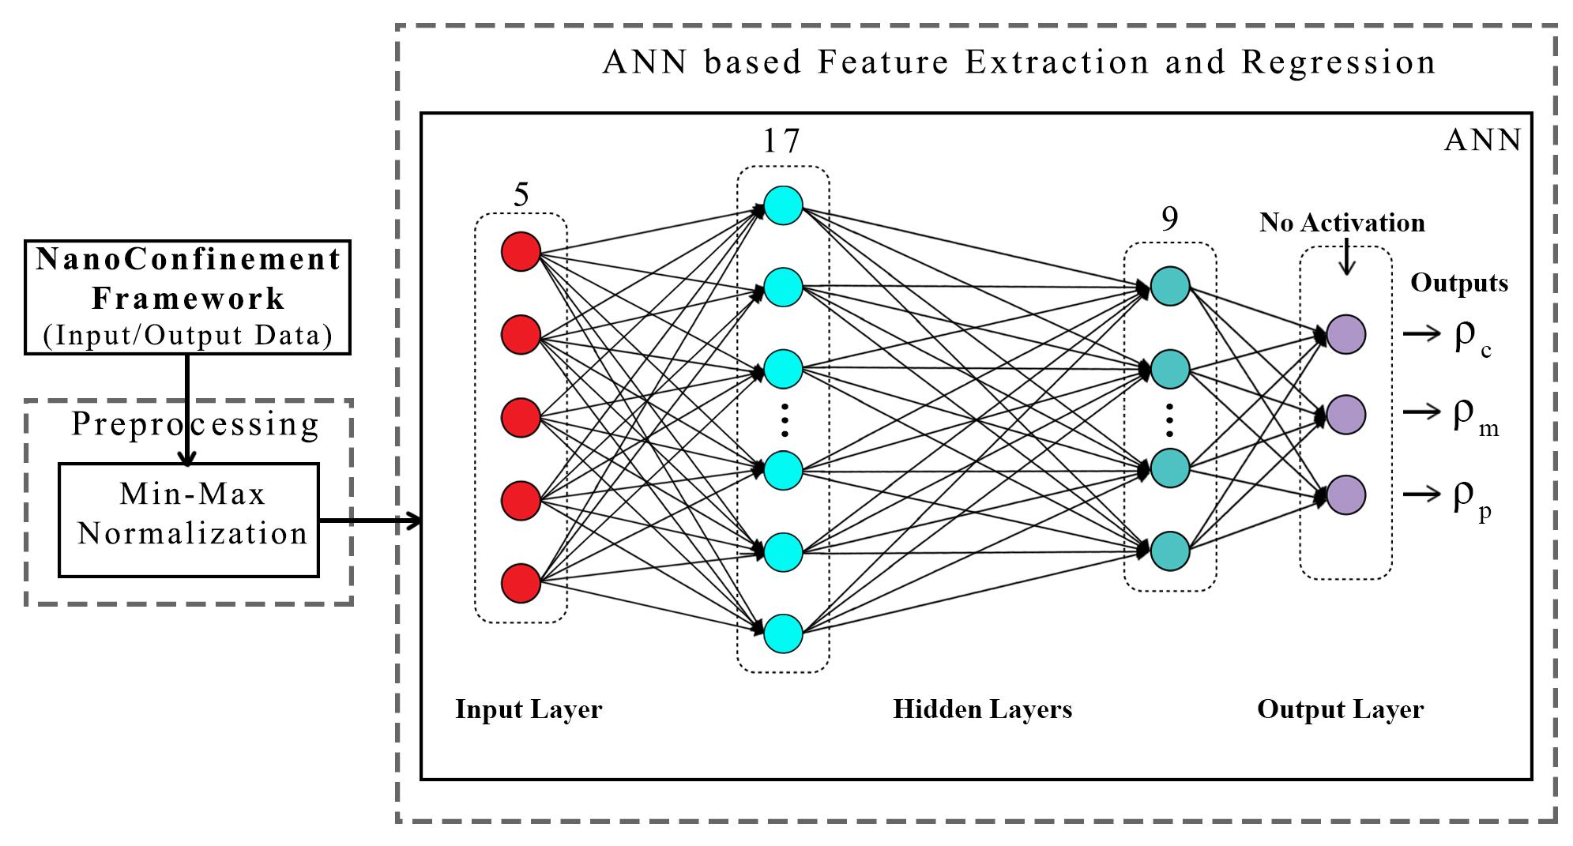
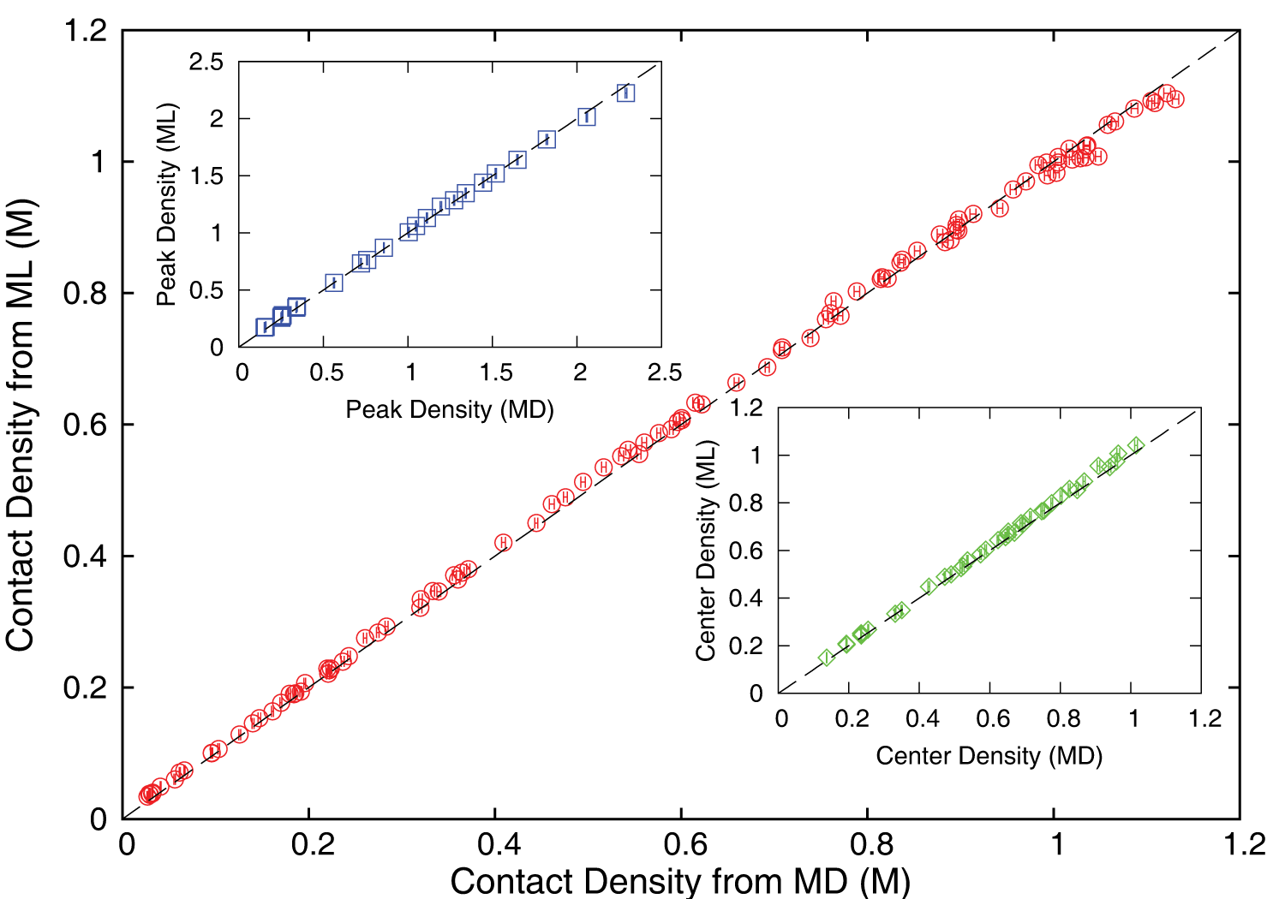
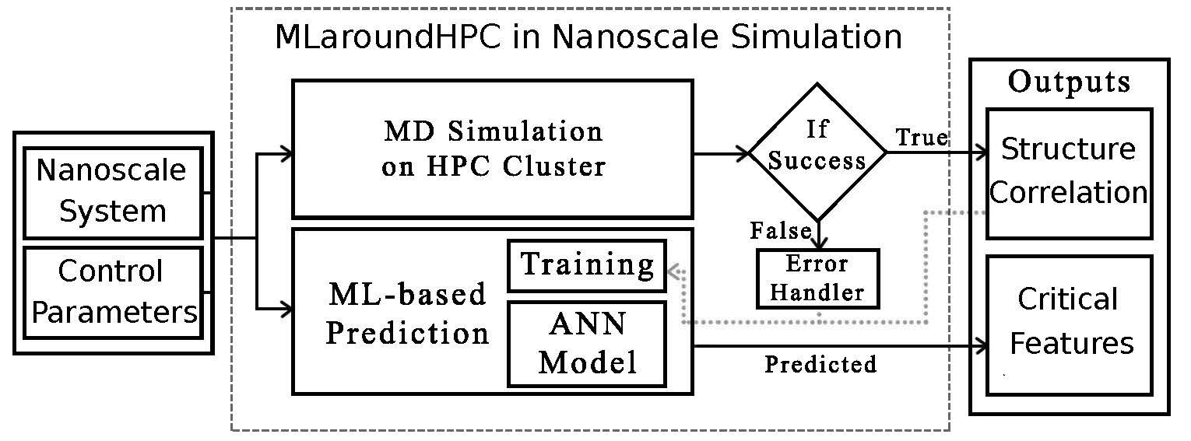
MLaroundHPC: Machine learning for performance enhancement with Surrogates of molecular dynamics simulations
Work with JCS Kadupitiya and Vikram Jadhao
Employed to extract the ionic structure in electrolyte solutions confined by planar and spherical surfaces.
Written with C++ and accelerated with hybrid MPI-OpenMP.
MLaroundHPC successfully learns desired features associated with the output ionic density that are in excellent agreement with the results from explicit molecular dynamics simulations.
Deployed on nanoHub where surrogates particularly useful in education
Speedup 10⁵
ML-Based Simulation Prediction ANN Model
Training
Inference

Slide 10
Speedup of MLaroundHPC
T_{seq} is sequential time
T_{train} time for a (parallel) simulation used in training ML
T_{learn} is time per point to run machine learning
T_{lookup} is time to run inference per instance
N_{train} number of training samples
N_{lookup} number of results looked up
Becomes T_{seq}/T_{train} if ML not used
Becomes T_{seq}/T_{lookup} (10⁵ in our case) if inference dominates (will overcome end of Moore’s law and win the race to zettascale)
Another factor as inferences uses one core; parallel simulation 128 cores
Speedup is strong (not weak with problem size increasing to improve performance) scaling as size fixed
N_{train} is 7K to 16K in our work

Slide 11
INSILICO MEDICINE USED CREATIVE AI TO DESIGN POTENTIAL DRUGS IN JUST 21 DAYS
September 4 2019 News Item
Map Drug (Material) Structure to Drug (Material) Properties
Hong Kong-based Insilico Medicine sent shockwaves through the pharma industry after publishing research in Nature Biotechnology that proves its AI-powered drug discovery system was capable of producing at least one potential treatment for fibrosis in less than a month's time.
The system uses a Deep Reinforcement Learning algorithm that can imagine potential protein structures based on existing research and certain preprogrammed design criteria.
Insilico's system initially produced 30,000 possible designs, which the research team whittled down to six that were synthesized in the lab, with one design eventually tested on mice to promising results.
Insilico's AI-powered research process could offer a massive push forward for the pharmaceutical industry, which faces increasingly high drug development costs. In just a handful of weeks and for approximately $150,000, Insilico delivered what typically takes pharmaceutical companies $2.6 billion over seven years.

Slide 12
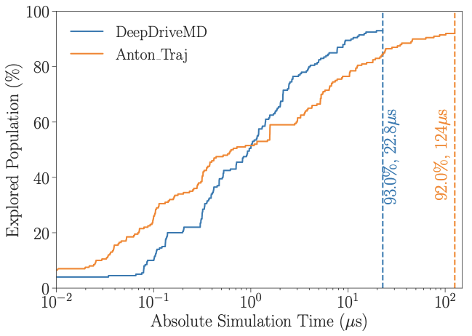
DeepDriveMD Smart Ensemble
O(10) improvement in sampling efficiency with DL model
O(1000) concurrent simulations on Summit supercomputer
Jha (BNL/Rutgers) and Ramanathan (ANL)
Notes:
Not a lucky

Slide 13
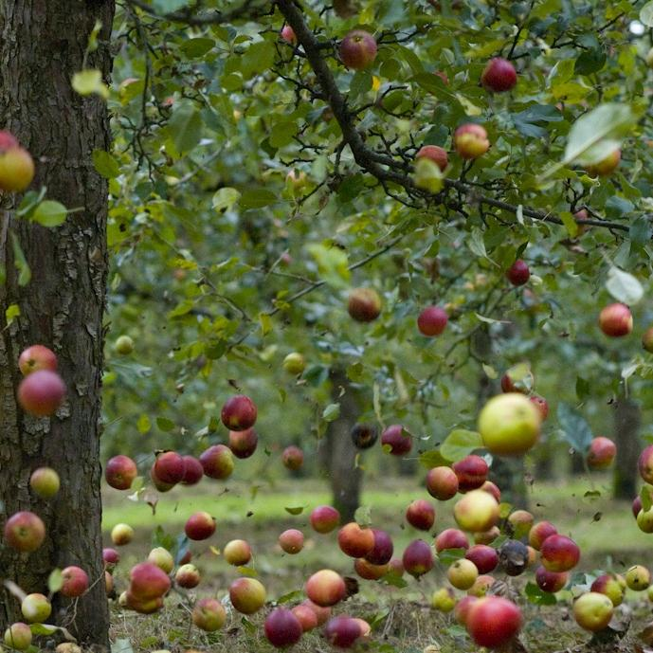
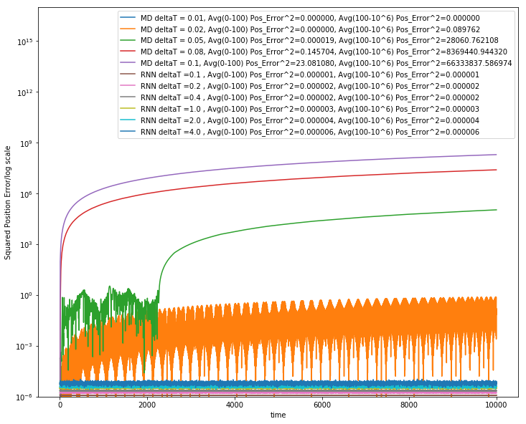
Learning how Apples Fall ?
Work with JCS Kadupitiya and Vikram Jadhao
We could use F=ma with 1D ODE solved by Verlet
Or use Recurrent Neural Network (LSTM) and Tensorflow (the new Newton) for particle in Lennard-Jones potential
Error Squared
MD dt > 0.01
12833 Trained Parameters
MD dt = 0.01, LSTM

Slide 14
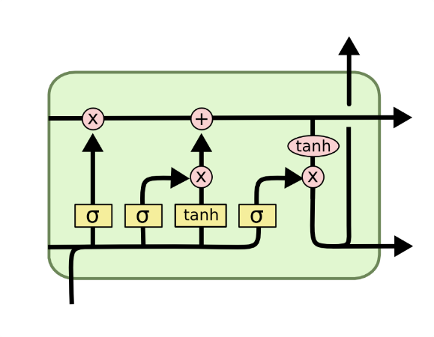
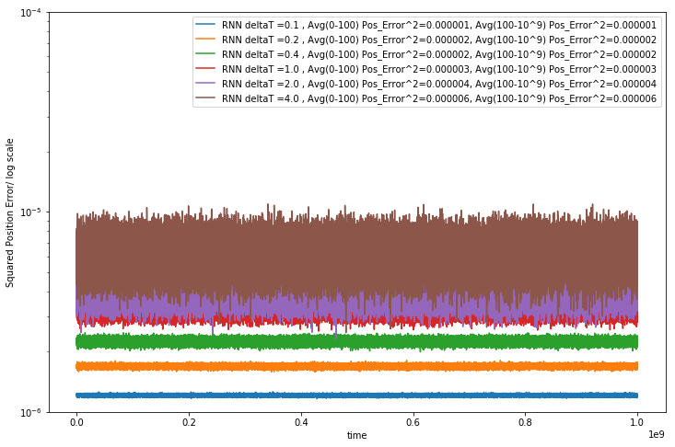
Extending to longer times
LSTM Cell
System trained up to t=100; network used up to t=10,000 or 10,000,000
Plots show error for MD and LSTM for different time steps. LSTM upto t=4
LSTM allows reliable large time steps; learns potential and differential operator
Compared to classic numerics has LOTS of parameters, statistical averaging (e.g. 32 initial LSTM’s only differing in randomized initial conditions) and nonlinear activation nodes
Looking at multiparticle systems learning O(N^2) potentia
Simple Harmonic Oscillator used upto 10⁹ dt=.01
Error Squared
Timesteps

Slide 15
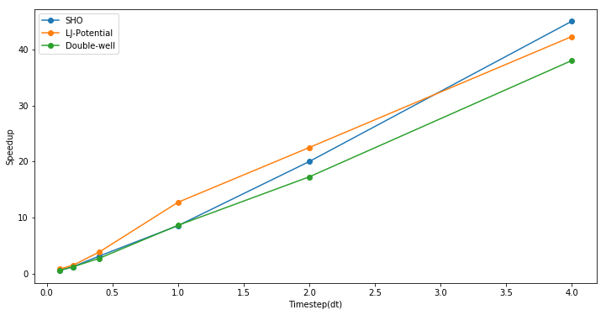
Speedup from use of LSTM compared to Velocity Verlet
Timings are integration from t=0 to 100 and MD velocity verlet used dt of 0.001 to get a accurate result
Speedup = (Time to do MD Simulation with dt=0.001) / (Time to do RNN (LSTM)-based simulation)
Can increase dt=4 and increase speedup

Slide 16
Implications of MLforHPC for Benchmarking
Hyperparameter choice and impact on performance
Dynamic integration of ML and Simulation needs to be optimized and benchmarked
Important if nodes can do simulation and DL like CPU’s and GPU’s
Not much experience/consensus
Need to benchmark both the effort spent running ML to support HPC but also the performance increase gotten
This performance is raw speed for surrogates but is more subtle for use of collective coordinates and smart ensembles
Need to verify accuracy of surrogates and quality of learnt structure
When can we get to Zettascale or Yottascale remembering our first example achieved a speedup of 10⁵ and others have reached 10⁸?

