Slide 1
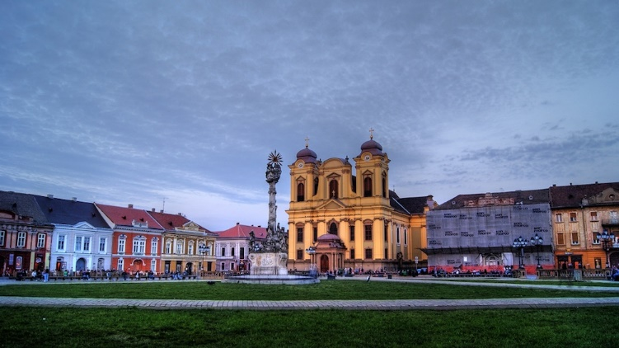
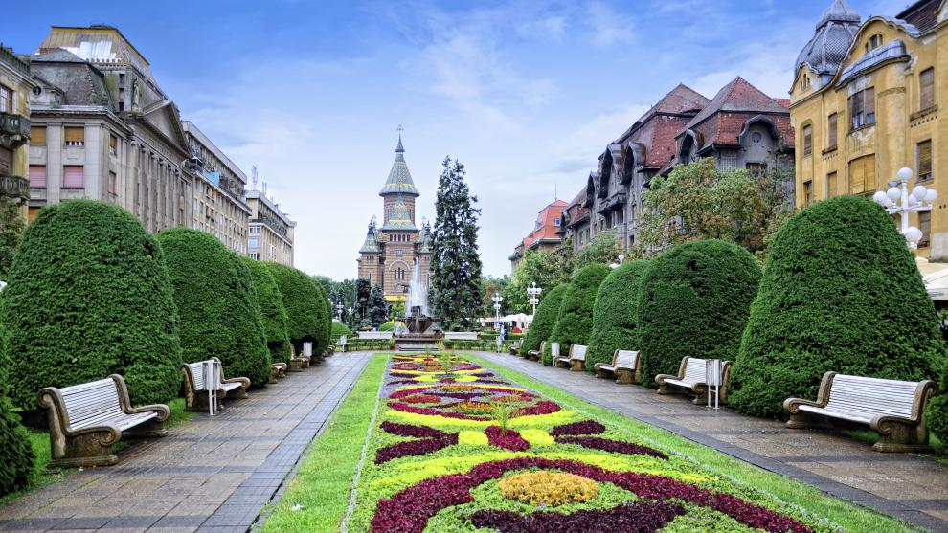
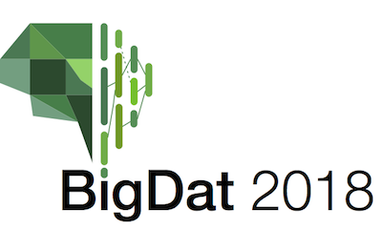
Panel on Research Challenges in Big Data
4th International Winter School on Big Data
Timişoara, Romania, January 22-26, 2018
http://grammars.grlmc.com/BigDat2018/
January 24, 2018
Geoffrey Fox gcf@indiana.edu
http://www.dsc.soic.indiana.edu/, http://spidal.org/ http://hpc-abds.org/kaleidoscope/
Department of Intelligent Systems Engineering
School of Informatics and Computing, Digital Science Center
Indiana University Bloomington

Slide 2
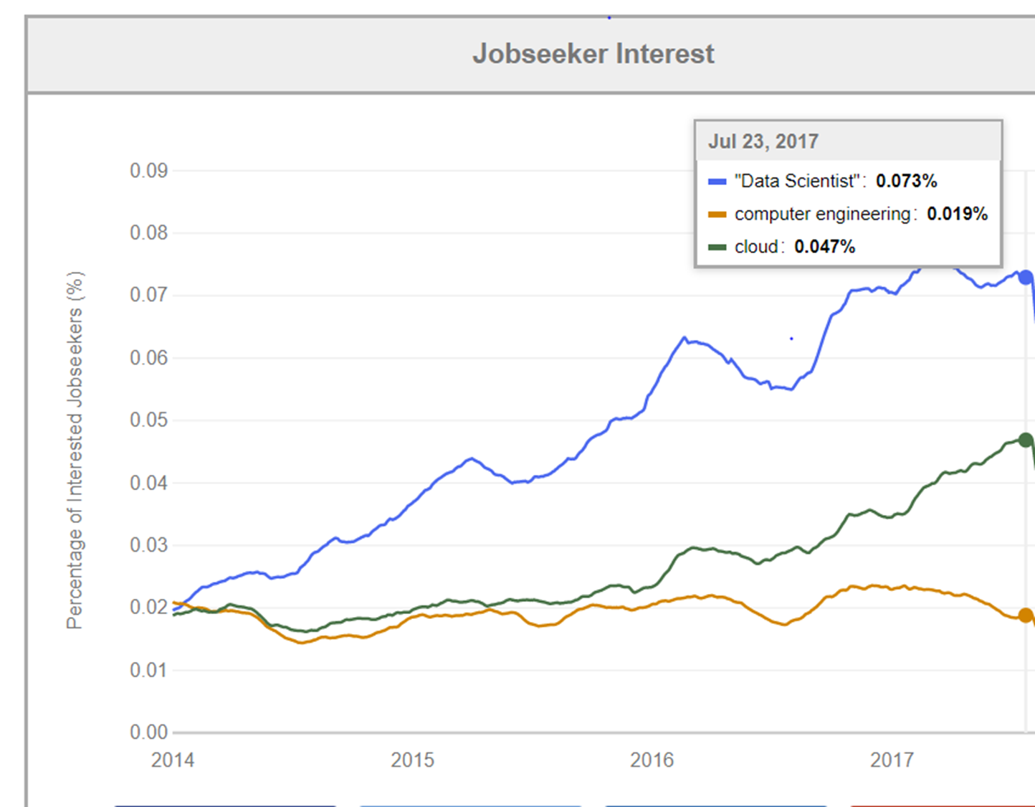
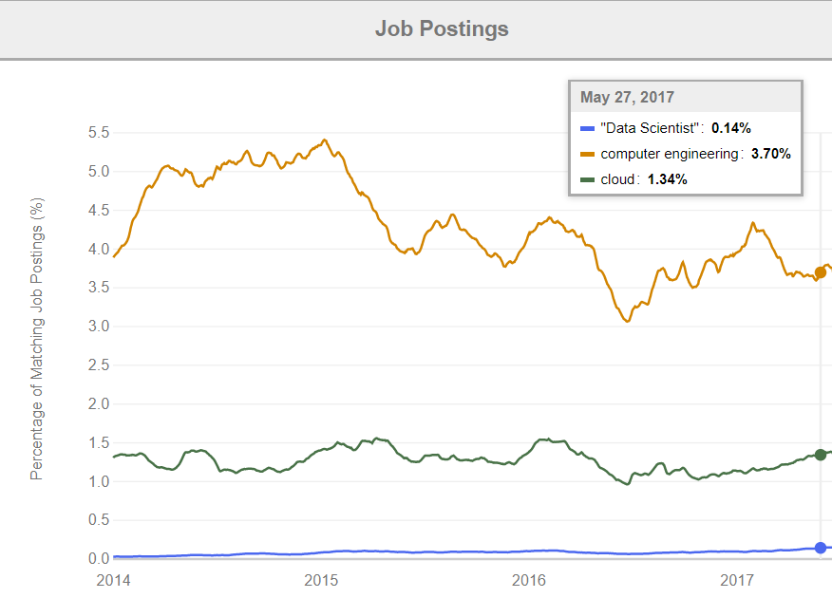
Indeed.com Trends
Is this a problem?
Job Postings and Job Seeker interests seem completely misaligned!
At IU, Data Science masters over twice size of Computer Science+Engineering combined and former take machine learning not cloud computing (infrastructure to run ML) courses

Slide 3
Requirements
On general principles parallel and distributed computing have different requirements even if sometimes similar functionalities
Apache stack ABDS typically uses distributed computing concepts
Large scale simulations use parallel computing concepts
Big Data requirements are not agreed but there are some key use types
Pleasingly parallel processing (including local machine learning LML) as of different tweets from different users with perhaps MapReduce style of statistics and visualizations; possibly Streaming
Database model with queries again supported by MapReduce for horizontal scaling
Global Machine Learning GML with single job using multiple nodes as classic parallel computing
Deep Learning certainly needs HPC – possibly only multiple small systems – often GPU
Scientific Data Analysis can’t change as fast as industry and many fields haven’t understood role of modern Big Data Technologies
Different application requirements need different infrastructure.
Which is best when?
What system architecture needed?
What Big Data algorithms will academic research use?

Slide 4
Difficulty in Parallelism Size of Synchronization constraints
Commodity Clouds
HPC Clouds
High Performance Interconnect
HPC Clouds/Supercomputers
Memory access also critical
Disk I/O
especially relevant in loosely
coupled case
Loosely Coupled
Unstructured Adaptive Sparsity
Medium size Jobs
MapReduce as in scalable databases
Global Machine Learning
e.g. parallel clustering
Deep Learning
LDA
Graph Analytics e.g. subgraph mining
Pleasingly Parallel
Often independent events
Often Linear Algebra at core (typically sparse)
Linear Algebra at core (typically not sparse)
Large scale simulations
Current major Big Data category
Structured Adaptive Sparsity
Huge Jobs
Spectrum of Applications and Algorithms
Exascale Supercomputers

