Slide 1
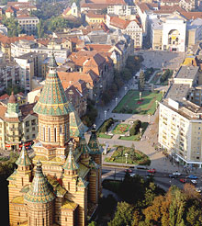
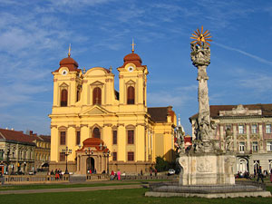
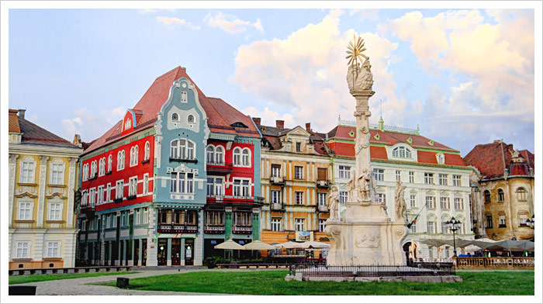
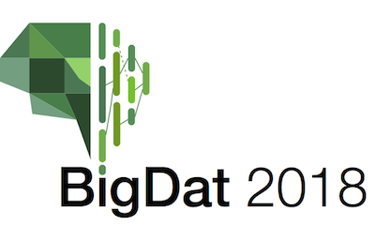
Integration of HPC, Big Data Analytics and The Software Ecosystem Overview
4th International Winter School on Big Data
Timişoara, Romania, January 22-26, 2018
http://grammars.grlmc.com/BigDat2018/
January 25, 2018
Geoffrey Fox gcf@indiana.edu
http://www.dsc.soic.indiana.edu/, http://spidal.org/ http://hpc-abds.org/kaleidoscope/
Department of Intelligent Systems Engineering
School of Informatics and Computing, Digital Science Center
Indiana University Bloomington

Slide 2
Abstract of Full Tutorial
This tutorial covers both data analytics and the hardware/software system that supports them
  Analytics are parallel (what I call Global Machine Learning)
  Software systems support batch (all types including parallel) and streaming big data
General principles: HPC-ABDS, Ogres, Clouds, Convergence
Twister2 Open Source Big Data Programming environment
  Design principles and initial implementation
  Download and run
Harp-DAAL Parallel High Performance Machine Learning Framework
  Initial results on Clustering, LDA, Subgraph counting
  Docker image and video illustrating use
SPIDAL (Scalable Parallel Interoperable Data Analytics Library)
  Performance results of optimized parallel machine learning and visualization
  Video illustrates sophisticated clustering, dimension reduction, visualization

Slide 3
Requirements
On general principles parallel and distributed computing have different requirements even if sometimes similar functionalities
  Apache stack ABDS typically uses distributed computing concepts
  For example, Reduce operation is different in MPI (Harp) and Spark
Large scale simulation requirements are well understood
Big Data requirements are not agreed but there are a few key use types
  Pleasingly parallel processing (including local machine learning LML) as of different tweets from different users with perhaps MapReduce style of statistics and visualizations; possibly Streaming
  Database model with queries again supported by MapReduce for horizontal scaling
  Global Machine Learning GML with single job using multiple nodes as in classic parallel computing
  Deep Learning certainly needs HPC – possibly only multiple small systems
Current workloads stress 1) and 2) and are suited to current clouds and to ABDS (with no HPC)
  This explains why Spark with poor GML performance is so successful and why it can ignore MPI even though MPI uses best technology for parallel computing

Slide 4
Predictions/Assumptions
Supercomputers will be essential for large simulations and will run other applications
HPC Clouds or Next-Generation Commodity Systems will be a dominant force
  Merge Cloud HPC and (support of) Edge computing
  Federated Clouds running in multiple giant datacenters offering all types of computing
  Distributed data sources associated with device and Fog processing resources
  Server-hidden computing and Function as a Service FaaS for user pleasure
  “No server is easier to manage than no server”
  Support a distributed event-driven serverless dataflow computing model covering batch and streaming data as HPC-FaaS
  Needing parallel and distributed (Grid) computing ideas
  Span Pleasingly Parallel to Data management to Global Machine Learning
Clouds increasing 19% per year; legacy data center down -3% per year for next 10 years
New applications will use containers (Docker+Kubernetes) NOT hypervisors and NOT OpenStack

Slide 5
Background Remarks
Use of public clouds increasing rapidly
  Clouds becoming diverse with subsystems containing GPU’s, FPGA’s, high performance networks, storage, memory …
Rich software stacks:
  HPC (High Performance Computing) for Parallel Computing less used than(?)
  Apache for Big Data Software Stack ABDS including center and edge computing (streaming)
Surely Big Data requires High Performance Computing?
Service-oriented Systems, Internet of Things and Edge Computing growing in importance
A lot of confusion coming from different communities (database, distributed, parallel computing, machine learning, computational/data science) investigating similar ideas with little knowledge exchange and mixed up (unclear) requirements
Notes:
Barga Edge and Serverless driving AWS

Slide 6
(IU) Contributions
Can classify applications from a uniform point of view and understand similarities and differences between simulation and data intensive applications
Can parallelize with high efficiency all data analytics remember “Parallel Computing Works” (on all large problems)
In spite of many arguments, Big data technology like Spark, Flink, Hadoop, Storm, Heron are not designed to support parallel computing well and tend to get poor performance on those jobs needing tight task synchronization and/or use high performance hardware
  They are nearer grid computing!
  Huge success of unmodified Apache software says not so much classic parallel computing in commercial workloads; confirmed by success of clouds that typically have major overheads on parallel jobs
One can add HPC and parallel computing to these Apache systems at some cost in fault tolerance and ease of use
  HPC-ABDS is HPC Apache Big Data Stack Integration
  Similarly can make Java run with performance similar to C.
Leads to HPC- Big Data Convergence

Slide 7

HPC Runtime versus ABDS distributed Computing Model on Data Analytics
Hadoop writes to disk and is slowest; Spark and Flink spawn many processes and do not support AllReduce directly;
MPI does in-place combined reduce/broadcast and is fastest
Need Polymorphic Reduction capability choosing best implementation
Use HPC architecture with
  Mutable model
  Immutable data

Slide 8
Use Case Analysis
Started with NIST collection of 51 use cases
“Version 2” https://bigdatawg.nist.gov/V2_output_docs.php just released August 2017
64 Features of Data and Model for large scale big data or simulation use cases

Slide 9
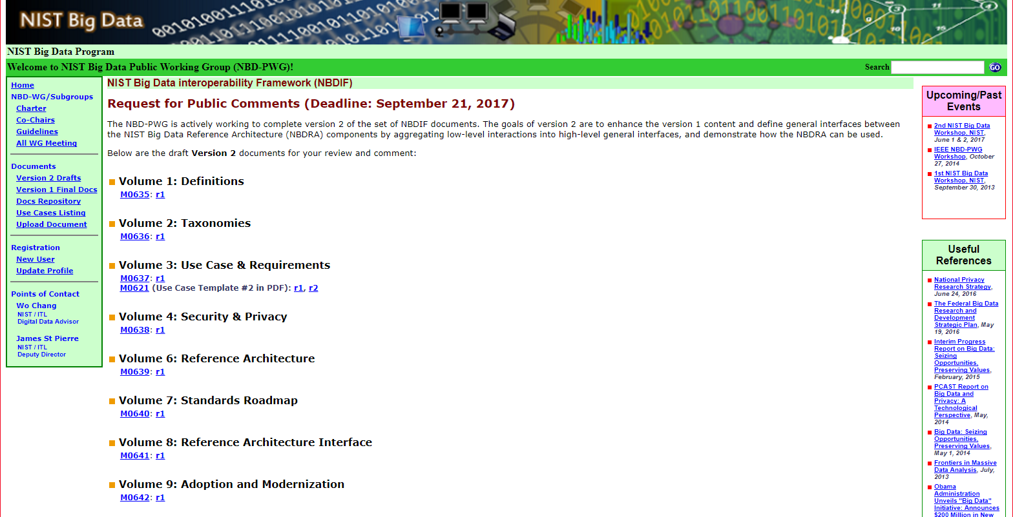
NIST Big Data Public Working Group
Standards
Best Practice
https://bigdatawg.nist.gov/V2_output_docs.php
Indiana
Indiana Cloudmesh launching Twister2

Slide 10
64 Features in 4 views for Unified Classification of Big Data and Simulation Applications
41/51 Streaming
26/51 Pleasingly Parallel
25/51 Mapreduce

Slide 11
Note Problem and System Architecture as efficient execution says they must match
Global Machine Learning
Classic Cloud Workload
These 3 are focus of Twister2 but we need to preserve capability on first 2 paradigms

Slide 12
Data and Model in Big Data and Simulations I
Need to discuss Data and Model as problems have both intermingled, but we can get insight by separating which allows better understanding of Big Data - Big Simulation “convergence” (or differences!)
The Model is a user construction and it has a “concept”, parameters and gives results determined by the computation. We use term “model” in a general fashion to cover all of these.
Big Data problems can be broken up into Data and Model
  For clustering, the model parameters are cluster centers while the data is set of points to be clustered
  For queries, the model is structure of database and results of this query while the data is whole database queried and SQL query
  For deep learning with ImageNet, the model is chosen network with model parameters as the network link weights. The data is set of images used for training or classification

Slide 13
Data and Model in Big Data and Simulations II
Simulations can also be considered as Data plus Model
  Model can be formulation with particle dynamics or partial differential equations defined by parameters such as particle positions and discretized velocity, pressure, density values
  Data could be small when just boundary conditions
  Data large with data assimilation (weather forecasting) or when data visualizations are produced by simulation
Big Data implies Data is large but Model varies in size
  e.g. LDA (Latent Dirichlet Allocation) with many topics or deep learning has a large model
  Clustering or Dimension reduction can be quite small in model size
Data often static between iterations (unless streaming); Model parameters vary between iterations
Data and Model Parameters are often confused in papers as term data used to describe the parameters of models.
Models in Big Data and Simulations have many similarities and allow convergence

Slide 14
Convergence/Divergence Points for HPC-Cloud-Edge- Big Data-Simulation
Applications – Divide use cases into Data and Model and compare characteristics separately in these two components with 64 Convergence Diamonds (features).
  Identify importance of streaming data, pleasingly parallel, global/local machine-learning
Software – Single model of High Performance Computing (HPC) Enhanced Big Data Stack HPC-ABDS. 21 Layers adding high performance runtime to Apache systems HPC-FaaS Programming Model
  Serverless Infrastructure as a Service IaaS
Hardware system designed for functionality and performance of application type e.g. disks, interconnect, memory, CPU acceleration different for machine learning, pleasingly parallel, data management, streaming, simulations
  Use DevOps to automate deployment of event-driven software defined systems on hardware: HPCCloud 2.0
Total System Solutions (wisdom) as a Service: HPCCloud 3.0

Slide 15
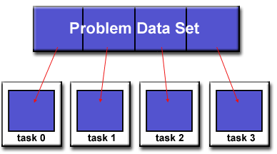
Parallel Computing: Big Data and Simulations
All the different programming models (Spark, Flink, Storm, Naiad, MPI/OpenMP) have the same high level approach but application requirements and system architecture can give different appearance
First: Break Problem Data and/or Model-parameters into parts assigned to separate nodes, processes, threads
Then: In parallel, do computations typically leaving data untouched but changing model-parameters. Called Maps in MapReduce parlance; typically owner computes rule.
If Pleasingly parallel, that’s all it is except for management
If Globally parallel, need to communicate results of computations between nodes during job
Communication mechanism (TCP, RDMA, Native Infiniband) can vary
Communication Style (Point to Point, Collective, Pub-Sub) can vary
Possible need for sophisticated dynamic changes in
partioning (load balancing)
Computation either on fixed tasks or flow between tasks
Choices: “Automatic Parallelism or Not”
Choices: “Complicated Parallel Algorithm or Not”
Fault-Tolerance model can vary
Output model can vary: RDD or Files or Pipes

Slide 16
Software
HPC-ABDS
HPC-FaaS

Slide 17





NSF 1443054: CIF21 DIBBs: Middleware and High Performance Analytics Libraries for Scalable Data Science
Ogres Application Analysis
HPC-ABDS and HPC-FaaS Software
Harp and Twister2 Building Blocks
SPIDAL Data Analytics Library
Software: MIDAS
HPC-ABDS

Slide 18
HPC-ABDS
Integrated wide range of HPC and Big Data technologies.
I gave up updating list in January 2016!

Slide 19
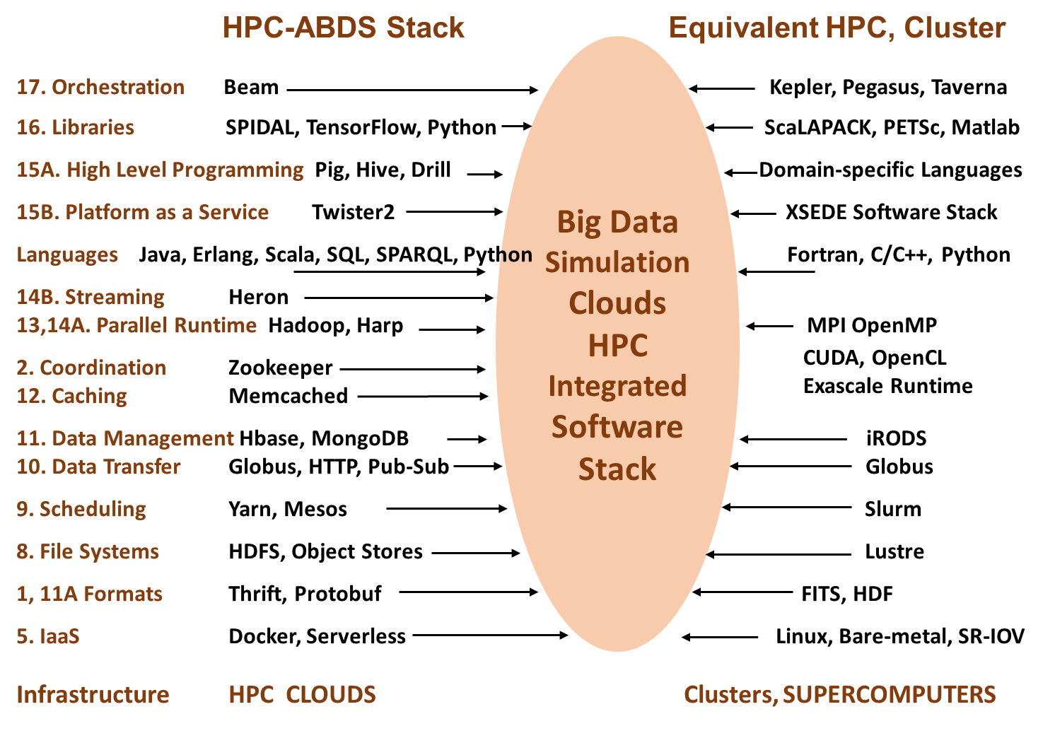
Different choices in software systems in Clouds and HPC. HPC-ABDS takes cloud software augmented by HPC when needed to improve performance
16 of 21 layers plus languages

Slide 20



Implementing Twister2 to support a Grid linked to an HPC Cloud
Streamed data, Cloud-like fog, Dataflow, Parallel Computing
Cloud
HPC
Cloud
HPC
Fog
Cloud
HPC
HPC Cloud can
be federated
Centralized HPC Cloud + IoT Devices
Centralized HPC Cloud + Edge = Fog + IoT Devices

Slide 21
Twister2: “Next Generation Grid - Edge – HPC Cloud”
Original 2010 Twister paper has 930 citations; it was a particular approach to MapCollective iterative processing for machine learning
Re-engineer current Apache Big Data and HPC software systems as a toolkit
Support a serverless (cloud-native) dataflow event-driven HPC-FaaS (microservice) framework running across application and geographic domains.
  Support all types of Data analysis from GML to Edge computing
Build on Cloud best practice but use HPC wherever possible to get high performance
Smoothly support current paradigms Hadoop, Spark, Flink, Heron, MPI, DARMA …
Use interoperable common abstractions but multiple polymorphic implementations.
  i.e. do not require a single runtime
Focus on Runtime but this implies HPC-FaaS programming and execution model
This defines a next generation Grid based on data and edge devices – not computing as in old Grid
See paper http://dsc.soic.indiana.edu/publications/twister2_design_big_data_toolkit.pdf

Slide 22
Proposed Twister2 Approach
Unit of Processing is an Event driven Function (a microservice) replaces libraries running in containers
  Can have state that may need to be preserved in place (Iterative MapReduce)
  Functions can be single or 1 of 100,000 maps in large parallel code
Processing units run in HPC clouds, fogs or devices but these all have similar software architecture (see AWS Greengrass and Lambda)
  Universal Programming model so Fog (e.g. car) looks like a cloud to a device (radar sensor) while public cloud looks like a cloud to the fog (car)
Analyze the runtime of existing systems
  Hadoop, Spark, Flink, Pregel Big Data Processing
  Storm, Heron Streaming Dataflow
  Kepler, Pegasus, NiFi workflow systems
  Harp Map-Collective, MPI and HPC AMT runtime like DARMA
  And approaches such as GridFTP and CORBA/HLA (!) for wide area data links

Slide 23
Parallel Machine Learning

Slide 24
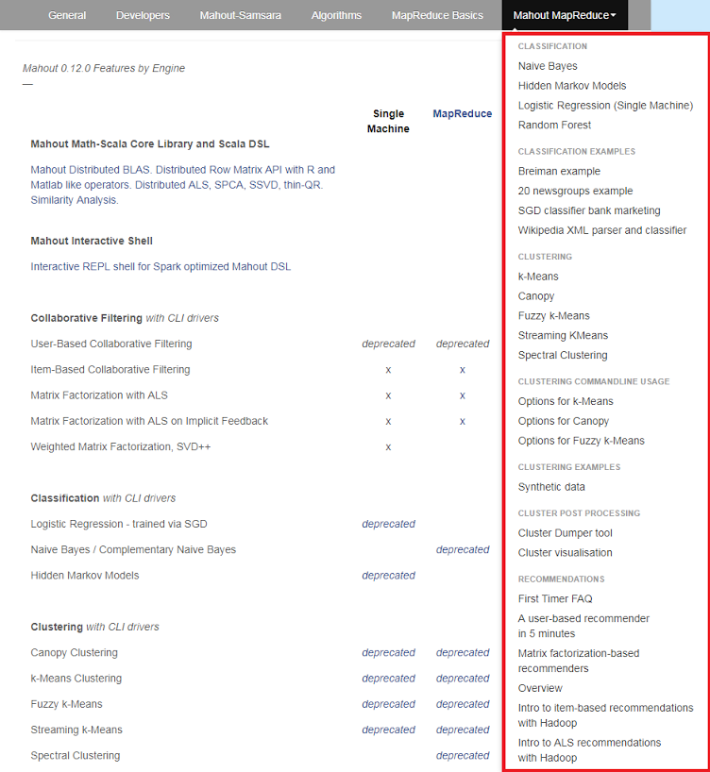
Mahout and SPIDAL
Mahout was Hadoop machine learning library but largely abandoned as Spark outperformed Hadoop
SPIDAL outperforms Spark Mllib and Flink due to better communication and in-place dataflow.
Has Harp-(DAAL) optimized machine learning interface
SPIDAL also has community algorithms
  Biomolecular Simulation
  Graphs for Network Science
  Image processing for pathology and polar science

Slide 25
Qiu/Fox Core SPIDAL Parallel HPC Library with Collective Used
DA-MDS Rotate, AllReduce, Broadcast
Directed Force Dimension Reduction AllGather, Allreduce
Irregular DAVS Clustering Partial Rotate, AllReduce, Broadcast
DA Semimetric Clustering (Deterministic Annealing) Rotate, AllReduce, Broadcast
K-means AllReduce, Broadcast, AllGather DAAL
SVM AllReduce, AllGather
SubGraph Mining AllGather, AllReduce
Latent Dirichlet Allocation Rotate, AllReduce
Matrix Factorization (SGD) Rotate DAAL
Recommender System (ALS) Rotate DAAL
Singular Value Decomposition (SVD) AllGather DAAL
QR Decomposition (QR) Reduce, Broadcast DAAL
Neural Network AllReduce DAAL
Covariance AllReduce DAAL
Low Order Moments Reduce DAAL
Naive Bayes Reduce DAAL
Linear Regression Reduce DAAL
Ridge Regression Reduce DAAL
Multi-class Logistic Regression Regroup, Rotate, AllGather
Random Forest AllReduce
Principal Component Analysis (PCA) AllReduce DAAL
DAAL implies integrated on node with Intel DAAL Optimized Data Analytics Library (Runs on KNL!)

Slide 26
Harp Plugin for Hadoop: Important part of Twister2
Work of Judy Qiu

Slide 27
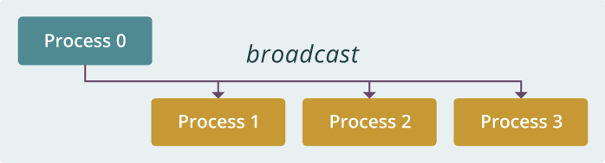
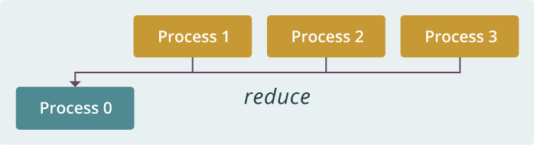
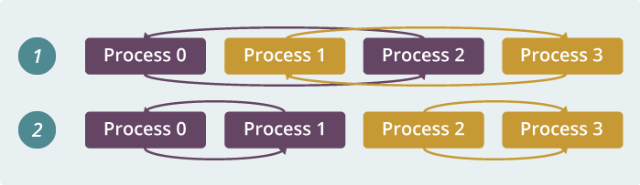
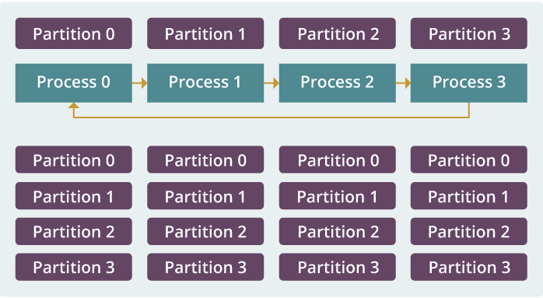
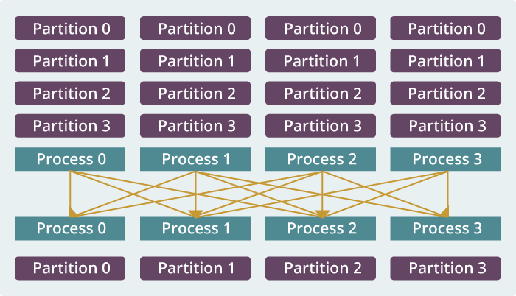
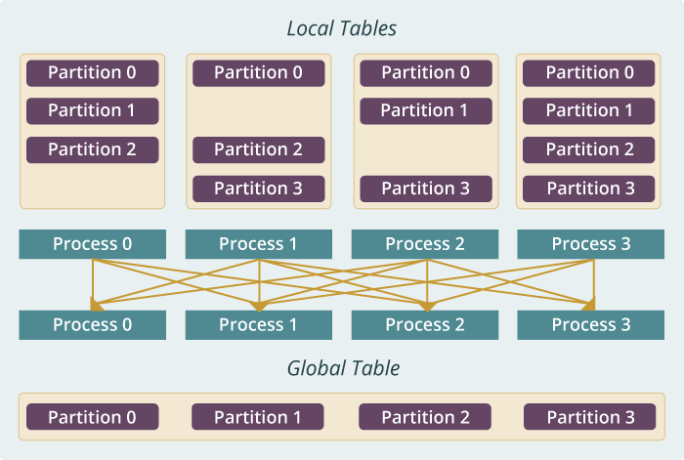
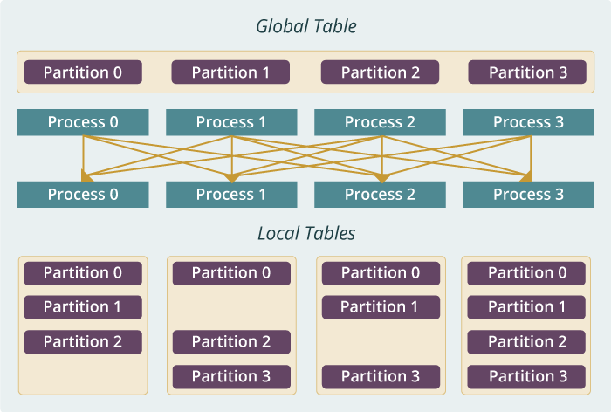
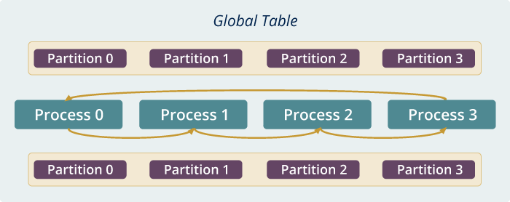
Qiu MIDAS run time software for Harp
broadcast
reduce
allreduce
allgather
regroup
push & pull
rotate
Map Collective Run time merges MapReduce and HPC

Slide 28
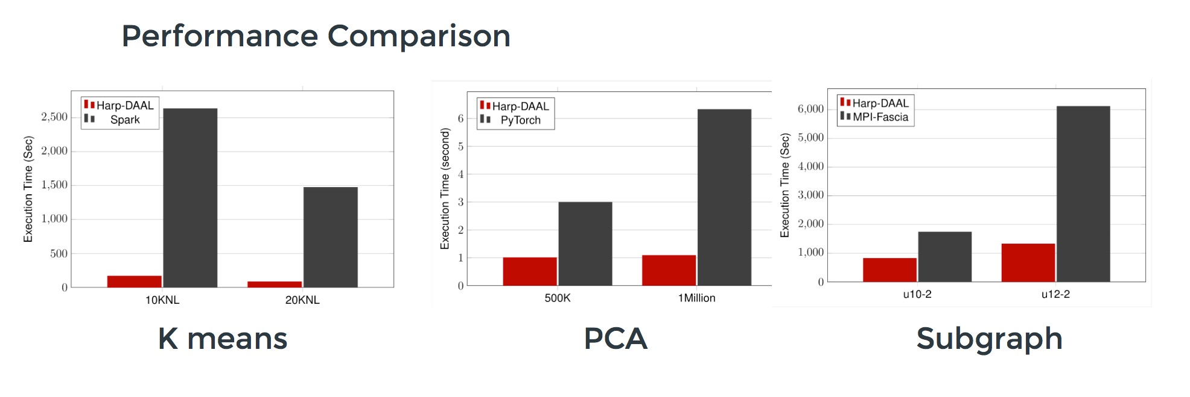
Harp v. Spark Harp v. Torch Harp v. MPI
Datasets: 5 million points, 10 thousand centroids, 10 feature dimensions
10 to 20 nodes of Intel KNL7250 processors
Harp-DAAL has 15x speedups over Spark MLlib
Datasets: 500K or 1 million data points of feature dimension 300
Running on single KNL 7250 (Harp-DAAL) vs. single K80 GPU (PyTorch)
Harp-DAAL achieves 3x to 6x speedups
Datasets: Twitter with 44 million vertices, 2 billion edges, subgraph templates of 10 to 12 vertices
25 nodes of Intel Xeon E5 2670
Harp-DAAL has 2x to 5x speedups over state-of-the-art MPI-Fascia solution

Slide 29
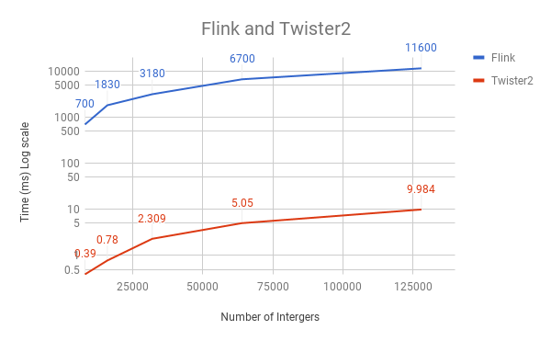
Initial Twister2 Performance
Eventually test lots of choices of task managers and communication models; threads versus processes; languages etc.
Here 16 Haswell nodes each with 1 process running 20 tasks as threads; Java
Reduce microbenchmark for Apache Flink and Twister2; Flink poor performance due to nonoptimized reduce operation
Twister2 has a new dataflow communication library based on MPI – in this case a 1000 times faster than Flink

