Slide 1

Big Data Benchmarking:
Applications and Systems
Geoffrey Fox, December 10, 2018
2018 International Symposium on Benchmarking, Measuring and Optimizing (Bench’ 18) at IEEE Big Data 2018
Dec 10 - Dec 11, 2018 @ Seattle, WA, USA
Digital Science Center
Indiana University
gcf@indiana.edu, http://www.dsc.soic.indiana.edu/, http://spidal.org/

Slide 2
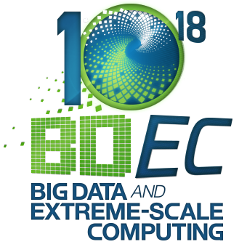
Big Data and Extreme-scale Computing http://www.exascale.org/bdec/
BDEC Pathways to Convergence Report
New series BDEC2 “Common Digital Continuum Platform for Big Data and Extreme Scale Computing” with first meeting November 28-30, 2018 Bloomington Indiana USA (focus on applications).
  Working groups on platform (technology), applications, community building
  BigDataBench presented a white paper
Next meetings: February 19-21 Kobe, Japan (focus on platform) followed by two in Europe, one in USA and one in China.
http://www.exascale.org/bdec/sites/www.exascale.org.bdec/files/whitepapers/bdec2017pathways.pdf

Slide 3
Benchmarks should mimic Use Cases?
Need to collect use cases?
Can classify use cases and benchmarks along several different dimensions

Slide 4





NSF 1443054: CIF21 DIBBs: Middleware and High Performance Analytics Libraries for Scalable Data Science
Ogres Application Analysis
HPC-ABDS and HPC-FaaS Software
Harp and Twister2 Building Blocks
SPIDAL Data Analytics Library
Software: MIDAS
HPC-ABDS

Slide 5
My view of System
GAIMSC

Slide 6
Systems Challenges for GAIMSC
Microsoft noted we are collectively building the Global AI Supercomputer.
Generalize by adding modeling
Architecture of the Global AI and Modeling Supercomputer GAIMSC must reflect
  Global captures the need to mashup services from many different sources;
  AI captures the incredible progress in machine learning (ML);
  Modeling captures both traditional large-scale simulations and the models and digital twins needed for data interpretation;
  Supercomputer captures that everything is huge and needs to be done quickly and often in real time for streaming applications.
The GAIMSC includes an intelligent HPC cloud linked via an intelligent HPC Fog to an intelligent HPC edge. We consider this distributed environment as a set of computational and data-intensive nuggets swimming in an intelligent aether.
  We will use a dataflow graph to define a mesh in the aether

Slide 7
Global AI and Modeling Supercomputer GAIMSC
There is only a cloud at the logical center but it’s physically distributed and owned by a few major players
There is a very distributed set of devices surrounded by local Fog computing; this forms the logically and physically distribute edge
The edge is structured and largely data
  These are two differences from the Grid of the past
  e.g. self driving car will have its own fog and will not share fog with truck that it is about to collide with
The cloud and edge will both be very heterogeneous with varying accelerators, memory size and disk structure.
GAIMSC requires parallel computing to achieve high performance on large ML and simulation nuggets and distributed system technology to build the aether and support the distributed but connected nuggets.
In the latter respect, the intelligent aether mimics a grid but it is a data grid where there are computations but typically those associated with data (often from edge devices).
  So unlike the distributed simulation supercomputer that was often studied in previous grids, GAIMSC is a supercomputer aimed at very different data intensive AI-enriched problems.

Slide 8
GAIMSC Global AI & Modeling Supercomputer Questions
What do gain from the concept? e.g. Ability to work with Big Data community
What do we lose from the concept? e.g. everything runs as slow as Spark
Is GAIMSC useful for BDEC2 initiative? For NSF? For DoE?
For Universities? For Industry? For users?
Does adding modeling to concept add value?
What are the research issues for GAIMSC? e.g. how to program?
What can we do with GAIMSC that we couldn’t do with classic Big Data technologies?
What can we do with GAIMSC that we couldn’t do with classic HPC technologies?
Are there deep or important issues associated with the “Global” in GAIMSC?
Is the concept of an auto-tuned Global AI and Modeling Supercomputer scary?

Slide 9
Integration of Data and Model functions with ML wrappers in GAIMSC
There is a rapid increase in the integration of ML and simulations.
ML can analyze results, guide the execution and set up initial configurations (auto-tuning). This is equally true for AI itself -- the GAIMSC will use itself to optimize its execution for both analytics and simulations.
In principle every transfer of control (job or function invocation, a link from device to the fog/cloud) should pass through an AI wrapper that learns from each call and can decide both if call needs to be executed (maybe we have learned the answer already and need not compute it) and how to optimize the call if it really needs to be executed.
The digital continuum proposed by BDEC2 is an intelligent aether learning from and informing the interconnected computational actions that are embedded in the aether.
  Implementing the intelligent aether embracing and extending the edge, fog, and cloud is a major research challenge where bold new ideas are needed!
  We need to understand how to make it easy to automatically wrap every nugget with ML.

Slide 10
Implementing the GAIMSC
The new MIDAS middleware designed in SPIDAL has been engineered to support high-performance technologies and yet preserve the key features of the Apache Big Data Software.
  MIDAS seems well suited to build the prototype intelligent high-performance aether.
Note this will mix many relatively small nuggets with AI wrappers generating parallelism from the number of nuggets and not internally to the nugget and its wrapper.
However, there will be also large global jobs requiring internal parallelism for individual large-scale machine learning or simulation tasks.
Thus parallel computing and distributed systems (grids) must be linked in a deep fashion although the key parallel computing ideas needed for ML are closely related to those already developed for simulations.

Slide 11
Underlying HPC Big Data Convergence Issues

Slide 12
Data and Model in Big Data and Simulations I
Need to discuss Data and Model as problems have both intermingled, but we can get insight by separating which allows better understanding of Big Data - Big Simulation “convergence” (or differences!)
The Model is a user construction and it has a “concept”, parameters and gives results determined by the computation. We use term “model” in a general fashion to cover all of these.
Big Data problems can be broken up into Data and Model
  For clustering, the model parameters are cluster centers while the data is set of points to be clustered
  For queries, the model is structure of database and results of this query while the data is whole database queried and SQL query
  For deep learning with ImageNet, the model is chosen network with model parameters as the network link weights. The data is set of images used for training or classification

Slide 13
Data and Model in Big Data and Simulations II
Simulations can also be considered as Data plus Model
  Model can be formulation with particle dynamics or partial differential equations defined by parameters such as particle positions and discretized velocity, pressure, density values
  Data could be small when just boundary conditions
  Data large with data assimilation (weather forecasting) or when data visualizations are produced by simulation
Big Data implies Data is large but Model varies in size
  e.g. LDA (Latent Dirichlet Allocation) with many topics or deep learning has a large model
  Clustering or Dimension reduction can be quite small in model size
Data often static between iterations (unless streaming); Model parameters vary between iterations
Data and Model Parameters are often confused in papers as term data used to describe the parameters of models.
Models in Big Data and Simulations have many similarities and allow convergence

Slide 14
Local and Global Machine Learning
Many applications use LML or Local machine Learning where machine learning (often from R or Python or Matlab) is run separately on every data item such as on every image
But others are GML Global Machine Learning where machine learning is a basic algorithm run over all data items (over all nodes in computer)
  maximum likelihood or χ² with a sum over the N data items – documents, sequences, items to be sold, images etc. and often links (point-pairs).
  GML includes Graph analytics, clustering/community detection, mixture models, topic determination, Multidimensional scaling, (Deep) Learning Networks
Note Facebook may need lots of small graphs (one per person and ~LML) rather than one giant graph of connected people (GML)

Slide 15
Convergence/Divergence Points for HPC-Cloud-Edge- Big Data-Simulation
Applications – Divide use cases into Data and Model and compare characteristics separately in these two components with 64 Convergence Diamonds (features).
  Identify importance of streaming data, pleasingly parallel, global/local machine-learning
Software – Single model of High Performance Computing (HPC) Enhanced Big Data Stack HPC-ABDS. 21 Layers adding high performance runtime to Apache systems HPC-FaaS Programming Model
  Serverless Infrastructure as a Service IaaS
Hardware system designed for functionality and performance of application type e.g. disks, interconnect, memory, CPU acceleration different for machine learning, pleasingly parallel, data management, streaming, simulations
  Use DevOps to automate deployment of event-driven software defined systems on hardware: HPCCloud 2.0
Total System Solutions (wisdom) as a Service: HPCCloud 3.0

Slide 16
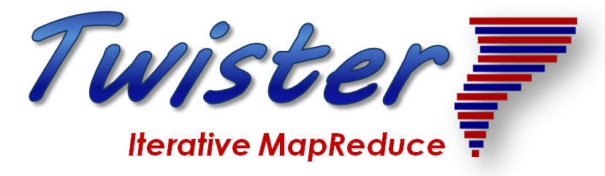
Application Structure
2
http://www.iterativemapreduce.org/

Slide 17
Structure of Applications
Real-time (streaming) data is increasingly common in scientific and engineering research, and it is ubiquitous in commercial Big Data (e.g., social network analysis, recommender systems and consumer behavior classification)
  So far little use of commercial and Apache technology in analysis of scientific streaming data
Pleasingly parallel applications important in science (long tail) and data communities
Commercial-Science application differences: Search and recommender engines have different structure to deep learning, clustering, topic models, graph analyses such as subgraph mining
  Latter very sensitive to communication and can be hard to parallelize
  Search typically not as important in Science as in commercial use as search volume scales by number of users
Should discuss data and model separately
  Term data often used rather sloppily and often refers to model

Slide 18
Distinctive Features of Applications
Ratio of data to model sizes: vertical axis on next slide
Importance of Synchronization – ratio of inter-node communication to node computing: horizontal axis on next slide
Sparsity of Data or Model; impacts value of GPU’s or vector computing
Irregularity of Data or Model
Geographic distribution of Data as in edge computing; use of streaming (dynamic data) versus batch paradigms
Dynamic model structure as in some iterative algorithms

Slide 19
Big Data and Simulation Difficulty in Parallelism
Size of Synchronization constraints
Loosely Coupled
Tightly Coupled
HPC Clouds: Accelerators
High Performance Interconnect
HPC Clouds/Supercomputers
Memory access also critical
Commodity Clouds
Size of Disk I/O
MapReduce as in scalable databases
Global Machine Learning
e.g. parallel clustering
Deep Learning
Graph Analytics e.g. subgraph mining
LDA
Pleasingly Parallel
Often independent events
Unstructured Adaptive Sparse
Current major Big Data category
Linear Algebra at core (often not sparse)
Structured Adaptive Sparse
Parameter sweep simulations
Largest scale simulations
Just two problem characteristics
There is also data/compute distribution seen in grid/edge computing
Exascale Supercomputers

Slide 20
Application Nexus of HPC, Big Data, Simulation Convergence
Use-case Data and Model
NIST Collection
Big Data Ogres
Convergence Diamonds
https://bigdatawg.nist.gov/

Slide 21

Original Use Case Template
26 fields completed for 51 areas
Government Operation: 4
Commercial: 8
Defense: 3
Healthcare and Life Sciences: 10
Deep Learning and Social Media: 6
The Ecosystem for Research: 4
Astronomy and Physics: 5
Earth, Environmental and Polar Science: 10
Energy: 1
Security & Privacy Enhanced version 2
BDEC HPC enhanced version

Slide 22
51 Detailed Use Cases: Contributed July-September 2013
Covers goals, data features such as 3 V’s, software, hardware
Government Operation(4): National Archives and Records Administration, Census Bureau
Commercial(8): Finance in Cloud, Cloud Backup, Mendeley (Citations), Netflix, Web Search, Digital Materials, Cargo shipping (as in UPS)
Defense(3): Sensors, Image surveillance, Situation Assessment
Healthcare and Life Sciences(10): Medical records, Graph and Probabilistic analysis, Pathology, Bioimaging, Genomics, Epidemiology, People Activity models, Biodiversity
Deep Learning and Social Media(6): Driving Car, Geolocate images/cameras, Twitter, Crowd Sourcing, Network Science, NIST benchmark datasets
The Ecosystem for Research(4): Metadata, Collaboration, Language Translation, Light source experiments
Astronomy and Physics(5): Sky Surveys including comparison to simulation, Large Hadron Collider at CERN, Belle Accelerator II in Japan
Earth, Environmental and Polar Science(10): Radar Scattering in Atmosphere, Earthquake, Ocean, Earth Observation, Ice sheet Radar scattering, Earth radar mapping, Climate simulation datasets, Atmospheric turbulence identification, Subsurface Biogeochemistry (microbes to watersheds), AmeriFlux and FLUXNET gas sensors
Energy(1): Smart grid
Published by NIST as version 2 https://bigdatawg.nist.gov/_uploadfiles/NIST.SP.1500-3r1.pdf with common set of 26 features recorded for each use-case
26 Features for each use case Biased to science

Slide 23

Part of Property Summary Table

Slide 24
51 Use Cases: What is Parallelism Over?
People: either the users (but see below) or subjects of application and often both
Decision makers like researchers or doctors (users of application)
Items such as Images, EMR, Sequences below; observations or contents of online store
  Images or “Electronic Information nuggets”
  EMR: Electronic Medical Records (often similar to people parallelism)
  Protein or Gene Sequences;
  Material properties, Manufactured Object specifications, etc., in custom dataset
  Modelled entities like vehicles and people
Sensors – Internet of Things
Events such as detected anomalies in telescope or credit card data or atmosphere
(Complex) Nodes in RDF Graph
Simple nodes as in a learning network
Tweets, Blogs, Documents, Web Pages, etc.
  And characters/words in them
Files or data to be backed up, moved or assigned metadata
Particles/cells/mesh points as in parallel simulations

Slide 25
Sample Features of 51 Use Cases I
PP (26) “All” Pleasingly Parallel or Map Only
MR (18) Classic MapReduce MR (add MRStat below for full count)
MRStat (7) Simple version of MR where key computations are simple reduction as found in statistical averages such as histograms and averages
MRIter (23) Iterative MapReduce or MPI (Flink, Spark, Twister)
Graph (9) Complex graph data structure needed in analysis
Fusion (11) Integrate diverse data to aid discovery/decision making; could involve sophisticated algorithms or could just be a portal
Streaming (41) Some data comes in incrementally and is processed this way
Classify (30) Classification: divide data into categories
S/Q (12) Index, Search and Query

Slide 26
Sample Features of 51 Use Cases II
CF (4) Collaborative Filtering for recommender engines
LML (36) Local Machine Learning (Independent for each parallel entity) – application could have GML as well
GML (23) Global Machine Learning: Deep Learning, Clustering, LDA, PLSI, MDS,
  Large Scale Optimizations as in Variational Bayes, MCMC, Lifted Belief Propagation, Stochastic Gradient Descent, L-BFGS, Levenberg-Marquardt . Can call EGO or Exascale Global Optimization with scalable parallel algorithm
Workflow (51) Universal
GIS (16) Geotagged data and often displayed in ESRI, Microsoft Virtual Earth, Google Earth, GeoServer etc.
HPC (5) Classic large-scale simulation of cosmos, materials, etc. generating (visualization) data
Agent (2) Simulations of models of data-defined macroscopic entities represented as agents

Slide 27
BDEC2 and NIST Use Cases
https://docs.google.com/document/d/1YBkdKP4TOXprNy9YOPAsfsFZey5r5jb71P7eQdfHgD8/edit?usp=sharing
https://docs.google.com/document/d/1iLijV2L0iqSlb4EI1XqrgvJu_9oGIjuUadcBl7H0rR0/edit?usp=sharing

Slide 28
53 NIST Use Cases for Research Space I
GOVERNMENT OPERATION
  1: Census 2010 and 2000—Title 13 Big Data
  2: NARA Accession, Search, Retrieve, Preservation
  3: Statistical Survey Response Improvement
  4: Non-Traditional Data in Statistical Survey Response Improvement (Adaptive Design)
  1-4 are related to social science survey problems and are “Classic Data+ML” with interesting algorithms (recommender engines) plus databases and important privacy issues which are present in research cases
COMMERCIAL
  5: Cloud Eco-System for Financial Industries NO
  6: Mendeley—An International Network of Research
  7: Netflix Movie Service NO
  8: Web Search NO
  9: Big Data Business Continuity and Disaster Recovery Within a Cloud Eco-System NO
  10: Cargo Shipping Edge Computing NO
  11: Materials Data for Manufacturing
  12: Simulation-Driven Materials Genomics
  6 is “Classic Data+ML” with Text Analysis (citation identification, topic models etc.)
  10 is DHL/Fedex/UPS and has no direct scientific analog. However, it is a good example of Edge computing system of a similar nature to the scientific research case.
  11 and 12 are material science covered in BDEC2 meeting

Slide 29
53 NIST Use Cases for Research Space II
DEFENSE
  13: Cloud Large-Scale Geospatial Analysis and Visualization
  14: Object Identification and Tracking from Wide-Area Large Format Imagery or Full Motion Video—Persistent Surveillance
  15: Intelligence Data Processing and Analysis
  13-15 are very similar to disaster response problems. They involve extensive “Classic Data+ML” for sensor collections and/or image processing. GIS and spatial analysis are important as in BDEC2 Pathology and Spatial Imagery talk. The geospatial aspect of applications means they are similar to earth science examples.
Color coding of use cases
NO means not similar to research application
Red means not relevant to BDEC2
Orange means related to BDEC2 Bloomington presentations
Black are unique use cases of relevance to BDEC2 but not presented at Bloomington
Purple are comments

Slide 30
Use Cases III: HEALTH CARE AND LIFE SCIENCES
16: Electronic Medical Record
17: Pathology Imaging/Digital Pathology
18: Computational Bioimaging
19: Genomic Measurements
20: Comparative Analysis for Metagenomes and Genome
21: Individualized Diabetes Management
22: Statistical Relational Artificial Intelligence for Health Care
23: World Population-Scale Epidemiological Study
24: Social Contagion Modeling for Planning, Public Health, and Disaster Management
25: Biodiversity and LifeWatch

Slide 31
Comments on Use Cases III
16 and 22 are “classic data + ML + database” based use cases using an important technique, understood by the community but not presented at BDEC2
17 came originally from Saltz’s group and was updated in his BDEC2 talk
18 describes biology image processing from many instruments microscopes, MRI and light sources. The latter was directly discussed at BDEC2 and the other instruments were implicit.
19 and 20 are well recognized as a distributed Big Data problems with significant computing. They were represented by Chandrasekaran’s presentation at BDEC2 which inevitably only covered part (gene assembly) of problem.
21 relies on “classic data + graph analytics” which was not discussed in BDEC2 meeting but is certainly actively pursued.
23 and 24 originally came from Marathe and were updated in his BDEC2 presentation on massive bio-social systems
25 generalizes BDEC2 talks by Taufer and Rahnemoonfar on ocean and land monitoring and sensor array analysis.

Slide 32
Use Cases IV: DEEP LEARNING AND SOCIAL MEDIA
26: Large-Scale Deep Learning
27: Organizing Large-Scale, Unstructured Collections of Consumer Photos NO
28: Truthy—Information Diffusion Research from Twitter Data
29: Crowd Sourcing in the Humanities as Source for Big and Dynamic Data
30: CINET—Cyberinfrastructure for Network (Graph) Science and Analytics
31: NIST Information Access Division—Analytic Technology Performance Measurements, Evaluations, and Standards
26 on deep learning was covered in great depth at the BDEC2 meeting
27 describes an interesting image processing challenge of geolocating multiple photographs which is not so far directly related to scientific data analysis although related image processing algorithms are certainly important
28-30 are “classic data + ML” use cases with a focus on graph and text mining algorithms not covered in BDEC2 but certainly relevant to the process
31 on benchmarking and standard datasets is related to BigDataBench talk at end of BDEC2 meeting and Fosters talk on a model database

Slide 33
53 NIST Use Cases for Research Space VI
THE ECOSYSTEM FOR RESEARCH
32: DataNet Federation Consortium
33: The Discinnet Process NO
34: Semantic Graph Search on Scientific Chemical and Text-Based Data
35: Light Source Beamlines
32 covers data management with iRODS which is well regarded by the community but not discussed in BDEC2.
33 is a Teamwork approach that doesn’t seem relevant to BDEC2
34 is a “classic data+ML” use case with a similar comments to 28-30
35 was covered with more advanced deep learning algorithms in Yager and Foster’s BDEC2 talks
ASTRONOMY AND PHYSICS
36: Catalina Real-Time Transient Survey: A Digital, Panoramic, Synoptic Sky Survey
37: DOE Extreme Data from Cosmological Sky Survey and Simulations
38: Large Survey Data for Cosmology
39: Particle Physics—Analysis of Large Hadron Collider Data: Discovery of Higgs Particle
40: Belle II High Energy Physics Experiment
36 to 38 are “Classic Data+ML” astronomy use cases related to BDEC2 SKA presentation and covering both archival and event detection cases. Use case 37 covers the integration of simulation data and observational data FOR ASTRONOMY; A TOPIC COVERED IN OTHER CASES AT BDEC2.
39 and 40 are “Classic Data+ML” use cases for accelerator data analysis. This was not covered in BDEC2 but is currently the largest volume scientific data analysis problem whose importance and relevance is well understood.

Slide 34
Use Cases VII: EARTH, ENVIRONMENTAL, AND POLAR SCIENCE
41: European Incoherent Scatter Scientific Association 3D Incoherent Scatter Radar System Big Radar instrument monitoring atmosphere.
42: Common Operations of Environmental Research Infrastructure
43: Radar Data Analysis for the Center for Remote Sensing of Ice Sheets
44: Unmanned Air Vehicle Synthetic Aperture Radar (UAVSAR) Data Processing, Data Product Delivery, and Data Services
45: NASA Langley Research Center/ Goddard Space Flight Center iRODS Federation Test Bed
46: MERRA Analytic Services (MERRA/AS) Instrument
47: Atmospheric Turbulence – Event Discovery and Predictive Analytics Imaging
48: Climate Studies Using the Community Earth System Model at the U.S. Department of Energy (DOE) NERSC Center
49: DOE Biological and Environmental Research (BER) Subsurface Biogeochemistry Scientific Focus Area
50: DOE BER AmeriFlux and FLUXNET Networks Sensor Networks
2-1: NASA Earth Observing System Data and Information System (EOSDIS) Instrument
2-2: Web-Enabled Landsat Data (WELD) Processing Instrument

Slide 35
Comments on Use Cases VII
41 43 44 are “Classic Data+ML” use cases involving radar data from different instruments-- specialized ground, vehicle/plane, satellite - not directly covered in BDEC2
2-1 and 2-2 are use cases similar to 41 43 and 44 but applied to EOSDIS and LANDSAT earth observations from satellites in multiple modalities.
42 49 and 50 are “Classic Data+ML” environmental sensor arrays that extend the scope of talks of Taufer and Rahnemoonfar at BDEC2. See also use case 25 above
45 to 47 describe datasets from instruments and computations relevant to climate and weather. It relates to BDEC2 talk by Denvil and Miyoshi. 47 discusses the correlation of aircraft turbulent reports with simulation datasets
48 is data analytics and management associated with climate studies as covered in BDEC2 talk by Denvil

Slide 36
Use Cases VIII: ENERGY
51: Consumption Forecasting in Smart Grids
51 is a different subproblem but in the same area as Pothen and Azad’s talk on the electric power grid at BDEC2. This is a challenging edge computing problem as a large number of distributed but correlated sensors
SC-18 BOF Application/Industry Perspective by David Keyes, King Abdullah University of Science and Technology (KAUST)
https://www.exascale.org/bdec/sites/www.exascale.org.bdec/files/SC18_BDEC2_BoF-Keyes.pdf
This is a presentation by David Keyes on seismic imaging for oil discovery and exploitation. It is “Classic Data+ML” for an array of sonic sensors

Slide 37
BDEC2 Use Cases I: Classic Observational Data plus ML
BDEC2-1: M. Deegan, Big Data and Extreme Scale Computing, 2nd Series (BDEC2) - Statement of Interest from the Square Kilometre Array Organisation (SKAO)
Environmental Science
BDEC2-2: M. Rahnemoonfar, Semantic Segmentation of Underwater Sonar Imagery based on Deep Learning
BDEC2-3: M. Taufer, Cyberinfrastructure Tools for Precision Agriculture in the 21st Century
Healthcare and Life sciences
BDEC2-4: J. Saltz, Multiscale Spatial Data and Deep Learning
BDEC2-5: R. Stevens, Exascale Deep Learning for Cancer
BDEC2-6: S. Chandrasekaran, Development of a parallel algorithm for whole genome alignment for rapid delivery of personalized genomics
BDEC2-7: M. Marathe, Pervasive, Personalized and Precision (P3) analytics for massive bio-social systems
Instruments include Satellites, UAV’s, Sensors (see edge examples), Light sources (X-ray MRI Microscope etc.), Telescopes, Accelerators, Tokomaks (Fusion), Computers (as in Control, Simulation, Data, ML Integration)

Slide 38
BDEC2 Use Cases II: Control, Simulation, Data, ML Integration
BDEC2-8: W. Tang, New Models for Integrated Inquiry: Fusion Energy Exemplar
BDEC2-9: O. Beckstein, Convergence of data generation and analysis in the biomolecular
simulation community
BDEC2-10: S. Denvil, From the production to the analysis phase: new approaches needed in climate modeling
BDEC2-11: T. Miyoshi, Prediction Science: The 5th Paradigm Fusing the Computational Science and Data Science (weather forecasting)
See also Marathe and Stevens talks
See also instruments under Classic Observational Data plus ML
Material Science
BDEC2-12: K. Yager, Autonomous Experimentation as a Paradigm for Materials Discovery
BDEC2-13: L. Ward, Deep Learning, HPC, and Data for Materials Design
BDEC2-14: J. Ahrens, A vision for a validated distributed knowledge base of material behavior at extreme conditions using the Advanced Cyberinfrastructure Platform
BDEC2-15: T. Deutsch, Digital transition of Material Nano-Characterization.

Slide 39
Comments on Control, Simulation, Data, ML Integration
Simulations often involve outside Data but always inside Data (from simulation itself). Fields covered include Materials (nano), Climate, Weather, Biomolecular, Virtual tissues (no use case written up)
We can see ML wrapping simulations to achieve many goals. ML replaces functions and/or ML guides functions
  Initial Conditions
  Boundary Conditions
  Data assimilation
  Configuration -- blocking, use of cache etc.
  Steering and Control
  Support multi-scale
  ML learns from previous simulations and so can predict function calls
Digital Twins are a commercial link between simulation and systems
There are fundamental simulations covered by laws of physics and growingly Complex System simulations with Bio (tissue) or social entities.

Slide 40
BDEC2 Use Cases III: Edge Computing
Smart City and Related Edge Applications
BDEC2-16: P. Beckman, Edge to HPC Cloud
BDEC2-17: G. Ricart, Smart Community CyberInfrastructure at the Speed of Life
BDEC2-18: T. El-Ghazawi, Convergence of AI, Big Data, Computing and IOT (ABCI)- Smart City as an Application Driver and Virtual Intelligence Management (VIM)
BDEC2-19: M. Kondo, The Challenges and opportunities of BDEC systems for Smart Cities
Other Edge Applications
BDEC2-20: A Pothen, High-End Data Science and HPC for the Electrical Power Grid
BDEC2-21: J. Qiu, Real-Time Anomaly Detection from Edge to HPC-Cloud
There are correlated edge devices such as power grid and nearby vehicles (racing, road). Also largely independent edge devices interacting via databases such as surveillance cameras

Slide 41
BDEC Use Cases IV
BDEC Ecosystem
BDEC2-22: I Foster, Learning Systems for Deep Science
BDEC2-23: W. Gao, BigDataBench: A Scalable and Unified Big Data and AI Benchmark Suite
Image-based Applications
One cross-cutting theme is understanding Generalized (light, sound, other sensors such as temperature, chemistry, moisture) Images with 2D, 3D spatial and time dependence
Modalities include Radar, MRI, Microscopes, Surveillance and other cameras, X-ray scattering, UAV hosted, and related non-optical sensor networks as in agriculture, wildfires, disaster monitoring and Oil exploration. GIS and geospatial properties are often relevant

Slide 42
3 Broad classes of Science Applications to drive “Next Generation Scientific Computing Platform”
B-1: Heterogeneous Distributed Edge to Cloud: Power Grid or Smart City (US-Ignite)
B-2: MLforHPC biomolecular, fusion, materials, epidemics, coarse-graining in multiscale problems
B-3: Bio and Light source and Astronomy Imaging including multi-source data/simulations

Slide 43
NIST Generic Data Processing Use Cases

Slide 44
10 Generic Data Processing Use Cases
Multiple users performing interactive queries and updates on a database with basic availability and eventual consistency (BASE = (Basically Available, Soft state, Eventual consistency) as opposed to ACID = (Atomicity, Consistency, Isolation, Durability) )
Perform real time analytics on data source streams and notify users when specified events occur
Move data from external data sources into a highly horizontally scalable data store, transform it using highly horizontally scalable processing (e.g. Map-Reduce), and return it to the horizontally scalable data store (ELT Extract Load Transform)
Perform batch analytics on the data in a highly horizontally scalable data store using highly horizontally scalable processing (e.g MapReduce) with a user-friendly interface (e.g. SQL like)
Perform interactive analytics on data in analytics-optimized database with 5A) Science
Visualize data extracted from horizontally scalable Big Data store
Move data from a highly horizontally scalable data store into a traditional Enterprise Data Warehouse (EDW)
Extract, process, and move data from data stores to archives
Combine data from Cloud databases and on premise data stores for analytics, data mining, and/or machine learning
Orchestrate multiple sequential and parallel data transformations and/or analytic processing using a workflow manager

Slide 45
Access Pattern 5A. Perform interactive analytics on observational scientific data
Science Analysis Code, Mahout, R
Science Analysis Code, Mahout, R
Science Analysis Code, Mahout, R
Science Analysis Code, Mahout, R
Grid or Many Task Software, Hadoop, Spark, Giraph, Pig …
Grid or Many Task Software, Hadoop, Spark, Giraph, Pig …
Grid or Many Task Software, Hadoop, Spark, Giraph, Pig …
Grid or Many Task Software, Hadoop, Spark, Giraph, Pig …
Data Storage: HDFS, Hbase, File Collection
Data Storage: HDFS, Hbase, File Collection
Data Storage: HDFS, Hbase, File Collection
Data Storage: HDFS, Hbase, File Collection
Direct Transfer
Transport batch of data to primary analysis data system
Streaming Twitter data for Social Networking
Streaming Twitter data for Social Networking
Streaming Twitter data for Social Networking
Streaming Twitter data for Social Networking
Local Accumulate and initial computing
Local Accumulate and initial computing
Local Accumulate and initial computing
Local Accumulate and initial computing
Examples include LHC, Remote Sensing, Astronomy and Bioinformatics
Record Scientific Data in “field”
Record Scientific Data in “field”
Record Scientific Data in “field”
Record Scientific Data in “field”

Slide 46
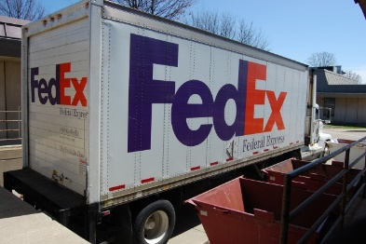
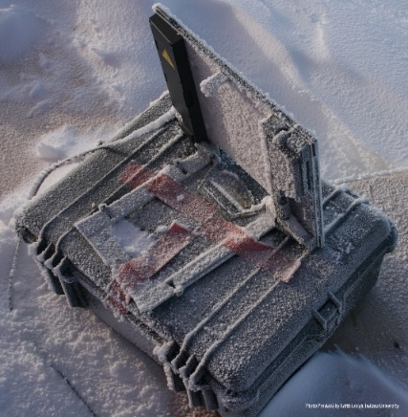
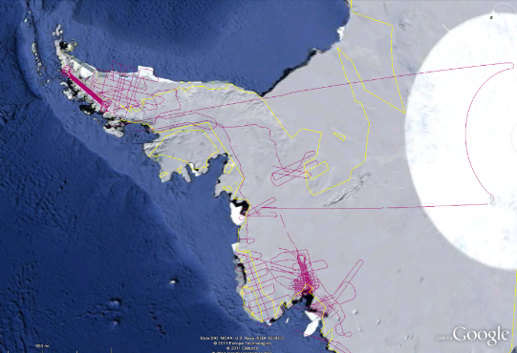

Polar Grid
Lightweight Cyberinfrastructure to support mobile Data gathering expeditions plus classic central resources (as a cloud)
BATCH MODE

Slide 47
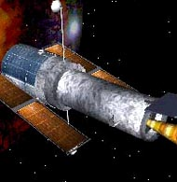
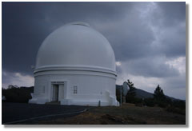
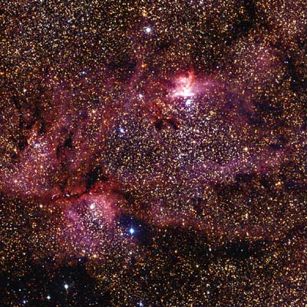
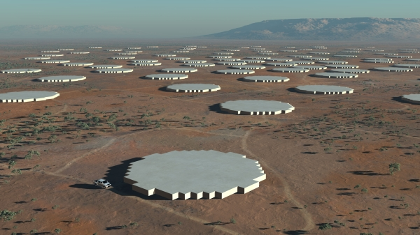
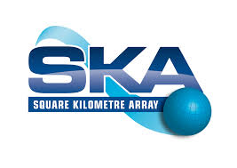
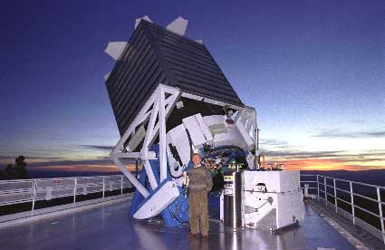
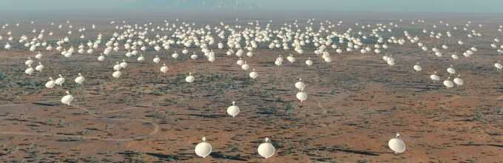
Tracking the Heavens
“The Universe is now being explored systematically, in a panchromatic way, over a range of spatial and temporal scales that lead to a more complete, and less biased understanding of its constituents, their evolution, their origins, and the physical processes governing them.”
Towards a National Virtual Observatory
Hubble Telescope
Palomar Telescope
Sloan Telescope
DISTRIBUTED LARGE INSTRUMENT MODE

Slide 48
Other Use-case Collections

Slide 49
7 Computational Giants of
NRC Massive Data Analysis Report
http://www.nap.edu/catalog.php?record_id=18374 Big Data Models?
G1: Basic Statistics e.g. MRStat
G2: Generalized N-Body Problems
G3: Graph-Theoretic Computations
G4: Linear Algebraic Computations
G5: Optimizations e.g. Linear Programming
G6: Integration e.g. LDA and other GML
G7: Alignment Problems e.g. BLAST

Slide 50
HPC (Simulation) Benchmark Classics
Linpack or HPL: Parallel LU factorization
for solution of linear equations; HPCG
NPB version 1: Mainly classic HPC solver kernels
  MG: Multigrid
  CG: Conjugate Gradient
  FT: Fast Fourier Transform
  IS: Integer sort
  EP: Embarrassingly Parallel
  BT: Block Tridiagonal
  SP: Scalar Pentadiagonal
  LU: Lower-Upper symmetric Gauss Seidel
Simulation Models

Slide 51
13 Berkeley Dwarfs
Dense Linear Algebra
Sparse Linear Algebra
Spectral Methods
N-Body Methods
Structured Grids
Unstructured Grids
MapReduce
Combinational Logic
Graph Traversal
Dynamic Programming
Backtrack and
Branch-and-Bound
Graphical Models
Finite State Machines
First 6 of these correspond to Colella’s original. (Classic simulations)
Monte Carlo dropped.
N-body methods are a subset of Particle in Colella.
Note a little inconsistent in that MapReduce is a programming model and spectral method is a numerical method.
Need multiple facets to classify use cases!
Largely Models for Data or Simulation

Slide 52
Classifying Use cases

Slide 53
Classifying Use Cases
The Big Data Ogres built on a collection of 51 big data uses gathered by the NIST Public Working Group where 26 properties were gathered for each application.
This information was combined with other studies including the Berkeley dwarfs, the NAS parallel benchmarks and the Computational Giants of the NRC Massive Data Analysis Report.
The Ogre analysis led to a set of 50 features divided into four views that could be used to categorize and distinguish between applications.
The four views are Problem Architecture (Macro pattern); Execution Features (Micro patterns); Data Source and Style; and finally the Processing View or runtime features.
We generalized this approach to integrate Big Data and Simulation applications into a single classification looking separately at Data and Model with the total facets growing to 64 in number, called convergence diamonds, and split between the same 4 views.
A mapping of facets into work of the SPIDAL project has been given.

Slide 54
The original 50 Ogres in 4 views
Processing
Data Source and Style
Problem Architecture (metapatterns)
Execution (micropatterns)

Slide 55
64 Features in 4 views for Unified Classification of Big Data and Simulation Applications
Both
Simulations
Analytics
(Model for Big Data)
(Nearly all Data)
(All Model)
(Mix of Data and Model)
(Nearly all Data+Model)

Slide 56
Convergence Diamonds and their 4 Views I
One view is the overall problem architecture or macropatterns which is naturally related to the machine architecture needed to support application.
  Unchanged from Ogres and describes properties of problem such as “Pleasing Parallel” or “Uses Collective Communication”
The execution (computational) features or micropatterns view, describes issues such as I/O versus compute rates, iterative nature and regularity of computation and the classic V’s of Big Data: defining problem size, rate of change, etc.
  Significant changes from ogres to separate Data and Model and add characteristics of Simulation models. e.g. both model and data have “V’s”; Data Volume, Model Size
  e.g. O(N²) Algorithm relevant to big data or big simulation model

Slide 57
Convergence Diamonds and their 4 Views II
The data source & style view includes facets specifying how the data is collected, stored and accessed. Has classic database characteristics
  Simulations can have facets here to describe input or output data
  Examples: Streaming, files versus objects, HDFS v. Lustre
Processing view has model (not data) facets which describe types of processing steps including nature of algorithms and kernels by model e.g. Linear Programming, Learning, Maximum Likelihood, Spectral methods, Mesh type,
  mix of Big Data Processing View and Big Simulation Processing View and includes some facets like “uses linear algebra” needed in both: has specifics of key simulation kernels and in particular includes facets seen in NAS Parallel Benchmarks and Berkeley Dwarfs
Instances of Diamonds are particular problems and a set of Diamond instances that cover enough of the facets could form a comprehensive benchmark/mini-app set
Diamonds and their instances can be atomic or composite

Slide 58
Programming Environment for Global AI and Modeling Supercomputer GAIMSC
2
http://www.iterativemapreduce.org/

Slide 59
Ways of adding High Performance to
Global AI (and Modeling) Supercomputer
Fix performance issues in Spark, Heron, Hadoop, Flink etc.
  Messy as some features of these big data systems intrinsically slow in some (not all) cases
  All these systems are “monolithic” and difficult to deal with individual components
Execute HPBDC from classic big data system with custom communication environment – approach of Harp for the relatively simple Hadoop environment
Provide a native Mesos/Yarn/Kubernetes/HDFS high performance execution environment with all capabilities of Spark, Hadoop and Heron – goal of Twister2
Execute with MPI in classic (Slurm, Lustre) HPC environment
Add modules to existing frameworks like Scikit-Learn or Tensorflow either as new capability or as a higher performance version of existing module.

Slide 60
GAIMSC Programming Environment Components I
Area | Component | Implementation | Comments: User API
Architecture Specification | Coordination Points | State and Configuration Management; Program, Data and Message Level | Change execution mode; save and reset state
 | Execution Semantics | Mapping of Resources to Bolts/Maps in Containers, Processes, Threads | Different systems make different choices - why?
 | Parallel Computing | Spark Flink Hadoop Pregel MPI modes | Owner Computes Rule
Job Submission | (Dynamic/Static) Resource Allocation | Plugins for Slurm, Yarn, Mesos, Marathon, Aurora | Client API (e.g. Python) for Job Management
Task System | Task migration | Monitoring of tasks and migrating tasks for better resource utilization | Task-based programming with Dynamic or Static Graph API; FaaS API; Support accelerators (CUDA,FPGA, KNL)
 | Elasticity | OpenWhisk
 | Streaming and FaaS Events | Heron, OpenWhisk, Kafka/RabbitMQ
 | Task Execution | Process, Threads, Queues
 | Task Scheduling | Dynamic Scheduling, Static Scheduling, Pluggable Scheduling Algorithms
 | Task Graph | Static Graph, Dynamic Graph Generation

Slide 61
GAIMSC Programming Environment Components II
Area | Component | Implementation | Comments
Communication API | Messages | Heron | This is user level and could map to multiple communication systems
 | Dataflow Communication | Fine-Grain Twister2 Dataflow communications: MPI,TCP and RMA Coarse grain Dataflow from NiFi, Kepler? | Streaming, ETL data pipelines; Define new Dataflow communication API and library
 | BSP Communication Map-Collective | Conventional MPI, Harp | MPI Point to Point and Collective API
Data Access | Static (Batch) Data | File Systems, NoSQL, SQL | Data API
 | Streaming Data | Message Brokers, Spouts
Data Management | Distributed Data Set | Relaxed Distributed Shared Memory(immutable data), Mutable Distributed Data | Data Transformation API; Spark RDD, Heron Streamlet
Fault Tolerance | Check Pointing | Upstream (streaming) backup; Lightweight; Coordination Points; Spark/Flink, MPI and Heron models | Streaming and batch cases distinct; Crosses all components
Security | Storage, Messaging, execution | Research needed | Crosses all Components

Slide 62
Integrating HPC and Apache Programming Environments
Harp-DAAL with a kernel Machine Learning library exploiting the Intel node library DAAL and HPC communication collectives within the Hadoop ecosystem.
  Harp-DAAL supports all 5 classes of data-intensive AI first computation, from pleasingly parallel to machine learning and simulations.
Twister2 is a toolkit of components that can be packaged in different ways
  Integrated batch or streaming data capabilities familiar from Apache Hadoop, Spark, Heron and Flink but with high performance.
  Separate bulk synchronous and data flow communication;
  Task management as in Mesos, Yarn and Kubernetes
  Dataflow graph execution models
  Launching of the Harp-DAAL library with native Mesos/Kubernetes/HDFS environment
  Streaming and repository data access interfaces,
  In-memory databases and fault tolerance at dataflow nodes. (use RDD to do classic checkpoint-restart)

Slide 63
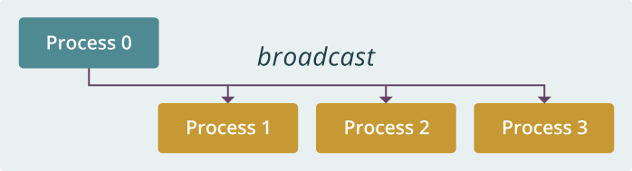
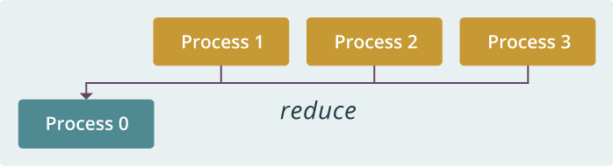
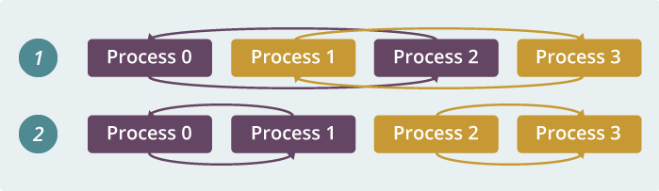
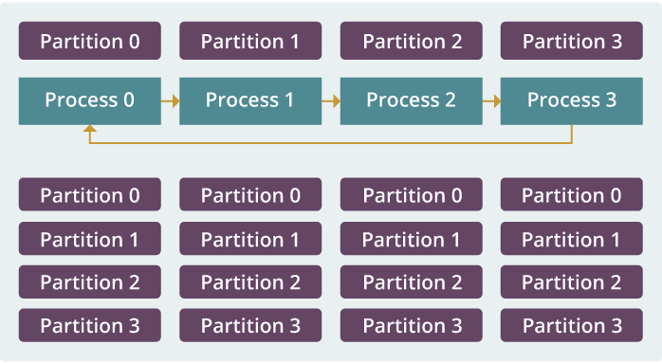
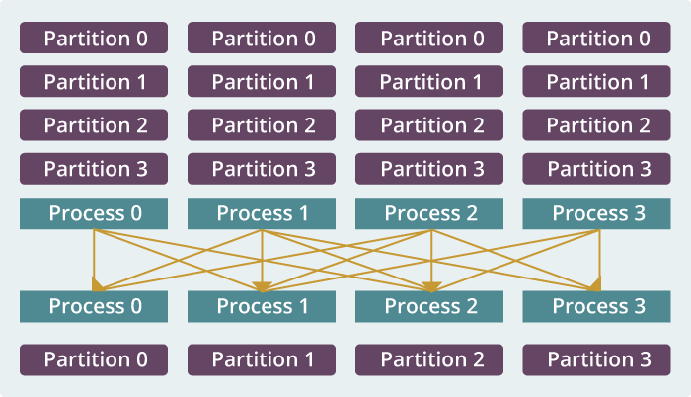
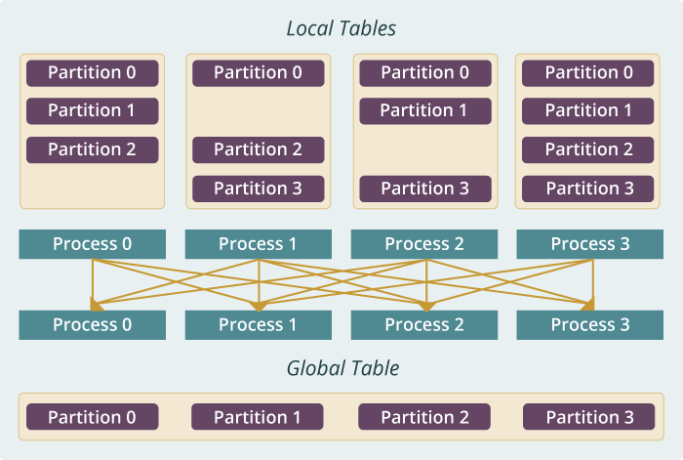
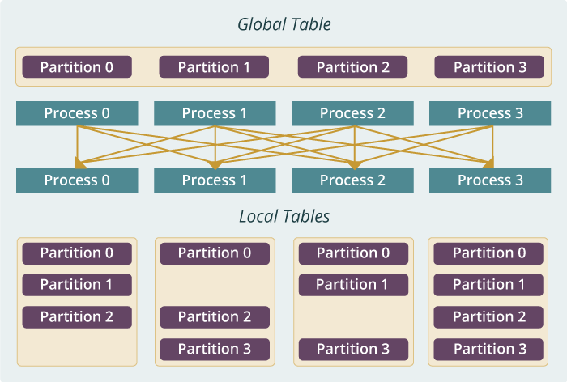
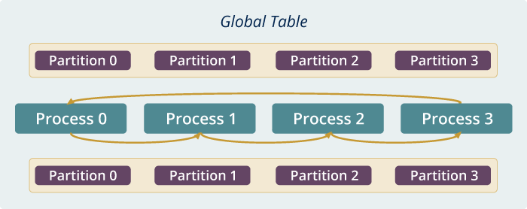
Run time software for Harp
broadcast
reduce
allreduce
allgather
regroup
push & pull
rotate
Map Collective Run time merges MapReduce and HPC

Slide 64
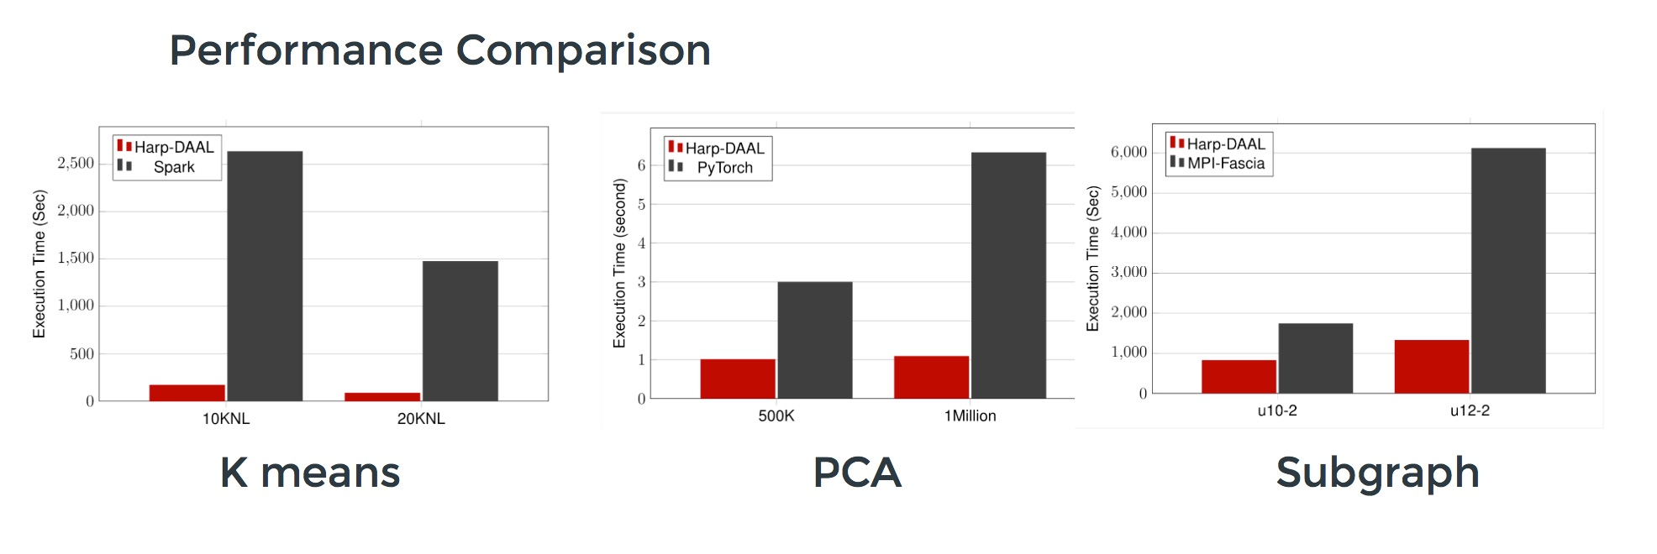
Harp v. Spark Harp v. Torch Harp v. MPI
Datasets: 5 million points, 10 thousand centroids, 10 feature dimensions
10 to 20 nodes of Intel KNL7250 processors
Harp-DAAL has 15x speedups over Spark MLlib
Datasets: 500K or 1 million data points of feature dimension 300
Running on single KNL 7250 (Harp-DAAL) vs. single K80 GPU (PyTorch)
Harp-DAAL achieves 3x to 6x speedups
Datasets: Twitter with 44 million vertices, 2 billion edges, subgraph templates of 10 to 12 vertices
25 nodes of Intel Xeon E5 2670
Harp-DAAL has 2x to 5x speedups over state-of-the-art MPI-Fascia solution

Slide 65
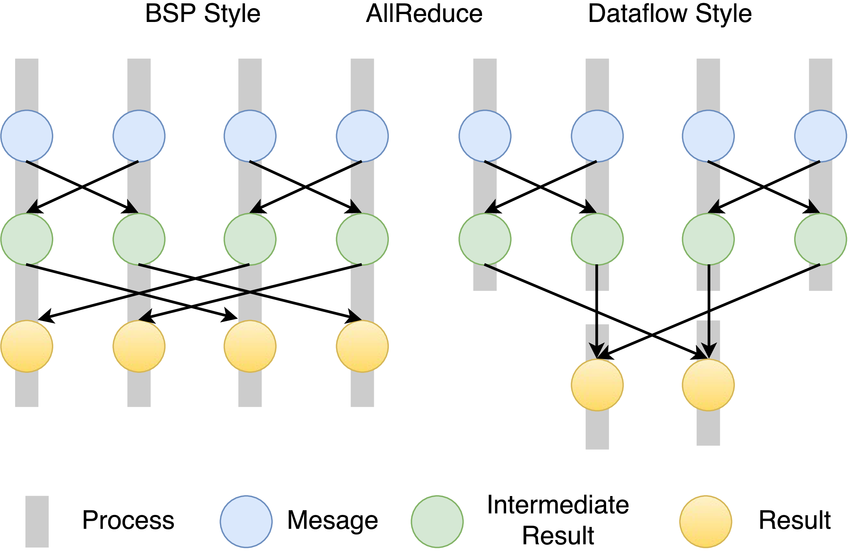
Twister2 Dataflow Communications
Twister:Net offers two communication models
BSP (Bulk Synchronous Processing) message-level communication using TCP or MPI separated from its task management plus extra Harp collectives
DFW a new Dataflow library built using MPI software but at data movement not message level
  Non-blocking
  Dynamic data sizes
  Streaming model
    Batch case is modeled as a finite stream
  The communications are between a set of
  tasks in an arbitrary task graph
  Key based communications
  Data-level Communications spilling to disks
  Target tasks can be different from source tasks

Slide 66
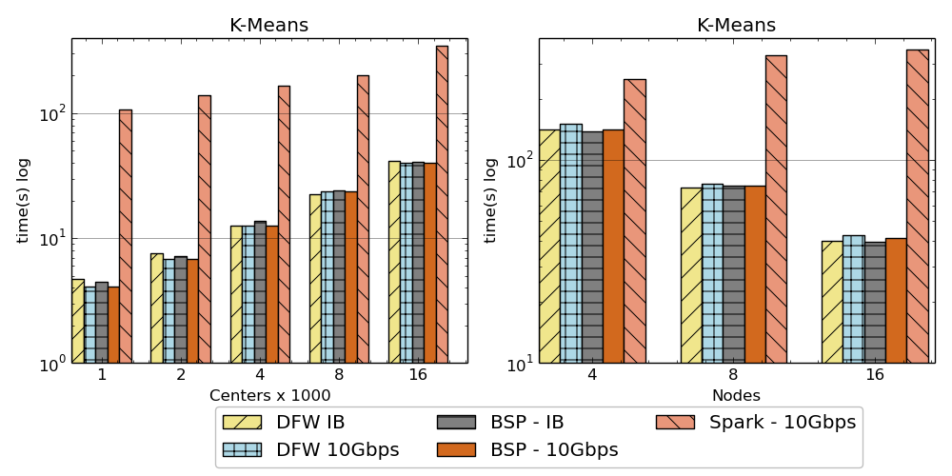
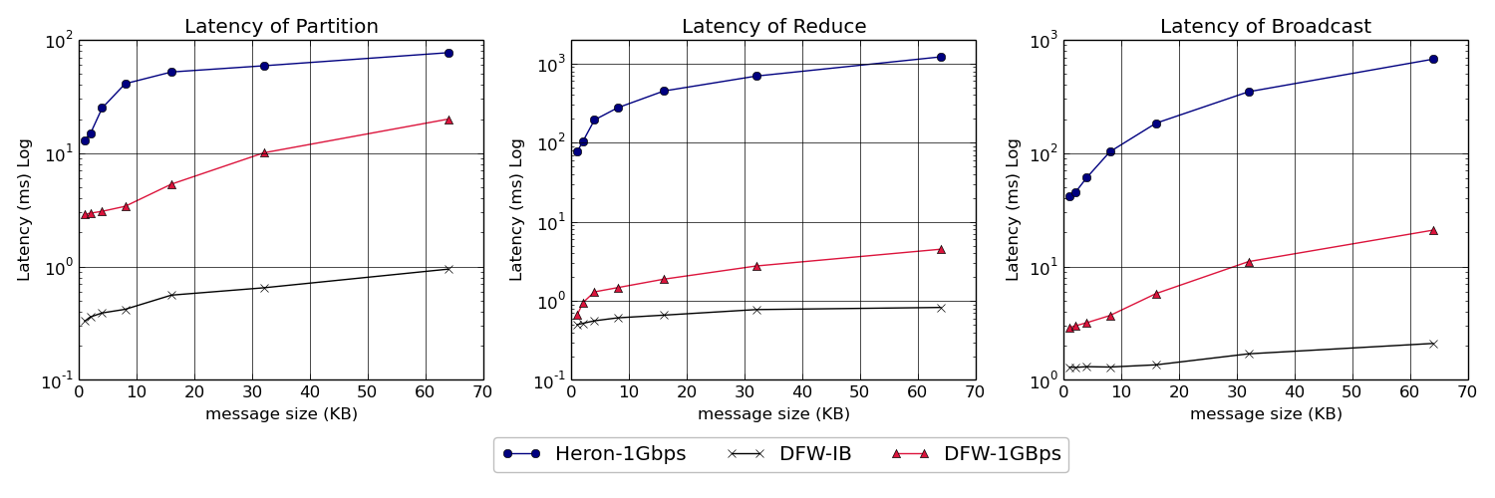
Twister:Net and Apache Heron and Spark
Left: K-means job execution time on 16 nodes with varying centers, 2 million points with 320-way parallelism. Right: K-Means wth 4,8 and 16 nodes where each node having 20 tasks. 2 million points with 16000 centers used.
Latency of Apache Heron and Twister:Net DFW (Dataflow) for Reduce, Broadcast and Partition operations in 16 nodes with 256-way parallelism

Slide 67
Intelligent Dataflow Graph
The dataflow graph specifies the distribution and interconnection of job components
  Hierarchical and Iterative
Allow ML wrapping of component at each dataflow node
Checkpoint after each node of the dataflow graph
  Natural synchronization point
  Let’s allows user to choose when to checkpoint (not every stage)
  Save state as user specifies; Spark just saves Model state which is insufficient for complex algorithms
Intelligent nodes support customization of checkpointing, ML, communication
Nodes can be coarse (large jobs) or fine grain requiring different actions

Slide 68

Dataflow at Different Grain sizes
Coarse Grain Dataflows links jobs in such a pipeline
Visualization
Dimension
Reduction
Data preparation
Clustering
But internally to each job you can also elegantly express algorithm as dataflow but with more stringent performance constraints
Corresponding to classic Spark K-means Dataflow
P = loadPoints()
C = loadInitCenters()
for (int i = 0; i < 10; i++) {
T = P.map().withBroadcast(C)
C = T.reduce() }
Internal Execution
Dataflow Nodes
Reduce
Iterate
HPC
Communication
Maps
Iterate

Slide 69
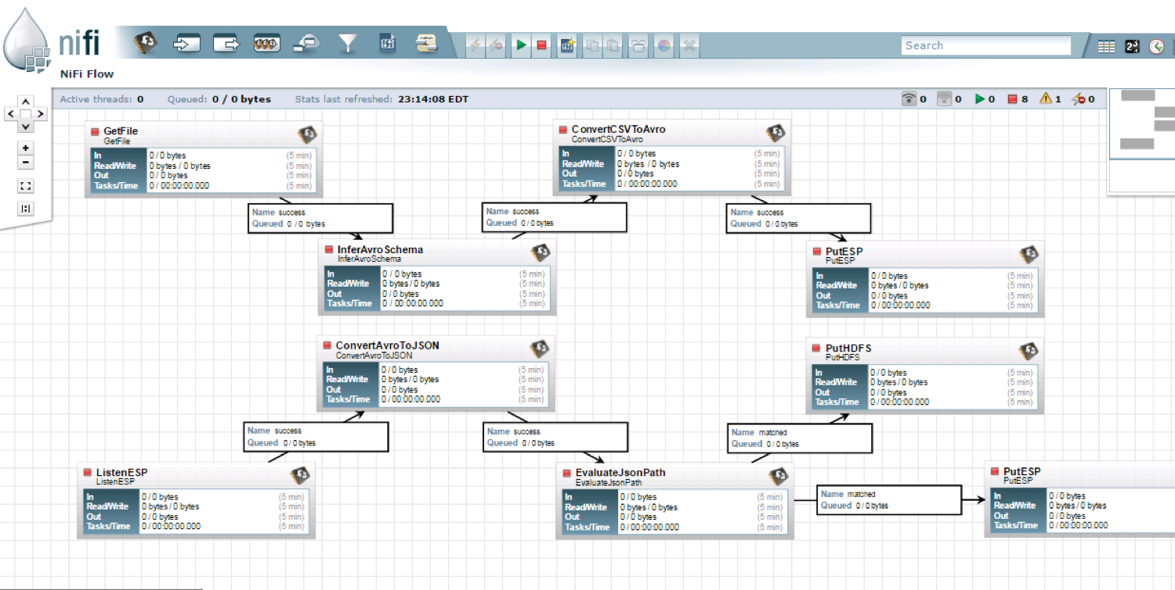
NiFi Coarse-grain Workflow

Slide 70
Futures
Implementing Twister2 for Global AI and Modeling Supercomputer
2
http://www.iterativemapreduce.org/

Slide 71
Twister2 Timeline:
Current Release (End of September 2018)
Twister:Net Dataflow Communication API
  Dataflow communications with MPI or TCP
Data access
  Local File Systems
  HDFS Integration
Task Graph
Streaming and Batch analytics – Iterative jobs
Data pipelines
Deployments on Docker, Kubernetes, Mesos (Aurora), Slurm
Harp for Machine Learning (Custom BSP Communications)
  Rich collectives
  Around 30 ML algorithms

Slide 72
Twister2 Timeline: January 2018
DataSet API similar to Spark batch and Heron streaming with Tset realization
  Can use Tsets for writing RDD/Streamlet style datasets
Fault tolerance as in Heron and Spark
Storm API for Streaming
Hierarchical Dynamic Heterogeneous Task Graph
  Coarse grain and fine grain dataflow
Cyclic task graph execution
Dynamic scaling of resources and heterogeneous resources (at the resource layer) for streaming and heterogeneous workflow
Link to Pilot Jobs

Slide 73
Twister2 Timeline: July 1, 2019
Naiad model based Task system for Machine Learning
Native MPI integration to Mesos, Yarn
Dynamic task migrations
RDMA and other communication enhancements
Integrate parts of Twister2 components as big data systems enhancements (i.e. run current Big Data software invoking Twister2 components)
  Heron (easiest), Spark, Flink, Hadoop (like Harp today)
  Tsets become compatible with RDD (Spark) and Streamlet (Heron)
Support different APIs (i.e. run Twister2 looking like current Big Data Software),Hadoop, Spark (Flink), Storm
Refinements like Marathon with Mesos etc.
Function as a Service and Serverless
Support higher level abstractions
  Twister:SQL (major Spark use case)
Graph API

Slide 74
Conclusions
Can make use case collections to motivate benchmarks
  NIST and BDEC have templates
  Could helpfully fill in templates for benchmarks
Research applications have some similarities but many differences from commercial use cases
Increasing importance of integration of simulation and Machine Learning
Increasing importance of distributed Edge applications
Should benchmark dataflow and BSP style communication
Twister2 will combine Heron and Spark with built in HPC performance

