Slide 1
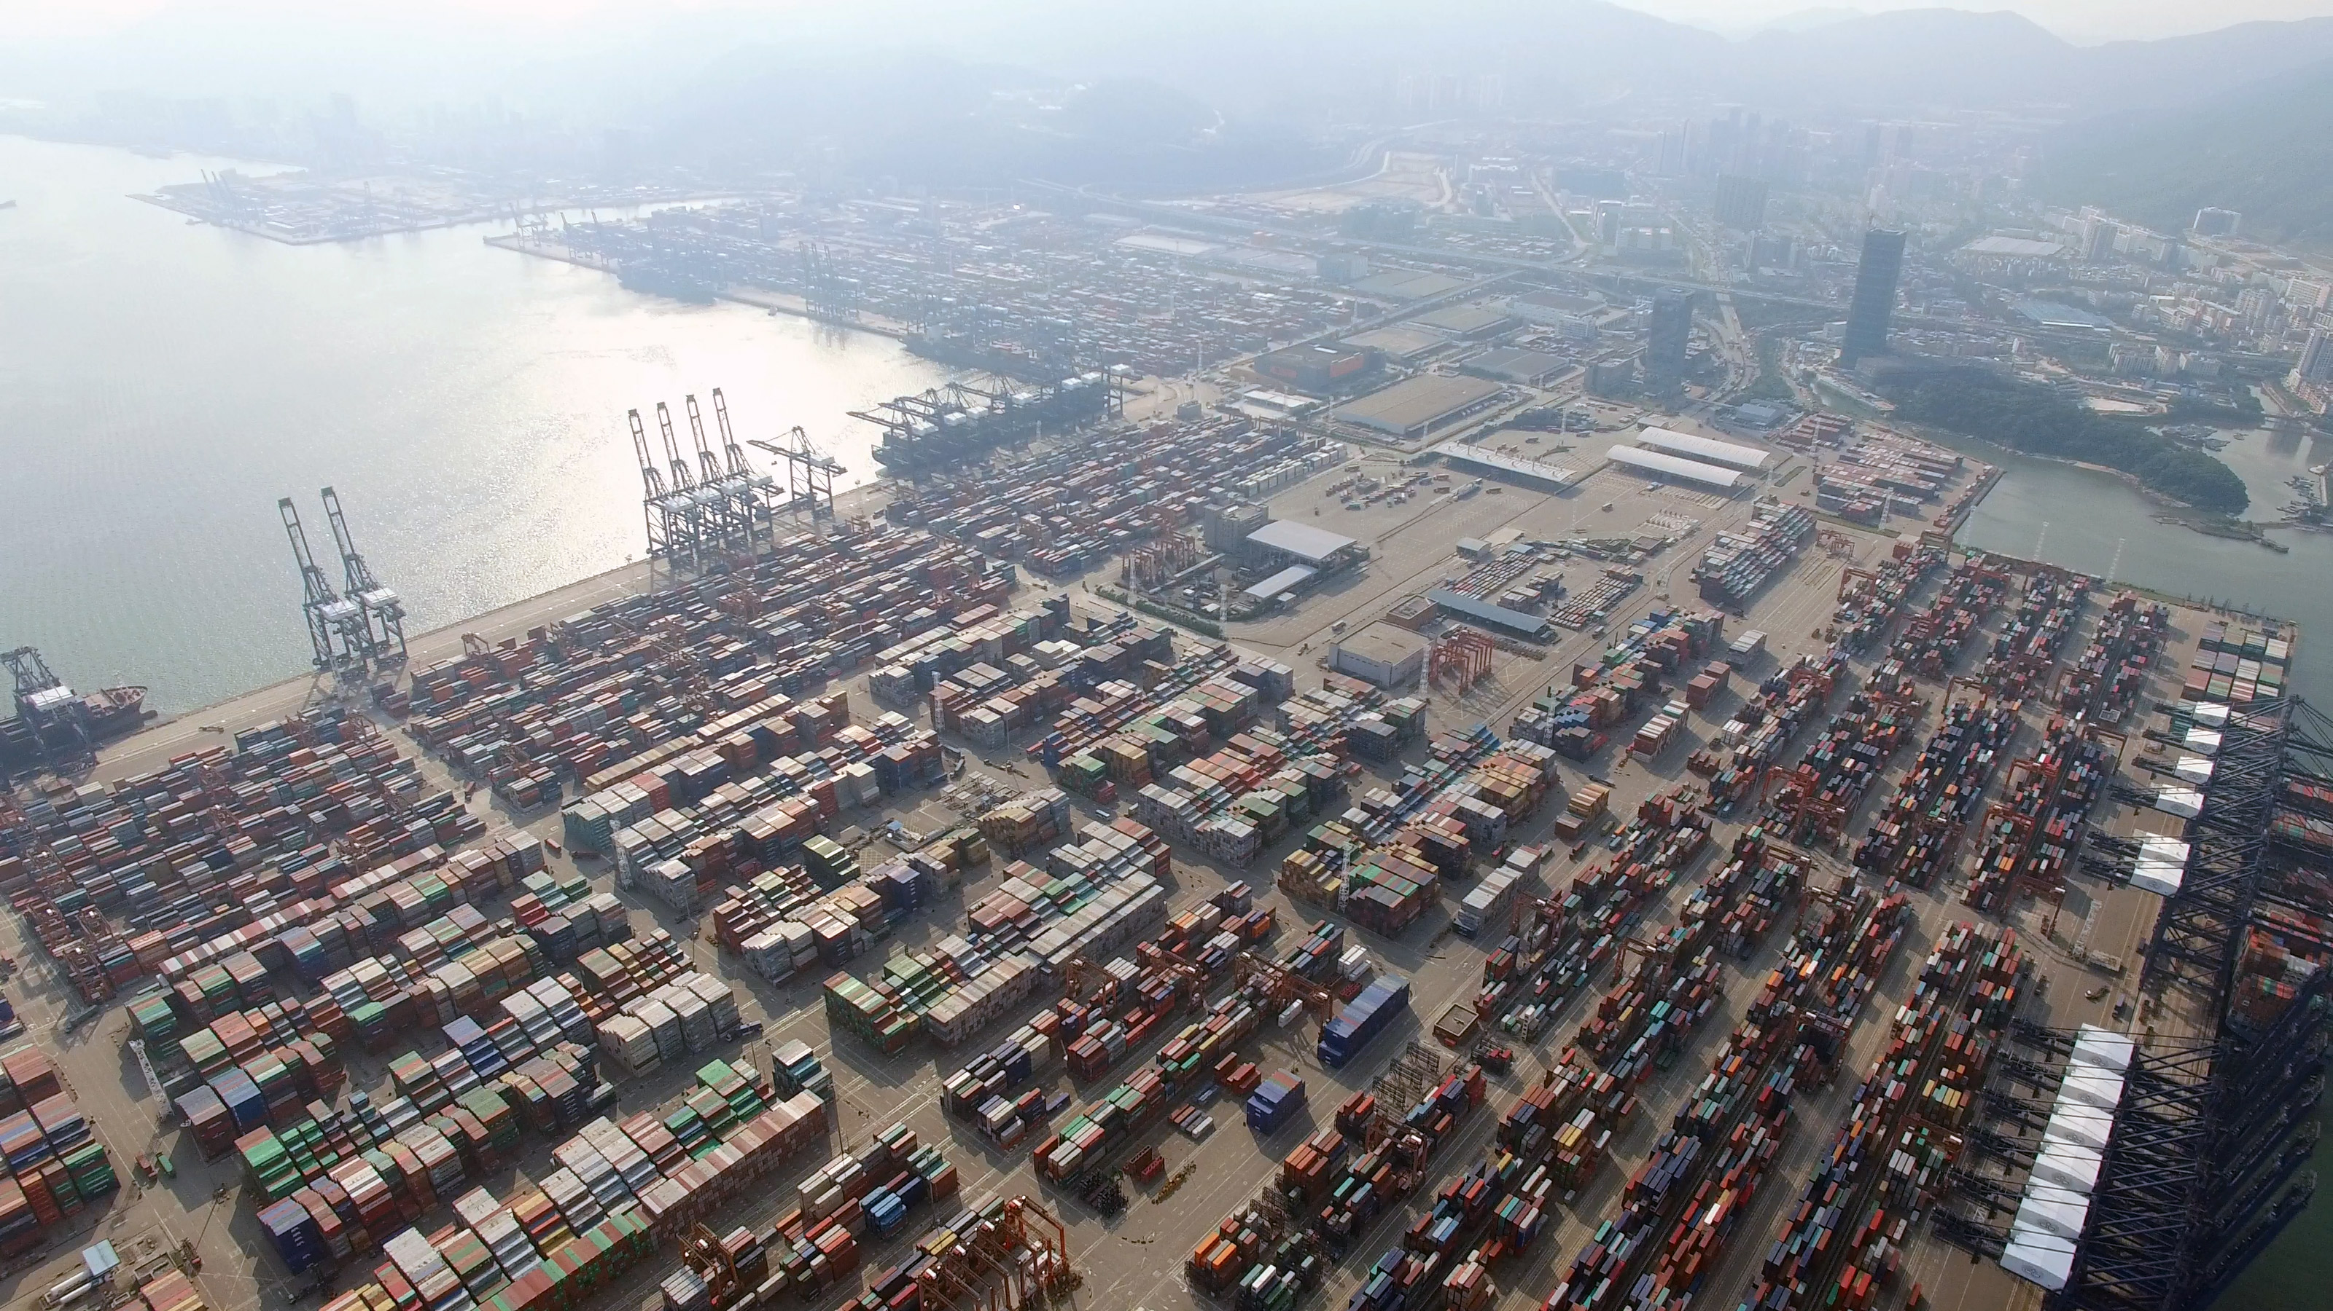
Building HPC Big Data Systems
Shenzhen, China Geoffrey Fox, May 10, 2019 gcf@indiana.edu, http://www.dsc.soic.indiana.edu/, http://spidal.org/
Digital Science Center

Slide 2
Abstract
We assume that High-Performance Computing HPC is naturally important in Big Data applications so as to provide timely results.
However, the differences between HPC software architectures and Big Data Systems such as Hadoop, Spark, and TensorFlow makes it not easy to integrate HPC and Big Data.
Further Machine Learning ML can be used to accelerate HPC by optimizing configurations and components and by learning results; this implies the need for even closer integration of HPC and ML.
We review this situation and consider a programming model where "every call" is wrapped by a learning framework that configures execution (auto-tuning) and learns results.
We describe our big data framework Twister2 and explain where it can offer improved capabilities over current systems.

Slide 3
Overall Global AI and Modeling Supercomputer GAIMSC
2
http://www.iterativemapreduce.org/

Slide 4
aa
From Microsoft
aa

Slide 5
aa
From Microsoft
aa
https://www.microsoft.com/en-us/research/event/faculty-summit-2018/

Slide 6
Overall Global AI and Modeling Supercomputer GAIMSC Architecture
There is only a cloud at the logical center but it’s physically distributed and owned by a few major players
There is a very distributed set of devices surrounded by local Fog computing; this forms the logically and physically distribute edge
The edge is structured and largely data
These are two differences from the Grid of the past
e.g. self driving car will have its own fog and will not share fog with truck that it is about to collide with
The cloud and edge will both be very heterogeneous with varying accelerators, memory size and disk structure.
What is software model for GAIMSC? Twister2 is designed to be this

Slide 7
MLforHPC and HPCforML
We tried to distinguish between different interfaces for ML/DL and HPC.
HPCforML: Using HPC to execute and enhance ML performance, or using HPC simulations to train ML algorithms (theory guided machine learning), which are then used to understand experimental data or simulations.
MLforHPC: Using ML to enhance HPC applications and systems; Big Data comes from the computation
A special case of Dean at NIPS 2017 – "Machine Learning for Systems and Systems for Machine Learning",
Microsoft 2018 meeting focus on MLforBigDataComputations

Slide 8
HPCforML in detail
HPCforML can be further subdivided
HPCrunsML: Using HPC to execute ML with high performance
SimulationTrainedML: Using HPC simulations to train ML algorithms, which are then used to understand experimental data or simulations. (Return to this as similar to MLaroundHPC)
Twister2 supports HPCrunsML by using high performance technology everywhere and this has been my major emphasis over last 5 years

Slide 9
Big Data and Simulation Difficulty in Parallelism Size of Synchronization constraints
Loosely Coupled
Tightly Coupled
HPC Clouds: Accelerators
High Performance Interconnect
HPC Clouds/Supercomputers
Memory access also critical
Commodity Clouds
Size of Disk I/O
MapReduce as in scalable databases
Global Machine Learning
e.g. parallel clustering
Deep Learning
Graph Analytics e.g. subgraph mining
LDA
Pleasingly Parallel
Often independent events
Unstructured Adaptive Sparse
Current major Big Data category
Linear Algebra at core (often not sparse)
Structured Adaptive Sparse
Parameter sweep simulations
Largest scale simulations
Just two problem characteristics There is also data/compute distribution seen in grid/edge computing
Exascale Supercomputers

Slide 10
HPCrunsML Comparing Spark, Flink and MPI
2
http://www.iterativemapreduce.org/

Slide 11
Machine Learning with MPI, Spark and Flink
Three algorithms implemented in three runtimes
Multidimensional Scaling (MDS)
Terasort
K-Means (drop as no time and looked at later)
Implementation in Java
MDS is the most complex algorithm - three nested parallel loops
K-Means - one parallel loop
Terasort - no iterations (see later)
With care, Java performance ~ C performance
Without care, Java performance << C performance (details omitted)

Slide 12
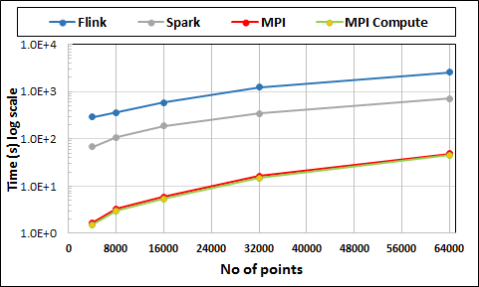
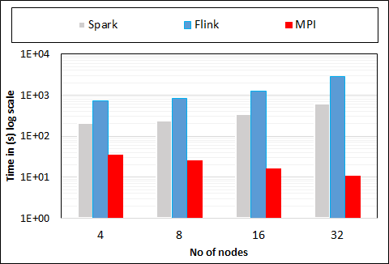
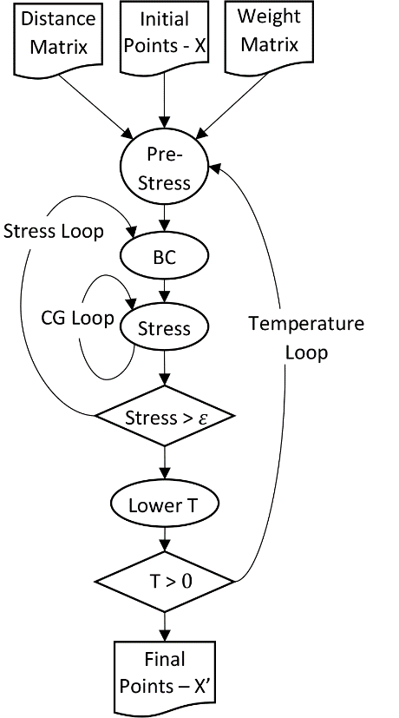
Multidimensional Scaling: 3 Nested Parallel Sections
Flink
Spark
MPI
MPI Factor of 20-200 Faster than Spark/Flink
MDS execution time with 32000 points on varying number of nodes. Each node runs 20 parallel tasks
Spark, Flink No Speedup
MDS execution time on 16 nodes with 20 processes in each node with varying number of points
Flink especially loses touch with relationship of computing and data location

Slide 13
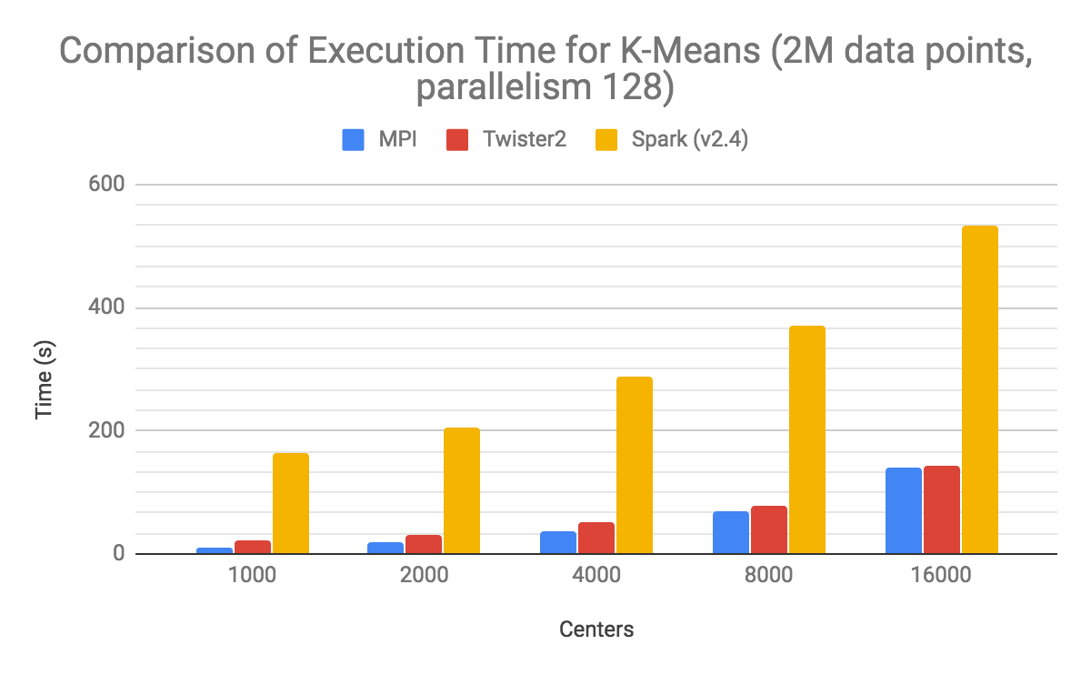

Slide 14
MLforHPC examples
2
http://www.iterativemapreduce.org/

Slide 15
MLforHPC in detail
MLforHPC can be further subdivided into several categories:
MLautotuning: Using ML to configure (autotune) ML or HPC simulations.
MLafterHPC: ML analyzing results of HPC as in trajectory analysis and structure identification in biomolecular simulations
MLaroundHPC: Using ML to learn from simulations and produce learned surrogates for the simulations or parts of simulations. The same ML wrapper can also learn configurations as well as results. Most Important
MLControl: Using simulations (with HPC) in control of experiments and in objective driven computational campaigns. Here the simulation surrogates are very valuable to allow real-time predictions.
Twister2 supports MLforHPC by allowing nodes of HPC dataflow representation to be wrapped with ML

Slide 16
MLforHPC Details I
MLAutoTuningHPC: Learning Configurations This is classic Autotuning and one optimizes some mix of performance and quality of results with the learning network inputting the configuration parameters of the computation. This includes initial values and also dynamic choices such as block sizes for cache use, variable step sizes in space and time. It can also include discrete choices as to the type of solver to be used.
MLAutoTuningHPC: Smart Ensembles Here we choose the best set of computation defining parameters to achieve some goal such as providing the most efficient training set with defining parameters spread well over the relevant phase space.
MLAutoTuningHPC: Learning Model Setups from Observational Data Seen when simulation set up as a set of agents.Tuning agent (model) parameters to optimize agent outputs to available empirical data presents one of the greatest challenges in model construction.

Slide 17
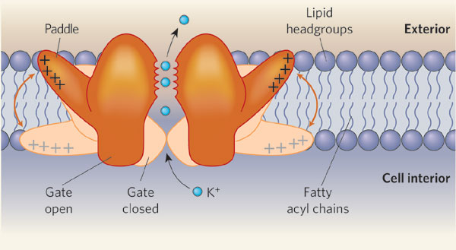
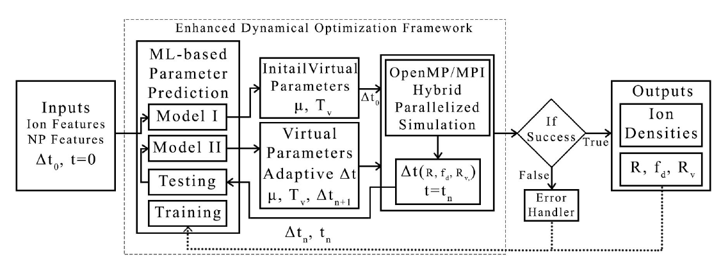
MLAutotunedHPC. Machine Learning for Parameter Auto-tuning in Molecular Dynamics Simulations: Efficient Dynamics of Ions near Polarizable Nanoparticles
Integration of machine learning (ML) methods for parameter prediction for MD simulations by demonstrating how they were realized in MD simulations of ions near polarizable NPs.
Note ML used at start and end of simulation blocks
JCS Kadupitiya, Geoffrey Fox, Vikram Jadhao
ML-Based Simulation Configuration
Inference I
Inference I
Inference II
Inference II
Testing
Testing
Training
Training

Slide 18
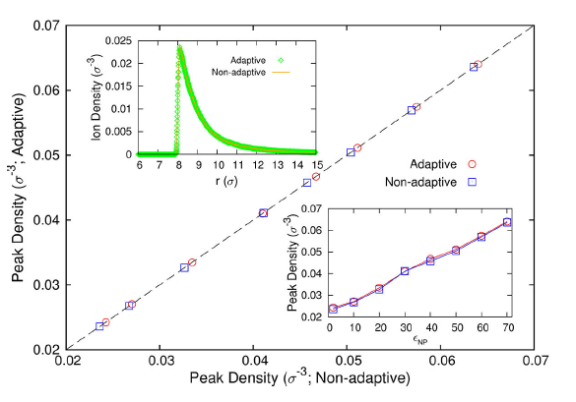
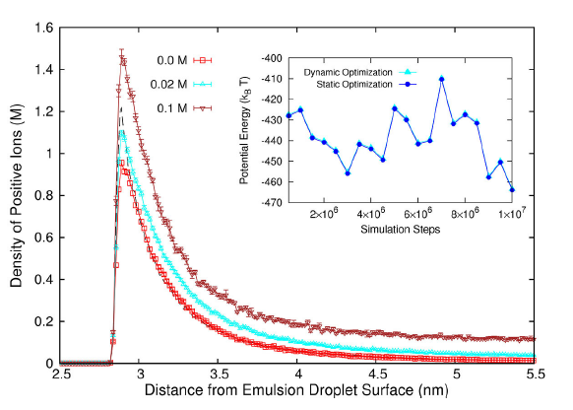
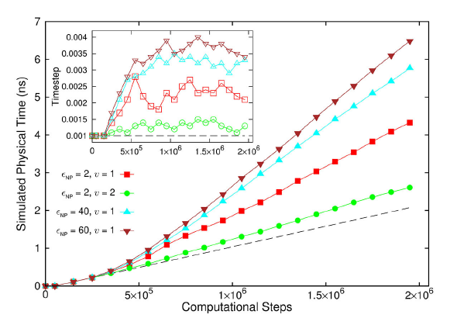
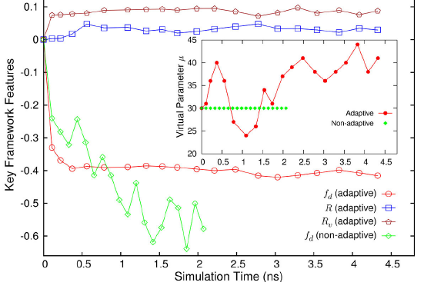
Results for MLAutotuning
Comparison of results for peak densities of counterions between adaptive (ML) and original non-adaptive cases (they look identical)
Ionic densities from MLAutotuned system. Inset compares ML system results with those of slower original system
Key characteristics of simulated system showing greater stability for ML enabled adaptive approach.
Quality of simulation measured by time simulated per step with increasing use of ML enhancements. (Larger is better). Inset is timestep used
An ANN based regression model was integrated with MD simulation and predicted excellent simulation environment 94:3% of the time; human operation is more like 20(student)-50(faculty)% and runs simulation slower to be safe.
Auto-tuning of parameters generated accurate dynamics of ions for 10 million steps while improving the stability.
The integration of ML-enhanced framework with hybrid OpenMP/MPI parallelization techniques reduced the computational time of simulating systems with 1000 of ions and induced charges from 1000 of hours to 10 of hours, yielding a maximum speedup of 3 from MLAutoTuning and a maximum speedup of 600 from the combination of ML and parallel computing.
The approach can be generalized to select optimal parameters in other MD applications & energy minimization problems.

Slide 19
MLforHPC Details II
MLaroundHPC: Learning Outputs from Inputs: This has a wide spectrum of use cases with two extreme cases given below. It includes SimulationTrainedML where the simulations are performed tomdirectly train an AI system rather than the AI system being added to learn a simulation.
Fields from Fields Here one feeds in initial conditions and the neural network learns the result where initial and final results are fields
Computation Results from Computation defining Parameters Here one just feeds in a modest number of metaparameters that the define the problem and learn a modest number of calculated answers. This presumably requires fewer training samples than a)

Slide 20
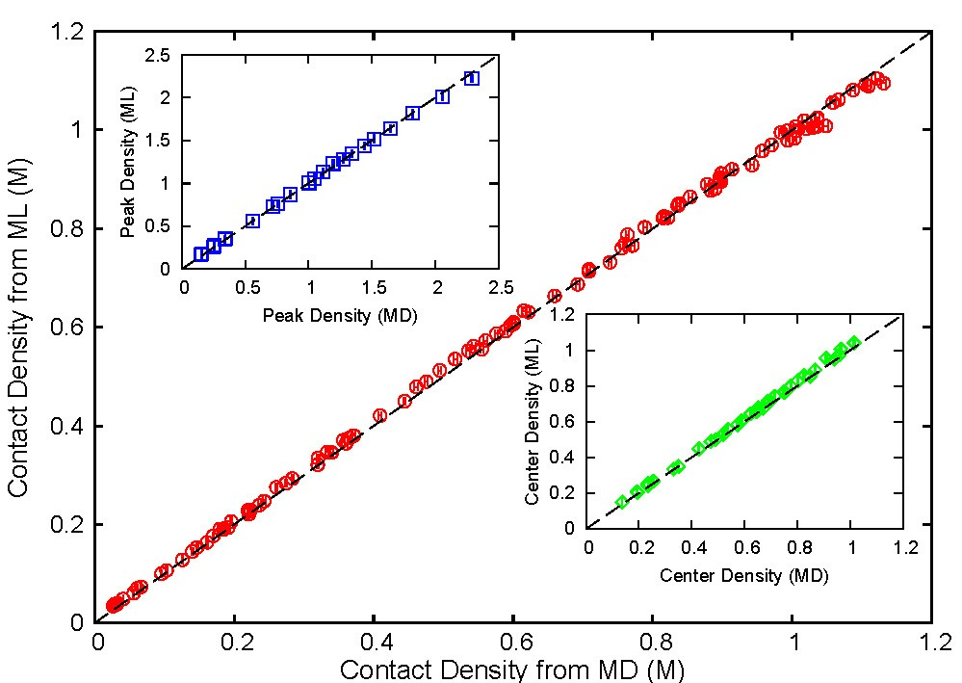
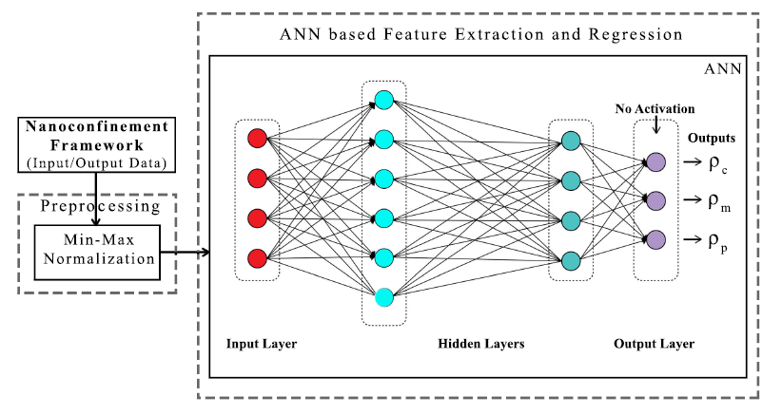
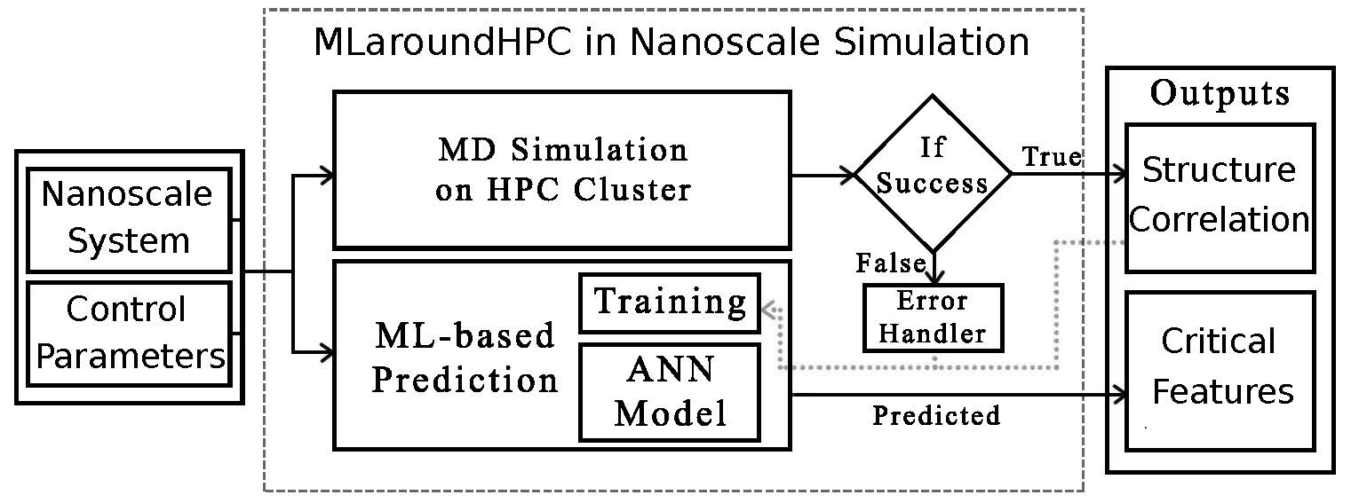
MLaroundCI: Machine learning for performance enhancement with Surrogates of molecular dynamics simulations
We find that an artificial neural network based regression model successfully learns desired features associated with the output ionic density profiles (the contact, mid-point and peak densities) generating predictions for these quantities that are in excellent agreement with the results from explicit molecular dynamics simulations.
The integration of an ML layer enables real-time and anytime engagement with the simulation framework, thus enhancing the applicability for both research and educational use.
Will be deployed on nanoHUB for education
ML-Based Simulation Prediction ANN Model
Training
Inference
ML used during simulation

Slide 21
Speedup of MLaroundCI
T_{seq} is sequential time
T_{train} time for a (parallel) simulation used in training ML
T_{learn} is time per point to run machine learning
T_{lookup} is time to run inference per instance
N_{train} number of training samples
N_{lookup} number of results looked up
Becomes T_{seq}/T_{train} if ML not used
Becomes T_{seq}/T_{lookup} (10⁵ faster in our case) if inference dominates (will overcome end of Moore’s law and win the race to zettascale)
This application to be deployed on nanoHub for high performance education use
N_{train} is 7K to 16K in our work

Slide 22
MLaroundHPC: Learning Model Details I
Learning Agent Behavior One has a model such as a set of cells modeling a virtual tissue. One can use ML to learn dynamics of cells replacing detailed computations by ML surrogates. As can be millions to billions of such agents the performance gain can be huge. Note for parallel computing that one has the same computation cost of full model but much smaller calculation. So parallel overheads go up
Learning Special Cases of Agent Behavior A few or lots of the cells are special such as those reflecting cancer for virtual tissue case
Learning Effective Potentials or Interaction Graphs An effective potential is an analytic, quasi-emperical or quasi-phenomological potential that combines multiple, perhaps opposing, effects into a single potential. Effective potential are typically defined using physical intuition. For example, we have a model specified at a microscopic scale and we define a coarse graining to a different scale with macroscopic entities defined to interact with effective dynamics specified in some fashion such as an effective potential or effective interaction graph. This is classic coarse graining strategy

Slide 23
MLaroundHPC: Learning Model Details II
Learning Agent Behavior One has a model such as a set of cells modeling a virtual tissue. One can use ML to learn dynamics of cells replacing detailed computations by ML surrogates. As can be millions to billions of such agents the performance gain can be huge. Note for parallel computing that one has the same computation cost of full model but much smaller calculation. So parallel overheads go up
Learning Special Cases of Agent Behavior A few or lots of the cells are special such as those reflecting cancer for virtual tissue case
Learning Effective Potentials or Interaction Graphs An effective potential is an analytic, quasi-emperical or quasi-phenomological potential that combines multiple, perhaps opposing, effects into a single potential. Effective potential are typically defined using physical intuition. For example, we have a model specified at a microscopic scale and we define a coarse graining to a different scale with macroscopic entities defined to interact with effective dynamics specified in some fashion such as an effective potential or effective interaction graph. This is classic coarse graining strategy

Slide 24
MLaroundHPC: Learning Model Details III
(d) Learning Agent Behavior – a Predictor-Corrector approach Here one time steps models and at each step optimize the parameters to minimize divergence between simulation and ground truth data. The ground truth here may be in the form of experimental data, or from highly detailed (and expensive) quantum or micro-scale calculations. The time series of parameter adjustments define information missing from the model.. This is an extended data assimilation approach.
Example: produce a generic model organism such as an embryo. Take this generic model as a template and learn the different adjustments for particular individual organisms.
(e) Inference of Missing Model Structure In this case we aggregate the Learned Predictor Corrector MLs, there is substantial evidence that in some signifiant cases, we can infer unknown model structure from the aggregation of individual learned predictor corrector models. In these cases we can then add these inferred mechanisms to the base model structure and repeat the basic predictor-corrector steps. In addition, this aggregation means that every completed data set and simulation increases the expressiveness of the base model

Slide 25
MLControl
(a) Experiment Control Using simulations (possibly with HPC) in control of experiments and in objective driven computational campaigns . Here the simulation surrogates are very valuable to allow real-time predictions. Applied in Material Science and Fusion
(b) Experiment Design One of the biggest challenges of models is the uncertainty in the precise model structures and parameters. Model-based design of experiments (MBDOE) assists in the planning of highly effective and efficient experiments – it capitalizes on the uncertainty in the models to investigate how to perturb the real system to maximize the information obtained from experiments. MBDOE with new ML assistance identifies the optimal conditions for stimuli and measurements that yield the most information about the system given practical limitations on realistic experiments

Slide 26
Programming Environment for Global AI and Modeling Supercomputer GAIMSC
2
http://www.iterativemapreduce.org/
Uses HPCforML(HPC for Big Data) and supports MLforHPC

Slide 27
Ways of adding High Performance to Global AI (and Modeling) Supercomputer
Fix performance issues in Spark, Heron, Hadoop, Flink etc.
Messy as some features of these big data systems intrinsically slow in some (not all) cases
All these systems are “monolithic” and difficult to deal with individual components
Execute HPBDC from classic big data system with custom communication environment – approach of Harp for the relatively simple Hadoop environment
Provide a native Mesos/Yarn/Kubernetes/HDFS high performance execution environment with all capabilities of Spark, Hadoop and Heron – goal of Twister2
Execute with MPI in classic (Slurm, Lustre) HPC environment
Add modules to existing frameworks like Scikit-Learn or Tensorflow either as new capability or as a higher performance version of existing module.

Slide 28
Twister2 Highlights I
“Big Data Programming Environment” such as Hadoop, Spark, Flink, Storm, Heron but with significant differences (improvements)
Uses HPC wherever appropriate
Links to “Apache Software” (Kafka, Hbase, Beam) wherever appropriate
Runs preferably under Kubernetes and Mesos but Slurm supported
Highlight is high performance dataflow supporting iteration, fine-grain, coarse grain, dynamic, synchronized, asynchronous, batch and streaming
Two distinct communication environments
DFW Dataflow with distinct source and target tasks; data not message level
BSP for parallel programming; MPI is default. Inappropriate for dataflow
Rich state model for objects supporting in-place, distributed, cached, RDD style persistence

Slide 29
Twister2 Highlights II
Can be a pure batch engine
Not built on top of a streaming engine
Can be a pure streaming engine supporting Storm/Heron API
Not built on on top of a batch engine
Fault tolerance as in Spark or MPI today; dataflow nodes define natural synchronization points
Many API’s: Data (at many levels), Communication, Task
High level (as in Spark) and low level (as in MPI)
High-level Data API hides communication and decomposition from the user
Component based architecture -- it is a toolkit
Defines the important layers of a distributed processing engine
Implements these layers cleanly aiming at high performance data analytics

Slide 30
Twister2 Highlights III
Key features of Twister2 are associated with its dataflow model
Fast and functional inter-node linkage; distributed from edge to cloud or in-place between identical source and target tasks
Streaming or Batch nodes (Storm persisent or Spark emphemeral model)
Supports both Orchestration (as in Pegasus, Kepler, NiFi) or high performance streaming flow (as in Naiad) model
Tset Twister2 datasets like RDD define a full object state model supported across links of dataflow

Slide 31
Twister2 Logistics
Open Source - Apache Licence Version 2.0
Github - https://github.com/DSC-SPIDAL/twister2
Documentation - https://twister2.gitbook.io/twister2 with tutorial
Developer Group - twister2@googlegroups.com – India(1) Sri Lanka(9) and Turkey(2)
Started in the 4th Quarter of 2017; reversing previous philosophy which was to modify Hadoop, Spark, Heron;
Bootstrapped using Heron code but that code now changed
About 80000 Lines of Code (plus 50,000 for SPIDAL+Harp HPCforML)
Languages - Primarily Java with some Python

Slide 32
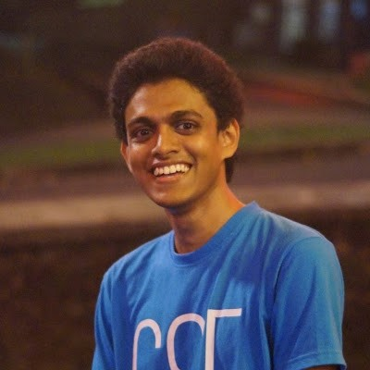
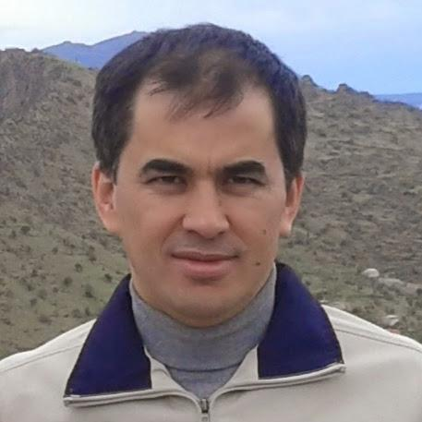
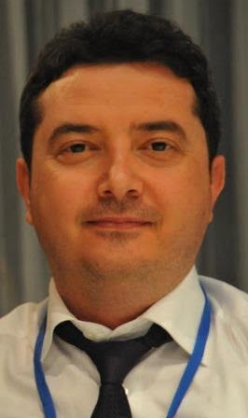
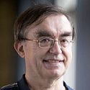
Twister2 Team

Slide 33
Twister2 Features by Level of Effort
Feature | Current Lines of Code | Near-term Addons
Mesos+Kubernetes+Slurm Integration + Resource and Job Management (Job master) | 15000
Task system (scheduler + dataflow graph + executor) | 10000
DataFlow operators, Twister:Net | 20000
Fault tolerance | 2000 | 3000
Python API |  | 5000
Tset and Object State | 2500
Apache Storm Compatibility | 2000
Apache Beam Connection |  | 2000-5000
Connected (external) Dataflow | 5000 | 4000-8000
Data Access API | 5000 | 5000
Connectors ( RabbitMQ, MQTT, SQL, HBase etc.) | 1000 (Kafka) | 10000
Utilities and common code | 9000 (5000 + 4000)
Application Test code | 10000
Dashboard | 4000

Slide 34
Twister2 Implementation by Language
Language | Files | Blank Lines | Comment Lines | Line of Code
Java | 916 | 16247 | 26415 | 66045
Python | 54 | 2240 | 3178 | 6707
XML | 20 | 93 | 241 | 3714
Javascript | 35 | 220 | 217 | 2092
Bourne (Again) Shell | 25 | 242 | 344 | 338
YAML | 47 | 429 | 727 | 812
SASS | 12 | 93 | 53 | 423
Maven | 1 | 12 | 1 | 91
HTML | 1 | 3 | 20 | 22
SUM: | 1111 | 19579 | 31196 | 80801
Software Engineering will double amount of code with unit tests etc.

Slide 35
GAIMSC Programming Environment Components I
Area | Component | Implementation | Comments: User API
Architecture Specification | Coordination Points | State and Configuration Management; Program, Data and Message Level | Change execution mode; save and reset state
 | Execution Semantics | Mapping of Resources to Bolts/Maps in Containers, Processes, Threads | Different systems make different choices - why?
 | Parallel Computing | Spark Flink Hadoop Pregel MPI modes | Owner Computes Rule
Job Submission | (Dynamic/Static) Resource Allocation | Plugins for Slurm, Yarn, Mesos, Marathon, Aurora | Client API (e.g. Python) for Job Management
Task System | Task migration | Monitoring of tasks and migrating tasks for better resource utilization | Task-based programming with Dynamic or Static Graph API; FaaS API; Support accelerators (CUDA,FPGA, KNL)
 | Elasticity | OpenWhisk
 | Streaming and FaaS Events | Heron, OpenWhisk, Kafka/RabbitMQ
 | Task Execution | Process, Threads, Queues
 | Task Scheduling | Dynamic Scheduling, Static Scheduling, Pluggable Scheduling Algorithms
 | Task Graph | Static Graph, Dynamic Graph Generation

Slide 36
GAIMSC Programming Environment Components II
Area | Component | Implementation | Comments
Communication API | Messages | Heron | This is user level and could map to multiple communication systems
 | Dataflow Communication | Fine-Grain Twister2 Dataflow communications: MPI,TCP and RMA Coarse grain Dataflow from NiFi, Kepler? | Streaming, ETL data pipelines; Define new Dataflow communication API and library
 | BSP Communication Map-Collective | Conventional MPI, Harp | MPI Point to Point and Collective API
Data Access | Static (Batch) Data | File Systems, NoSQL, SQL | Data API
 | Streaming Data | Message Brokers, Spouts
Data Management | Distributed Data Set | Relaxed Distributed Shared Memory(immutable data), Mutable Distributed Data | Data Transformation API; Spark RDD, Heron Streamlet
Fault Tolerance | Check Pointing | Upstream (streaming) backup; Lightweight; Coordination Points; Spark/Flink, MPI and Heron models | Streaming and batch cases distinct; Crosses all components
Security | Storage, Messaging, execution | Research needed | Crosses all Components

Slide 37
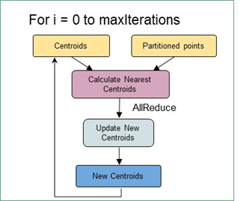
Some Choices in Dataflow Systems
NiFi
Classic coarse-grain workflow
Computations (maps) happen at nodes
Generalized Communication happens on links
Direct, Keyed, Collective (broadcast, reduce), Join
In coarse-grain workflow, communication can be by disk
In fine-grain dataflow (as in K-means), communication needs to be fast
Caching and/or use in-place tasks
In-place not natural for streaming as persistent nodes/tasks
K-means in Spark, Flink, Twister2

Slide 38
Execution as a Graph for Data Analytics
The graph created by the user API can be executed using an event model
The events flow through the edges of the graph as messages
The compute units are executed upon arrival of events
Supports Function as a Service
Execution state can be checkpointed automatically with natural synchronization at node boundaries
Fault tolerance in June 2019 release
T
T
Task Schedule
Events flow through edges
Graph
Execution Graph (Plan)
R

Slide 39
as a service
Continually interacting in the Intelligent Aether with
Software model supported by Twister2
(Omni)

Slide 40
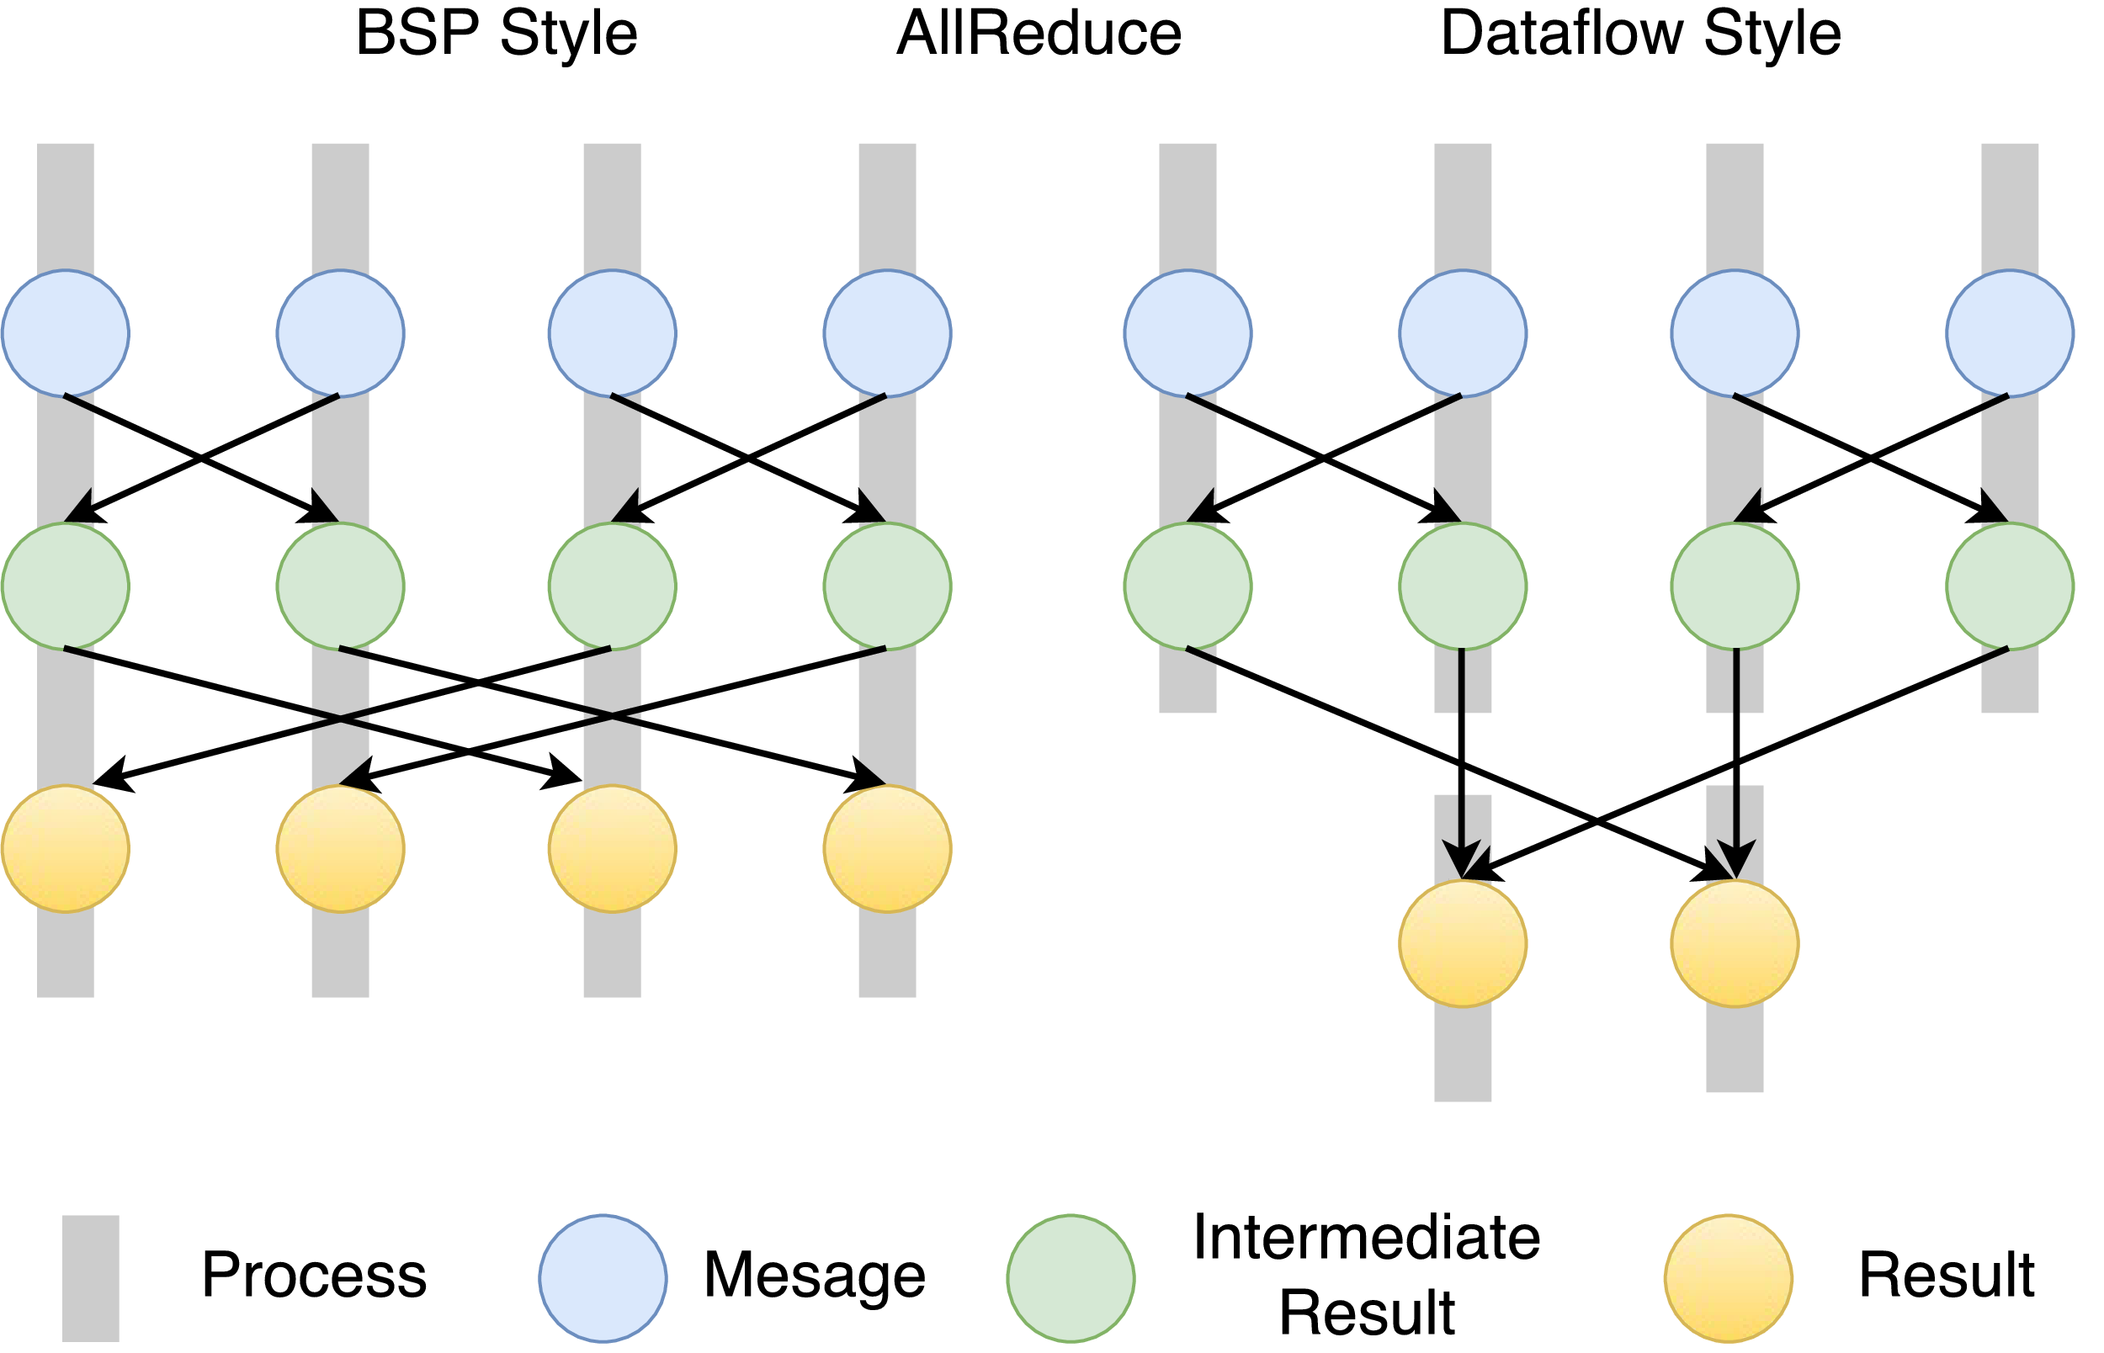
Twister2 Dataflow Communications
Twister:Net offers two communication models
BSP (Bulk Synchronous Processing) message-level communication using TCP or MPI separated from its task management plus extra Harp collectives
DFW a new Dataflow library built using MPI software but at data movement not message level
Non-blocking
Dynamic data sizes
Streaming model
Batch case is represented as a finite stream
The communications are between a set of tasks in an arbitrary task graph
Key based communications: all the MapReduce movement functions
Data-level Communications spilling to disks
Target tasks can be different from source tasks
BSP and DFW for Reduce Operation

Slide 41
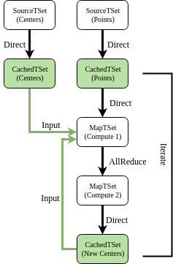
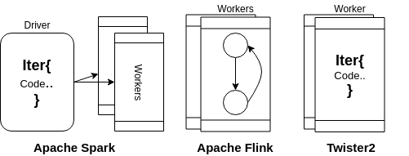
Structure of Iterations and Dataflow nodes in Spark, Flink and Twister2
K-Means TSet API dataflow graph

Slide 42
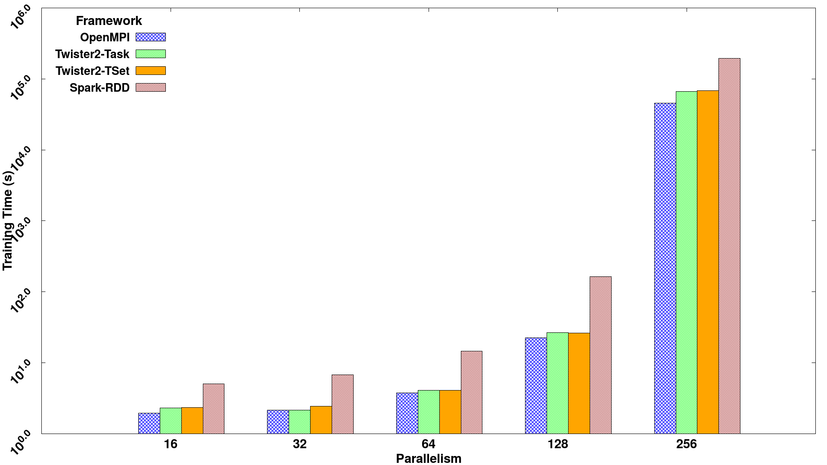
SVM execution time for 320K data points with 2000 features and 500 iterations, on 16 nodes with varying parallelism
Times
Spark RDD > Twister2 Tset > Twister2 Task > MPI

Slide 43
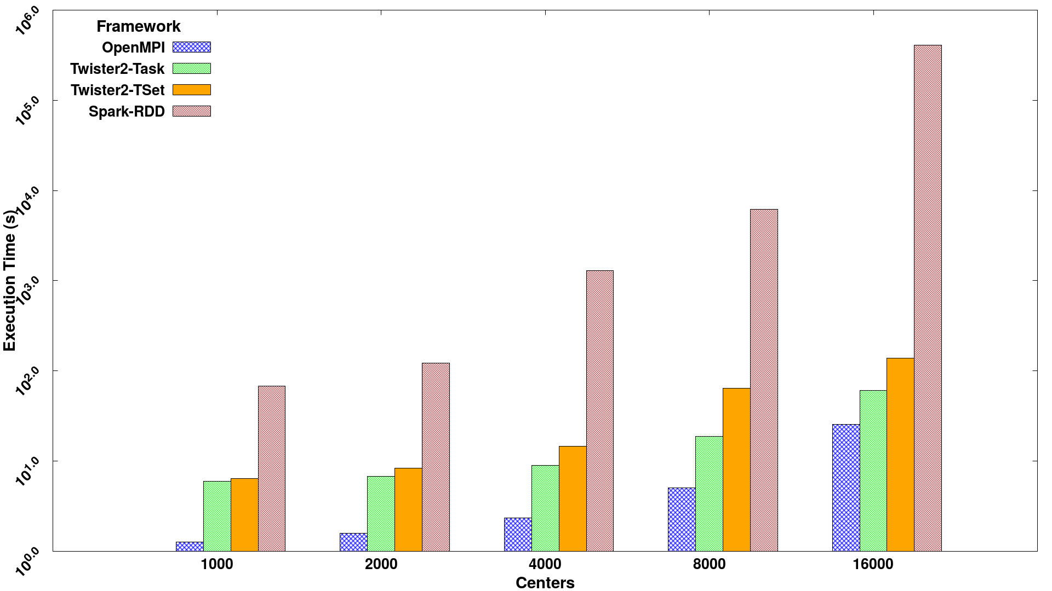
Kmeans versus Centers
2 million data points with 128-way parallelism for 100 iterations.
Times
Spark RDD > Twister2 Tset > Twister2 Task > MPI

Slide 44
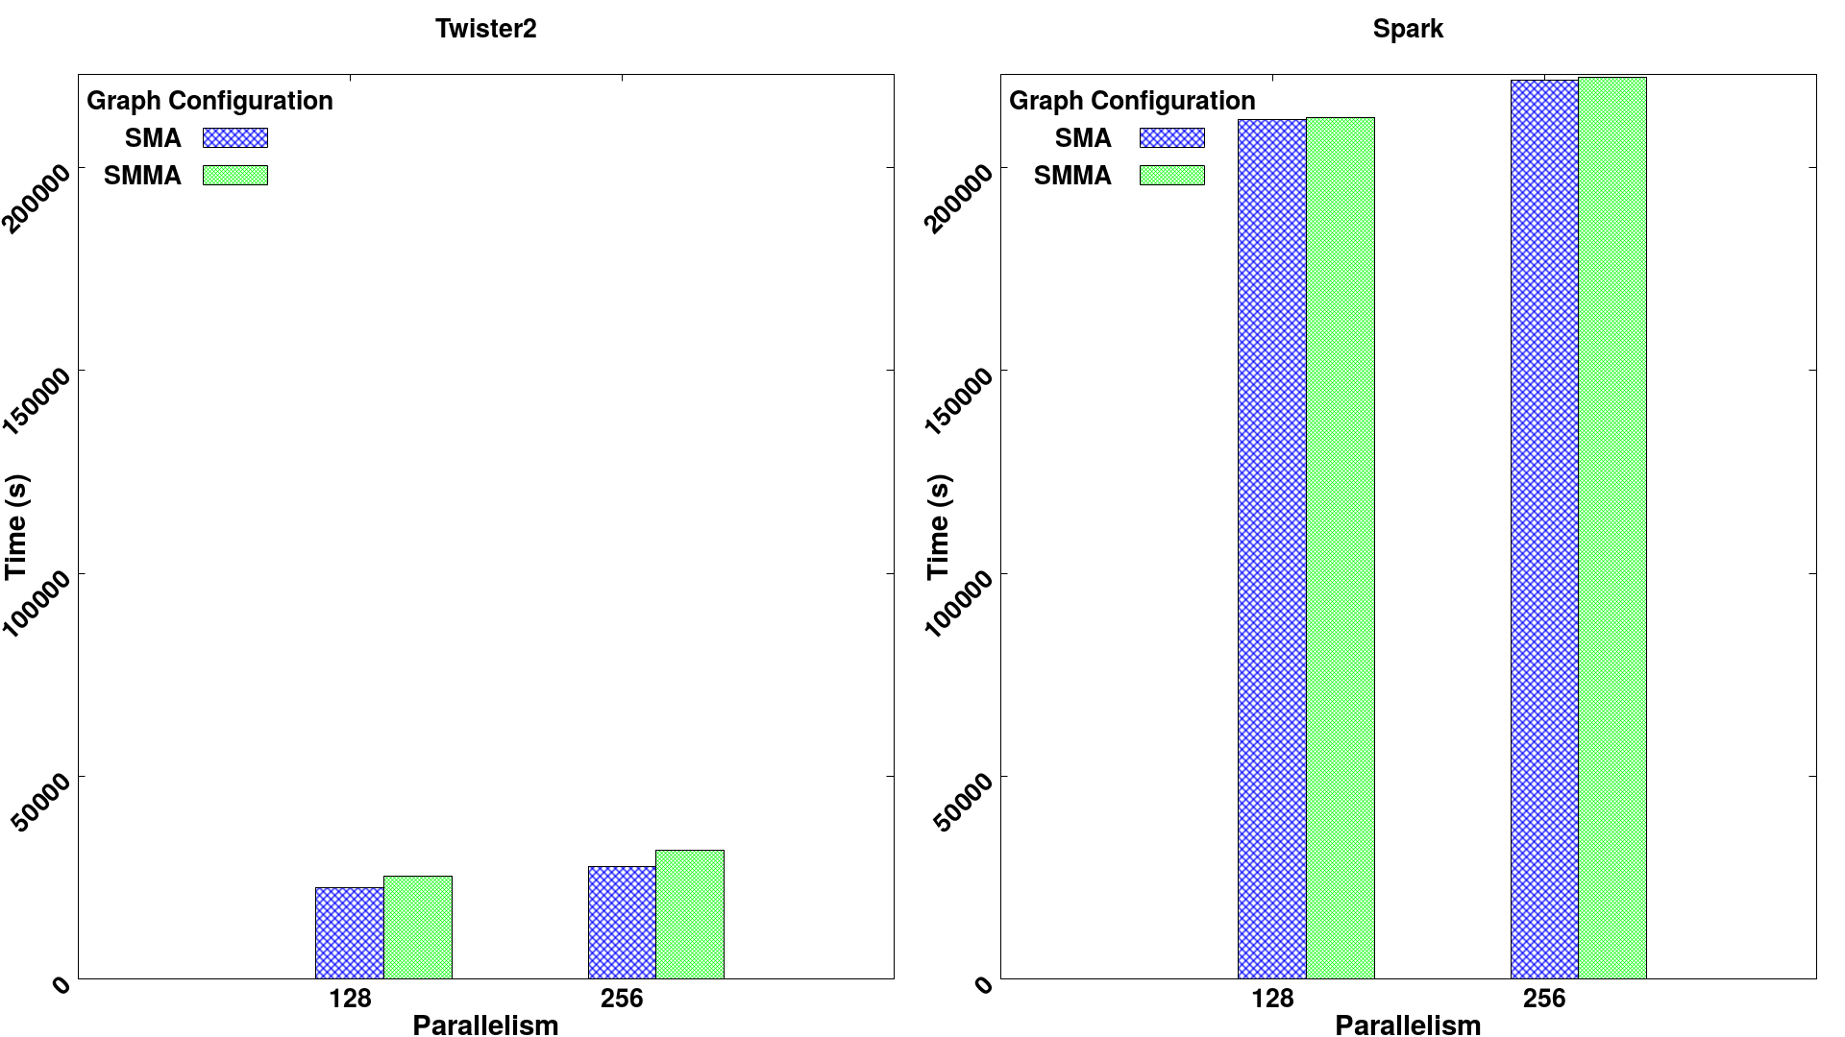
Effect of processing an extra dataflow node
Twister2 spawns a new context by “direct” dataflow node1 to node 2 which could be edge to cloud Spark always compiles 2 nodes into one. Twister2 will add this but Twister2’s transfer communication is very fast

Slide 45
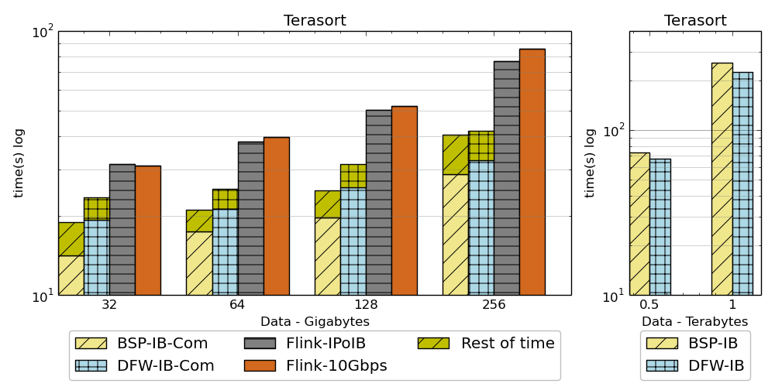
Results on Terasort
Twister2 performance against Apache Flink and MPI for Terasort.
Notation : DFW refers to Twister2 BSP refers to MPI (OpenMPI)

Slide 46
Summary of Big Data Systems
Interface of HPC/Computation and Machine Learning
HPCforML focus being extended to MLforHPC
Designing, building and using the Global AI and Modeling Supercomputer
Cloudmesh build interoperable Cloud systems (von Laszewski)
Harp is parallel high performance machine learning (Qiu)
Twister2 can offer the major Spark Hadoop Heron capabilities with clean high performance
Implements dataflow MLforHPC using HPCforBigData
Tset high performance RDD
DFW is distributed (dataflow) communication with data not message interface
Missing Apache Beam and Python; will complete by Fall 2019

