Slide 1
Panel Discussion Software Defined Ecosystems
June 24 2014
BigSystem 2014 - Software-Defined Ecosystems at HPDC Vancouver Canada
Geoffrey Fox

Slide 2
Questions
Q1.What are the key technology centers in this emerging ecosystem?
I will discuss a question I don’t know answer to
Q2.What are the separate (possibly partially overlapping) research, education, and industry communities? How to better bridge them?
Lets discuss continuing conference – perhaps colocated with a larger conference?
Q3.System research requires major effort in preparing foundation platform – what are the platforms available to build on, what need to be invented?
What are requirements?
Distributed v. central?; size?; hypervisor or not?
Q4.Suggestions on fostering a new – cross seeded – discipline for future students to tackle the challenges – and what are the challenges?
Always need to promote interdisciplinary work within existing disciplines?

Slide 3
Disaggregation and Composition
We learnt that datacenters were moving to disaggregation with for example memory, CPU’s, storage and networking separately defined
Then you can compose customized hardware systems to best fit an application needs
Applications involve a map Application → Numerical/Computational Formulation → Software System → Hardware System
Each of these 4 entities is a system and can be specified or measured in some way
We define units (disaggregated components) and their composition
Needed for reproducible computation
Related to Network Science / Complex Systems research

Slide 4
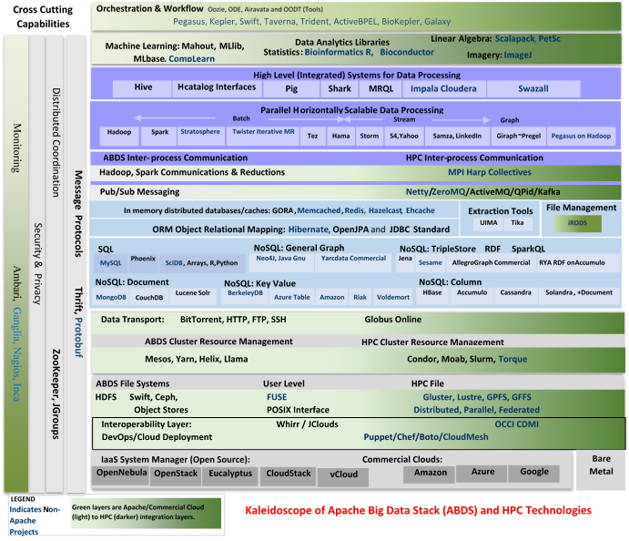
HPC-ABDS
Big Data Stack
120 software Systems

Slide 5
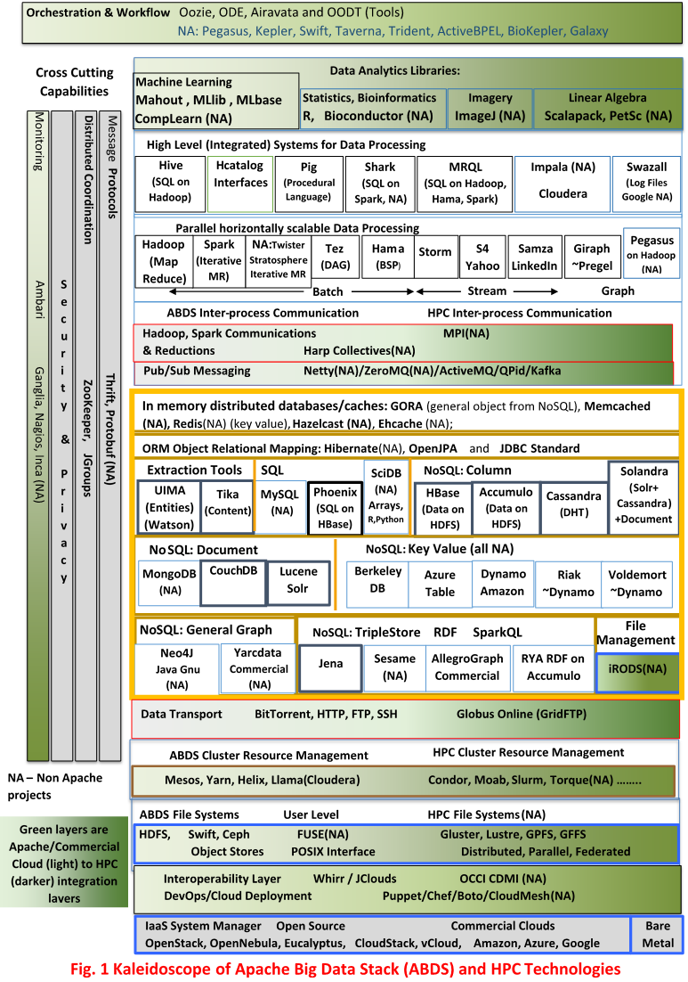

Slide 7
Broad Layers in HPC-ABDS
Workflow-Orchestration
Application and Analytics: Mahout, MLlib, R…
High level Programming
Basic Programming model and runtime
SPMD, Streaming, MapReduce, MPI
Inter process communication
Collectives, point-to-point, publish-subscribe
In-memory databases/caches
Object-relational mapping
SQL and NoSQL, File management
Data Transport
Cluster Resource Management (Yarn, Slurm, SGE)
File systems(HDFS, Lustre …)
DevOps (Puppet, Chef …)
IaaS Management from HPC to hypervisors (OpenStack)
Cross Cutting
Message Protocols
Distributed Coordination
Security & Privacy
Monitoring

Slide 8
How do we specify a Big Data Software System
Software built as lines of code (scripting), methods, objects, programs, libraries, services, Apache projects …..
Have “layers” and/or typical messaging interface
They are composed in different ways with different interfaces with different ways of defining interfaces – including formal and de facto standards
Correctness and Performance issues
Many workflow systems effectively support this type of specification as in Pegasus/Precip
But not standardized
Several orchestration standards with BPEL as best known but I don’t think they are very successful in terms of achieving braod adoption
Scripting as in mashups is another way …..
DevOps suggest we define 120 Chef or Puppet scripts but that’s not enough
Or is that plus IPython the solution?

