Slide 1

Cloud Computing and Large Scale Computing in the Life Sciences: Opportunities for Large Scale Sequence Processing
May 30 2013
Geoffrey Fox
gcf@indiana.edu
http://www.infomall.org http://www.futuregrid.org
School of Informatics and Computing
Digital Science Center
Indiana University Bloomington

Slide 2
Abstract
Characteristics of applications suitable for clouds
Iterative MapReduce and related programming models: Simplifying the implementation of many data parallel applications
FutureGrid and a software defined Computing Testbed as a Service
Developing algorithms for clustering and dimension reduction running on clouds
Education and Training via MOOC’s

Slide 3
Clouds for this talk
A bunch of computers in an efficient data center with an excellent Internet connection
They were produced to meet need of public-facing Web 2.0 e-Commerce/Social Networking sites
They can be considered as “optimal giant data center” plus internet connection
Note enterprises use private clouds that are giant data centers but not optimized for Internet access
By definition “cheapest computing” (your own 100% utilized cluster competitive)?
  Elasticity and nifty new software (Platform as a service) good

Slide 4
Clouds in Technical Computing and Research

Slide 5
2 Aspects of Cloud Computing:
Infrastructure and Runtimes
Cloud infrastructure: outsourcing of servers, computing, data, file space, utility computing, etc..
Cloud runtimes or Platform: tools to do data-parallel (and other) computations. Valid on Clouds and traditional clusters
  Apache Hadoop, Google MapReduce, Microsoft Dryad, Bigtable, Chubby and others
  MapReduce designed for information retrieval but is excellent for a wide range of science data analysis applications
  Can also do much traditional parallel computing for data-mining if extended to support iterative operations
  Data Parallel File system as in HDFS and Bigtable

Slide 6
What Applications work in Clouds
Pleasingly (moving to modestly) parallel applications of all sorts with roughly independent data or spawning independent simulations
  Long tail of science and integration of distributed sensors
Commercial and Science Data analytics that can use MapReduce (some of such apps) or its iterative variants (most other data analytics apps)
Which science applications are using clouds?
  Venus-C (Azure in Europe): 27 applications not using Scheduler, Workflow or MapReduce (except roll your own)
  Substantial fraction of Azure applications are Life Science
  50% of domain applications on FutureGrid (>30 projects) are from Life Science
  Locally Lilly corporation is commercial cloud user (for drug discovery) but not IU Biology

Slide 7
27 Venus-C Azure Applications
Chemistry (3)
• Lead Optimization in Drug Discovery
• Molecular Docking
Civil Protection (1)
• Fire Risk estimation and fire propagation
Biodiversity &
Biology (2)
• Biodiversity maps in marine species
• Gait simulation
Civil Eng. and Arch. (4)
• Structural Analysis
• Building information Management
• Energy Efficiency in Buildings
• Soil structure simulation
Physics (1)
• Simulation of Galaxies configuration
Earth Sciences (1)
• Seismic propagation
Mol, Cell. & Gen. Bio. (7)
• Genomic sequence analysis
• RNA prediction and analysis
• System Biology
• Loci Mapping
• Micro-arrays quality.
ICT (2)
• Logistics and vehicle routing
• Social networks analysis
Medicine (3)
• Intensive Care Units decision support.
• IM Radiotherapy planning.
• Brain Imaging
Mathematics (1)
• Computational Algebra
Mech, Naval & Aero. Eng. (2)
• Vessels monitoring
• Bevel gear manufacturing simulation

Slide 8
Recent Life Science Azure Highlights
Twister4Azure iterative MapReduce applied to clustering and visualization of sequences
eScience Central in UK has developed an Azure backend to run workflows submitted in portal; large scale QSAR use
BetaSIM, a simulator from COSBI at Teento is driven by BlenX - a stochastic, process algebra based programming language for modeling and simulating biological systems as well as other complex dynamic systems and has beenported to Azure.
Annotation of regulatory sequences (UNC Charlotte) in sequenced bacterial genomes using comparative genomics-based algorithms using Azure Web and Worker roles or using Hadoop
Rosetta@home from Baker (Washington) used 2000 Azure cores serving as a BOINC service to run a substantial folding challenge
AzureBlast Clouds excellent at Blast and related applications

Slide 9
Parallelism over Users and Usages
“Long tail of science” can be an important usage mode of clouds.
In some areas like particle physics and astronomy, i.e. “big science”, there are just a few major instruments generating now petascale data driving discovery in a coordinated fashion.
In other areas such as genomics and environmental science, there are many “individual” researchers with distributed collection and analysis of data whose total data and processing needs can match the size of big science.
Clouds can provide scaling convenient resources for this important aspect of science.
Can be map only use of MapReduce if different usages naturally linked e.g. exploring docking of multiple chemicals or alignment of multiple DNA sequences
  Collecting together or summarizing multiple “maps” is a simple Reduction

Slide 10
Data Intensive Programming Models

Slide 11
Science Computing Environments
Large Scale Supercomputers – Multicore nodes linked by high performance low latency network
  Increasingly with GPU enhancement
  Suitable for highly parallel simulations
High Throughput Systems such as European Grid Initiative EGI or Open Science Grid OSG typically aimed at pleasingly parallel jobs
  Can use “cycle stealing”
  Classic example is LHC data analysis
Grids federate resources as in EGI/OSG or enable convenient access to multiple backend systems including supercomputers
Use Services (SaaS)
  Portals make access convenient and
  Workflow integrates multiple processes into a single job

Slide 12
Classic Parallel Computing
HPC: Typically SPMD (Single Program Multiple Data) “maps” typically processing particles or mesh points interspersed with multitude of low latency messages supported by specialized networks such as Infiniband and technologies like MPI
  Often run large capability jobs with 100K (going to 1.5M) cores on same job
  National DoE/NSF/NASA facilities run 100% utilization
  Fault fragile and cannot tolerate “outlier maps” taking longer than others
Clouds: MapReduce has asynchronous maps typically processing data points with results saved to disk. Final reduce phase integrates results from different maps
  Fault tolerant and does not require map synchronization
  Map only useful special case
HPC + Clouds: Iterative MapReduce caches results between “MapReduce” steps and supports SPMD parallel computing with large messages as seen in parallel kernels (linear algebra) in clustering and other data mining

Slide 13
Clouds HPC and Grids
Synchronization/communication Performance
Grids > Clouds > Classic HPC Systems
Clouds naturally execute effectively Grid workloads but are less clear for closely coupled HPC applications
Classic HPC machines as MPI engines offer highest possible performance on closely coupled problems
The 4 forms of MapReduce/MPI
  Map Only – pleasingly parallel
  Classic MapReduce as in Hadoop; single Map followed by reduction with fault tolerant use of disk
  Iterative MapReduce use for data mining such as Expectation Maximization in clustering etc.; Cache data in memory between iterations and support the large collective communication (Reduce, Scatter, Gather, Multicast) use in data mining
  Classic MPI! Support small point to point messaging efficiently as used in partial differential equation solvers

Slide 14
Data Intensive Applications
Applications tend to be new and so can consider emerging technologies such as clouds
Do not have lots of small messages but rather large reduction (aka Collective) operations
  New optimizations e.g. for huge messages
EM (expectation maximization) tends to be good for clouds and Iterative MapReduce
  Quite complicated computations (so compute largish compared to communicate)
  Communication is Reduction operations (global sums or linear algebra in our case)
We looked at Clustering and Multidimensional Scaling using deterministic annealing which are both EM
  See also Latent Dirichlet Allocation and related Information Retrieval algorithms with similar EM structure

Slide 15
Map Collective Model (Judy Qiu)
Combine MPI and MapReduce ideas
Implement collectives optimally on Infiniband, Azure, Amazon ……
Iterate
Input
map
Initial Collective Step
Generalized Reduce
Final Collective Step

Slide 16
Twister for Data Intensive
Iterative Applications
Generalize to arbitrary Collective
Broadcast
Compute
Communication
Reduce/ barrier
New Iteration
Smaller Loop-Variant Data
Larger Loop-Invariant Data
(Iterative) MapReduce structure with Map-Collective is framework
Twister runs on Linux or Azure
Twister4Azure is built on top of Azure tables, queues, storage
Qiu, Gunarathne
Notes:
Most of these applications consists of iterative computation and communication steps where single iterations can easily be specified as MapReduce computations.
Large input data sizes which are loop-invariant and can be reused across iterations.
Loop-variant results.. Orders of magnitude smaller…
While these can be performed using traditional MapReduce frameworks, Traditional is not efficient for these types of computations. MR leaves lot of room for improvements in terms of iterative applications.

Slide 17
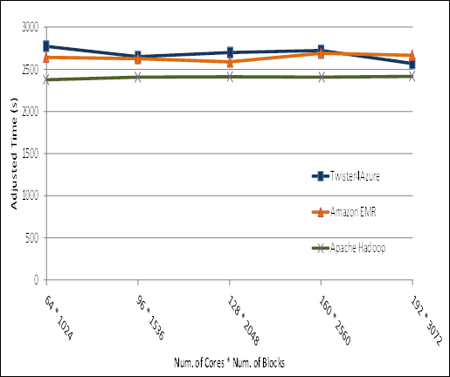

Pleasingly Parallel
Performance Comparisons
Smith Waterman
Sequence Alignment
BLAST Sequence Search
Cap3 Sequence Assembly

Slide 18
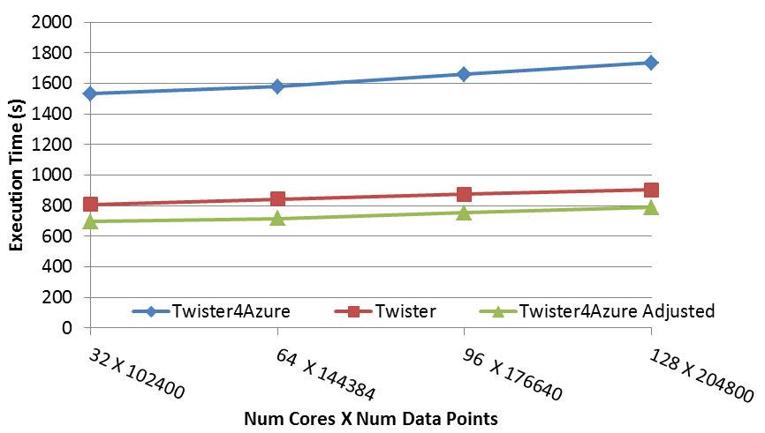
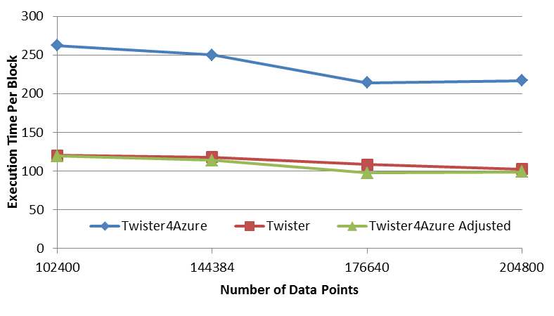
Multi Dimensional Scaling
BC: Calculate BX
X: Calculate invV (BX)
Calculate Stress
Map
Reduce
Merge
Map
Reduce
Merge
Map
Reduce
Merge
New Iteration
Performance adjusted for sequential performance difference
Weak Scaling
Data Size Scaling
Scalable Parallel Scientific Computing Using Twister4Azure. Thilina Gunarathne, BingJing Zang, Tak-Lon Wu and Judy Qiu. Submitted to Journal of Future Generation Computer Systems. (Invited as one of the best 6 papers of UCC 2011)
Notes:
The Java HPC Twister experiment was performed in a dedicated large-memory cluster of Intel(R) Xeon(R) CPU E5620 (2.4GHz) x 8 cores with 192GB memory per compute node and with Gigabit Ethernet on Linux. Java HPC Twister results do not include the initial data distribution time.
Azure large instances with 4 workers per instances is used. Memory mapped based caching and AllGather primitive are used.
Left: Weak scaling where workload per core is ~constant. Ideal is a straight horizontal line. X axis is
Right: Data size scaling with 128 Azure small instances/cores, 20 iterations.
The Twister4Azure adjusted (t_{a}) depicts the performance of Twister4Azure normalized according to the sequential MDS BC calculation and Stress calculation performance ratio between the Azure(t_{sa}) and Cluster(t_{sc}) environments used for Java HPC Twister. It is calculated using t_{a} x (t_{sc}/t_{sa}). This estimation however does not account for the overheads that remain constant irrespective of the computation time. Hence Twister4Azure seems to perform better, but in reality when the task execution times become smaller, twister4Azure overheads will become relatively larger and the performance would not be as good as shown in the adjusted curve.

Slide 19
Kmeans
Hadoop adjusted for Azure: Hadoop KMeans run time adjusted for the performance difference of iDataplex vs Azure

Slide 20
FutureGrid

Slide 21
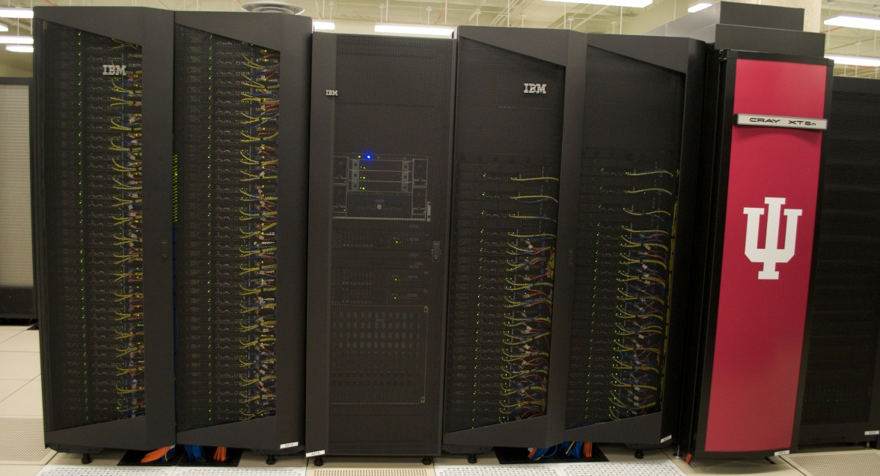
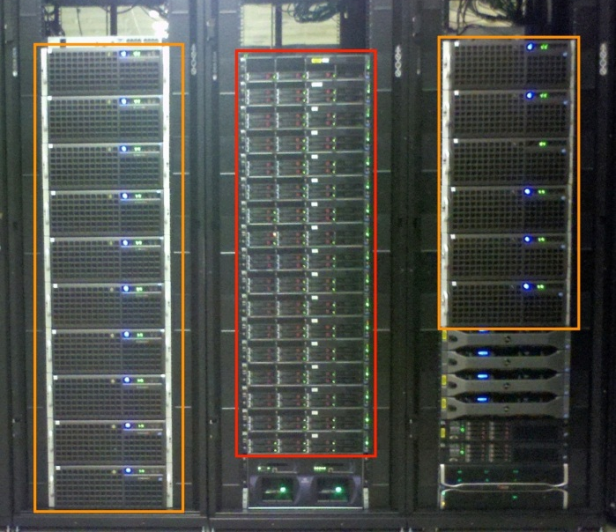
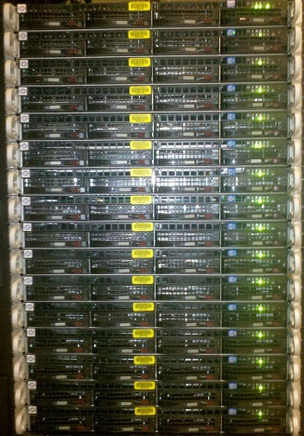
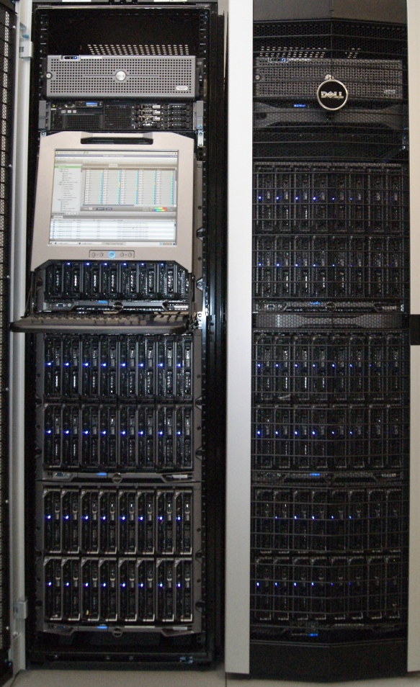
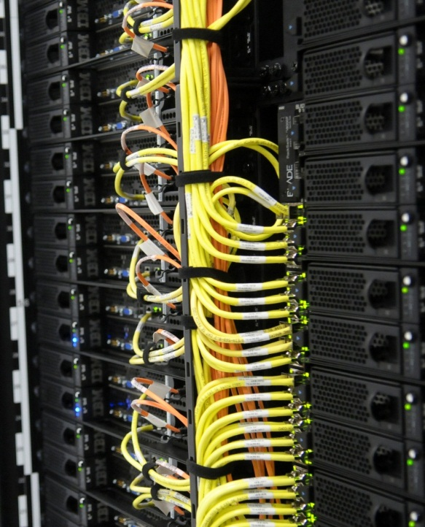
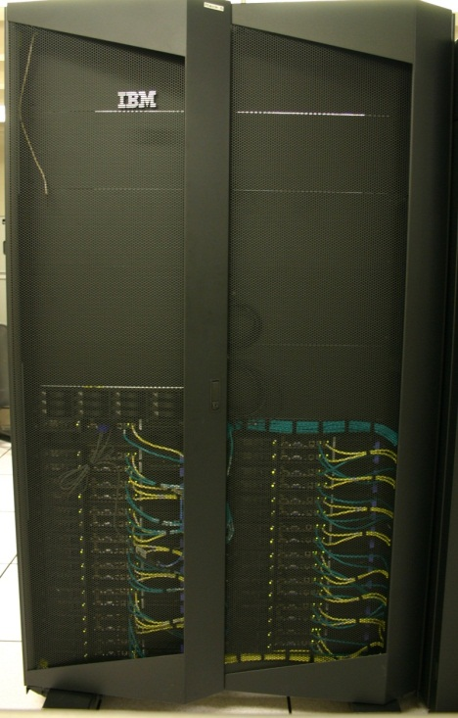
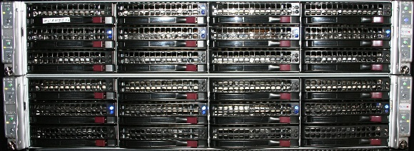
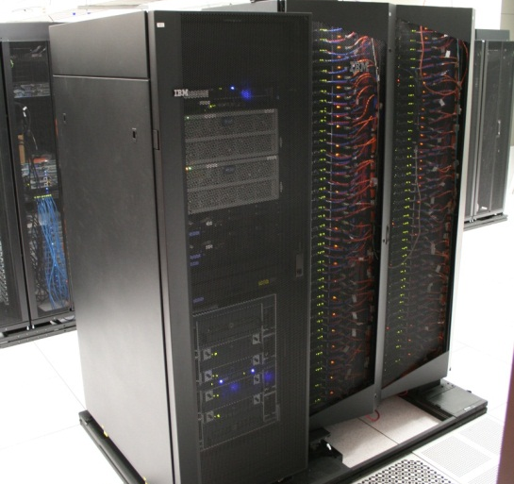
FutureGrid Distributed Computing TestbedaaS
Bravo Delta Echo (IU)
India (IBM) and Xray (Cray) (IU)
Lima (SDSC)
Hotel (Chicago)
Foxtrot (UF)
Sierra (SDSC)
Alamo (TACC)

Slide 22
FutureGrid Testbed as a Service
FutureGrid is part of XSEDE set up as a testbed with cloud focus
Operational since Summer 2010 (i.e. now in third year of use)
The FutureGrid testbed provides to its users a flexible development and testing platform for middleware and application users looking at interoperability, functionality, performance or evaluation
  A rich education and teaching platform for classes
Offers major cloud and HPC environments OpenStack, Eucalyptus, Nimbus, OpenNebula, HPC (MPI) on same hardware
302 approved projects (1822 users) May 29 2013
  USA(77%), Puerto Rico(2.9%- Students in class), India, China, lots of European countries (Italy at 2.3% as class)
  Industry, Government, Academia
Major use is Computer Science but 10% of projects Life Sciences
You can apply to use

Slide 23
Sample FutureGrid Life Science Projects I
FG337 Content-based Histopathology Image Retrieval (CBIR) using a CometCloud-based infrastructure. We explore a broad spectrum of potential clinical applications in pathology with a newly developed set of retrieval algorithms that were fine-tuned for each class of digital pathology images.
FG326 simulation of cardiovascular control with focus on medullary sympathetic outflow and baroreflex. Convert Matlab to GPU
FG325 BioCreative (community-wide effort for evaluating information extraction and text mining developments in biology) Task help database curators rapidly and accurately identify gene function information in full-length articles
FG320 Morphomics builds risk prediction models Identifying and improving factors that enhance surgical decision-making would have an obvious value for patients.

Slide 24
Sample FutureGrid Projects II
FG315 biome representational in silico karyotyping (BRISK) bioinformatics processing chain using Hadoop to perform complex analyses of microbiomes with the sequencing output from BRiSK
FG277 Monte Carlo based Radiotherapy Simulations dynamic scheduling and load balancing
FG271 Sequence alignment for Phylogenetic Tree Generation on Big Data Set with up to million sequences
FG270 Microbial community structure of boreal and Artic soil samples analyze 454 and Illumina data
FG266 Secure medical files sharing investigating cryptographic systems to implement a flexible access control layer to protect the confidentiality of hosted files
……………….
FG18 Privacy preserving gene read mapping developed hybrid MapReduce. Small private secure + large public with safe data. Won 2011 PET Award for Outstanding Research in Privacy Enhancing Technologies

Slide 25
Data Analytics
Clustering
Visualization

Slide 26
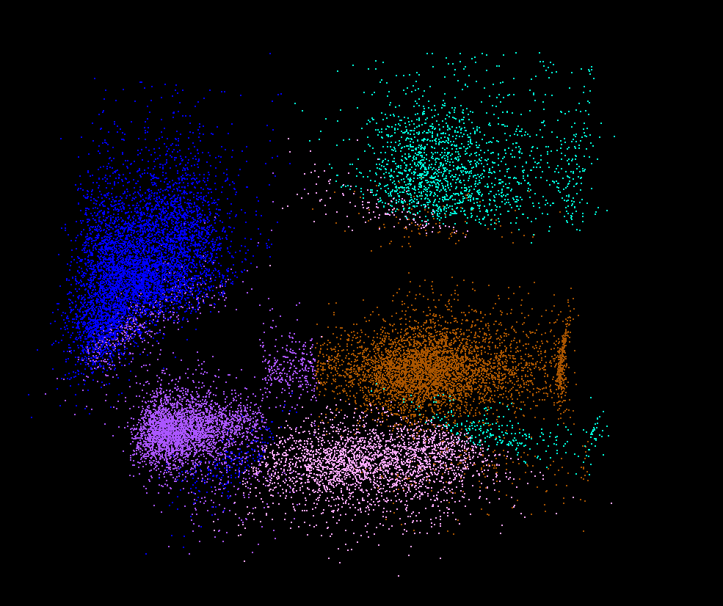
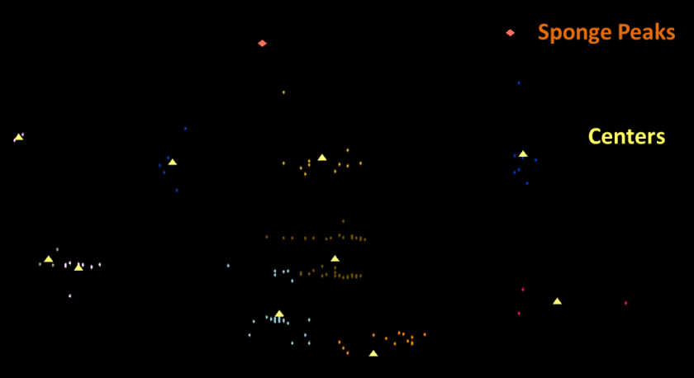
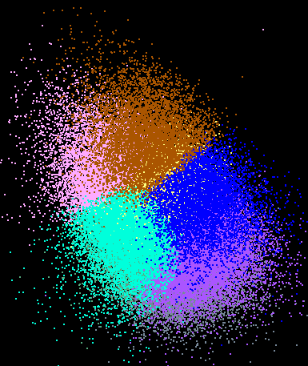
Dimension Reduction/MDS
You can get answers but do you believe them!
Need to visualize
H_{MDS} = Σ_{x<y=1}^{N} weight(x,y) (δ(x, y) – d_{3D}(x, y))²
Here x and y separately run over all points in the system, δ(x, y) is distance between x and y in original space while d_{3D}(x, y) is distance between them after mapping to 3 dimensions. One needs to minimize H_{MDS} for optimal choices of mapped positions X_{3D}(x).
LC-MS 2D
Pathology 54D
Lymphocytes 4D

Slide 27

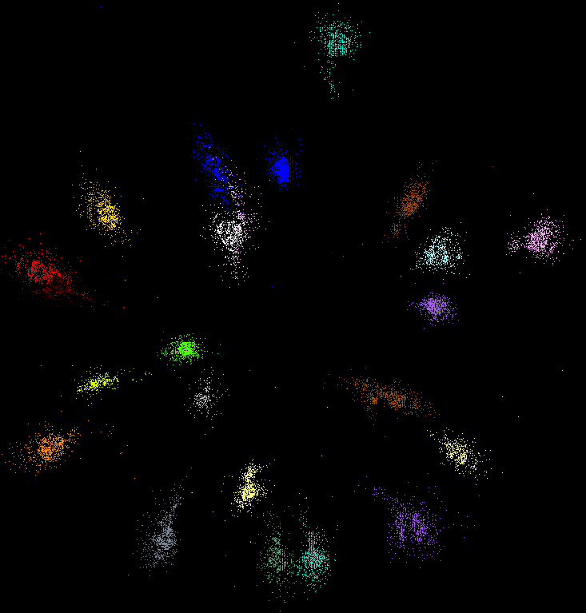
MDS and Clustering runs as well in Metric and non Metric Cases
Proteomics clusters not separated as in metagenomics
COG Database with a few biology clusters
Metagenomics with DA clusters

Slide 28
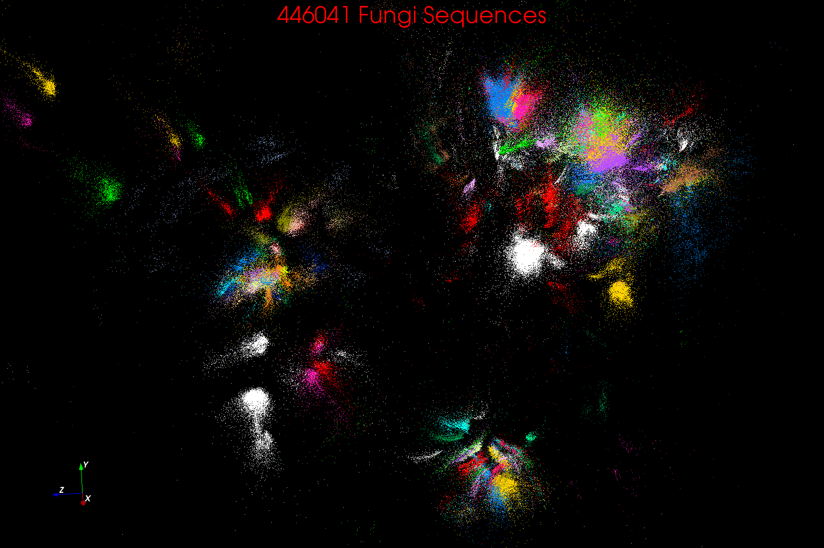
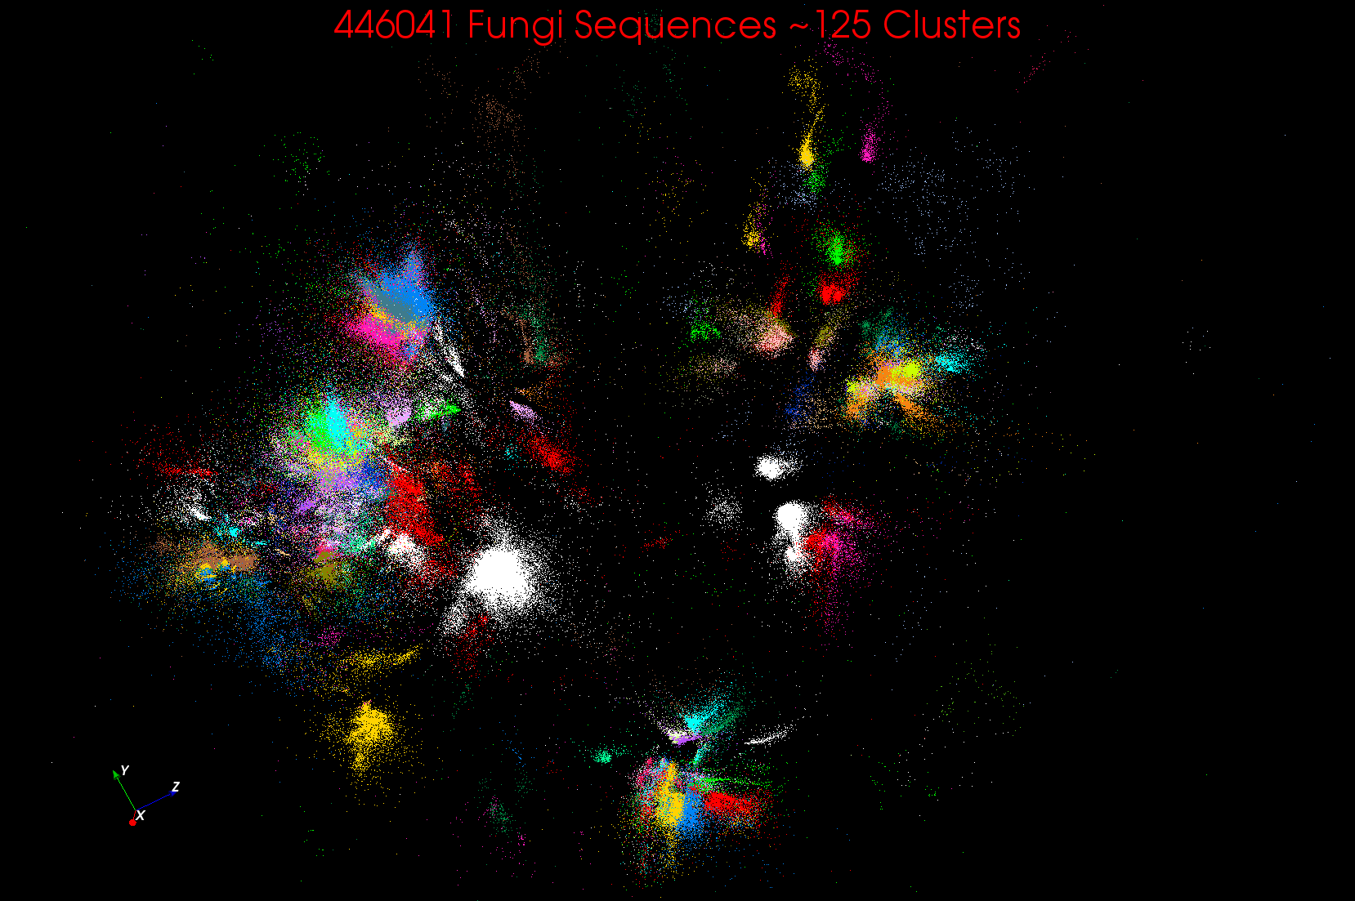
~125 Clusters from Fungi sequence set

Slide 29
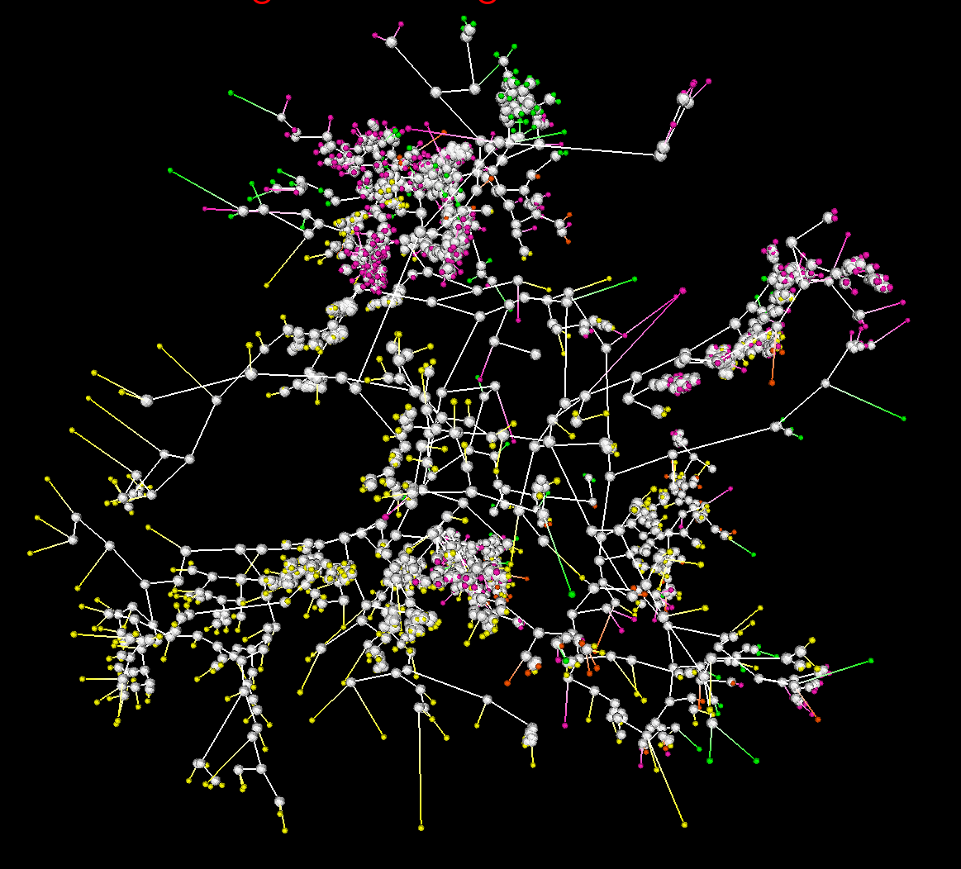
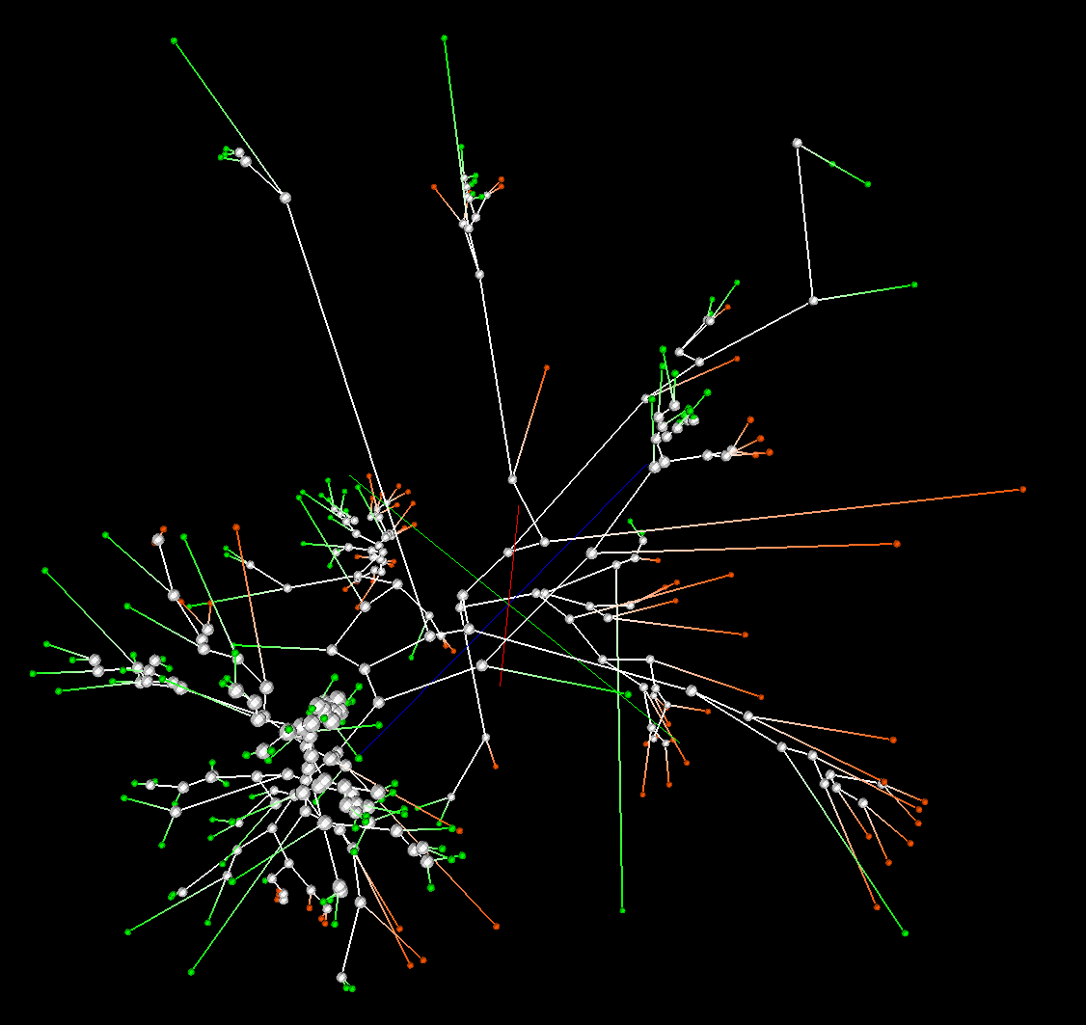
Phylogenetic tree using MDS
MDS can substitute Multiple Sequence Alignment
2133 Sequences
Extended from set of 200
Trees by Neighbor Joining in 3D map
Silver Spheres Internal Nodes
200 Sequences
(126 centers of clusters found from 446K)
Tree found from mapping sequences to 10D using Neighbor Joining
Whole collection mapped to 3D

Slide 30
Data Science Education
Jobs and MOOC’s
see recent New York Times articles
http://datascience101.wordpress.com/2013/04/13/new-york-times-data-science-articles/

Slide 31
Data Science Education
Broad Range of Topics from Policy to curation to applications and algorithms, programming models, data systems, statistics, and broad range of CS subjects such as Clouds, Programming, HCI,
Plenty of Jobs and broader range of possibilities than computational science but similar cosmic issues
  What type of degree (Certificate, minor, track, “real” degree)
  What implementation (department, interdisciplinary group supporting education and research program)

Slide 32
Massive Open Online Courses (MOOC)
MOOC’s are very “hot” these days with Udacity and Coursera as start-ups
Over 100,000 participants but concept valid at smaller sizes
Relevant to Data Science as this is a new field with few courses at most universities
Technology to make MOOC’s: Google Open Source Course Builder is lightweight LMS (learning management system)
Supports MOOC model as a collection of short prerecorded segments (talking head over PowerPoint) termed lessons – typically 15 minutes long
Compose playlists of lessons into sessions, modules, courses
  Session is an “Album” and lessons are “songs” in an iTunes analogy

Slide 33
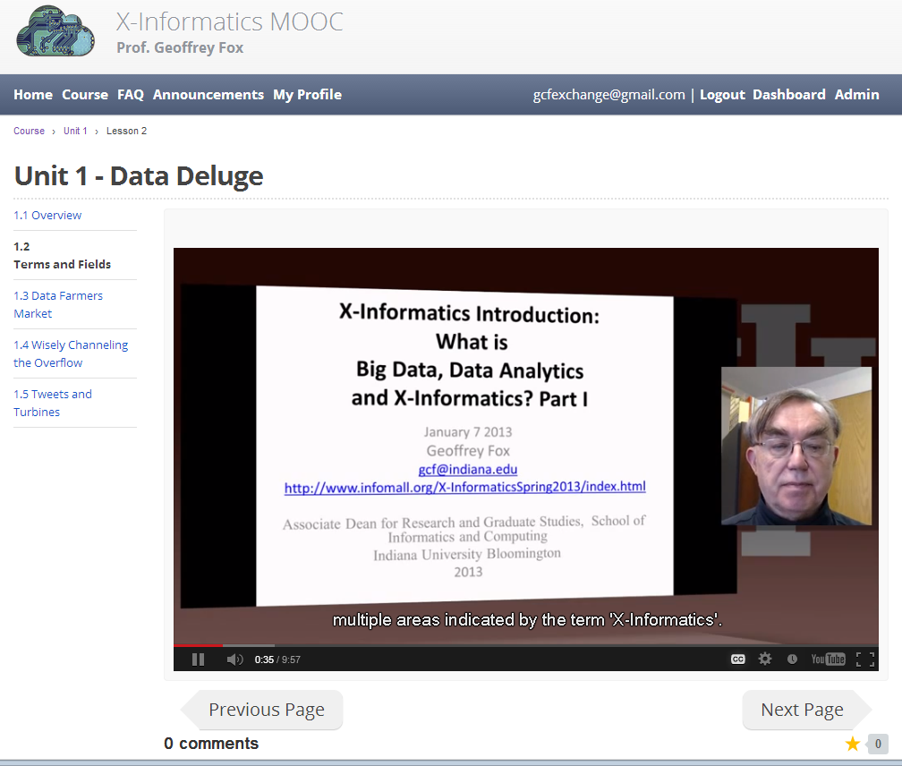
MOOC’s for Traditional Lectures
We can take MOOC lessons and view them as a “learning object” that we can share between different teachers
i.e. as a way of teaching typical sized classes but with less effort as shared material
Start with what’s in repository;
pick and choose;
Add custom material of individual teachers
The ~15 minute Video over PowerPoint of MOOC’s much easier to re-use than PowerPoint
Do not need special mentoring support
Defining how to support computing labs with FutureGrid or appliances + Virtual Box

Slide 34
Conclusions

Slide 35
Conclusions
Clouds and HPC are here to stay and one should plan on using both
Data Intensive programs are suitable for clouds
Iterative MapReduce an interesting approach; need to optimize collectives for new applications (Data analytics) and resources (clouds, GPU’s …)
Need an initiative to build scalable high performance data analytics library on top of interoperable cloud-HPC platform
FutureGrid available for experimentation
MOOC’s important and relevant for new fields like data science

