Slide 1
DATA MINING MEETS PHYSICS AND CYBERINFRASTRUCTURE
Biocomplexity Institute Spring 2009 Seminar Series, February 17, 2009, Indiana University
Geoffrey Fox
gcf@indiana.edu www.infomall.org/salsa
Community Grids Laboratory,
Chair Department of Informatics
School of Informatics
Indiana University

Slide 2
Abstract
We describe work of SALSA group in the Community Grids Laboratory that is developing and applying parallel and distributed Cyberinfrastructure to support large scale data analysis.
http://grids.ucs.indiana.edu/ptliupages/publications/DataminingMedicalInformatics.pdf and http://grids.ucs.indiana.edu/ptliupages/publications/CetraroWriteupJan09_v12.pdf
The exponentially growing volumes of data requires robust high performance tools.
We show how clusters of multicore systems give high parallel performance while Grid and Web 2.0 technologies (Hadoop from Yahoo and Dryad from Microsoft) allow the integration of the large data repositories with data analysis engines from BLAST to Information retrieval.
We describe implementations of clustering and Multi Dimensional Scaling (Dimension Reduction) which are rendered quite robust with deterministic annealing -- the analytic smoothing of objective functions with the Gibbs distribution.
We present detailed performance results.

Slide 3
Collaboration of SALSA Project
Microsoft Research
Technology Collaboration
Dryad
Roger Barga
CCR
George Chrysanthakopoulos
DSS
Henrik Frystyk Nielsen
Indiana University
SALSA Team
Geoffrey Fox
Xiaohong Qiu
Scott Beason
Seung-Hee Bae
Jaliya Ekanayake
Jong Youl Choi
Yang Ruan
Others
Application Collaboration
Bioinformatics, CGB
Haiku Tang, Mina Rho, Qufeng Dong
IU Medical School
Gilbert Liu
Demographics (GIS)
Neil Devadasan
Cheminformatics
Rajarshi Guha, David Wild
Community Grids Lab
and UITS RT -- PTI
Sangmi Pallickara,
Shrideep Pallickara,
Marlon Pierce

Slide 4

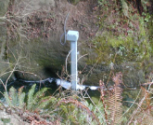






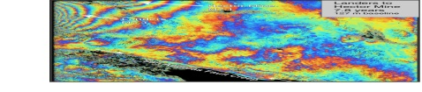
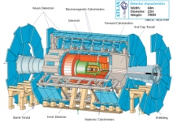
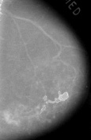



Data Intensive Cyberinfrastructure
Raw Data → Data → Information → Knowledge → Wisdom → Decisions
Another
Grid
Another
Grid
SS
SS
SS
SS
SS
SS
fs
fs
Discovery
Cloud
Filter
Service
Portal
Filter
Cloud
fs
fs
SS
fs
fs
Filter
Cloud
Inter-Service Messages
Another
Service
fs
fs
SS
Filter
Cloud
fs
Filter
Service
fs
fs
fs
SS
fs
fs
fs
Filter
Service
fs
Discovery
Cloud
fs
fs
fs
fs
SS
Traditional Grid with exposed services
Filter
Cloud
fs
Filter
Service
fs
Filter
Cloud
Filter
Cloud
SS
fs
fs
Another
Grid
SS
SS
SS
SS
SS
SS
Sensor or Data
Interchange
Service
SS
SS
SS
SS
SS
SS
Compute
Cloud
Storage
Cloud
Database

Slide 5
What is Cyberinfrastructure
Cyberinfrastructure is infrastructure that supports distributed research and learning (e-Science, e-Research, e-Education)
  Links data, people and computers
Exploits Internet technology (Web2.0 and Clouds) adding (via Grid technology) management, security, supercomputers etc.
It has two aspects: parallel – low latency (microseconds) between nodes and distributed – highish latency (milliseconds) between nodes
Parallel needed to get high performance on individual large simulations, data analysis etc.; must decompose problem
Distributed aspect integrates already distinct components
Integrate with TeraGrid (and Open Science Grid)
  From Laptops at the North and South poles to 30 Teraflops at IU to Petaflops at Oak Ridge and NCSA
We develop new technologies but also learn by using Cyberinfrastructure – with innovation from special characteristics of use; earth science, particle physics, cheminformatics, polar science, command and control (sensor nets)
5
Notes:
5

Slide 6
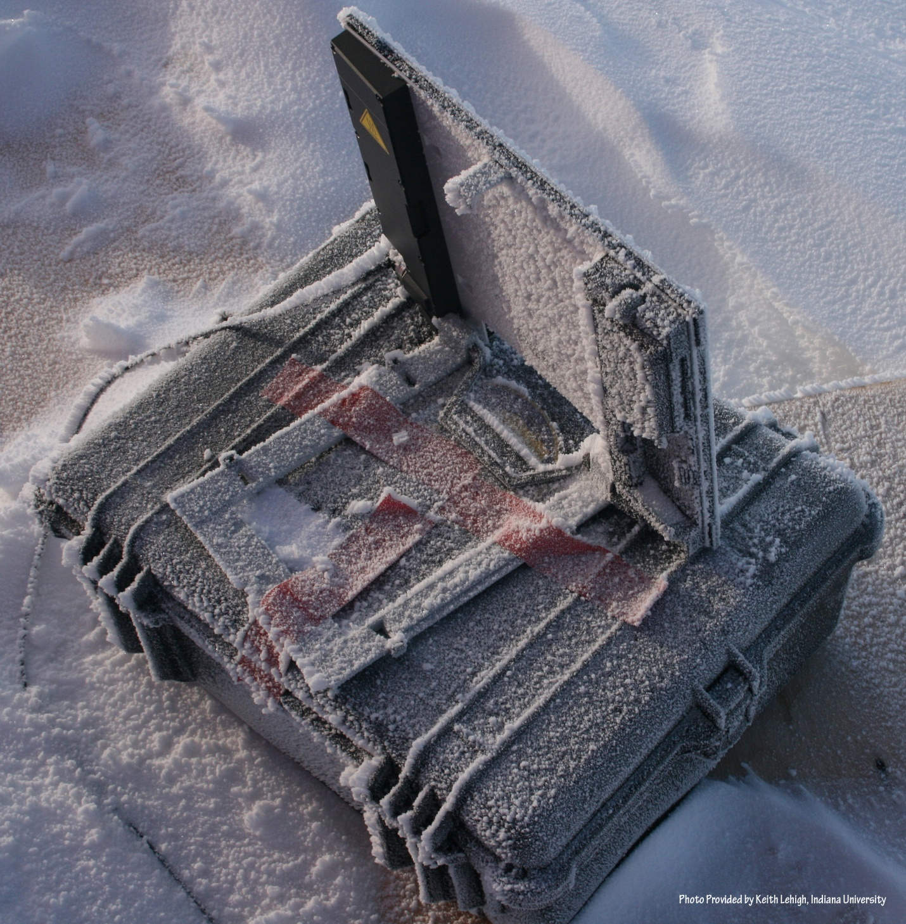
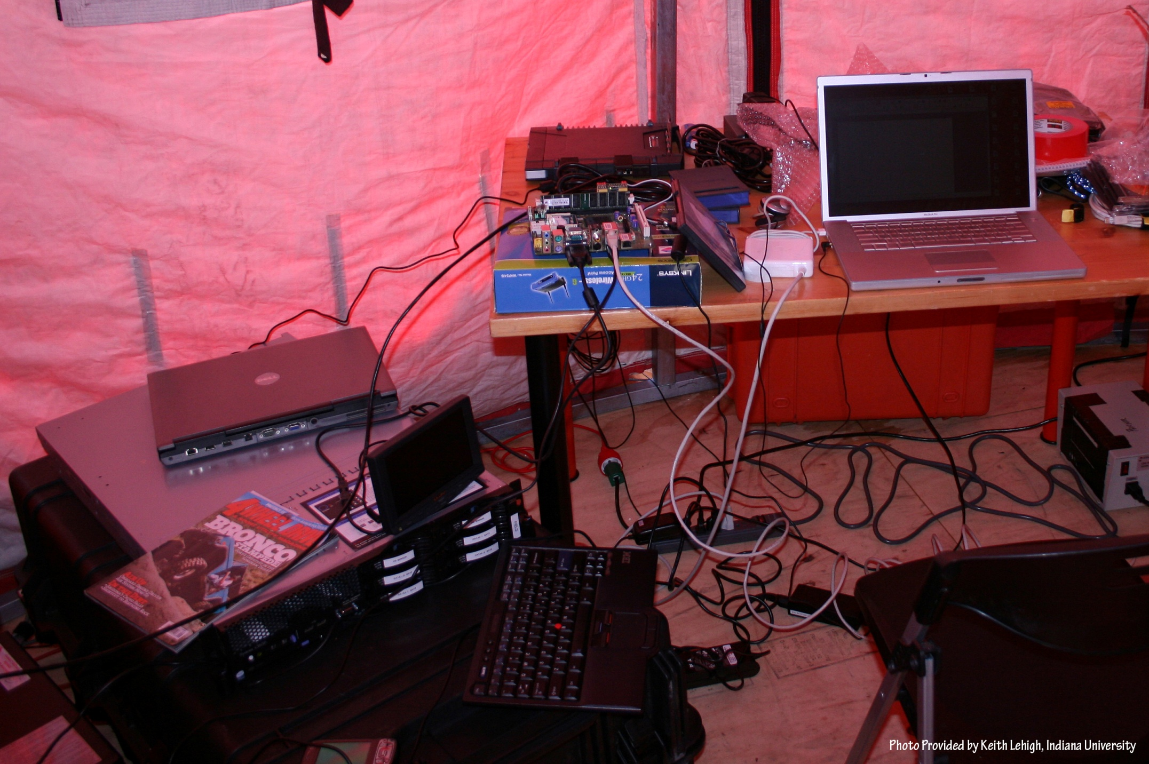
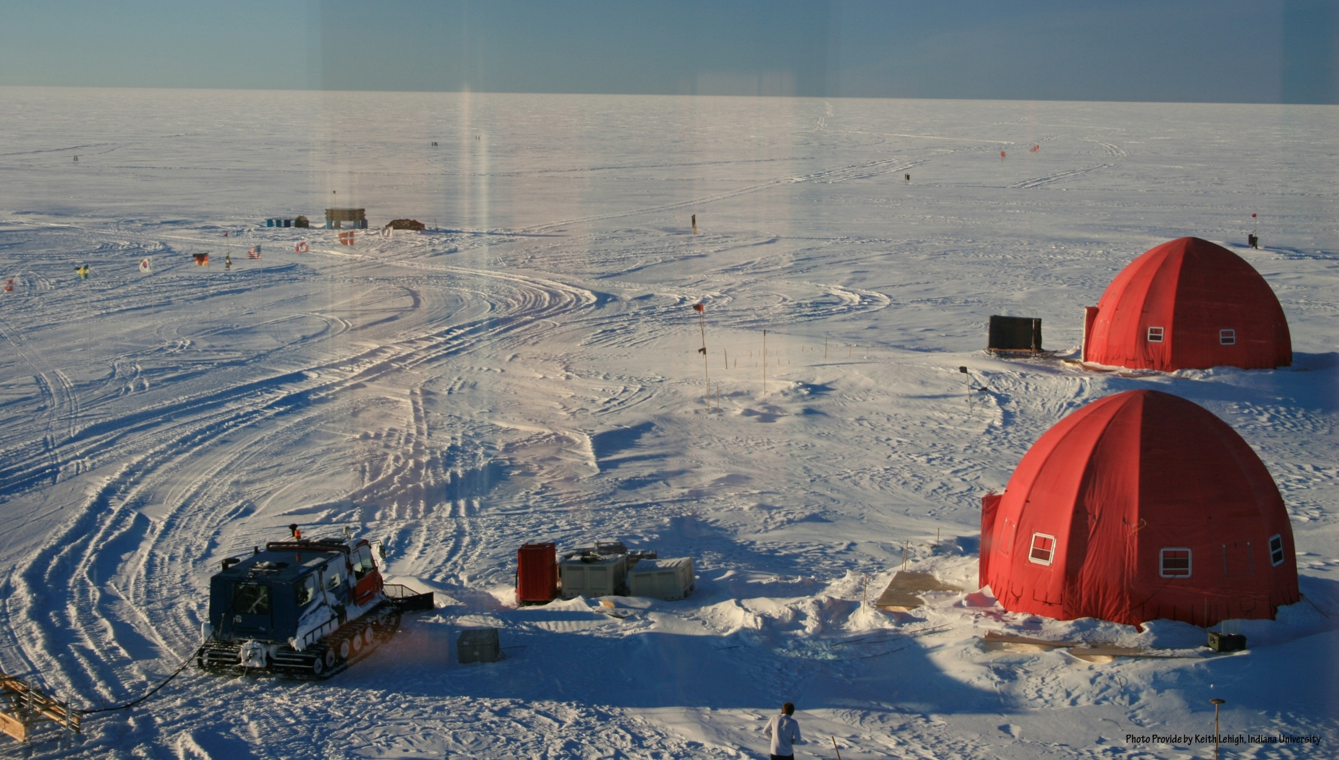

Slide 7
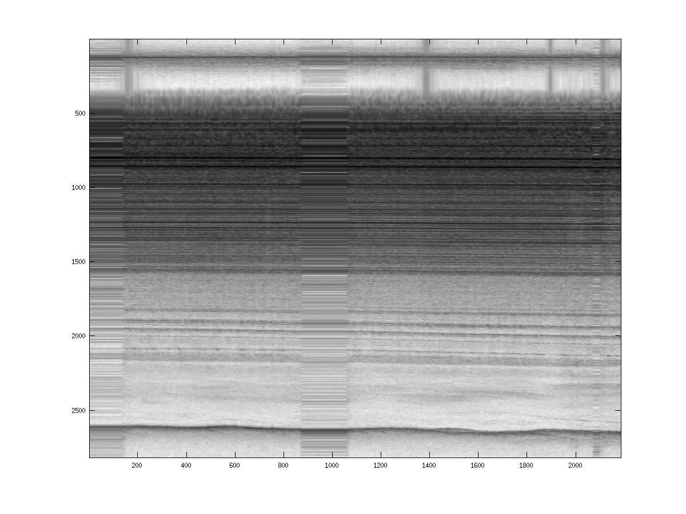
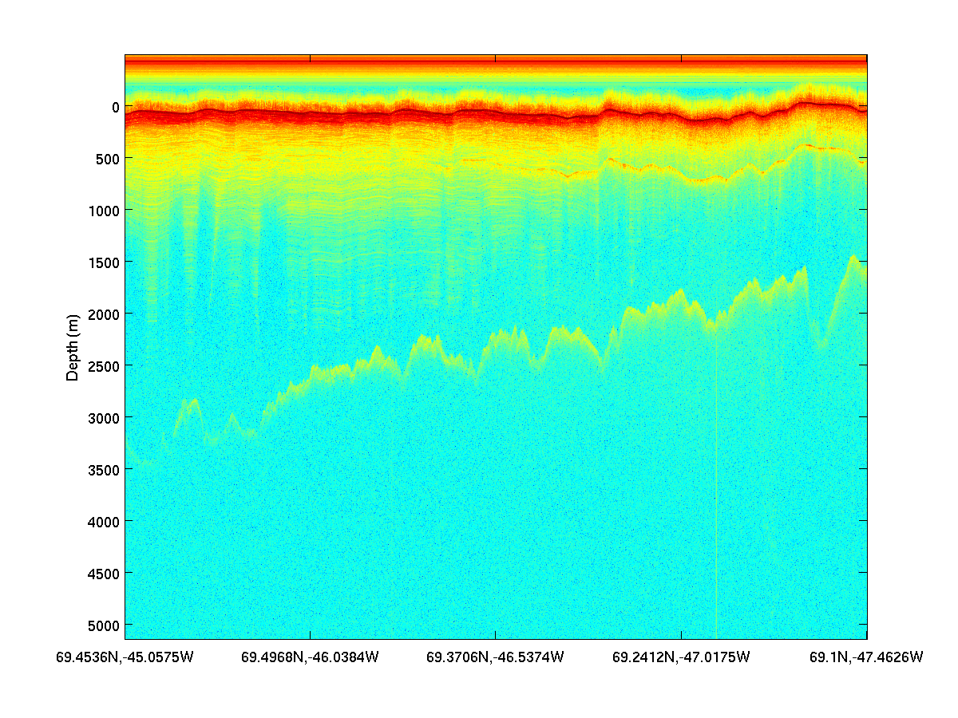
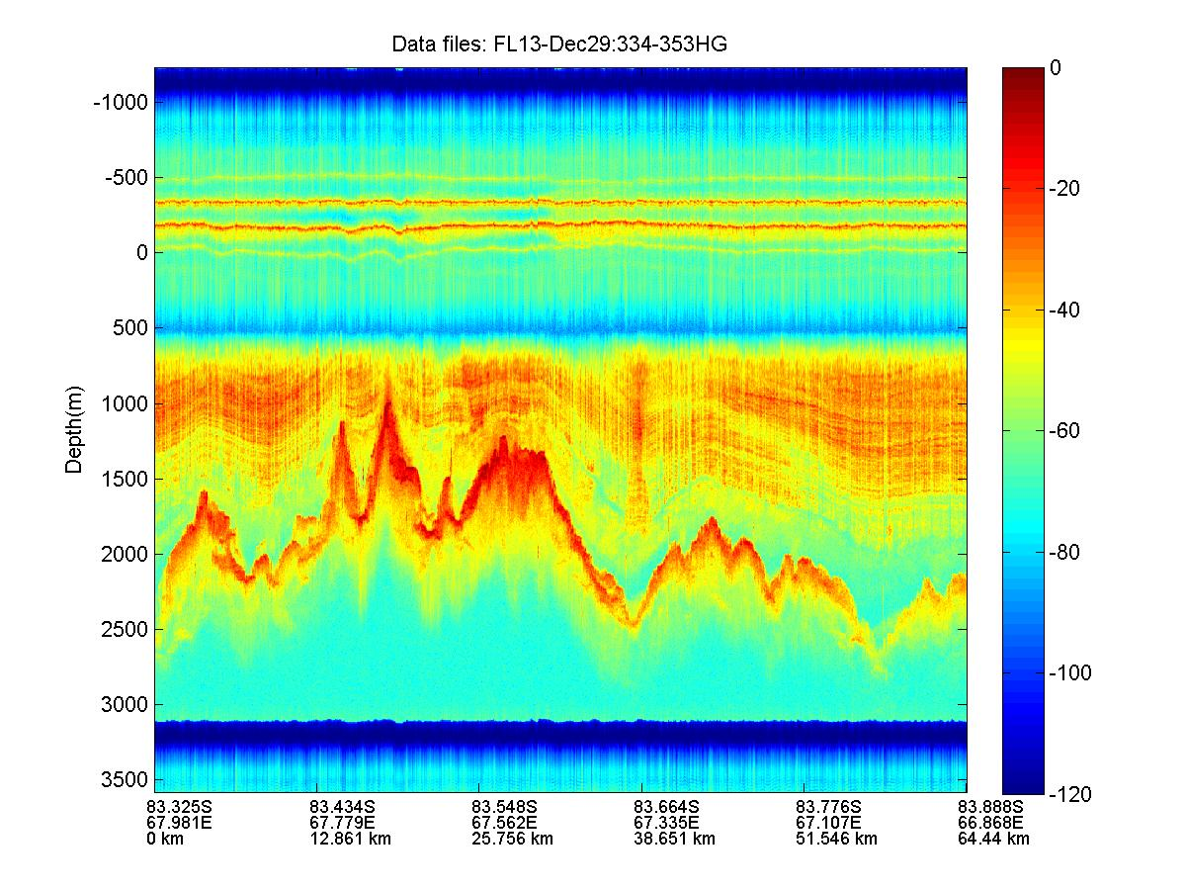
PolarGrid Field Results – 2008/09
“Without on-site processing enabled by PolarGrid, we would not have identified aircraft inverter-generated RFI. This capability allowed us to replace these “noisy” components with better quality inverters, incorporating CReSIS-developed shielding, to solve the problem mid-way through the field experiment.”
Jakobshavn 2008
NEEM 2008
GAMBIT 2008/09

Slide 8
Datamining in QuakeSim Cyberinfrastructure

Slide 9
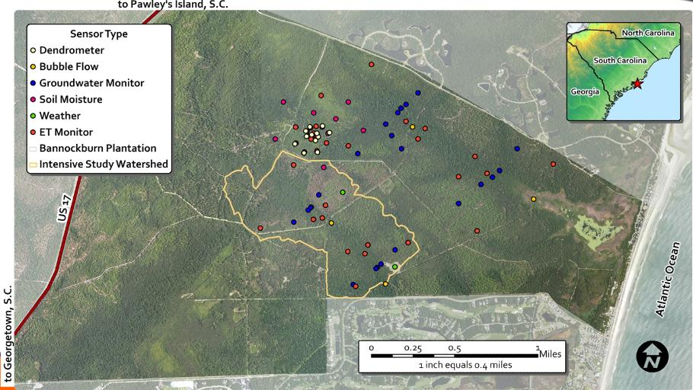
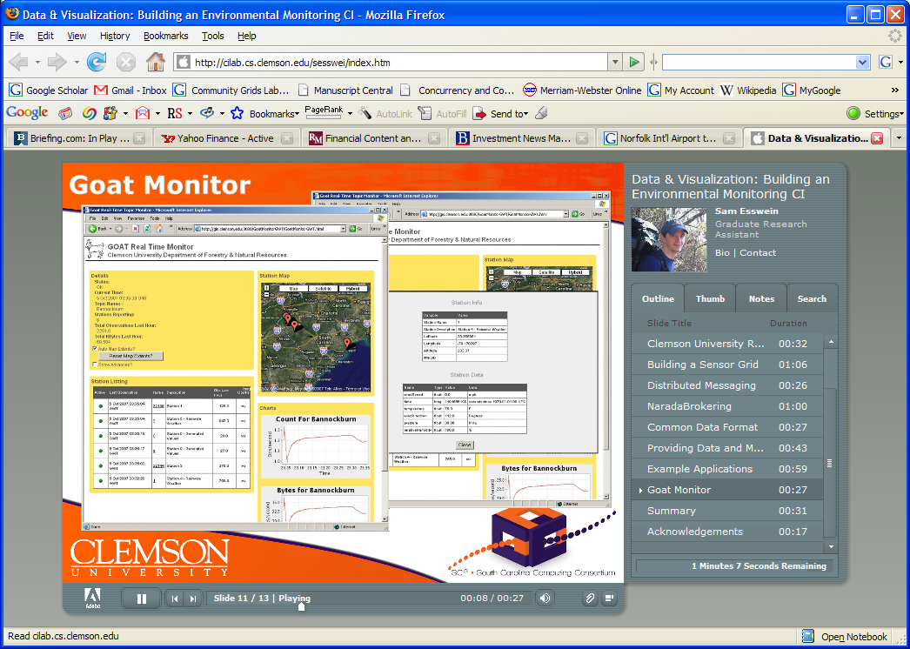
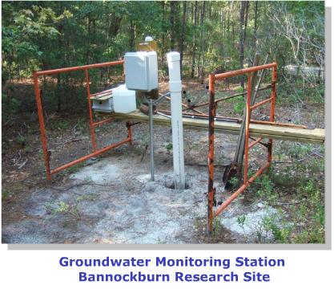
Environmental Monitoring Cyberinfrastructure at Clemson

Slide 10
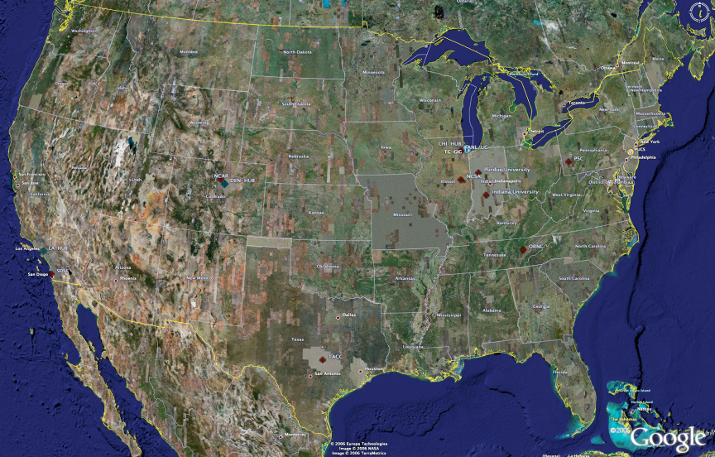
TeraGrid High Performance Computing Systems
UC/ANL
PSC
PU
NCAR
NCSA
IU
2008
(~1PF)
ORNL
Tennessee
SDSC
(504TF)
LONI/LSU
TACC
2 Petaflops; 20 Petabytes storage
Computational Resources
(size approximate - not to scale)
Slide Courtesy Tommy Minyard, TACC

Slide 11
Data Intensive (Science) Applications
1) Data starts on some disk/sensor/instrument
  It needs to be partitioned; often partitioning natural from source of data
2) One runs a filter of some sort extracting data of interest and (re)formatting it
  Pleasingly parallel of often “millions” of jobs
  Communication latencies can be many milliseconds and can involve disks
3) Using same (or map to a new) decomposition, one runs a parallel application that requires iterative steps between communicating processes
  Communication latencies is at most some microseconds and involves shared memory or high speed networks
Workflow links 1) 2) 3) with multiple instances of 2) 3)
  Pipeline or more complex graphs

Slide 12
Use any Collection of Computers
We can have various hardware
  Multicore – Shared memory, low latency
  High quality Cluster – Distributed Memory, Low latency
  Standard distributed system – Distributed Memory, High latency
We can program the coordination of these units by
  Threads on cores
  MPI on cores and/or between nodes
  MapReduce/Hadoop/Dryad../AVS for dataflow
  Workflow or Mashups linking services
  These can all be considered as some sort of execution unit exchanging information (messages) with some other unit
And there are higher level programming models such as OpenMP, PGAS, HPCS Languages – Ignore!

Slide 13
Components of System
Package all Software as a Service (SaaS) allowing easy invocation and integration into workflows and data intensive filters (Platform as a Service)
If software parallel, parallelism (MPI, Threads, Hadoop)) is hidden inside service as happens for example in Internet search
  Hadoop etc. support file parallel model – read lots of files – write lots of files
Build portal or Gateway as interface to services and workflows
Provide needed visualization and local analysis tools
(Eventually) use clouds (Infrastructure as a Service) for pleasing parallel parts of systems – all except MPI and multi-threaded codes – giving flexible dynamic infrastructure
Use optimized separate MPI parallel hardware (may be delivered in cloud in future but not now)

Slide 14

CICC Chemical Informatics and Cyberinfrastructure Collaboratory Web Service Infrastructure
Dimension Reduction
Embedding
OSCAR Document Analysis
InChI Generation/Search
Computational Chemistry (Gamess, Jaguar etc.)
Varuna.net
Quantum Chemistry
Core Grid Services
Service Registry
Job Submission and Management
Local Clusters
IU Big Red, TeraGrid, Open Science Grid
Portal Services
RSS Feeds
User Profiles
Collaboration as in Sakai

Slide 15
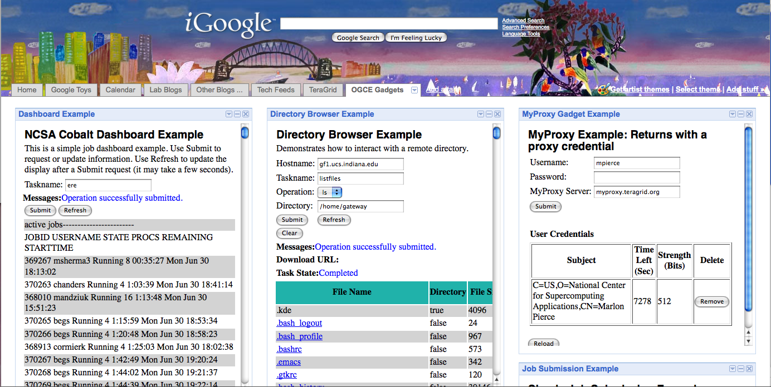
OGCE (Open Grid Computing Environments) Google Gadget-based Portal/Gateway:
Job status, remote file browser, and security management.

Slide 16
LEAD Cyberinfrastructure

Slide 17
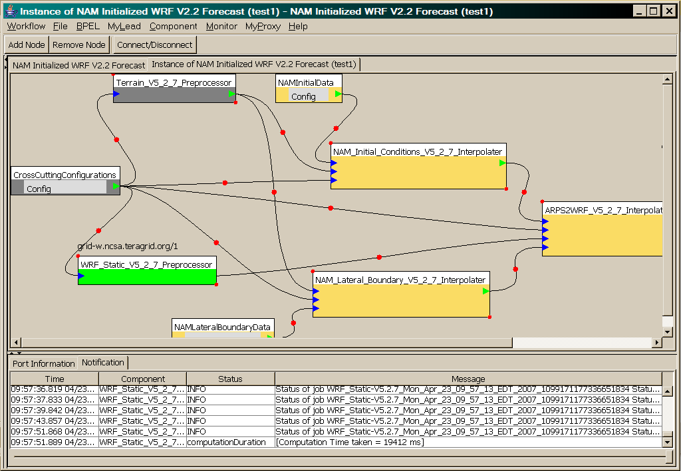
Workflow Tools used in LEAD
WRF-Static running on Tungsten

Slide 18
Data Analysis Examples
LHC Particle Physics analysis: File parallel over events
  Filter1: Process raw event data into “events with physics parameters”
  Filter2: Process physics into histograms
  Reduce2: Add together separate histogram counts
  Information retrieval similar parallelism over data files
Bioinformatics - Gene Families: Data parallel over sequences
  Filter1: Calculate similarities (distances) between sequences
  Filter2: Align Sequences (if needed)
  Filter3a: Calculate cluster centers
  Reduce3b: Add together center contributions
  Filter 4: Apply Dimension Reduction to 3D
  Filter5: Visualize
Informational Retrieval: New innovative Disk/File parallel software systems that can be applied to Disk/File parallel problems
Iterate

Slide 19
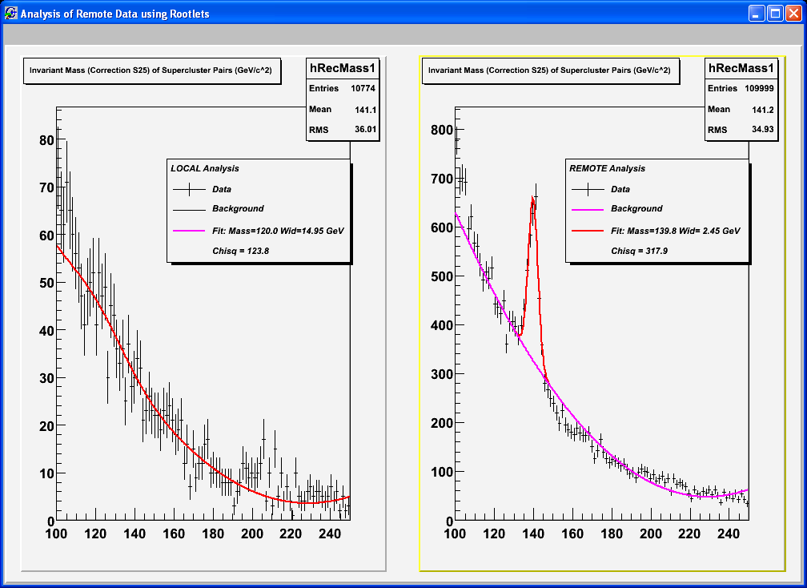
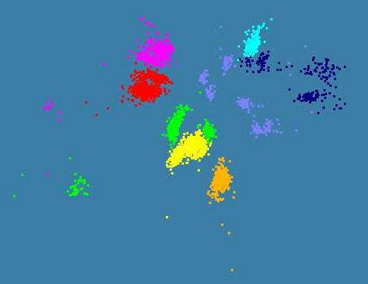
Applications Illustrated
LHC Monte Carlo with Higgs
4500 ALU Sequences with 8 Clusters mapped to 3D and projected by hand to 2D

Slide 20
Some File Parallel Examples suggested by Qufeng Dong of CGB
EST Assembly: see detailed analysis and SWARM test
MultiParanoid/InParanoid gene sequence clustering: 476 core years just for Prokaryotes
Population Genomics: (Lynch group) Looking at all pairs separated by up to 1000 nucleotides
Sequence-based transcriptome profiling: (Cherbas, Innes) MAQ, SOAP
Systems Microbiology (Brun) BLAST, InterProScan
Metagenomics (Fortenberry, Nelson) Pairwise alignment of 7243 16s sequence data took 12 hours on Big Red

Slide 21
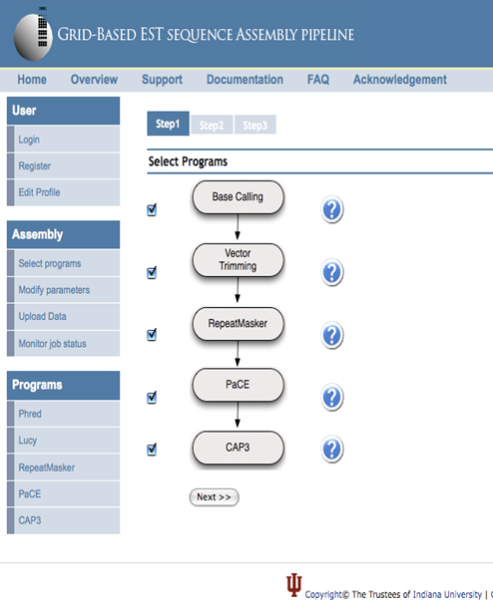
mRNA Sequence Clustering and Assembly Workflow
Collaborative work with Dr. Qunfeng Dong of the Center for Genomics and Bioinformatics in Indiana University
Sequence Assembly: Deriving consensus sequences (contigs) from individual overlapping DNA fragments.
Expressed Sequence Tag(EST) sequencing : assemble fragments of messenger RNAs
  Stage 1 : data preprocess(data trimming): serial job
  Stage 2: data preprocess(repeat masker): serial job
  Stage 3: clustering mRNA fragments: medium ~ large scale parallel job
  Stage 4: assemble fragments within each cluster: large number of small scale parallel or serial jobs
  E.g. for a Human mRNA assembly, more than 8 million sequences need to be assembled.

Slide 22


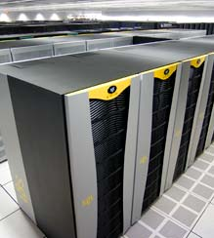


SWARM at a glance
Distributed HPC
clusters
Desktop users
Swarm Infrastructure
Web portals
Schedule millions of jobs over distributed clusters
A monitoring framework for large scale jobs
User based job scheduling
Ranking resources based on predicted wait times
Standard Web Service interface for web applications
Extensible design for the domain specific software logics
Scientific
Gateways

Slide 23
Example of EST Computation
Example Dataset: Human mRNA sequences.
Total size: 8.1 million – so we ran estimates for 2 million
Data preprocess for 2 Million sequences
  Single process (BigRed)
  Very quick
  Generates 1 output files of 192MBytes
  Note these steps often limited by data set size – Need file parallelism
Sequence clustering for 2 Million sequences
  With 400 processors (BigRed)
  Execution time 15 hours
  Generates 540,000 clusters (files): clusters of sequences. Most of the clusters contain only one sequence.
Sequence assembly for 2 Million sequences
  Among the 540,000 clusters, the clusters which have more than one sequence (75,000 clusters) are processed in the sequence assembly software.
  Quick but a lot of jobs

Slide 24
MapReduce implemented
by Hadoop
H
map(key, value)
reduce(key, list<value>)
Y
n
Y
U
U
S
4n
S
Example: Word Histogram
Start with a set of words
Each map task counts number of occurrences in each data partition
Reduce phase adds these counts
M
4n
M
D
n
D
X
n
X
Dryad supports general dataflow
U
N
U
N

Slide 25
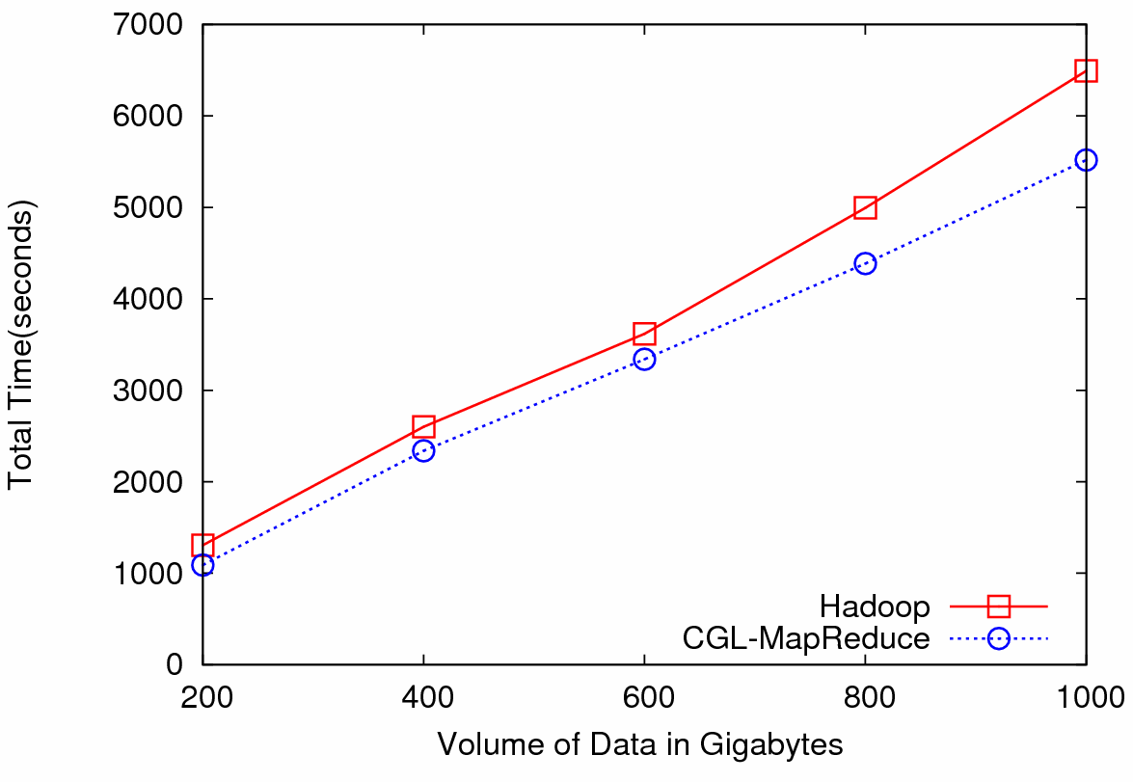

Particle Physics (LHC) Data Analysis
Data: Up to 1 terabytes of data, placed in IU Data Capacitor
Processing:12 dedicated computing nodes from Quarry (total of 96 processing cores)
MapReduce for LHC data analysis
LHC data analysis, execution time vs. the volume of data (fixed compute resources)
Hadoop and CGL-MapReduce both show similar performance
The amount of data accessed in each analysis is extremely large
Performance is limited by the I/O bandwidth (as in Information Retrieval applications?)
The overhead induced by the MapReduce implementations has negligible effect on the overall computation

Slide 26
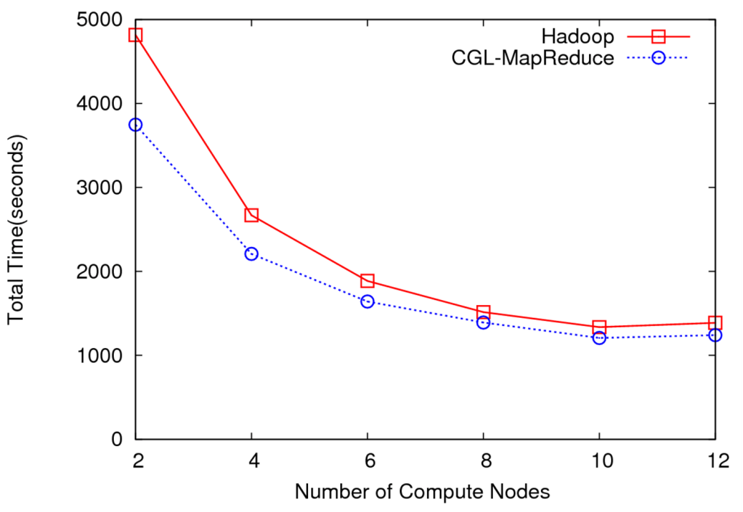
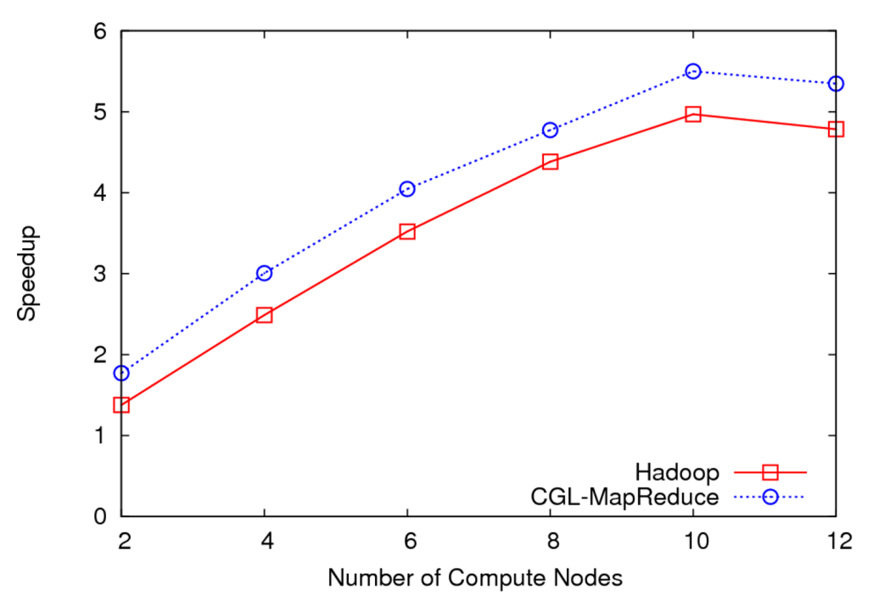
LHC Data Analysis Scalability and Speedup
Execution time vs. the number of compute nodes (fixed data)
Speedup for 100GB of HEP data
100 GB of data
One core of each node is used (Performance is limited by the I/O bandwidth)
Speedup = MapReduce Time / Sequential Time
Speed gain diminish after a certain number of parallel processing units (after around 10 units)
Computing brought to data in a distributed fashion
Will release this as Granules at http://www.naradabrokering.org

Slide 27
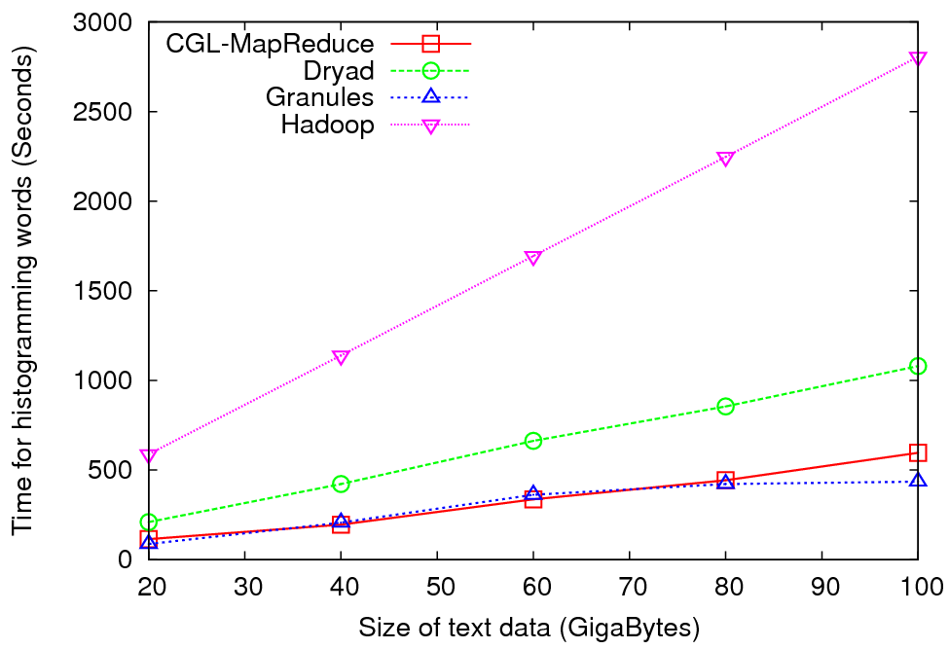
Word Histogramming

Slide 28
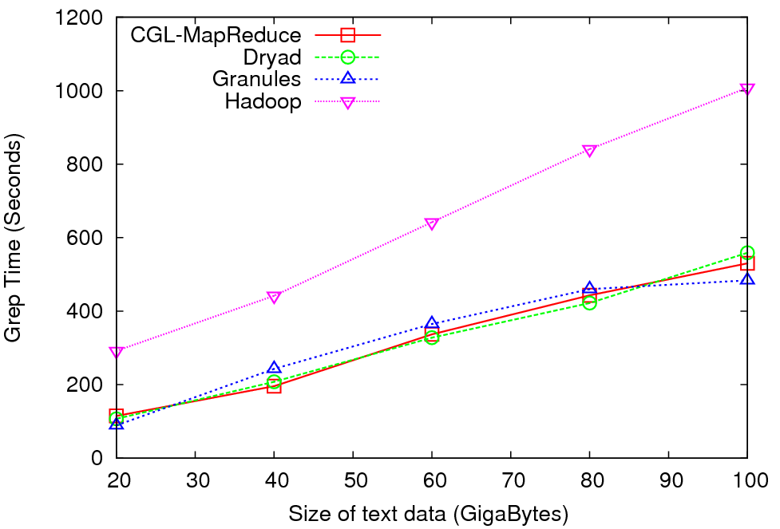
Grep Benchmark

Slide 29
Deterministic Annealing I
Gibbs Distribution at Temperature T
P(χ) = exp( - H(χ)/T) / ∫ dχ exp( - H(χ)/T)
Or P(χ) = exp( - H(χ)/T + F/T )
Minimize Free Energy
F = < H - T S(P) > = ∫ dχ {P(χ)H + T P(χ) lnP(χ)}
Where χ are (a subset of) parameters to be minimized
Simulated annealing corresponds to doing these integrals by Monte Carlo
Deterministic annealing corresponds to doing integrals analytically and is naturally much faster
In each case temperature is lowered slowly – say by a factor 0.99 at each iteration

Slide 30
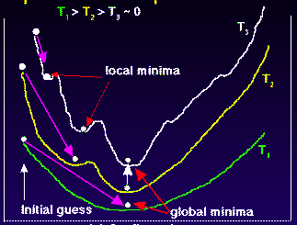
Deterministic
Annealing
F({y}, T)
Solve Linear Equations for each temperature
Nonlinearity effects mitigated by initializing with solution at previous higher temperature
Configuration {y}
Minimum evolving as temperature decreases
Movement at fixed temperature going to local minima if not initialized “correctly

Slide 31
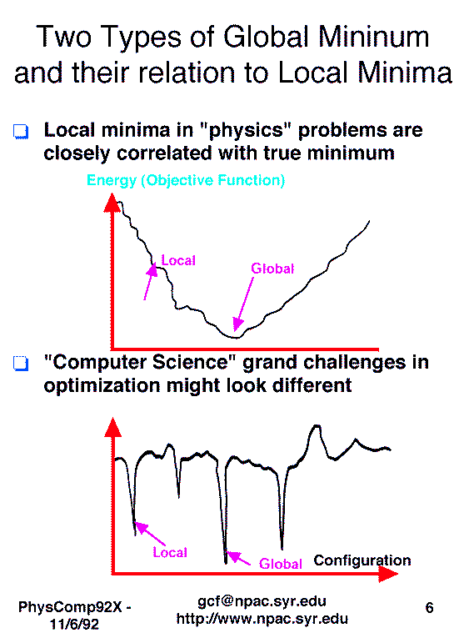
Views from Past on Physical Computation/
Optimization

Slide 32
Deterministic Annealing II
For some cases such as vector clustering and Gaussian Mixture Models one can do integrals by hand but usually will be impossible
So introduce Hamiltonian H₀(χ, ε) which by choice of ε can be made similar to H(χ) and which has tractable integrals
P₀(χ) = exp( - H₀(χ)/T + F₀/T ) approximate Gibbs
F_{R} (P₀) = < H_{R} - T S₀(P₀) >|₀ = < H_{R} – H₀> |₀ + F₀(P₀)
Where <…>|₀ denotes ∫ dχ P_{o}(χ)
Easy to show that real Free Energy
F_{A} (P_{A}) ≤ F_{R} (P₀)
In many problems, decreasing temperature is classic multiscale – finer resolution (T is “just” distance scale)

Slide 33
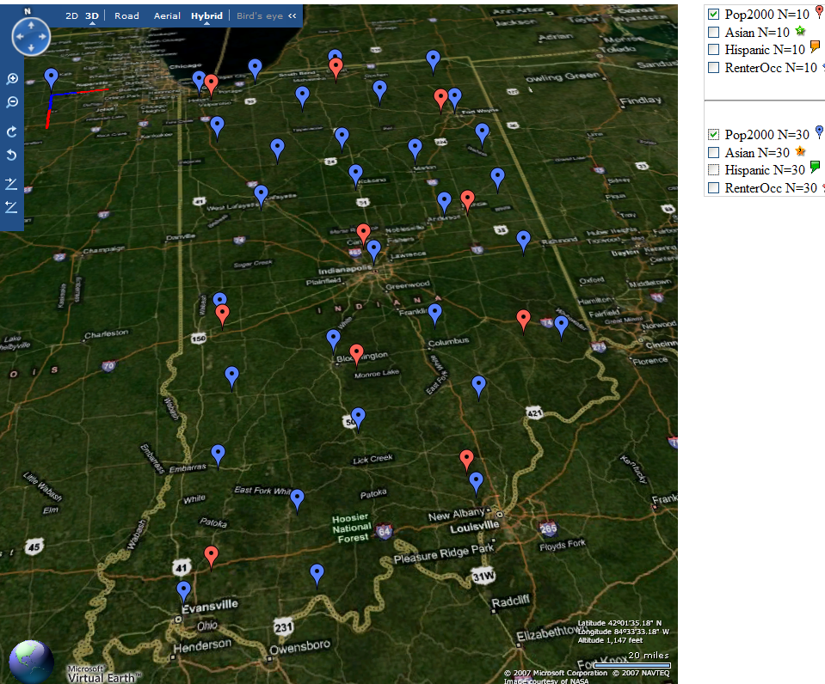
Deterministic Annealing Clustering of Indiana Census Data
Decrease temperature (distance scale) to discover more clusters
Distance Scale
Temperature^{0.5}
Red is coarse resolution with 10 clusters
Blue is finer resolution with 30 clusters
Clusters find cities in Indiana
Distance Scale is √Temperature

Slide 34
Implementation of Method I
Expectation step E is find ε minimizing F_{R} (P₀) and
Follow with M step setting χ = <χ> |₀ = ∫ dχ χ P_{o}(χ) and if one does not anneal over all parameters and one follows with a traditional minimization of remaining parameters
In clustering, one then looks at second derivative matrix of F_{R} (P₀) wrt ε and as temperature is lowered this develops negative eigenvalue corresponding to instability
This is a phase transition and one splits cluster into two and continues EM iteration
One starts with just one cluster

Slide 35
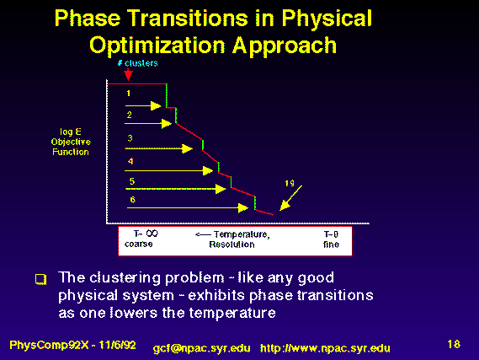
Rose, K., Gurewitz, E., and Fox, G. C. ``Statistical mechanics and phase transitions in clustering,'' Physical Review Letters, 65(8):945-948, August 1990.
My #5 my most cited article (311)

Slide 36
Implementation II
Clustering variables are M_{i}(k) where this is probability point i belongs to cluster k
In Clustering, take H₀ = ∑_{i=1}^{N} ∑_{k=1}^{K} M_{i}(k) ε_{i}(k)
<M_{i}(k)> = exp( -ε_{i}(k)/T ) / ∑_{k=1}^{K} exp( -ε_{i}(k)/T )
Central clustering has ε_{i}(k) = (X(i)- Y(k))² and ε_{i}(k) determined by Expectation step in pairwise clustering
  H_{Central} = ∑_{i=1}^{N} ∑_{k=1}^{K} M_{i}(k) (X(i)- Y(k))²
  H_{central} and H₀ are identical
  Centers Y(k) are determined in M step
Pairwise Clustering given by nonlinear form
H_{PC} = 0.5 ∑_{i=1}^{N} ∑_{j=1}^{N} δ(i, j) ∑_{k=1}^{K} M_{i}(k) M_{j}(k) / C(k)
with C(k) = ∑_{i=1}^{N} M_{i}(k) as number of points in Cluster k
And now H₀ and H_{PC} are different

Slide 37
Multidimensional Scaling MDS
Map points in high dimension to lower dimensions
Many such dimension reduction algorithm (PCA Principal component analysis easiest); simplest but perhaps best is MDS
Minimize Stress
σ(X) = Σ_{i<j=1}^{n} weight(i,j) (δ_{ij} - d(X_{i} , X_{j}))²
δ_{ij} are input dissimilarities and d(X_{i} , X_{j}) the Euclidean distance squared in embedding space (3D usually)
SMACOF or Scaling by minimizing a complicated function is clever steepest descent (expectation maximization EM) algorithm
Computational complexity goes like N². Reduced Dimension
There is Deterministic annealed version of it
Could just view as non linear χ² problem (Tapia et al. Rice)
All will/do parallelize with high efficiency

Slide 38
Implementation III
One tractable form was linear Hamiltonians
Another is Gaussian H₀ = Σ_{i=1}^{n} (X(i) - μ(i))² / 2
Where X(i) are vectors to be determined as in formula for Multidimensional scaling
H_{MDS} = Σ_{i< j=1}^{n} weight(i,j) (δ(i, j) - d(X(i) , X(j) ))²
Where δ(i, j) are observed dissimilarities and we want to represent as Euclidean distance between points X(i) and X(j) (H_{MDS} is quartic or involves square roots)
The E step is minimize
Σ_{i< j=1}^{n} weight(i,j) (δ(i, j) – constant.T - (μ(i) - μ(j))² )²
with solution μ(i) = 0 at large T
Points pop out from origin as Temperature lowered

Slide 39
References
See K. Rose, "Deterministic Annealing for Clustering, Compression, Classification, Regression, and Related Optimization Problems," Proceedings of the IEEE, vol. 80, pp. 2210-2239, November 1998
T Hofmann, JM Buhmann Pairwise data clustering by deterministic annealing, IEEE Transactions on Pattern Analysis and Machine Intelligence 19, pp1-13 1997
Hansjörg Klock and Joachim M. Buhmann Data visualization by multidimensional scaling: a deterministic annealing approach Pattern Recognition Volume 33, Issue 4, April 2000, Pages 651-669
Granat, R. A., Regularized Deterministic Annealing EM for Hidden Markov Models, Ph.D. Thesis, University of California, Los Angeles, 2004. We use for Earthquake prediction
Sporadic other papers in areas like protein structure alignment

Slide 40

N data points E(x) in D dim. space and Minimize F by EM
  Deterministic Annealing Clustering (DAC)
a(x) = 1/N or generally p(x) with Σ p(x) =1
g(k)=1 and s(k)=0.5
T is annealing temperature varied down from ∞ with final value of 1
Vary cluster center Y(k)
K starts at 1 and is incremented by algorithm; pick resolution NOT number of clusters
My 4th most cited article but little used; probably as no good software compared to simple K-means
Avoid local minima
SALSA
Notes:
40

Slide 41
N data points E(x) in D dim. space and Minimize F by EM
  Traditional Gaussian
  mixture models GM
  Deterministic Annealing Clustering (DAC)
  Generative Topographic Mapping (GTM)
  Deterministic Annealing Gaussian
  Mixture models (DAGM)
a(x) = 1/N or generally p(x) with Σ p(x) =1
g(k)=1 and s(k)=0.5
T is annealing temperature varied down from ∞ with final value of 1
Vary cluster center Y(k) but can calculate weight P_{k} and correlation matrix s(k) = σ(k)² (even for matrix σ(k)²) using IDENTICAL formulae for Gaussian mixtures
K starts at 1 and is incremented by algorithm
As DAGM but set T=1 and fix K
a(x) = 1 and g(k) = (1/K)(β/2π)^{D/2}
s(k) = 1/ β and T = 1
Y(k) = Σ_{m=1}^{M} W_{m}φ_{m}(X(k))
Choose fixed φ_{m}(X) = exp( - 0.5 (X-μ_{m})²/σ² )
Vary W_{m} and β but fix values of M and K a priori
Y(k) E(x) W_{m} are vectors in original high D dimension space
X(k) and μ_{m} are vectors in 2 dimensional mapped space
  DAGTM: Deterministic Annealed
  Generative Topographic Mapping
a(x) = 1
g(k)={P_{k}/(2πσ(k)²)^{D/2}}^{1/T}
s(k)= σ(k)² (taking case of spherical Gaussian)
T is annealing temperature varied down from ∞ with final value of 1
Vary Y(k) P_{k} and σ(k)
K starts at 1 and is incremented by algorithm
GTM has several natural annealing versions based on either DAC or DAGM: under investigation
DAMDS, Pairwise different form as different Gibbs distribution (different E₀)
SALSA
Notes:
41

Slide 42
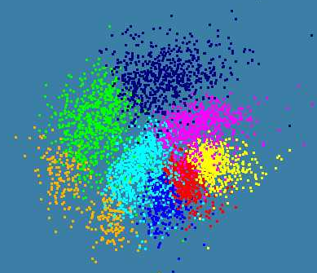
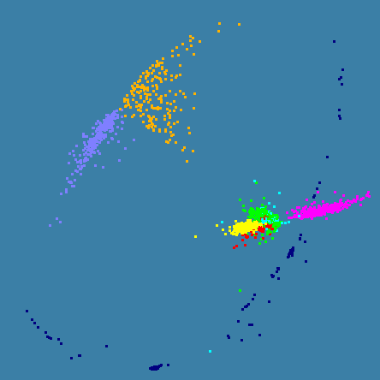
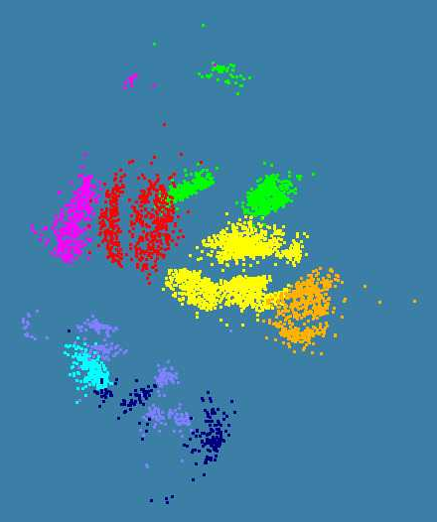
Various Sequence Clustering Results
4500 Points : Pairwise Aligned
3000 Points : Clustal MSA
Kimura2 Distance
4500 Points : Clustal MSA
Map distances to 4D Sphere before MDS

Slide 43
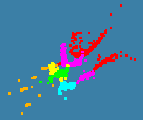

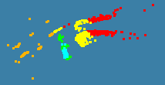
Obesity Patient ~ 20 dimensional data
Will use our 8 node Windows HPC system to run 36,000 records
Working with Gilbert Liu IUPUI to map patient clusters to environmental factors
2000 records 6 Clusters
4000 records
8 Clusters
Refinement of 3 of
clusters to left into 5

Slide 44
Windows Thread Runtime System
We implement thread parallelism using Microsoft CCR
(Concurrency and Coordination Runtime) as it supports both MPI rendezvous and dynamic (spawned) threading style of parallelism http://msdn.microsoft.com/robotics/
CCR Supports exchange of messages between threads using named ports and has primitives like:
FromHandler: Spawn threads without reading ports
Receive: Each handler reads one item from a single port
MultipleItemReceive: Each handler reads a prescribed number of items of a given type from a given port. Note items in a port can be general structures but all must have same type.
MultiplePortReceive: Each handler reads a one item of a given type from multiple ports.
CCR has fewer primitives than MPI but can implement MPI collectives efficiently
Can use DSS (Decentralized System Services) built in terms of CCR for service model
DSS has ~35 µs and CCR a few µs overhead

Slide 45
MPI Exchange Latency in µs (20-30 µs computation between messaging)
Machine | OS | Runtime | Grains | Parallelism | MPI Latency
Intel8c:gf12 (8 core 2.33 Ghz) (in 2 chips) | Redhat | MPJE(Java) | Process | 8 | 181
 |  | MPICH2 (C) | Process | 8 | 40.0
 |  | MPICH2:Fast | Process | 8 | 39.3
 |  | Nemesis | Process | 8 | 4.21
Intel8c:gf20 (8 core 2.33 Ghz) | Fedora | MPJE | Process | 8 | 157
 |  | mpiJava | Process | 8 | 111
 |  | MPICH2 | Process | 8 | 64.2
Intel8b (8 core 2.66 Ghz) | Vista | MPJE | Process | 8 | 170
 | Fedora | MPJE | Process | 8 | 142
 | Fedora | mpiJava | Process | 8 | 100
 | Vista | CCR (C#) | Thread | 8 | 20.2
AMD4 (4 core 2.19 Ghz) | XP | MPJE | Process | 4 | 185
 | Redhat | MPJE | Process | 4 | 152
 |  | mpiJava | Process | 4 | 99.4
 |  | MPICH2 | Process | 4 | 39.3
 | XP | CCR | Thread | 4 | 16.3
Intel(4 core) | XP | CCR | Thread | 4 | 25.8
Messaging CCR versus MPI C# v. C v. Java
SALSA
Notes:
45

Slide 46
Notes on Performance
Speed up = T(1)/T(P) = ε (efficiency ) P
  with P processors
Overhead f = (PT(P)/T(1)-1) = (1/ε -1)
is linear in overheads and usually best way to record results if overhead small
For communication f ∝ ratio of data communicated to calculation complexity = n^{-0.5} for matrix multiplication where n (grain size) matrix elements per node
Overheads decrease in size as problem sizes n increase (edge over area rule)
Scaled Speed up: keep grain size n fixed as P increases
Conventional Speed up: keep Problem size fixed n ∝ 1/P

Slide 47
Comparison of MPI and Threads on Classic parallel Code
Parallel
Overhead f
Speedup = 24/(1+f)
24-way
16-way
2-way
4-way
8-way
1-way
Speedup 28
MPI 1 2 1 4 2 1 8 4 2 1 16 8 4 2 1 24 12 8 6 4 3 2 1 Processes
CCR 1 1 2 1 2 4 1 2 4 8 1 2 4 8 16 1 2 3 4 6 8 12 24 Threads
4 Intel Six Core Xeon E7450 2.4GHz 48GB Memory 12M L2 Cache
3 Dataset sizes

Slide 48
Parallel Deterministic Annealing Clustering
Scaled Speedup Tests on four 8-core Systems
(10 Clusters; 160,000 points per cluster per thread)
Parallel Overhead
≈ 1-efficiency
= (PT(P)/T(1)-1)
On P processors
= (1/efficiency)-1
Parallel Overhead
32-way
16-way
8-way
4-way
2-way
(1,1,1)
(CCR thread,
MPI process,
node)
(1,1,2)
(1,2,1)
(2,1,1)
(1,2,2)
(1,4,1)
(2,1,2)
(2,2,1)
(4,1,1)
(1,4,2)
(1,8,1)
(2,2,2)
(2,4,1)
(4,1,2)
(4,2,1)
(8,1,1)
(2,4,2)
(2,8,1)
(4,2,2)
(4,4,1)
(8,2,1)
(1,8,4)
(2,8,2)
(4,4,2)
(8,2,2)
Parallel Patterns
1, 2, 4, 8, 16, 32-way parallelism
C# Deterministic annealing Clustering Code with MPI and/or CCR threads

Slide 49
Parallel Deterministic Annealing Clustering
Scaled Speedup Tests on two 16-core Systems
(10 Clusters; 160,000 points per cluster per thread)
Parallel Overhead
8-way
32-way
48-way
2-way
4-way
(4,4,1)
(1,8,6)
(8,1,2)
(8,2,1)
(16,1,1)
(1,1,1)
(1,16,2)
(1,1,2)
(1,2,1)
(2,1,1)
(1,2,2)
(1,4,1)
(2,1,2)
(2,2,1)
(4,1,1)
(1,4,2)
(1,8,1)
(2,2,2)
(2,4,1)
(4,1,2)
(4,2,1)
(8,1,1)
(1,8,2)
(1,16,1)
(2,4,2)
(2,8,1)
(4,2,2)
(2,8,2)
(4,4,2)
(CCR thread,
MPI process,
node)
(8,2,2)
(16,1,2)
Parallel Patterns
1, 2, 4, 8, 16, 32, 48-way parallelism
48 way is 8 processes running on 4 8-core and 2 16-core systems
MPI always good. CCR deteriorates for 16 threads

Slide 50
Parallel Deterministic Annealing Clustering
Scaled Speedup Tests on eight 16-core Systems
(10 Clusters; 160,000 points per cluster per thread)
Parallel Overhead
128-way
64-way
16-way
32-way
48-way
4-way
8-way
2-way
(1,1,1)
(1,1,2)
(1,2,1)
(2,1,1)
(1,2,2)
(1,4,1)
(2,1,2)
(2,2,1)
(4,1,1)
(1,4,2)
(1,8,1)
(2,2,2)
(2,4,1)
(4,1,2)
(4,2,1)
(8,1,1)
(1,8,2)
(2,4,2)
(2,8,1)
(4,2,2)
(4,4,1)
(8,1,2)
(8,2,1)
(1,8,1)
(2,8,2)
(4,4,2)
(8,2,2)
(1,8,6)
(2,4,6)
(1,8,8)
(4,2,8)
(8,1,8)
(2,8,8)
(4,4,8)
(CCR thread,
MPI process,
node)
(1,16,1)
(1,16,4)
(8,2,8)
(16,1,1)
(1,16,2)
(16,1,2)
(1,16,3)
(1,16,8)
(16,1,8)
Parallel Patterns

Slide 51
Components of a Scientific Computing environment
Laptop using a dynamic number of cores for runs
  Threading (CCR) parallel model allows such dynamic switches if OS told application how many it could – we use short-lived NOT long running threads
  Very hard with MPI as would have to redistribute data
The cloud for dynamic service instantiation including ability to launch:
  Disk/File parallel data analysis
  MPI engines for large closely coupled computations
    Petaflops for million particle clustering/dimension reduction?
Analysis programs like MDS and clustering will run OK for large jobs with “millisecond” (as in Granules) not “microsecond” (as in MPI, CCR) latencies

