Slide 1
Time Series Research in DSC Digital Science Center
Brainstorming Geoffrey Fox 24 April 2020
Digital Science Center, Indiana University gcf@indiana.edu, http://www.dsc.soic.indiana.edu/

Slide 2
Summary of Activities
Intersection Big Data, High Performance Computing and Deep Learning
Streaming real-time systems
Data Engineering (HPC Spark Hadoop) as in support of
SICE Social Media Observatory (last 6 years)
Global Pervasive Computational Epidemiology with University of Virginia
Deep Learning Surrogates for large scale simulations with Rutgers, Argonne, IU
Smart Ensembles for exploring Chemical Phase Space applied to COVID-19 drugs
Large time steps for particle dynamics with recurrent neural networks
Future application to agent-based computational biology (IU, Glazier) and epidemiology (UVa)
Deep Learning for geospatial timeseries
Particle Dynamics Surrogates (above)
Earthquakes with UC Davis and JPL
COVID-19 case data versus demographics with Pittsburgh Public Health
(Best work in DL-TS is ride hailing by Uber and Didi)
MLPerf Consortium for Science Data (over 80 members)
Also DL for Speech and Recommender Engines

Slide 3
Deep Learning for Time Series
Best developed commercially for audio and video – Google etc.
Geospatial time series best developed for transportation – Uber, Didi
Surprisingly little use for COVID-19; instead use curve fitting or epidemic SIR SIS models
Could be event based but easier to think about data aggregated in time slices
Day to year earthquakes
Day COVID-19
Multiple features for each time slice but some could be fixed in time
Features can have space as one label
Southern California 2400 pixels – each 11 km on a side with magnitude, number and depth
Accumulate data as energy and convert to magnitude
DNN don’t like giant energies
Divide data into time sequences of length <~ 50 (larger in transformer)

Slide 4
Methods
Recurrent Neural Nets -- GRU or LSTM
Use 2 to 3 layers
Transformer or Reformer
Use non-recurrent nets presenting time sequences flattened
Structure of fixed time features
Images – convolutional LSTM or convolutional+LSTM in weather and earthquakes
Graphs – road networks in transportation and faults in Earthquakes
and mixtures thereof

Slide 5
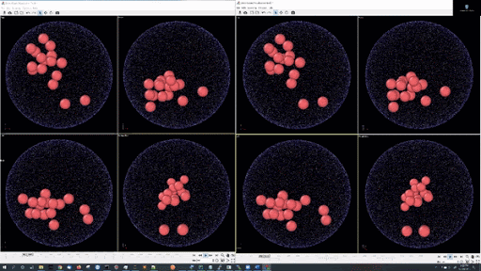
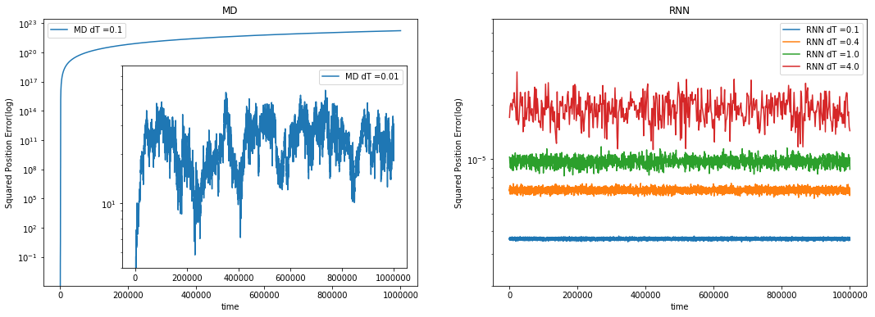
Learn Newton’s laws with Recurrent Neural Networks
(work with JCS Kadupitiya, Vikram Jadhao)
Molecular Dynamics Surrogates for integrating sets of differential equations
Train the network on traditional 5 time step series from (Verlet) difference equations
Verlet needs time step .001 for reliable integration but
Learnt LSTM network is reliable for time steps which are 4000 times longer and also learn potential.
Simulation
LSTM
Speedup is 30000 on 16 particles interacting with Lennard-Jones potentials
2 layer-64 units per layer LSTM network: 65,072 trainable parameters
5000 training simulations
Apply to Agent-based simulations with James Glazier for COVID-19 speedup
Simulation Error
LSTM Error
10²³
RNN Error² up to step size dT=4 and total time 10⁶
10⁻⁵
10¹
Verlet error² dT = 0.01, 0.1

Slide 6
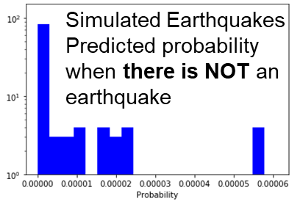
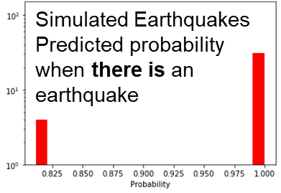
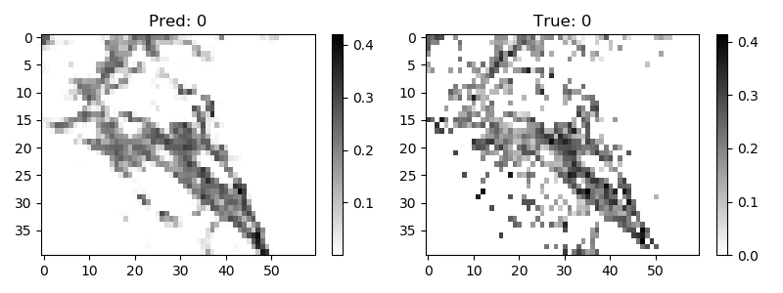
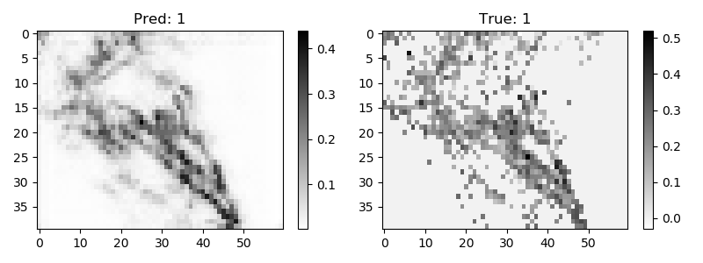
Hidden Theories and Hidden Instances
Earthquakes are hard to predict with simulations as unknown fault friction
The LSTM description of particle dynamics suggests that the DNN has learnt “Newton’s laws” and then you look at different instances in the inference
To the right is model learning simulated earthquakes
Below are two predictions compared to observation for annual earthquake activity in Southern California (each pixel is about 11 km square)
Uses Convolutional LSTM with 5 time steps and data is log of aggregated energy released (can’t use energy as too large a dynamic range)
Earthquakes use graphs (faults) and images (see below) with challenging integrations of space and time in deep learning
DNN learns theories

