Slide 1
FutureGrid Overview
Geoffrey Fox
gcf@indiana.edu www.infomall.org
School of Informatics and Computing
and Community Grids Laboratory,
Digital Science Center
Pervasive Technology Institute
Indiana University

Slide 2
FutureGrid
The goal of FutureGrid is to support the research on the future of distributed, grid, and cloud computing.
FutureGrid will build a robustly managed simulation environment or testbed to support the development and early use in science of new technologies at all levels of the software stack: from networking to middleware to scientific applications.
The environment will mimic TeraGrid and/or general parallel and distributed systems – FutureGrid is part of TeraGrid and one of two experimental TeraGrid systems (other is GPU)
This test-bed will succeed if it enables major advances in science and engineering through collaborative development of science applications and related software.
FutureGrid is a (small 5600 core) Science Cloud but it is more accurately a virtual machine based simulation environment

Slide 3
FutureGrid Hardware

Slide 4
FutureGrid Hardware
FutureGrid has dedicated network (except to TACC) and a network fault and delay generator
Can isolate experiments on request; IU runs Network for NLR/Internet2
(Many) additional partner machines will run FutureGrid software and be supported (but allocated in specialized ways)

Slide 5
FutureGrid Partners
Indiana University (Architecture, core software, Support)
Purdue University (HTC Hardware)
San Diego Supercomputer Center at University of California San Diego (INCA, Monitoring)
University of Chicago/Argonne National Labs (Nimbus)
University of Florida (ViNE, Education and Outreach)
University of Southern California Information Sciences Institute (Pegasus to manage experiments)
University of Tennessee Knoxville (Benchmarking)
University of Texas at Austin/Texas Advanced Computing Center (Portal)
University of Virginia (OGF, Advisory Board and allocation)
Center for Information Services and GWT-TUD from Technische Universtität Dresden. (VAMPIR)
Blue institutions have FutureGrid hardware

Slide 6
Other Important Collaborators
NSF
Early users from an application and computer science perspective and from both research and education
Grid5000/Aladin and D-Grid in Europe
Commercial partners such as
  Eucalyptus ….
  Microsoft (Dryad + Azure) – Note current Azure external to FutureGrid as are GPU systems
  Application partners
TeraGrid
Open Grid Forum
?Open Nebula, Open Cirrus Testbed, Open Cloud Consortium, Cloud Computing Interoperability Forum. IBM-Google-NSF Cloud, UIUC Cloud?

Slide 7
FutureGrid Architecture

Slide 8
FutureGrid Architecture
Open Architecture allows to configure resources based on images
Managed images allows to create similar experiment environments
Experiment management allows reproducible activities
Through our modular design we allow different clouds and images to be “rained” upon hardware.
Note will be supported 24x7 at “TeraGrid Production Quality”
Will support deployment of “important” middleware including TeraGrid stack, Condor, BOINC, gLite, Unicore, Genesis II

Slide 9
FutureGrid Usage Scenarios
Developers of end-user applications who want to develop new applications in cloud or grid environments, including analogs of commercial cloud environments such as Amazon or Google.
  Is a Science Cloud for me?
Developers of end-user applications who want to experiment with multiple hardware environments.
Grid/Cloud middleware developers who want to evaluate new versions of middleware or new systems.
Networking researchers who want to test and compare different networking solutions in support of grid and cloud applications and middleware. (Some types of networking research will likely best be done via through the GENI program.)
Education as well as research
Interest in performance requires that bare metal important

Slide 10
Typical (simple) Example
Evaluate usability and performance of Clouds and Cloud Technologies on biology applications
Hadoop (on Linux) v Dryad (on Windows) or Sector v MPI v “Nothing (worker nodes)” (on Linux or Windows) on
  Bare Metal or
  Virtual Machines (of various types)
FutureGrid supports rapid configuration of hardware and core software to enable such reproducible experiments

Slide 11
Alu Sequencing Workflow
Data is N sequences – ~300 characters (A, C, G, and T) long
  These cannot be thought of as vectors because there are missing characters
  “Multiple Sequence Alignment” (creating vectors of characters) doesn’t seem to work if N larger than O(100)
First calculate N² dissimilarities (distances) between sequences (all pairs) in Dryad Hadoop or MPI
Find families by clustering (using much better methods than Kmeans). As no vectors, use vector free O(N²) methods
Map to 3D for visualization by O(N²) Multidimensional Scaling MDS
N = 50,000 runs in 10 hours (all above) on 768 cores
Our collaborators just gave us 170,000 sequences and want to look at 1.5 million – will develop new “fast multipole” algorithms!
MDS/Clustering need MPI (just Barrier, Reduce, Broadcast) or enhanced MapReduce – how general?

Slide 12
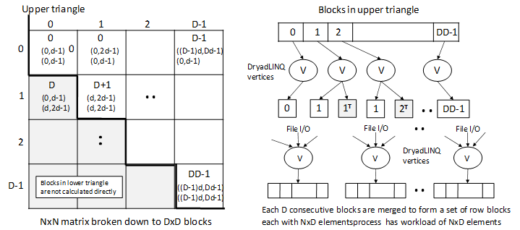
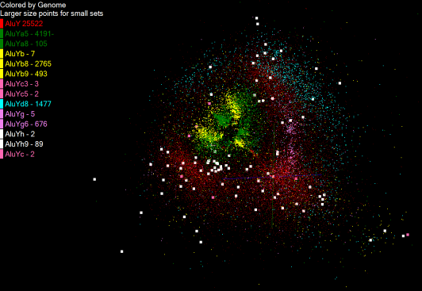
Gene Family from Alu Sequencing
1250 million distances
4 hours & 46 minutes
Calculate pairwise distances for a collection of genes (used for clustering, MDS)
O(N^2) problem
“Doubly Data Parallel” at Dryad Stage
Performance close to MPI
Performed on 768 cores (Tempest Cluster)
Processes work better than threads when used inside vertices
100% utilization vs. 70%
Notes:
1~180 lines without threading in DryadLINQ, with threading, it is about 400 lines
MPI ~500 lines
The Alu clustering problem [27] is one of the most challenging problems for sequencing clustering because Alus represent the largest repeat families in human genome. There are about 1 million copies of Alu sequences in human genome, in which most insertions can be found in other primates and only a small fraction (~ 7000) are human-specific. This indicates that the classification of Alu repeats can be deduced solely from the 1 million human Alu elements. Notable, Alu clustering can be viewed as a classical case study for the capacity of computational infrastructures because it is not only of great intrinsic biological interests, but also a problem of a scale that will remain as the upper limit of many other clustering problem in bioinformatics for the next few years, e.g. the automated protein family classification for a few millions of proteins predicted from large metagenomics projects. In our work here we examine Alu samples of 35339 and 50,000 sequences.

Slide 13


Slide 14


Slide 15
Dryad versus MPI for Smith Waterman
Flat is perfect scaling

Slide 16
Hadoop/Dryad Comparison
Inhomogeneous Data
Dryad with Windows HPCS compared to Hadoop with Linux RHEL on Idataplex
Both runs can be optimized further
Notes:
10k data size

Slide 17
Selected FutureGrid Timeline
October 1 2009 Project Starts
November 16-19 SC09 Demo/F2F Committee Meetings/Chat up colalborators
January 2010 – Significant Hardware available
March 2010 FutureGrid network complete
March 2010 FutureGrid Annual Meeting
September 2010 All hardware (except Track IIC lookalike) accepted
October 1 2011 FutureGrid allocatable via TeraGrid process – first two years by user/science board led by Andrew Grimshaw

