Slide 1
HPC-ABDS High Performance Computing Enhanced
Apache Big Data Stack
(with a bias to Streaming)
2nd International Workshop on
Scalable Computing For Real-Time Big Data Applications (SCRAMBL'15)
in conjunction with CCGrid'15
May 4, 2015
Geoffrey Fox, Judy Qiu, Shantenu Jha,
Supun Kamburugamuve, Andre Luckow
gcf@indiana.edu http://www.infomall.org
School of Informatics and Computing
Digital Science Center
Indiana University Bloomington

Slide 2
HPC-ABDS

Slide 4
There are a lot of Big Data and HPC Software systems in 17 (21) layers
Build on – do not compete with the over 300 HPC-ABDS systems

Slide 5
NIST Big Data Initiative
Led by Chaitin Baru, Bob Marcus, Wo Chang

Slide 6
NBD-PWG (NIST Big Data Public Working Group) Subgroups & Co-Chairs
There were 5 Subgroups
  Note mainly industry
Requirements and Use Cases Sub Group
  Geoffrey Fox, Indiana U.; Joe Paiva, VA; Tsegereda Beyene, Cisco
Definitions and Taxonomies SG
  Nancy Grady, SAIC; Natasha Balac, SDSC; Eugene Luster, R2AD
Reference Architecture Sub Group
  Orit Levin, Microsoft; James Ketner, AT&T; Don Krapohl, Augmented Intelligence
Security and Privacy Sub Group
  Arnab Roy, CSA/Fujitsu Nancy Landreville, U. MD Akhil Manchanda, GE
Technology Roadmap Sub Group
  Carl Buffington, Vistronix; Dan McClary, Oracle; David Boyd, Data Tactics
See http://bigdatawg.nist.gov/usecases.php
And http://bigdatawg.nist.gov/V1_output_docs.php

Slide 7
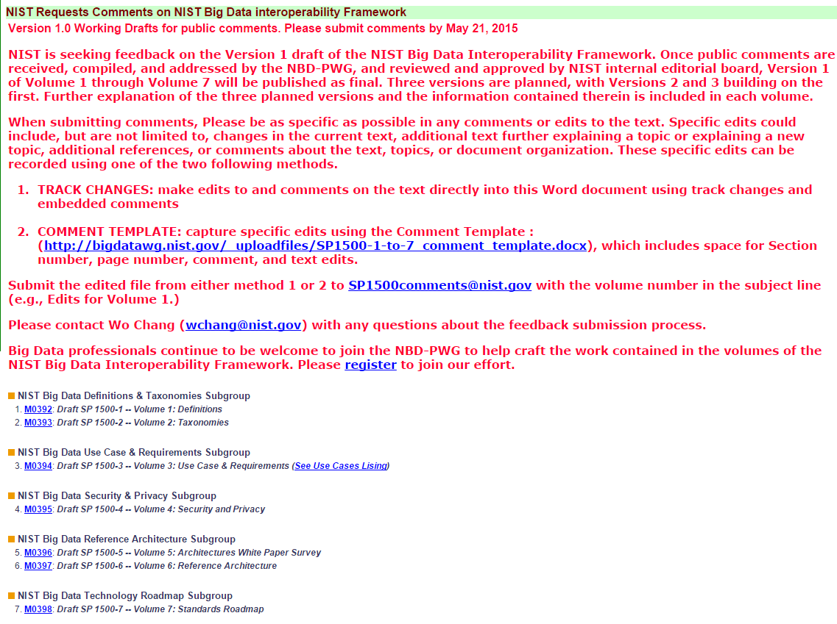
Comment period ends May 21
http://bigdatawg.nist.gov/V1_output_docs.php

Slide 8

Use Case Template
26 fields completed for 51 areas
Government Operation: 4
Commercial: 8
Defense: 3
Healthcare and Life Sciences: 10
Deep Learning and Social Media: 6
The Ecosystem for Research: 4
Astronomy and Physics: 5
Earth, Environmental and Polar Science: 10
Energy: 1

Slide 9
51 Detailed Use Cases: Contributed July-September 2013
Covers goals, data features such as 3 V’s, software, hardware
26 Features for each use case
Biased to science
http://bigdatawg.nist.gov/usecases.php
https://bigdatacoursespring2014.appspot.com/course (Section 5)
Government Operation(4): National Archives and Records Administration, Census Bureau
Commercial(8): Finance in Cloud, Cloud Backup, Mendeley (Citations), Netflix, Web Search, Digital Materials, Cargo shipping (as in UPS)
Defense(3): Sensors, Image surveillance, Situation Assessment
Healthcare and Life Sciences(10): Medical records, Graph and Probabilistic analysis, Pathology, Bioimaging, Genomics, Epidemiology, People Activity models, Biodiversity
Deep Learning and Social Media(6): Driving Car, Geolocate images/cameras, Twitter, Crowd Sourcing, Network Science, NIST benchmark datasets
The Ecosystem for Research(4): Metadata, Collaboration, Language Translation, Light source experiments
Astronomy and Physics(5): Sky Surveys including comparison to simulation, Large Hadron Collider at CERN, Belle Accelerator II in Japan
Earth, Environmental and Polar Science(10): Radar Scattering in Atmosphere, Earthquake, Ocean, Earth Observation, Ice sheet Radar scattering, Earth radar mapping, Climate simulation datasets, Atmospheric turbulence identification, Subsurface Biogeochemistry (microbes to watersheds), AmeriFlux and FLUXNET gas sensors
Energy(1): Smart grid

Slide 10

Table 4: Characteristics of 6 Distributed Applications
Application Example | Execution Unit | Communication | Coordination | Execution Environment
Montage | Multiple sequential and parallel executable | Files | Dataflow (DAG) | Dynamic process creation, execution
NEKTAR | Multiple concurrent parallel executables | Stream based | Dataflow | Co-scheduling, data streaming, async. I/O
Replica-Exchange | Multiple seq. and parallel executables | Pub/sub | Dataflow and events | Decoupled coordination and messaging
Climate Prediction (generation) | Multiple seq. & parallel executables | Files and messages | Master-Worker, events | @Home (BOINC)
Climate Prediction (analysis) | Multiple seq. & parallel executables | Files and messages | Dataflow | Dynamics process creation, workflow execution
SCOOP | Multiple Executable | Files and messages | Dataflow | Preemptive scheduling, reservations
Coupled Fusion | Multiple executable | Stream-based | Dataflow | Co-scheduling, data streaming, async I/O
Part of Property Summary Table

Slide 11
Features and Examples with a streaming tinge ……

Slide 12
51 Use Cases: What is Parallelism Over?
People: either the users (but see below) or subjects of application and often both
Decision makers like researchers or doctors (users of application)
Items such as Images, EMR, Sequences below; observations or contents of online store
  Images or “Electronic Information nuggets”
  EMR: Electronic Medical Records (often similar to people parallelism)
  Protein or Gene Sequences;
  Material properties, Manufactured Object specifications, etc., in custom dataset
  Modelled entities like vehicles and people
Sensors – Internet of Things
Events such as detected anomalies in telescope or credit card data or atmosphere
(Complex) Nodes in RDF Graph
Simple nodes as in a learning network
Tweets, Blogs, Documents, Web Pages, etc.
  And characters/words in them
Files or data to be backed up, moved or assigned metadata
Particles/cells/mesh points as in parallel simulations

Slide 13
Features of 51 Use Cases I
PP (26) “All” Pleasingly Parallel or Map Only
MR (18) Classic MapReduce MR (add MRStat below for full count)
MRStat (7) Simple version of MR where key computations are simple reduction as found in statistical averages such as histograms and averages
MRIter (23) Iterative MapReduce or MPI (Spark, Twister)
Graph (9) Complex graph data structure needed in analysis
Fusion (11) Integrate diverse data to aid discovery/decision making; could involve sophisticated algorithms or could just be a portal
Streaming (41) Some data comes in incrementally and is processed this way
Classify (30) Classification: divide data into categories
S/Q (12) Index, Search and Query

Slide 14
Features of 51 Use Cases II
CF (4) Collaborative Filtering for recommender engines
LML (36) Local Machine Learning (Independent for each parallel entity) – application could have GML as well
GML (23) Global Machine Learning: Deep Learning, Clustering, LDA, PLSI, MDS,
  Large Scale Optimizations as in Variational Bayes, MCMC, Lifted Belief Propagation, Stochastic Gradient Descent, L-BFGS, Levenberg-Marquardt . Can call EGO or Exascale Global Optimization with scalable parallel algorithm
Workflow (51) Universal
GIS (16) Geotagged data and often displayed in ESRI, Microsoft Virtual Earth, Google Earth, GeoServer etc.
HPC (5) Classic large-scale simulation of cosmos, materials, etc. generating (visualization) data
Agent (2) Simulations of models of data-defined macroscopic entities represented as agents

Slide 15
Internet of Things and Streaming Apps
It is projected that there will be 24 (Mobile Industry Group) to 50 (Cisco) billion devices on the Internet by 2020.
The cloud natural controller of and resource provider for the Internet of Things.
Smart phones/watches, Wearable devices (Smart People), “Intelligent River” “Smart Homes and Grid” and “Ubiquitous Cities”, Robotics.
Majority of use cases (41/51) are streaming – experimental science gathers data in a stream – sometimes batched as in a field trip. Below is sample
10: Cargo Shipping Tracking as in UPS, Fedex PP GIS LML
13: Large Scale Geospatial Analysis and Visualization PP GIS LML
28: Truthy: Information diffusion research from Twitter Data PP MR for Search, GML for community determination
39: Particle Physics: Analysis of LHC Large Hadron Collider Data: Discovery of Higgs particle PP Local Processing Global statistics
50: DOE-BER AmeriFlux and FLUXNET Networks PP GIS LML
51: Consumption forecasting in Smart Grids PP GIS LML

Slide 16
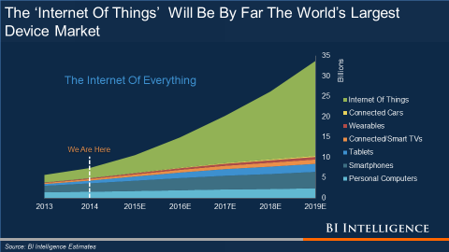
Growth of Internet of Things December 2014
Currently Phones etc. but will change to “real things”

Slide 17
Big Data Patterns – the Big Data present and parallel computing past

Slide 18
7 Computational Giants of
NRC Massive Data Analysis Report
http://www.nap.edu/catalog.php?record_id=18374
G1: Basic Statistics e.g. MRStat
G2: Generalized N-Body Problems
G3: Graph-Theoretic Computations
G4: Linear Algebraic Computations
G5: Optimizations e.g. Linear Programming
G6: Integration e.g. LDA and other GML
G7: Alignment Problems e.g. BLAST

Slide 19
HPC Benchmark Classics
Linpack or HPL: Parallel LU factorization
for solution of linear equations
NPB version 1: Mainly classic HPC solver kernels
  MG: Multigrid
  CG: Conjugate Gradient
  FT: Fast Fourier Transform
  IS: Integer sort
  EP: Embarrassingly Parallel
  BT: Block Tridiagonal
  SP: Scalar Pentadiagonal
  LU: Lower-Upper symmetric Gauss Seidel

Slide 20
13 Berkeley Dwarfs
Dense Linear Algebra
Sparse Linear Algebra
Spectral Methods
N-Body Methods
Structured Grids
Unstructured Grids
MapReduce
Combinational Logic
Graph Traversal
Dynamic Programming
Backtrack and
Branch-and-Bound
Graphical Models
Finite State Machines
First 6 of these correspond to Colella’s original.
Monte Carlo dropped.
N-body methods are a subset of Particle in Colella.
Note a little inconsistent in that MapReduce is a programming model and spectral method is a numerical method.
Need multiple facets!

Slide 21
What’s after Giants and Dwarfs?
Ogres ……..
Facets of the Ogres

Slide 22
Introducing Big Data Ogres and their Facets I
Big Data Ogres provide a systematic approach to understanding applications, and as such they have facets which represent key characteristics defined both from our experience and from a bottom-up study of features from several individual applications.
The facets capture common characteristics (shared by several problems)which are inevitably multi-dimensional and often overlapping.
Ogres characteristics are cataloged in four distinct dimensions or views.
Each view consists of facets; when multiple facets are linked together, they describe classes of big data problems represented as an Ogre.
Instances of Ogres are particular big data problems
A set of Ogre instances that cover a rich set of facets could form a benchmark set
Ogres and their instances can be atomic or composite

Slide 23
Introducing Big Data Ogres and their Facets II
Ogres characteristics are cataloged in four distinct dimensions or views.
Each view consists of facets; when multiple facets are linked together, they describe classes of big data problems represented as an Ogre.
One view of an Ogre is the overall problem architecture which is naturally related to the machine architecture needed to support data intensive application while still being different.
Then there is the execution (computational) features view, describing issues such as I/O versus compute rates, iterative nature of computation and the classic V’s of Big Data: defining problem size, rate of change, etc.
The data source & style view includes facets specifying how the data is collected, stored and accessed.
The final processing view has facets which describe classes of processing steps including algorithms and kernels. Ogres are specified by the particular value of a set of facets linked from the different views.

Slide 24

14
$O\left(N^{2}\right)$ = NN / $O(N)$ = N
Shared / Dedicated / Transient / Permanent
13
Metric = M / Non-Metric = N
12
Data Abstraction
11
Iterative / Simple
Execution View
Regular = R / Irregular = I
10
Geospatial Information System
Archived/Batched/Streaming
9
Dynamic = D / Static = S
8
Communication Structure
Metadata/Provenance
Enterprise Data Model
SQL/NoSQL/NewSQL
7
Veracity
HDFS/Lustre/GPFS
6
Variety
HPC Simulations
5
Velocity
Internet of Things
4
Volume
Files/Objects
3
Execution Environment; Core libraries
2
Flops per Byte; Memory I/O
1
Performance Metrics
4 Ogre Views and 50 Facets
8
10
11
12
1
2
3
4
5
6
7
9
10
9
8
7
6
5
4
3
2
1
Single Program Multiple Data
Bulk Synchronous Parallel
Micro-benchmarks
Problem
Architecture
View
1
Local Analytics
2
Classic MapReduce
Map Point-to-Point
Global Analytics
Pleasingly Parallel
3
Map-Collective
Map Streaming
Shared Memory
Base Statistics
4
Recommendations
5
Dataflow
Workflow
Search / Query / Index
6
Fusion
Agents
Data Source and Style View
Classification
7
Learning
8
Optimization Methodology
9
Streaming
10
Alignment
11
Linear Algebra Kernels
12
Processing View
Graph Algorithms
13
Visualization
14

Slide 25
Facets of the Ogres
Meta or Macro Aspects:
Problem Architecture

Slide 26
Problem Architecture View of Ogres (Meta or MacroPatterns)
Pleasingly Parallel – as in BLAST, Protein docking, some (bio-)imagery including Local Analytics or Machine Learning – ML or filtering pleasingly parallel, as in bio-imagery, radar images (pleasingly parallel but sophisticated local analytics)
Classic MapReduce: Search, Index and Query and Classification algorithms like collaborative filtering (G1 for MRStat in Features, G7)
Map-Collective: Iterative maps + communication dominated by “collective” operations as in reduction, broadcast, gather, scatter. Common datamining pattern
Map-Point to Point: Iterative maps + communication dominated by many small point to point messages as in graph algorithms
Map-Streaming: Describes streaming, steering and assimilation problems
Shared Memory: Some problems are asynchronous and are easier to parallelize on shared rather than distributed memory – see some graph algorithms
SPMD: Single Program Multiple Data, common parallel programming feature
BSP or Bulk Synchronous Processing: well-defined compute-communication phases
Fusion: Knowledge discovery often involves fusion of multiple methods.
Dataflow: Important application features often occurring in composite Ogres
Use Agents: as in epidemiology (swarm approaches)
Workflow: All applications often involve orchestration (workflow) of multiple components
Note problem and machine architectures are related
Notes:
Big dwarfs are Ogres
Implement Ogres in ABDS+

Slide 27
Hardware, Software, Applications
In my old papers (especially book Parallel Computing Works!), I discussed computing as multiple complex systems mapped into each other
Problem → Numerical formulation → Software → Hardware
Each of these 4 systems has an architecture that can be described in similar language
One gets an easy programming model if architecture of problem matches that of Software
One gets good performance if architecture of hardware matches that of software and problem
So “MapReduce” can be used as architecture of software (programming model) or “Numerical formulation of problem”

Slide 28

8 Data Analysis Problem Architectures
1) Pleasingly Parallel PP or “map-only” in MapReduce
  BLAST Analysis; Local Machine Learning
2A) Classic MapReduce MR, Map followed by reduction
  High Energy Physics (HEP) Histograms; Web search; Recommender Engines
2B) Simple version of classic MapReduce MRStat
  Final reduction is just simple statistics
3) Iterative MapReduce MRIter
  Expectation maximization Clustering Linear Algebra, PageRank
4A) Map Point to Point Communication
  Classic MPI; PDE Solvers and Particle Dynamics; Graph processing Graph
4B) GPU (Accelerator) enhanced 4A) – especially for deep learning
5) Map + Streaming + Communication
  Images from Synchrotron sources; Telescopes; Internet of Things IoT
  6) Shared memory allowing parallel threads which are tricky to program but lower latency
  Difficult to parallelize asynchronous parallel Graph Algorithms

Slide 29
6 Forms of MapReduce
PP
Local Analytics
MR
Basic Statistics
Iterative
Graph
Streaming
Shared Memory

Slide 30
Facets in the Execution Features Views

Slide 31
One View of Ogres has Facets that are micropatterns or Execution Features
Performance Metrics; property found by benchmarking Ogre
Flops per byte; memory or I/O
Execution Environment; Core libraries needed: matrix-matrix/vector algebra, conjugate gradient, reduction, broadcast; Cloud, HPC etc.
Volume: property of an Ogre instance
Velocity: qualitative property of Ogre with value associated with instance
Variety: important property especially of composite Ogres
Veracity: important property of “mini-applications” but not kernels
Communication Structure; Interconnect requirements; Is communication BSP, Asynchronous, Pub-Sub, Collective, Point to Point?
Is application (graph) static or dynamic?
Most applications consist of a set of interconnected entities; is this regular as a set of pixels or is it a complicated irregular graph?
Are algorithms Iterative or not?
Data Abstraction: key-value, pixel, graph(G3), vector, bags of words or items
Are data points in metric or non-metric spaces?
Is algorithm O(N²) or O(N) (up to logs) for N points per iteration (G2)

Slide 32
Facets of the Ogres
Data Source and Style Aspects

Slide 33
Data Source and Style View of Ogres I
SQL NewSQL or NoSQL: NoSQL includes Document,
Column, Key-value, Graph, Triple store; NewSQL is SQL redone to exploit NoSQL performance
Other Enterprise data systems: 10 examples from NIST integrate SQL/NoSQL
Set of Files or Objects: as managed in iRODS and extremely common in scientific research
File systems, Object, Blob and Data-parallel (HDFS) raw storage: Separated from computing or colocated? HDFS v Lustre v. Openstack Swift v. GPFS
Archive/Batched/Streaming: Streaming is incremental update of datasets with new algorithms to achieve real-time response (G7); Before data gets to compute system, there is often an initial data gathering phase which is characterized by a block size and timing. Block size varies from month (Remote Sensing, Seismic) to day (genomic) to seconds or lower (Real time control, streaming)
Notes:
Big dwarfs are Ogres
Implement Ogres in ABDS+

Slide 34
Data Source and Style View of Ogres II
Shared/Dedicated/Transient/Permanent: qualitative property of data; Other characteristics are needed for permanent auxiliary/comparison datasets and these could be interdisciplinary, implying nontrivial data movement/replication
Metadata/Provenance: Clear qualitative property but not for kernels as important aspect of data collection process
Internet of Things: 24 to 50 Billion devices on Internet by 2020
HPC simulations: generate major (visualization) output that often needs to be mined
Using GIS: Geographical Information Systems provide attractive access to geospatial data
Note 10 Bob Marcus (led NIST effort) Use cases
Notes:
Big dwarfs are Ogres
Implement Ogres in ABDS+

Slide 35
2. Perform real time analytics on data source streams and notify users when specified events occur
Specify filter
Filter Identifying Events
Fetch streamed Data
Post Selected Events
Streaming Data
Posted Data
Identified Events
Streaming Data
Streaming Data
Archive
Repository
Storm, Kafka, Hbase, Zookeeper

Slide 36



5. Perform interactive analytics on data in analytics-optimized database
Mahout, R
Hadoop, Spark, Giraph, Pig …
Data Storage: HDFS, Hbase
Data, Streaming, Batch …..

Slide 37
5A. Perform interactive analytics on observational scientific data
Science Analysis Code, Mahout, R
Grid or Many Task Software, Hadoop, Spark, Giraph, Pig …
Data Storage: HDFS, Hbase, File Collection
Direct Transfer
Transport batch of data to primary analysis data system
Streaming Twitter data for Social Networking
Local Accumulate and initial computing
NIST examples include LHC, Remote Sensing, Astronomy and Bioinformatics
Record Scientific Data in “field”

Slide 38
Facets of the Ogres Processing View

Slide 39
Facets in Processing (run time) View of Ogres I
Micro-benchmarks ogres that exercise simple features of hardware such as communication, disk I/O, CPU, memory performance
Local Analytics executed on a single core or perhaps node
Global Analytics requiring iterative programming models (G5,G6) across multiple nodes of a parallel system
Optimization Methodology: overlapping categories
  Nonlinear Optimization (G6)
  Machine Learning
  Maximum Likelihood or χ² minimizations
  Expectation Maximization (often Steepest descent)
  Combinatorial Optimization
  Linear/Quadratic Programming (G5)
  Dynamic Programming
Visualization is key application capability with algorithms like MDS useful but it itself part of “mini-app” or composite Ogre
Alignment (G7) as in BLAST compares samples with repository
Notes:
Big dwarfs are Ogres
Implement Ogres in ABDS+

Slide 40
Facets in Processing (run time) View of Ogres II
Streaming divided into 5 categories depending on event size and synchronization and integration
  Set of independent events where precise time sequencing unimportant.
  Time series of connected small events where time ordering important.
  Set of independent large events where each event needs parallel processing with time sequencing not critical
  Set of connected large events where each event needs parallel processing with time sequencing critical.
  Stream of connected small or large events to be integrated in a complex way.
Basic Statistics (G1): MRStat in NIST problem features
Search/Query/Index: Classic database which is well studied (Baru, Rabl tutorial)
Recommender Engine: core to many e-commerce, media businesses; collaborative filtering key technology
Classification: assigning items to categories based on many methods
  MapReduce good in Alignment, Basic statistics, S/Q/I, Recommender, Calssification
Deep Learning of growing importance due to success in speech recognition etc.
Problem set up as a graph (G3) as opposed to vector, grid, bag of words etc.
Using Linear Algebra Kernels: much machine learning uses linear algebra kernels
Notes:
Big dwarfs are Ogres
Implement Ogres in ABDS+

Slide 41
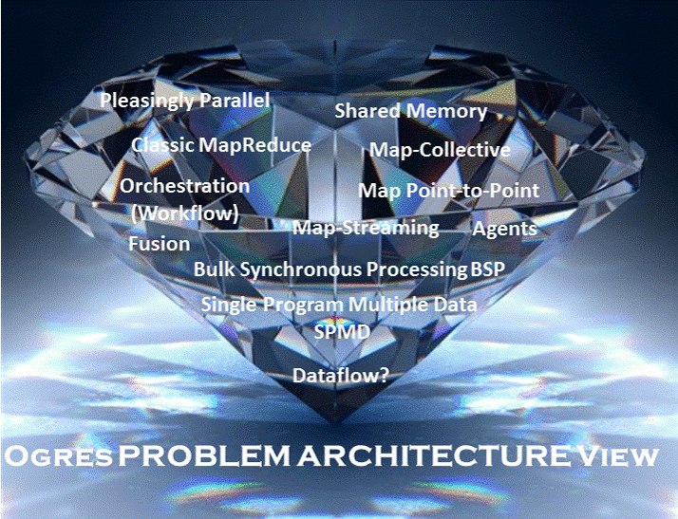

Slide 42
Benchmarks based on Ogres
Analytics

Slide 43
Benchmarks/Mini-apps spanning Facets
Look at NSF SPIDAL Project, NIST 51 use cases, Baru-Rabl review
Catalog facets of benchmarks and choose entries to cover “all facets”
Micro Benchmarks: SPEC, EnhancedDFSIO (HDFS), Terasort, Wordcount, Grep, MPI, Basic Pub-Sub ….
SQL and NoSQL Data systems, Search, Recommenders: TPC (-C to x–HS for Hadoop), BigBench, Yahoo Cloud Serving, Berkeley Big Data, HiBench, BigDataBench, Cloudsuite, Linkbench
  includes MapReduce cases Search, Bayes, Random Forests, Collaborative Filtering
Spatial Query: select from image or earth data
Alignment: Biology as in BLAST
Streaming: Online classifiers, Cluster tweets, Robotics, Industrial Internet of Things, Astronomy; BGBenchmark; choose to cover all 5 subclasses
Pleasingly parallel (Local Analytics): as in initial steps of LHC, Pathology, Bioimaging (differ in type of data analysis)
Global Analytics: Outlier, Clustering, LDA, SVM, Deep Learning, MDS, PageRank, Levenberg-Marquardt, Graph 500 entries
Workflow and Composite (analytics on xSQL) linking above

Slide 44
HPC-ABDS Runtime

Slide 46
There are a lot of Big Data and HPC Software systems in 17 (21) layers
Build on – do not compete with the over 300 HPC-ABDS systems

Slide 47
6 Forms of MapReduce
PP
Local Analytics
MR
Basic Statistics
Iterative
Graph
Streaming
Shared Memory

Slide 48
8 Data Analysis Problem Architectures
1) Pleasingly Parallel PP or “map-only” in MapReduce
  BLAST Analysis; Local Machine Learning
2A) Classic MapReduce MR, Map followed by reduction
  High Energy Physics (HEP) Histograms; Web search; Recommender Engines
2B) Simple version of classic MapReduce MRStat
  Final reduction is just simple statistics
3) Iterative MapReduce MRIter
  Expectation maximization Clustering Linear Algebra, PageRank
4A) Map Point to Point Communication
  Classic MPI; PDE Solvers and Particle Dynamics; Graph processing Graph
4B) GPU (Accelerator) enhanced 4A) – especially for deep learning
5) Map + Streaming + Communication
  Images from Synchrotron sources; Telescopes; Internet of Things IoT
  6) Shared memory allowing parallel threads which are tricky to program but lower latency
  Difficult to parallelize asynchronous parallel Graph Algorithms

Slide 49
Functionality of 21 HPC-ABDS Layers
Message Protocols:
Distributed Coordination:
Security & Privacy:
Monitoring:
IaaS Management from HPC to hypervisors:
DevOps:
Interoperability:
File systems:
Cluster Resource Management:
Data Transport:
A) File management
B) NoSQL
C) SQL
In-memory databases&caches / Object-relational mapping / Extraction Tools
Inter process communication Collectives, point-to-point, publish-subscribe, MPI:
A) Basic Programming model and runtime, SPMD, MapReduce:
B) Streaming:
A) High level Programming:
B) Frameworks
Application and Analytics:
Workflow-Orchestration:
Here are 21 functionalities. (including 11, 14, 15 subparts)
Lets discuss how these are used in particular applications
4 Cross cutting at top
17 in order of layered diagram starting at bottom

Slide 50
Exemplar Software for a Big Data Initiative
Functionality of ABDS and Performance of HPC
Workflow: Apache Crunch, Python or Kepler
Data Analytics: Mahout, R, ImageJ, Scalapack
High level Programming: Hive, Pig
Batch Parallel Programming model: Hadoop, Spark, Giraph, Harp, MPI;
Streaming Programming model: Storm, Kafka or RabbitMQ
In-memory: Memcached
Data Management: Hbase, MongoDB, MySQL
Distributed Coordination: Zookeeper
Cluster Management: Yarn, Slurm
File Systems: HDFS, Object store (Swift),Lustre
DevOps: Cloudmesh, Chef, Puppet, Docker, Cobbler
IaaS: Amazon, Azure, OpenStack, Docker, SR-IOV
Monitoring: Inca, Ganglia, Nagios

Slide 51
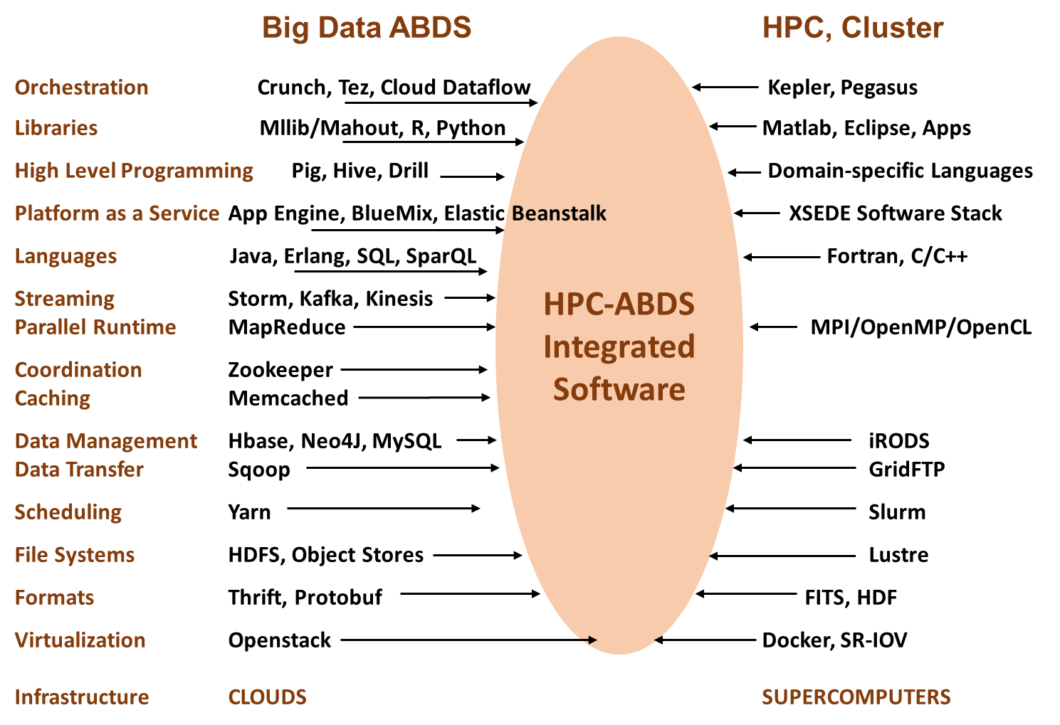
ABDS v. HPC Architecture

Slide 52
HPC-ABDS Stack Summarized I
The HPC-ABDS software is broken up into 21 layers so that one can discuss software systems in reasonable size groups.
  The layers where there is especial opportunity to integrate HPC are colored green in figure.
We note that data systems that we construct from this software can run interoperably on virtualized or non-virtualized environments aimed at key scientific data analysis problems.
Most of ABDS emphasizes scalability but not performance and one of our goals is to produce high performance environments. Here there is clear need for better node performance and support of accelerators like Xeon-Phi and GPU’s.
Figure “ABDS v. HPC Architecture” contrasts modern ABDS and HPC stacks illustrating most of the 21 layers and labelling on left with layer number used in HPC-ABDS Figure.
The omitted layers in architecture figure are Interoperability, DevOps, Monitoring and Security (layers 7, 6, 4, 3) which are all important and clearly applicable to both HPC and ABDS.
We also add an extra layer “language” not discussed in HPC-ABDS Figure.

Slide 53
HPC-ABDS Stack Summarized II
Lower layers where HPC can make a major impact include scheduling layer 9 where Apache technologies like Yarn and Mesos need to be integrated with the sophisticated HPC cluster and HTC approaches.
Storage layer 8 is another important area where HPC distributed and parallel storage environments need to be reconciled with the “data parallel” storage seen in HDFS in many ABDS systems.
However the most important issues are probably at the higher layers with data management(11), communication(13), (high layer or basic) programming(15, 14), analytics (16) and orchestration (17). These are areas where there is rapid commodity/commercial innovation and we discuss them in order below.
Much science data analysis is centered on files (8) but we expect movement to the common commodity approaches of Object stores (8), SQL and NoSQL (11) where latter has a proliferation of systems with different characteristics – especially in the data abstraction that varies over row/column, key-value, graph and documents.
Note recent developments at the programming layer (15A) like Apache Hive and Drill, which offer high-layer access models like SQL implemented on scalable NoSQL data systems.
  Generalize Drill to other views such as “FITS on anything” (astronomy”) or “Excel on Anything” or “Matplotlib on anything”

Slide 54
HPC-ABDS Stack Summarized III
The communication layer (13) includes Publish-subscribe technology used in many approaches to streaming data as well the HPC communication technologies (MPI) which are much faster than most default Apache approaches but can be added to some systems like Hadoop whose modern version is modular and allows plug-ins for HPC stalwarts like MPI and sophisticated load balancers.
  Need to extend to Giraph and include load-balancing
The programming layer (14) includes both the classic batch processing typified by Hadoop (14A) and streaming by Storm (14B).
Investigating Map-Streaming programming models seems important. ABDS Streaming is nice but doesn’t support real-time or parallel processing.
The programming offerings (14) differ in approaches to data model (key-value, array, pixel, bags, graph), fault tolerance and communication. The trade-offs here have major performance issues.
  Too many ~identical programming systems!
  Recent survey of graph databases from Wikidata with 49 features; chose BlazeGraph
You also see systems like Apache Pig (15A) offering data parallel interfaces.
At the high layer we see both programming models (15A) and Platform (15B) as a Service toolkits where the Google App Engine is well known but there are many entries include the recent BlueMix from IBM.

Slide 55
HPC-ABDS Stack Summarized IV
The orchestration or workflow layer 17 has seen an explosion of activity in the ABDS space although with systems like Pegasus, Taverna, Kepler, Swift and IPython, HPC has substantial experience.
There are commodity orchestration dataflow systems like Tez and projects like Apache Crunch with a data parallel emphasis based on ideas from Google FlumeJava.
  A modern version of the latter presumably underlies Google’s recently announced Cloud Dataflow that unifies support of multiple batch and streaming components; a capability that we expect to become common.
The implementation of the analytics layer 16 depends on details of orchestration and especially programming layers but probably most important are quality parallel algorithms.
  As many machine learning algorithms involve linear algebra, HPC expertise is directly applicable as is fundamental mathematics needed to develop O(NlogN) algorithms for analytics that are naively O(N²).
  Streaming (online) algorithms are an important new area of research

Slide 56
DevOps, Platforms and Orchestration
DevOps Level 6 includes several automation capabilities including systems like OpenStack Heat, Juju and Kubernetes to build virtual clusters and a standard TOSCA that has several good studies from Stuttgart
  TOSCA specifies system to be instantiated and managed
TOSCA is closely related to workflow (orchestration) standard BPEL
  BPEL specifies system to be executed
In Level 17, should evaluate new orchestration systems from ABDS such as NiFi or Crunch and toolkits like Cascading
  Ensure streaming and batch supported
Level 15B has application hosting environments such as GAE, Heroku, Dokku (for Docker), Jelastic
  These platforms bring together a focused set of tools to address a finite but broad application area
Should look at these 3 levels to build HPC and Streaming systems

Slide 57
Analytics and the DIKW Pipeline
Data goes through a pipeline (Big Data is also Big Wisdom etc.)
Raw data → Data → Information → Knowledge → Wisdom → Decisions
Each link enabled by a filter which is “business logic” or “analytics”
  All filters are Analytics
However I am most interested in filters that involve “sophisticated analytics” which require non trivial parallel algorithms
  Improve state of art in both algorithm quality and (parallel) performance
See Apache Crunch or Google Cloud Dataflow supporting pipelined analytics
  And Pegasus, Taverna, Kepler from Grid community
Data
Information
Analytics
Information
Knowledge
More Analytics

Slide 58
Cloud DIKW based on HPC-ABDS to integrate streaming and batch Big Data
System Orchestration / Dataflow / Workflow
Archival Storage – NOSQL like Hbase
Batch Processing (Iterative MapReduce)
Analytics
Raw Data
Data
Information
Knowledge
Wisdom
Decisions
Analytics
Streaming Processing (Iterative MapReduce)
Storm
Storm
Storm
Storm
Storm
Storm
Pub-Sub
Internet of Things

Slide 59
5 Classes of Streaming Applications
Set of independent small events where precise time sequencing unimportant.
  e.g. Independent search requests or tweets from users
Time series of connected small events where time ordering important.
  e.g. Streaming audio or video; robot monitoring
Set of independent large events where each event needs parallel processing with time sequencing not critical
  e.g. Processing images from telescopes or light sources with material or biological sciences.
Set of connected large events where each event needs parallel processing with time sequencing critical.
  e.g. Processing high resolution monitoring (including video) information from robots (self-driving cars) with real time response needed
Stream of connected small or large events that need to be integrated in a complex way.
  e.g. Tweets or other online data where we are using them to update old and find new clusters rather just classifying tweets based on previous clusters i.e. where we update model as well as using it to classify event.

Slide 60
Science Streaming Examples
Streaming Application |  | Details
1 | Data Assimilation | Integrate data into simulations to enhance quality. Distributed Data sources
2 | Analysis of Simulation Results | Climate, Fusion, Molecular Dynamics, Materials. Typically local or in-situ data
3 | Steering Experiments | Control of simulation or Experiment. Data could be local or distributed
4 | Astronomy, Light Sources | Outlier event detection; classification; build model, accumulate data. Distributed Data sources
5 | Environmental Sensors, Smart Grid, Transportation systems | Environmental sensor data or Internet of Things; many small events. Distributed Data sources.
6 | Robotics | Cloud control of Robots including cars. Need processing near robot when decision time < ~1 second
7 | Network Science: Online Classification | Build model and classify with online (streaming) algorithms

Slide 61
IoT Activities at Indiana University
Parallel Clustering for Tweets: Judy Qiu, Emilio Ferrara, Xiaoming Gao
Parallel Cloud Control for Robots: Supun Kamburugamuve, Hengjing He, David Crandall

Slide 62
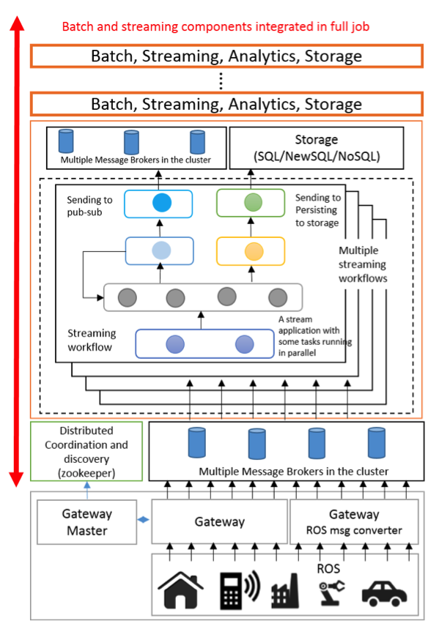
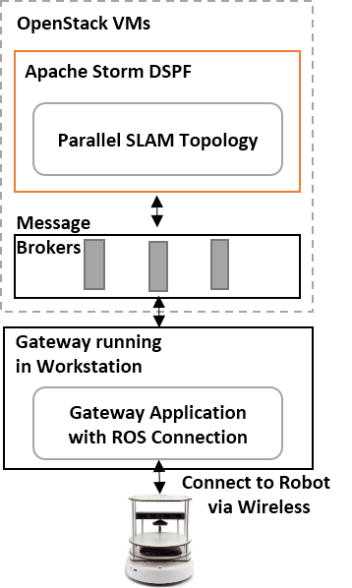
IoTCloud uses Zookeeper, Storm, Hbase, RabbitMQ for robot cloud control
Focus on high performance (parallel) control functions
Guaranteed real time response
Parallel
simultaneous localization and mapping
(SLAM) in the cloud

Slide 63
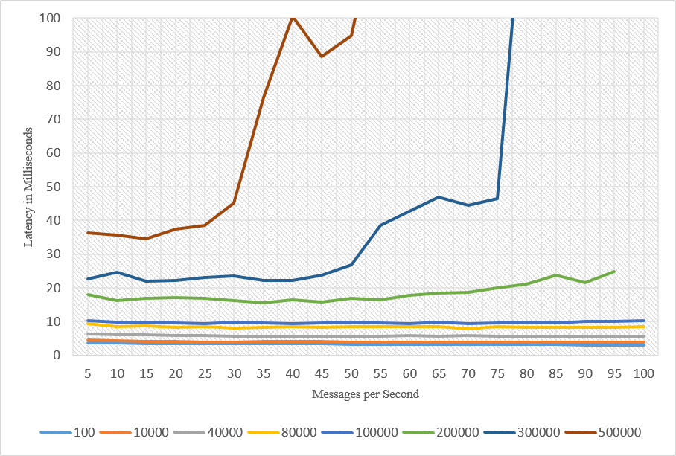
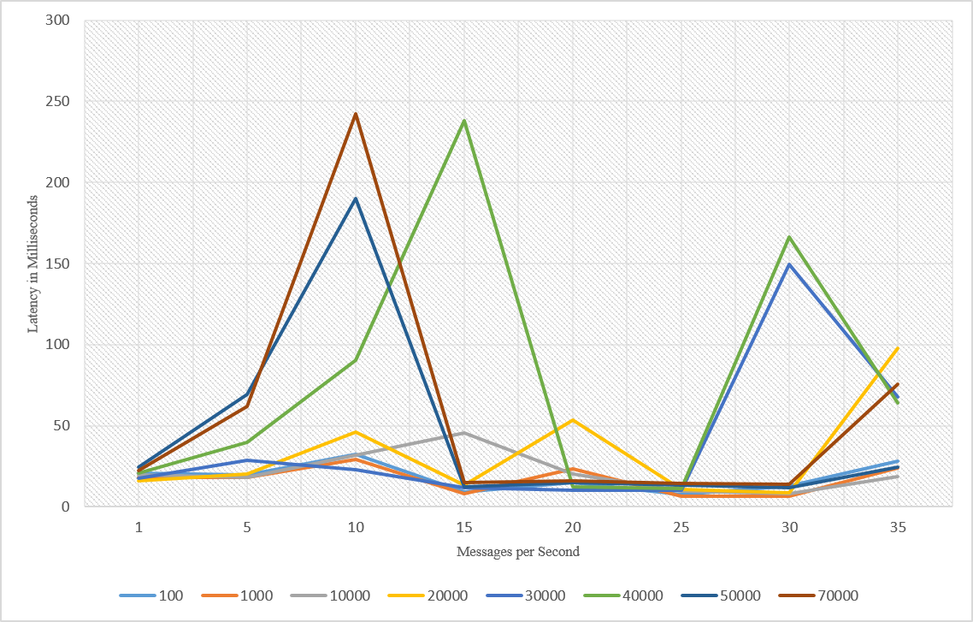
Latency with Kafka
Note change in scales for latency and message size
Latency with RabbitMQ
Different Message sizes in bytes

Slide 64
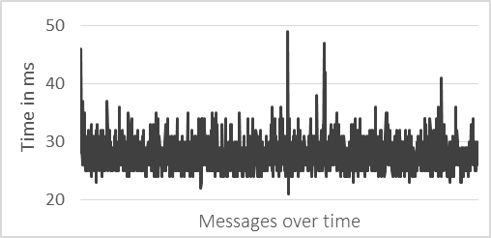
Robot Latency Kafka & RabbitMQ
RabbitMQ versus Kafka
Kinect with
Turtlebot and RabbitMQ

Slide 65
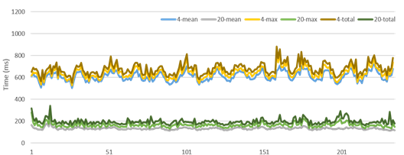
Parallel SLAM Simultaneous Localization and Mapping by Particle Filtering

Slide 66
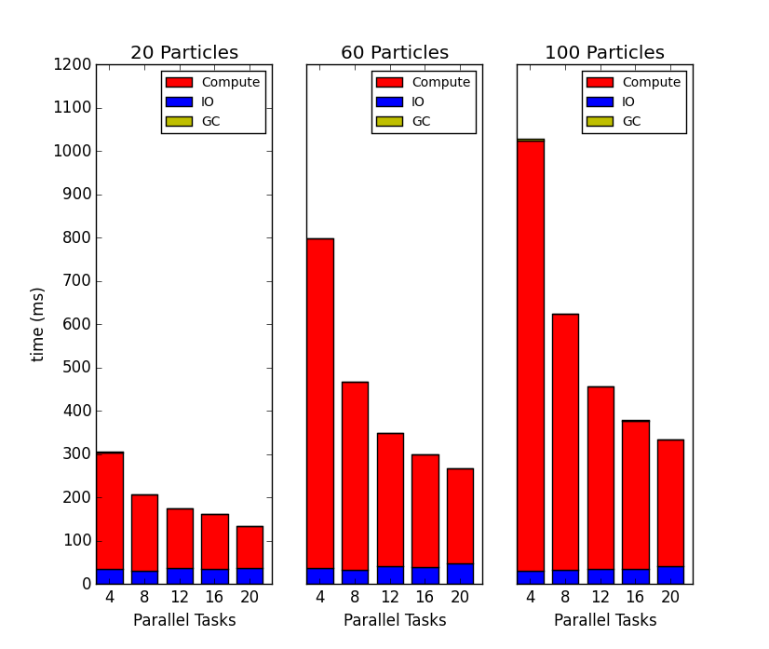
Parallel Overheads SLAM Simultaneous Localization and Mapping: I/O and Garbage Collection

Slide 67
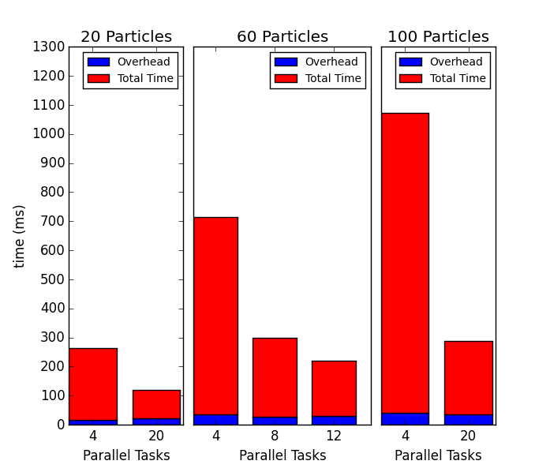
Parallel Overheads SLAM Simultaneous Localization and Mapping: Load Imbalance
Load Imbalance overhead

Slide 68
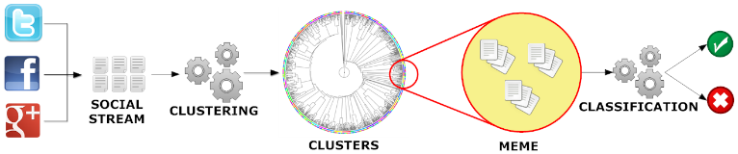
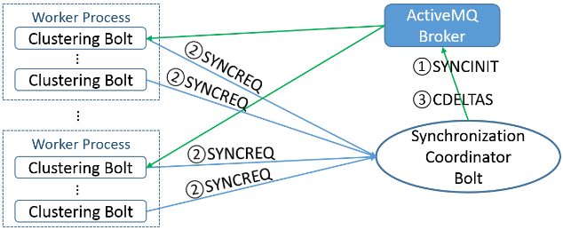
Parallel Tweet Clustering with Storm
Judy Qiu, Emilio Ferrara and Xiaoming Gao
Storm Bolts coordinated by ActiveMQ to synchronize parallel cluster center updates – add loops to Storm
2 million streaming tweets processed in 40 minutes; 35,000 clusters
Sequential
Parallel – eventually 10,000 bolts

Slide 69
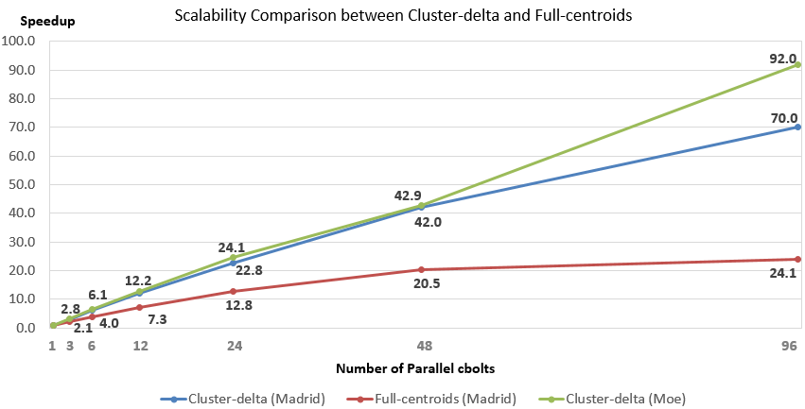
Parallel Tweet Clustering with Storm
Speedup on up to 96 bolts on two clusters Moe and Madrid
Red curve is old algorithm;
green and blue new algorithm
Full Twitter – 1000 way parallelism
Full Everything – 10,000 way parallelism

Slide 70
Data Science Curriculum

Slide 71
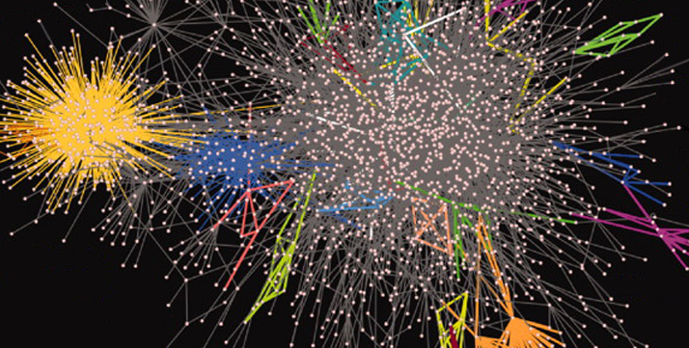
SOIC Data Science Program
Cross Disciplinary Faculty – 31 in School of Informatics and Computing, a few in statistics and expanding across campus
Affordable online and traditional residential curricula or mix thereof
Masters, Certificate, PhD Minor in place; Full PhD being studied
http://www.soic.indiana.edu/graduate/degrees/data-science/index.html

Slide 72
IU Data Science Program
Program managed by cross disciplinary Faculty in Data Science. Currently Statistics and Informatics and Computing School but will expand scope to full campus
A purely online 4-course Certificate in Data Science has been running since January 2014
  Fall 2015 expect ~100 students enrolled taking 1-2 classes per semester/year
  Most students are professionals taking courses in “free time”
A campus wide Ph.D. Minor in Data Science has been approved.
Exploring PhD in Data Science
Courses labelled as “Decision-maker” and “Technical” paths where McKinsey says an order of magnitude more (1.5 million by 2018) unmet job openings in Decision-maker track

Slide 73

McKinsey Institute on Big Data Jobs
http://www.mckinsey.com/mgi/publications/big_data/index.asp
There will be a shortage of talent necessary for organizations to take advantage of big data. By 2018, the United States alone could face a shortage of 140,000 to 190,000 people with deep analytical skills as well as 1.5 million managers and analysts with the know-how to use the analysis of big data to make effective decisions.
IU Data Science Decision Maker Path aimed at 1.5 million jobs. Technical Path covers the 140,000 to 190,000

Slide 74
IU Data Science Program: Masters
Masters Fully approved by University and State October 14 2014 and started January 2015
Blended online and residential (any combination)
  Online offered at in-state rates (~$1100 per course)
Informatics, Computer Science, Information and Library Science in School of Informatics and Computing and the Department of Statistics, College of Arts and Science, IUB
30 credits (10 conventional courses)
Basic (general) Masters degree plus tracks
  Currently only track is “Computational and Analytic Data Science ”
  Other tracks expected such as Biomedical Data Science
Fall 2015, over 200 applicants to program; cap enrollment

Slide 75
Some Online Data Science Classes
Big Data Applications & Analytics
  ~40 hours of video mainly discussing applications (The X in X-Informatics or X-Analytics) in context of big data and clouds https://bigdatacourse.appspot.com/course
Big Data Open Source Software and Projects http://bigdataopensourceprojects.soic.indiana.edu/
  ~27 Hours of video discussing HPC-ABDS and use on FutureSystems for Big Data software
Divided into sections (coherent topics), units (~lectures) and lessons (5-20 minutes) where student is meant to stay awake

Slide 76
Big Data Applications & Analytics Topics
1 Unit: Organizational Introduction
1 Unit: Motivation: Big Data and the Cloud; Centerpieces of the Future Economy
3 Units: Pedagogical Introduction: What is Big Data, Data Analytics and X-Informatics
SideMOOC: Python for Big Data Applications and Analytics: NumPy, SciPy, MatPlotlib
SideMOOC: Using FutureSystems for Java and Python
4 Units: X-Informatics with X= LHC Analysis and Discovery of Higgs particle
  Integrated Technology: Explore Events; histograms and models; basic statistics (Python and some in Java)
3 Units on a Big Data Use Cases Survey
SideMOOC: Using Plotviz Software for Displaying Point Distributions in 3D
3 Units: X-Informatics with X= e-Commerce and Lifestyle
Technology (Python or Java): Recommender Systems - K-Nearest Neighbors
Technology: Clustering and heuristic methods
1 Unit: Parallel Computing Overview and familiar examples
4 Units: Cloud Computing Technology for Big Data Applications & Analytics
2 Units: X-Informatics with X = Web Search and Text Mining and their technologies
Technology for Big Data Applications & Analytics : Kmeans (Python/Java)
Technology for Big Data Applications & Analytics: MapReduce
Technology for Big Data Applications & Analytics : Kmeans and MapReduce Parallelism (Python/Java)
Technology for Big Data Applications & Analytics : PageRank (Python/Java)
3 Units: X-Informatics with X = Sports
1 Unit: X-Informatics with X = Health
1 Unit: X-Informatics with X = Internet of Things & Sensors
1 Unit: X-Informatics with X = Radar for Remote Sensing
Red = Software

Slide 77
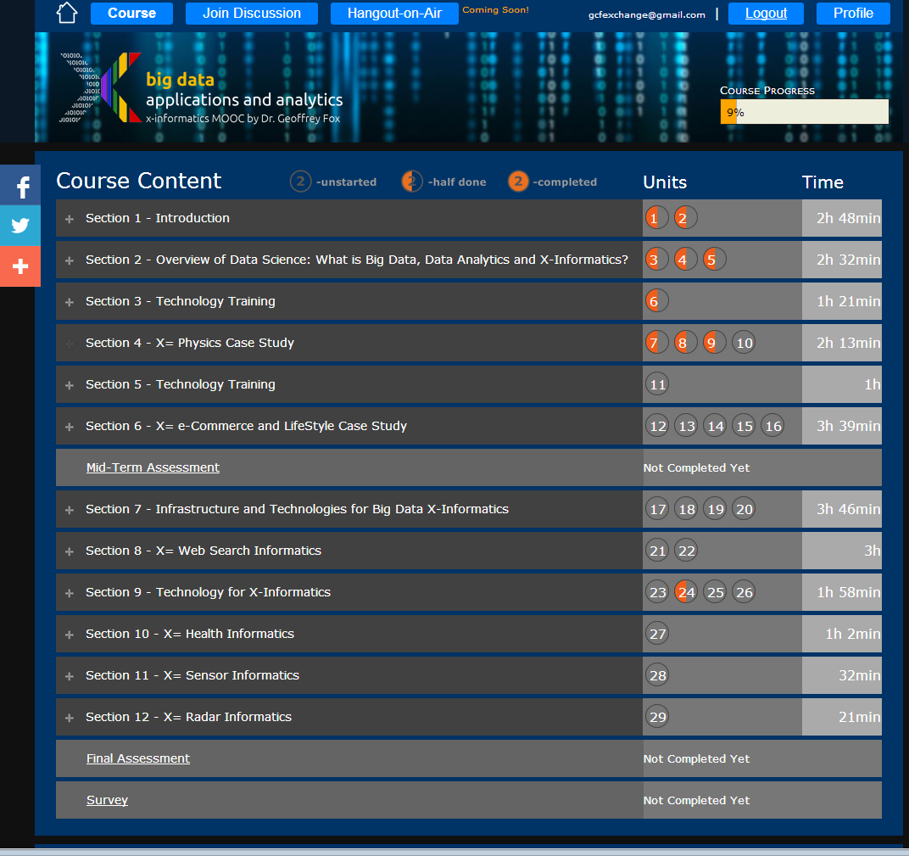
Example
Google
Course Builder MOOC
4 levels
Course
Section (12)
Units(29)
Lessons(~150)
Units are roughly traditional lecture
Lessons are ~10 minute segments
http://x-informatics.appspot.com/course

Slide 78
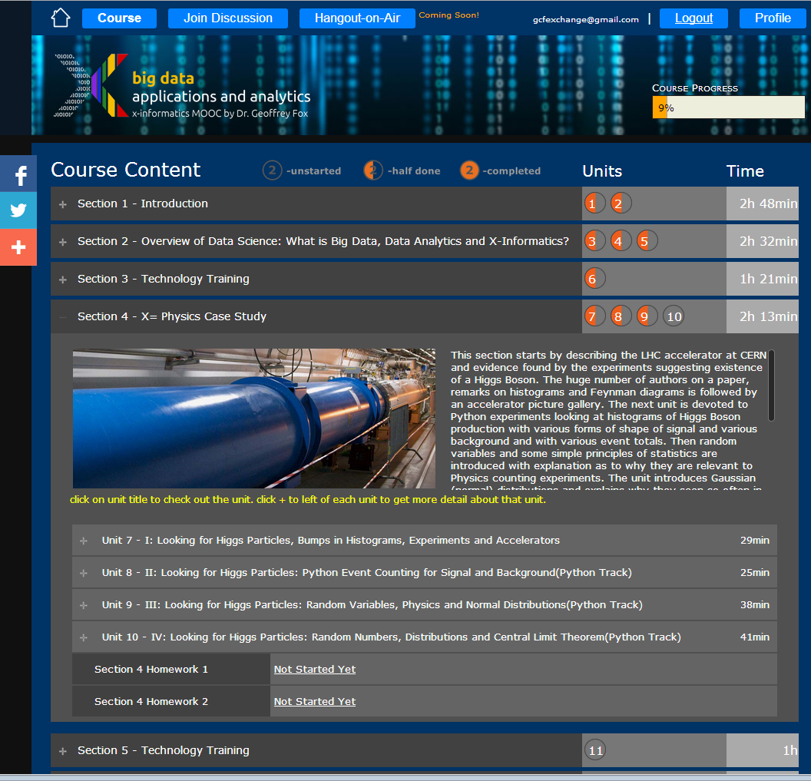
Example
Google
Course Builder
MOOC
The Physics Section expands to 4 units and 2 Homeworks
Unit 9 expands to 5 lessons
Lessons played on YouTube
“talking head video + PowerPoint”
http://x-informatics.appspot.com/course

Slide 79
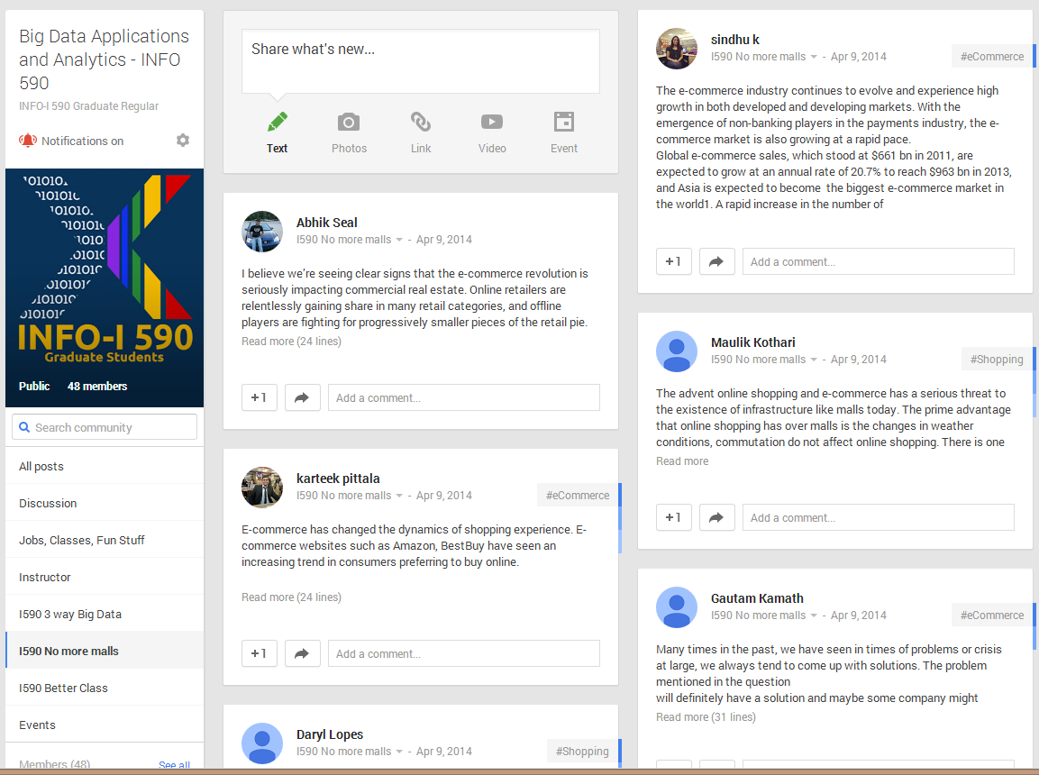
The community group for one of classes and one forum (“No more malls”)

Slide 80
Big Data & Open Source Software Projects Overview
This course studies DevOps and software used in many commercial activities to study Big Data.
The course of this talk!!
The backdrop for course is the ~300 software subsystems HPC-ABDS (High Performance Computing enhanced - Apache Big Data Stack) illustrated at http://hpc-abds.org/kaleidoscope/
The cloud computing architecture underlying ABDS and contrast of this with HPC.
The main activity of the course is building a significant project using multiple HPC-ABDS subsystems combined with user code and data.
Projects will be suggested or students can chose their own
http://cloudmesh.github.io/introduction_to_cloud_computing/class/lesson/projects.html
For more information, see: http://bigdataopensourceprojects.soic.indiana.edu/ and
http://cloudmesh.github.io/introduction_to_cloud_computing/class/bdossp_sp15/week_plan.html

Slide 81
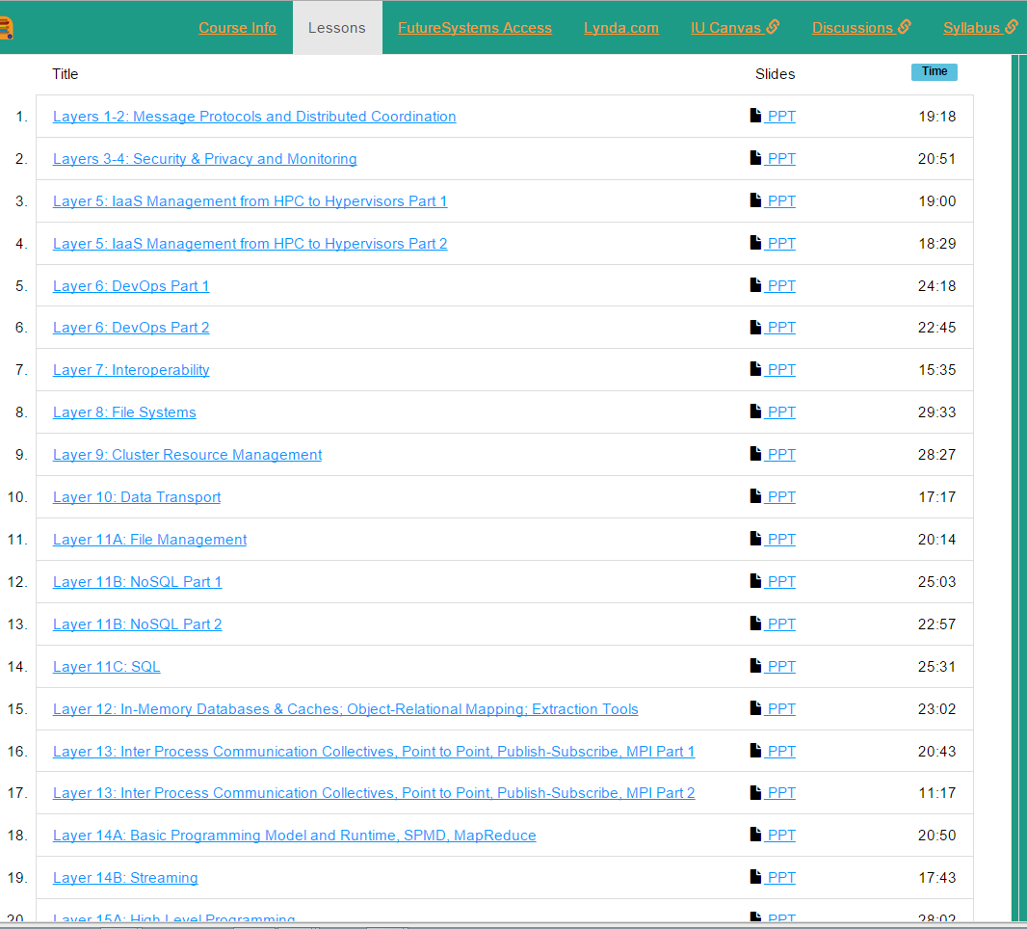

Slide 82
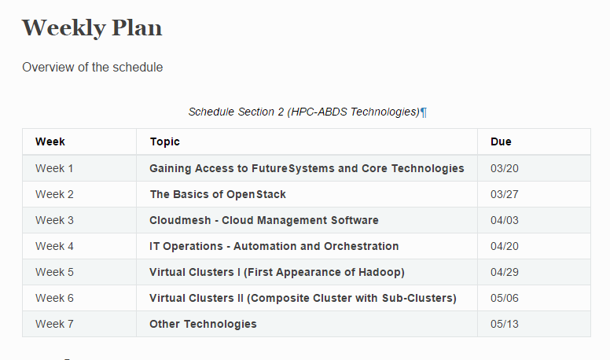

Slide 83
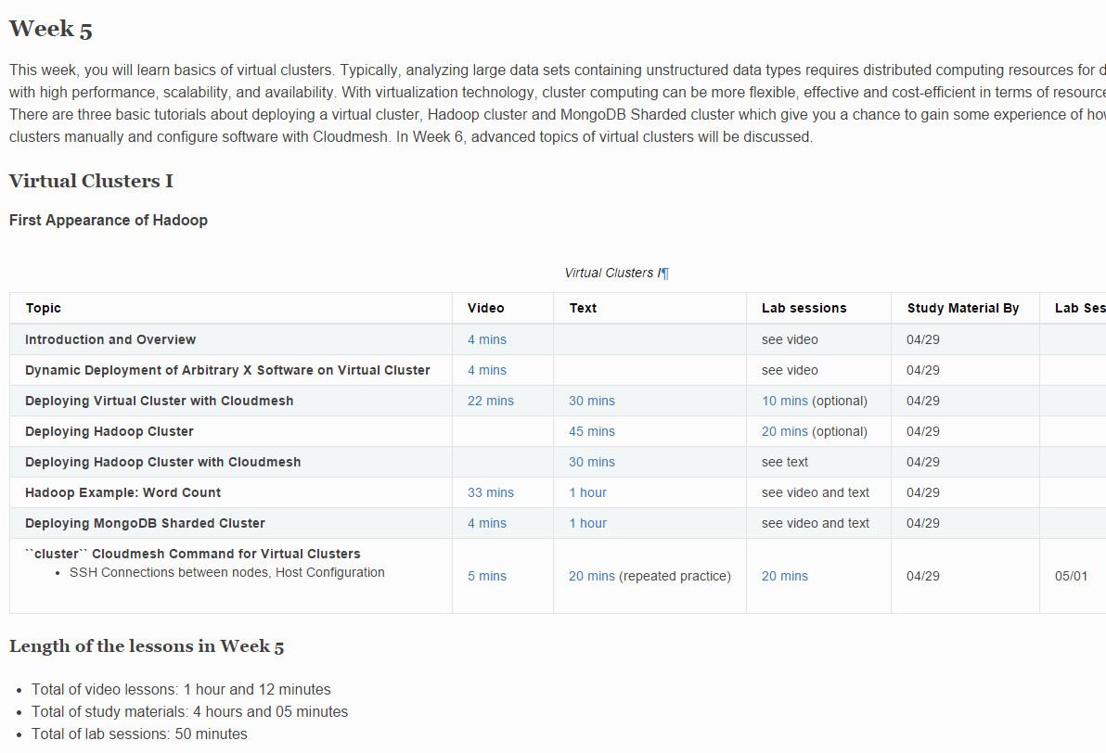

Slide 84
Potpourri of Online Technologies
Canvas (Indiana University Default): Best for interface with IU grading and records
Google Course Builder: Best for management and integration of components
Ad hoc web pages: alternative easy to build integration
Microsoft Mix: Simplest faculty preparation interface
Adobe Presenter/Camtasia: More powerful video preparation that support subtitles but not clearly needed
Google Community: Good social interaction support
YouTube: Best user interface for videos
Hangout: Best for instructor-students online interactions (one instructor to 9 students with live feed). Hangout on air mixes live and streaming (30 second delay from archived YouTube) and more participants
OpenEdX possible future of Google Course Builder and getting easier to use

Slide 85
Lessons / Insights
Proposed classification of Big Data applications with features generalized as facets and kernels for analytics
Integrate (don’t compete) HPC with “Commodity Big data” (Google to Amazon to Enterprise/Startup Data Analytics)
  i.e. improve Mahout; don’t compete with it
  Use Hadoop plug-ins rather than replacing Hadoop
Enhanced Apache Big Data Stack HPC-ABDS has over 300 members with HPC opportunities at Resource management, Storage/Data, Streaming, Programming, monitoring, workflow layers.

