Slide 1
Collective Collaborative Tagging System
Jong Y. Choi, Joshua Rosen, Siddharth Maini, Marlon E. Pierce, and Geoffrey C. Fox
Community Grids Laboratory
Indiana University

Slide 2
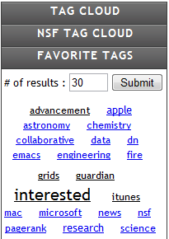
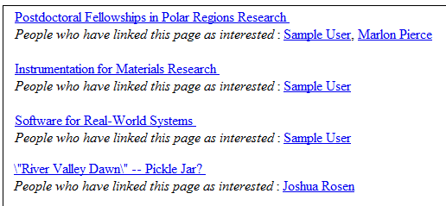
People-Powered Knowledge
Social web contents are increasing
Blogs, wikis, ratings, reviews, social tags, …
Help to utilize power of people’s knowledge
Collaborative Tagging
Social bookmarks with metadata annotated
Connotea, Delicious, Flickr, MSI-CIEC
Pros and cons
High-quality classifier by using human annotation
But lack of control or authority

Slide 3
Motivations
Distributed and fragmented knowledge ➔ Need an unified data set ➔ More accurate and richer information
No flexibility in choosing different IR algorithms ➔ Need a playground to do experiment with various IR techniques ➔ Help to discover hidden knowledge
User-friendly Web2.0 style web application

Slide 4
Proposed System
Collective Collaborative Tagging (CCT) System
CCT System
Data Importer
RDF
RSS
Atom
HTML
Data Coordinator
Distributed Collaborative Tagging Sites
Populate tags
Repository
Query with various options
User Service
Search Result

Slide 5
Service Types and Algorithms
Type
Service
Description
Algorithm
I
Searching
Given input tags, returning the most relevant X (X = URLs, tags, or users)
LSI, FolkRank, Tag Graph
II
Recommendation
With/without input tags, returning undiscovered X
LSI, FolkRank, Tag Graph
III
Clustering
Community discovering. Finding a group or a community with similar interests
K-Means, DA clustering, Pairwise DA
IV
Trend detection
Analysis the tagging activities in time-series manner and detect abnormality
Time Series Analsysis

Slide 6
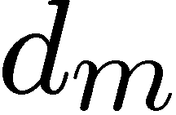
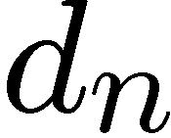
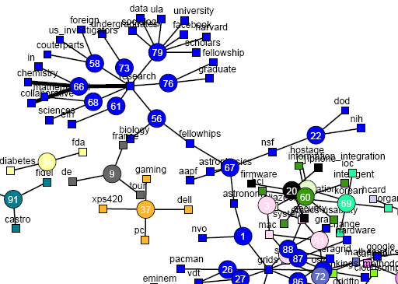
Two Models
Vector-space model or bag-of-words model
q-dimension vector d_{i} = (t₁, t₂, … , t_{q})
Easy and convenient
Graph model
Building a tag graph
Emphasis on relationship

Slide 7
Vector-space Vs. Graph
Vector-space Model
Graph Model
Represen-tation
-. q-dimensional vector
-. q-by-n matrix
-. G(V, E)
-. V = {URL, tags, users}
Dis-similarity
-. Distances, cosine, …
-. O(N²) complexity
-. Paths, hops, connectivity, …
-. O(N³) complexity
Algorithm
-. Latent Semantic Indexing
-. Dimension reduction schemes
-. PCA
-. PageRank, FolkRank, …
-. Pairwise clustering
-. MDS

Slide 8
Latent Semantic Indexing
Dimension reduction from high q to low d(q À d)
Removing noisy terms
Extracting latent concepts
Using SVD to get optimized d-dim. matrix
Recall
Precision

Slide 9
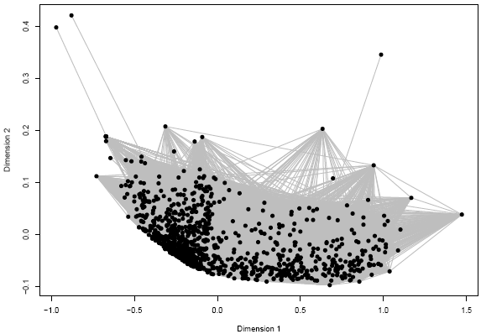
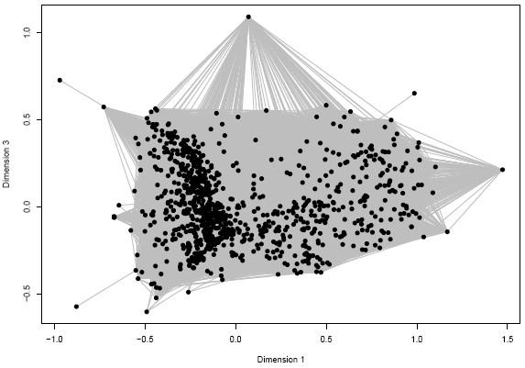
Pairwise Dissimilarity
Pairwise distance (or dissimilarity) matrix
N-by-N matrix and each element represents a degree of distance or dissimilarity
Used as an input
Multi-Dimensional Scaling (MDS) : to recover dimension information

Slide 10
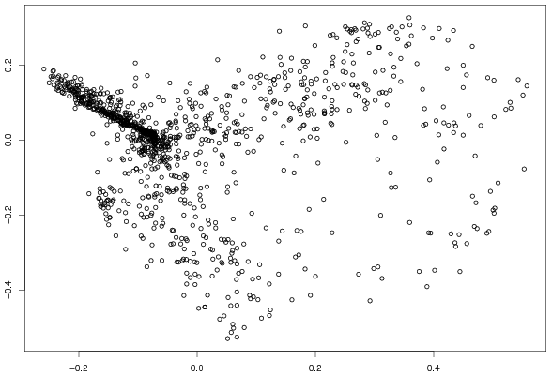
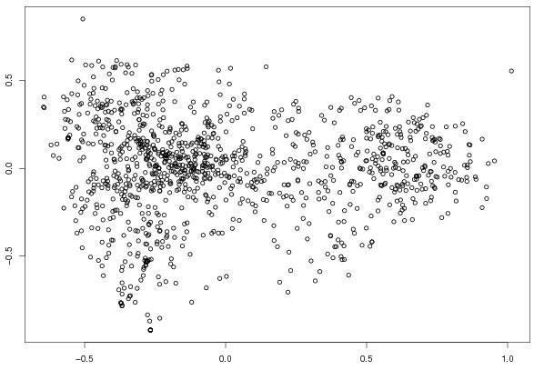
Pairwise Dissimilarity
Pairwise clustering
Input from vector-based model vs. graph model
How to avoid local minima/maxima?
Vector-based model
Graph model

Slide 11
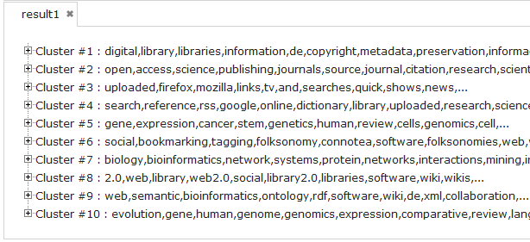
Deterministic Annealing Clustering
Deterministically avoid local minima
Tracing global solution by changing level of energy
Analogy to physical annealing process (High → Low)

Slide 12
More Machine Learning Algorithms
Classification
To response more quickly to user’s requests
Training data based on user’s input and answering questions based on the training results
Artificial Neural Network, Support Vector Machine,…
Trend Detection
Time-series analysis

Slide 13
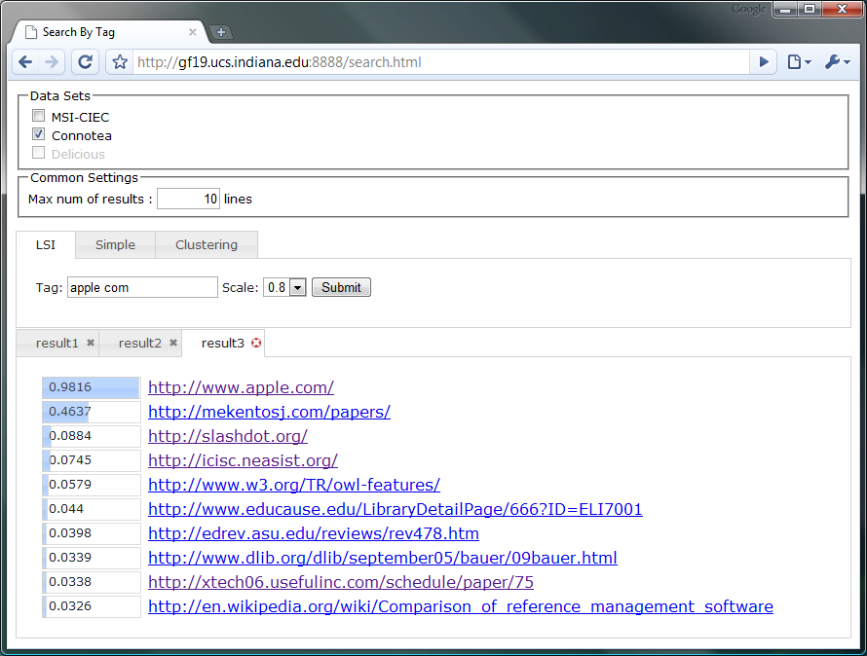
Ongoing Development
Different Data Sources
Various IR algorithms
Flexible Options
Result Comparison

Slide 14
Thank you!!
Questions?
jychoi@cs.indiana.edu

