Slide 1
Technology Futures and Lots of Sensor Grids
Community Grids Laboratory
October 1 2008
Geoffrey Fox
Community Grids Laboratory, School of informatics
Indiana University
gcf@indiana.edu, http://www.infomall.org
1
Notes:
1

Slide 2
Gartner 2006 Technology Hype Curve

Slide 3
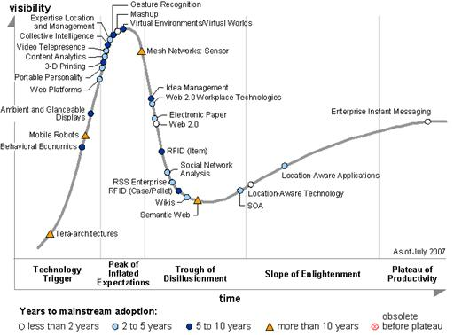
Gartner 2007 Technology Hype Curve
No Grids!
Sensor Nets
Web 2.0

Slide 4
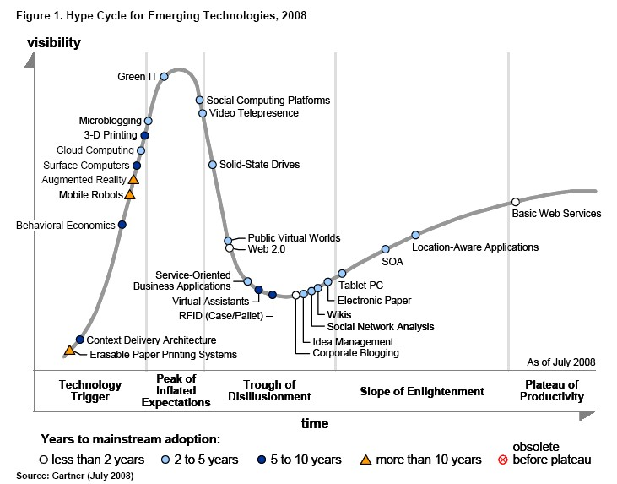
Gartner 2008 Technology Hype Curve
Clouds, Microblogs and Green IT appear
Basic Web Services, Wikis and SOA
becoming mainstream

Slide 5
QuakeSpace
QuakeSim built using Web 2.0 and Cloud Technology
Applications, Sensors, Data Repositories as Services
Computing via Clouds
Portals as Gadgets
Metadata by tagging
Data sharing as in YouTube
Alerts by RSS
Virtual Organizations via Social Networking
Workflow by Mashups
Performance by multicore
Interfaces via iPhone, Android etc.

Slide 6
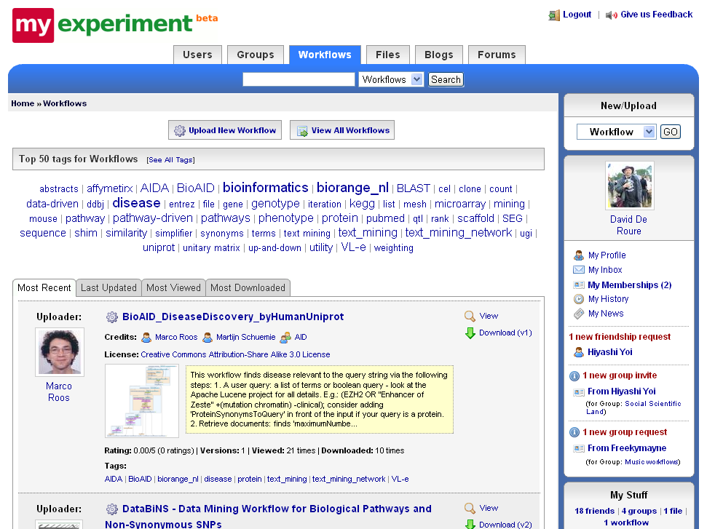

Slide 7
Enterprise Approach | Web 2.0 Approach
JSR 168 Portlets | Gadgets, Widgets
Server-side integration and processing | AJAX, client-side integration and processing, JavaScript
SOAP | RSS, Atom, JSON
WSDL | REST (GET, PUT, DELETE, POST)
Portlet Containers | Open Social Containers (Orkut, LinkedIn, Shindig); Facebook; StartPages
User Centric Gateways | Social Networking Portals
Workflow managers (Taverna, Kepler, etc) | Mash-ups
Grid computing: Globus, condor, etc | Cloud computing: Amazon WS Suite, Xen Virtualization

Slide 8
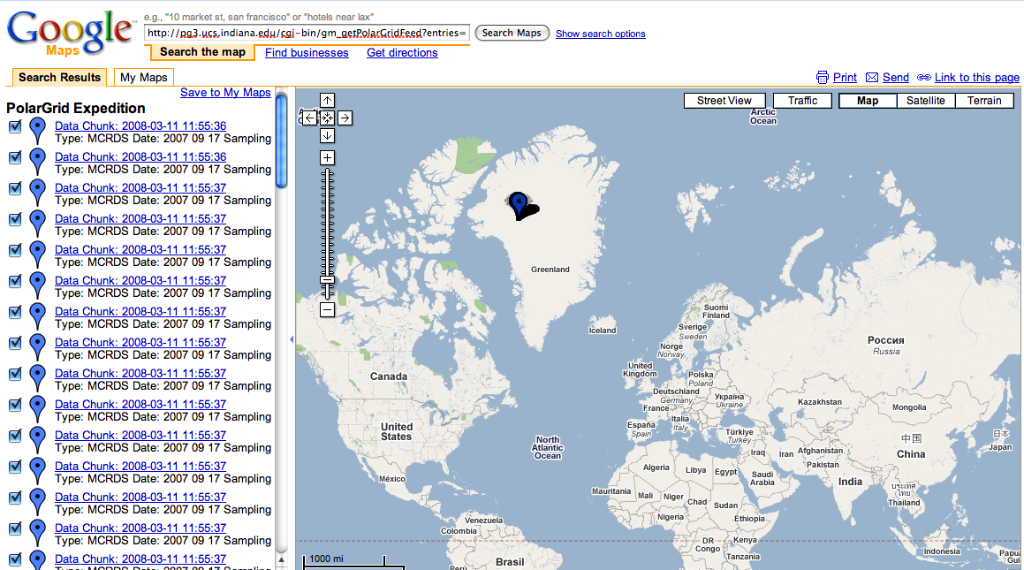
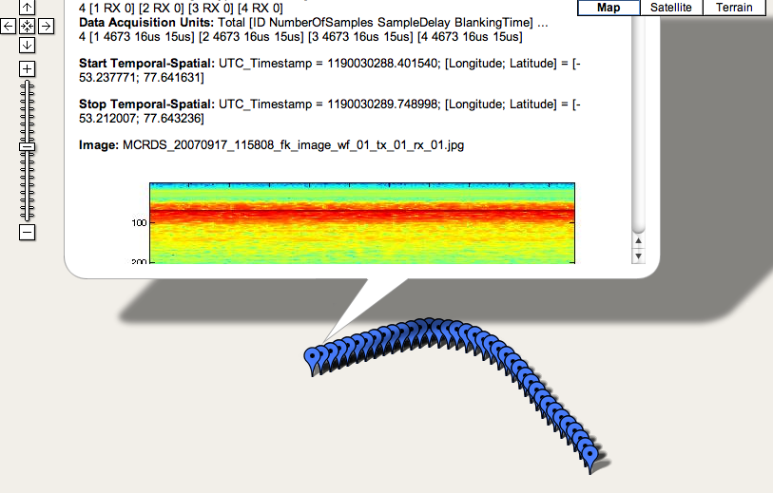
Google Maps and GeoRSS

Slide 9
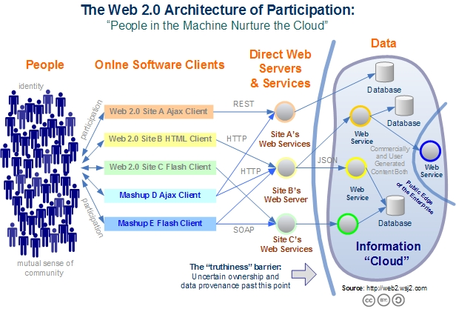
Web 2.0 Systems like Grids have Portals, Services, Resources
Captures the incredible development of interactive Web sites enabling people to create and collaborate

Slide 10
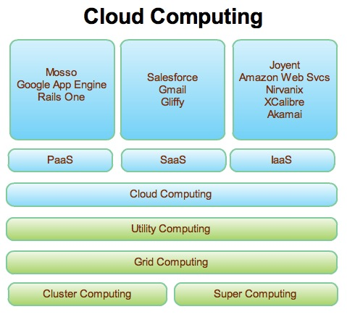
Web 2.0 and Clouds
Grids are less popular but most of what we did is reusable
Clouds are designed heterogeneous (for functionality) scalable distributed systems whereas Grids integrate a priori heterogeneous (for politics) systems
Clouds should be easier to use,
cheaper, faster and scale to larger
sizes than Grids
Grids assume you can’t design
system but rather must accept
results of N independent
supercomputer funding calls
SaaS: Software as a Service
IaaS: Infrastructure as a Service
or HaaS: Hardware as a Service
PaaS: Platform as a Service
delivers SaaS on IaaS

Slide 11
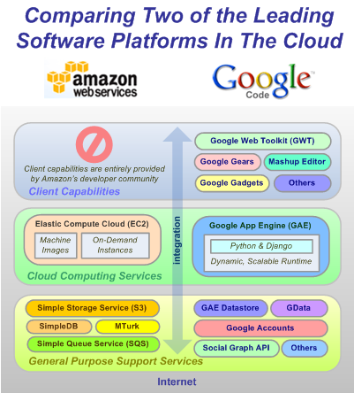
The Big Players!
Amazon and Google
IBM, Dell, Microsoft, Sun ….
are not far behind

Slide 12

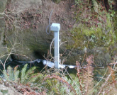
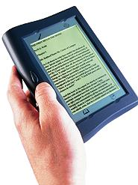





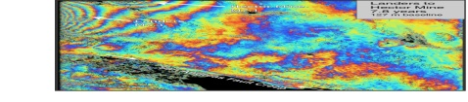
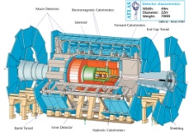
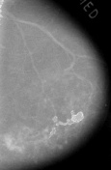

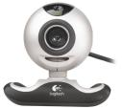

Information and Cyberinfrastructure
Raw Data → Data → Information → Knowledge → Wisdom → Decisions
Another
Grid
Another
Grid
SS
SS
SS
SS
SS
SS
fs
fs
Discovery
Cloud
Filter
Service
Portal
Filter
Cloud
fs
fs
SS
fs
fs
Filter
Cloud
Inter-Service Messages
Another
Service
fs
fs
SS
Filter
Cloud
fs
Filter
Service
fs
fs
fs
SS
fs
fs
fs
Filter
Service
fs
Discovery
Cloud
fs
fs
fs
fs
SS
Traditional Grid with exposed services
Filter
Cloud
fs
Filter
Service
fs
Filter
Cloud
Filter
Cloud
SS
fs
fs
Another
Grid
SS
SS
SS
SS
SS
SS
Sensor or Data
Interchange
Service
SS
SS
SS
SS
SS
SS
Compute
Cloud
Storage
Cloud
Database

Slide 13
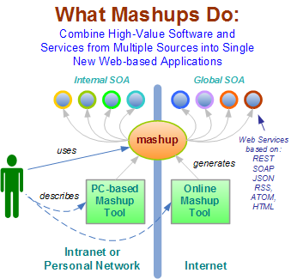
Mashups v Workflow?
Mashup Tools are reviewed at http://blogs.zdnet.com/Hinchcliffe/?p=63
Workflow Tools are reviewed by Gannon and Fox http://grids.ucs.indiana.edu/ptliupages/publications/Workflow-overview.pdf
Both include scripting in PHP, Python, ssh etc. as both implement distributed programming at level of services
Mashups use all types of service interfaces and perhaps do not have the potential robustness (security) of Grid service approach
Mashups typically “pure” HTTP (REST)
13
Notes:
13

Slide 14
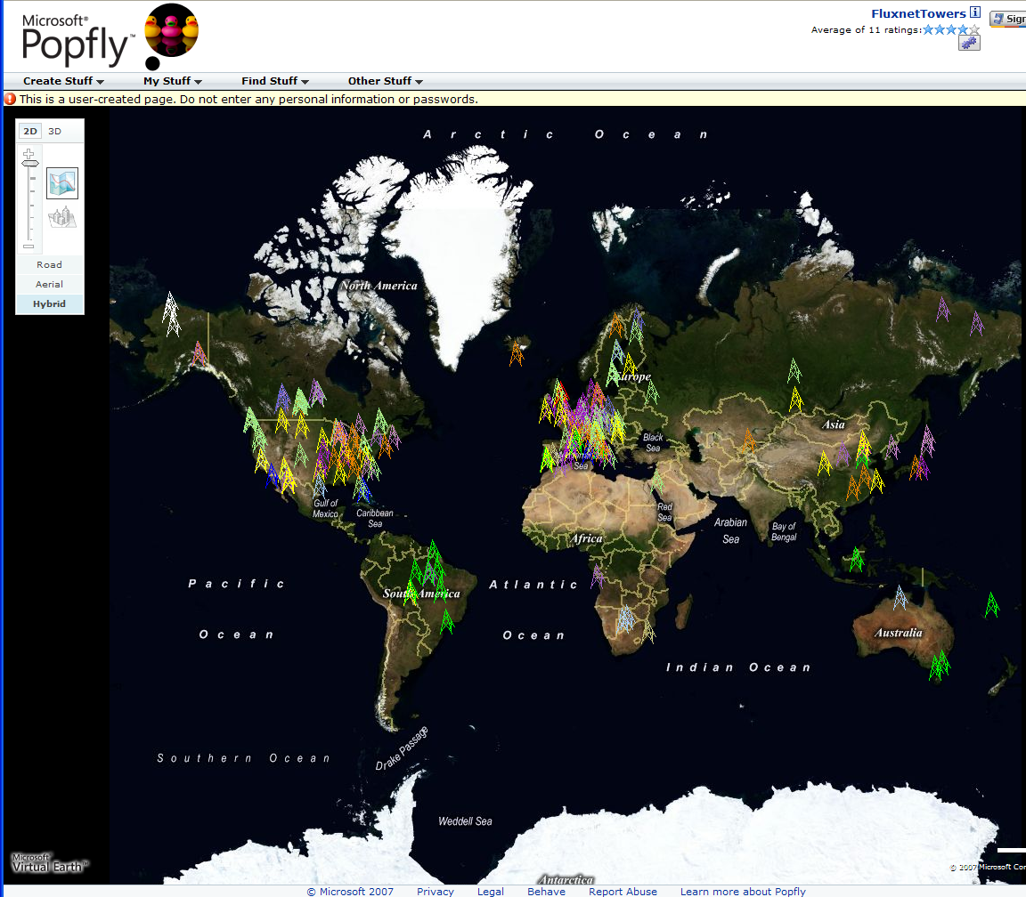
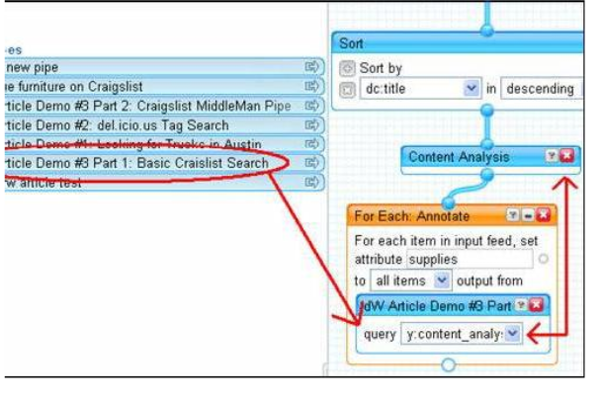
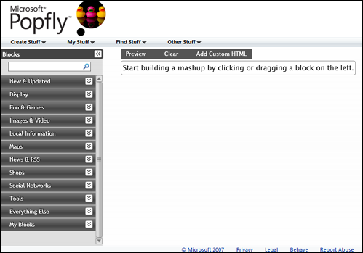
Major Companies entering mashup area
Web 2.0 Mashups (by definition the largest market) are likely to drive composition tools for Grid and web
Recently we see Mashup tools like Yahoo Pipes and Microsoft Popfly which have familiar graphical interfaces
Currently only simple examples but tools could become powerful
Yahoo Pipes

Slide 15
Core (eScience) Cloud Architecture
Deploy VM
IAAS
PAAS
Build VO
Build Portal
Gadgets
Open Social
Ringside
Move Service
(from PC or internet
to Cloud)
Classic Compute File Database
on a cloud
Build Cloud Application
Ruby on Rails
Django(GAI)
Workflow
VM
VM
VM
VM
VM
VM
VM
VM
EC2, S3, SimpleDB
CloudDB
Bigtable
GFS (Hadoop)
? Lustre GPFS
(low level ||)
MPI CCR
Linux Clusters
? Windows Cluster
MapReduce
Taverna
BPEL
F#
DSS
Windows Workflow
DRYAD
Security
Model
VOMS
“UNIX”
Shib
OpenID
Libraries
Scripted Math
PAAS = Platform As A Service
R, SCALAPACK
Sho
Matlab
Mathematica
IAAS = Infrastructure As A Service
High level
Parallel
“HPF”, PGAS, OpenMP

Slide 16
Deploying eScience Cloud
INTERNET
Other clouds
Petaflop
Client PC
Cloud
extending Client
”simple compute”
Modestly Parallel
Portal Services
Web 2.0
Data access analysis
Capacity Clouds
(smallish clusters)
Mobile
Portal
Virtual
World
Archives
Satellites, Sensors,
LHC, Microarray,
Cell Phones
Display
“walls”
Specialized Machines
Grape
Road Runner
FPGA, GPU …
Legacy Systems
e.g. current TeraGrid
Other nifty
user interface

Slide 17
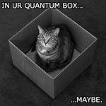
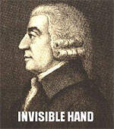


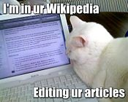
Famous Lolcats
LOL is Internet Slang for
Laughing out Loud

Slide 18
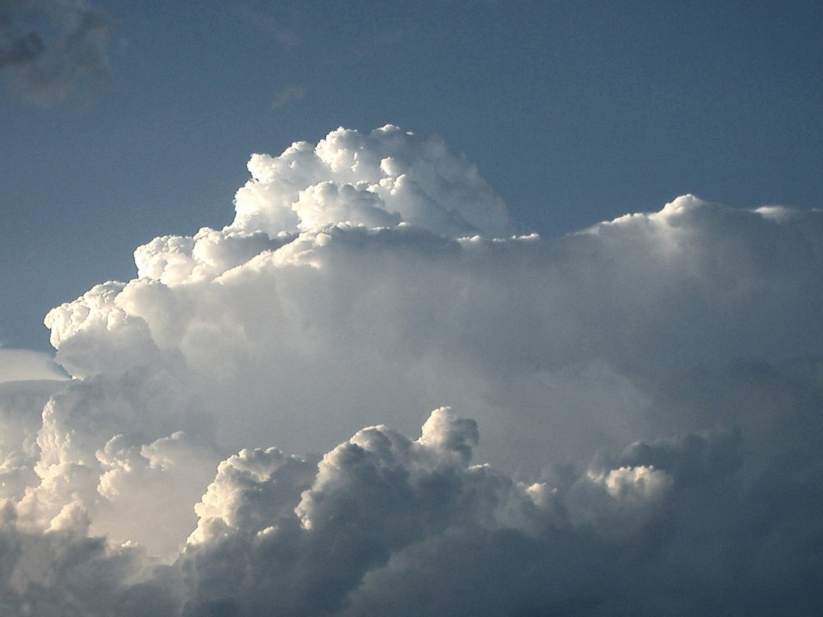
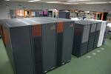
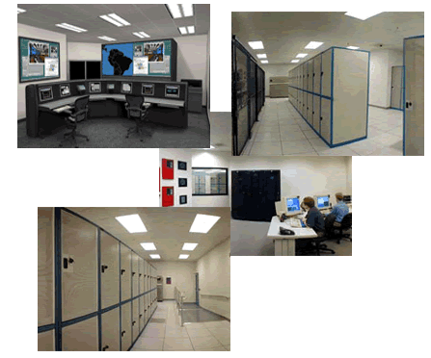
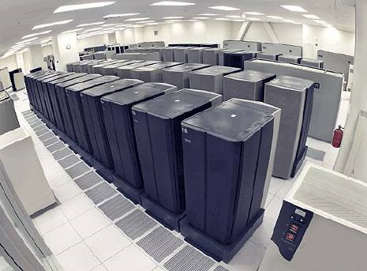
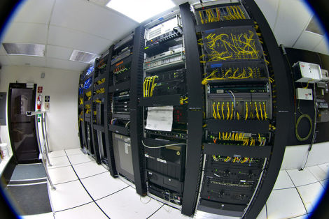
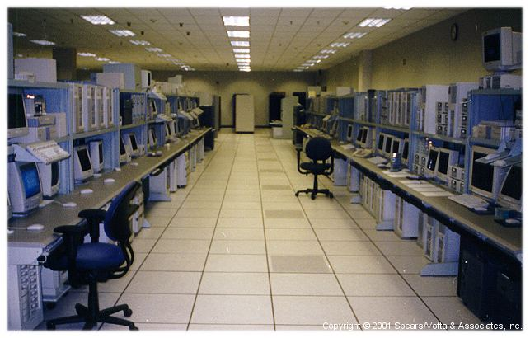
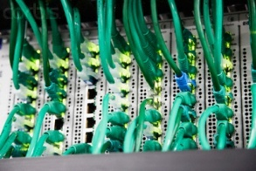
I’M IN UR CLOUD
INVISIBLE COMPLEXITY

Slide 19
Too much Computing?
Historically both grids and parallel computing have tried to increase computing capabilities by
  Optimizing performance of codes at cost of re-usability
  Exploiting all possible CPU’s such as Graphics co-processors and “idle cycles” (across administrative domains)
  Linking central computers together such as NSF/DoE/DoD supercomputer networks without clear user requirements
Next Crisis in technology area will be the opposite problem – commodity chips will be 32-128way parallel in 5 years time and we currently have no idea how to use them on commodity systems – especially on clients
  Only 2 releases of standard software (e.g. Office) in this time span so need solutions that can be implemented in next 3-5 years
Intel RMS analysis: Gaming and Generalized decision support (data mining) are ways of using these cycles

Slide 20
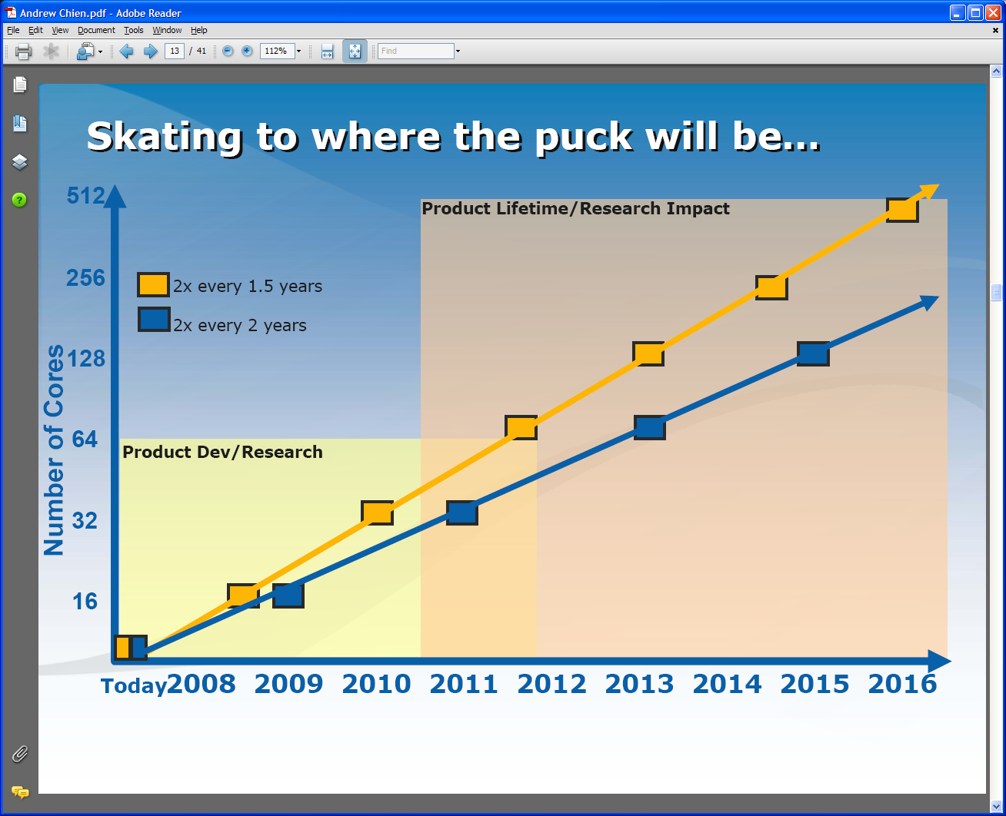
Intel’s Projection
Technology might support:
2010: 16—64 cores 200GF—1 TF
2013: 64—256 cores 500GF– 4 TF
2016: 256--1024 cores 2 TF– 20 TF

Slide 21
Intel’s Application Stack

Slide 22
Too much Data to the Rescue?
Multicore servers have clear “universal parallelism” as many users can access and use machines simultaneously
Maybe also need application parallelism (e.g. datamining) as needed on client machines
Over next years, we will be submerged of course in data deluge
  Scientific observations for e-Science
  Local (video, environmental) sensors
  Data fetched from Internet defining users interests
Maybe data-mining of this “too much data” will use up the “too much computing” both for science and commodity PC’s
  PC will use this data(-mining) to be intelligent user assistant?
  Must have highly parallel algorithms

Slide 23
Sensors as a Service
Similar architecture for a Web/Net/Grid of
  Mobile Phones
  Video cams
  Surveillance devices
  Smart Cities/Homes
  Environmental/Polar/Earthquake sensors
  Military sensors
Similar System support for
  QuakeSim
  PolarGrid
  Command and Control
  Emergency Response
  Distance Education

Slide 24
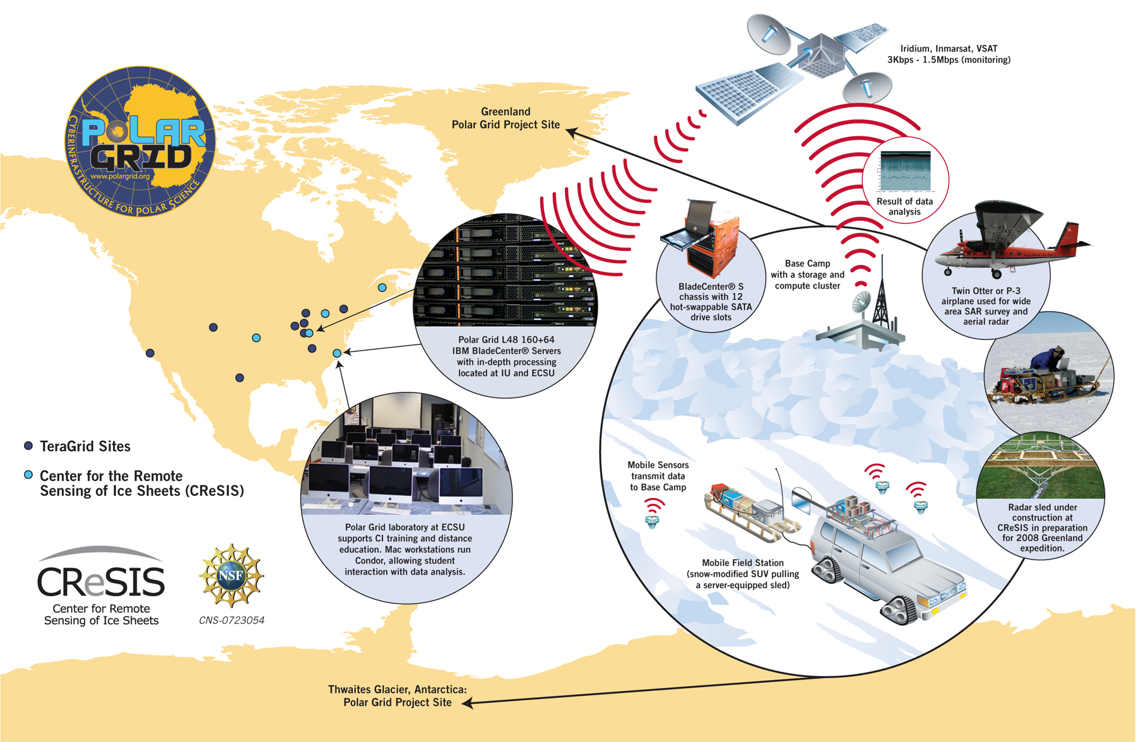
PolarGrid (collaboration ECSU and Indiana) has remote and TeraGrid components

Slide 25
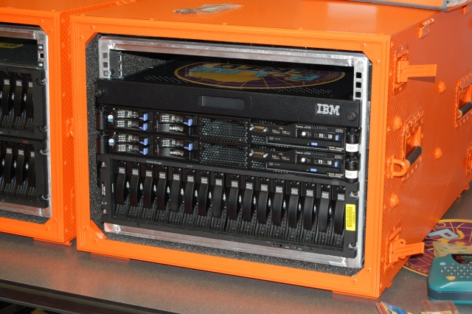
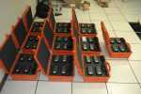
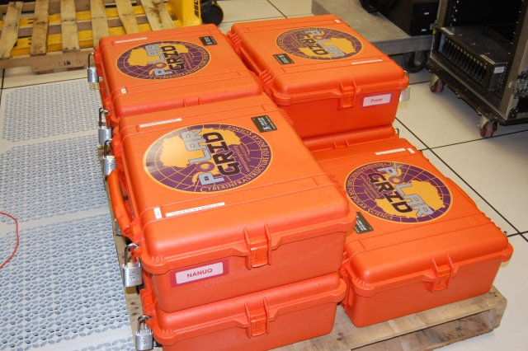
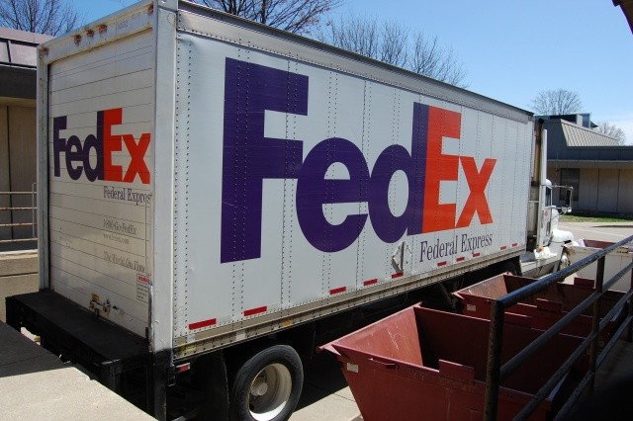
Polar Grid goes to Greenland
Leaving IU for Greenland
Field 8 core server and ruggedized laptops with USB Storage
Base camp 8-64 cores and 32 GB storage
Power: Solar, Hotel Room, Generator

Slide 26
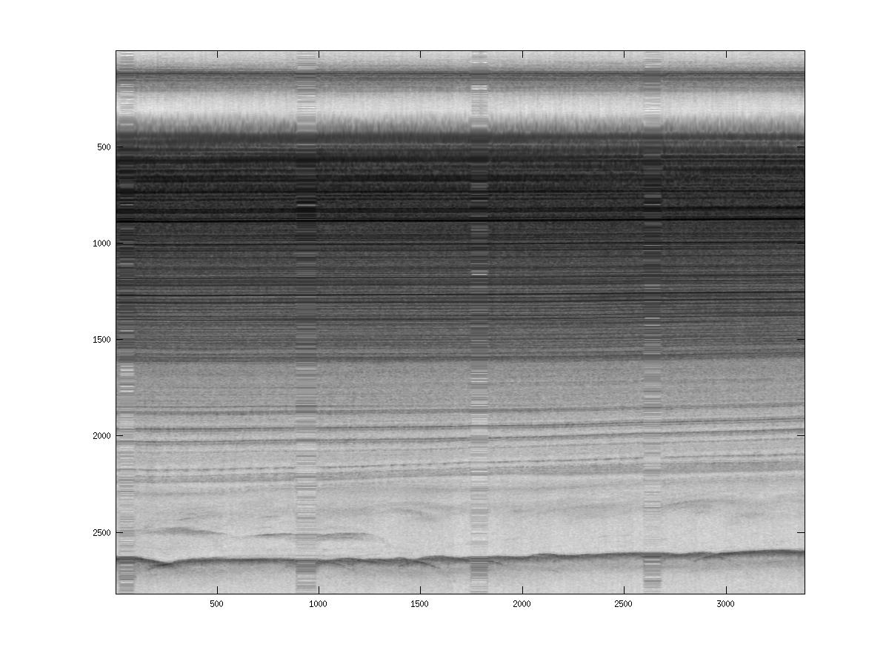
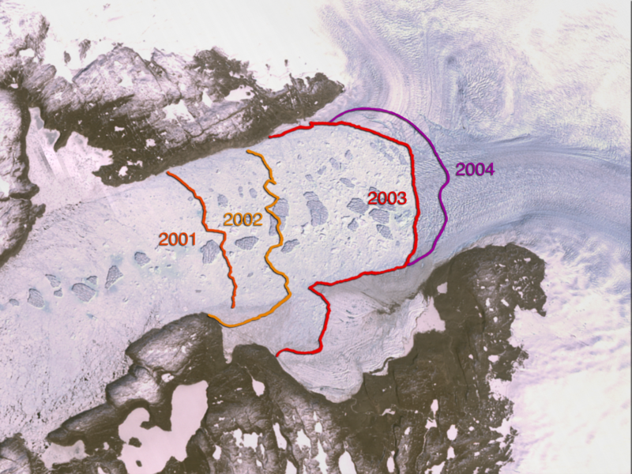
PolarGrid (collaboration ECSU and Indiana) has remote and TeraGrid components
Retreat of Jakobshavn Glacier
PolarGrid August 9 2008 looking at bed 2500metres deep; real time analysis removes noise

Slide 27
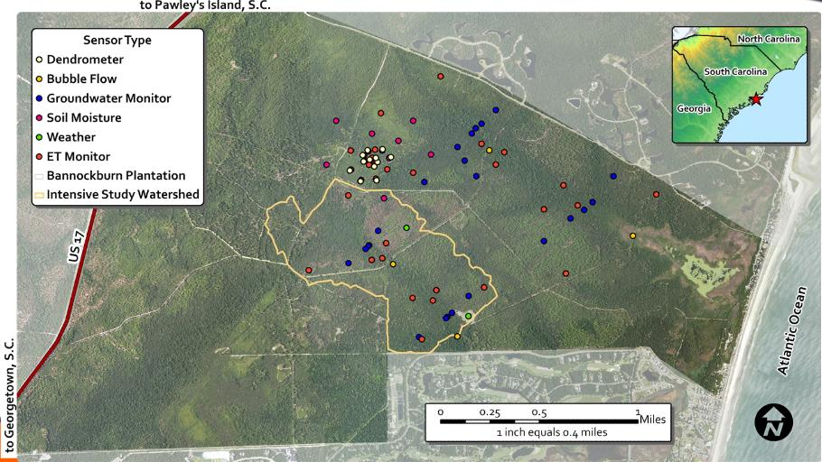
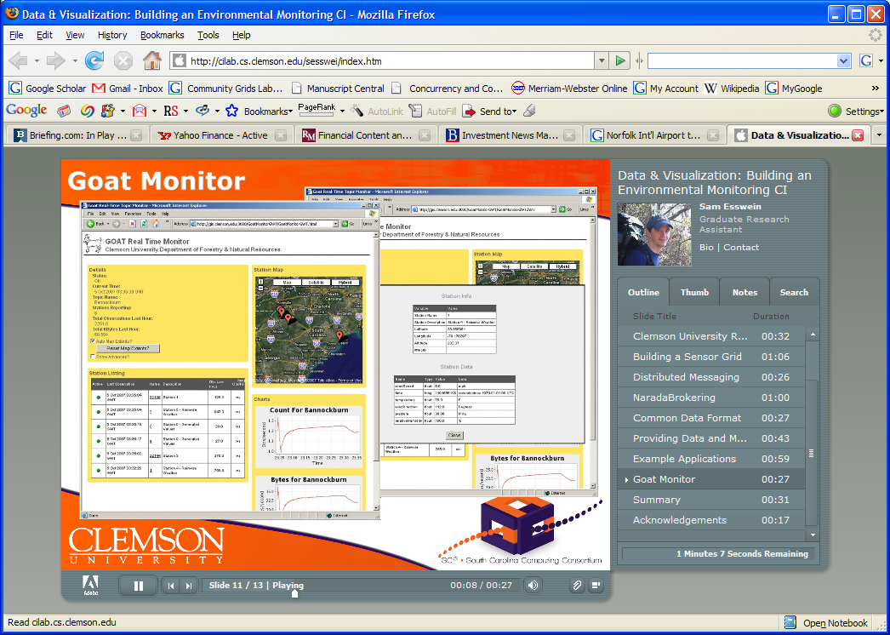
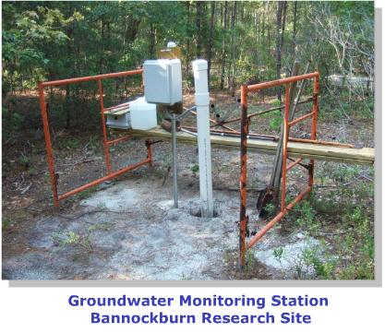
Environmental Monitoring Sensor Grid at Clemson

Slide 28
Heterogeneous Sensor Grids
Note sensors are any time dependent source of information and a fixed source of information is just a broken sensor
  SAR Satellites
  Environmental Monitors
  Nokia N800 pocket computers
  RFID tags and readers
  GPS Sensors
  Lego Robots including , accelerometer, gyroscope, compass, ultrasonic, temperature sensors
  RSS Feeds
  Wii remote sensor
  Audio/video: web-cams
  Presentation of teacher in distance education
  Text chats of students

Slide 29

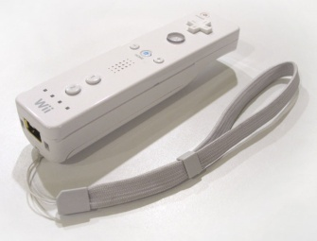
Components of the Sensor Grid
Laptop for PowerPoint
2 Robots used
Wii remote
Lego Robot GPS Nokia N800 RFID Tag RFID Reader

Slide 30
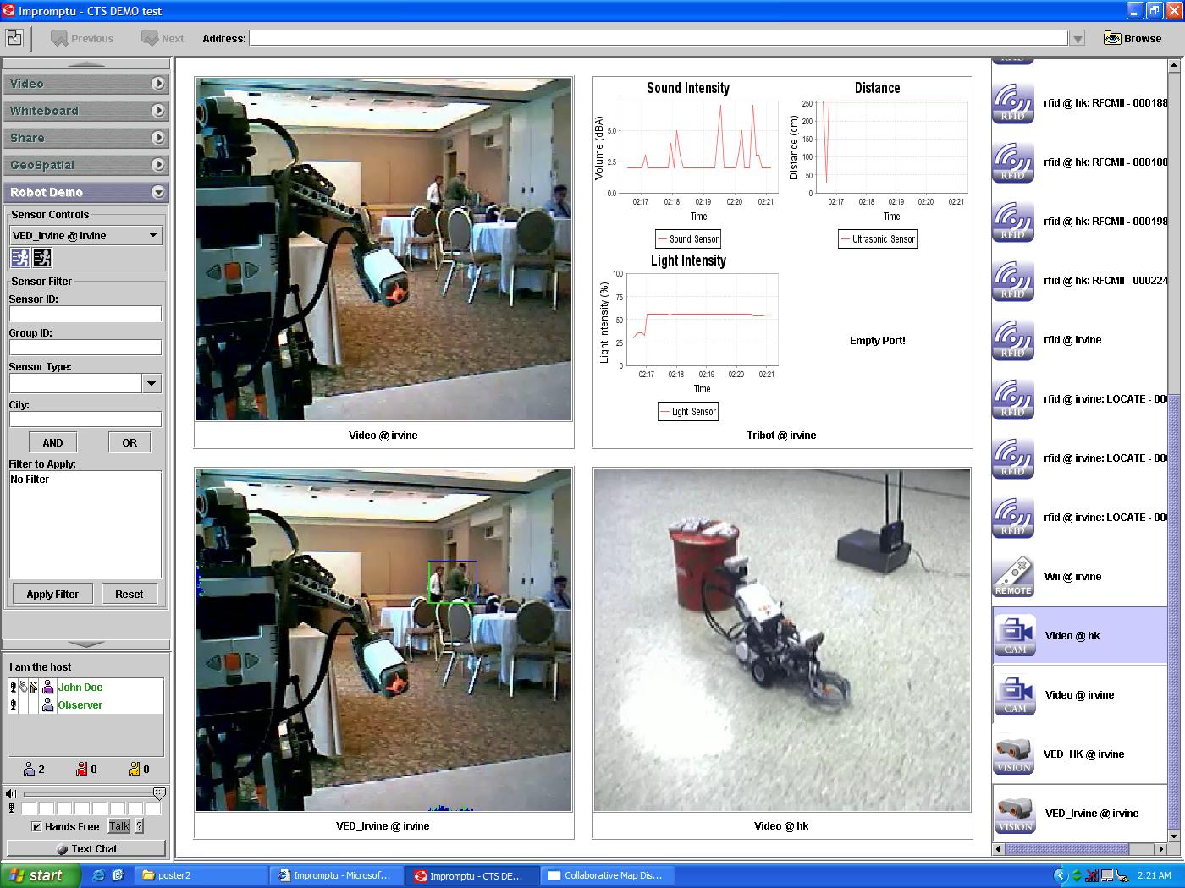
ANABAS

Slide 31
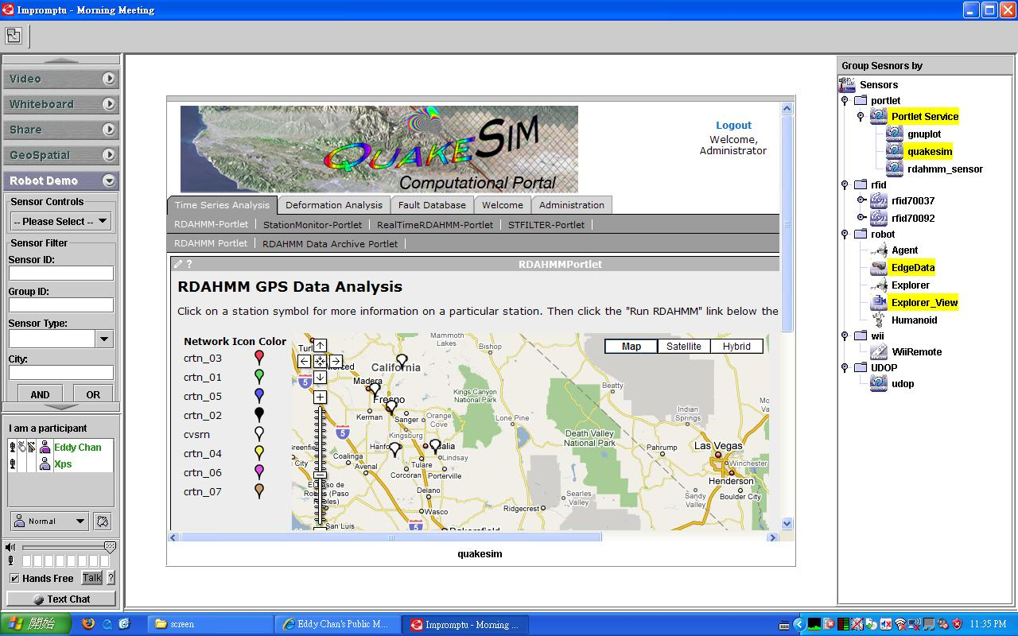
QuakeSim Grid of Grids with RDAHMM Filter (Compute) Grid

